Slide 1


Haptic implementation of the single reed pressure response.
Using the TorqueTuner
MA. Maxwell Gentili-Morin
MUMT 620 – Prof. Marcelo Wanderley
Input Devices and Music Interaction Laboratory - IDML
Notes:
Hello!
Name
Bucket Brigade Devices
Currently doing research in the IDMIL Lab with Marcelo as an Undergrad!

Slide 2

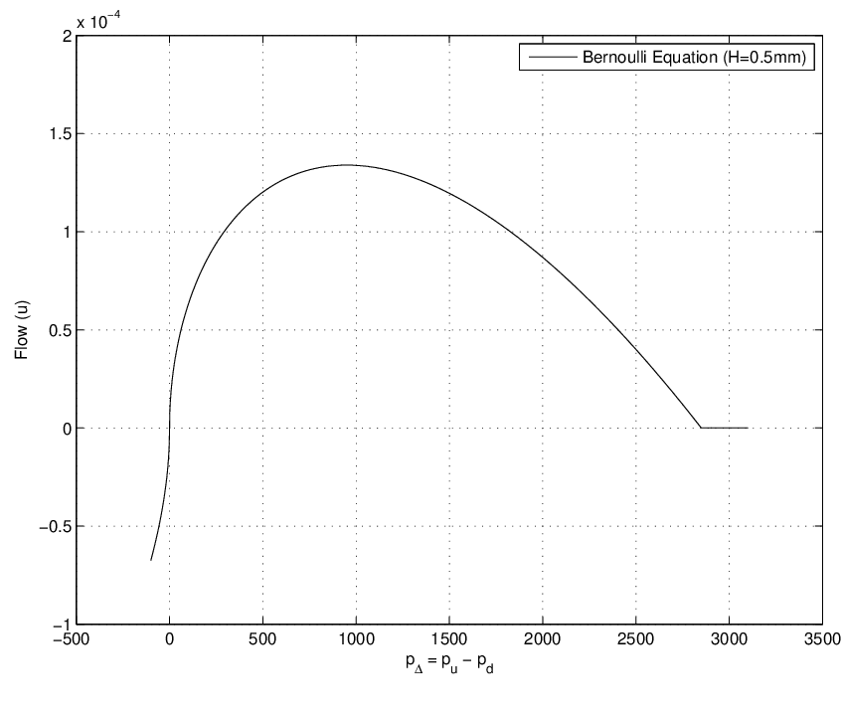

Concept
What is the single reed pressure response?
It is the flow of air going through the mouthpiece.
Dependent on the pressure difference between the mouth and the instruments cavity.
Represented by the simplified Bernoulli equation:
$$u=\left(H\sqrt{\left|pΔ\right|}−\frac{\sqrt{\left|pΔ\right|}pΔ}{k}\right)sgn⁡(pΔ)$$
N. H. Fletcher and T. D. Rossing. The Physics of Musical Instruments. Springer-Verlag, New York, 1991.
Notes:
Guitar Effect pedals
Analogy
Actual explanation

Slide 3
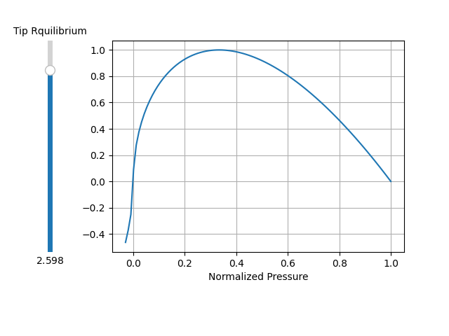
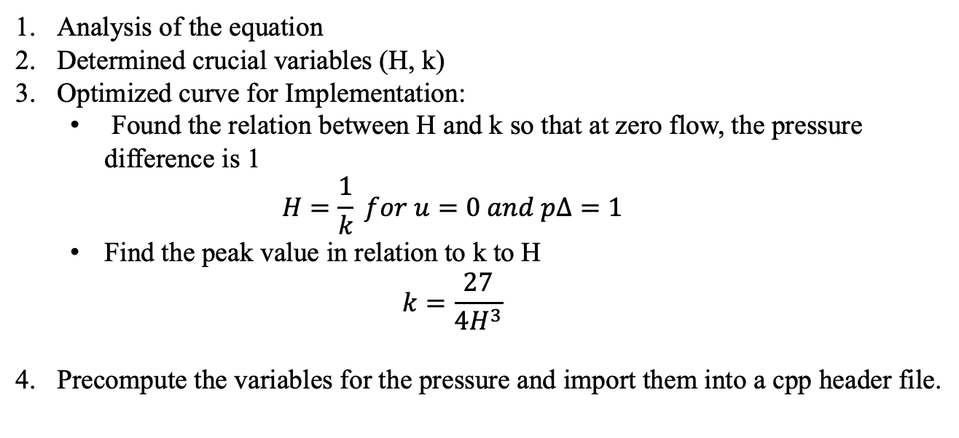
Implementation
Modeling the effect in python
Analysis of the equation
Determined crucial variables (H, k)
Optimized curve for Implementation:
Found the relation between H and k so that at zero flow, the pressure difference is 1
$$H=\frac{1}{k} for u=0 and pΔ=1$$
Find the peak value in relation to k to H
$$k=\frac{27}{4H^{3}}$$
Precompute the variables for the pressure and import them into a cpp header file.

Slide 4
Implementation
Extending the TorqueTuner Firmware
Using the current firmware on the esp32, I created a mode, and implemented the function.
Simple as that.
int16_t Reed_Basic::calc(void* ptr){
TorqueTuner* knob = (TorqueTuner*)ptr;
float val = (H_init * rp_table[idx] - rp_B_table[idx]/k_init)*rp_sgn_table[idx];
val *= -knob->scale;
return static_cast<int16_t> (round(val));
}
int16_t Mode::calc_index(void* ptr) {
TorqueTuner* knob = (TorqueTuner*)ptr;
state += static_cast<int16_t> (round(knob->angle_delta * knob->stretch));
if (wrap_haptics)
{
idx = mod(state, 3600);
} else {
idx = clip(state, 0, 3600);
}
return idx;
};

Slide 5
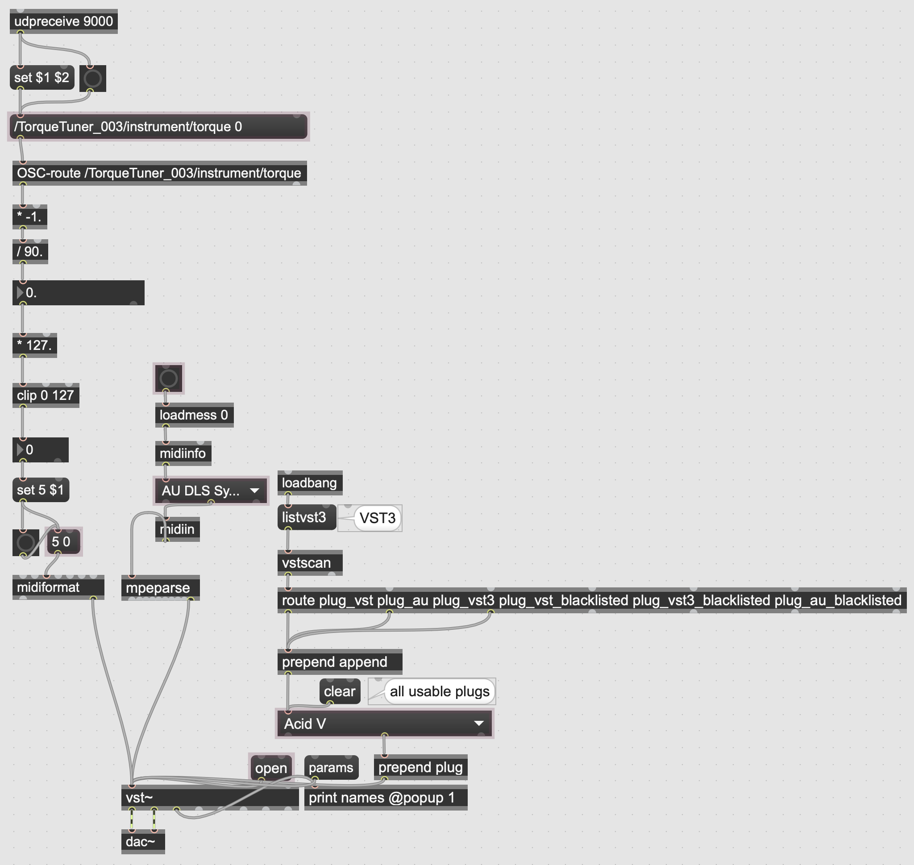
Implementation
Incorporating it into a playable situation.
So as to have a simple method of testing the haptic effect, I pair it with the Linnstrument and a software called Surge XT
Demo Time

Slide 6
Implementation
Current signal flow
Angle
OSC
Pressure
Esp32
Flow
Moteus
Reed Model
Synth
Torque
Flow
Note
Linnstrument
Max MSP

Slide 7
Implementation
Signal flow
How would we map these?
Velocity
Esp32
Note
Pressure
Reed Model
Torque
Angle
X
Linnstrument
Y
H
K
Z

Slide 8
Road to Final Project
Refine the haptic effect – create different modes with different intentions
Define meaningful and transparent mappings between variables
3D print a enclosure so that the Linnstrument and TorqueTuner can be held together.
Choose a fitting synthesis tool
Analyze how other interact with it.

Slide 9
Q & A

