Slide 1
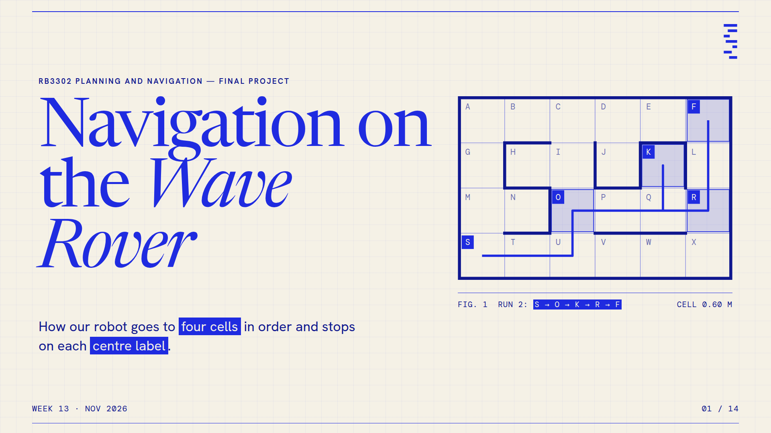
Notes:
01 · Title. Image of the HTML slide; the animated version is index.html.

Slide 2
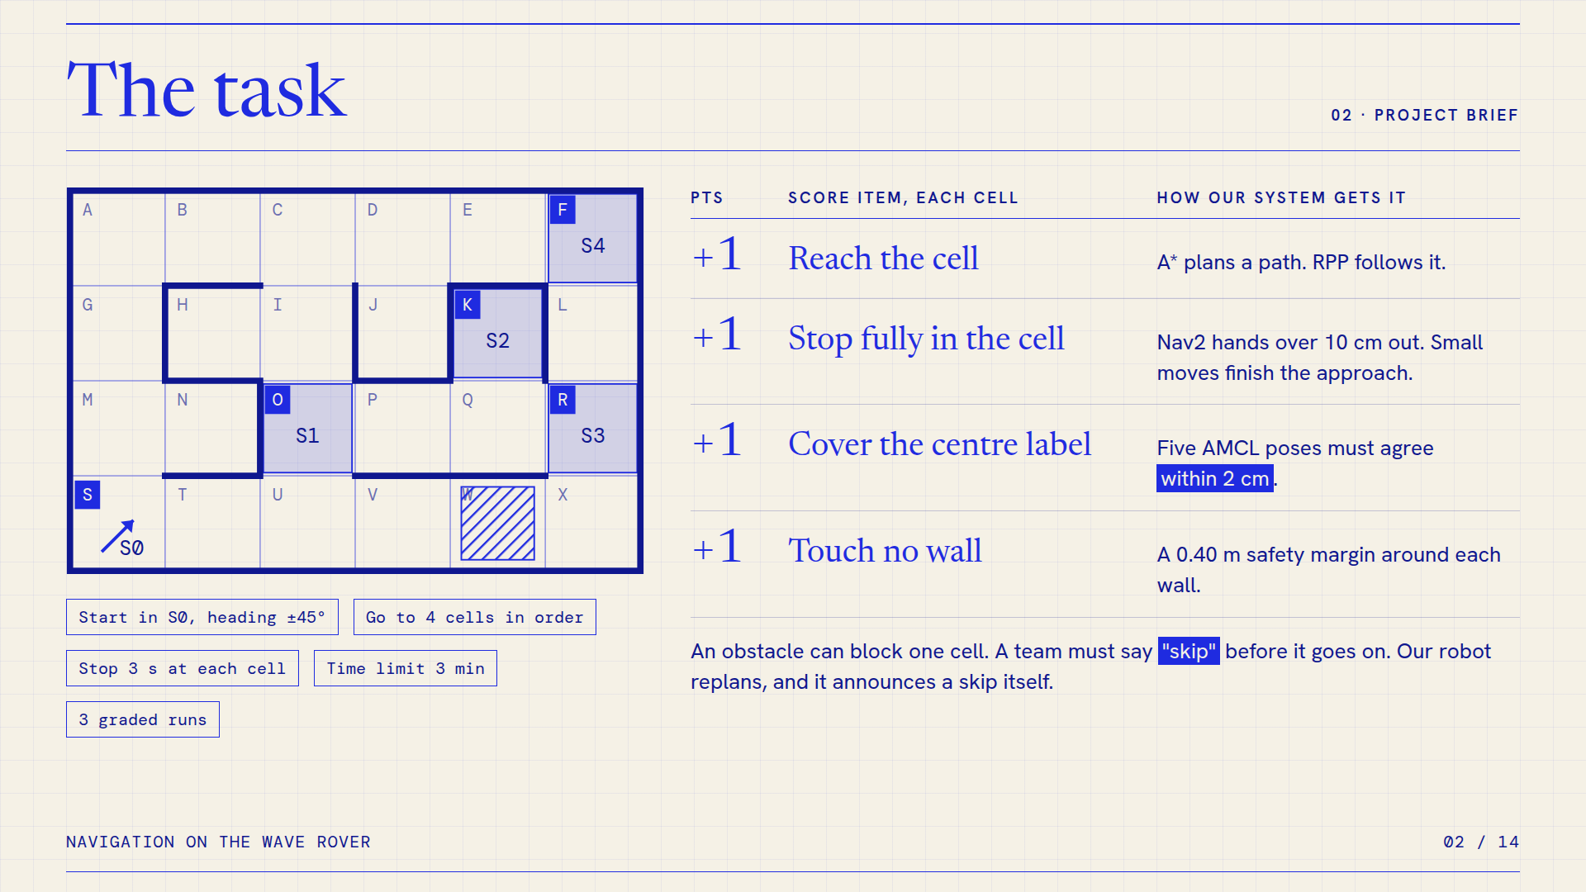
Notes:
02 · The task. Image of the HTML slide; the animated version is index.html.

Slide 3
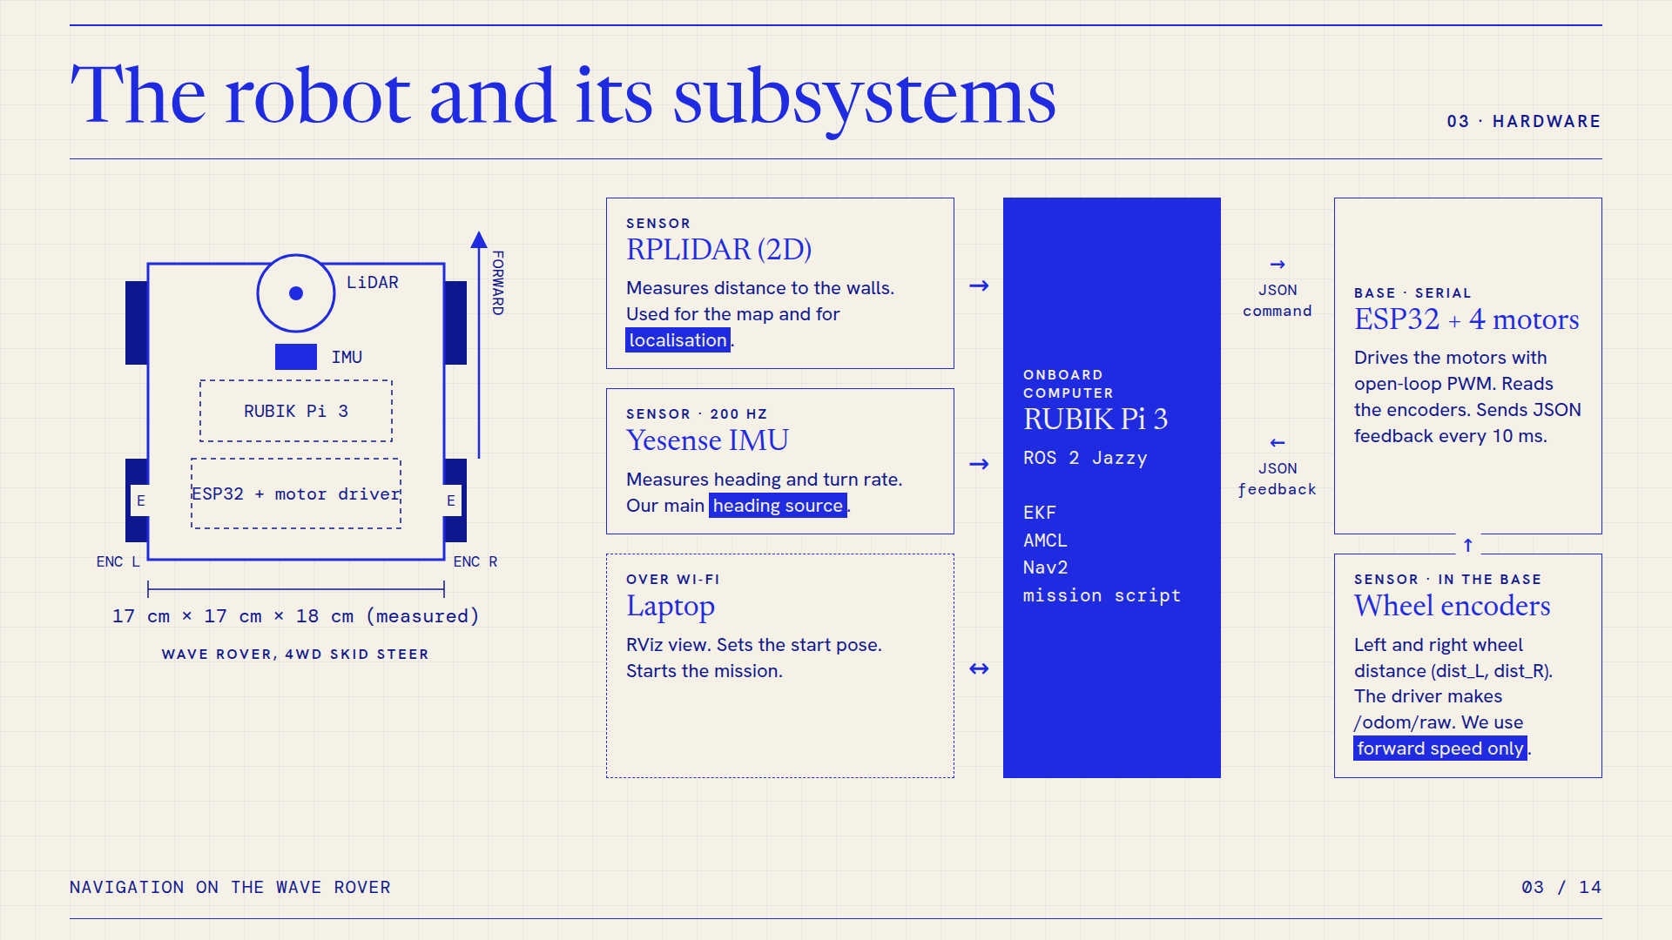
Notes:
03 · The robot and its subsystems. Image of the HTML slide; the animated version is index.html.

Slide 4
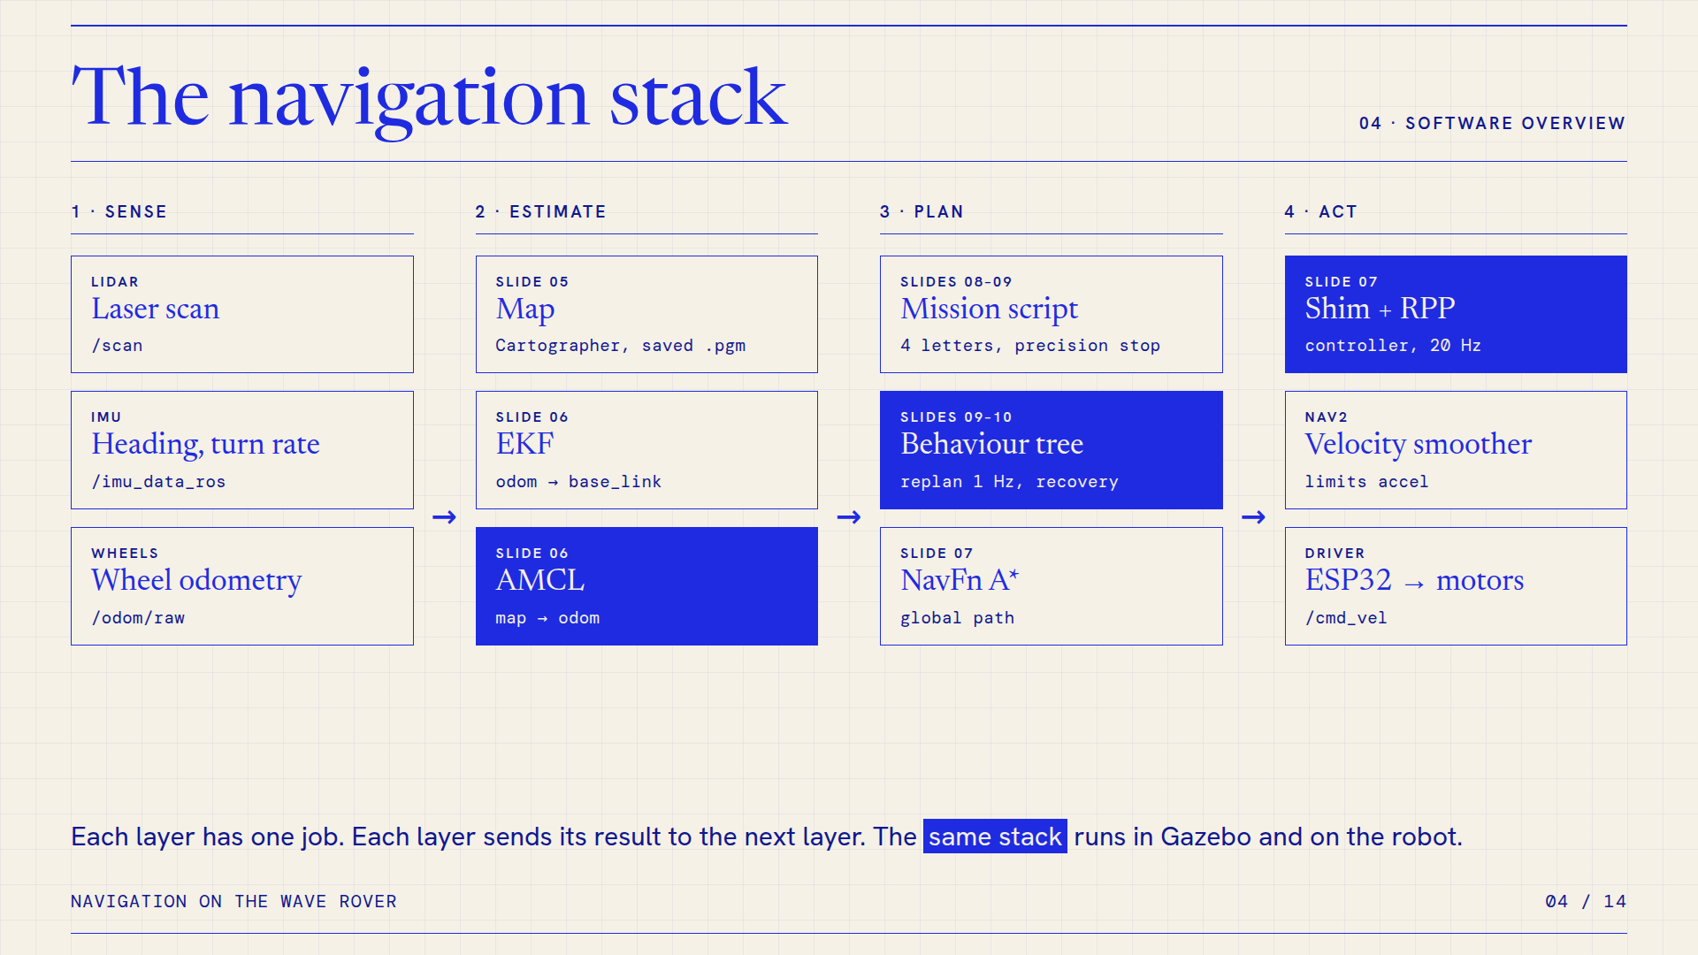
Notes:
04 · The navigation stack. Image of the HTML slide; the animated version is index.html.

Slide 5
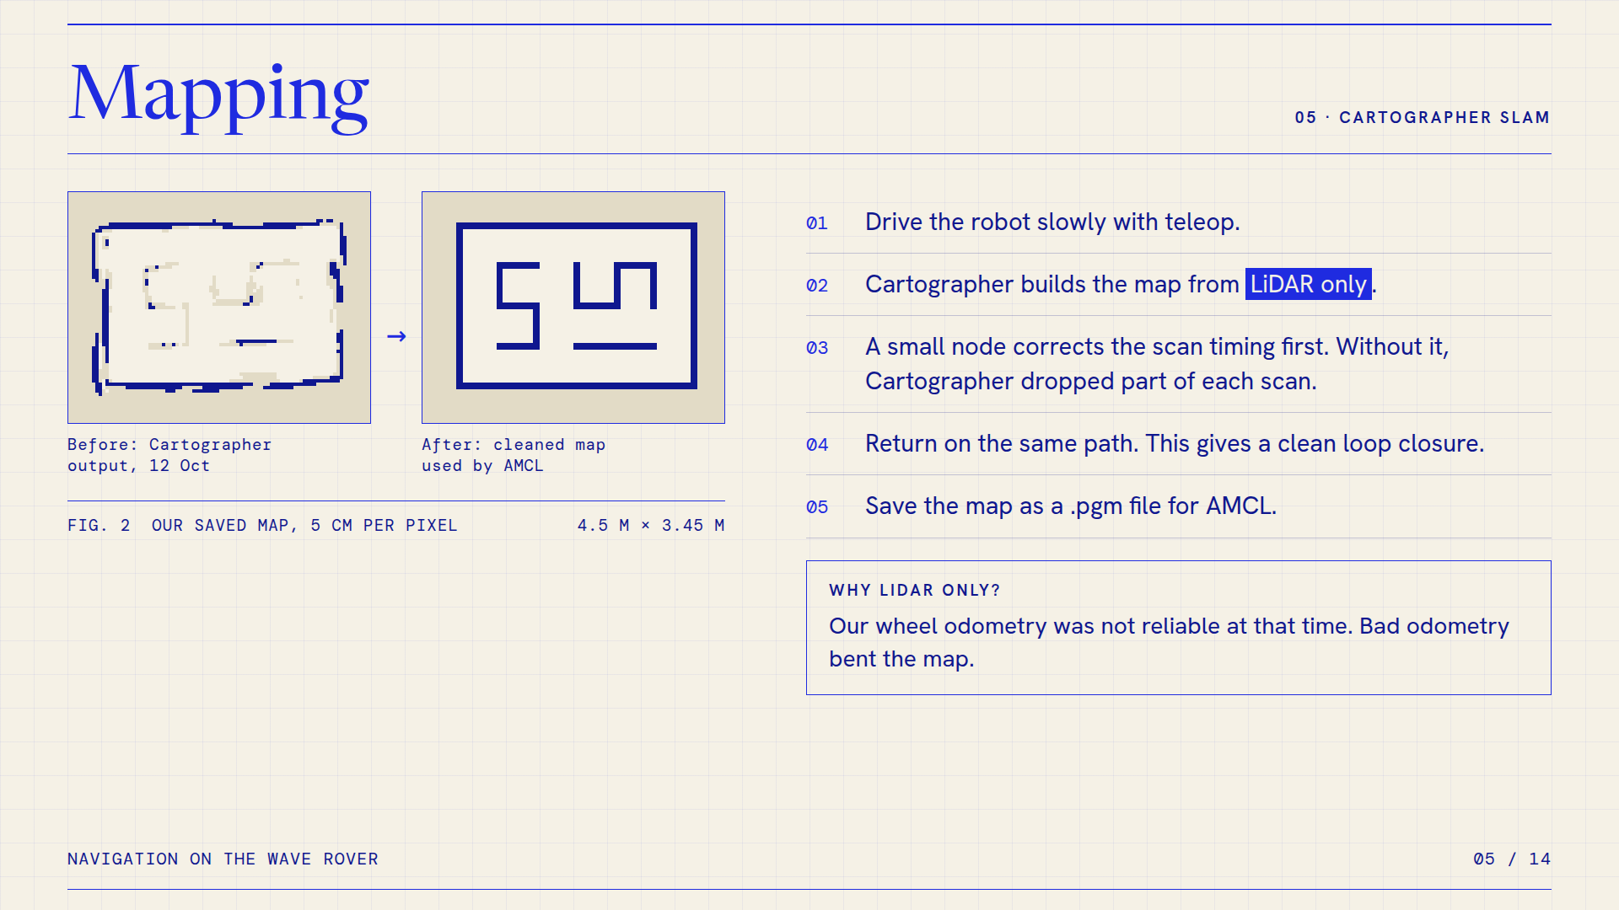
Notes:
05 · Mapping. Image of the HTML slide; the animated version is index.html.

Slide 6
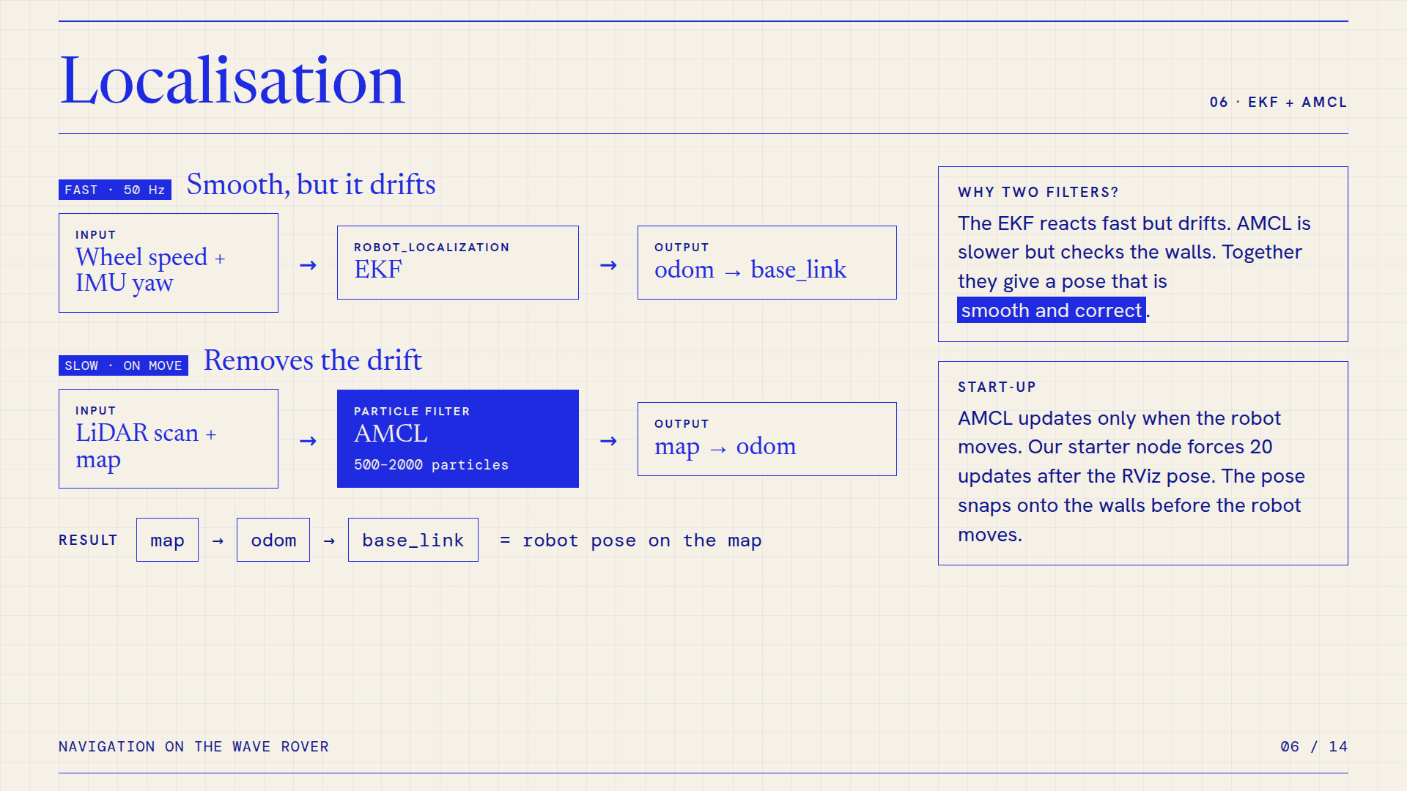
Notes:
06 · Localisation. Image of the HTML slide; the animated version is index.html.

Slide 7
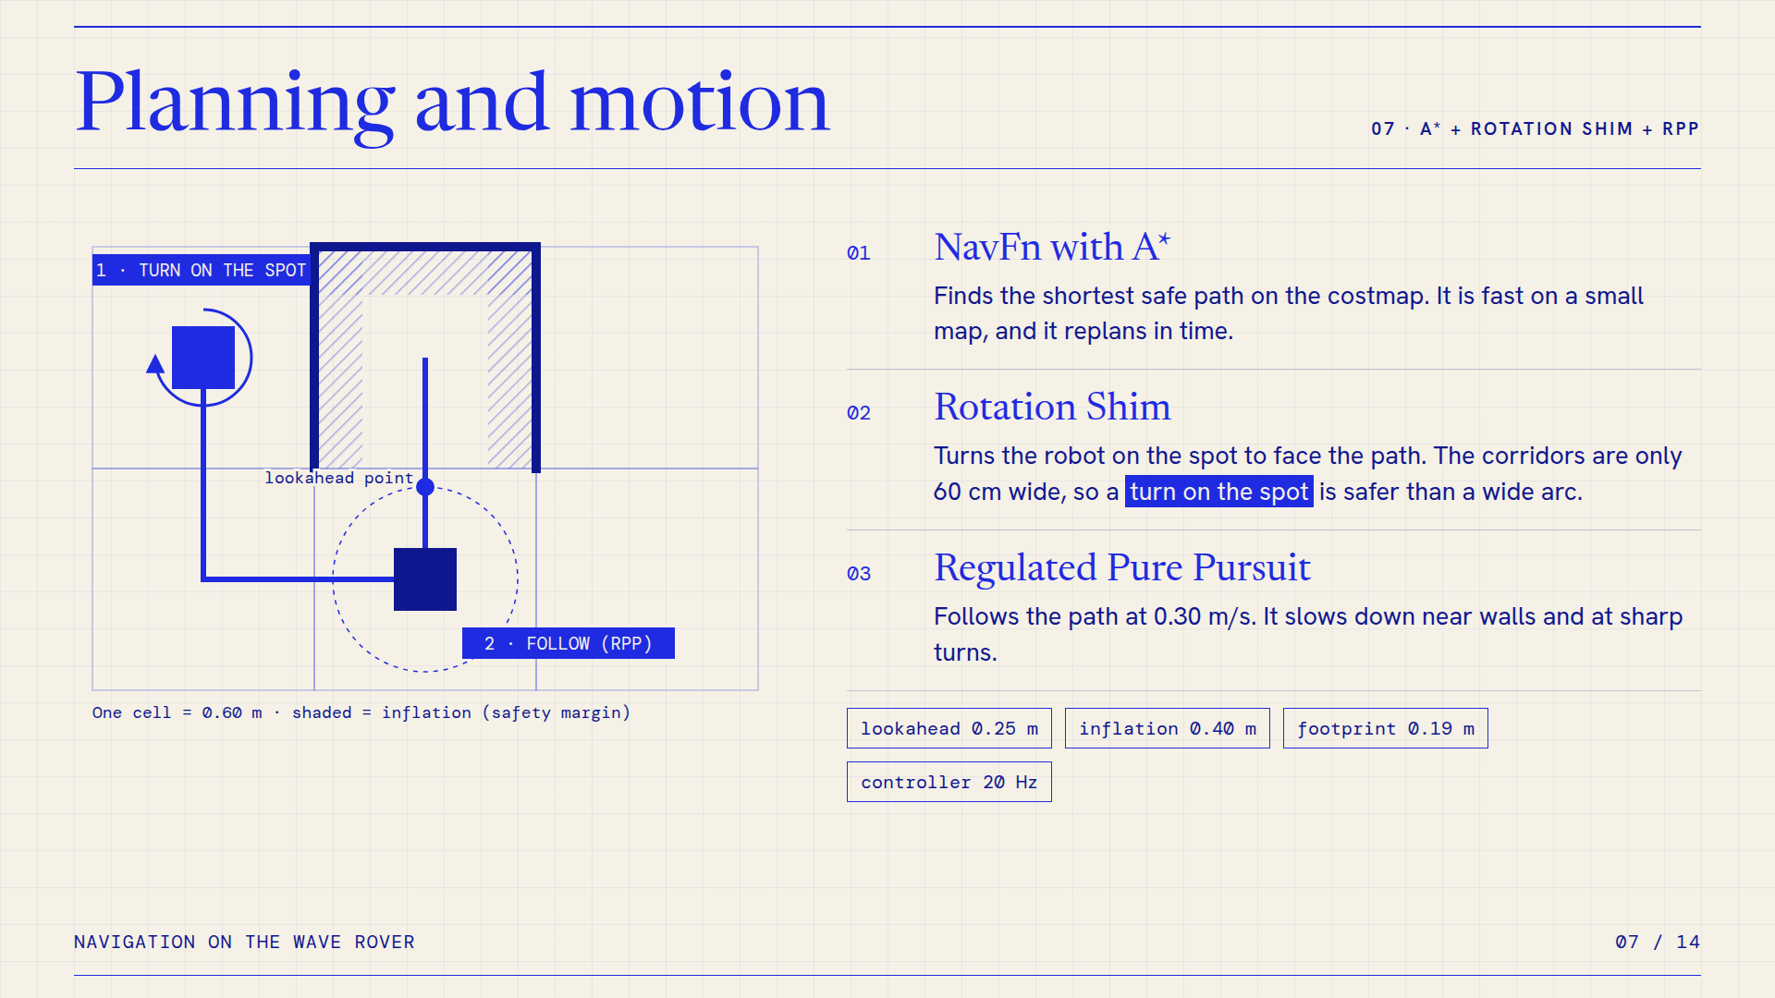
Notes:
07 · Planning and motion. Image of the HTML slide; the animated version is index.html.

Slide 8
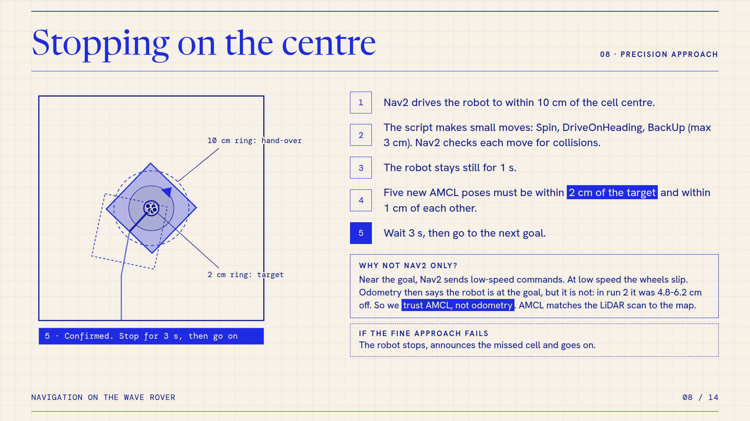
Notes:
08 · Stopping on the centre. Image of the HTML slide; the animated version is index.html.

Slide 9
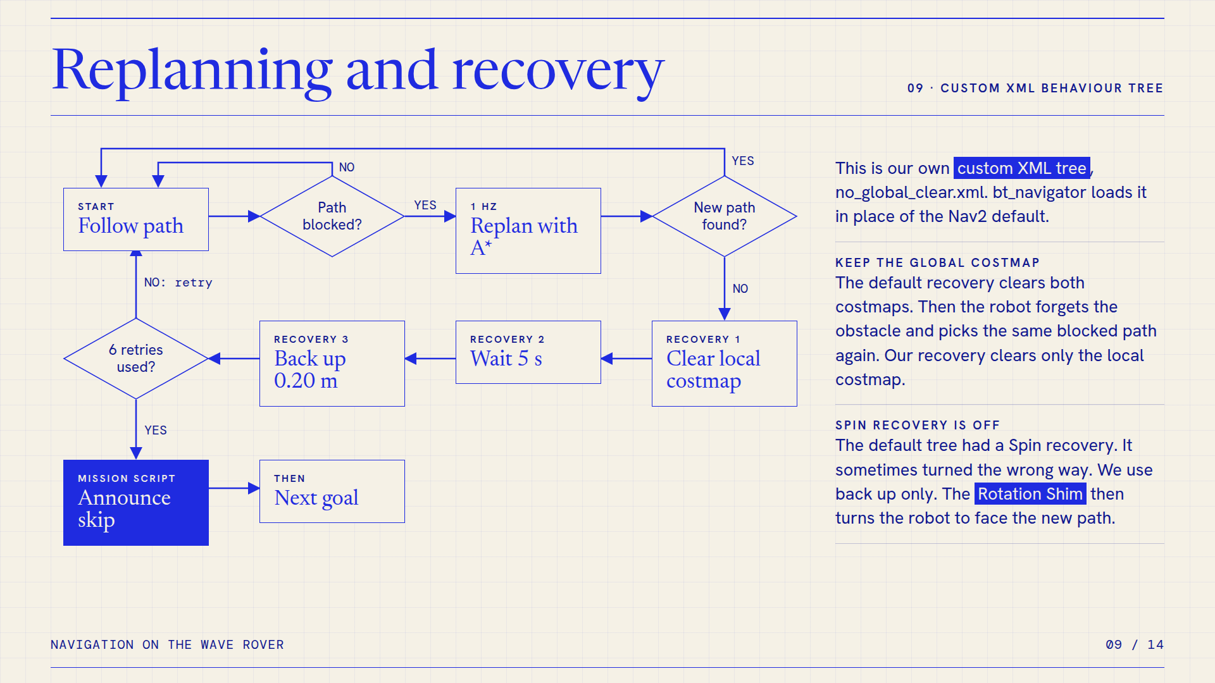
Notes:
09 · Replanning and recovery. Image of the HTML slide; the animated version is index.html.

Slide 10
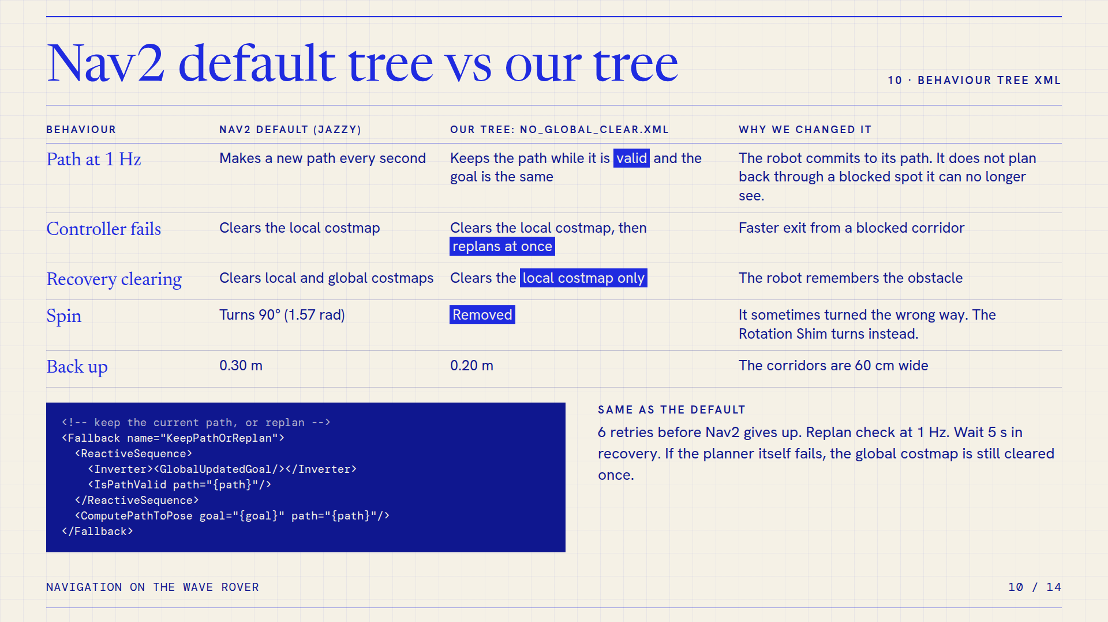
Notes:
10 · Nav2 default tree vs our tree. Image of the HTML slide; the animated version is index.html.

Slide 11
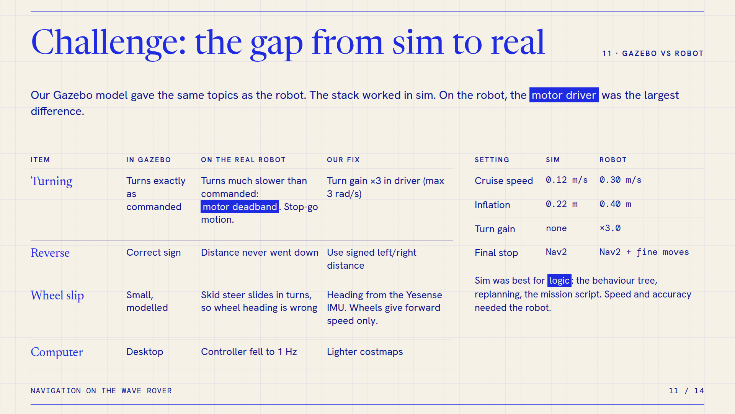
Notes:
11 · Challenge: the gap from sim to real. Image of the HTML slide; the animated version is index.html.

Slide 12
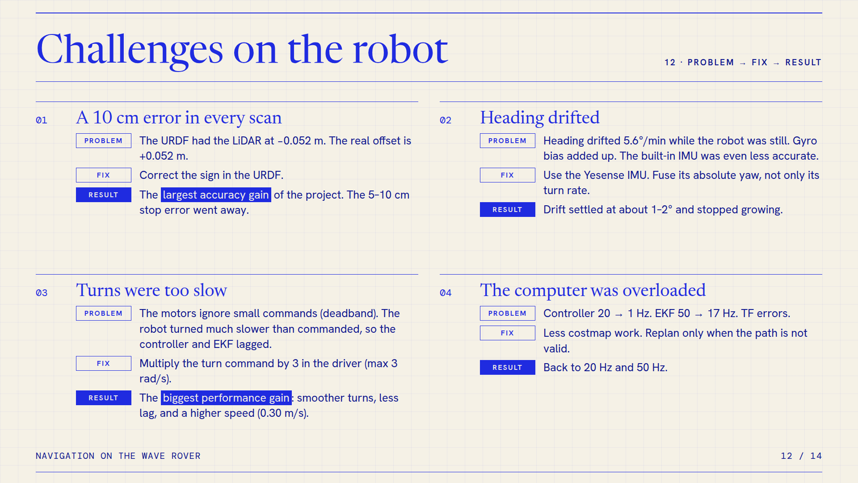
Notes:
12 · Challenges on the robot. Image of the HTML slide; the animated version is index.html.

Slide 13
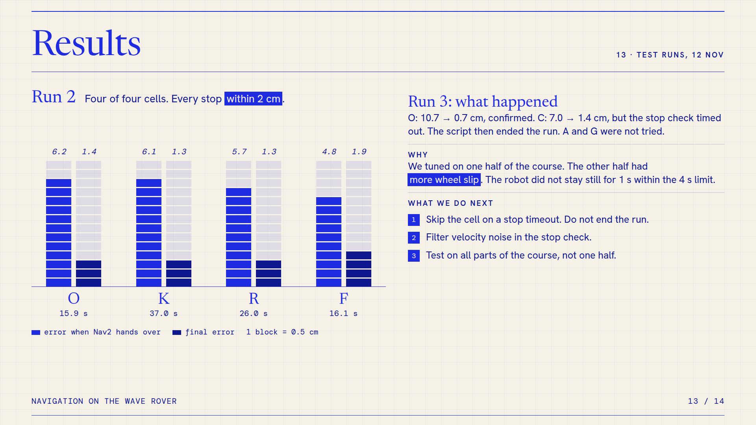
Notes:
13 · Results. Image of the HTML slide; the animated version is index.html.

Slide 14
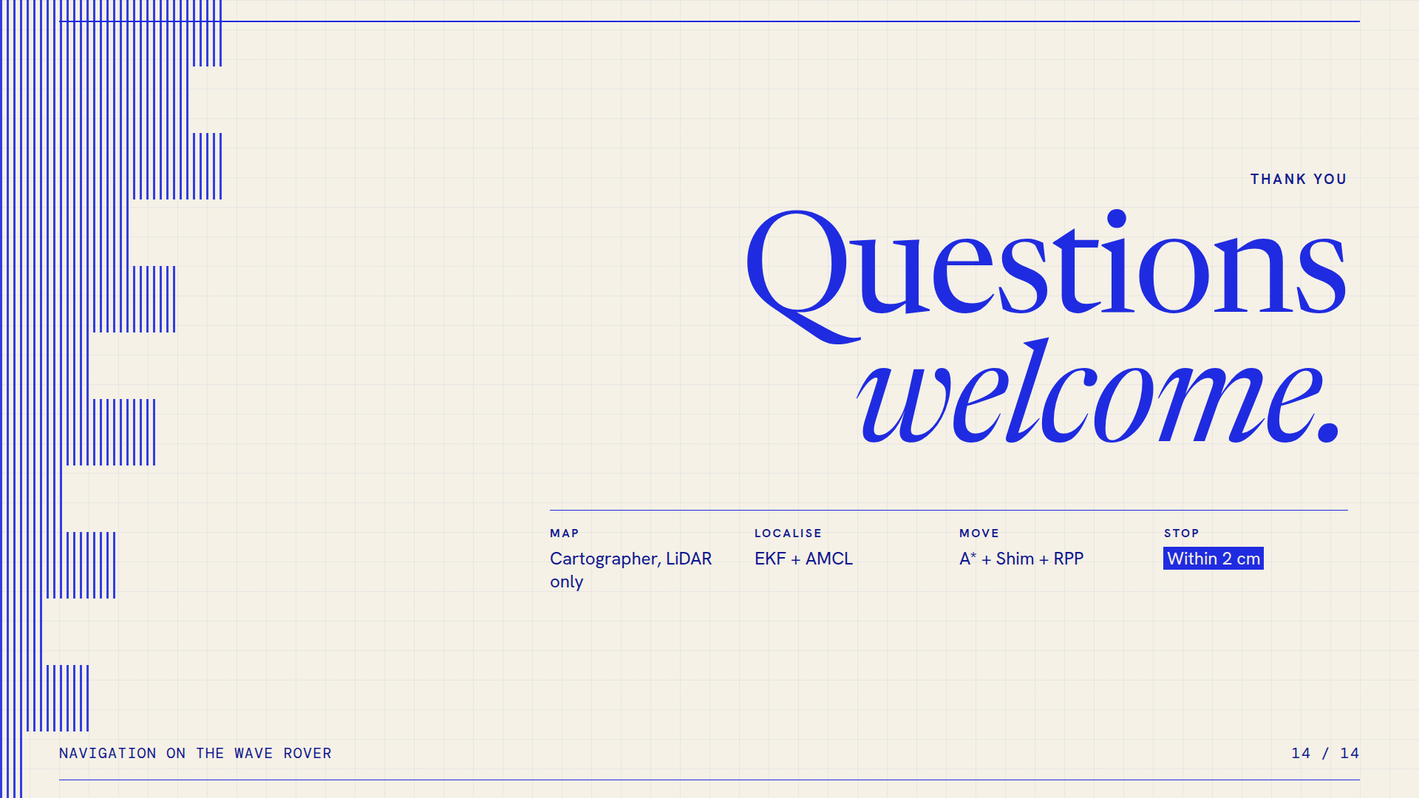
Notes:
14 · Questions. Image of the HTML slide; the animated version is index.html.

