Slide 1
Risk and Bio-Economic Modeling of Farming Systems
Maxwell Mkondiwa
CIMMYT
Presented at International Training on System Approaches for Integrated Analysis of Agricultural Systems,
Sept 14-16, 2026.

Slide 2
Outline
Yield gaps, profit gaps, and livelihood gaps: Systems thinking
Economist’s translation of typologies as socio-technical groups and yield gaps as in-efficiencies: Latent class stochastic frontier approach
Dealing with multiple objectives: Systems and risk considerations
Regional farm type and individual farm model (IFM) level bio-economic optimization

Slide 3
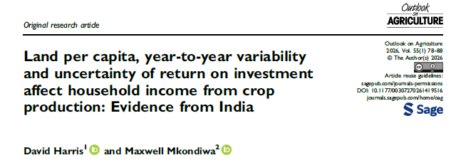
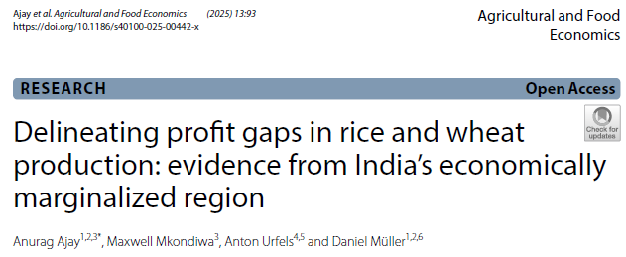
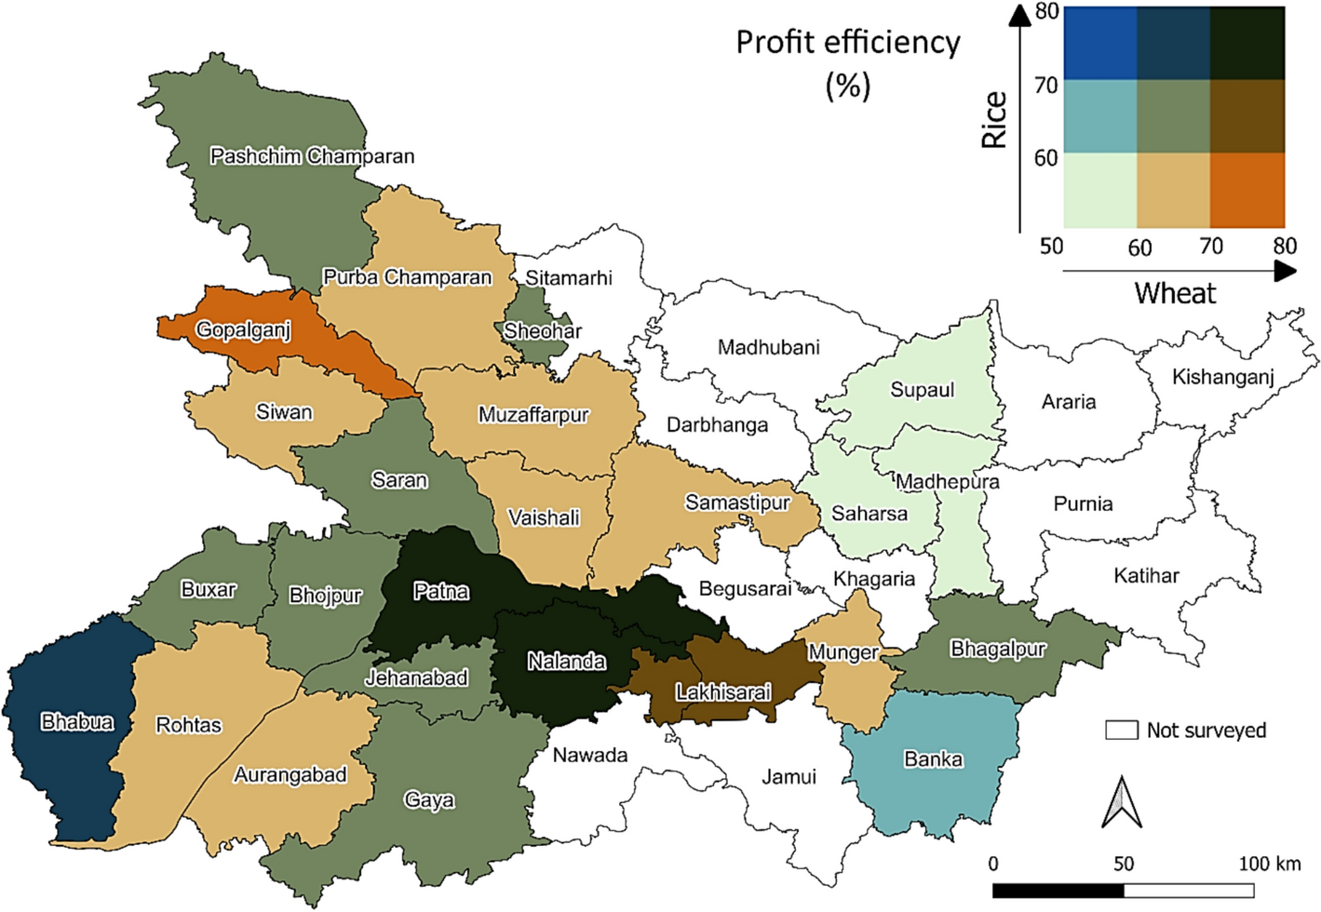
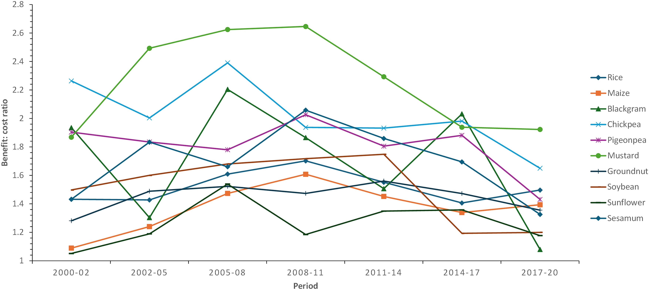
(1) From yield gaps to profit gaps and livelihood gaps
Though field crops profitable, across 2000-2020, only mustard and chickpea generate enough income (crop personal daily income, CPDI) to reach $2.15/person/day poverty line for those with <1 ha/capita

Slide 4
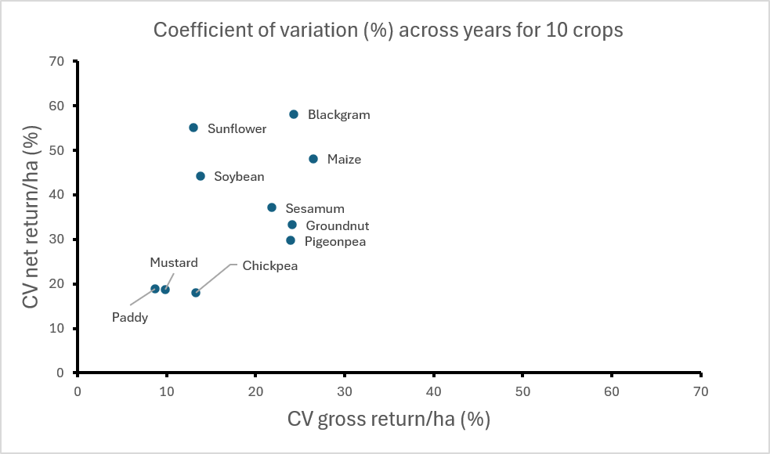
Stylized facts: (1) Net returns more variable than gross returns, (2) farmers growing multiple crops per year still poor despite potential
SURVEY EVIDENCE
AGRONOMIC TRIAL EVIDENCE

Slide 5
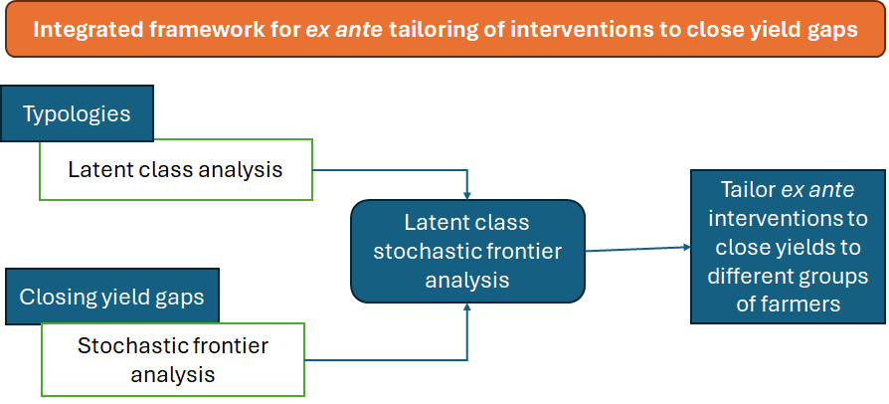
(2) Integrated typology-yield/welfare gap analysis framework: On-going work

Slide 6
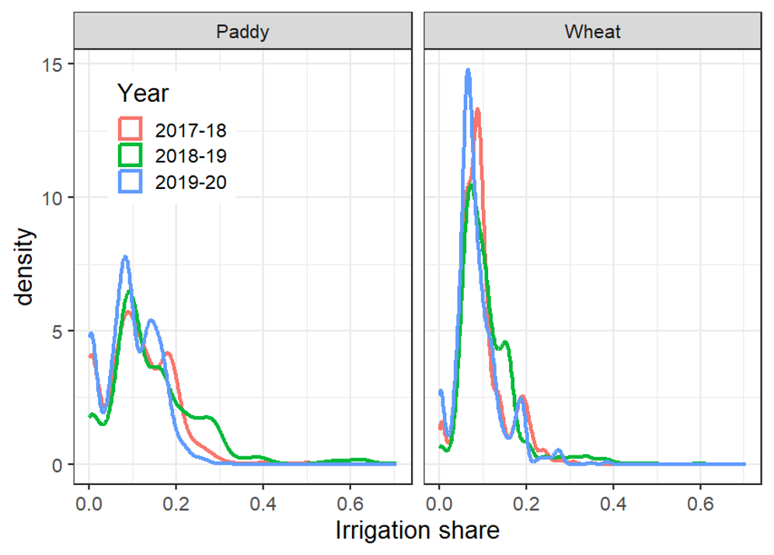
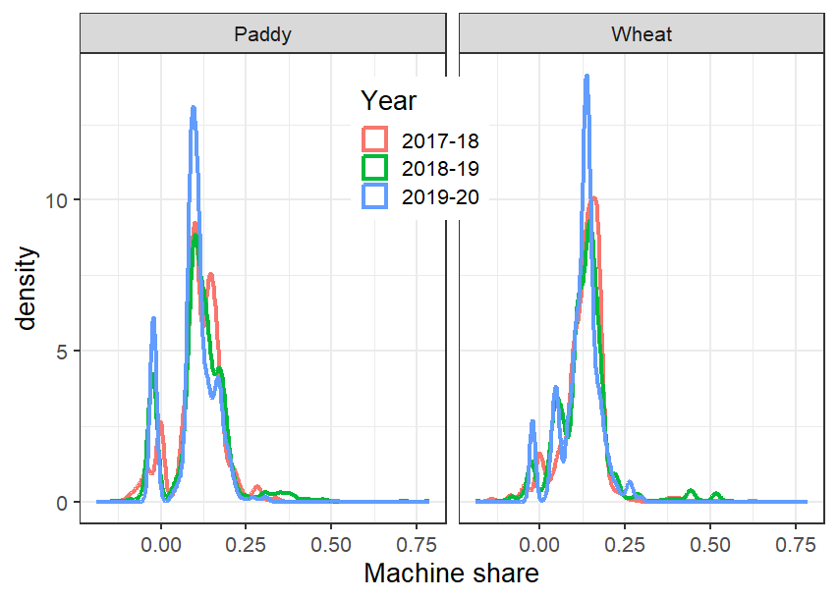
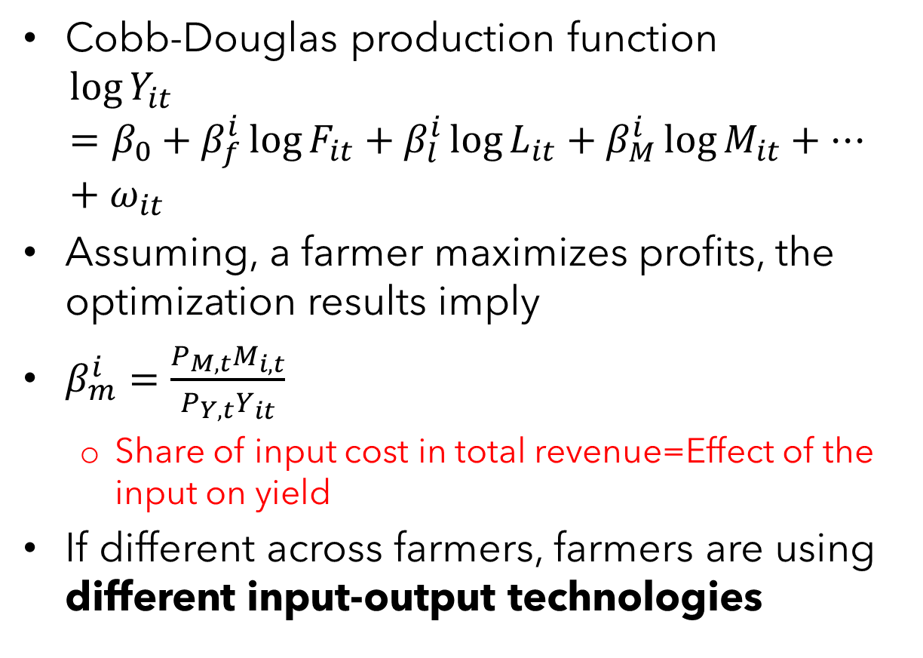
Descriptive heterogeneity analysis
Cobb-Douglas production function
$$\log{Y_{it}}=β_{0}+β_{f}^{i}\log{F_{it}}+β_{l}^{i}\log{L_{it}}+β_{M}^{i}\log{M_{it}}+…+ω_{it}$$
Assuming, a farmer maximizes profits, the optimization results imply
$β_{m}^{i}=\frac{P_{M,t}M_{i,t}}{P_{Y,t}Y_{it}}$
  Share of input cost in total revenue=Effect of the input on yield
If different across farmers, farmers are using different input-output technologies

Slide 7
Efficiency scores for all farmers, typology probability factors and transitions
 | Wheat |  |  | Rice
 | Pooled model | Type 1 | Type 2 | Pooled model | Type 1 | Type 2
Min. | 0.34 | 0.31 | 0.86 | 0.17 | 0.71 | 0.16
1st Quartile | 0.76 | 0.70 | 0.93 | 0.66 | 0.89 | 0.65
Median | 0.83 | 0.80 | 0.94 | 0.78 | 0.92 | 0.78
Mean | 0.81 | 0.77 | 0.94 | 0.75 | 0.91 | 0.75
3rd Quartile | 0.88 | 0.87 | 0.95 | 0.86 | 0.94 | 0.86
Max. | 0.97 | 0.96 | 0.97 | 0.96 | 0.96 | 0.96
Typology separating variables (probability of typology 1)
Transition matrix of farmer typology across rice and wheat seasons
 | Rice |  |  | Wheat
 | Estimate | Std.Error | P.value | Estimate | Std. Error | P.value
Cl1_(Intercept) | -5.204 | 1.076 | 0.000 | 0.596 | 0.521 | 0.253
Cl1_Irrigation source: Shallow tubewell | 0.363 | 0.258 | 0.161 | 0.728 | 0.234 | 0.002
Cl1_Irrigation source: Surface | 0.228 | 0.710 | 0.749 | 2.381 | 0.406 | 0.000
Cl1_Distance to market | -0.462 | 0.067 | 0.000 | 0.151 | 0.047 | 0.001
Cl1_Drainage class: Medium land | -0.088 | 0.356 | 0.804 | 0.299 | 0.292 | 0.305
Cl1_Drainage class: Upland | -0.413 | 0.497 | 0.406 | 0.437 | 0.390 | 0.263
Cl1_Elevation | -2.084 | 0.652 | 0.001 | -2.946 | 0.515 | 0.000
Cl1_Soil texture: Light | 4.192 | 1.074 | 0.000 | -1.202 | 0.468 | 0.010
Cl1_Soil texture: Medium | 3.691 | 1.025 | 0.000 | -1.683 | 0.401 | 0.000
 |  |  | To wheat typology
 |  |  | Productive | Less productive | All
 | Productive | N | 1651 | 145 | 1796
 |  | % row | 91.9 | 8.1 | 100
From rice typology | Less productive | N | 1660 | 364 | 2024
 |  | % row | 82 | 18 | 100
 | All | N | 3311 | 509 | 3820
 |  | % row | 86.7 | 13.3 | 100
sfalcmcross function in sfaR package

Slide 8
(3) Dealing with multiple objectives: Farm level modeling
Shadow price approach (valuing non-monetary services): Revenues and GHG (plus many other indicators).
Multivariate models of mean and variance
Pareto frontier: Farm profits and risk
Regional farm type and individual farm model (IFM) level bio-economic optimization: Ex ante

Slide 9
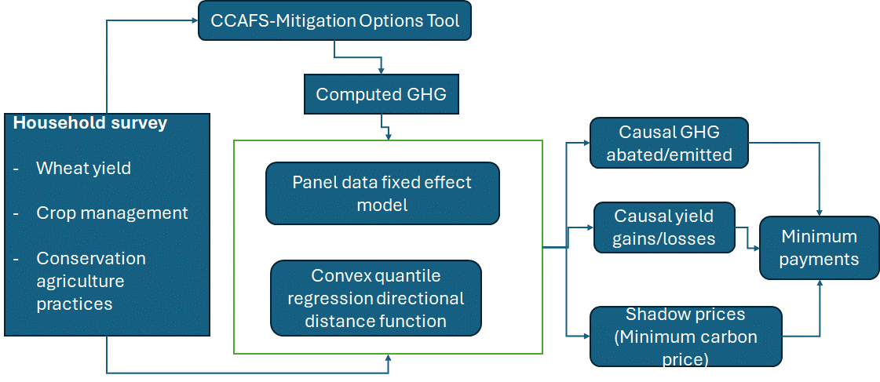
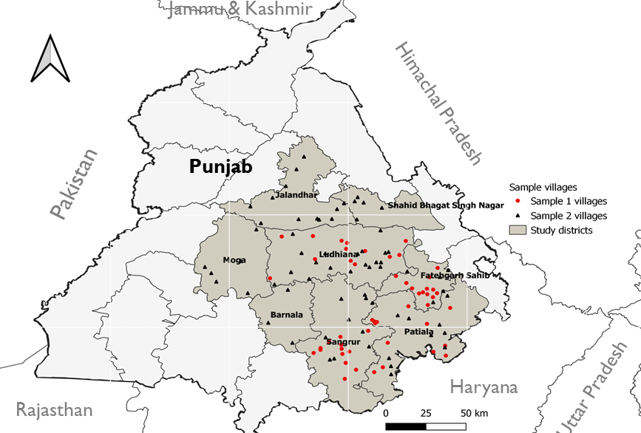
Estimating minimum carbon credit payments:
Steps linking yield–emission outcomes, shadow prices, and farmer-level payment benchmarks
Cariappa, Noufa, C.K, Mkondiwa: Under review

Slide 10
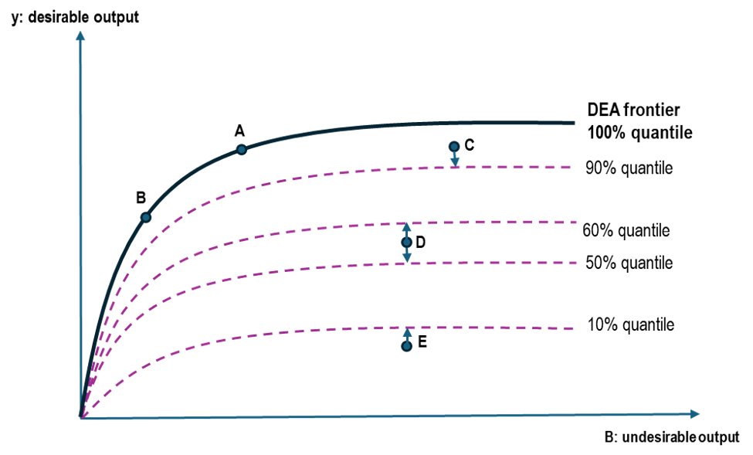
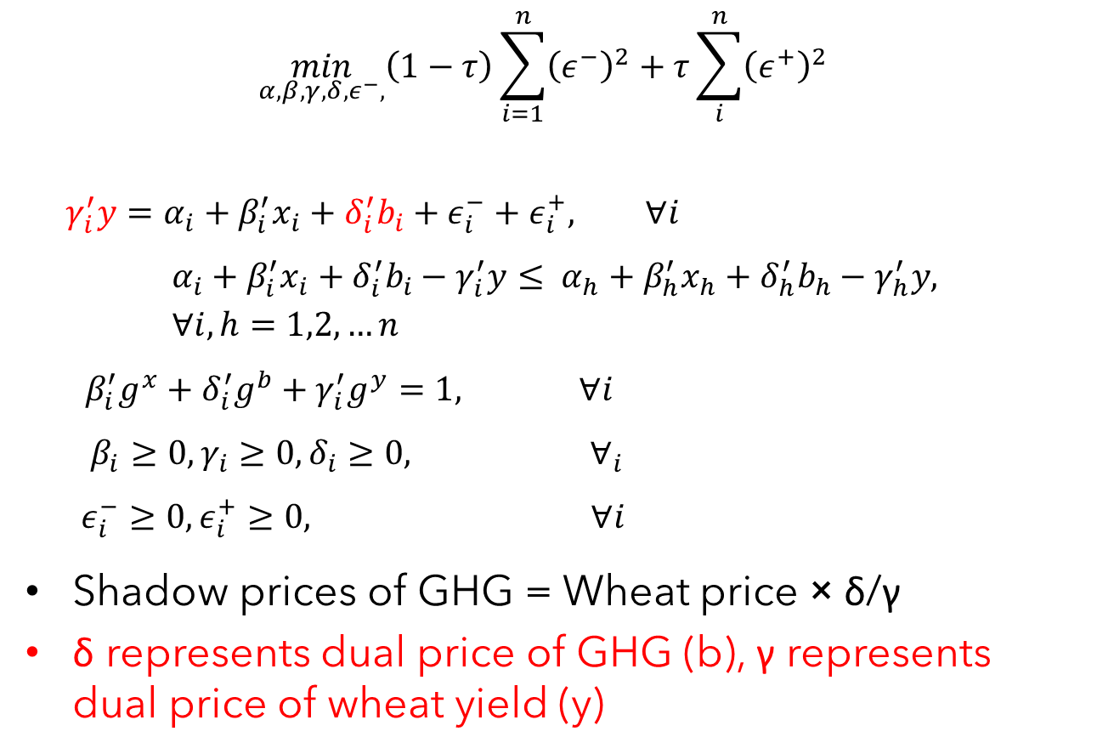
Convex quantile regression directional distance function (CQR-DDF)
$$\min_{α,β,γ,δ,ε^{−},}\left(1−τ\right)\sum_{i=1}^{n}{{\left(ε^{−}\right)}^{2}}+τ\sum_{i}^{n}{{\left(ε^{+}\right)}^{2}}$$
$$γ_{i}^{′}y=α_{i}+β_{i}^{′}x_{i}+δ_{i}^{′}b_{i}+ε_{i}^{−}+ε_{i}^{+}, ∀i$$
$$α_{i}+β_{i}^{′}x_{i}+δ_{i}^{′}b_{i}−γ_{i}^{′}y≤ α_{h}+β_{h}^{′}x_{h}+δ_{h}^{′}b_{h}−γ_{h}^{′}y, ∀i,h=1,2,…n$$
$$β_{i}^{′}g^{x}+δ_{i}^{′}g^{b}+γ_{i}^{′}g^{y}=1, ∀i$$
$$β_{i}≥0, γ_{i}≥0, δ_{i}≥0, ∀_{i}$$
$$ε_{i}^{−}≥0, ε_{i}^{+}≥0, ∀i$$
Shadow prices of GHG = Wheat price × δ/γ
δ represents dual price of GHG (b), γ represents dual price of wheat yield (y)
pyStoNED python package

Slide 11
CA practice | Yield gains (t/ha) | Wheat price (USD/t) | Revenue gains (USD/ha) | Median shadow price of GHG (USD/t) | Amount abated (t/ha) | Cost of abated GHG (USD/ha) | Net benefits (USD/ha) | Class | Recommendation | Minimum carbon price (USD/ha)
A | B | C | D=B * C | E | F | G=E*F | H=D-G | I | J | K
ZT | -0.08 | 222 | -18 | 58 | 0.39*** | 23 | -40 | Loss-win | pay H | 40
No residue burning | 0.02 | 222 | 4 | 58 | 1.09*** | 63 | -59 | Win-win | pay G | 63
No N overuse | -0.12** | 222 | -27** | 58 | 0.39*** | 22 | -49 | Loss-win | pay H | 49
Mulching | 0.03 | 222 | 6 | 58 | 0.13 | 7 | -2 | Neutral | NA | NA
Recommended minimum price of carbon credits
Note: 1 USD = 83.67 INR (https://wdi.worldbank.org/table/4.16)
Column B – from FE regression
Column C – Minimum Support Price (MSP) for wheat announced by the Government of India
Column E – from CQR-DDF
Column F – from FE regression
NA – not applicable, ***p<0.01, **p<0.05. All revenue and payment values are rounded off; statistically insignificant yield effects (<0.5%) are treated as zero for interpretability.

Slide 12
Why risk modeling?
When outcomes are uncertain, farmers may be more hesitant to adopt a practice, requiring additional compensation to induce adoption (Kurkalova et al., 2006; ).
Agricultural researchers usually use stability or inter-temporal variability (standard deviation, coefficient of variation) as a measure of risk.
Good starting point. This talk will focus on how economists think about outcome-based risk.
But need to think about
  Downside risks, whole distribution not just mean/variance
  Risk preferences of the farmer,
  Farmer perceptions,
  Portfolio choices and diversification,
  Monetary cost of risk and
  Shadow prices of ecosystem services.

Slide 13
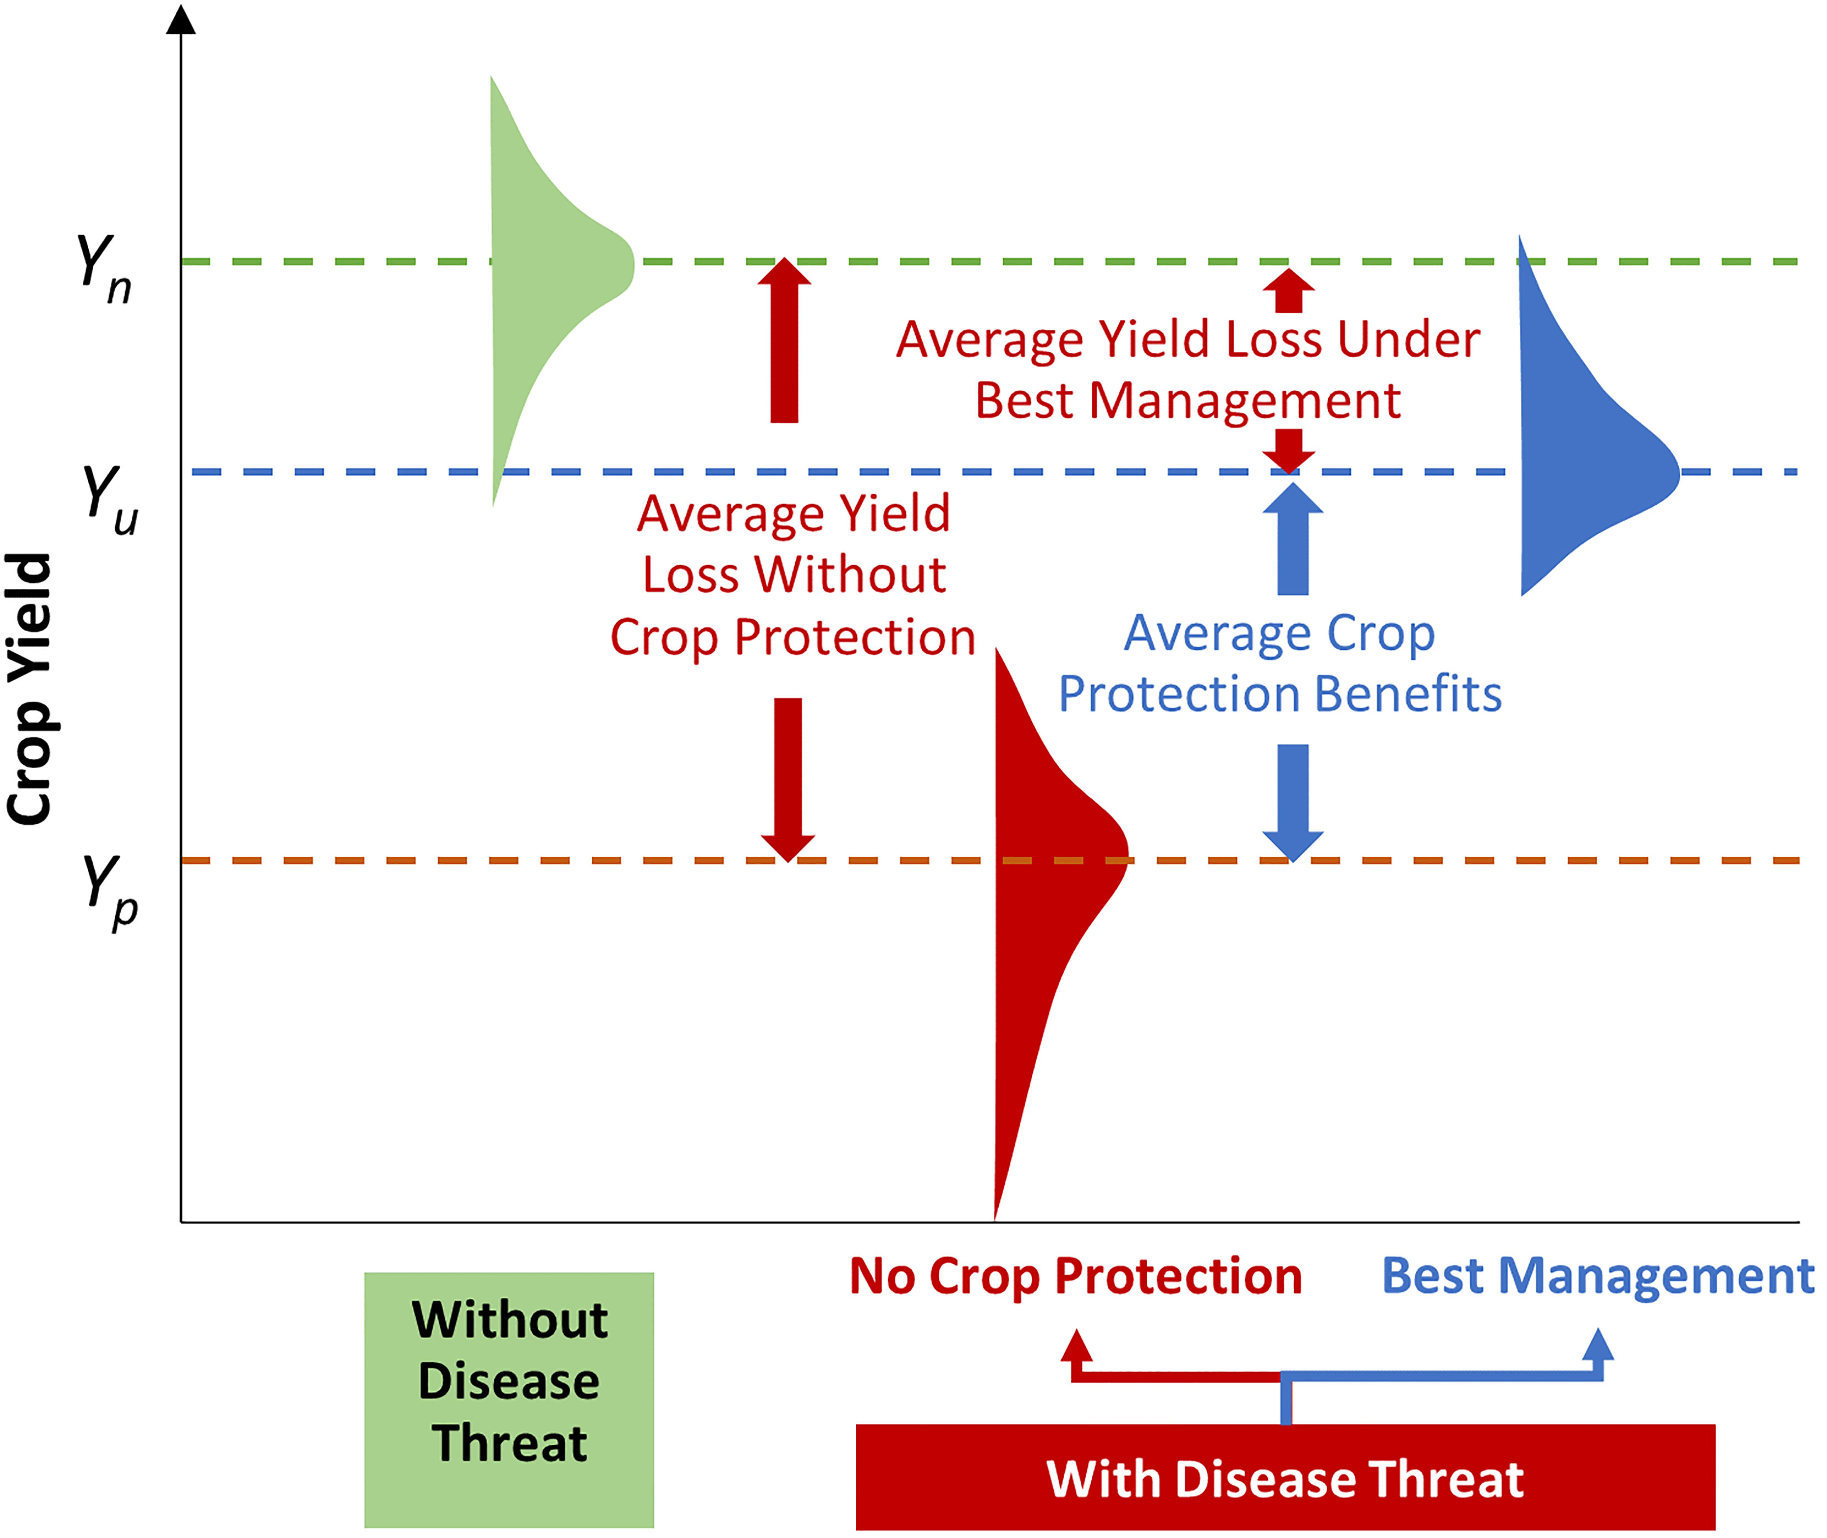
Goal: Risk proofing agriculture
Chai et al (2022)
Without Drought Threat
With Drought Threat

Slide 14
EV and CVaR Quadratic programming: Nayak, Mkondiwa et al 2024 European Journal of Agronomy
(a) Mean-variance (EV) or mean-conditional value at risk (CVaR) for downside risk: Designing new untested cropping systems from LTEs
R code for methodology: https://github.com/EiA2030-ex-ante/Risk_modern_portfolio_theory_EV_model

Slide 15
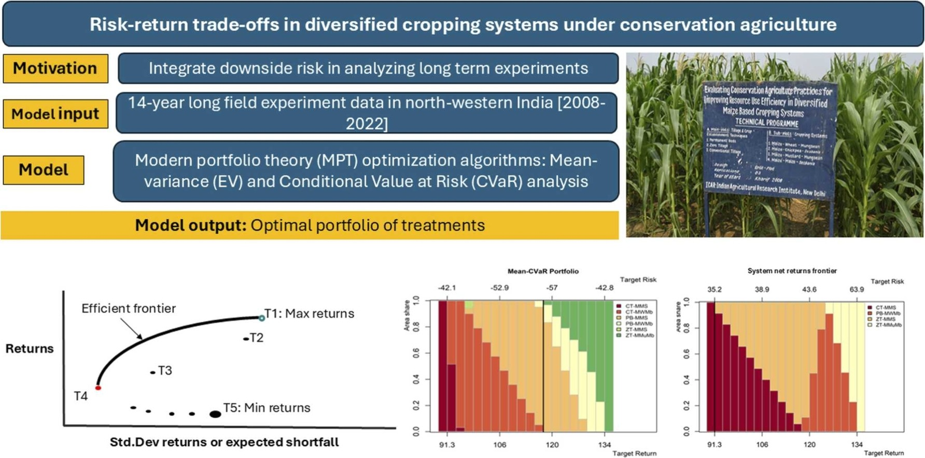
IARI New Delhi LTE, India

Slide 16
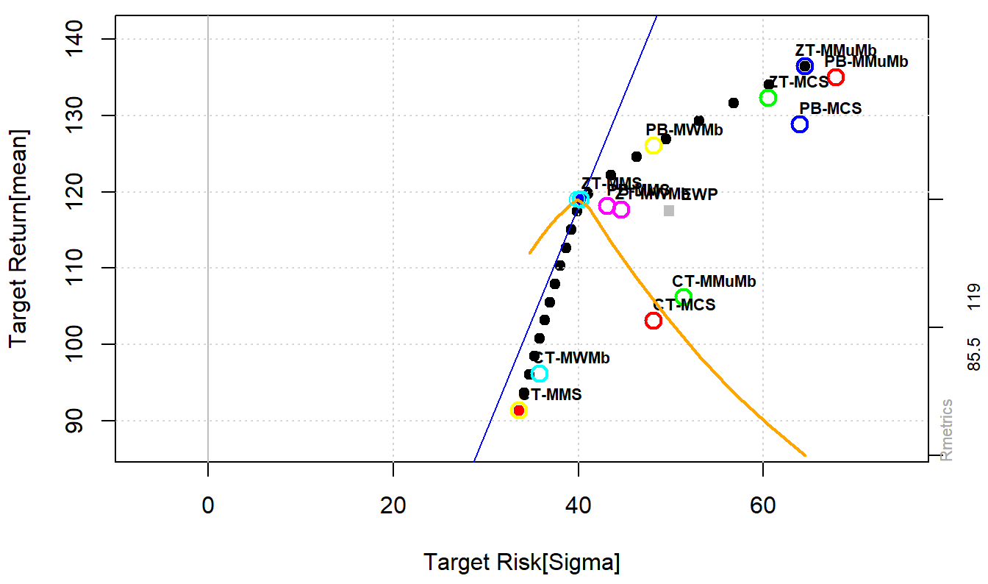
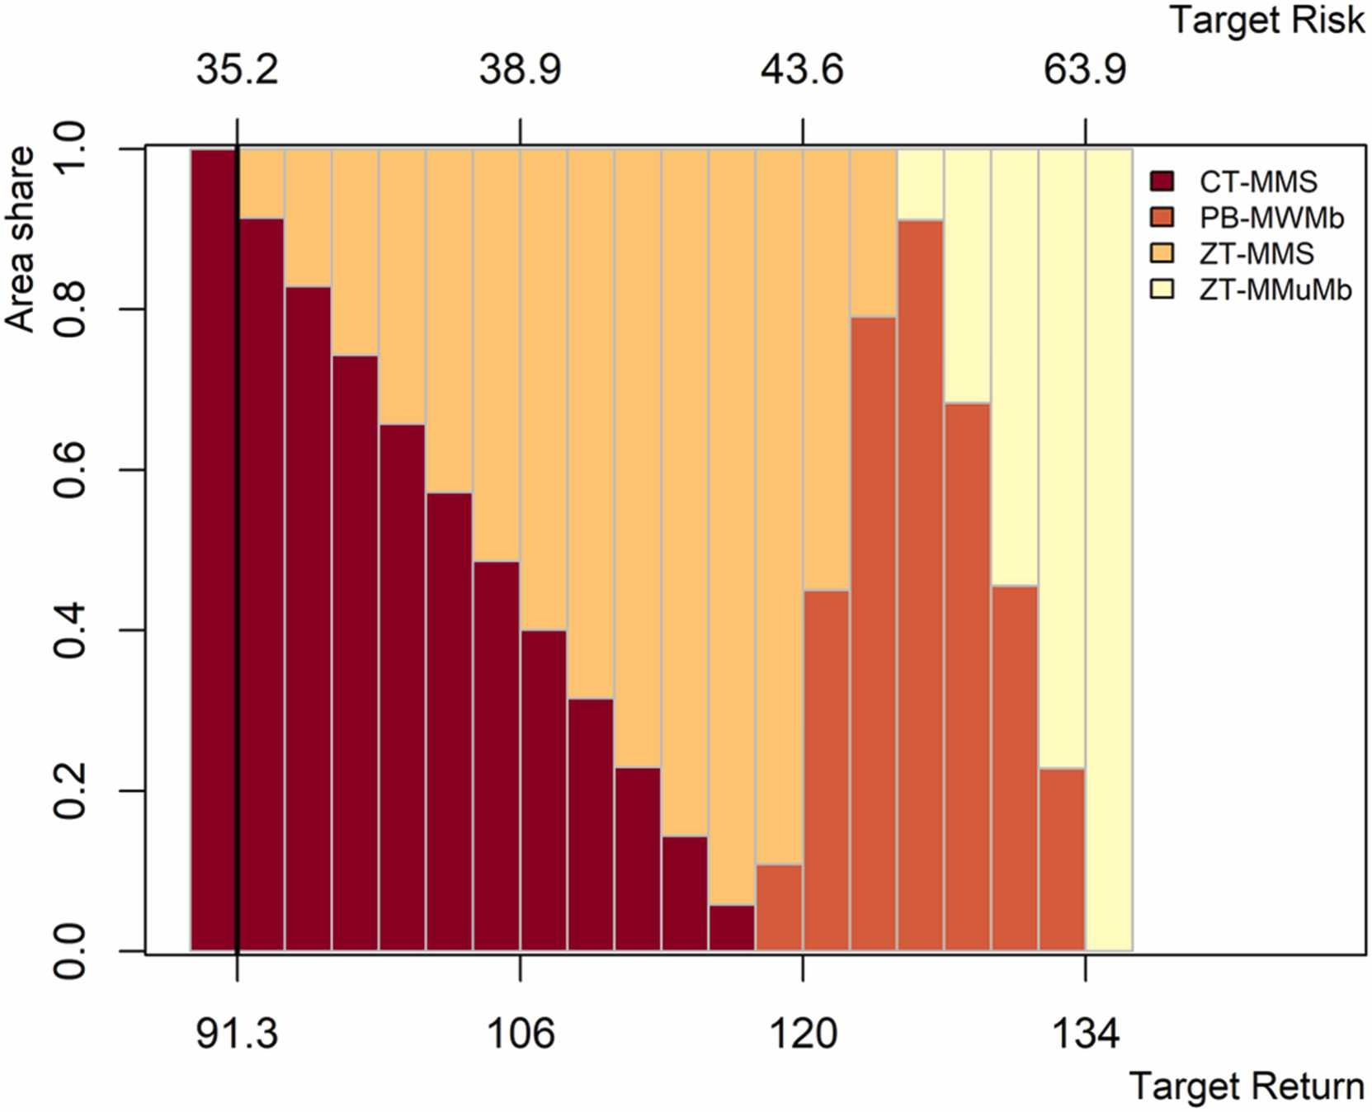
Main result
Highest profit for risk neutral farmer:
  ZT: Maize: Mustard: Mungbean
CT-MMS: On frontier for very risk averse farmers but mostly if in combination with ZT-MMS.

Slide 17
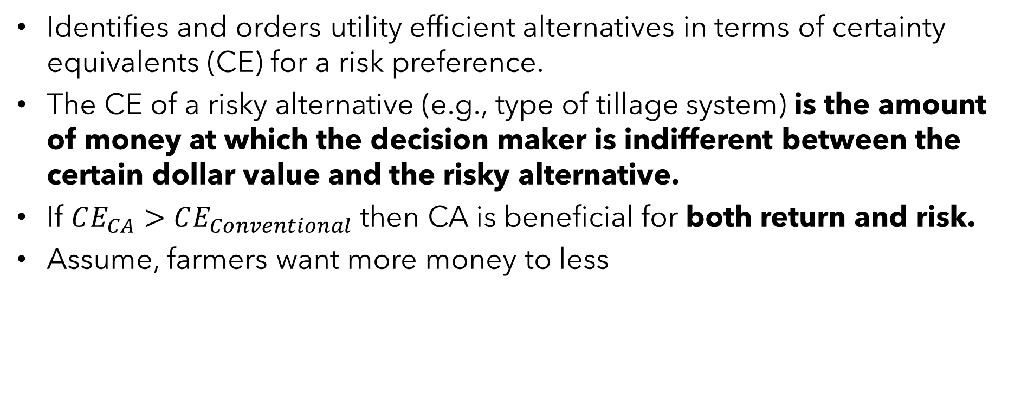
(b) Stochastic efficiency with respect to a function (certainty equivalence and risk premium)
Identifies and orders utility efficient alternatives in terms of certainty equivalents (CE) for a risk preference.
The CE of a risky alternative (e.g., type of tillage system) is the amount of money at which the decision maker is indifferent between the certain dollar value and the risky alternative.
If $CE_{CA}>CE_{Conventional}$ then CA is beneficial for both return and risk.
Assume, farmers want more money to less

Slide 18
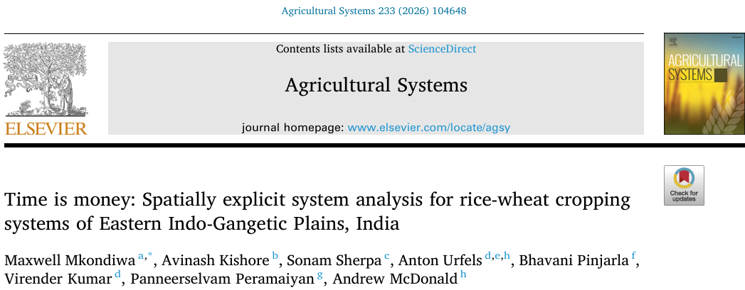
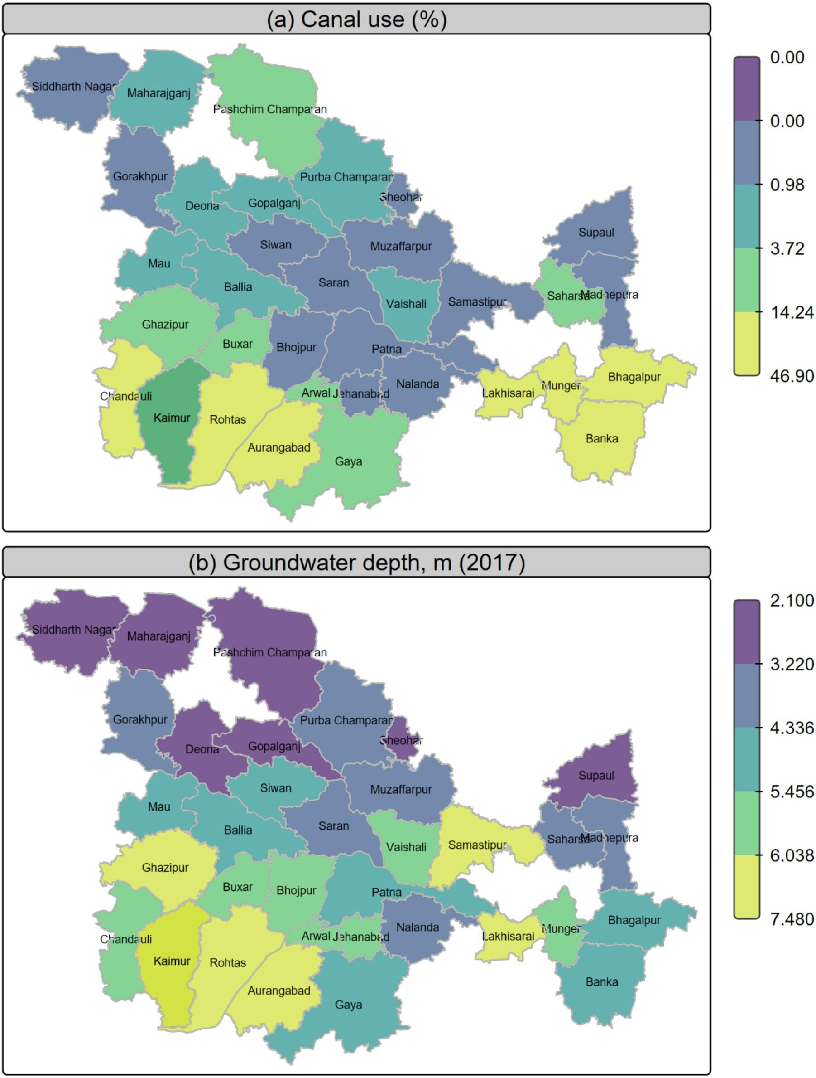
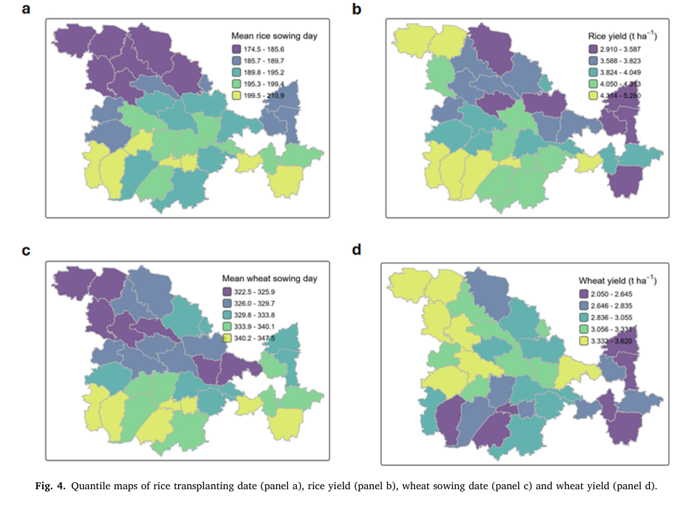
Spatial system risk analysis using Bayesian geo-additive modeling of location and scale

Slide 19
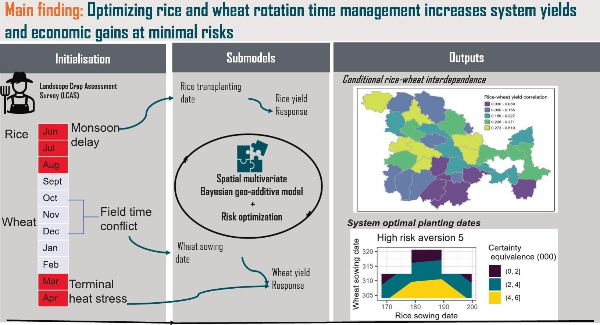
Bamlss R package

Slide 20
(c) Stochastic dominance analysis and identifying willingness to pay [Trade-offs]

Slide 21
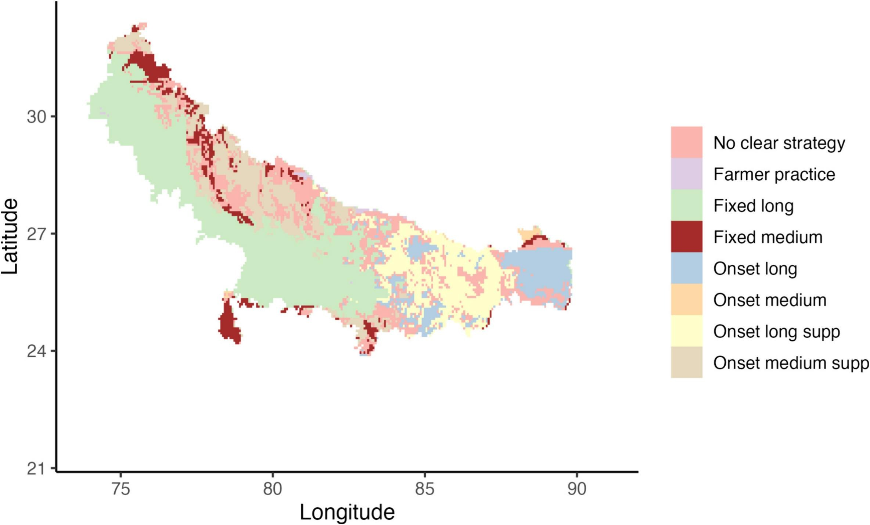
Climatic risk and bio-economic modeling: Future risk proofing agricultural innovations
Optimal rice-wheat sowing strategy even for risk-averse farmer under climatic risk
APSIM + Gridded prices + Golden section search stochastic dominance optimization
R code: https://github.com/EiA2030-ex-ante/WTP_Bounds_SOSD_Risk_Model

Slide 22
(4) Regional farm type and individual farm model (IFM) level bio-economic optimization
Bioeconomic (BE) modeling: Hybrid models of biology and economics. Underscores tradeoffs in ecological and economic functions.
Well-known examples of bioeconomic models: IMPACT by IFPRI, CAPRI by EU, FASOM-GHG and REAP by USDA.
Can have crop growth models, livestock models, LTEs, survey evidence, e.t.c
  Caveats: Mostly regional models and not capturing individual farmer behavior.
  Integrating Causal AI, probabilistic programming, and consistent disaggregation can add personalized assessment, bridging the micro-meso-macro dynamics.

Slide 23
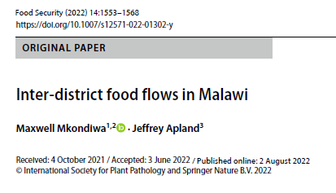
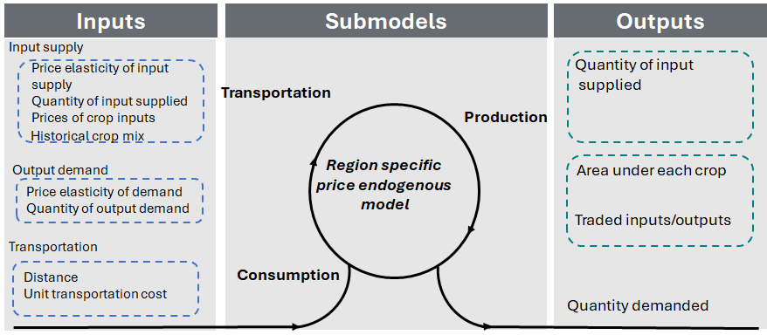
Price endogenous mathematical programming for bioeconomic sector modeling
Forthcoming paper on GAMS code and GUI for the model: RAGS: Regional Mathematical Agricultural Sector Models for Policy Modeling in Data Limited Environments
(Malawi, USA, India)
GAMS code: https://github.com/MaxwellMkondiwa/Malawi-ASM

Slide 24
Conclusion
System risk-return analysis can help in discovering new farming systems.
Shadow pricing as a strategy for giving monetary values to non-monetary indicators, e.g., GHG.
Multivariate geoadditive Bayesian models allow understanding factors affecting interdependence between components of a system.
Individual farm modeling, farm type modeling and regional farm models can help in understanding farming systems.
  Advances in AI, probabilistic programming, and consistent aggregation allow disaggregated models and foresight modeling for future typologies.

Slide 25
m.mkondiwa@cgiar.org

