Slide 1
Variables
Exposure: average daily pm2.5 exposure over course of pregnancy
Outcome: birthweight
Measured confounders: age, Kotelchuck index, maternal education, race/ethnicity, income, (binary) parity, NDVI
Income tract-level per-capita from the 2006-2010 ACS
Categorical variables controlled for by factor

Slide 2
Inclusion/exclusion
Year 2013 conceptions
Complete case analysis (“unknown” values from masterfile excluded)
Gestational age less than 22 weeks or greater than 44 weeks excluded
Final analysis of 457,973 births
Age cutoff? (ranges from 12 to 74 years)
Birthweight cutoff? (ranges from 64 to 6861 grams)

Slide 3
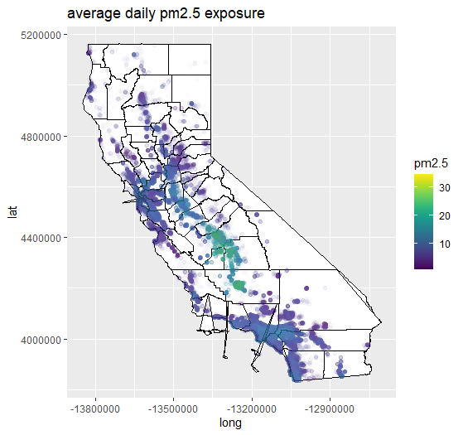

Slide 4
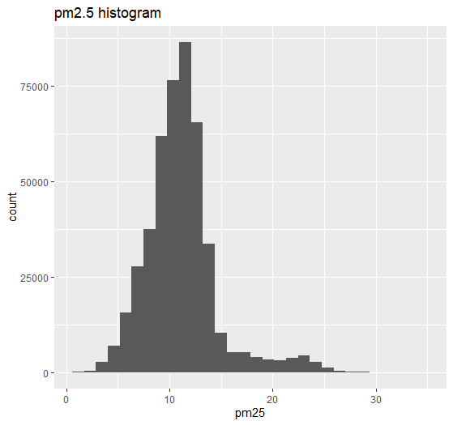

Slide 5
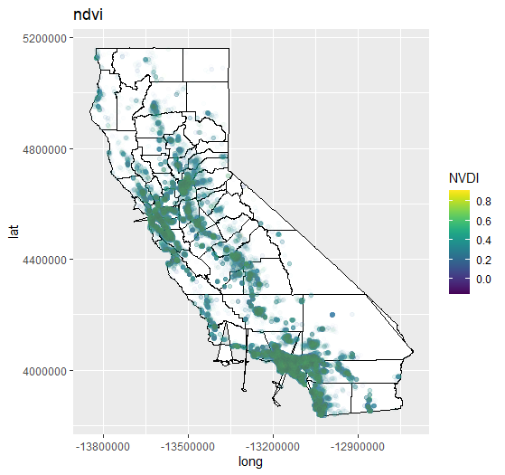

Slide 6
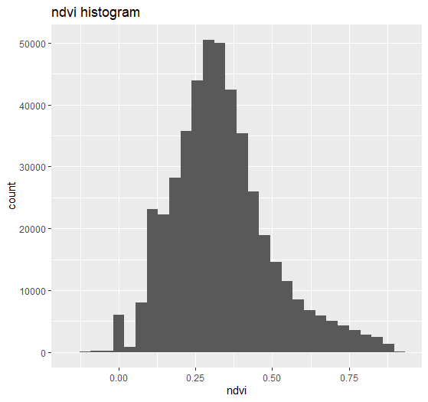

Slide 7
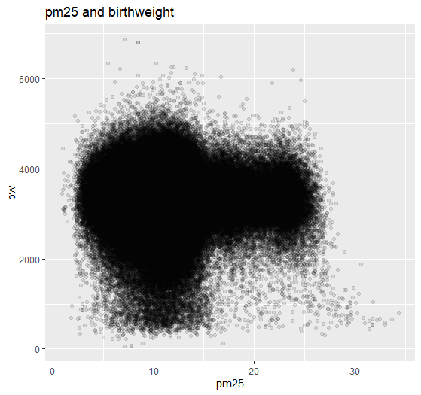

Slide 9
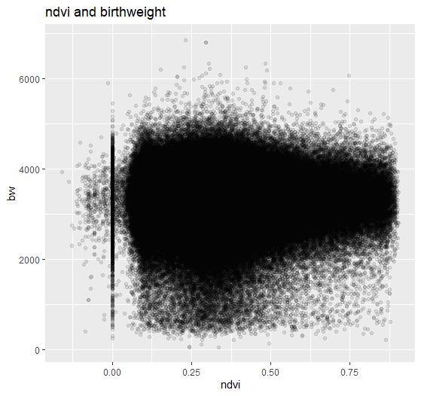

Slide 10
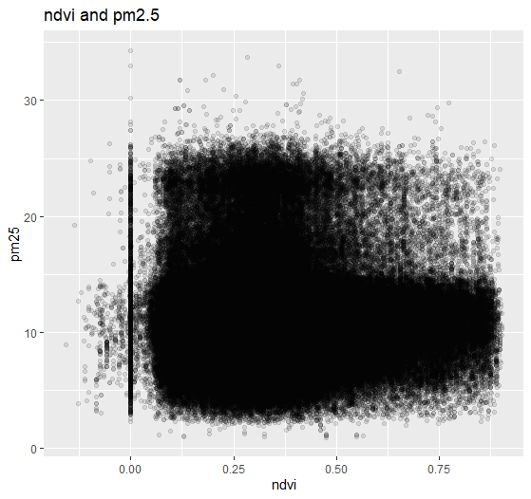

Slide 11
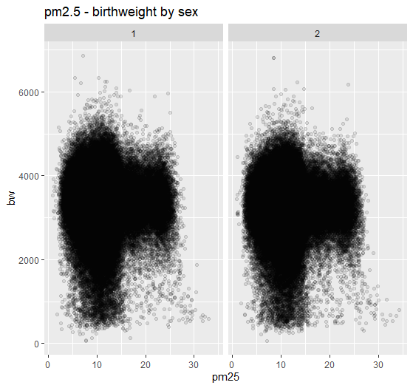

Slide 12
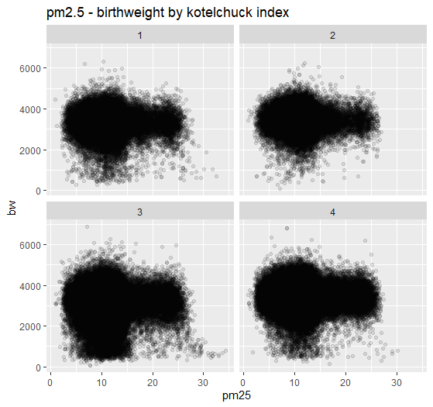

Slide 13
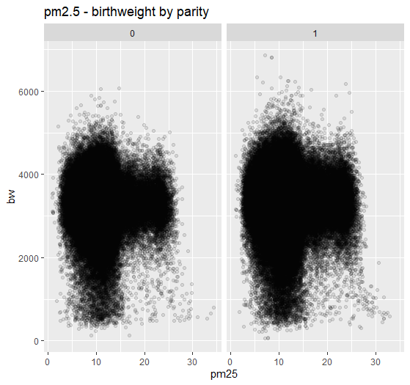

Slide 14
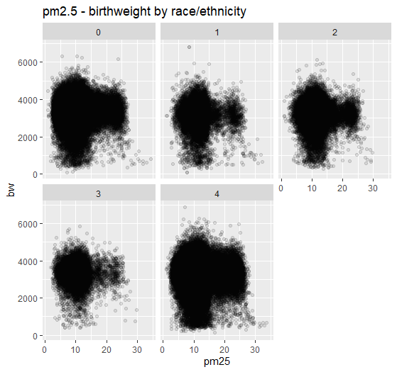

Slide 15
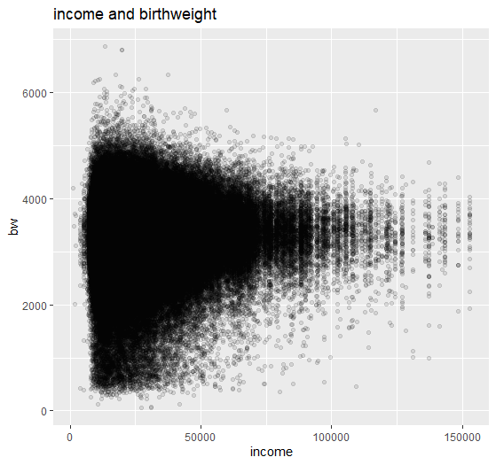

Slide 16
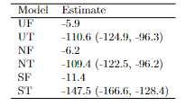
U = unadjusted, N = NDVI-adjusted, S = spatial-adjusted
F = full data, T = thresholded data

