Slide 1
Efficient Design of Spiking Neural Network with STDP Learning Based on Fast CORDIC
Jiajun Wu, Yi Zhan, Zixuan Peng, Xinglong Ji, Guoyi Yu, Rong Zhao and Chao Wang
2021/02/24

Slide 2
Outline
Introduction
CORDIC in Spiking Neural Networks
Hardware Design and Implementation of Proposed Fast-convergence CORDIC SNN
Implementation Results and Discussion
Conclusion

Slide 3



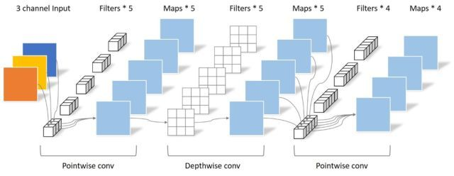
Introduction (1/5)
With the development of Internet-of-Thing (IoT), hardware accelerators with low latency and high energy-efficient become more and more important.
Face Recognition
Autonomous Driving
Object Tracking
Conventional artificial Neural Networks (ANN) are difficult to be implemented with on-line training due to the large amount of parameters and large network scales. Besides, the learning rule of ANN cannot reflect the learning strategy in human brains.

Slide 4

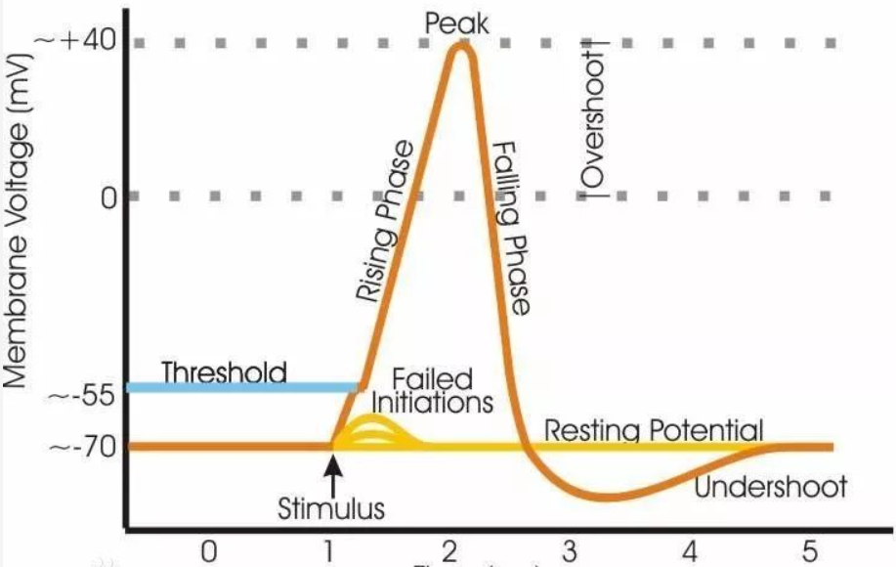
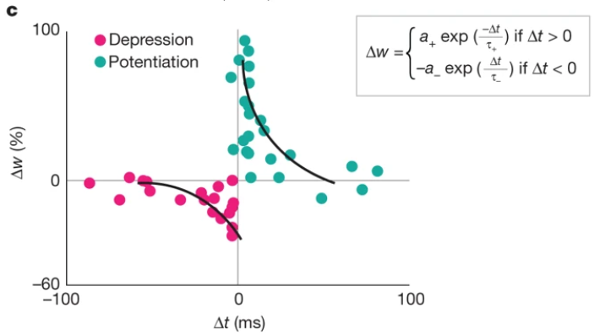
Introduction (2/5)
Efficient design and implementation of bio-inspired neurons and synapses to enable on-line learning is very essential: performance, cost and power, etc.
Why on-line learning?
Intelligent IoT edge devices
SNN on-line learning models – nonlinear dynamics [1]-[3]
Causes
Computation-intensive, hardware-expensive and power-hungry
especially for massive SNN design
How to make a design choice for hardware implementation?
LIF/Izhikevich neurons
Analog and Mixed
-signal design
More immune to device nonidealities and noises
Benefits from CMOS technology scaling
Very popular to massive hardware implementation
Reduce latency.
Minimize power.
Ensure security.
Protect privacy.
It is a trend for AI accelerator
Digital design
(selected)
STDP based and STDP-like (derived from STDP) synapse

Slide 5
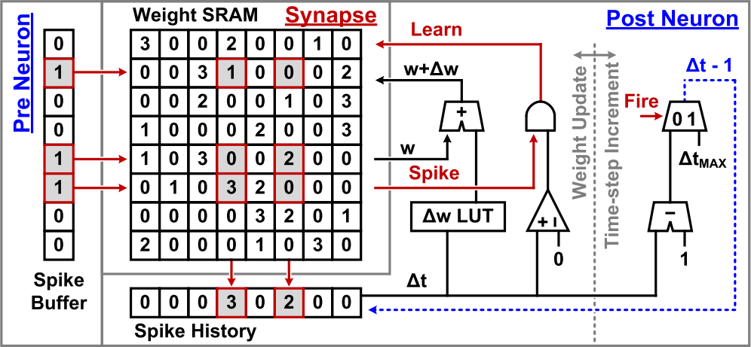
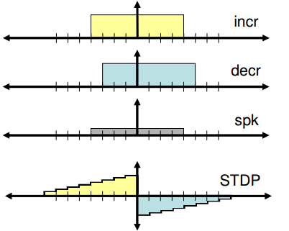
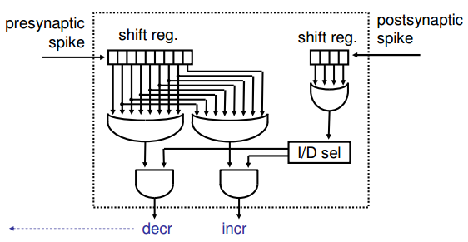
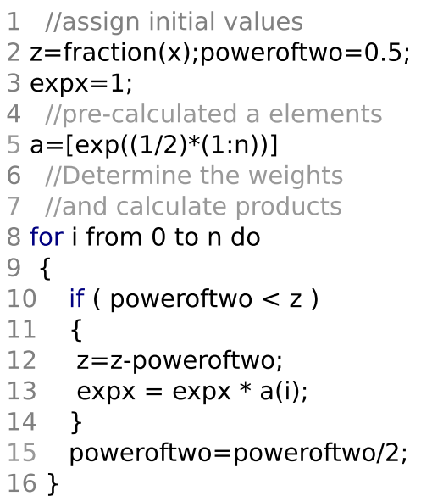
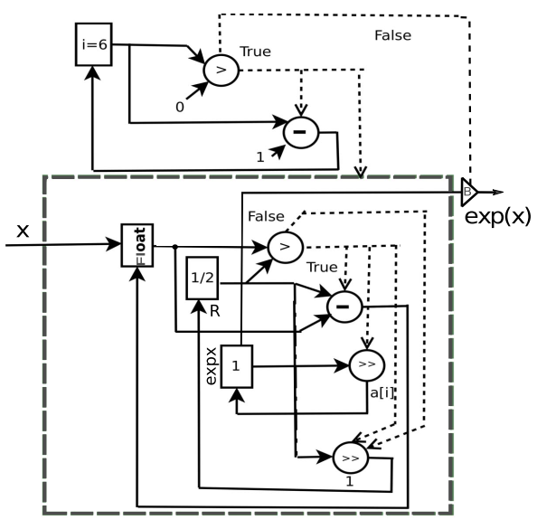
Introduction (3/5)
In the recent research of digital SNN hardware, STDP-based synapses are implemented based on: (1) LUT; (2) Triangular approximation; (3) CORDIC.
(1) Look Up Tables (LUT)
(2) Triangular approximation
CORDIC gained a lot of interests to implement neuron and synapse circuits
Use simple shift & add operations to approximate multiplication and exponentiation in a number of iterations => More accurate, less costly.
(3) CORDIC

Slide 6
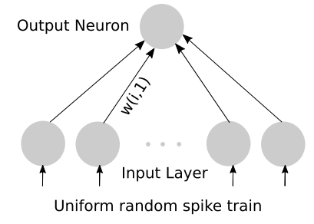
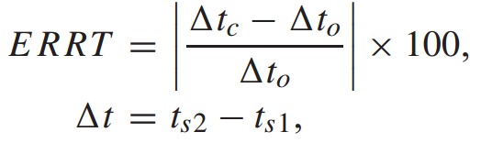
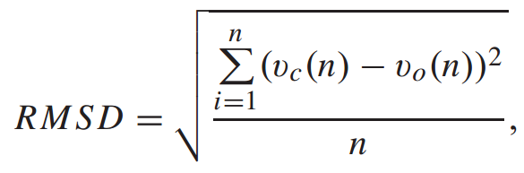
Introduction (4/5)
Error analysis has also been performed to ensure the model-level accuracy of the proposed CORDIC neuron. However, there still has some cirical issues:
(1) The existing work has only assessed model-level precision and constructed a relatively simple network to demonstrate unsupervised Hebbian learning in terms of weight distribution;
(2) STDP learning speed has not been evaluated.
(3) The precision evaluation in the existing works has only analyzed the local spiking-train errors instead of network-level accuracy with respect to learning results.
In summary, hardware effieicny including learning performance and energy efficiency of CORDIC-based SNN design has not been sysmtematically studied.

Slide 7
Introduction (5/5)
This study proposes a systematic design and evaluation method of CORDIC-based SNN, from theoretical CORDIC-level error analysis to application-level learning performance on MNIST dataset.
(1) Optimal CORDIC type and lowest bit-width precision can be identified, by trading affordable performance loss and hardware overhead for overall SNN hardware efficiency;
(2) A reconfigurable SNN design based on selected 8-bit fast-convergence CORDIC in [21] is presented;
(3) The FPGA results confirms that the propsoed SNN design outperformas the existing methods in terms of hardware efficiency, STDP-based learning performance and energy efficiency
Design and evaluation flow of the
proposed CORDIC SNN

Slide 8
CORDIC in Spiking Neural Networks (1/4)
Network Model & Learning Rule
Advantages:
High accuracy over MNIST dataset (95%)
Biological plausibility
Online learning -> On-chip learning
Including exponential calculations -> CORDIC
SNN architecture and working mechanism

Slide 9
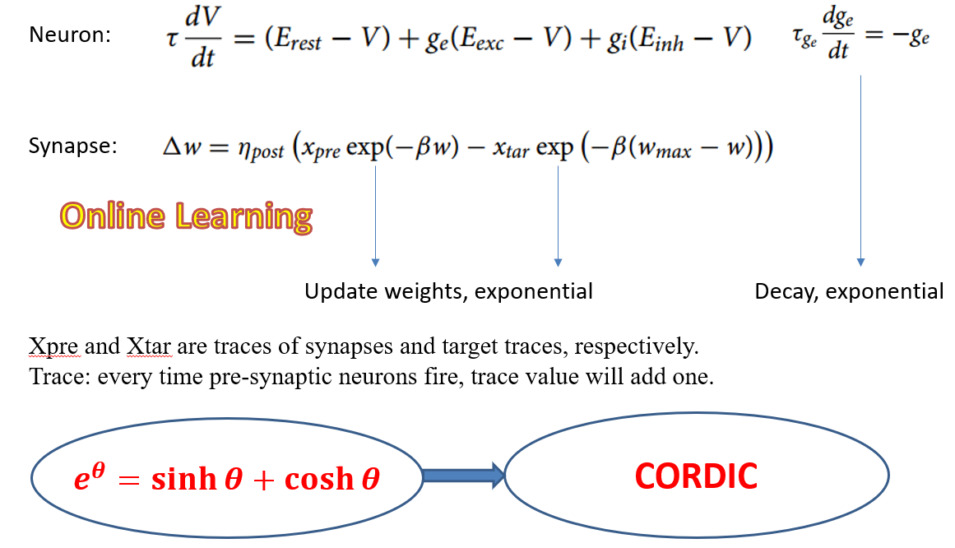
CORDIC in Spiking Neural Networks (2/4)
Network Model & Learning Rule
With comparable classification accuracies (up to 95%), the selected STDP rule involves exponentiation, which is less complex than the other STDP variants based on power-law functions.
The exponentiation is implemented with CORDIC

Slide 10
CORDIC in Spiking Neural Networks (3/4)
CORDIC for Exponentiation
Illustration of CORDIC algorithms (a) conventional CORDIC, (b) fast-convergence CORDIC
Iteration No. of Conventional/Heidarpur’s CORDIC | 6 | 8 | 16 | 24
Average No. of Fast-convergence CORDIC | 2.27 | 4.18 | 7.88 | 10.48
Saving of Redundant Iterations | 62.2% | 47.8% | 50.8% | 56.3%
Average number of iterations

Slide 11
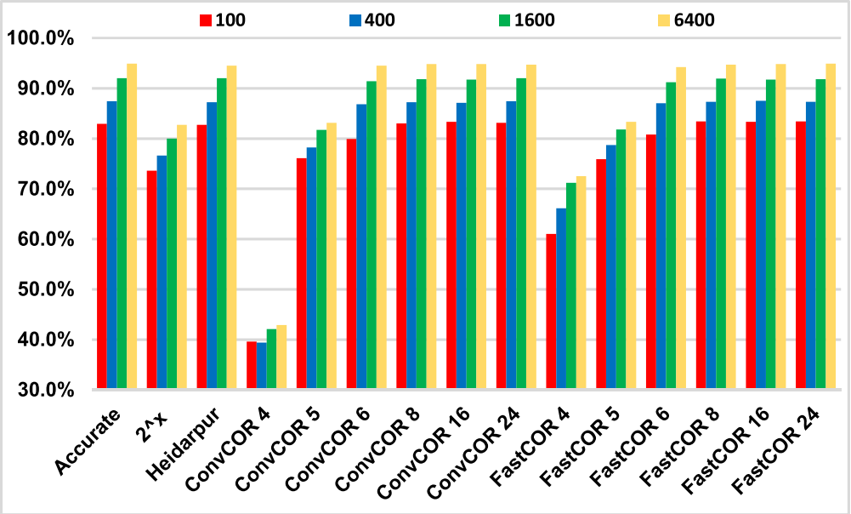
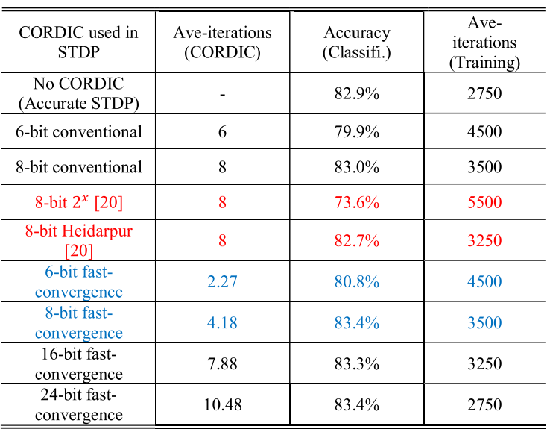
CORDIC in Spiking Neural Networks (4/4)
Performance Analysis of CORDIC SNN
Classification accuracy of SNN based on different CORDIC under various bit-width precision.
6 and 8-bit are selected

Slide 12
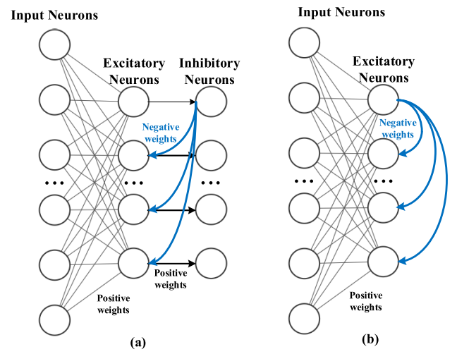
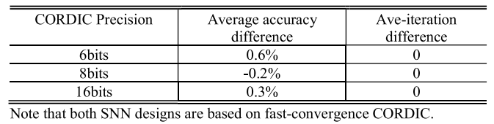
Hardware Design and Implementation (1/3)
Removing Inhibitory Neurons for simplification
Accuracy loss is acceptable!
Intra-layer inhibitory synapses among the excitatory neurons is proposed to optimize the SNN architecture to reduce hardware complexity and energy consumption by removing the inhibitory neurons
Proposed SNN architecture by substituting inhibitory neurons in original model with intra-layer inhibitory synapses

Slide 13
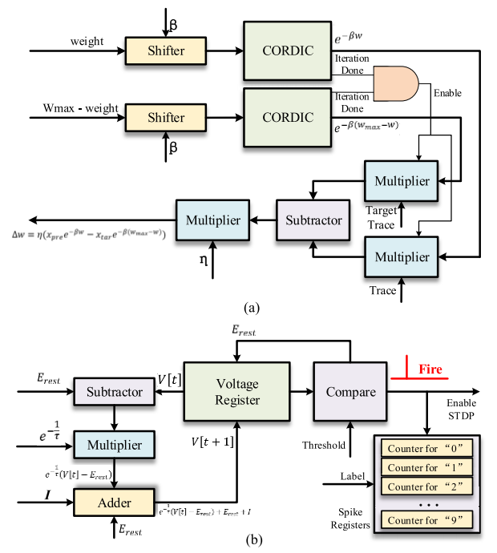
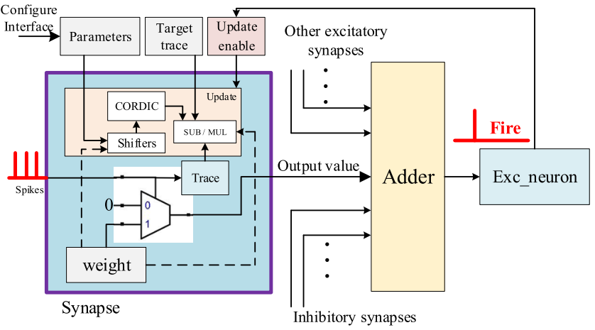
Hardware Design and Implementation (2/3)
Synaptic Circuit Design and Dataflow
The target traces are shared between different synapses
Local weight update (local learning)

Slide 14
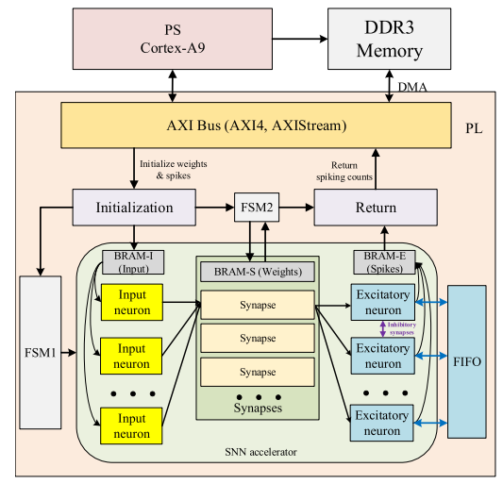
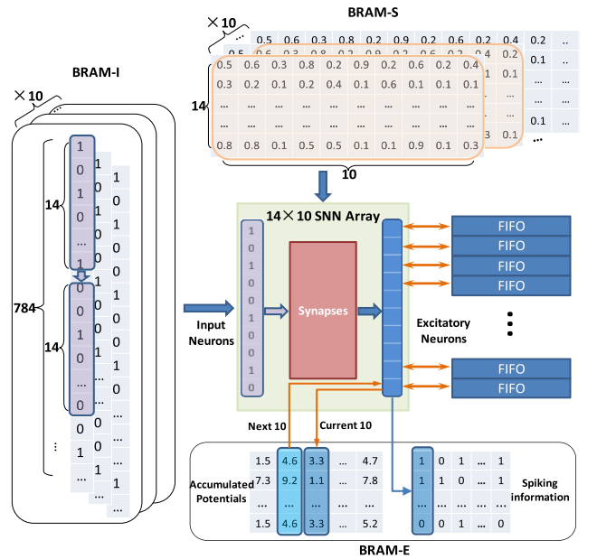
Hardware Design and Implementation (3/3)
System Design and Dataflow
System design
Time-Division Multiplexing

Slide 15
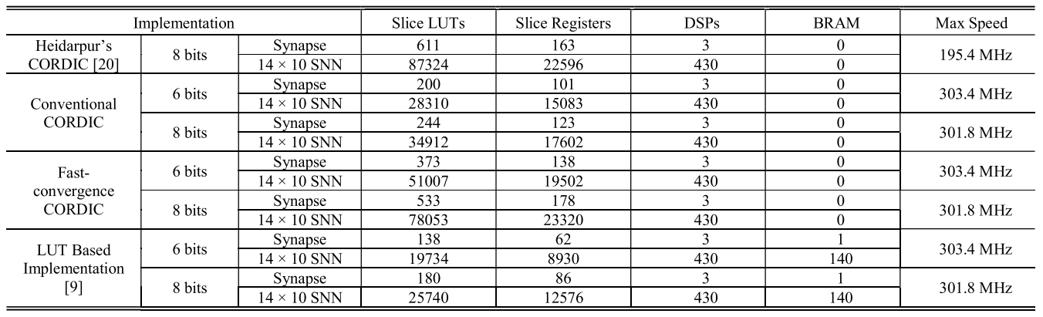
Implementation Results and Discussion (1/3)
HARDWARE UTILIZATION AND MAX SPEED FOR SNN WITH DIFFERENT IMPLEMENTATIONS
Requiring extra LUT to store scaling factors and logic slices to perform shift & add based scaling.
Heidarpur’s CORDIC requires more shift & add operations to multiply the pre-calculated values in the iterations, causing a much longer carry chain than the other CORDIC designs (lower frequency).

Slide 16
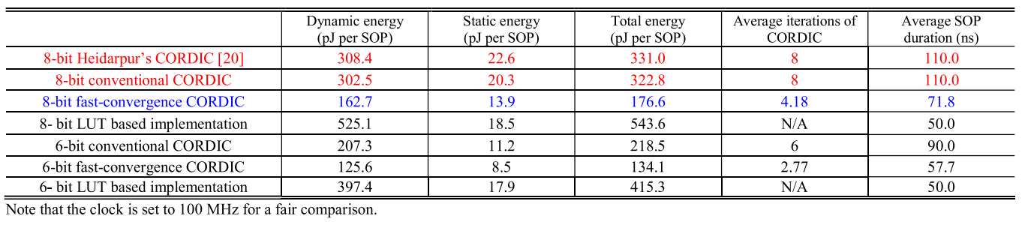
Implementation Results and Discussion (2/3)
Energy Efficiency Evaluation
For fair comparison, the energy consumption must be divided into “energy per synaptic operation (SOP)”
As the fast-convergence CORDIC takes much fewer iterations and computation to finish STDP calculation, the proposed fast-convergence CORDIC SNN design achieves dynamic energy saving significantly.

Slide 17
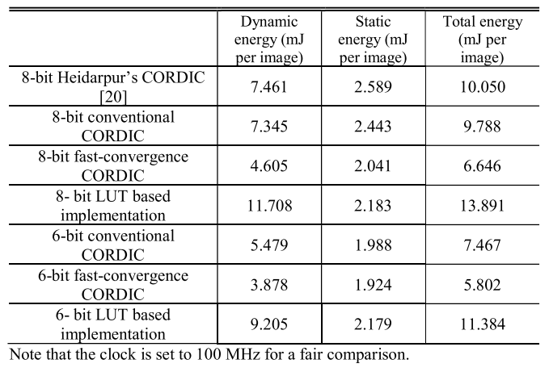
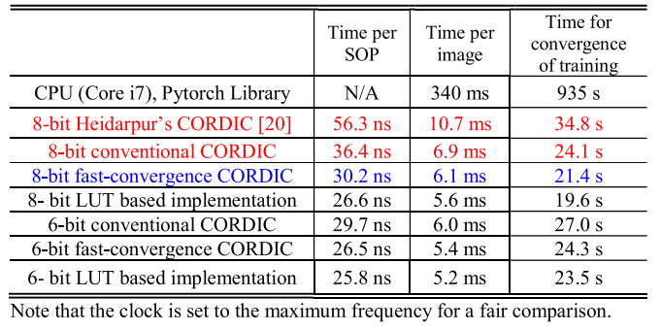
Implementation Results and Discussion (3/3)
Other Evaluations
Acceleration
Energy per image

Slide 18
Conclusion
A system design and evaluation method of CORDIC SNN is proposed to evaluate the hardware efficiency of SNN based on different CORDIC algorithm types and bit-width precisions. The comprehensive evaluation proves that selected 8-bit fast-convergence CORDIC with pipeline AR method outperforms both the conventional and the state-of-the-art CORDIC designs, in terms of the theoretical CORDIC-level error analysis, the application-level learning and classification performance on MNIST benchmark.
The implementation results confirm that the proposed fast-convergence CORDIC SNN design has better hardware efficiency than the conventional and state-of-the-art CORDIC methods, in terms of the STDP learning speed and energy efficiency, the image processing speed and learning convergence speed.

