Slide 1
An Energy-efficient Multi-core Restricted Boltzmann Machine Processor with On-chip Bio-plausible Learning and Reconfigurable Sparsity
¹Jiajun Wu, ¹Xuan Huang, ¹Le Yang, ¹Liang Wang, ¹Jipeng Wang, ³Zuozhu Liu, ⁴Kwen-Siong Chong, ²Shaowei Lin and ¹Chao Wang
1. Huazhong University of Science and Technology, Wuhan, China
2. Singapore University of Technology and Design, Singapore
3. National University of Singapore, Singapore
4. Nanyang Technological University, Singapore

Slide 2
Outline
Background
Previous RBM Processor
VPF Learning Rule
Proposed RBM Processor
Measurement Results and Comparison
Conclusions and Future Work

Slide 3
Background (1/2)

Slide 4
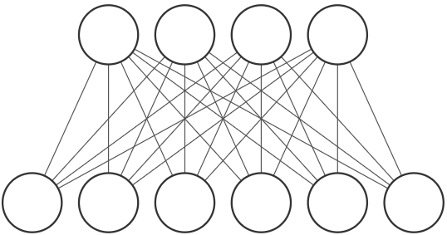
Background (2/2)
Restricted Boltzmann Machine (RBM) Model
Hidden Layer
1
0
1
1
1
0
Visible Layer
Original image
Reconstructed image
Traditional learning rule - Contrastive Divergence (CD)
Unsupervised learning – No labels required.
Less computation complexity compared with Deep Neural Networks

Slide 5
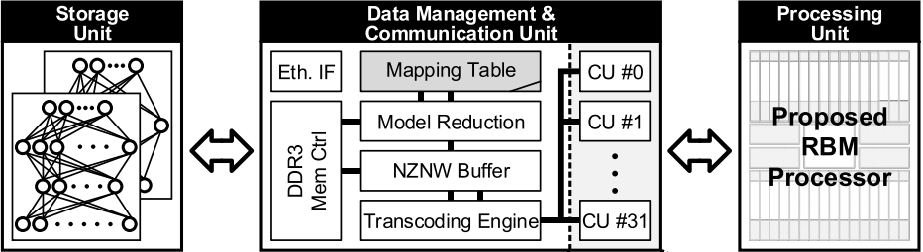
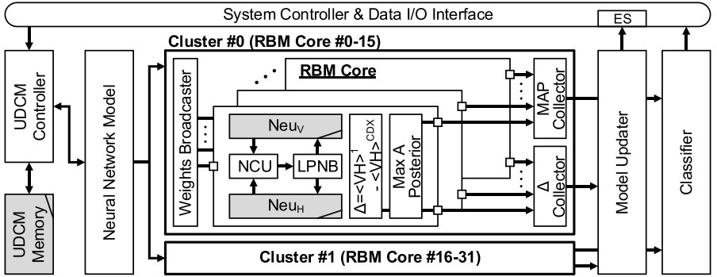
Previous RBM Processor (1/2)
DDR
FPGA
On-Chip
Need extra devices (FPGA, DDR memory) for data communication
Large external storage
High bandwidth required
[3] C. Tsai et al., “A 41.3pJ/26.7pJ per neuron weight RBM processor for on-chip learning/inference applications,” Proc. IEEE A-SSCC, pp. 265-268, Nov. 2016.

Slide 6
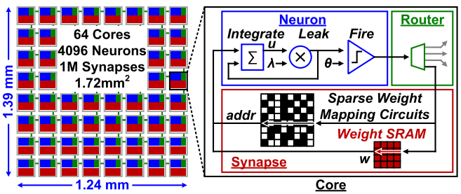
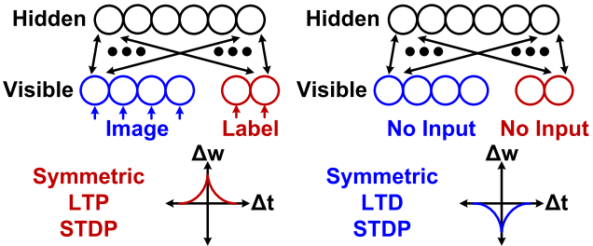
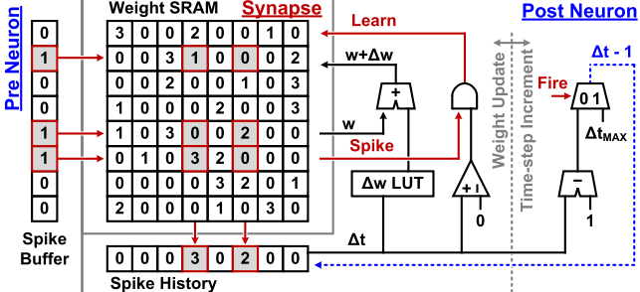
Previous RBM Processor (2/2)
NoC based Spiking RBM processor
Spiking CD, semi-supervised learning
Semi-supervised learning still needs label information.
Large area consumption for weight update LUT.
Low flexibility due to spikes based architecture.
LUT based weight update strategy
[4] G. K. Chen et al., “A 4096-neuron 1M-synapse 3.8-pJ/SOP spiking neural network with on-chip STDP learning and sparse weights in 10-nm FinFET CMOS,” IEEE JSSC, vol. 54, no. 4, pp. 992-1002, Apr. 2019.

Slide 7
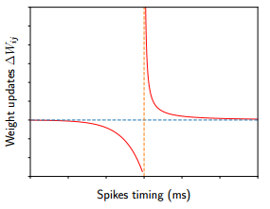
VPF Learning Rule
STDP
Advanced learning rule - Variational Probability Flow (VPF)
Bio-plausible and unsupervised learning rule.
Only one generation phase (phase 2) which needs Gibbs Sampling (GS).
[5] Z. Liu et al., “Variational probability flow for biologically plausible training of deep neural networks,” Proc. AAAI 2018.

Slide 8
Proposed RBM Processor (1/7)

Slide 9
Proposed RBM Processor (2/7)
M × M RBM model is mapped into a mesh of n × n RBM cores.
Asynchronous accumulation of different partial summations.
Sparse connection in RBM core.

Slide 10
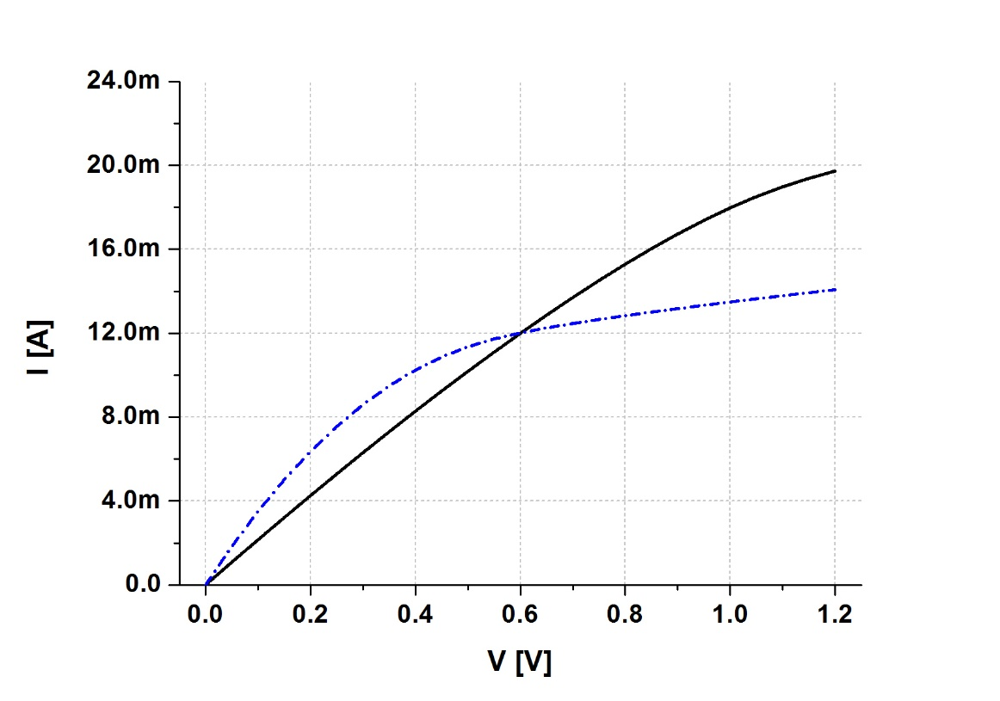
Non-linearity of pull-down DR
Pull-down driver
I-V characteristic of pull-down driver

Slide 11
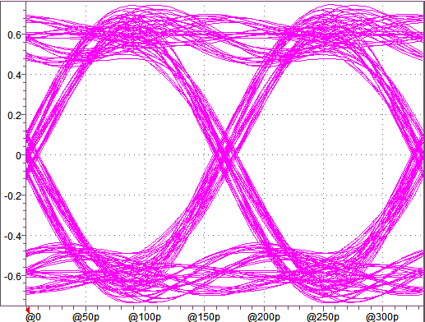
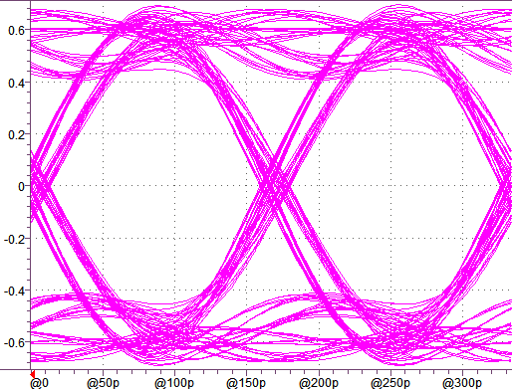
Effect of non-linearity of pull-down DR
Conventional driver
Proposed driver
R_{T} = 50 Ohm, TX pin C = 1.7pF L=2.5nH, RX pin C = 1.7pF L=2.5nH
No appreciable difference between proposed and conventional drivers

Slide 12
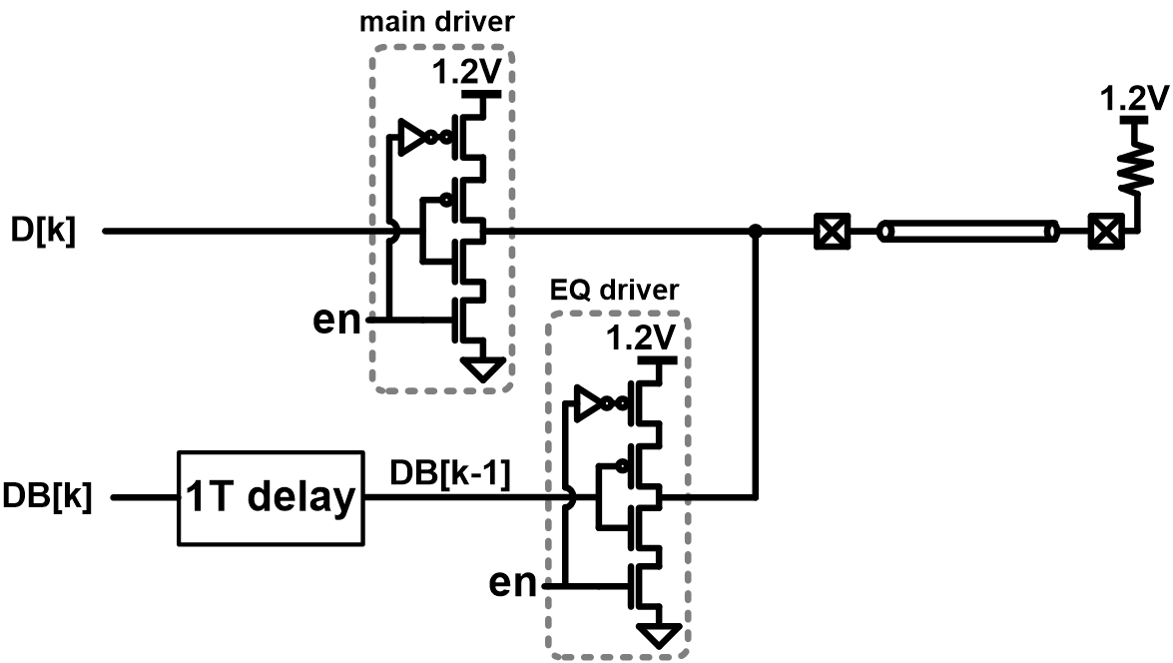
All-synthesizable 2-tap FFE
6Gbps FF not used for 1T delay, because it cannot be implemented by synthesis

Slide 13
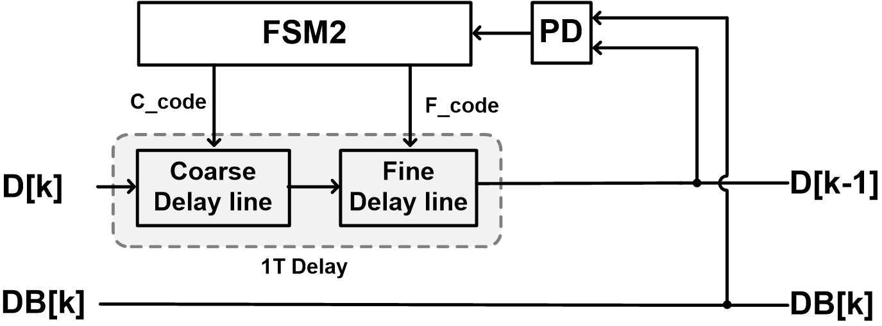
DLL for 1T delay generation
For DLL operation, training patterns are used (1010…)
1T = (delay of coarse delay line + delay of fine delay line)

Slide 14
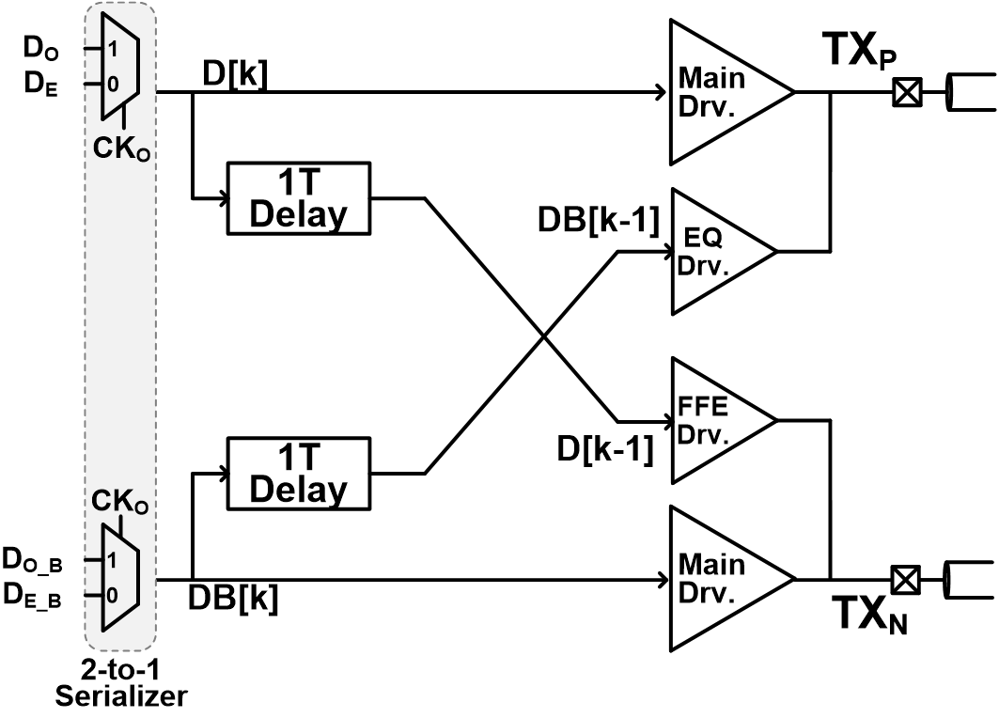
Proposed 2-tap FFE driver with 2-to-1 serializer

Slide 15
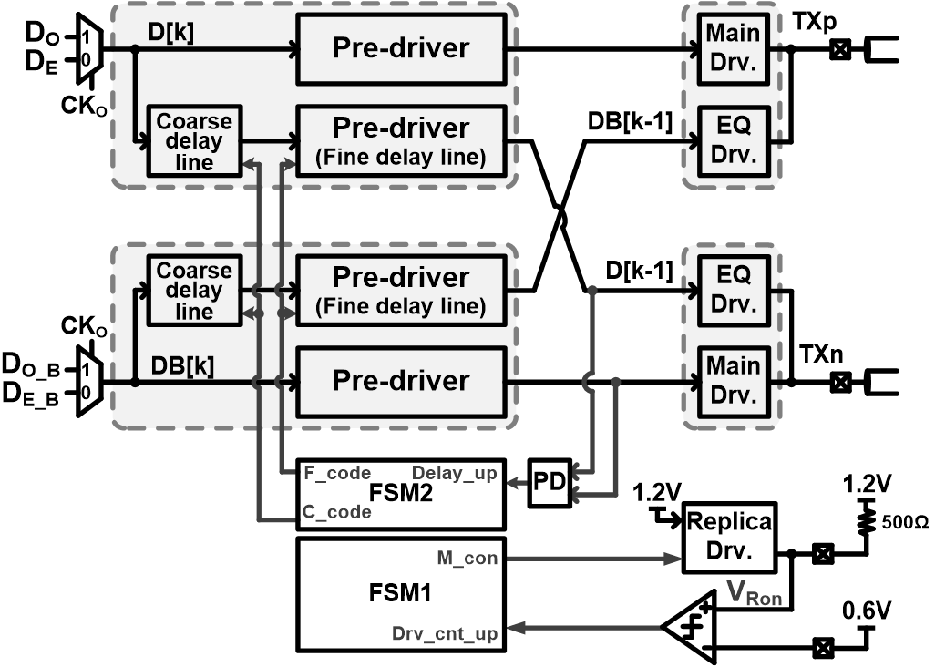
Final proposed all-synthesizable voltage-mode TX

Slide 16
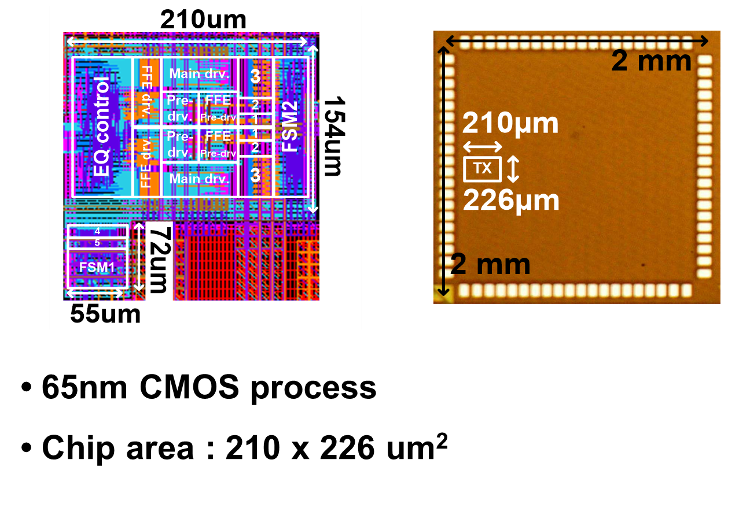
Chip photo and layout

Slide 17
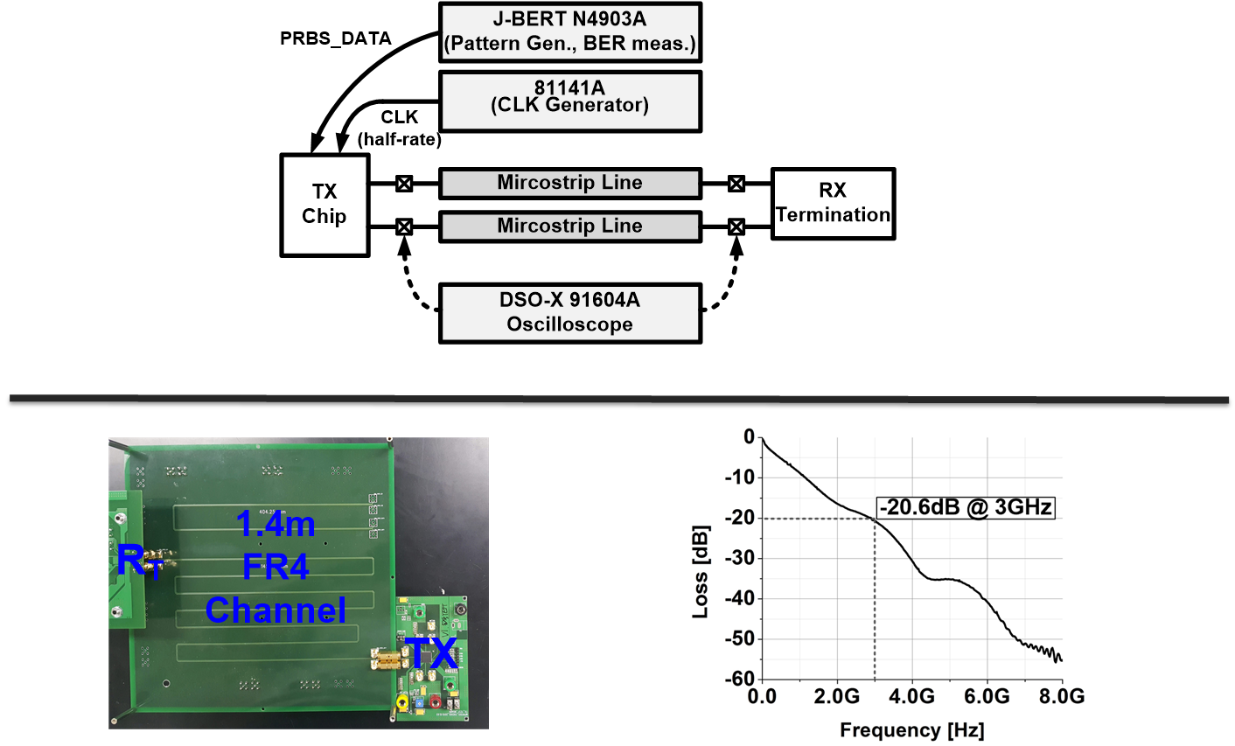
Measurement setup

Slide 18
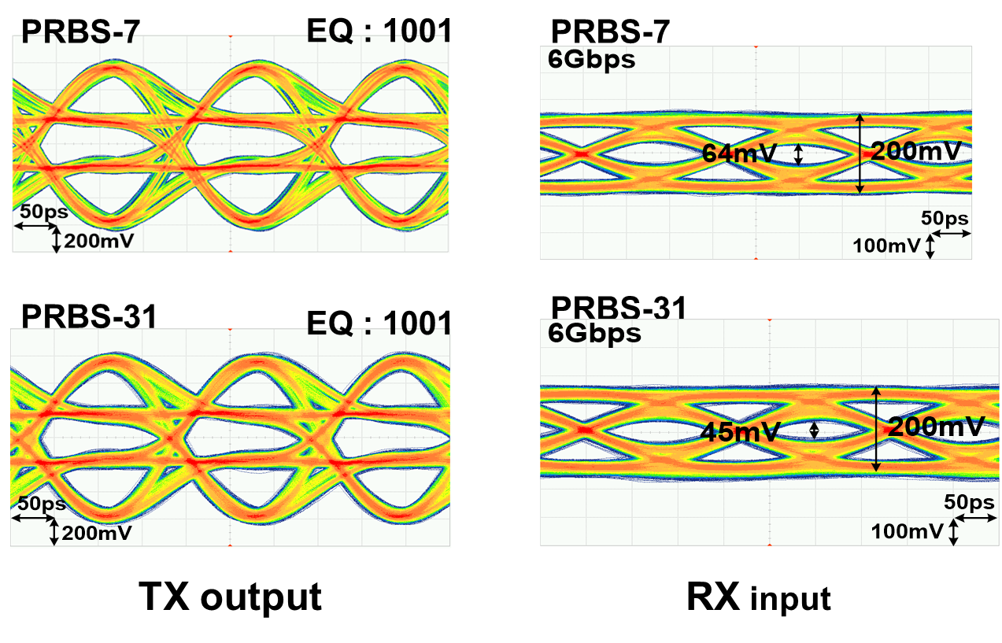
Measured eye-diagram (6Gbps)

Slide 19
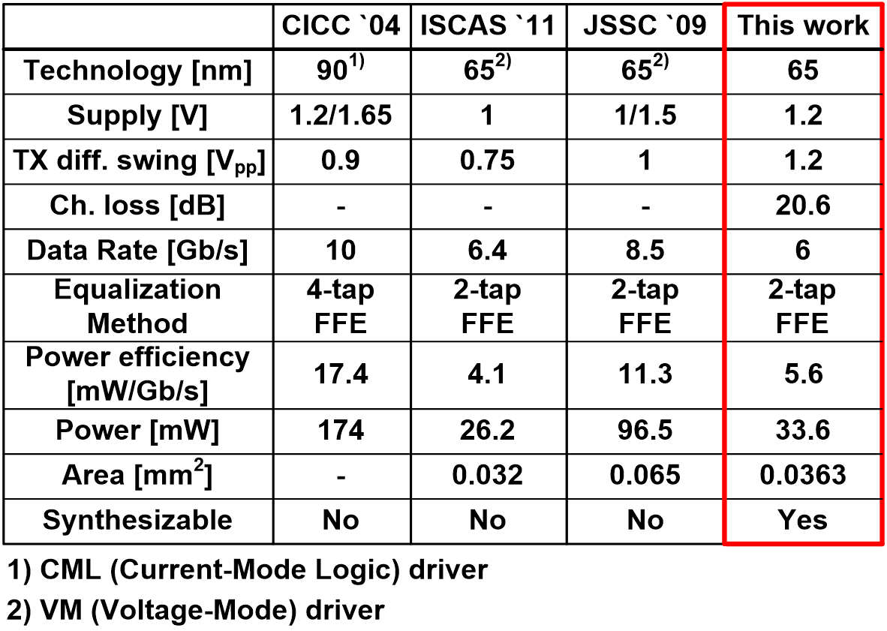
Performance summary

Slide 20
Conclusion
6Gbps voltage-mode TX synthesized with 2-tap FFE
Wide eye-opening achieved @ 1.4m FR4 channel
1-bit-period delay generation circuit for FFE because 6Gbps F/F cannot be implemented by synthesis

