Slide 1

Introduction to Computer Organization and Architecture (COA)
Notes:
Prepared by Trịnh Huy Hiệp

Slide 2
Explore Hardware Do it Yourself
Type Ctrl + Alt + Delete
Choose Start Task Manager
In the Windows Task Manager window,
Choose the tab Applications, count number of running applications
Choose the tab Processes
Click the button Show processes from all users at the bottom of the window, count number of running processes.
You knew number of processors in your computer and number of running processes.
In average, how many processes are executed by one processor?
How some processes can run on one processor?

Slide 3
Explore Hardware Do it Yourself
Right click the Computer item in the Start Menu
Choose Properties
You can see information about the CPU, Ram capacity, OS
Choose the item
Choose the tag Hardware in the System Properties window
Click the button Device Manager
Expand the item Processors in the Device Manager window you can see information about processors in your computer

Slide 4
Why should COA be studied? Course Objectives
Important questions:
How are computers organized?
How are computers made?
How are combinational circuits made?
How may we understand the way computers work?
How can computers allow many programs running concurrently?
What are answers for above questions?

Slide 5
Course Resource
Book: William Stallings, 2012, Computer Organization and Architecture: Design for Performance, 9th Edition, Prentice Hall.
Tool: MASM32 SDK version 11(masm32v11r.zip), MASM64
Free Download Link:
http://www.masm32.com/
https://www.microsoft.com/en-us/download/details.aspx?id=12654
http://www.windows8downloads.com/win8-masm-64.html
MASM 64( Important): Make sure you have Visual C++ 2005 Express Edition installed on your computer. This is a prerequisite for the installation of this package. It will not install otherwise.

Slide 6
Course Description
Chapter 1: Introduction
Chapter 2: Computer Evolution and Performance"
Chapter 3: A Top-Level View of Computer Function and Interconnection
Memories
Chapter 4: Cache Memory
Chapter 5: Internal Memory
Chapter 6: External Memory

Slide 7
Course Description
Chapter 7: Input/Output
Chapter 8: Operating System Support
Chapter 11: Digital Logic
Instruction Set of CPU
Chapter 12: Instruction Sets: Characteristics and Functions
Chapter 13: Instruction Sets: Addressing Modes and Formats, Assembly Language

Slide 8
Course Description
CPUs
Chapter 14: Processor Structure and Function
Chapter 15: Reduced Instruction Set Computers
Chapter 16: Instruction-Level Parallelism and Superscalar Processors
Chapter 17: Parallel Processing
Chapter 18: Multicore Computers
Notes:
Hướng là thứ tự dữ liệu được xử lý
Xử lý trị đơn gọi vô hướng

Slide 9
Course plan
See it on CMS

Slide 10
Course Rules
How to conduct
Prepare contents of the next session at home
Following lessons in classrooms
Completing chapter assessment in time and Quizzes (via CMS)
Communication
Class
Interchange by FU-HCM CMS, Forum
Discussing actively in your teams and in classrooms
Free to question and answer
Others
Off phone/ No game, no chat in class
Use laptops under teacher’s instruction

Slide 11
Evaluation Strategy
Must attend more than 80% of contact hours (if not, not allow to take exam).
Evaluating
4 Exercises (E) 30 %
2 Assignment (A) 30% ( Assembly programs)
Final Exam (FE) 40 %
Total score=30%(E)+30%(A)+40% (FE)
Pass: All on-going assessment > 0 and Total score ≥ 5 and Final Examination ≥ 4 (of 10)
Retake only the Final Exam when not passed

Slide 12
How to study?
This course is complex knowledge (however, it’s attractive and exciting), so you need to keep tight grip on it
Read
On the books to get the general concept
Reference, study, collection from anywhere else (internet, your classmate, forum …)
Attend lectures
Listens, understand, then make your own notes
Give your explanation about some topic in lectures
Ask questions
Practice all the exercises, demo to make your sense
After classes
Discuss your classmate in directly, on forum
Do the lab, assignments to submit via CMS, and do more exercises
Build your teams in yourselves to support together in studying

Slide 13
Academic Policy
Cheating, plagiarism and breach of copyright are serious offenses under this Policy.
Cheating
Cheating during a test or exam is construed as talking, peeking at another student’s paper or any other clandestine method of transmitting information.
Plagiarism
Plagiarism is using the work of others without citing it; that is, holding the work of others out as your own work.
Breach of Copyright
If you photocopy a textbook without the copyright holder's permission, you violate copyright law.

Slide 14
Enjoy the Course
Be enthusiastic about the material because it is interesting, useful and an important part of your training as an IT engineer.
We will do our best but we need your help.
So let’s all have fun together with COA!!!

Slide 15
William Stallings, Computer Organization and Architecture. 9th Edition
Chapter 1: Introduction
Notes:
Lecture slides prepared for “Computer Organization and Architecture”, 9/e, by William Stallings, Chapter 1 “Introduction”.
Modified by Thân Văn Sử

Slide 16
Objectives
Why should we study this chapter?
Distinguishing architecture and organization
What is a hierachical system?
What are basic computer functions?
What are main structural components of the computer?
System: an assemblage of related parts in which there exists an operating mechanism.
Hierarchical system: a system in which each part have a level but without a like or equal
Notes:
Ví dụ về hệ thống phân cấp kết hợp hệ thống
- Gia đình: ông bà, mỗi gia đình (của chính mình, chú, cô). Mỗi gia đình là một hệ thống bao gồm (cha me, con cái)

Slide 17
Contents
1.1- Organization and Architecture.
1.2- Structure and functions

Slide 18
1.1- Computer Organization and Architecture
Attributes of a system visible to the programmer
Have a direct impact(affect) on the logical execution of a program
Instruction set, number of bits used to represent various data types, I/O mechanisms, techniques for addressing memory
Computer Architecture
Architectural attributes include:
Differences:
Organizational attributes include:
Computer Organization
Hardware details transparent to the programmer, control signals, interfaces between the computer and peripherals, memory technology used
The operational units and their interconnections that realize the architectural specifications
Notes:
In describing computers, a distinction is often made between computer architecture
and computer organization. Although it is difficult to give precise definitions
for these terms, a consensus exists about the general areas covered by each
(e.g., see [VRAN80], [SIEW82], and [BELL78a]); an interesting alternative view
is presented in [REDD76].
Computer architecture refers to those attributes of a system visible to a
programmer or, put another way, those attributes that have a direct impact on
the logical execution of a program. Computer organization refers to the operational
units and their interconnections that realize the architectural specifications.
Examples of architectural attributes include the instruction set, the number of bits
used to represent various data types (e.g., numbers, characters), I/O mechanisms,
and techniques for addressing memory. Organizational attributes include those
hardware details transparent to the programmer, such as control signals; interfaces
between the computer and peripherals; and the memory technology used.
For example, it is an architectural design issue whether a computer will have
a multiply instruction. It is an organizational issue whether that instruction will
be implemented by a special multiply unit or by a mechanism that makes repeated
use of the add unit of the system. The organizational decision may be based on the
anticipated frequency of use of the multiply instruction, the relative speed of the two
approaches, and the cost and physical size of a special multiply unit.
Historically, and still today, the distinction between architecture and organization
has been an important one. Many computer manufacturers offer a family of
computer models, all with the same architecture but with differences in organization.
Consequently, the different models in the family have different price and performance
characteristics. Furthermore, a particular architecture may span many years and
encompass a number of different computer models, its organization changing with
changing technology.

Slide 19

Read by yourself: IBM System/370 Architecture
IBM System/370 architecture
Was introduced in 1970
Included a number of models
Could upgrade to a more expensive, faster model without having to abandon (chối bỏ) original software
New models are introduced with improved technology, but retain the same architecture so that the customer’s software investment is protected
Architecture has survived to this day as the architecture of IBM’s mainframe product line
More details: https://en.wikipedia.org/wiki/IBM_System/370
Notes:
A prominent example of both these phenomena is the IBM
System/370 architecture. This architecture was first introduced in 1970 and included
a number of models. The customer with modest requirements could buy a cheaper,
slower model and, if demand increased, later upgrade to a more expensive, faster
model without having to abandon software that had already been developed. Over
the years, IBM has introduced many new models with improved technology to replace
older models, offering the customer greater speed, lower cost, or both. These newer
models retained the same architecture so that the customer’s software investment was
protected. Remarkably, the System/370 architecture, with a few enhancements, has
survived to this day as the architecture of IBM’s mainframe product line.

Slide 20
Building Block
Who are interested in computers with architectral look?
Who are interested in computers with organizational look?

Slide 21
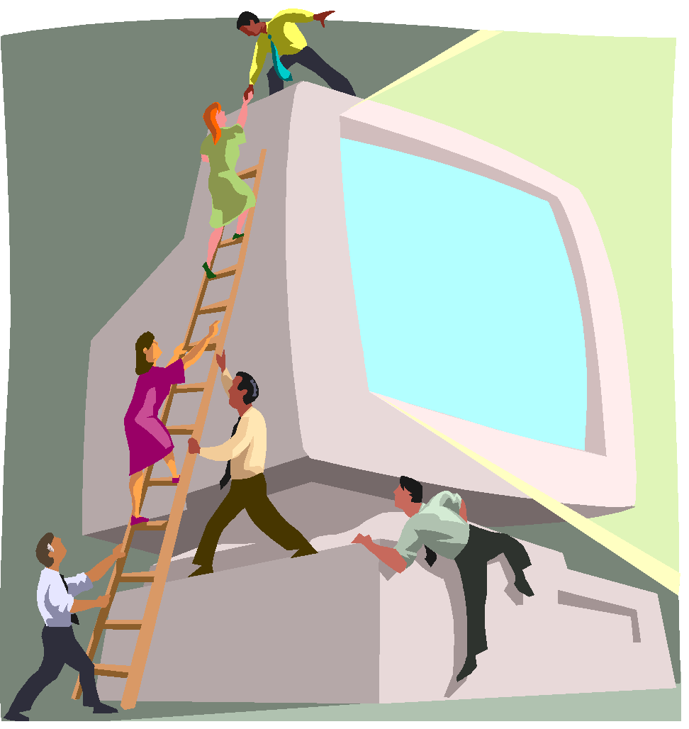
1.2- Structure and Function
Hierarchical system
Set of interrelated subsystems (modules)
Hierarchical nature of complex systems is essential to both their design and their description
Designer need only deal with a particular level of the system at a time
Concerned with structure and function at each level
Structure
The way in which components relate to each other
Function
The operation of individual components as part of the structure
Modularity is the degree to which system's components may be separated and recombined
Module is a specific discrete thing/named code/circuit which has it’s own function to use
Notes:
A computer is a complex system; contemporary computers contain millions of
Elementary electronic components. How, then, can one clearly describe them?
The key is to recognize the hierarchical nature of most complex systems, including
the computer [SIMO96]. A hierarchical system is a set of interrelated subsystems,
each of the latter, in turn, hierarchical in structure until we reach some lowest level
of elementary subsystem.
The hierarchical nature of complex systems is essential to both their design
and their description. The designer need only deal with a particular level of the
system at a time. At each level, the system consists of a set of components and
their interrelationships. The behavior at each level depends only on a simplified,
abstracted characterization of the system at the next lower level. At each level, the
designer is concerned with structure and function:
• Structure: The way in which the components are interrelated.
• Function: The operation of each individual component as part of the structure.
In terms of description, we have two choices: starting at the bottom and building
up to a complete description, or beginning with a top view and decomposing the
system into its subparts. Evidence from a number of fields suggests that the top-down
approach is the clearest and most effective [WEIN75].
The approach taken in this book follows from this viewpoint. The computer
system will be described from the top down. We begin with the major components
of a computer, describing their structure and function, and proceed to successively
lower layers of the hierarchy. The remainder of this section provides a very brief
overview of this plan of attack.

Slide 22
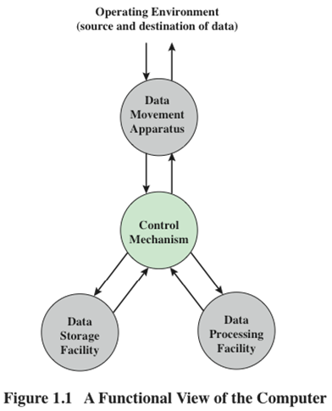
Functions
Apparatus: Things provided as means to some end (peripherals )
A computer can perform four basic functions:
Data processing
Data storage
Data movement
Control
Notes:
Both the structure and functioning of a computer are, in essence, simple. Figure 1.1
depicts the basic functions that a computer can perform. In general terms, there are
only four:
• Data processing
• Data storage
• Data movement
• Control
The computer, of course, must be able to process data. The data may take a wide
variety of forms, and the range of processing requirements is broad. However, we
shall see that there are only a few fundamental methods or types of data processing.
It is also essential that a computer store data. Even if the computer is processing
data on the fly (i.e., data come in and get processed, and the results go out
immediately), the computer must temporarily store at least those pieces of data
that are being worked on at any given moment. Thus, there is at least a short-term
data storage function. Equally important, the computer performs a long-term data
storage function. Files of data are stored on the computer for subsequent retrieval
and update.
The computer must be able to move data between itself and the outside
world. The computer’s operating environment consists of devices that serve as
either sources or destinations of data. When data are received from or delivered to
a device that is directly connected to the computer, the process is known as input–
output (I/O), and the device is referred to as a peripheral. When data are moved
over longer distances, to or from a remote device, the process is known as data
communications.
Finally, there must be control of these three functions. Ultimately, this control
is exercised by the individual(s) who provides the computer with instructions. Within
the computer, a control unit manages the computer’s resources and orchestrates the
performance of its functional parts in response to those instructions.

Slide 23
Practical & Discussion
Open the Notepad application
Input text to this application
Minimize the Notepad window and all opened windows to the task bar
Type the keyboard the text: “I hate you”
Give your explanation about things happened

Slide 24
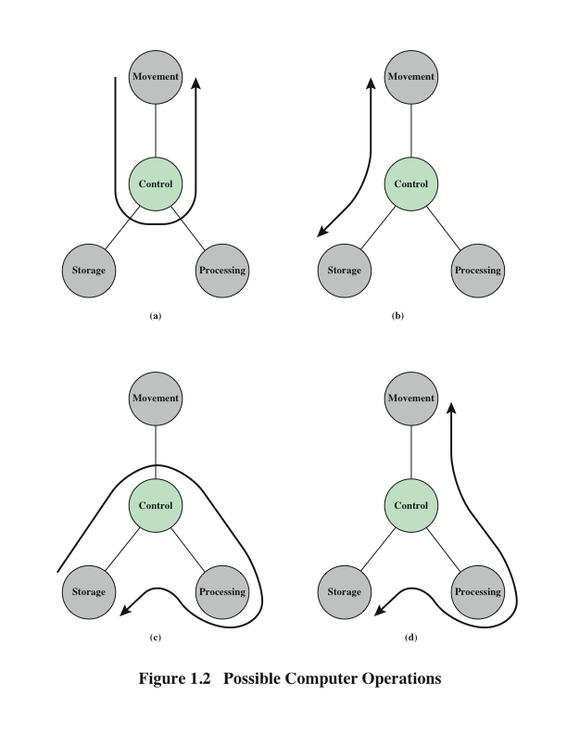
Operations (a) Data movement
Peripheral 1
Peripheral 2
Notes:
At this general level of discussion, the number of possible operations that
can be performed is few. Figure 1.2 depicts the four possible types of operations.
The computer can function as a data movement device (Figure 1.2a), simply
transferring data from one peripheral or communication line to another.

Slide 25
Operations (b) Data storage
External
environment
read
write
Building block:
Why data from an external device can not move to storage automatically?
Notes:
It can also function as a data storage device (Figure 1.2b), with data transferred from
the external environment to computer storage (read) and vice versa (write).

Slide 26
Operations (c) Data movement
Building block:
Open the Calculator to compute some numeric operations. Give your explanation
read
write
compute
Notes:
The final two diagrams show operations involving data processing, on data either in
storage (Figure 1.2c)

Slide 27
Operations (d) Control
Notes:
En route between storage and the external environment
(Figure 1.2d).

Slide 28
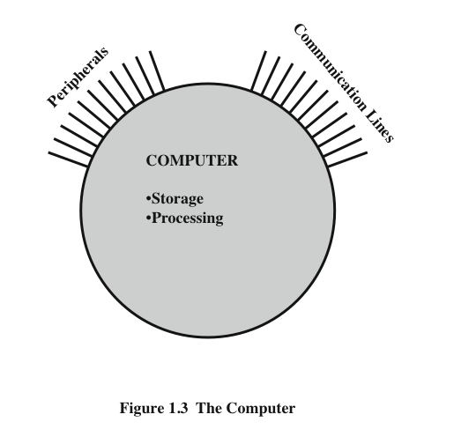
The Computer
linkages
Notes:
Figure 1.3 is the simplest possible depiction of a computer. The computer interacts
in some fashion with its external environment. In general, all of its linkages to
the external environment can be classified as peripheral devices or communication
lines. We will have something to say about both types of linkages.

Slide 29
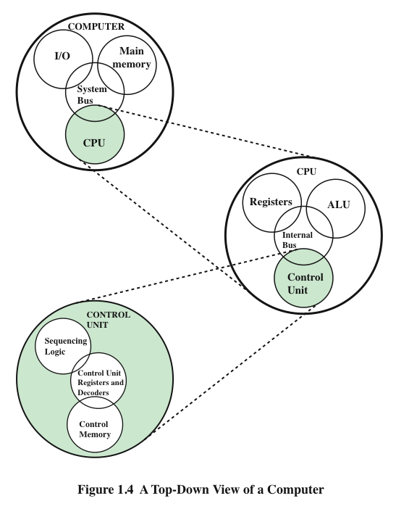
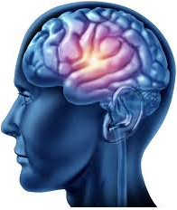
Structure
1+2
1
+
2
3
Try to verify
Notes:
But of greater concern in this book is the internal structure of the computer
itself, which is shown in Figure 1.4. There are four main structural components:
Central Processing Unit (CPU)
Main Memory
I/O
System Interconnection

Slide 30
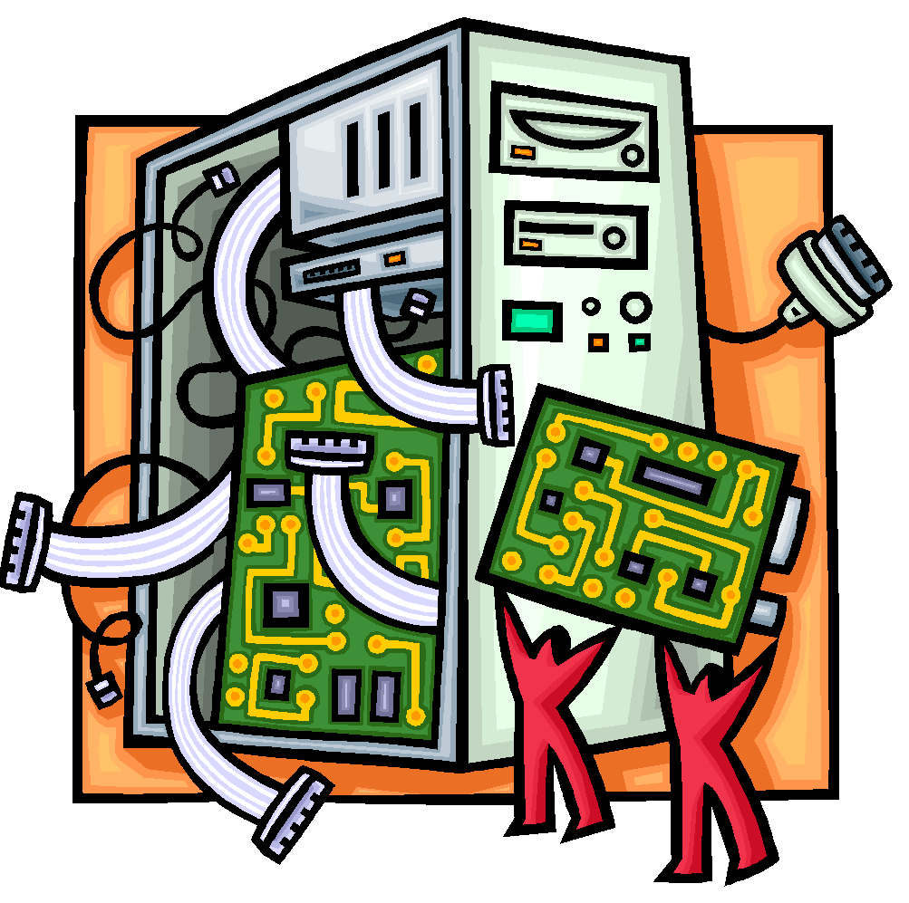
CPU – controls the operation of the computer and performs its data processing functions
Main Memory – stores data
I/O – moves data between the computer and its external environment
System Interconnection – some mechanism that provides for communication among CPU, main memory, and I/O
There are four main structural components
of the computer:
Notes:
There are four main structural components:
• Central processing unit (CPU): Controls the operation of the computer and
performs its data processing functions; often simply referred to as processor.
• Main memory: Stores data.
• I/O: Moves data between the computer and its external environment.
• System interconnection: Some mechanism that provides for communication
among CPU, main memory, and I/O. A common example of system interconnection
is by means of a system bus, consisting of a number of conducting
wires to which all the other components attach.

Slide 31
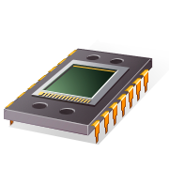
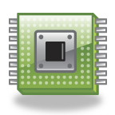
CPU
Control Unit
Controls the operation of the CPU and hence the computer
Arithmetic and Logic Unit (ALU)
Performs the computer’s data processing function
Registers
Provide storage internal to the CPU
CPU Interconnection
Some mechanism that provides for communication among the control unit, ALU, and registers
Major structural components:
Notes:
There may be one or more of each of the aforementioned components.
Traditionally, there has been just a single processor. In recent years, there has been
increasing use of multiple processors in a single computer. Some design issues relating
to multiple processors crop up and are discussed as the text proceeds; Part Five
focuses on such computers.
Each of these components will be examined in some detail in Part Two.
However, for our purposes, the most interesting and in some ways the most complex
component is the CPU. Its major structural components are as follows:
• Control unit: Controls the operation of the CPU and hence the computer.
• Arithmetic and logic unit (ALU):Performs the computer’s data processing
functions.
• Registers: Provides storage internal to the CPU.
• CPU interconnection: Some mechanism that provides for communication
among the control unit, ALU, and registers.

Slide 32
Exercises (Write your answers to your notebook)
1.1 What, in general terms, is the distinction between computer organization and computer architecture?
1.2 What, in general terms, is the distinction between computer structure and computer function?
1.3 What are the four main functions of a computer?
1.4 List and briefly define the main structural components of a computer.
1.5 List and briefly define the main structural components of a processor.
Notes:
Terminologies
In general terms: diễn đạt ngắn gọn
Briefly define: Định nghĩa ngắn gọn

Slide 33
Summary
Introduction
Chapter 1
Computer Organization
Computer Architecture
Function
Data processing
Data storage
Data movement
Control
Structure
CPU
Main memory
I/O
System interconnection
CPU structural components
Control unit
ALU
Registers
CPU interconnection
Notes:
Chapter 1 summary.

Slide 34
Internet Resources - Web site for book
http://WilliamStallings.com/COA/COA9e.html
Links to sites of interest
Links to sites for courses that use the book
Errata list for book
Information on other books by W. Stallings
http://WilliamStallings.com/StudentSupport.html
Math
How-to
Research resources
Misc
Notes:
Internet resources.

