Slide 1

William Stallings, Computer Organization and Architecture, 9th Edition
Chapter 4
Cache Memory
Notes:
Lecture slides prepared for “Computer Organization and Architecture”, 9/e, by William Stallings, Chapter 4 “Cache Memory”.
Adapted by Thân Văn Sử

Slide 2
Objectives
How are internal memory elements of a computer structured?
After studying this chapter, you should be able to:
Present an overview of the main characteristics of computer memory systems and the use of a memory hierarchy.
Describe the basic concepts and intent of cache memory. Discuss the key elements of cache design.
Distinguish among direct mapping, associative mapping, and set-associative mapping.
Explain the reasons for using multiple levels of cache.
Understand the performance implications of multiple levels of memory.
Notes:
The term location in Table 4.1 refers to whether memory is internal and external
to the computer. Internal memory is often equated with main memory. But there
are other forms of internal memory. The processor requires its own local memory, in
the form of registers (e.g., see Figure 2.3). Further, as we shall see, the control unit
portion of the processor may also require its own internal memory. We will defer
discussion of these latter two types of internal memory to later chapters. Cache is
another form of internal memory. External memory consists of peripheral storage
devices, such as disk and tape, that are accessible to the processor via I/O controllers.
An obvious characteristic of memory is its capacity. For internal memory, this is
typically expressed in terms of bytes (1 byte = 8 bits) or words. Common word lengths
are 8, 16, and 32 bits. External memory capacity is typically expressed in terms of bytes.
A related concept is the unit of transfer. For internal memory, the unit
of transfer is equal to the number of electrical lines into and out of the memory
module. This may be equal to the word length, but is often larger, such as 64, 128, or
256 bits. To clarify this point, consider three related concepts for internal memory:
• Word: The “natural” unit of organization of memory. The size of a word is typically
equal to the number of bits used to represent an integer and to the instruction
length. Unfortunately, there are many exceptions. For example, the CRAY
C90 (an older model CRAY supercomputer) has a 64-bit word length but uses
a 46-bit integer representation. The Intel x86 architecture has a wide variety of
instruction lengths, expressed as multiples of bytes, and a word size of 32 bits.
• Addressable units: In some systems, the addressable unit is the word. However,
many systems allow addressing at the byte level. In any case, the relationship
between the length in bits A of an address and the number N of addressable
units is 2A = N.
• Unit of transfer: For main memory, this is the number of bits read out of or
written into memory at a time. The unit of transfer need not equal a word or
an addressable unit. For external memory, data are often transferred in much
larger units than a word, and these are referred to as blocks

Slide 3
Contents
4.1- Computer Memory Systems Overview
4.2- Cache Memory Principles
4.3- Elements of Cache Design
Notes:
The term location in Table 4.1 refers to whether memory is internal and external
to the computer. Internal memory is often equated with main memory. But there
are other forms of internal memory. The processor requires its own local memory, in
the form of registers (e.g., see Figure 2.3). Further, as we shall see, the control unit
portion of the processor may also require its own internal memory. We will defer
discussion of these latter two types of internal memory to later chapters. Cache is
another form of internal memory. External memory consists of peripheral storage
devices, such as disk and tape, that are accessible to the processor via I/O controllers.
An obvious characteristic of memory is its capacity. For internal memory, this is
typically expressed in terms of bytes (1 byte = 8 bits) or words. Common word lengths
are 8, 16, and 32 bits. External memory capacity is typically expressed in terms of bytes.
A related concept is the unit of transfer. For internal memory, the unit
of transfer is equal to the number of electrical lines into and out of the memory
module. This may be equal to the word length, but is often larger, such as 64, 128, or
256 bits. To clarify this point, consider three related concepts for internal memory:
• Word: The “natural” unit of organization of memory. The size of a word is typically
equal to the number of bits used to represent an integer and to the instruction
length. Unfortunately, there are many exceptions. For example, the CRAY
C90 (an older model CRAY supercomputer) has a 64-bit word length but uses
a 46-bit integer representation. The Intel x86 architecture has a wide variety of
instruction lengths, expressed as multiples of bytes, and a word size of 32 bits.
• Addressable units: In some systems, the addressable unit is the word. However,
many systems allow addressing at the byte level. In any case, the relationship
between the length in bits A of an address and the number N of addressable
units is 2A = N.
• Unit of transfer: For main memory, this is the number of bits read out of or
written into memory at a time. The unit of transfer need not equal a word or
an addressable unit. For external memory, data are often transferred in much
larger units than a word, and these are referred to as blocks

Slide 4
4.1- Computer Memory System Overview
Characteristics of Memory System.
The Memory Hierarchy
Notes:
The term location in Table 4.1 refers to whether memory is internal and external
to the computer. Internal memory is often equated with main memory. But there
are other forms of internal memory. The processor requires its own local memory, in
the form of registers (e.g., see Figure 2.3). Further, as we shall see, the control unit
portion of the processor may also require its own internal memory. We will defer
discussion of these latter two types of internal memory to later chapters. Cache is
another form of internal memory. External memory consists of peripheral storage
devices, such as disk and tape, that are accessible to the processor via I/O controllers.
An obvious characteristic of memory is its capacity. For internal memory, this is
typically expressed in terms of bytes (1 byte = 8 bits) or words. Common word lengths
are 8, 16, and 32 bits. External memory capacity is typically expressed in terms of bytes.
A related concept is the unit of transfer. For internal memory, the unit
of transfer is equal to the number of electrical lines into and out of the memory
module. This may be equal to the word length, but is often larger, such as 64, 128, or
256 bits. To clarify this point, consider three related concepts for internal memory:
• Word: The “natural” unit of organization of memory. The size of a word is typically
equal to the number of bits used to represent an integer and to the instruction
length. Unfortunately, there are many exceptions. For example, the CRAY
C90 (an older model CRAY supercomputer) has a 64-bit word length but uses
a 46-bit integer representation. The Intel x86 architecture has a wide variety of
instruction lengths, expressed as multiples of bytes, and a word size of 32 bits.
• Addressable units: In some systems, the addressable unit is the word. However,
many systems allow addressing at the byte level. In any case, the relationship
between the length in bits A of an address and the number N of addressable
units is 2A = N.
• Unit of transfer: For main memory, this is the number of bits read out of or
written into memory at a time. The unit of transfer need not equal a word or
an addressable unit. For external memory, data are often transferred in much
larger units than a word, and these are referred to as blocks

Slide 5
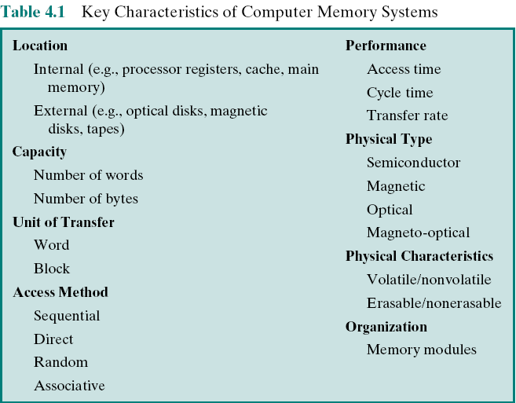
Key Characteristics of Computer Memory Systems
Notes:
The complex subject of computer memory is made more manageable if we classify
memory systems according to their key characteristics. The most important of these
are listed in Table 4.1.

Slide 6
Characteristics of Memory Systems
Location
Refers to whether memory is internal and external to the computer
Internal memory is often equated (make equal) with main memory
Processor requires its own local memory, in the form of registers
Cache is another form of internal memory
External memory consists of peripheral storage devices that are accessible to the processor via I/O controllers
Capacity
Memory is typically expressed in terms of bytes
Unit of transfer
For internal memory the unit of transfer is equal to the number of electrical lines into and out of the memory module
Notes:
The term location in Table 4.1 refers to whether memory is internal and external
to the computer. Internal memory is often equated with main memory. But there
are other forms of internal memory. The processor requires its own local memory, in
the form of registers (e.g., see Figure 2.3). Further, as we shall see, the control unit
portion of the processor may also require its own internal memory. We will defer
discussion of these latter two types of internal memory to later chapters. Cache is
another form of internal memory. External memory consists of peripheral storage
devices, such as disk and tape, that are accessible to the processor via I/O controllers.
An obvious characteristic of memory is its capacity. For internal memory, this is
typically expressed in terms of bytes (1 byte = 8 bits) or words. Common word lengths
are 8, 16, and 32 bits. External memory capacity is typically expressed in terms of bytes.
A related concept is the unit of transfer. For internal memory, the unit
of transfer is equal to the number of electrical lines into and out of the memory
module. This may be equal to the word length, but is often larger, such as 64, 128, or
256 bits. To clarify this point, consider three related concepts for internal memory:
• Word: The “natural” unit of organization of memory. The size of a word is typically
equal to the number of bits used to represent an integer and to the instruction
length. Unfortunately, there are many exceptions. For example, the CRAY
C90 (an older model CRAY supercomputer) has a 64-bit word length but uses
a 46-bit integer representation. The Intel x86 architecture has a wide variety of
instruction lengths, expressed as multiples of bytes, and a word size of 32 bits.
• Addressable units: In some systems, the addressable unit is the word. However,
many systems allow addressing at the byte level. In any case, the relationship
between the length in bits A of an address and the number N of addressable
units is 2A = N.
• Unit of transfer: For main memory, this is the number of bits read out of or
written into memory at a time. The unit of transfer need not equal a word or
an addressable unit. For external memory, data are often transferred in much
larger units than a word, and these are referred to as blocks

Slide 7
Method of Accessing Units of Data
Sequential access
Direct access
Random access
Associative
Memory is organized into units of data called records
Involves a shared read-write mechanism
Each addressable location in memory has a unique, physically wired-in addressing mechanism
A word is retrieved based on a portion of its contents rather than its address
Access must be made in a specific linear sequence
Individual blocks or records have a unique address based on physical location
The time to access a given location is independent of the sequence of prior accesses and is constant
Each location has its own addressing mechanism and retrieval time is constant independent of location or prior access patterns
Access time is variable
Access time is variable
Any location can be selected at random and directly addressed and accessed
Cache memories may employ associative access
Main memory and some cache systems are random access
More details: Next slides
Notes:
Another distinction among memory types is the method of accessing units of
data. These include the following:
• Sequential access: Memory is organized into units of data, called records.
Access must be made in a specific linear sequence. Stored addressing information
is used to separate records and assist in the retrieval process. A shared
read–write mechanism is used, and this must be moved from its current location
to the desired location, passing and rejecting each intermediate record.
Thus, the time to access an arbitrary record is highly variable. Tape units, discussed
in Chapter 6, are sequential access.
Direct access: As with sequential access, direct access involves a shared
read–write mechanism. However, individual blocks or records have a unique
address based on physical location. Access is accomplished by direct access
to reach a general vicinity plus sequential searching, counting, or waiting to
reach the final location. Again, access time is variable. Disk units, discussed in
Chapter 6, are direct access.
• Random access: Each addressable location in memory has a unique, physically
wired-in addressing mechanism. The time to access a given location is independent
of the sequence of prior accesses and is constant. Thus, any location
can be selected at random and directly addressed and accessed. Main memory
and some cache systems are random access.
• Associative: This is a random access type of memory that enables one to make
a comparison of desired bit locations within a word for a specified match, and
to do this for all words simultaneously. Thus, a word is retrieved based on a
portion of its contents rather than its address. As with ordinary random-access
memory, each location has its own addressing mechanism, and retrieval time
is constant independent of location or prior access patterns. Cache memories
may employ associative access.

Slide 8
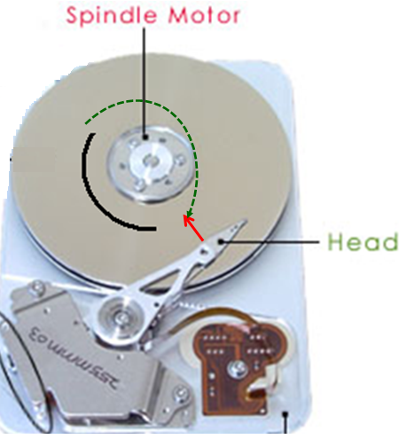
Method of Accessing Units of Data:
Direct Access
Location of each sector is idenfified by a unique number
T1: seek time, time for moving the head to the accessed track
T2: Rotational delay, time for rotating the disk to position the head to the beginning of the accessed sector
T3: Transfer time, time for rotating the disk to access all the accessed sector
Access time = T1 + T2 + T3
Each sector is accessed using different access time

Slide 9
Method of Accessing Units of Data:
Random Access
CPU
Mem. Decoder
Address bus
The time to access a given location is independent of the sequence of prior accesses and is constant
Main memory

Slide 10
Capacity and Performance:
The two most important characteristics of memory
Three performance parameters are used:
Access time (latency)
For random-access memory it is the time it takes to perform a read or write operation
For non-random-access memory it is the time it takes to position the read-write mechanism at the desired location
Memory cycle time
Access time plus any additional time required before second access can commence
Additional time may be required for transients to die out on signal lines or to regenerate data if they are read destructively
Concerned with the system bus, not the processor
Transfer rate
The rate at which data can be transferred into or out of a memory unit
For random-access memory it is equal to 1/(cycle time)
Notes:
From a user’s point of view, the two most important characteristics of memory
are capacity and performance. Three performance parameters are used:
• Access time (latency): For random-access memory, this is the time it takes to
perform a read or write operation, that is, the time from the instant that an
address is presented to the memory to the instant that data have been stored
or made available for use. For non-random-access memory, access time is the
time it takes to position the read–write mechanism at the desired location.
• Memory cycle time: This concept is primarily applied to random-access memory
and consists of the access time plus any additional time required before a second
access can commence. This additional time may be required for transients to die
out on signal lines or to regenerate data if they are read destructively. Note that
memory cycle time is concerned with the system bus, not the processor.
• Transfer rate: This is the rate at which data can be transferred into or out of a
memory unit. For random-access memory, it is equal to 1/(cycle time).

Slide 11

Memory
The most common forms are:
Semiconductor memory
Magnetic surface memory
Optical
Magneto-optical
Several physical characteristics of data storage are important:
Volatile memory
Information decays naturally or is lost when electrical power is switched off
Nonvolatile memory
Once recorded, information remains without deterioration until deliberately changed
No electrical power is needed to retain information
Magnetic-surface memories : Are nonvolatile
Semiconductor memory : May be either volatile or nonvolatile
Nonerasable memory
Cannot be altered, except by destroying the storage unit
Semiconductor memory of this type is known as read-only memory (ROM)
For random-access memory the organization is a key design issue
Organization refers to the physical arrangement of bits to form words
Notes:
A variety of physical types of memory have been employed. The most common
today are semiconductor memory, magnetic surface memory, used for disk and
tape, and optical and magneto-optical.
Several physical characteristics of data storage are important. In a volatile
memory, information decays naturally or is lost when electrical power is switched
off. In a nonvolatile memory, information once recorded remains without deterioration
until deliberately changed; no electrical power is needed to retain information.
Magnetic-surface memories are nonvolatile. Semiconductor memory (memory
on integrated circuits) may be either volatile or nonvolatile. Nonerasable memory
cannot be altered, except by destroying the storage unit. Semiconductor memory of
this type is known as read-only memory (ROM). Of necessity, a practical nonerasable
memory must also be nonvolatile.
For random-access memory, the organization is a key design issue. In this context,
organization refers to the physical arrangement of bits to form words. The
obvious arrangement is not always used, as is explained in Chapter 5.

Slide 12
Memory Hierarchy
Design constraints on a computer’s memory can be summed up by three questions:
How much, how fast, how expensive
There is a trade-off among capacity, access time, and cost
Faster access time, greater cost per bit
Greater capacity, smaller cost per bit
Greater capacity, slower access time
The way out of the memory dilemma is not to rely on a single memory component or technology, but to employ a memory hierarchy
A great capacity memory but cheap and low speed + one or some small capacity memory but fast and more expensive (cache) .
Notes:
The design constraints on a computer’s memory can be summed up by three questions:
How much? How fast? How expensive?
The question of how much is somewhat open ended. If the capacity is there,
applications will likely be developed to use it. The question of how fast is, in a sense,
easier to answer. To achieve greatest performance, the memory must be able to
keep up with the processor. That is, as the processor is executing instructions, we
would not want it to have to pause waiting for instructions or operands. The final
question must also be considered. For a practical system, the cost of memory must
be reasonable in relationship to other components.
As might be expected, there is a trade-off among the three key characteristics
of memory: capacity, access time, and cost. A variety of technologies are used to
implement memory systems, and across this spectrum of technologies, the following
relationships hold:
• Faster access time, greater cost per bit
• Greater capacity, smaller cost per bit
• Greater capacity, slower access time
The dilemma facing the designer is clear. The designer would like to use memory
technologies that provide for large-capacity memory, both because the capacity
is needed and because the cost per bit is low. However, to meet performance
requirements, the designer needs to use expensive, relatively lower-capacity memories
with short access times.
The way out of this dilemma is not to rely on a single memory component or
technology, but to employ a memory hierarchy.

Slide 13
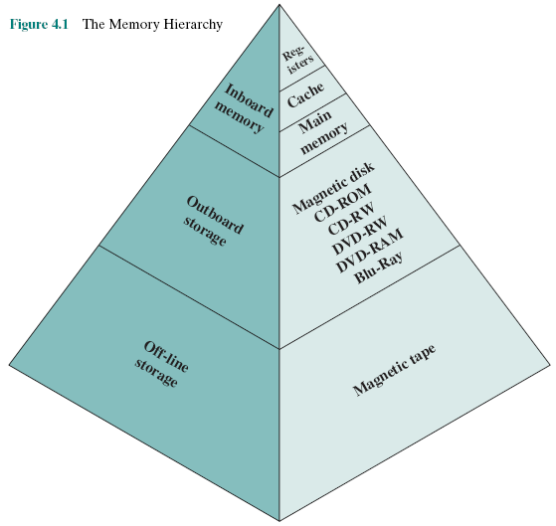
Memory Hierarchy…
Notes:
The design constraints on a computer’s memory can be summed up by three questions:
How much? How fast? How expensive?
The question of how much is somewhat open ended. If the capacity is there,
applications will likely be developed to use it. The question of how fast is, in a sense,
easier to answer. To achieve greatest performance, the memory must be able to
keep up with the processor. That is, as the processor is executing instructions, we
would not want it to have to pause waiting for instructions or operands. The final
question must also be considered. For a practical system, the cost of memory must
be reasonable in relationship to other components.
As might be expected, there is a trade-off among the three key characteristics
of memory: capacity, access time, and cost. A variety of technologies are used to
implement memory systems, and across this spectrum of technologies, the following
relationships hold:
• Faster access time, greater cost per bit
• Greater capacity, smaller cost per bit
• Greater capacity, slower access time
The dilemma facing the designer is clear. The designer would like to use memory
technologies that provide for large-capacity memory, both because the capacity
is needed and because the cost per bit is low. However, to meet performance
requirements, the designer needs to use expensive, relatively lower-capacity memories
with short access times.
The way out of this dilemma is not to rely on a single memory component or
technology, but to employ a memory hierarchy.

Slide 14
4.2- Cache Memory Principles
What is cache?
Cache and Main Memory

Slide 15
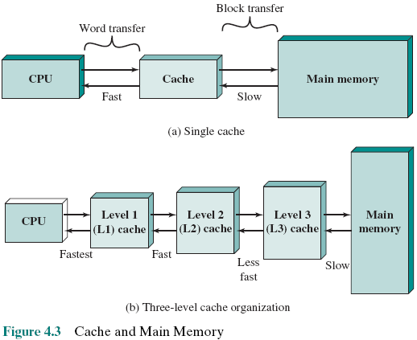
What is a Cache?
Memory Management Unit - MMU
Cache: A small size, expensive, memory which has high-speed access is located between CPU and RAM (large memory size, cheaper, and lower-speed
Memory).
L0: cache in CPU, working with CPU rate. It is not usually implemented.
Notes:
Cache memory is designed to combine the memory access time of expensive, high-speed
memory combined with the large memory size of less expensive, lower-speed
memory.
The concept is illustrated in Figure 4.3a. There is a relatively large and slow
main memory together with a smaller, faster cache memory. The cache contains a
copy of portions of main memory. When the processor attempts to read a word of
memory, a check is made to determine if the word is in the cache. If so, the word is
delivered to the processor. If not, a block of main memory, consisting of some fixed
number of words, is read into the cache and then the word is delivered to the processor.
Because of the phenomenon of locality of reference, when a block of data is
fetched into the cache to satisfy a single memory reference, it is likely that there will
be future references to that same memory location or to other words in the block.
Figure 4.3b depicts the use of multiple levels of cache. The L2 cache is slower
and typically larger than the L1 cache, and the L3 cache is slower and typically
larger than the L2 cache.

Slide 16
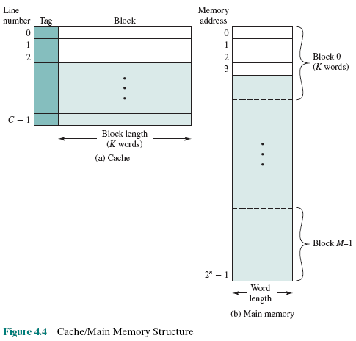
Cache/Main Memory Structure
Main memory is divided into the same size blocks. Some blocks will be loaded to cache.
Each line includes a tag that identifies which particular block is currently being stored
Address in cache is different from those in main memory 🡪 A mapping is needed.
Cache Addr 🡪 Main Mem Addr
Notes:
Mapping- ánh xạ: Cách gán ghép chủ quan, cố tính mỗi phần tử trong tập hợp A sẽ tương ứng với một phần tử duy nhất trong tập hợp B
Trong trường hợp này: A = tập các lines của cache, B: tập các blocks trong main memory. Mỗi line sẽ chứa nội dung của một block.
Tag là gì: Tag là dữ liệu, thông tin được đính kèm. Tag của mỗi line chứa dữ liệu cho biết nội dung của line này ứng với block nào trong main memory. Data trong tag mô tả ánh xạ từ Cache sang Memory
Tại sao mỗi line phải có phần tag?: Một line có thể chứa cả data lẫn intructions. Cache có dung lượng nhỏ nên chúng ta có thể hiểu việc chạy chương trình giống như cơ chế làm theo từng mẻ. Data trong cache chỉ mang tính tạm thời, data trong main memory mới là data chính thức. Như vậy, những data đã bị modified trong cache cần phải được cập nhật về main memory. Chính dữ liệu trong tag giúp việc cập nhật này được thực thi chình xác, dúng chỗ

Slide 17
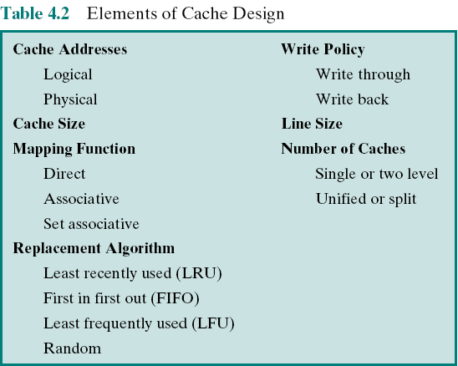
4.3- Elements of Cache Design
Overview of cache design parameters
Notes:
This section provides an overview of cache design parameters and reports some
typical results. We occasionally refer to the use of caches in high-performance computing
(HPC). HPC deals with supercomputers and their software, especially for
scientific applications that involve large amounts of data, vector and matrix computation,
and the use of parallel algorithms. Cache design for HPC is quite different
than for other hardware platforms and applications. Indeed, many researchers
have found that HPC applications perform poorly on computer architectures that
employ caches [BAIL93]. Other researchers have since shown that a cache hierarchy
can be useful in improving performance if the application software is tuned to
exploit the cache [WANG99, PRES01].
Although there are a large number of cache implementations, there are a few
basic design elements that serve to classify and differentiate cache architectures.
Table 4.2 lists key elements.

Slide 18
Main Memory Address Specifications
Opcode
Memory Add.
Physical Address
Abtract Address
Virtual Address
3010
3005
App
Physical Addresses
3005
CPU
PC=3010
3000
Mem. Of Operating System
Mem. Decoder
3005
Notes:
Memory for application is announced (3000 bytes if theis example).
Compiler will dertermine addresses in an application accordingly
All application content is loaded to the main memory
At a time, only one process runs.

Slide 19
Main Memory Address Specifications
Physical Addresses
When the operating system is upgraded, the OS needs more memory ( ex: 4000 bytes), old applications are not compatible.
Address must be specified by an other way to ensure that old programs can be run in new OS.
Abstract addresses
3005
OldApp.
4000
Mem. Of Operating System
3005
Notes:
Memory for application is announced (3000 bytes in this example).
Compiler will dertermine addresses in an application accordingly
All application contents are loaded to the main memory
At a time, only one process runs.

Slide 20
Main Memory Address Specifications
Abstract Addresses
All addresses in an application will be specified by compilers using an offset (difference) from the base address (position at which the app. is loaded)
A register (base register) must be added to maintain the base address of the process
🡺 An address is specified by <base, offset)
5
4005
pp.
4000
Mem. Of Operating System
CPU
Mem.
Decoder
Base:4000
+
Add. bus
5
Notes:
An application can be loaded to any position of main memory
Suppose that a process is swapped to then swapped in, it can be loaded to a position which is different from initial position
Whwn an application is allowed to run, all it’s content must be loaded to main memory

Slide 21
Main Memory Address Specifications
Virtual Addresses: Paging- Segmentation
Contemporary OSs allows many programs running concurrently although system’s memory is limited. Solution is that the program content and memory will be divided into some pages (same-size, ex: 4KB) or segments (different size). Only needed pages/segments are loaded to system memory.
🡺Compilers must translate program’s addresses to a suitable form (virtual address). Virtual address format:
<page/segment, offset>
X=10
4
3
2
Address of X:
(3,4)
1
0
Notes:
Figure 4.4 depicts the structure of a cache/main-memory system.

Slide 22
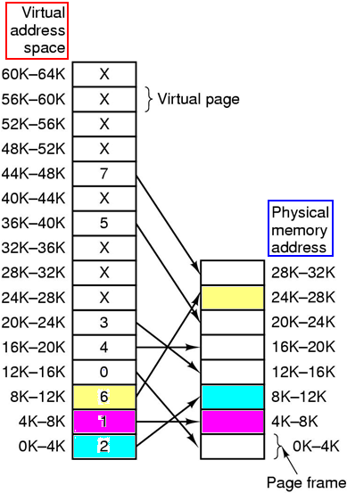
Main Memory Address Specifications
Virtual Addresses: Paging- Segmentation
When an instruction/data is accessed, physical address must be supplied. A mapping is needed as a mean for determining physical addresses from their virtual addresses. This mapping is implemented in OS as a page table.
A hardware is needed to translate virtual address to physical address🡪 MMU – Memory Management Unit.
Operating Systems - Tannenbaum
Notes:
Figure 4.4 depicts the structure of a cache/main-memory system.

Slide 23
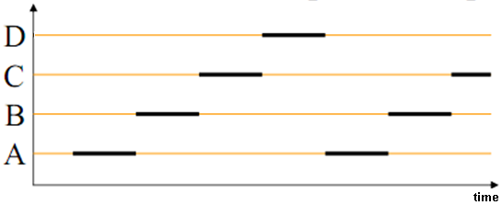
Main Memory Address Specifications
Virtual Addresses: Paging- Segmentation
Time-sharing
mechanism
How do OSs permit many program running concurrently? 🡺 Only some pages/segments of a process are loaded and the time-sharing mechanism is applied.
Advantages of memory paging: Many apps can run concurrently in limited memory. A page of a program can loaded into arbitrary physical memory location.
- Disadvantages of memory paging: If a page fault occurs, cost must be paid when an in-memory frame must be swapped to disk from memory (swap out) then a page from disk will be loaded to memory (swap in) – Paging replacement.
Notes:
Figure 4.4 depicts the structure of a cache/main-memory system.

Slide 24

Cache Addresses: Virtual Address
Virtual memory
Facility that allows programs to address memory from a logical point of view, without regard to the amount of main memory physically available. Only some needed small parts of a program are loaded to main memory at a time. So, a large program can run although memory size is smaller
When used, the address fields of machine instructions contain virtual addresses
For reads from and writes to main memory, a hardware memory management unit (MMU) translates each virtual address into a physical address in main memory
Notes:
Almost all non-embedded processors, and many embedded processors, support virtual
memory, a concept discussed in Chapter 8. In essence, virtual memory is a facility
that allows programs to address memory from a logical point of view, without
regard to the amount of main memory physically available. When virtual memory is
used, the address fields of machine instructions contain virtual addresses. For reads
to and writes from main memory, a hardware memory management unit (MMU)
translates each virtual address into a physical address in main memory.

Slide 25
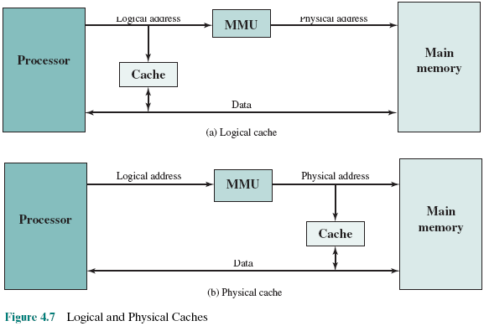
Logical and Physical Caches
Virtual/Logical cache stores data using virtual addresses
Physical cache stores data using physical addresses
Notes:
When virtual addresses are used, the system designer may choose to place the
cache between the processor and the MMU or between the MMU and main memory
(Figure 4.7). A logical cache, also known as a virtual cache, stores data using
virtual addresses. The processor accesses the cache directly, without going through
the MMU. A physical cache stores data using main memory physical addresses.
One obvious advantage of the logical cache is that cache access speed is faster
than for a physical cache, because the cache can respond before the MMU performs
an address translation. The disadvantage has to do with the fact that most virtual
memory systems supply each application with the same virtual memory address
space. That is, each application sees a virtual memory that starts at address 0. Thus,
the same virtual address in two different applications refers to two different physical
addresses. The cache memory must therefore be completely flushed with each
application context switch, or extra bits must be added to each line of the cache to
identify which virtual address space this address refers to.

Slide 26
Mapping Function
Because there are fewer cache lines than main memory blocks, an algorithm is needed for mapping main memory blocks into cache lines
Three techniques can be used:
Direct
Associative
Set Associative
The simplest technique
Maps each block of main memory into only one possible cache line
Permits each main memory block to be loaded into any line of the cache
The cache control logic interprets a memory address simply as a Tag and a Word field
To determine whether a block is in the cache, the cache control logic must simultaneously examine every line’s Tag for a match
A compromise that exhibits the strengths of both the direct and associative approaches while reducing their disadvantages
Notes:
Because there are fewer cache lines than main memory blocks, an algorithm is
needed for mapping main memory blocks into cache lines. Further, a means is
needed for determining which main memory block currently occupies a cache line.
The choice of the mapping function dictates how the cache is organized. Three
techniques can be used: direct, associative, and set associative.
Direct mapping: The simplest technique, known as direct mapping, maps each
block of main memory into only one possible cache line.
Associative mapping: Associative mapping overcomes the disadvantage of direct
mapping by permitting each main memory block to be loaded into any line of the
cache.
Set-associative mapping: Set-associative mapping is a compromise that
exhibits the strengths of both the direct and associative approaches while reducing
their disadvantages.

Slide 27
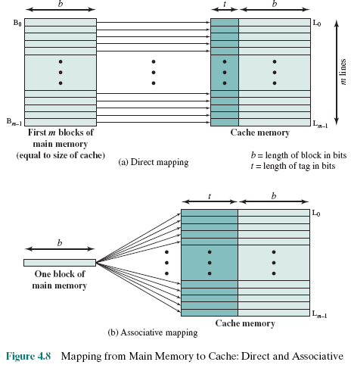
Direct Mapping
The block j in main memory will be loaded to the line i of the cache: i = j mod m
A block in main memory can be load to any line of the cache
Notes:
The mapping is expressed as
i = j modulo m
where
i = cache line number
j = main memory block number
m = number of lines in the cache
Figure 4.8a shows the mapping for the first m blocks of main memory. Each
block of main memory maps into one unique line of the cache. The next m blocks
of main memory map into the cache in the same fashion; that is, block B_{m} of main
memory maps into line L₀ of cache, block _{Bm+1} maps into line L₁, and so on.
Yếu điểm chính của kỹ thuật direct mapping (cà ri dê nguyên tô) là khi có cache miss
(thí dụ cần truy xuất một biến ở khối m trong hình (a)),
phải đổ hết cache về bộ nhớ rồi lại chép cả một khới lớn các blocks từ mem và cache
Để giảm chi phí chép qua qua lại mem-cache quá nhiều, kỹ thuật associative được dùng.
Khi gặp cahe miss, phải chép 1 block vào cache nhưng không có line nào trống. Bài toán ở
đây là line nào phải hi sinh, được chuyển về mem, nhường chỗ cho block mới. Việc này sẽ được
Giải quyết trong phần replacement algorithms – các slide sau.

Slide 28
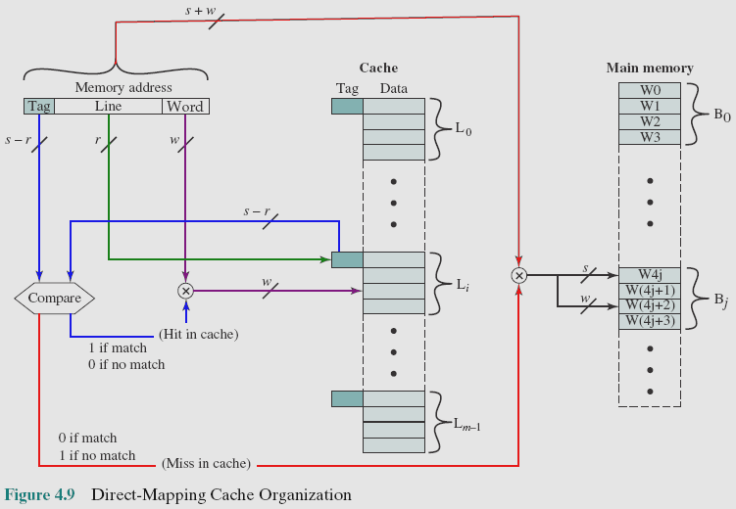
Direct Mapping Cache Organization
READ BY YOURSELF
s: Block index
r: Line index
w: word index
penalty
Notes:
Cache hit: an address of read word is in cache
Cache miss: an address of read word is not in cache
Cấu trúc một địa chỉ bộ nhớ được truy xuất dùng cache: <Tag, Line, Word> mang nghĩa là địa chỉ này thuộc về block nào trên bộ nhớ chính (tag),
dòng thứ mấy của cache, từ thứ mấy trong dòng này
Bước 1: Đọ (Compare) 2 giá trị Tag (đường mầu blue)
Bước 2: Nếu 2 trị này bằng nhau (hit), địa chỉ này có trong cache rồi, dựa vào Line (mầu green) để xác định line trong cache và Word (mầu tím) xác định được địa chỉ (word thứ mất trong line này) của ô nhớ cần đọc
Bước 3: Ngược lại, địa chỉ cần truy xuất chưa nằm trong cache (mầu đỏ) mà nằm trong bộ nhớ, thông qua Tag, đến bộ nhớ để mang block này vào cache sau khi đã đẩy 1 line ra khỏi cache (victim line) – Replacement algorithms (cuối chương)

Slide 29
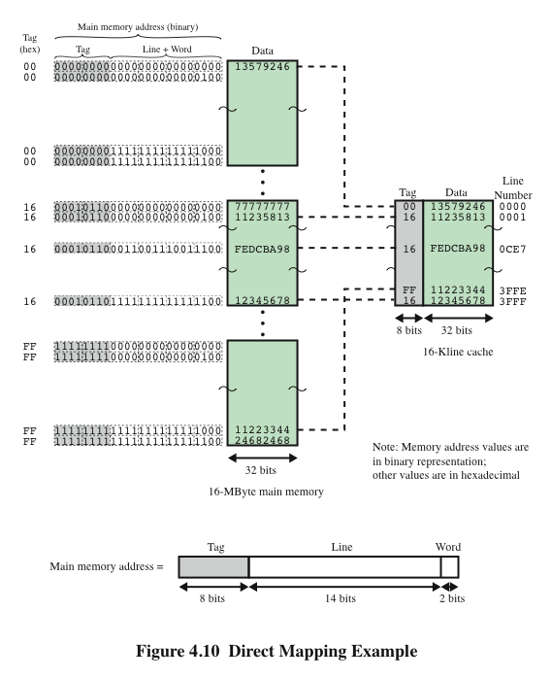
Direct Mapping Example
READ BY YOURSELF
Notes:
Figure 4.10 Direct Mapping Example.

Slide 30
Direct Mapping Summary
READ BY YOURSELF
Address length = (s + w) bits
Number of addressable units = 2^{s+w} words or bytes
Block size = line size = 2^{w} words or bytes
Number of blocks in main memory = 2^{s+ w}/2^{w} = 2^{s}
Number of lines in cache = m = 2r
Size of tag = (s – r) bits
Notes:
The direct mapping technique is simple and inexpensive to implement. Its
main disadvantage is that there is a fixed cache location for any given block. Thus,
if a program happens to reference words repeatedly from two different blocks that
map into the same line, then the blocks will be continually swapped in the cache,
and the hit ratio will be low (a phenomenon known as thrashing).

Slide 31

Victim Cache
READ BY YOURSELF
Originally proposed as an approach to reduce the conflict misses of direct mapped caches without affecting its fast access time
Fully associative cache
Typical size is 4 to 16 cache lines
Residing between direct mapped L1 cache and the next level of memory
Notes:
One approach to lower the miss penalty is to remember what was discarded
in case it is needed again. Since the discarded data has already been fetched, it can
be used again at a small cost. Such recycling is possible using a victim cache. Victim
cache was originally proposed as an approach to reduce the conflict misses of direct
mapped caches without affecting its fast access time. Victim cache is a fully associative
cache, whose size is typically 4 to 16 cache lines, residing between a direct mapped L1
cache and the next level of memory. This concept is explored in Appendix D.

Slide 32
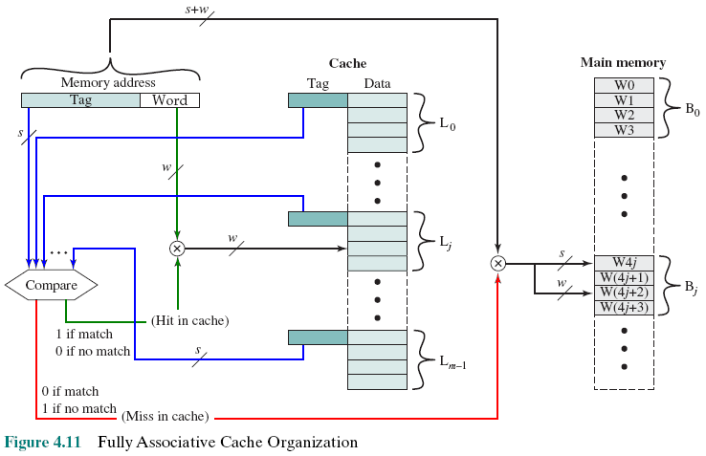
Fully Associative Cache Organization
READ BY YOURSELF
A block can be loaded to any cache line
Compare to each Tag
Notes:
Associative mapping overcomes the disadvantage of direct
mapping by permitting each main memory block to be loaded into any line of the
cache (Figure 4.8b). In this case, the cache control logic interprets a memory address
simply as a Tag and a Word field. The Tag field uniquely identifies a block of main
memory. To determine whether a block is in the cache, the cache control logic must
simultaneously examine every line’s tag for a match. Figure 4.11 illustrates the logic.

Slide 33
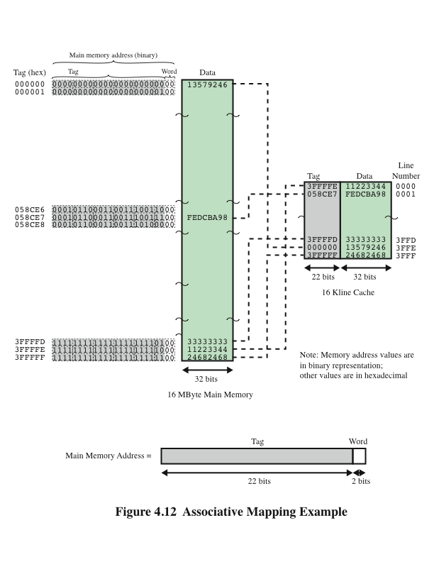
Associative Mapping Example
READ BY YOURSELF
Notes:
Figure 4.12 Associative Mapping Example.

Slide 34
Associative Mapping Summary
READ BY YOURSELF
Address length = (s + w) bits
Number of addressable units = 2^{s+w} words or bytes
Block size = line size = 2^{w} words or bytes
Number of blocks in main memory= 2^{s+ w}/2^{w} = 2^{s}
Number of lines in cache = undetermined
Size of tag = s bits
Notes:
With associative mapping, there is flexibility as to which block to replace when
a new block is read into the cache. Replacement algorithms, discussed later in this
section, are designed to maximize the hit ratio. The principal disadvantage of associative
mapping is the complex circuitry required to examine the tags of all cache
lines in parallel.

Slide 35
Set Associative Mapping
READ BY YOURSELF
Compromise (thỏa hiệp) that exhibits the strengths of both the direct and associative approaches while reducing their disadvantages
Cache consists of a number of sets
Each set contains a number of lines
A given block maps to any line in a given set
e.g. 2 lines per set
2 way associative mapping
A given block can be in one of 2 lines in only one set
Go to Replacement Algorithms
Notes:
Set-associative mapping is a compromise that
exhibits the strengths of both the direct and associative approaches while reducing
their disadvantages.
In this case, the cache consists of a number sets, each of which consists of a
number of lines. The relationships are
m = v* k
i = j modulo v
where
i = cache set number
j = main memory block number
m = number of lines in the cache
v = number of sets
k = number of lines in each set
This is referred to as k-way set-associative mapping.

Slide 36
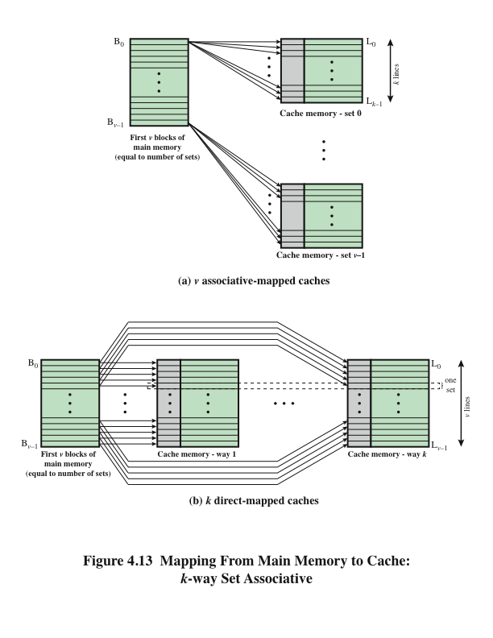
Mapping From Main Memory to Cache: k-Way Set Associative
READ BY YOURSELF
Notes:
Figure 4.13a illustrates
this mapping for the first v blocks of main memory. As with associative mapping,
each word maps into multiple cache lines. For set-associative mapping, each word
maps into all the cache lines in a specific set, so that main memory block B₀ maps
into set 0, and so on. Thus, the set-associative cache can be physically implemented
as n associative caches. It is also possible to implement the set-associative cache as
k direct mapping caches, as shown in Figure 4.13b. Each direct-mapped cache is
referred to as a way, consisting of v lines. The first v lines of main memory are direct
mapped into the v lines of each way; the next group of v lines of main memory are
similarly mapped, and so on. The direct-mapped implementation is typically used
for small degrees of associativity (small values of k) while the associative-mapped
implementation is typically used for higher degrees of associativity [JACO08].

Slide 37
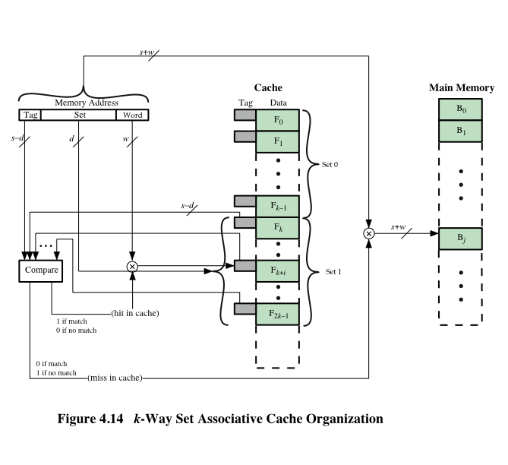
k-Way Set Associative Cache Organization
READ BY YOURSELF
Notes:
For set-associative mapping, the cache control logic interprets a memory
address as three fields: Tag, Set, and Word. The d set bits specify one of v = 2^{d} sets.
The s bits of the Tag and Set fields specify one of the 2^{s} blocks of main memory.
Figure 4.14 illustrates the cache control logic. With fully associative mapping, the
tag in a memory address is quite large and must be compared to the tag of every line
in the cache. With k-way set-associative mapping, the tag in a memory address is
much smaller and is only compared to the k tags within a single set.

Slide 38
Set Associative Mapping Summary
READ BY YOURSELF
Address length = (s + w) bits
Number of addressable units = 2^{s+w} words or bytes
Block size = line size = 2^{w} words or bytes
Number of blocks in main memory = 2^{s+w/}2^{w=}2^{s}
Number of lines in set = k
Number of sets = v = 2^{d}
Number of lines in cache = m=kv = k * 2^{d}
Size of cache = k * 2^{d+w}words or bytes
Size of tag = (s – d) bits
Notes:
Set Associative Mapping Summary.

Slide 39
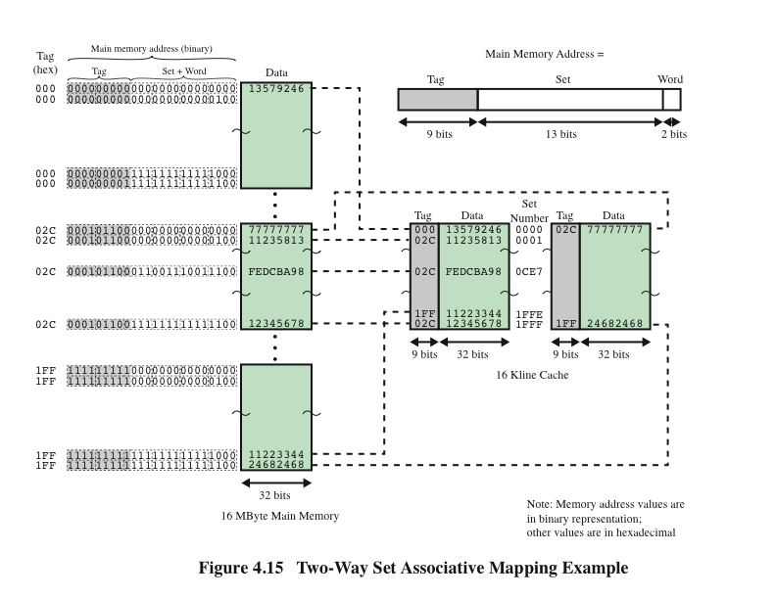
READ BY YOURSELF
Notes:
Figure 4.15 shows an example using set-associative mapping with two
lines in each set, referred to as two-way set-associative.

Slide 40
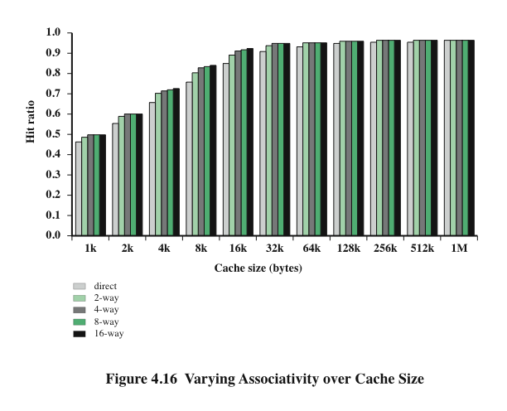
Varying Associativity Over Cache Size
READ BY YOURSELF
Notes:
Figure 4.16 shows the results of one simulation study of set-associative cache
performance as a function of cache size [GENU04]. The difference in performance
between direct and two-way set associative is significant up to at least a cache size of
64 kB. Note also that the difference between two-way and four-way at 4 kB is much
less than the difference in going from for 4 kB to 8 kB in cache size. The complexity
of the cache increases in proportion to the associativity, and in this case would not
be justifiable against increasing cache size to 8 or even 16 Kbytes. A final point to
note is that beyond about 32 kB, increase in cache size brings no significant increase
in performance.
The results of Figure 4.16 are based on simulating the execution of a GCC
compiler. Different applications may yield different results. For example, [CANT01]
reports on the results for cache performance using many of the CPU2000 SPEC
benchmarks. The results of [CANT01] in comparing hit ratio to cache size follow
the same pattern as Figure 4.16, but the specific values are somewhat different.

Slide 41
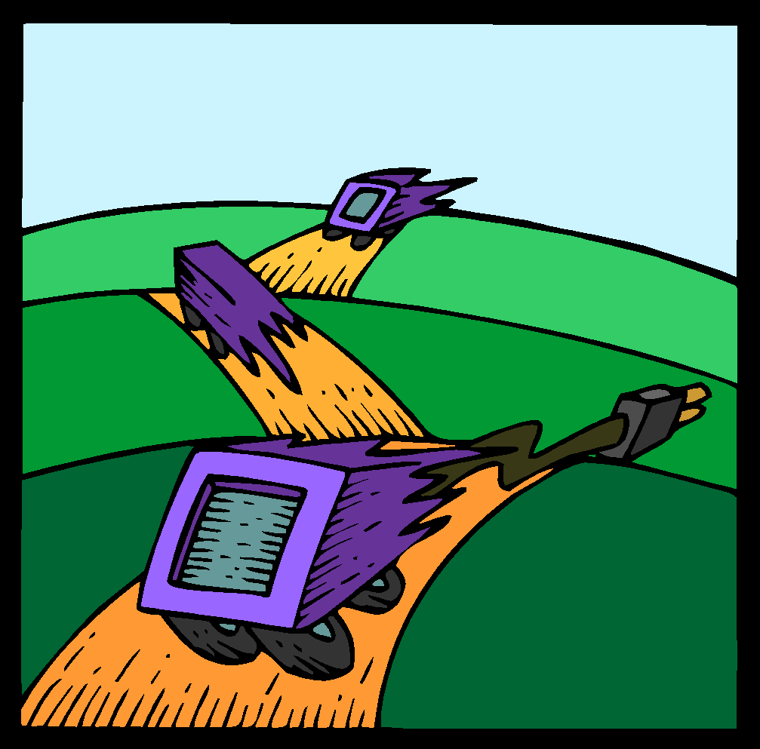
Replacement Algorithms
Two situations:
Cache hit: Accessed address exists in cache
Cache miss: Accessed address does not exist in cache. The memory block containing it must be loaded to the cache
Once the cache has been filled, when a new block is brought into the cache, one of the existing blocks must be replaced
For direct mapping there is only one possible line for any particular block and no choice is possible
For the associative and set-associative techniques a replacement algorithm is needed
To achieve high speed, an algorithm must be implemented in hardware
Notes:
Once the cache has been filled, when a new block is brought into the cache, one
of the existing blocks must be replaced. For direct mapping, there is only one possible
line for any particular block, and no choice is possible. For the associative
and set-associative techniques, a replacement algorithm is needed. To achieve high
speed, such an algorithm must be implemented in hardware.

Slide 42
The four most common replacement algorithms are:
Least recently used (LRU)
Most effective
Replace that block in the set that has been in the cache longest with no reference to it
Because of its simplicity of implementation, LRU is the most popular replacement algorithm
First-in-first-out (FIFO)
Replace that block in the set that has been in the cache longest
Easily implemented as a round-robin or circular buffer technique
Least frequently used (LFU)
Replace that block in the set that has experienced the fewest references
Could be implemented by associating a counter with each line
2 bits in tag can be used: 00, 01, 10, 11. Line with 00 should be swap out. See the note.
Notes:
A number of algorithms
have been tried. We mention four of the most common. Probably the most
effective is least recently used (LRU): Replace that block in the set that has been in
the cache longest with no reference to it. For two-way set associative, this is easily
implemented. Each line includes a USE bit. When a line is referenced, its USE bit
is set to 1 and the USE bit of the other line in that set is set to 0. When a block is to
be read into the set, the line whose USE bit is 0 is used. Because we are assuming
that more recently used memory locations are more likely to be referenced, LRU
should give the best hit ratio. LRU is also relatively easy to implement for a fully
associative cache. The cache mechanism maintains a separate list of indexes to all
the lines in the cache. When a line is referenced, it moves to the front of the list.
For replacement, the line at the back of the list is used. Because of its simplicity of
implementation, LRU is the most popular replacement algorithm.
Another possibility is first-in-first-out (FIFO): Replace that block in the set
that has been in the cache longest. FIFO is easily implemented as a round-robin
or circular buffer technique. Still another possibility is least frequently used (LFU):
Replace that block in the set that has experienced the fewest references. LFU could
be implemented by associating a counter with each line. A technique not based on
usage (i.e., not LRU, LFU, FIFO, or some variant) is to pick a line at random from
among the candidate lines. Simulation studies have shown that random replacement
provides only slightly inferior performance to an algorithm based on usage [SMIT82].

Slide 43
Write Policy
When a block that is resident in the cache is to be replaced there are two cases to consider:
There are two problems to contend with:
If the old block in the cache has not been altered then it may be overwritten with a new block without first writing out the old block
More than one device may have access to main memory
If at least one write operation has been performed on a word in that line of the cache then main memory must be updated by writing the line of cache out to the block of memory before bringing in the new block
A more complex problem occurs when multiple processors are attached to the same bus and each processor has its own local cache - if a word is altered in one cache it could conceivably invalidate a word in other caches
Notes:
When a block that is resident in the cache is to be replaced, there are two cases to
consider. If the old block in the cache has not been altered, then it may be overwritten
with a new block without first writing out the old block. If at least one write
operation has been performed on a word in that line of the cache, then main memory
must be updated by writing the line of cache out to the block of memory before
bringing in the new block. A variety of write policies, with performance and economic
trade-offs, is possible. There are two problems to contend with. First, more
than one device may have access to main memory. For example, an I/O module
may be able to read-write directly to memory. If a word has been altered only in the
cache, then the corresponding memory word is invalid. Further, if the I/O device
has altered main memory, then the cache word is invalid. A more complex problem
occurs when multiple processors are attached to the same bus and each processor
has its own local cache. Then, if a word is altered in one cache, it could conceivably
invalidate a word in other caches.

Slide 44
Write Through and Write Back
Write through- Ghi thẳng
Simplest technique
All write operations are made to main memory as well as to the cache
The main disadvantage of this technique is that it generates substantial (heavy) memory traffic and may create a bottleneck
Write back-Ghi ngầm
Minimizes memory writes
Updates are made only in the cache
Portions of main memory are invalid and hence accesses by I/O modules can be allowed only through the cache
This makes for complex circuitry and a potential bottleneck
Notes:
The simplest technique is called write through. Using this technique, all write
operations are made to main memory as well as to the cache, ensuring that main
memory is always valid. Any other processor–cache module can monitor traffic to
main memory to maintain consistency within its own cache. The main disadvantage
of this technique is that it generates substantial memory traffic and may create a bottleneck.
An alternative technique, known as write back, minimizes memory writes.
With write back, updates are made only in the cache. When an update occurs, a
dirty bit, or use bit, associated with the line is set. Then, when a block is replaced, it
is written back to main memory if and only if the dirty bit is set. The problem with
write back is that portions of main memory are invalid, and hence accesses by I/O
modules can be allowed only through the cache. This makes for complex circuitry
and a potential bottleneck. Experience has shown that the percentage of memory
references that are writes is on the order of 15% [SMIT82]. However, for HPC
applications, this number may approach 33% (vector-vector multiplication) and can
go as high as 50% (matrix transposition).
In a bus organization in which more than one device (typically a processor)
has a cache and main memory is shared, a new problem is introduced. If data in one
cache are altered, this invalidates not only the corresponding word in main memory,
but also that same word in other caches (if any other cache happens to have that
same word). Even if a write-through policy is used, the other caches may contain
invalid data. A system that prevents this problem is said to maintain cache coherency.
Possible approaches to cache coherency include the following:
• Bus watching with write through: Each cache controller monitors the address
lines to detect write operations to memory by other bus masters. If another
master writes to a location in shared memory that also resides in the cache
memory, the cache controller invalidates that cache entry. This strategy depends
on the use of a write-through policy by all cache controllers.
• Hardware transparency: Additional hardware is used to ensure that all updates
to main memory via cache are reflected in all caches. Thus, if one processor
modifies a word in its cache, this update is written to main memory. In addition,
any matching words in other caches are similarly updated.
• Non-cacheable memory: Only a portion of main memory is shared by more
than one processor, and this is designated as non-cacheable. In such a system,
all accesses to shared memory are cache misses, because the shared memory
is never copied into the cache. The non-cacheable memory can be identified
using chip-select logic or high-address bits.

Slide 45
Line Size
When a block of data is retrieved and placed in the cache not only the desired word but also some number of adjacent words are retrieved
As the block size increases more useful data are brought into the cache
Two specific effects come into play:
Larger blocks reduce the number of blocks that fit into a cache
As a block becomes larger each additional word is farther from the requested word
As the block size increases the hit ratio will at first increase because of the principle of locality
The hit ratio will begin to decrease as the block becomes bigger and the probability of using the newly fetched information becomes less than the probability of reusing the information that has to be replaced
Larger line size 🡪 More data 🡪 Cache hit increases, but expensive and more data in cache but not used (Normal: 64-128 bytes)
Notes:
Another design element is the line size. When a block of data is retrieved and placed
in the cache, not only the desired word but also some number of adjacent words are
retrieved. As the block size increases from very small to larger sizes, the hit ratio
will at first increase because of the principle of locality, which states that data in the
vicinity of a referenced word are likely to be referenced in the near future. As the
block size increases, more useful data are brought into the cache. The hit ratio will
begin to decrease, however, as the block becomes even bigger and the probability
of using the newly fetched information becomes less than the probability of reusing
the information that has to be replaced. Two specific effects come into play:
• Larger blocks reduce the number of blocks that fit into a cache. Because each
block fetch overwrites older cache contents, a small number of blocks results
in data being overwritten shortly after they are fetched.
• As a block becomes larger, each additional word is farther from the requested
word and therefore less likely to be needed in the near future.
The relationship between block size and hit ratio is complex, depending on
the locality characteristics of a particular program, and no definitive optimum value
has been found. A size of from 8 to 64 bytes seems reasonably close to optimum
[SMIT87, PRZY88, PRZY90, HAND98]. For HPC systems, 64- and 128-byte cache
line sizes are most frequently used.

Slide 46
Multilevel Caches
As logic density has increased it has become possible to have a cache on the same chip as the processor
The on-chip cache reduces the processor’s external bus activity and speeds up execution time and increases overall system performance
When the requested instruction or data is found in the on-chip cache, the bus access is eliminated
On-chip cache accesses will complete appreciably faster than would even zero-wait state bus cycles
During this period the bus is free to support other transfers
Two-level cache:
Internal cache designated as level 1 (L1)
External cache designated as level 2 (L2)
Potential savings due to the use of an L2 cache depends on the hit rates in both the L1 and L2 caches
The use of multilevel caches complicates all of the design issues related to caches, including size, replacement algorithm, and write policy
Notes:
As logic density has increased, it has become possible to
have a cache on the same chip as the processor: the on-chip cache. Compared with
a cache reachable via an external bus, the on-chip cache reduces the processor’s
external bus activity and therefore speeds up execution times and increases overall
system performance. When the requested instruction or data is found in the on-chip
cache, the bus access is eliminated. Because of the short data paths internal to
the processor, compared with bus lengths, on-chip cache accesses will complete
appreciably faster than would even zero-wait state bus cycles. Furthermore, during
this period the bus is free to support other transfers.
The inclusion of an on-chip cache leaves open the question of whether an
off-chip, or external, cache is still desirable. Typically, the answer is yes, and most contemporary
designs include both on-chip and external caches. The simplest such organization
is known as a two-level cache, with the internal cache designated as level 1 (L1)
and the external cache designated as level 2 (L2). The reason for including an L2 cache
is the following: If there is no L2 cache and the processor makes an access request
for a memory location not in the L1 cache, then the processor must access DRAM or
ROM memory across the bus. Due to the typically slow bus speed and slow memory
access time, this results in poor performance. On the other hand, if an L2 SRAM (static
RAM) cache is used, then frequently the missing information can be quickly retrieved.
If the SRAM is fast enough to match the bus speed, then the data can be accessed
using a zero-wait state transaction, the fastest type of bus transfer.
Two features of contemporary cache design for multilevel caches are noteworthy.
First, for an off-chip L2 cache, many designs do not use the system bus as
the path for transfer between the L2 cache and the processor, but use a separate
data path, so as to reduce the burden on the system bus. Second, with the continued
shrinkage of processor components, a number of processors now incorporate the L2
cache on the processor chip, improving performance.
The potential savings due to the use of an L2 cache depends on the hit rates
in both the L1 and L2 caches. Several studies have shown that, in general, the use
of a second-level cache does improve performance (e.g., see [AZIM92], [NOVI93],
[HAND98]). However, the use of multilevel caches does complicate all of the design
issues related to caches, including size, replacement algorithm, and write policy; see
[HAND98] and [PEIR99] for discussions.

Slide 47
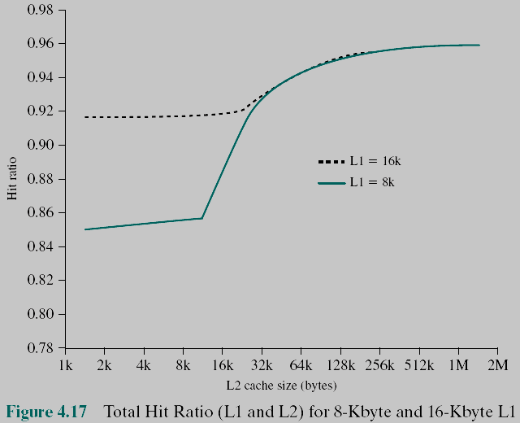
Hit Ratio (L1 & L2) For 8 Kbyte and 16Kbyte L1
Notes:
Figure 4.17 shows the results of one simulation study of two-level cache performance
as a function of cache size [GENU04]. The figure assumes that both
caches have the same line size and shows the total hit ratio. That is, a hit is counted
if the desired data appears in either the L1 or the L2 cache. The figure shows the
impact of L2 on total hits with respect to L1 size. L2 has little effect on the total
number of cache hits until it is at least double the L1 cache size. Note that the steepest
part of the slope for an L1 cache of 8 Kbytes is for an L2 cache of 16 Kbytes.
Again for an L1 cache of 16 Kbytes, the steepest part of the curve is for an L2 cache
size of 32 Kbytes. Prior to that point, the L2 cache has little, if any, impact on total
cache performance. The need for the L2 cache to be larger than the L1 cache to
affect performance makes sense. If the L2 cache has the same line size and capacity
as the L1 cache, its contents will more or less mirror those of the L1 cache.
With the increasing availability of on-chip area available for cache, most contemporary
microprocessors have moved the L2 cache onto the processor chip and
added an L3 cache. Originally, the L3 cache was accessible over the external bus.
More recently, most microprocessors have incorporated an on-chip L3 cache. In
either case, there appears to be a performance advantage to adding the third level
(e.g., see [GHAI98]). Further, large systems, such as the IBM mainframe zEnterprise
systems, now incorporate 3 on-chip cache levels and a fourth level of cache
shared across multiple chips [CURR11].

Slide 48
Unified Versus Split Caches
Has become common to split cache:
One dedicated to instructions
One dedicated to data
Both exist at the same level, typically as two L1 caches
Advantages of unified cache: Higher hit rate
Balances load of instruction and data fetches automatically
Only one cache needs to be designed and implemented
Trend is toward split caches at the L1 and unified caches for higher levels
Advantages of split cache:
Eliminates cache contention (tranh chấp) between instruction fetch/decode unit and execution unit
Important in pipelining (cơ chế đường ống, output của xử lý này là input của xử lý kế tiếp)
Notes:
When the on-chip cache first made an appearance,
many of the designs consisted of a single cache used to store references to both data
and instructions. More recently, it has become common to split the cache into two:
one dedicated to instructions and one dedicated to data. These two caches both exist
at the same level, typically as two L1 caches. When the processor attempts to fetch an
instruction from main memory, it first consults the instruction L1 cache, and when the
processor attempts to fetch data from main memory, it first consults the data L1 cache.
There are two potential advantages of a unified cache:
• For a given cache size, a unified cache has a higher hit rate than split caches
because it balances the load between instruction and data fetches automatically.
That is, if an execution pattern involves many more instruction fetches
than data fetches, then the cache will tend to fill up with instructions, and if an
execution pattern involves relatively more data fetches, the opposite will occur.
• Only one cache needs to be designed and implemented.
The trend is toward split caches at the L1 and unified caches for higher levels,
particularly for superscalar machines, which emphasize parallel instruction execution
and the prefetching of predicted future instructions. The key advantage of the
split cache design is that it eliminates contention for the cache between the instruction
fetch/decode unit and the execution unit. This is important in any design that
relies on the pipelining of instructions. Typically, the processor will fetch instructions
ahead of time and fill a buffer, or pipeline, with instructions to be executed. Suppose
now that we have a unified instruction/data cache. When the execution unit performs
a memory access to load and store data, the request is submitted to the unified cache.
If, at the same time, the instruction prefetcher issues a read request to the cache for
an instruction, that request will be temporarily blocked so that the cache can service
the execution unit first, enabling it to complete the currently executing instruction.
This cache contention can degrade performance by interfering with efficient use of
the instruction pipeline. The split cache structure overcomes this difficulty.

Slide 49
Exercises
4.1- What are the differences among sequential access, direct access, and random access?
4.2-What is the general relationship among access time, memory cost, and capacity?
4.3- How does the principle of locality relate to the use of multiple memory levels?
4.4- What are the differences among direct mapping and associative mapping,?
4.5- For a direct-mapped cache, a main memory address is viewed as consisting of three fields. List and define the three fields.
4.6- For an associative cache, a main memory address is viewed as consisting of two fields. List and define the two fields.

Slide 50
Summary
Cache
Memory
Chapter 4
Characteristics of Memory Systems
Location
Capacity
Unit of transfer
Memory Hierarchy
How much?
How fast?
How expensive?
Cache memory principles
Elements of cache design
Cache addresses
Cache size
Mapping function
Replacement algorithms
Write policy
Line size
Number of caches
Notes:
Chapter 4 summary.

