Slide 1
AIR TRAFFIC CONTROL
An LLM at the controls
GPT-6 Luna and GLM 5.3 Flash
Frankfurt-inspired simulation
Recorded scenarios and benchmark results
26 September 2026
Notes:
Synthetic benchmark results from command-driven simulation. This airport is a lightweight Frankfurt-inspired layout, not an operational airport digital twin.
Sources: https://github.com/MaxxP0/hackathonAirTraffic/blob/main/docs/evaluations/gpt-6-luna-runway_closure-seed7.json
https://github.com/MaxxP0/hackathonAirTraffic/blob/main/docs/evaluations/gpt-6-luna-emergency-seed7.json
https://github.com/MaxxP0/hackathonAirTraffic/blob/main/docs/evaluations/gpt-6-luna-wind_shift-seed7.json
https://github.com/MaxxP0/hackathonAirTraffic/blob/main/docs/evaluations/glm-5.3-flash-runway_closure-seed7.json
https://github.com/MaxxP0/hackathonAirTraffic/blob/main/docs/evaluations/glm-5.3-flash-emergency-seed7.json
https://github.com/MaxxP0/hackathonAirTraffic/blob/main/docs/evaluations/glm-5.3-flash-wind_shift-seed7.json

Slide 2
Benchmark setup
30 minutes
120 seconds
of simulated traffic
between controller decisions
The model receives text telemetry and issues commands for approaches, runway assignments, headings and takeoffs.
The simulator pauses during inference. Each model keeps recent dialogue and a persistent operational plan.
Same traffic seed and 30-minute horizon for both models. One run per scenario.
Notes:
Seed 7. Scenario duration 1,800 simulated seconds. Decision interval 120 seconds, 15 successful decisions per completed episode. Both use the same frankfurt-controller-v3 prompt, max output 8,192 tokens and low reasoning. The provider does not support a temperature parameter for Luna. GLM uses temperature 0. GLM completion resumes saved state after provider errors. Pausing inference means API delays do not add simulated waiting time.
Sources: https://github.com/MaxxP0/hackathonAirTraffic/blob/main/docs/evaluations/gpt-6-luna-runway_closure-seed7.json
https://github.com/MaxxP0/hackathonAirTraffic/blob/main/docs/evaluations/gpt-6-luna-emergency-seed7.json
https://github.com/MaxxP0/hackathonAirTraffic/blob/main/docs/evaluations/gpt-6-luna-wind_shift-seed7.json
https://github.com/MaxxP0/hackathonAirTraffic/blob/main/docs/evaluations/glm-5.3-flash-runway_closure-seed7.json
https://github.com/MaxxP0/hackathonAirTraffic/blob/main/docs/evaluations/glm-5.3-flash-emergency-seed7.json
https://github.com/MaxxP0/hackathonAirTraffic/blob/main/docs/evaluations/glm-5.3-flash-wind_shift-seed7.json

Slide 3
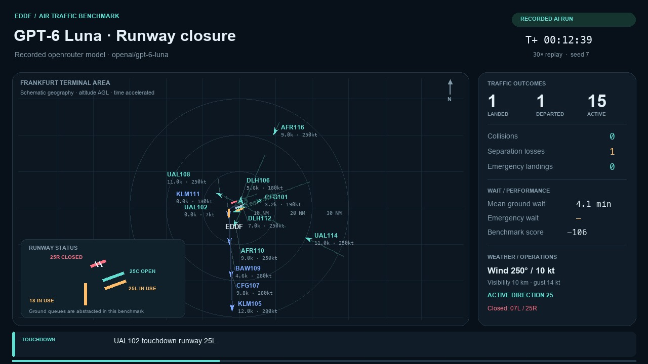
Luna: sudden runway closure
A closure forces CFG101 to go around.
Luna assigns runway 25C.
Click the video in Slide Show to play
32-second replay at 30× speed. The full episode recorded 3 diversions and 3 separation-loss events.
Notes:
This is an actual recorded GPT-6 Luna run. The MP4 is embedded in the PowerPoint. Replays speed up simulated time by 30 times. The full recorded trajectory was checked against the saved simulator result.
Sources: https://github.com/MaxxP0/hackathonAirTraffic/blob/main/atc_bench/web/videos/luna-runway-closure.run.json
https://github.com/MaxxP0/hackathonAirTraffic/blob/main/atc_bench/web/videos/luna-runway-closure.mp4

Slide 4
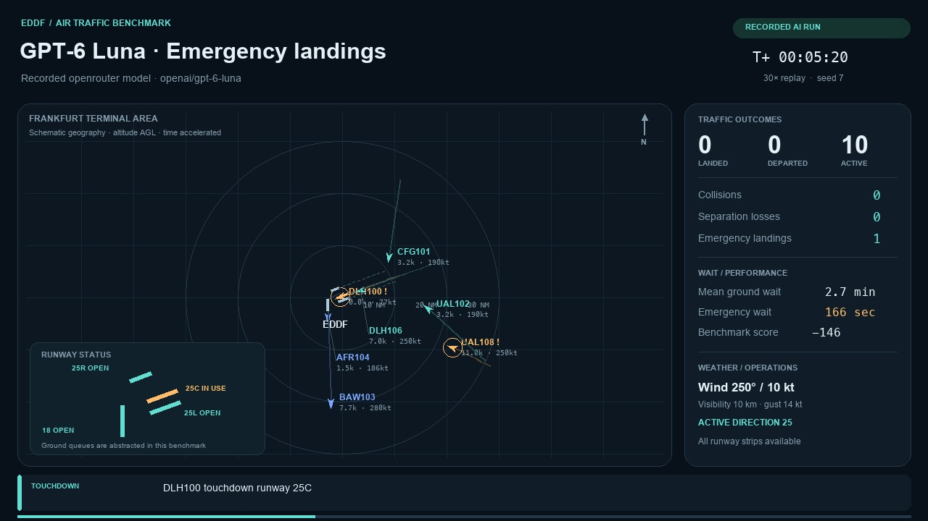
Luna: emergency arrivals
Luna resolves all three emergencies.
Mean emergency wait: 8.7 minutes.
Click the video in Slide Show to play
36-second replay at 30× speed. The full episode recorded 7 separation-loss events.
Notes:
This is an actual recorded GPT-6 Luna run. The MP4 is embedded in the PowerPoint. Replays speed up simulated time by 30 times. The full recorded trajectory was checked against the saved simulator result.
Sources: https://github.com/MaxxP0/hackathonAirTraffic/blob/main/atc_bench/web/videos/luna-emergency.run.json
https://github.com/MaxxP0/hackathonAirTraffic/blob/main/atc_bench/web/videos/luna-emergency.mp4

Slide 5
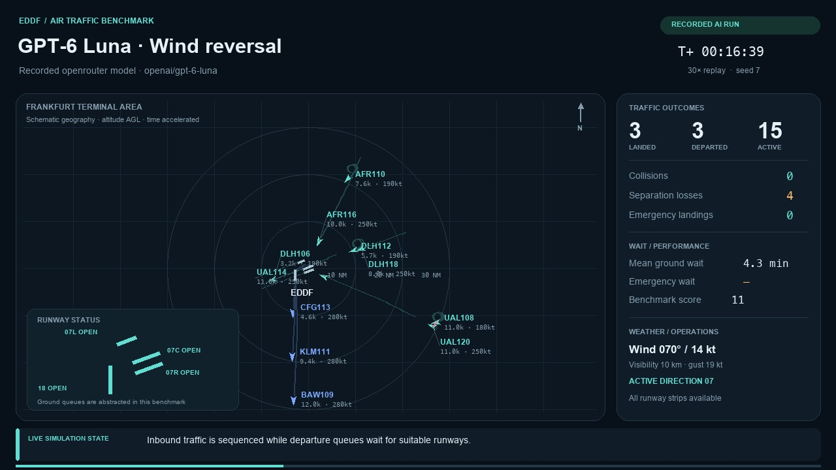
Luna: wind reversal
The active direction changes from 25 to 07.
DLH106 goes around and later lands on 07C.
Click the video in Slide Show to play
35-second replay at 30× speed. The full episode recorded 9 separation-loss events.
Notes:
This is an actual recorded GPT-6 Luna run. The MP4 is embedded in the PowerPoint. Replays speed up simulated time by 30 times. The full recorded trajectory was checked against the saved simulator result.
Sources: https://github.com/MaxxP0/hackathonAirTraffic/blob/main/atc_bench/web/videos/luna-wind-shift.run.json
https://github.com/MaxxP0/hackathonAirTraffic/blob/main/atc_bench/web/videos/luna-wind-shift.mp4

Slide 6
Scores across the three scenarios
Higher is better. These scores combine throughput, safety penalties and waiting-time penalties.
Notes:
Scores use final metrics.score only when status is completed and simulated time reaches 1,800 seconds. Bars are native editable PowerPoint charts. Negative values are valid penalties, not missing data. The benchmark also supplies a separate safety-first rank tuple. One seed does not establish general model superiority.
Sources: https://github.com/MaxxP0/hackathonAirTraffic/blob/main/docs/evaluations/gpt-6-luna-runway_closure-seed7.json
https://github.com/MaxxP0/hackathonAirTraffic/blob/main/docs/evaluations/gpt-6-luna-emergency-seed7.json
https://github.com/MaxxP0/hackathonAirTraffic/blob/main/docs/evaluations/gpt-6-luna-wind_shift-seed7.json
https://github.com/MaxxP0/hackathonAirTraffic/blob/main/docs/evaluations/glm-5.3-flash-runway_closure-seed7.json
https://github.com/MaxxP0/hackathonAirTraffic/blob/main/docs/evaluations/glm-5.3-flash-emergency-seed7.json
https://github.com/MaxxP0/hackathonAirTraffic/blob/main/docs/evaluations/glm-5.3-flash-wind_shift-seed7.json

Slide 7
Waiting time and arrival outcomes
Scenario | Model | Ground wait | Landing time | Emergency wait | Arrival outcomes
Runway closure | Luna | 5.1 | 14.8 | n/a | 5 / 5 / 3
Runway closure | GLM | 5.9 | 13.9 | n/a | 7 / 6 / 0
Emergencies | Luna | 7.8 | 13.3 | 8.7 | 9 / 4 / 0
Emergencies | GLM | 5.1 | 13.9 | 8.5 | 8 / 5 / 0
Wind reversal | Luna | 6.1 | 16.0 | n/a | 5 / 8 / 0
Wind reversal | GLM | 5.4 | 13.7 | n/a | 8 / 5 / 0
Landing time starts at sector entry and includes normal approach flight. Pending arrivals contribute time observed at the 30-minute horizon.
Means in minutes. Arrival outcomes show landed / pending / failed. Lower waits need to be read with outcomes.
Notes:
Ground wait is accumulated departure queue time until takeoff clearance. Emergency wait begins at declaration and ends at touchdown, crash or sector exit. Missing the emergency deadline records a failure but does not stop the timer. Landing service time is existing arrival airborne_time_s, stopping at touchdown, crash or sector exit. All spawned arrivals enter the means, including pending and failed outcomes. Landed here means touchdown, including aircraft still rolling or taxiing. Diverting, diverted and crashed arrivals count as failed. Landing time is a supplemental diagnostic and does not change the overall score. n/a means no emergency population.
Sources: https://github.com/MaxxP0/hackathonAirTraffic/blob/main/docs/evaluations/gpt-6-luna-runway_closure-seed7.json
https://github.com/MaxxP0/hackathonAirTraffic/blob/main/docs/evaluations/gpt-6-luna-emergency-seed7.json
https://github.com/MaxxP0/hackathonAirTraffic/blob/main/docs/evaluations/gpt-6-luna-wind_shift-seed7.json
https://github.com/MaxxP0/hackathonAirTraffic/blob/main/docs/evaluations/glm-5.3-flash-runway_closure-seed7.json
https://github.com/MaxxP0/hackathonAirTraffic/blob/main/docs/evaluations/glm-5.3-flash-emergency-seed7.json
https://github.com/MaxxP0/hackathonAirTraffic/blob/main/docs/evaluations/glm-5.3-flash-wind_shift-seed7.json

Slide 8
Safety outcomes
Scenario | Model | Collisions | Separation events | Pair-minutes below minima | Wake violations
Runway closure | Luna | 0 | 3 | 2.2 | 0
Runway closure | GLM | 0 | 21 | 18.4 | 1
Emergencies | Luna | 0 | 7 | 6.3 | 0
Emergencies | GLM | 0 | 10 | 8.4 | 1
Wind reversal | Luna | 0 | 9 | 6.2 | 0
Wind reversal | GLM | 0 | 23 | 30.0 | 1
Separation exposure sums seconds for each aircraft pair below both separation thresholds.
Notes:
A separation event counts the start of a pairwise loss of separation. Pair-minutes are summed exposure divided by 60. Simultaneous pairs each contribute. No collision does not imply safe separation. Threshold: horizontal distance below 3 NM and vertical separation below 1,000 ft. Collision threshold: horizontal below 0.06 NM and vertical below 100 ft.
Sources: https://github.com/MaxxP0/hackathonAirTraffic/blob/main/docs/evaluations/gpt-6-luna-runway_closure-seed7.json
https://github.com/MaxxP0/hackathonAirTraffic/blob/main/docs/evaluations/gpt-6-luna-emergency-seed7.json
https://github.com/MaxxP0/hackathonAirTraffic/blob/main/docs/evaluations/gpt-6-luna-wind_shift-seed7.json
https://github.com/MaxxP0/hackathonAirTraffic/blob/main/docs/evaluations/glm-5.3-flash-runway_closure-seed7.json
https://github.com/MaxxP0/hackathonAirTraffic/blob/main/docs/evaluations/glm-5.3-flash-emergency-seed7.json
https://github.com/MaxxP0/hackathonAirTraffic/blob/main/docs/evaluations/glm-5.3-flash-wind_shift-seed7.json
https://github.com/MaxxP0/hackathonAirTraffic/blob/main/atc_bench/environment.py
https://github.com/MaxxP0/hackathonAirTraffic/blob/main/docs/SCORING.md

Slide 9
Score interpretation and limits
Proximity penalties
What this comparison establishes
Below 3 NM horizontally and 1,000 ft vertically:
−0.5 points per pair per simulated second.
One seed per scenario provides an initial comparison. More seeds are needed to estimate consistency.
Collision threshold: 0.06 NM and 100 ft.
−1,000,000 points per collision, plus crash penalties.
GLM resumed from saved state after API interruptions. Provider and quantization changes may affect latency and model behavior.
Source code, recorded commands and full results: github.com/MaxxP0/hackathonAirTraffic
Notes:
The comparison uses synthetic traffic in a simplified Frankfurt-inspired airport. Detailed ground activity and BlueSky integration are outside this prototype. The score includes penalties for safety events, unresolved emergencies, delays and invalid commands, along with completion rewards. There is no gradual proximity penalty outside the fixed thresholds. GLM episodes preserve commands, simulator state, recent dialogue and long-term plan across resumption. Original successful GLM calls used InferenceNet. Resumed completion calls used Sail Research/fp8. Run records document provider routes. All external calls obeyed the user’s $10 provider limit.
Sources: https://github.com/MaxxP0/hackathonAirTraffic/blob/main/docs/evaluations/gpt-6-luna-runway_closure-seed7.json
https://github.com/MaxxP0/hackathonAirTraffic/blob/main/docs/evaluations/gpt-6-luna-emergency-seed7.json
https://github.com/MaxxP0/hackathonAirTraffic/blob/main/docs/evaluations/gpt-6-luna-wind_shift-seed7.json
https://github.com/MaxxP0/hackathonAirTraffic/blob/main/docs/evaluations/glm-5.3-flash-runway_closure-seed7.json
https://github.com/MaxxP0/hackathonAirTraffic/blob/main/docs/evaluations/glm-5.3-flash-emergency-seed7.json
https://github.com/MaxxP0/hackathonAirTraffic/blob/main/docs/evaluations/glm-5.3-flash-wind_shift-seed7.json
https://github.com/MaxxP0/hackathonAirTraffic/blob/main/docs/SCORING.md
https://github.com/MaxxP0/hackathonAirTraffic/blob/main/examples/resume_openrouter.py

