Slide 1


DIPLOMA PROJECT
Pyannote, Whisper and LM: Knights of Speaker Diarization
Deonise Costin-Alexandru
deonisealex@gmail.com, cdeonise@bitdefender.com
NATIONAL UNIVERSITY OF SCIENCE AND TECHNOLOGY POLITEHNICA BUCHAREST FACULTY OF AUTOMATIC CONTROL AND COMPUTERS COMPUTER SCIENCE DEPARTMENT
Iulie 2024 Prof. Dr. Ing. Florin Pop

Slide 2
Content
1 Introduction……………………………………………………...1
1.1 Context and Motivation . . . . . . . . . . . . . . . . . . . ….. . . . . . . . . 1
1.2 Problem Definition . . . . . . . . . . . . . . . . . . . . …... . . . . . . . . . . 2
1.3 Thesis Objectives . . . . . . . . . . . . . . . . . . . . . . . . . . . ……. . . . 2
2 Background and Previous Solutions…………………………….4
2.1 Speaker Diarization: An Overview . . . . . . . . . . . . . . . . . . …...4
2.2 Techniques in Speaker Diarization . . . . . . . . . . . . . . . . . . . . . ..5
2.3 Existing Technologies and Tools . . . . . . . . . . . . . . . . . . . . . . . .7
2.4 Challenges in Speaker Diarization . . . . . . . . . . . . . . . . . . . . . . 8
2.5 Innovations in the Field . . . . . . . . . . . . . . . . . . . . . . . . . . . ….10
3 Proposed Pipeline for Speaker Diarization……………………..11
3.1 Overview of the Pipeline . . . . . . . . . . . . . . . . . . . . . . . . . . . ...11
3.2 Pyannote for Speaker Diarization . . . . . . . . . . . . . . . . . . . . . ..12
3.3 Whisper for Text Extraction . . . . . . . . . . . . . . . . . . . . . . . . ...12
3.4 Integration with Language Models . . . . . . . . . . . . . .. . . . . . . .14
4 Detailed Methodology……………………………………………………..15
4.1 Dataset Description: CALLHOME English Dataset . . . . . . . . . . . . . ….15
4.2 Preprocessing Steps . . . . . . . . . . . . . . . . . . . . . . . . . . . . . . …………….16
4.3 Evaluation Metrics . . . . . . . . . . . . . . . . . . . . . . . . . . . . . . . …………….16
4.3.1 Diarization Purity . . . . . . . . . . . . . . . . . . . . . . . . . . . …………………17
4.3.2 Diarization Coverage . . . . . . . . . . . . . . . . . . . . . . . . . . ………………17
4.3.3 Word Diarization Error Rate (WDER) . . . . . . . . . . . . . . . . . …………17
4.3.4 Concatenated Minimum-Permutation Word Error Rate (cpWER) . . ...18
5 Implementation Details……………………………………………………19
5.1 Software Requirements and Environment Setup . . . . . . . . . . . . . . . . …19
5.2 Implementation of Pyannote . . . . . . . . . . . . . . . . . . . . . . . . . . …………19
5.3 Implementation of Whisper . . . . . . . . . . . . . . . . . . . . . . . . . . ………….22
5.4 Language Model Integration . . . . . . . . . . . . . . . . . . . . . . . . . . …………24
5.5 Code Structure and Modules . . . . . . . . . . . . . . . . . . . . . . . . . …………..25
5.6 Flowcharts and Diagrams . . . . . . . . . . . . . . . . . . . . . . . . . . ……………26
6 Experimental Results…………………………………………...28
6.1 Diarization Scenarios . . . . . . . . . . . . . . . . . . . . . . . . . . . . . . ..28
6.2 Performance Analysis and Metrics . . . . . . . . . . . . . . . . . . . . . 29
6.3 Case Studies . . . . . . . . . . . . . . . . . . . . . . . . . . . . . . . . . . ……31
6.3.1 cpWER Results . . . . . . . . . . . . . . . . . . . . . . . . . . . . ……….32
6.3.2 DiarizationPurity Results . . . . . . . . . . . . . . . . . . . . . . . . ….33
6.3.3 Diarization Coverage . . . . . . . . . . . . . . . . . . . . . . . . . . ……34
7 Conclusions…………………………………………………….36
Bibliography……………………………………………………...36
Appendix A Github code…………………………………………40
Appendix B Diarization Scenarios……………………………….41
Appendix C cpWER Results……………………………………..43
Appendix D Diarization Purity Results…………………………..44
Appendix E Diarization Coverage Results……………………….45

Slide 3
Abstract
This paper presents a pipeline for enhancing Speaker Diarization through integrated stateof-the-art models: Pyannote for Speaker Segmentations, Whisper for Speech-to-Text (STT), and a Large Language Model (LLM) for improving both word-level accuracy and speaker-level segmentation. The pipeline begins with Pyannote that segments the audio into chunks, which are then processed by Whisper to generate text for each speaker segment. These transcriptions undergo refinement using an LLM, aimed at improving diarization accuracy and transcript readability. There were a couple of LLMs that were interrogating, both of them are used frequently by humans. The model should be used in meetings or calls, just like the dataset that was used, CALLHOME American English Speech. GPT-4 was the best contestant for reducing the cpWER (0.72%), but overall GPT-3.5 Turbo managed to get better results in diarization tasks.
Legend: model, metrics, dataset

Slide 4
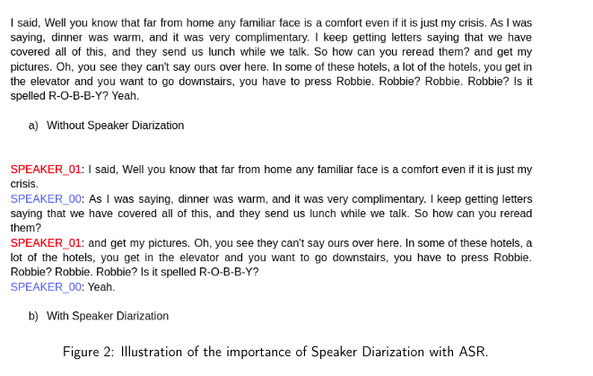
Introduction
Speaker Diarization:
Segmenting audio recordings by speaker.
Objective:
Enhance diarization accuracy using Pyannote, Whisper, and Language Models.
Motivation:
- Applications in military operations, psychology, sales, and marketing.
- Combining state-of-the-art models for better performance.

Slide 5
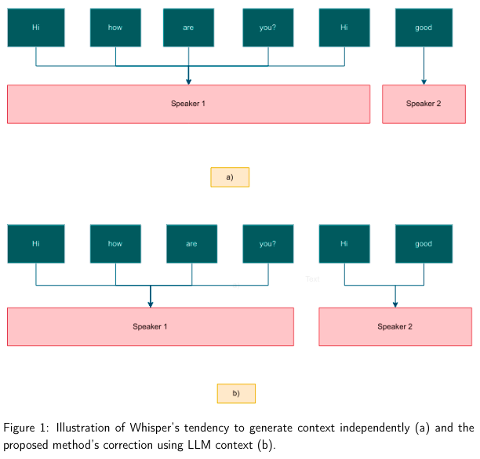
Problem Definition
Challenges:
- Variability in datasets and recording conditions.
- Overlapping speakers and varying microphone qualities.
- Managing multiple speakers and language variations.
Notes:
This variability can come from several sources: Different Recording Devices: Audio quality can vary significantly depending on the type of microphone or recording equipment used.
Environmental Noise: Background noise levels can vary widely. Speaker Characteristics: Different speakers have unique vocal characteristics, such as pitch, accent, and speaking style, which can affect the performance of diarization models.
Recording Conditions: The physical setup, such as the distance of the speaker from the microphone and the acoustics of the recording environment, can also impact audio quality.
Dataset Diversity: Datasets can contain recordings from various contexts, such as phone calls, meetings, or interviews, each with distinct characteristics. Ensuring that models perform well across all these scenarios is challenging.

Slide 6
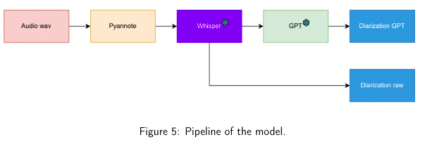
Proposed Solution
Pipeline:
- Pyannote: Speaker segmentation.
- Whisper: Speech-to-text conversion.
- Language Models: Refining transcripts for accuracy.
Innovations:
- Integration of state-of-the-art models.
- Post-processing with GPT-3.5 Turbo and GPT-4.

Slide 7
Methodology
Dataset: CALLHOME English dataset (12 hours of 140 conversations).
Preprocessing:
- Splitting audio with Pyannote.
- ASR with Whisper.
- Refinement with Language Models.
Metrics:
- Diarization Purity, Diarization Coverage, WDER, cpWER.

Slide 8
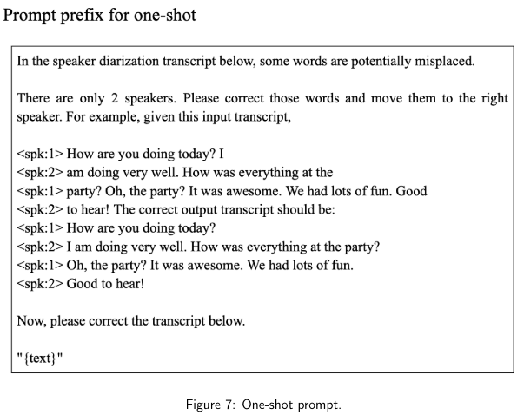



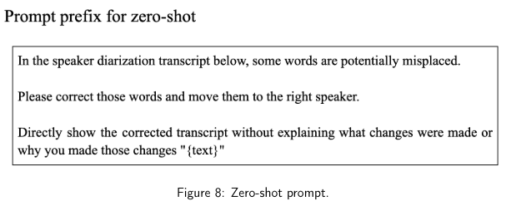
The concatenated minimum-permutation word error rate (cpWER) assesses the alignment of recognized words with ground truth transcripts considering all possible permutations of the recognized words.

Slide 9
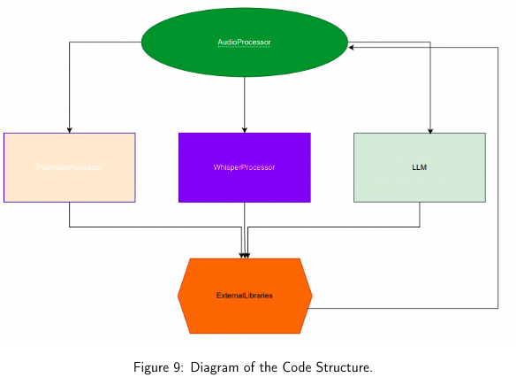
Implementation
Software and Setup:
- Pyannote version 3.1, Whisper large-v3.
Code Structure:
- Modules and flowcharts for the pipeline.
Integration:
- Combining outputs from Pyannote and Whisper.
- Post-processing with GPT-3.5 Turbo and GPT-4.

Slide 10
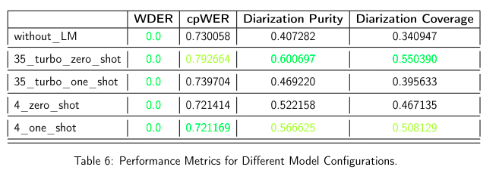
Experimental Results
Performance Analysis:
- Metrics: cpWER, Diarization Purity, Diarization Coverage.
Results:
- GPT-4 achieved the lowest cpWER (0.72%), but GPT-3.5 Turbo excelled in overall diarization tasks.
Case Studies:
- Detailed scenarios and performance in different conditions.

Slide 11
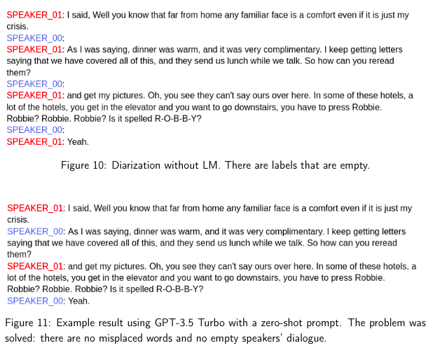

Slide 12
Conclusions
Summary:
- Successful integration of Pyannote, Whisper, and Language Models.
- Significant improvement in speaker diarization accuracy.
Future Work:
- Enhancing the model for real-time applications.
- Exploring other datasets and languages.

Slide 13
Bibliography
[1] Alexis Plaquet and Hervé Bredin. Powerset multi-class cross entropy loss for neural speaker diarization. In Proc. INTERSPEECH 2023, 2023.
[2] Hervé Bredin. pyannote.audio 2.1 speaker diarization pipeline: principle, benchmark, and recipe. In Proc. INTERSPEECH 2023, 2023.
[3] Alec Radford, Jong Wook Kim, Tao Xu, Greg Brockman, Christine McLeavey, and Ilya Sutskever. Robust speech recognition via large-scale weak supervision, 2022. arXiv.org perpetual, non-exclusive license.
[4] Humza Naveed, Asad Ullah Khan, Shi Qiu, Muhammad Saqib, Saeed Anwar, Muhammad Usman, Naveed Akhtar, Nick Barnes, and Ajmal Mian. A comprehensive overview of large language models, 2023.
[5] Vishal Pallagani, Bharath Muppasani, Keerthiram Murugesan, Francesca Rossi, Biplav Srivastava, Lior Horesh, Francesco Fabiano, and Andrea Loreggia. Understanding the capabilities of large language models for automated planning, 2023.
[6] A. Canavan, D. Graff, and G. Zipperlen. Callhome american english speech ldc97s42, 1997. LDC Catalog.
[7] Tae Jin Park, Naoyuki Kanda, Dimitrios Dimitriadis, Kyu J Han, Shinji Watanabe, and Shrikanth Narayanan. A review of speaker diarization: Recent advances with deep learning. Computer Speech & Language, 72:101317, 2022.
[8] Chao Zhang and Quan Wang. Speaker diarization: A journey from unsupervised to supervised approaches. In Odyssey: The Speaker and Language Recognition Workshop, 2022. Tutorial session.
[9] Hernawan Sulistyanto. Speaker diarization: Its developments, applications, and challenges. https://core.ac.uk/download/pdf/11734645.pdf, year not specified. School of Computer Science and Software Engineering, University of Wollongong, NSW, Australia, and Informatics Engineering, Muhammadiyah University of Surakarta, Central Java, Indonesia.
[10] Jiaming Wang, Zhihao Du, and Shiliang Zhang. Told: A novel two-stage overlap-aware framework for speaker diarization, 2023. 37
[11] Shota Horiguchi, Yusuke Fujita, Shinji Watanabe, Yawen Xue, and Paola Garcia. Encoder-decoder based attractors for end-to-end neural diarization. IEEE/ACM Transactions on Audio, Speech, and Language Processing, 2021. Accepted to IEEE/ACM TASLP. This article is based on our previous conference paper arXiv:2005.09921.
[12] Brian McFee, Colin Raffel, Dawen Liang, Daniel P. W. Ellis, Matt McVicar, Eric Battenberg, and Oriol Nieto. librosa: Audio and music signal analysis in python. https: //librosa.org/doc/latest/index.html, latest version accessed 2024. Accessed: 2024-06-24.
[13] C.-A. Deonise, T.-M. Coconu, T. Rebedea, and F. Pop. Improved speech activity detection model using convolutional neural networks. In 2023 22nd RoEduNet Conference: Networking in Education and Research (RoEduNet), pages 1–8, Craiova, Romania, 2023.
[14] S. Sharma, P. Rattan, and A. Sharma. Recent developments, challenges, and future scope of voice activity detection schemes—a review. In M.S. Kaiser, J. Xie, and V.S. Rathore, editors, Information and Communication Technology for Competitive Strategies (ICTCS 2020), volume 190 of Lecture Notes in Networks and Systems. Springer, Singapore, 2021.
[15] S. W. Chin, K. P. Seng, L.-M. Ang, and K. H. Lim. Improved voice activity detection for speech recognition system. In 2010 International Computer Symposium (ICS2010), pages 518–523, Tainan, Taiwan, 2010.
[16] Oleksii Kuchaiev, Jason Li, Huyen Nguyen, Oleksii Hrinchuk, Ryan Leary, Boris Ginsburg, Samuel Kriman, Stanislav Beliaev, Vitaly Lavrukhin, Jack Cook, Patrice Castonguay, Mariya Popova, Jocelyn Huang, and Jonathan M. Cohen. Nemo: a toolkit for building ai applications using neural modules. https://arxiv.org/abs/1909.09577, 2019. Accessed: 2024-06-24.
[17] Max Bain, Jaesung Huh, Tengda Han, and Andrew Zisserman. Whisperx: Time-accurate speech transcription of long-form audio. INTERSPEECH 2023, 2023. [18] Fan Yu, Shiliang Zhang, Yihui Fu, Lei Xie, Siqi Zheng, Zhihao Du, Weilong Huang, Pengcheng Guo, Zhijie Yan, Bin Ma, Xin Xu, and Hui Bu. M2MeT: The icassp 2022 multi-channel multi-party meeting transcription challenge. https://arxiv.org/abs/2203.09877, 2022. Accessed: 2024-06-24.
[19] Quan Wang, Yiling Huang, Guanlong Zhao, Evan Clark, Wei Xia, and Hank Liao. Diarizationlm: Speaker diarization post-processing with large language models. arXiv:2401.03506, 2024.
[20] Shota Horiguchi, Yusuke Fujita, Shinji Watanabe, Yawen Xue, and Paola Garcia. Encoder-decoder based attractors for end-to-end neural diarization. IEEE/ACM Transactions on Audio, Speech, and Language Processing, 30(2325-9285):1152–1164, 2022. Submitted on 20 Jun 2021 (v1), last revised 28 Mar 2022 (v2). 38
[21] Hugging Face. pyannote/speaker-diarization-3.1: PyAnnote Speaker Diarization Toolkit v3.1. https://huggingface.co/pyannote/speaker-diarization-3.1, 2023. Accessed: 2024-06-24.
[22] OpenAI. OpenAI Whisper Large v3. https://huggingface.co/openai/ whisper-large-v3, 2023. Accessed: 2024-06-24.
[23] OpenAI. OpenAI API Documentation. https://platform.openai.com/docs/ api-reference/chat/create, 2024. Accessed: 2024-06-24.
[24] PyAnnote. PyAnnote Metrics Documentation. https://pyannote.github.io/ pyannote-metrics/reference.html#purity-and-coverage, 2024. Accessed: 2024-06-24.
[25] Laurent El Shafey, Hagen Soltau, and Izhak Shafran. Joint speech recognition and speaker diarization via sequence transduction. In Proc. Interspeech, pages 396–400, 2019.
[26] Shinji Watanabe, Michael Mandel, Jon Barker, Emmanuel Vincent, Ashish Arora, Xuankai Chang, Sanjeev Khudanpur, Vimal Manohar, Daniel Povey, Desh Raj, and et al. Chime-6 challenge: Tackling multispeaker speech recognition for unsegmented recordings. arXiv preprint arXiv:2004.09249, 2020.

Slide 14
Questions?
Thanks!

