Slide 1

STOCK MARKET ANALYSIS

Slide 2
Project Overview
Conduct a statistical analysis using real-time stock price data for Microsoft, Tesla, and Apple to gain a deeper understanding of these companies' performance within the stock market.
80%
SCHEDULING

Slide 3
Dataset
Data set was extracted from Yahoo Finance, and it provides daily price and performance data for three major tech stocks [Microsoft (MSFT), Tesla (TSLA), Apple (AAPL)] and the broader market index [S&P 500 index] over the period from February 2018 to January 2023.
Includes the daily percent change in stock prices for MSFT, TSLA, and AAPL compared to the prior trading day
There are missing values on days when the market was closed (weekends, holidays, etc.)
Includes daily opening, closing, and adjusted closing stock prices for MSFT, TSLA, AAPL, and SP500. It also contains the highest and lowest prices for each day.
Includes the daily percent change in stock prices for MSFT, TSLA, and AAPL compared to the prior trading day
The S&P 500 is a widely followed stock market index representing 500 of the largest publicly traded companies in the United States, serving as a key benchmark for the overall U.S. stock market performance.
SCHEDULING

Slide 4
Summary Descriptive Statistics
In summary, Microsoft has the highest average stock price while Tesla showcases greater volatility, as evidenced by its elevated standard deviation.
In contrast, Apple maintains a relatively stable stock price compared to the other two.
Additionally, all three companies exhibit positive skewness values, suggesting a slight rightward skew in their stock price distributions, indicating a tendency towards higher stock prices.
Furthermore, negative kurtosis values across the board indicate that their distributions possess fewer extreme values and are less tailed.
MSFT |  | Tesla |  | Apple |  | SP500
Mean | 194.4709 | Mean | 131.8952 | Mean | 98.5741 | Mean | 3457.034
Standard Error | 2.076481 | Standard Error | 3.277467 | Standard Error | 1.291672 | Standard Error | 18.64546
Median | 203.58 | Median | 96.57333 | Median | 95.0875 | Median | 3294.67
Mode | 95.14 | Mode | 24 | Mode | 127.82 | Mode | 2832.41
Standard Deviation | 74.2324 | Standard Deviation | 117.1666 | Standard Deviation | 46.17614 | Standard Deviation | 666.559
Sample Variance | 5510.449 | Sample Variance | 13728.01 | Sample Variance | 2132.236 | Sample Variance | 444300.9
Kurtosis | -1.28796 | Kurtosis | -1.25726 | Kurtosis | -1.58204 | Kurtosis | -1.29724
Skewness | 0.149832 | Skewness | 0.470592 | Skewness | 0.121834 | Skewness | 0.33324
Range | 258.56 | Range | 399.3967 | Range | 146.635 | Range | 2513.8
Minimum | 86.06 | Minimum | 12.07333 | Minimum | 35.995 | Minimum | 2290.71
Maximum | 344.62 | Maximum | 411.47 | Maximum | 182.63 | Maximum | 4804.51
Sum | 248533.8 | Sum | 168562.1 | Sum | 125977.7 | Sum | 4418090
Count | 1278 | Count | 1278 | Count | 1278 | Count | 1278
SCHEDULING

Slide 5
Visualization
SCHEDULING
The stock price distributions of all three companies exhibit asymmetry, with Tesla and Apple displaying more noticeable positive skewness and a bimodal pattern. Additionally, there is moderately positive correlation, suggesting that prices generally rise over time, though decline can be observed for all three companies after 2021. The presence of variability and non-linearity in the data also hints at unpredictability in the stock price movements.

Slide 6
Regression Analysis
Regression Statistics
Multiple R | 0.777176
R Square | 0.604003
Adjusted R Square | 0.603692
Standard Error | 0.011342
Observations | 1277
Regression Statistics
Multiple R | 0.481352
R Square | 0.2317
Adjusted R Square | 0.231097
Standard Error | 0.038246
Observations | 1277
Regression Statistics
Multiple R | 0.741104
R Square | 0.549235
Adjusted R Square | 0.548881
Standard Error | 0.013902
Observations | 1277
 | Coefficients
Intercept | 0.000505973
X Variable 1 | 1.221495021
 | Coefficients
Intercept | 0.001914305
X Variable 1 | 1.831554187
 | Coefficients
Intercept | 0.000655733
X Variable 1 | 1.33818958
Microsoft exhibits the most pronounced linear association, where the market index has a substantial impact, elucidating roughly 60.4% of its variability. Conversely, Tesla exhibits the most feeble connection, with approximately 23.2% of its variability being accounted for by the market index. Apple, on the other hand, falls in an intermediate position, , showcasing a reasonably linear correlation (R-squared: 54.9%).

Slide 7

Conclusion
The statistical analysis provides insights into the relationships between the S&P 500 index and the stock prices of Microsoft, Tesla, and Apple.
Among these companies, Tesla's stock price displays a relatively weak association with the broader market. Its performance can be influenced by unique factors related to the electric vehicle industry, the company's innovations, and investor sentiment. Notably, Tesla boasts the highest BETA value among the three, signifying greater risk but potentially higher short-term returns for investors.
Conversely, Microsoft exhibits stability, as its stock price tends to align with the movements of the S&P 500 index. Therefore, during favorable market conditions, Microsoft's stock may parallel market performance, making it a consideration for long-term investment strategies.
Apple's stock price does exhibit correlation with shifts in the S&P 500 index, although it is somewhat offset by Microsoft's presence.
For investors, it is imperative to track broader market trends while remaining attentive to company-specific developments to make well-informed investment choices.

Slide 8
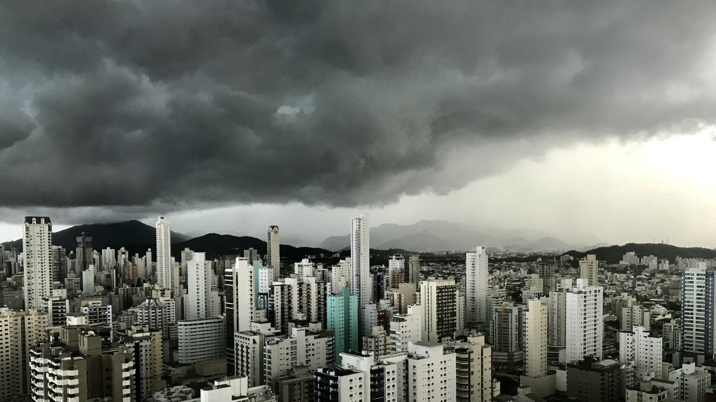
THANK YOU

