Slide 1
LIST OF GREAT ACHIEVERS

Slide 2
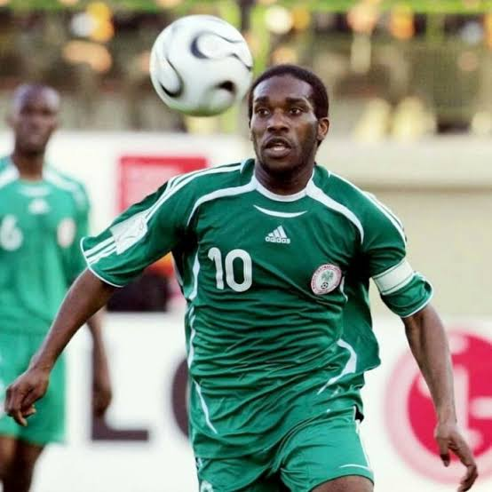
Augustine Azuka "Jay-Jay" Okocha
He was born in Enugu, Enugu State. His parents lived in Iwo local Government, Osun State, Nigeria. He began playing football on the streets just like many other football stars, usually with a makeshift ball. He is is a Nigerian former professional footballer who played as an attacking midfielderHe is regarded as one of the greatest football players from Africa. In Europe he got the nickname “jay-jay” due to his mesmerising and breathe-taking style of play

Slide 3
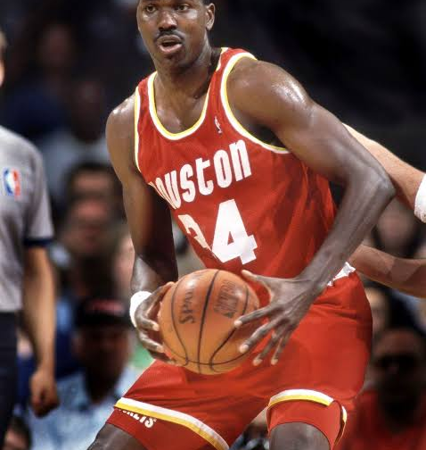
Hakeem Olajuwon
He was nicknamed "the Dream", is a Nigerian-American former professional basketball player. He was born in Lagos to parents who sold cement for a living and he didn't start to play basketball until he was 15 years old in Mushin, Lagos, after which he traveled to the USA for his university education and developed himself there playing and studying. He is widely considered to be one of the greatest centers (a playing position), as well as one of the greatest basketball players of all time.

Slide 4
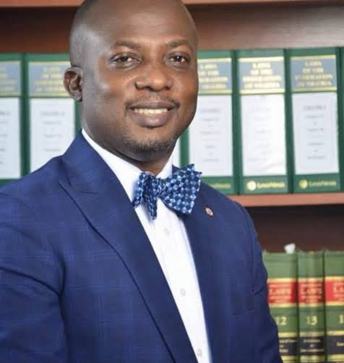
Barr Tokunboh Wahab
He is the Special Adviser for Education, Lagos State. His office gives advice on educational issues and works hand in hand with the commissioner of education and the Lagos state government to promote educational policies in Lagos state.

Slide 5
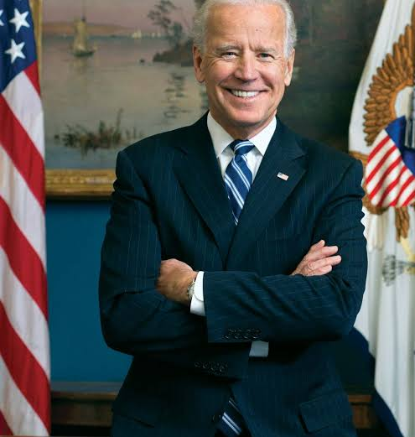
Joseph Biden Jr.
He is an American politician who is the 46th and current president of the United States of America. He previously served as the 47th vice president from 2009 to 2017 under President Barack Obama. He is the leader of the world's most powerful country.

Slide 6
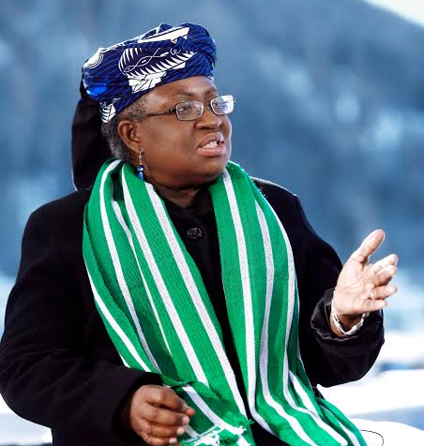
Professor Ngozi Okonjo-Iweala
She is a Nigerian-American economist who is Director-General of the World Trade Organization, she is the first woman and first African to lead the World Trade Organization as Director-General. She has also served as Nigeria's Minister of Finance and Minister of Foreign Affairs. During her first term as Finance Minister in the administration of President Olusegun Obasanjo, she spearheaded negotiations with the Paris Club that led to the wiping out of US$30 billion of Nigeria's debt, including the outright cancellation of US$18 billion

Slide 7
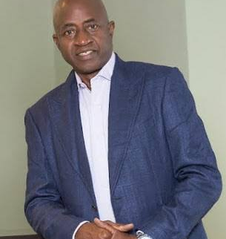
Patrick Olusegun Odegbami,
His name is shortened as Segun Odegbami, ia Nigerian former professional footballer who played as a forward. He was one of the Super Eagles players known then as the Green Eagles, who won for the country the African Cup of Nations for the first time in 1980. He is the founder of Segun Odegbami International Sport Academy which is Nigeria's FIRST & ONLY co-edu multi-sports secondary school. It is located in Wasimi, Ogun state

Slide 8
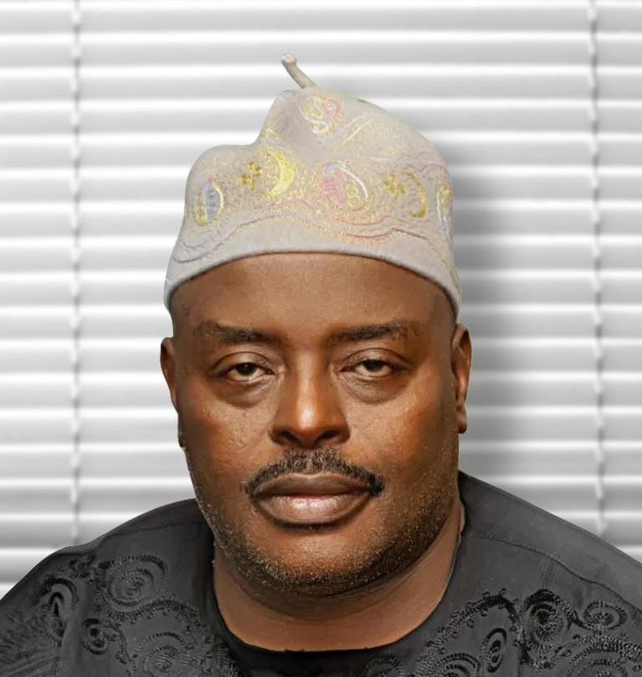
Hon. Wahab Olawale Alawiye-King
He is the Executive Chairman, Lagos State Universal Basic Education Board (LASUBEB). LASUBEB is the agency that advises the government on the development of basic education, management of affairs of teaching and non-teaching staff, upholding of children rights to education in Lagos state.

Slide 9
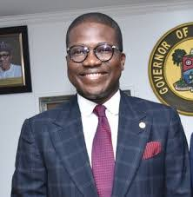
Hakeem Muri-Okunola
He was born 7 January 1972 is a Nigerian lawyer, public administrator, technocrat and the current Lagos State Head of Service.

Slide 10
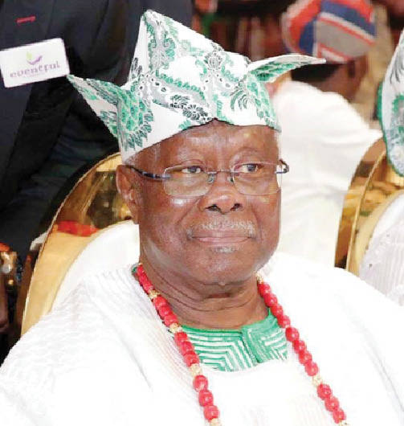
Chief Bode George
He is a Nigerian politician who became Military Governor of Ondo State, and later Chairman of the Nigerian Ports Authority, then national vice-chairman in the southwest zone of the People’s Democratic Party (PDP)

Slide 11
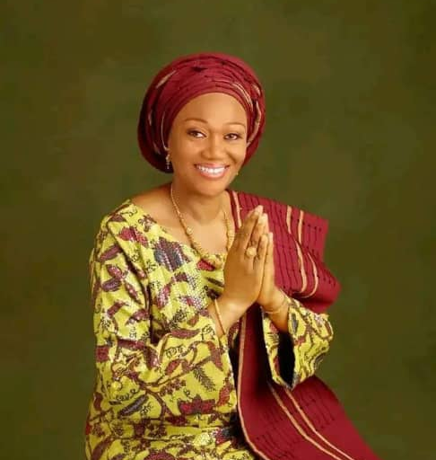
Oluremi Tinubu
She is a Nigerian politician who served as the first lady of Lagos State from 1999 to 2007 and is currently a senator representing Lagos Central Senatorial District at the Nigerian National Assembly. She is a member of the All Progressives Congress political part

Slide 12
THANK YOU FOR VIEWING.

