Slide 1
2026 ML Final Competition Intro.
2026/10/29

Slide 2
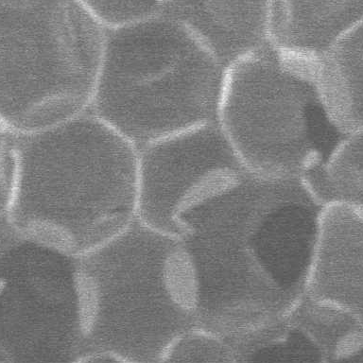
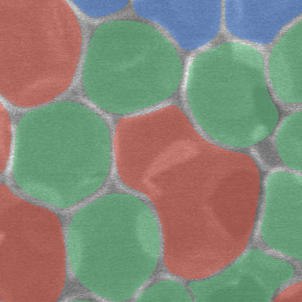
Task Description
Task:
  Image segmentation of foaming material SEM images.
  Classifies the size of each foams
Training dataset: 78 SEM images with 4-class labels (0–3, ignore 255), and 366 unlabeled SEM images(up to 1536 × 1103).
Evaluation dataset: 113 SEM images (384 × 384).
3 (Red) Large
2 (Green) Medium
1 (Blue) Small
0 for otherwise

Slide 3
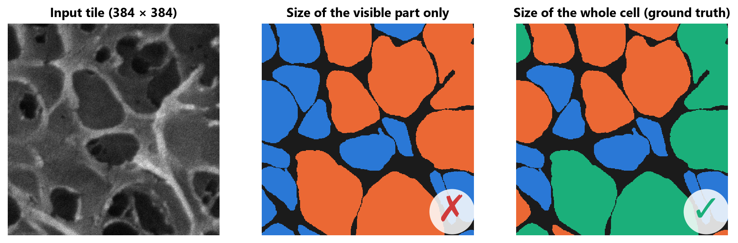
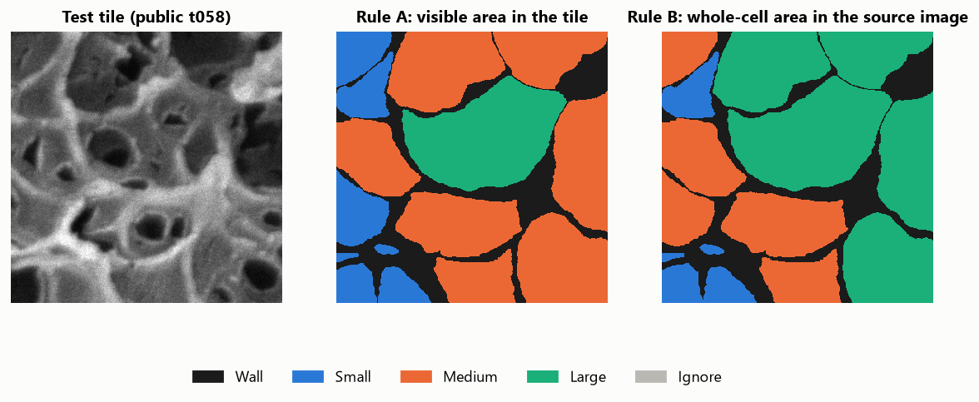
Task Description
Its size class is decided by its whole area in the original SEM image, even when figure shows only part of it.
Type | True Size(pixel) | label | % in dataset
Wall | x | 0 | 0.289
Small | < 6000 | 1 | 0.180
Medium | 6000 ~ 14000 | 2 | 0.170
Large | > 14000 | 3 | 0.283
Ignore | x | 255 | 0.077

Slide 4
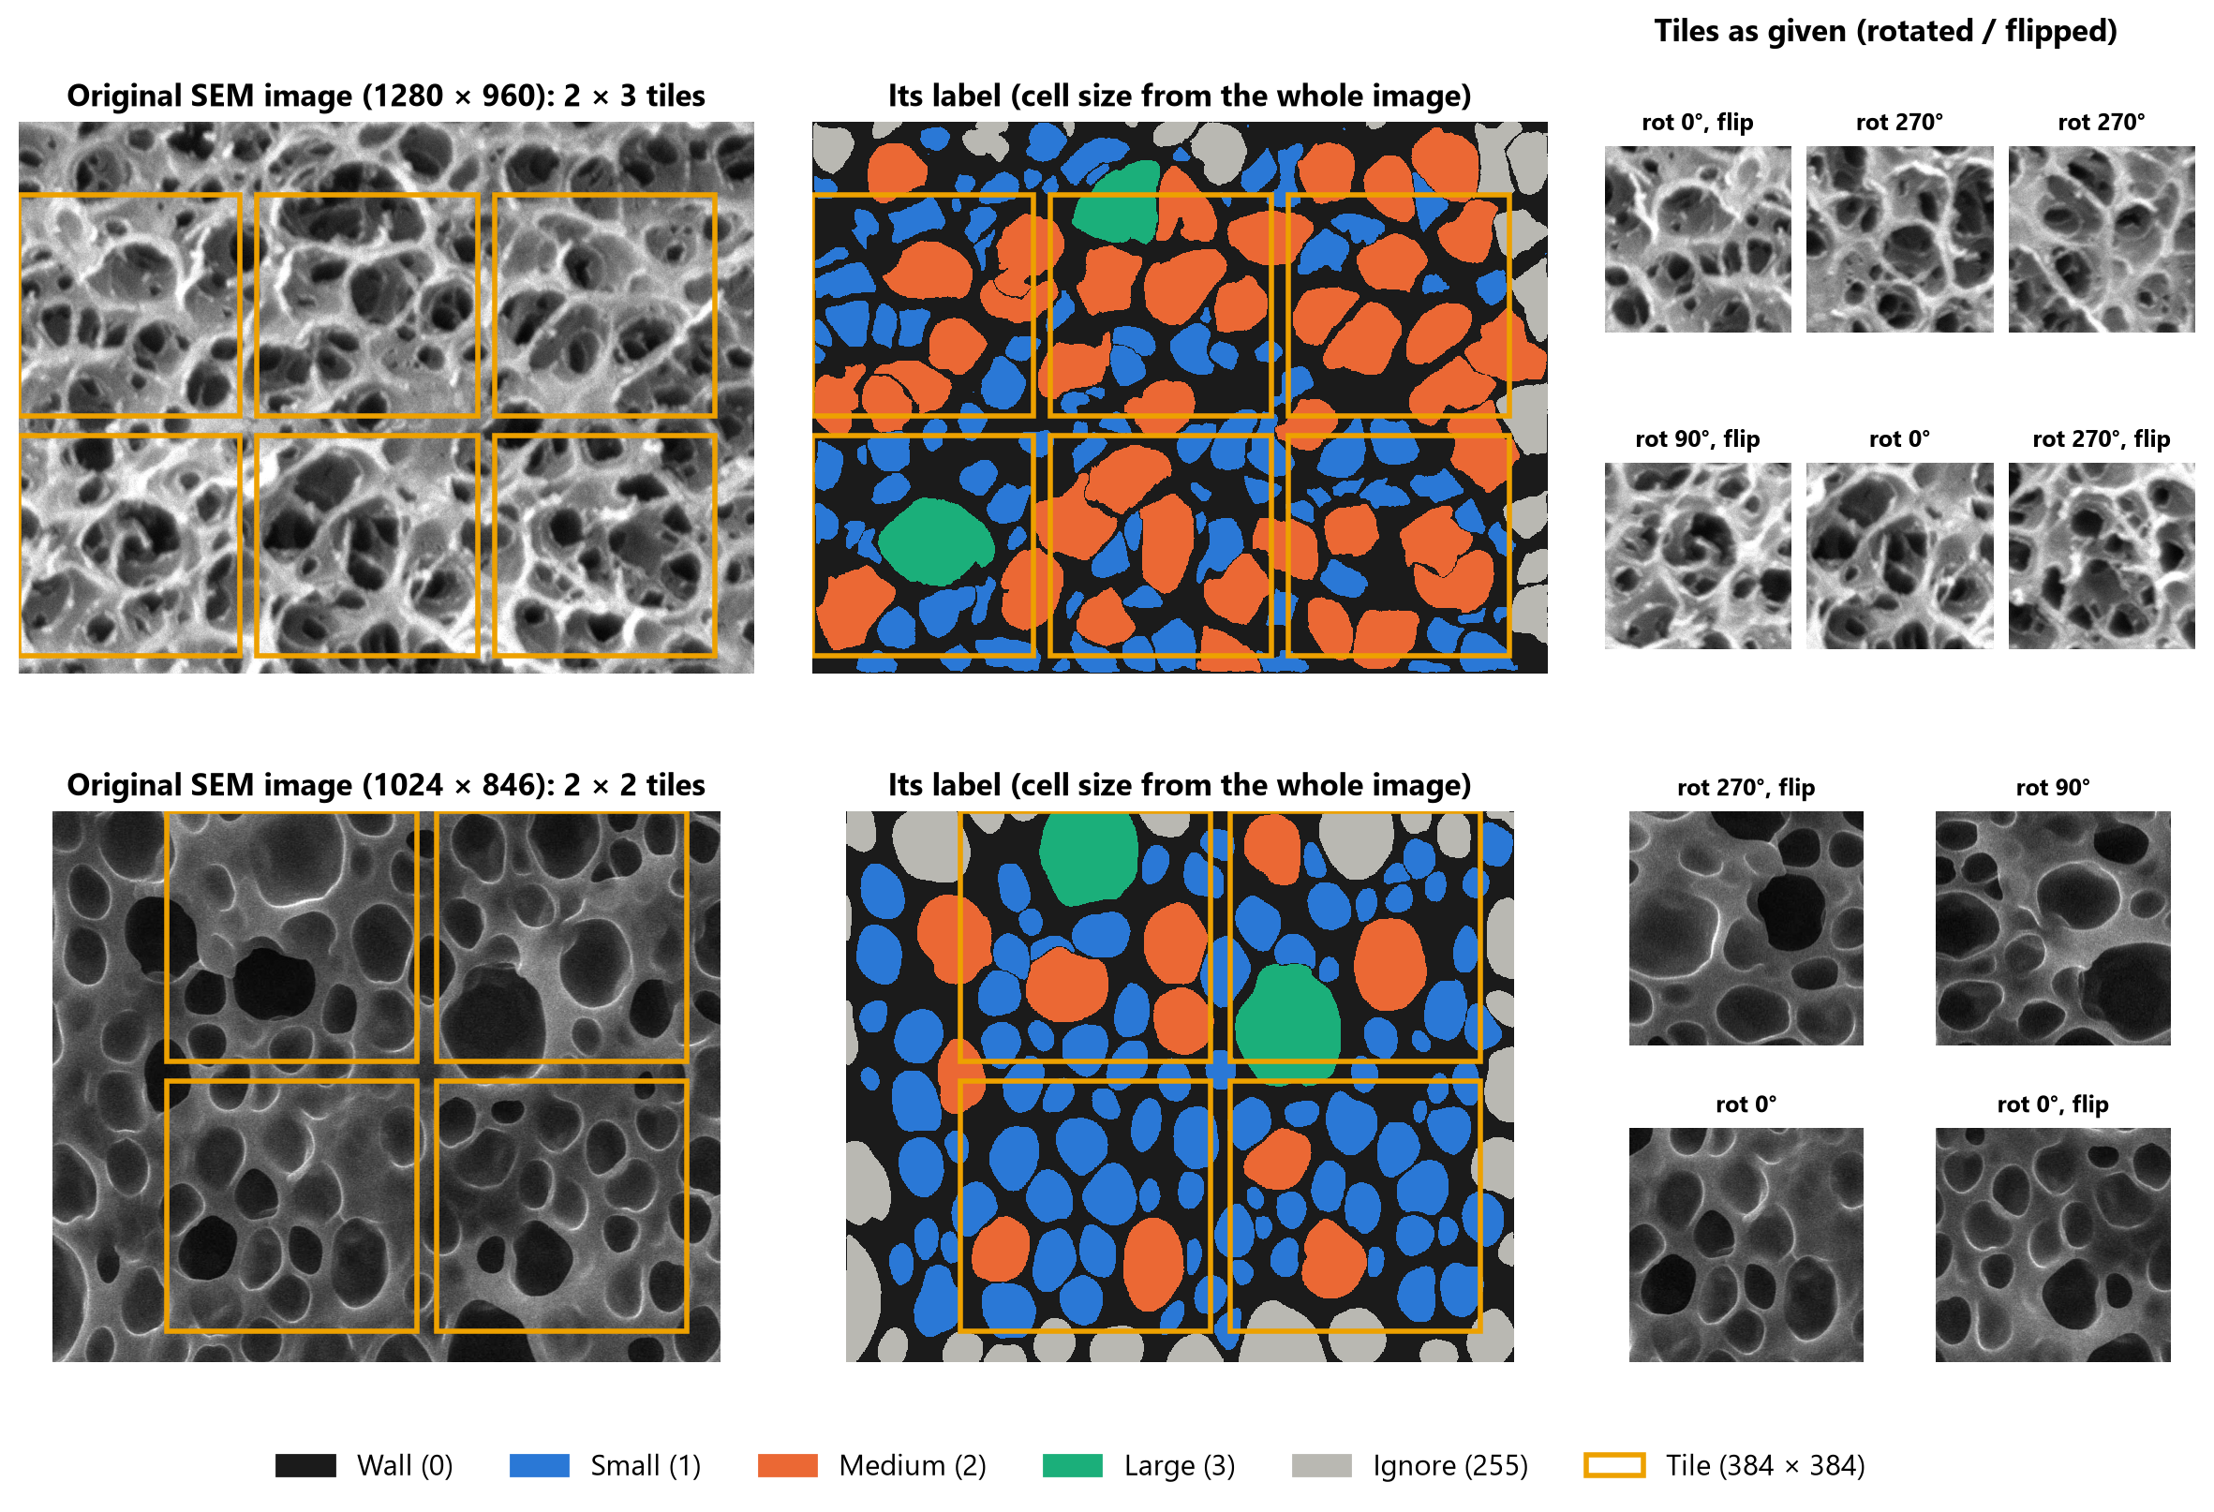
Dataset

Slide 5
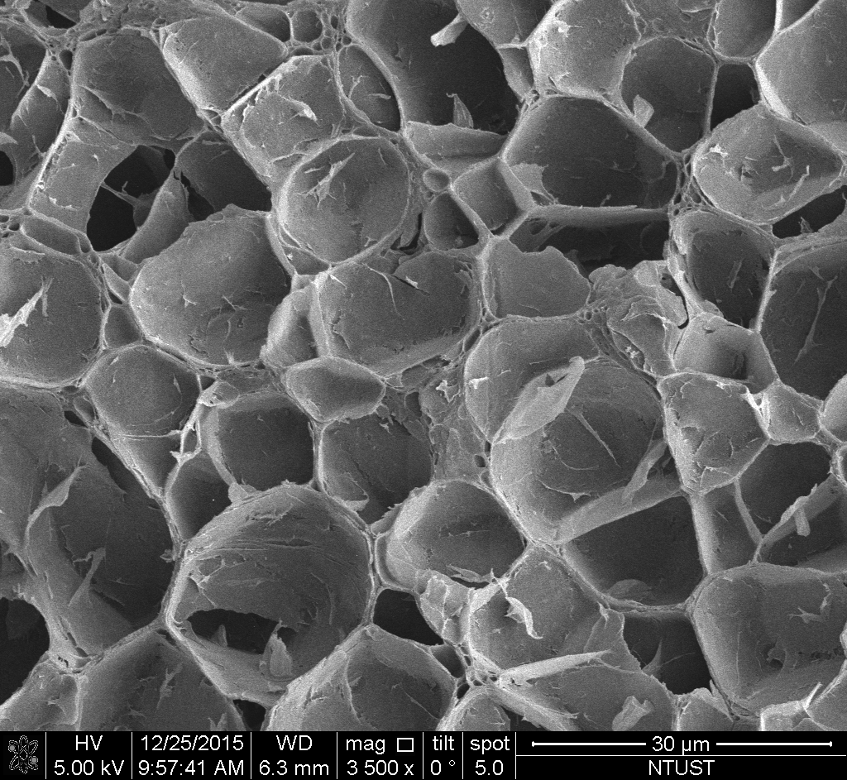
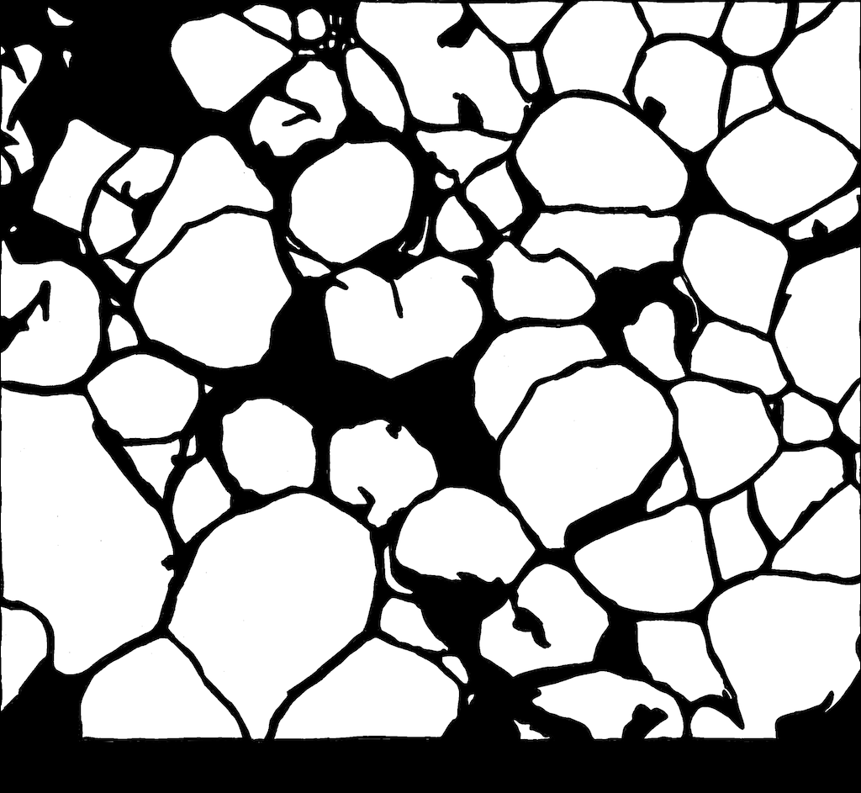
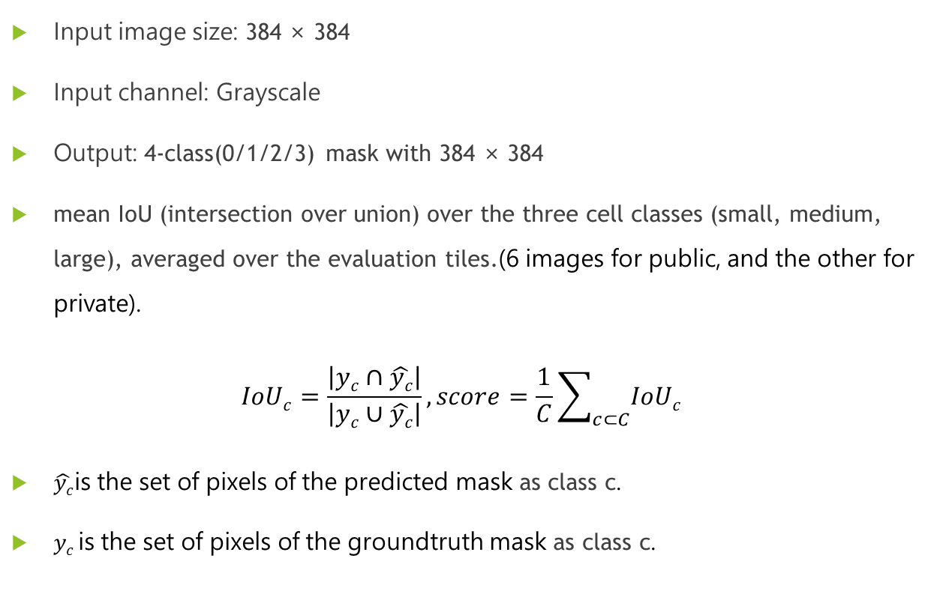
Evaluation
Input image size: 384 × 384
Input channel: Grayscale
Output: 4-class(0/1/2/3) mask with 384 × 384
mean IoU (intersection over union) over the three cell classes (small, medium, large), averaged over the evaluation tiles.(6 images for public, and the other for private).
$$IoUc=\frac{\left|yc∩\hat{yc}\right|}{\left|yc∪\hat{yc}\right|}, score=\frac{1}{C}\sum_{c⊂C}{IoUc}$$
$\hat{yc}$is the set of pixels of the predicted mask as class c.
$yc$is the set of pixels of the groundtruth mask as class c.

Slide 6
Grading Policy
等第+名次取高分

