Slide 1
Recursion
Prepared by May Esmail

Slide 2
What is Recursion?
The process in which a function calls itself directly or indirectly
Directly : by calling itself in it’s body
Indirectly : by calling other function that calls it in it’s body
Recursive Function Consists of 2 Major Parts:
=base case(s) (base condition(s) ): defines all cases in which the recursion of some sub-problem stops and returns a particular value hence in this case the answer of sub-problem is known.
For example in factorial function when we’re calculating factorial(1) or factorial(0) it returns 1
=Recursive Case(s) (calling sub-problem(s)): It is the case which brings us to the closer answer.

Slide 3
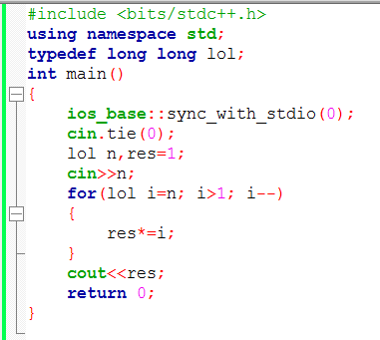
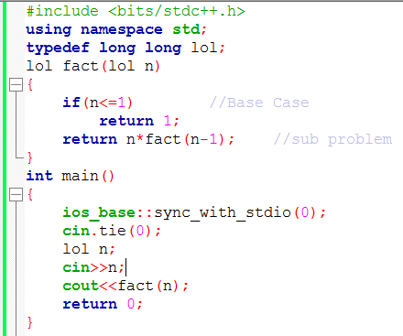
Note :when the function calls it self you must pass different arguments than it’s current parameters to avoid infinite looping
for example : factorial(n) can’t call factorial(n) and any rec(n,m,k,..) can’t call itself with same
arguments n,m,k,..
factorial(5) =5*4*3*2*1 So factoial(n)=n*(n-1)*(n-2)*…*2*1
Iterative Recursive

Slide 4
Tracing
Runtime Stack: It is a system stack allow us to save the frame stack of a function every recursion or every call. frame stack consists of the return address, local variables and return value if any
Briefly runtime stack will take last function call and execute it as shown:
suppose that we called fact(4)
First .. Execution starts from the main
main()
N=4
1

Slide 5
Tracing
N=4
n=4
If(n<=1)
//discarced
Fact(4)
2
main()
N=4
n=3
If(n<=1)
//discarced
Fact(3)
N-1=3
Fact(4)
3
main()

Slide 6
Tracing
N=3
n=2
If(n<=1)
//discarced
Fact(2)
N-1=2
Fact(3)
Fact(4)
4
main()
If(n<=1)
return 1
N=2
Fact(1)
Fact(2)
N-1=1
Fact(3)
Fact(4)
5
main()

Slide 7
Tracing (backtrack)
N=2
Returns 2*1
1
Fact(2)*1
Fact(3)
Fact(4)
4
main()
N=3
2
Returns 3*2
Fact(3)*2
Fact(4)
N-1=1
3
main()

Slide 8
Tracing (backtrack)
N=4
6
Returns 4*6
Fact(4)*6
2
main()
24
1
main()

Slide 9
Example 2 fibonacci
fib(n)=fib(n-1)+fib(n-2)
fib(0)=0 fib(1)=1
Given number n , what’s fib(n)??
Fibonacci series :
0,1, 1, 2, 3, 5, 8, 13, 21, 34,……….

Slide 10
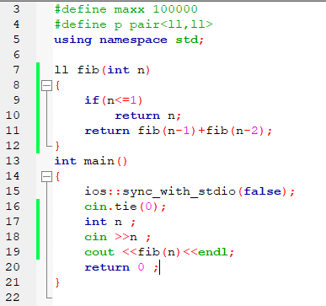
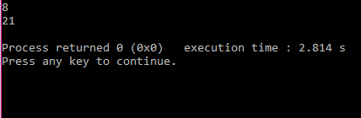
Example 2 fibonacci
What is cases we know it’s answer?
Fib(0)=0 fib(1)=1 => base case => if(n<=1) return n;
What are sub calls for each call? Each number is generated using value of last 2 elements so:
Sub calls Fib (n)= fib(n-1)+fib(n-2) => return fib(n-1)+fib(n-2);
Recursive code :

Slide 11
Example 3 fast power
Main idea
If power =0 so result is 1 //base case
If power is even divide it by 2 then multiply result*result
3^4=(3^2)^2=(3^2)*(3^2) //sub problem case1
If power is odd multiply base* base^(power-1)
//sub problem case 2 3^5=3*(3^4)
O(log n)

Slide 12
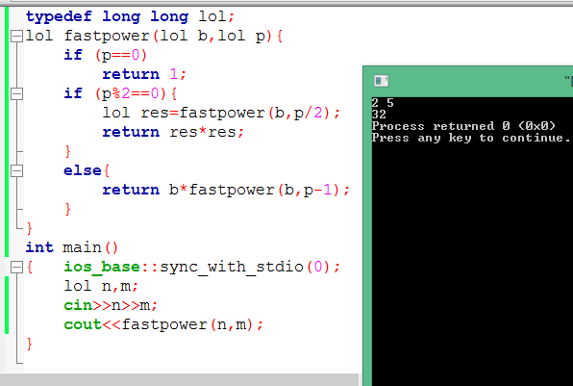
Example 3 fast power code

Slide 13
Example 4 maximum path sum
You’re given grid of positive numbers , start from top left (0,0) and end in bottom right
(n-1,m-1) , you can move only right or down .. Find the path with sum of numbers is maximum
Constraints 1<= n, m <=1000
Test 1:
1 5
2 4
Output : 10 Note: taken path is (1 ->5->4)
Test 2:
5 1 2
6 7 8
1 8 9
Output: 35 Note: taken path is (5 ->6 ->7 ->8 ->9)

Slide 14
Example 4 maximum path sum
Main idea:
For each iteration you’re in a cell of the grid with row r , Column c you must take the maximum of 2 paths (2 sub problems):
Right path with row r , col c+1
Down path with row r+1,col c
O(2^n)
When’ll it stop? (base case)
On reaching the bottom right cell (r==n-1&&c==m-1)

Slide 15
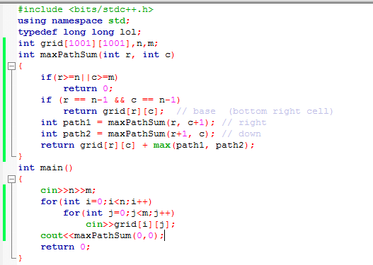
Example 4 maximum path sum
Code:

Slide 16
Example 5 Is their a path?
You’re given a grid of m*n cell each cell has contains ‘.’ or ‘X’, start point is (0,0) and end point is (n-1,m-1) find if there is a way from start to the end. ‘X’ mean block cell can’t move into it , ‘.’ is empty cell.
Test 1: Test 2:
5 5 3 4
. . . . X . . X .
. . . X . . . . X
. . X . . . X . .
. X . . . Output : 1
X . . . .
Output : 0

Slide 17
Example 5 Is their a path?
Main idea:
From each cell with row r and column c => cell (r,c) we have 4 paths (4 sub problems)
Go up => (r-1,c)
Go down => (r+1,c)
Go right => (r,c-1)
Go left => (r,c+1)
We should check validation for each cell .. For example if we’re in cell (0,0) so cells (-1,0) and (0,-1) are invalid
The cell r,c is valid if r>=0 && r<n && c>=0 && c<m
When’ll it stop? (base case)
On reaching the bottom right cell (r==n-1&&c==m-1)

Slide 18
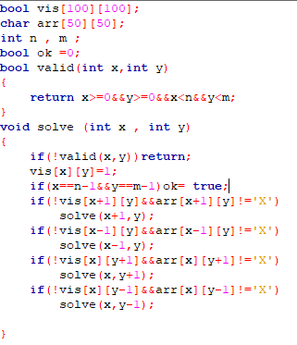
Example 5 Is their a path?
Code:
-we used Vis array to mark if we had visited this cell before or not to avoid cyclic paths
-bool ok to mark we reached the end or not.

Slide 19
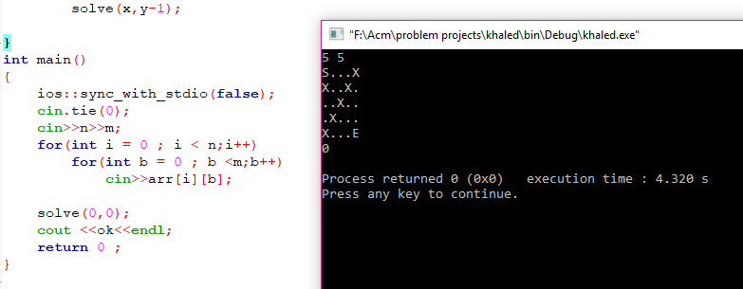
Example 5 Is their a path?
Code remaining:

Slide 20
Example 6 Merge Sort
Main idea:
Merge Sort is a Divide and conquer algorithm. It divides input array in two halves, calls itself for the two halves and then merges the two sorted.
Suppose that we have array with size =7
Merge sort(0:6)
Merge sort(0:3)
Merge sort(4:6)
Merge sort(0:1)
Merge sort(2:3)
Merge sort(4:5)
Merge sort(6:6)
Merge sort(0:0)
Merge sort(1:1)
Merge sort(2:2)
Merge sort(3:3)
Merge sort(4:4)
Merge sort(5:5)

Slide 21
Example 6 Merge Sort
Main idea:
The technique of Merge sort still dividing the current array into 2 halves until the current array consists of one element hence there is no more divisions (base case) and because it’s one element it represents a sorted array so it backtracks and merge it with other sorted array of other
Side
Else if array consists of more than 1 element it can
be divided into 2 halves (2 sub-problems)
MergeSort(start,mid)
MergeSort(mid+1,end)
Merge sort(0:6)
Merge sort(0:3)
Merge sort(4:6)
Merge sort(0:1)
Merge sort(2:3)
Merge sort(4:5)
Merge sort(6:6)
Merge sort(0:0)
Merge sort(1:1)
Merge sort(2:2)
Merge sort(3:3)
Merge sort(4:4)
Merge sort(5:5)

Slide 22
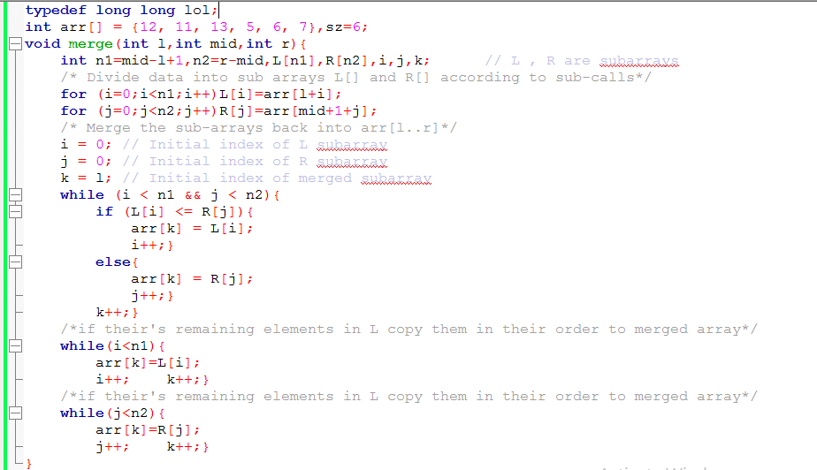
Example 6 Merge Sort
Code:

Slide 23
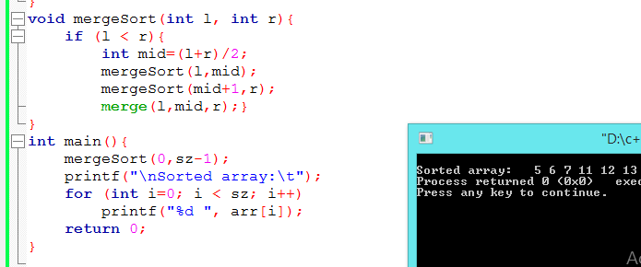
Example 6 Merge Sort
Code :

Slide 24
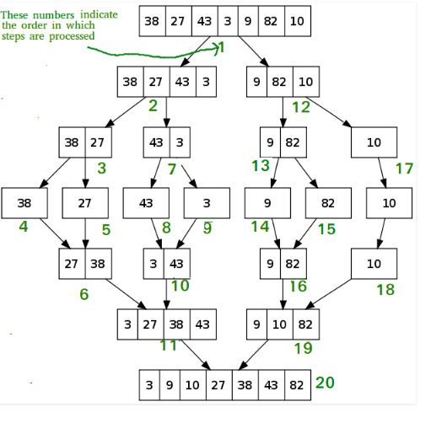
Example 6 Merge Sort
Geeks for geeks example:
Divide
Conquer

Slide 25
Recursion based techniques & Algorithms
Backtracking
DFS
DSU
Recursive DP techniques
Resources for recursion
https://www.geeksforgeeks.org/recursion/
https://www.youtube.com/watch?v=hyk46UmJPS4&t=1353s
Assignment
https://vjudge.net/contest/299151 first 7 problems

Slide 26
Thank You !!
#ACM_BFCI
#Keep_coding

