Slide 1
AirBorder
BKK → HND
→ LAX
Long-haul layover companion
Reference journey
Gate
Weather
Bags
Entry
Map
Return
A passenger-centered mobile assistant for complex international transits, airport changes, baggage handling, and time-sensitive city or airport plans.
Project presentation · July 2026

Slide 2
AIRBORDER
Long-haul transfers create too many moving parts for one screen
AirBorder’s design goal is to turn scattered travel information into one simple sequence: understand the connection, choose what is feasible, and always know how to get back to the gate.
What passengers ask
What changes live
What the UI must do
Do I have enough time? Are my bags transferred? Can I leave the airport? Where can I rest, work, eat, or buy something?
Gate, delay outlook, boarding time, weather, ground transport, facility hours, and the passenger’s current location.
Use short passenger-facing language, keep essential timing visible, and avoid exposing backend calculations unless the user opens supporting details.

Slide 3
AIRBORDER
Persona: an international traveler with a high-friction layover
Needs to know whether she must reclaim and recheck bags.
Alex Chen
38-year-old Singaporean business traveler
Bangkok → Tokyo → Los Angeles
Time-sensitive, budget-aware, carrying checked baggage
Wants a work pod, shower, affordable food, or a short city visit if time allows.
Prefers clear route steps over technical confidence labels.
Needs entry and transit information in plain language, with links kept inside the app.
Success means she reaches boarding calmly, not just that she sees a list of places.

Slide 4
AIRBORDER
Scenario: BKK–HND–LAX, with HND as the fully populated airport
Depart
BKK
Arrive
HND
Layover
Tokyo Haneda
Board
HND
Arrive
LAX
Core question
Additional scenario
Passenger outcome
Can the passenger safely use the layover for rest, work, food, shopping, a hotel, or a city visit?
If flights split across airports, AirBorder handles HND → NRT as a mandatory surface transfer before any optional stop.
The app shows the next action first, then the best options ranked by time, cost, access, fatigue, weather, and route complexity.

Slide 5
AIRBORDER
Storyboard: from ticket scan to boarding
1
2
3
4
5
Import ticket
Before landing
At the airport
Choose a plan
Get back on time
Scan a PDF or add flights manually. The app reads route, dates, airports, and airline context.
Flight progress, weather, and delay outlook update while offline details stay usable.
The journey screen shows the active layover, gate, return plan, and urgent changes.
Compare rest, work, food, shops, airport facilities, nearby hotels, or city options.
Map and AR guidance lead to the selected venue or directly back to the departure gate.

Slide 6
AIRBORDER
User flow: one itinerary, many grounded choices
Add trip
or scan ticket
Complete
traveler profile
Build
layover context
Pick
venue or city plan
Navigate
and receive alerts
The flow stays passenger-facing: “You may need to recheck bags,” “Show route,” “Refresh weather,” and “Return to gate” replace developer language such as thresholds, provenance internals, and route penalty names.

Slide 7
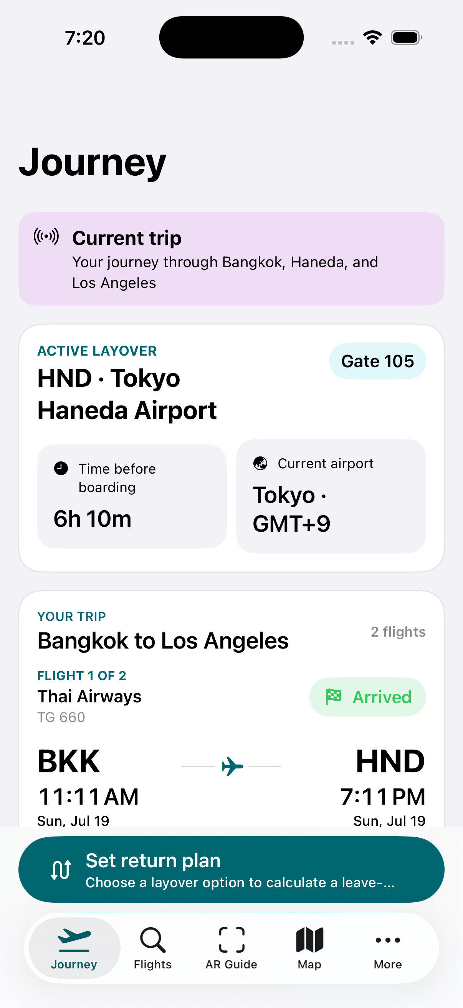
AIRBORDER
Implemented interface: the journey starts with the safest action
A day-of-travel summary shows route, airport, gate, layover, weather, and return status.
The “Return to gate” action is always available because getting back to boarding is the dominant travel goal.
Bottom navigation mirrors familiar airline-app patterns: trip, flights, guide/map, and more options.

Slide 8
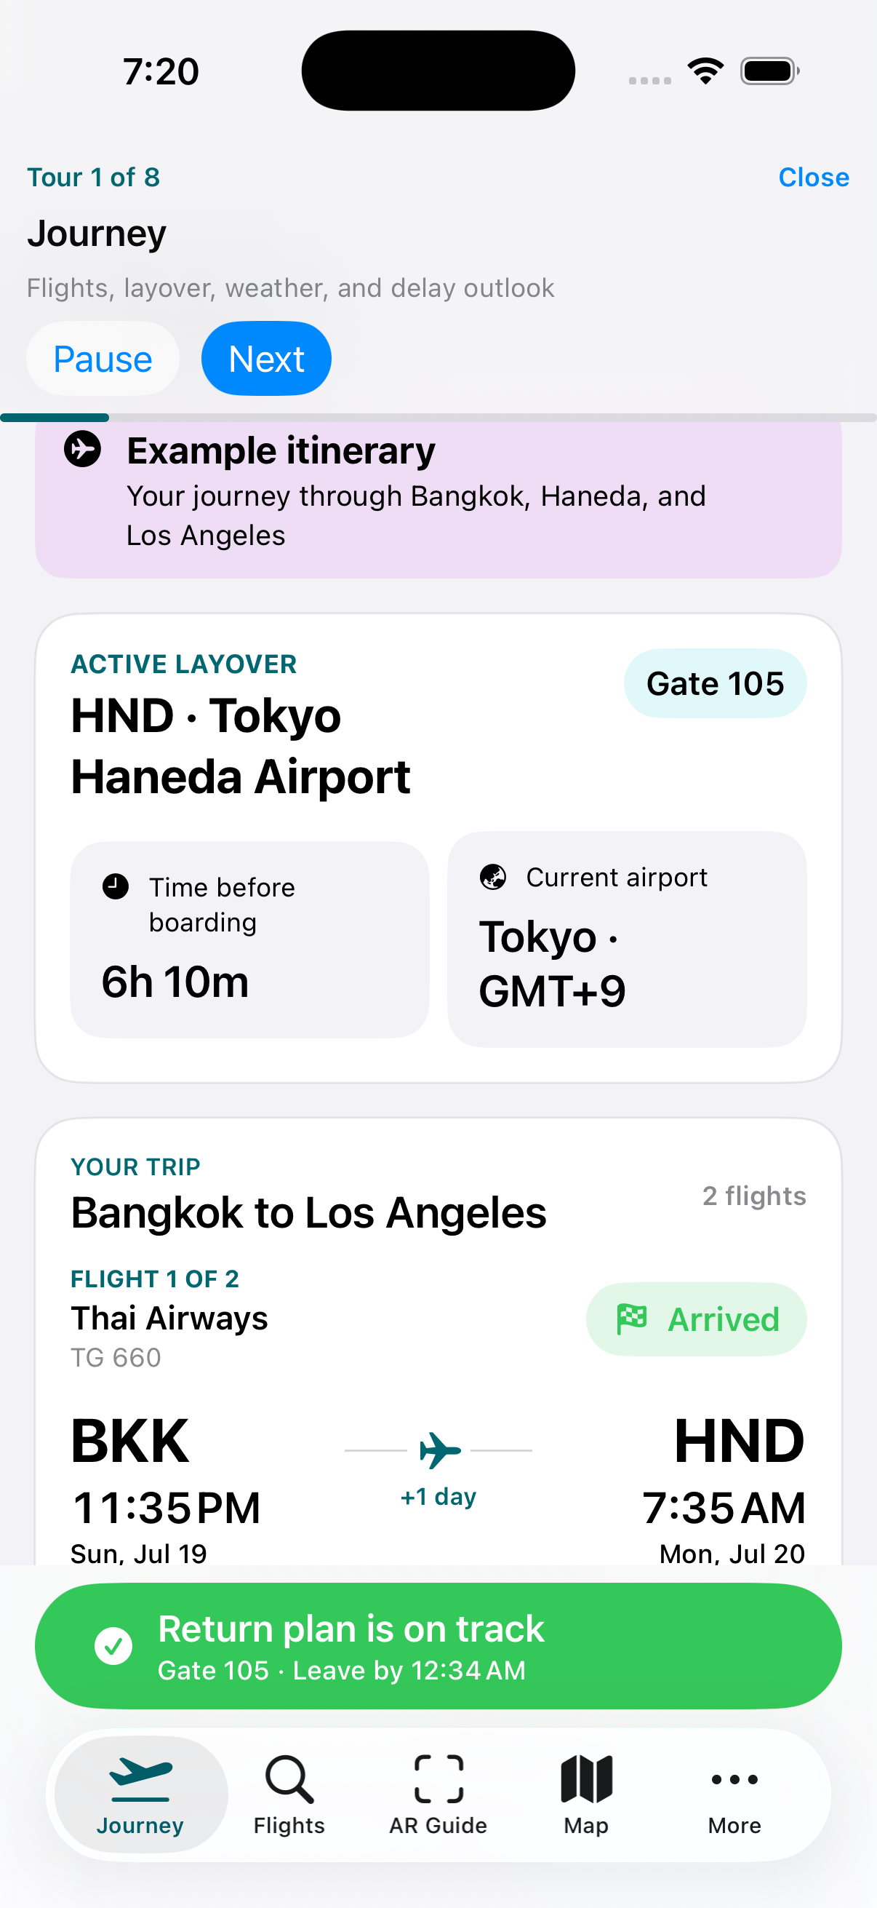
AIRBORDER
Demo mode walks through the system without manual setup
Terminal launch
./Scripts/run-simulator.sh walkthrough
What it shows
Journey overview, passenger details, weather, layover choices, map guidance, AR preview, and return-to-gate behavior.
Why it helps
A reviewer can see the full story even without live provider credentials or a physical-device AR setup.

Slide 9
AIRBORDER
Wireframes organize the app around traveler jobs
Journey
Flights
Layover
Map / AR
Profile
Flight timeline
Gate + boarding
Return route
Weather outlook
Add / scan ticket
Book & bags
Connection steps
Provider refresh
Airport services
Nearby hotels
Food + shops
City visit options
Venue route
Indoor steps
Direction arrows
Back-to-gate
Nationality text
Documents
Budget
Accessibility
Open
Open
Open
Open
Open

Slide 10
AIRBORDER
Design choices follow airline-app conventions and usability principles
Day-of-travel hierarchy
Visible system status
Clear exit path
Delta, American, and Singapore Airlines all foreground trip status, boarding passes, gate changes, and alerts. AirBorder makes the active layover the home screen.
The interface explains current gate, route state, weather, and refresh state in user language so passengers know what changed.
A persistent return-to-gate action acts like an emergency exit: it gets the user back to the main travel objective from any screen.
Sources: Delta mobile app, American Airlines app, SingaporeAir app, Nielsen Norman Group usability heuristics.

Slide 11
AIRBORDER
Architecture separates live facts, cached facts, and personal learning
Itinerary
Traveler profile
Provider proxy
On-device cache
Multi-leg flights, airport changes, gates, and layovers
Nationality, documents, budget, fatigue, accessibility
Flights, hotels, places, facilities, weather, entry links
Freshness rules, replay, private personalization
Build context
Compare plans
Route user
Notify changes
Provider keys stay on the backend/proxy. The app receives normalized facts and only uses private on-device learning for personal walking, queue, route, and preference patterns.

Slide 12
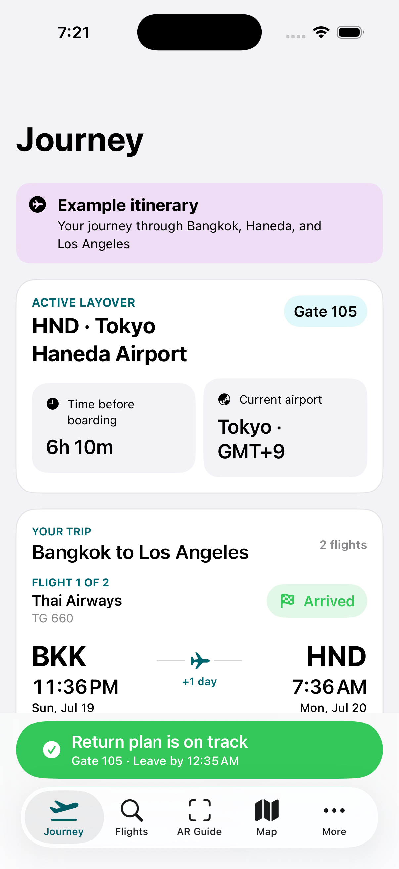
AIRBORDER
Demo and validation are ready for review
Launch commands
demo · walkthrough · ar-preview · weather · city-map · signal-location
Automated checks
Flight operational intelligence: 23 tests, 0 failures. Journey UI smoke test: passed after the launch fix.
Next build priorities
Live provider credentials, real indoor airport map partnerships, physical-device AR testing, and two-device calendar/reminder verification.

Slide 13
AirBorder turns a stressful layover into a clear travel plan.
The system combines itinerary context, airport services, maps, baggage/entry guidance, weather, cost, and alerts into one passenger-facing experience.
Demo: ./Scripts/run-simulator.sh walkthrough

