Slide 1
AirBorder
BKK → HND
→ NRT → LAX
Ticket-driven transfer companion
Reference journey
Gate
Weather
Bags
Entry
Map
Return
A passenger-facing mobile assistant that reads the itinerary, guides airport changes and baggage steps, and supports time-sensitive city or airport plans.
Project presentation · July 2026

Slide 2
AIRBORDER
Long-haul transfers create too many moving parts for one screen
AirBorder’s design goal is to turn scattered travel information into one simple sequence: understand the connection, choose what is feasible, and always know how to get back to the gate.
What passengers ask
What changes live
What the UI must do
Do I have enough time? Are my bags transferred? Can I leave the airport? Where can I rest, work, eat, or buy something?
Gate, delay outlook, boarding time, weather, ground transport, facility hours, and the passenger’s current location.
Use short passenger-facing language, keep essential timing visible, and avoid exposing backend calculations unless the user opens supporting details.

Slide 3
AIRBORDER
Persona: an international traveler with a high-friction layover
Needs to know whether she must reclaim and recheck bags.
Alex Chen
38-year-old Singaporean business traveler
Bangkok → Tokyo → Los Angeles
Time-sensitive, budget-aware, carrying checked baggage
Wants a work pod, shower, affordable food, or a short city visit if time allows.
Prefers clear route steps over technical confidence labels.
Needs entry and transit information in plain language, with links kept inside the app.
Success means she reaches boarding calmly, not just that she sees a list of places.

Slide 4
AIRBORDER
Scenario: BKK–HND–NRT–LAX from an imported ticket
Depart
BKK
Arrive
HND
Transfer
HND → NRT
Board
NRT
Arrive
LAX
Core question
Additional scenario
Passenger outcome
Can the passenger safely use the layover for rest, work, food, shopping, a hotel, or a city visit?
The ticket’s transfer details determine the plan: this self-transfer needs an HND → NRT airport transfer before the next flight.
The app leads with the next action, baggage direction, and the quickest airport-transfer choices, then shows the rest of the plan.

Slide 5
AIRBORDER
Storyboard: from ticket scan to boarding
1
2
3
4
5
Import ticket
Before landing
At the airport
Choose a plan
Get back on time
Import a PDF, image, or saved ticket. The app reads the route, airports, transfer type, and baggage direction.
Flight progress, weather, and delay outlook update while offline details stay usable.
The journey screen shows the active connection, baggage step, route, gate, and urgent changes.
Compare rest, work, food, shops, airport facilities, nearby hotels, or city options.
Map, globe, and AR guidance lead through the airport, between airports, or to a city stop and back to the gate.

Slide 6
AIRBORDER
User flow: one itinerary, many grounded choices
Import
ticket
Read route,
transfer & bags
Build
connection plan
Choose
airport or city plan
Navigate
and receive alerts
The app uses direct travel language: “Collect bags at HND,” “Transfer to NRT,” “Show route,” and “Return to gate.” Ticket details determine the connection steps.

Slide 7
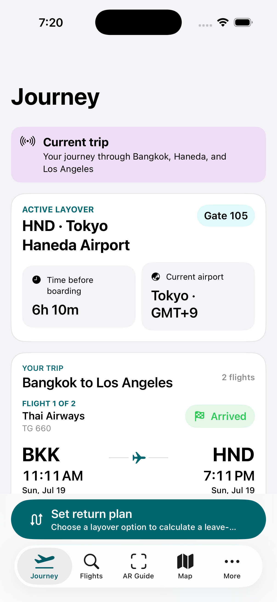
AIRBORDER
Implemented interface: the journey starts from the ticket
A day-of-travel summary shows the ticket route, active airport, gate, baggage step, weather, and return plan.
Guidance stays available from airport to airport and through a city stop, with the departure gate kept in view.
Bottom navigation mirrors familiar airline-app patterns: trip, flights, guide/map, and more options.

Slide 8
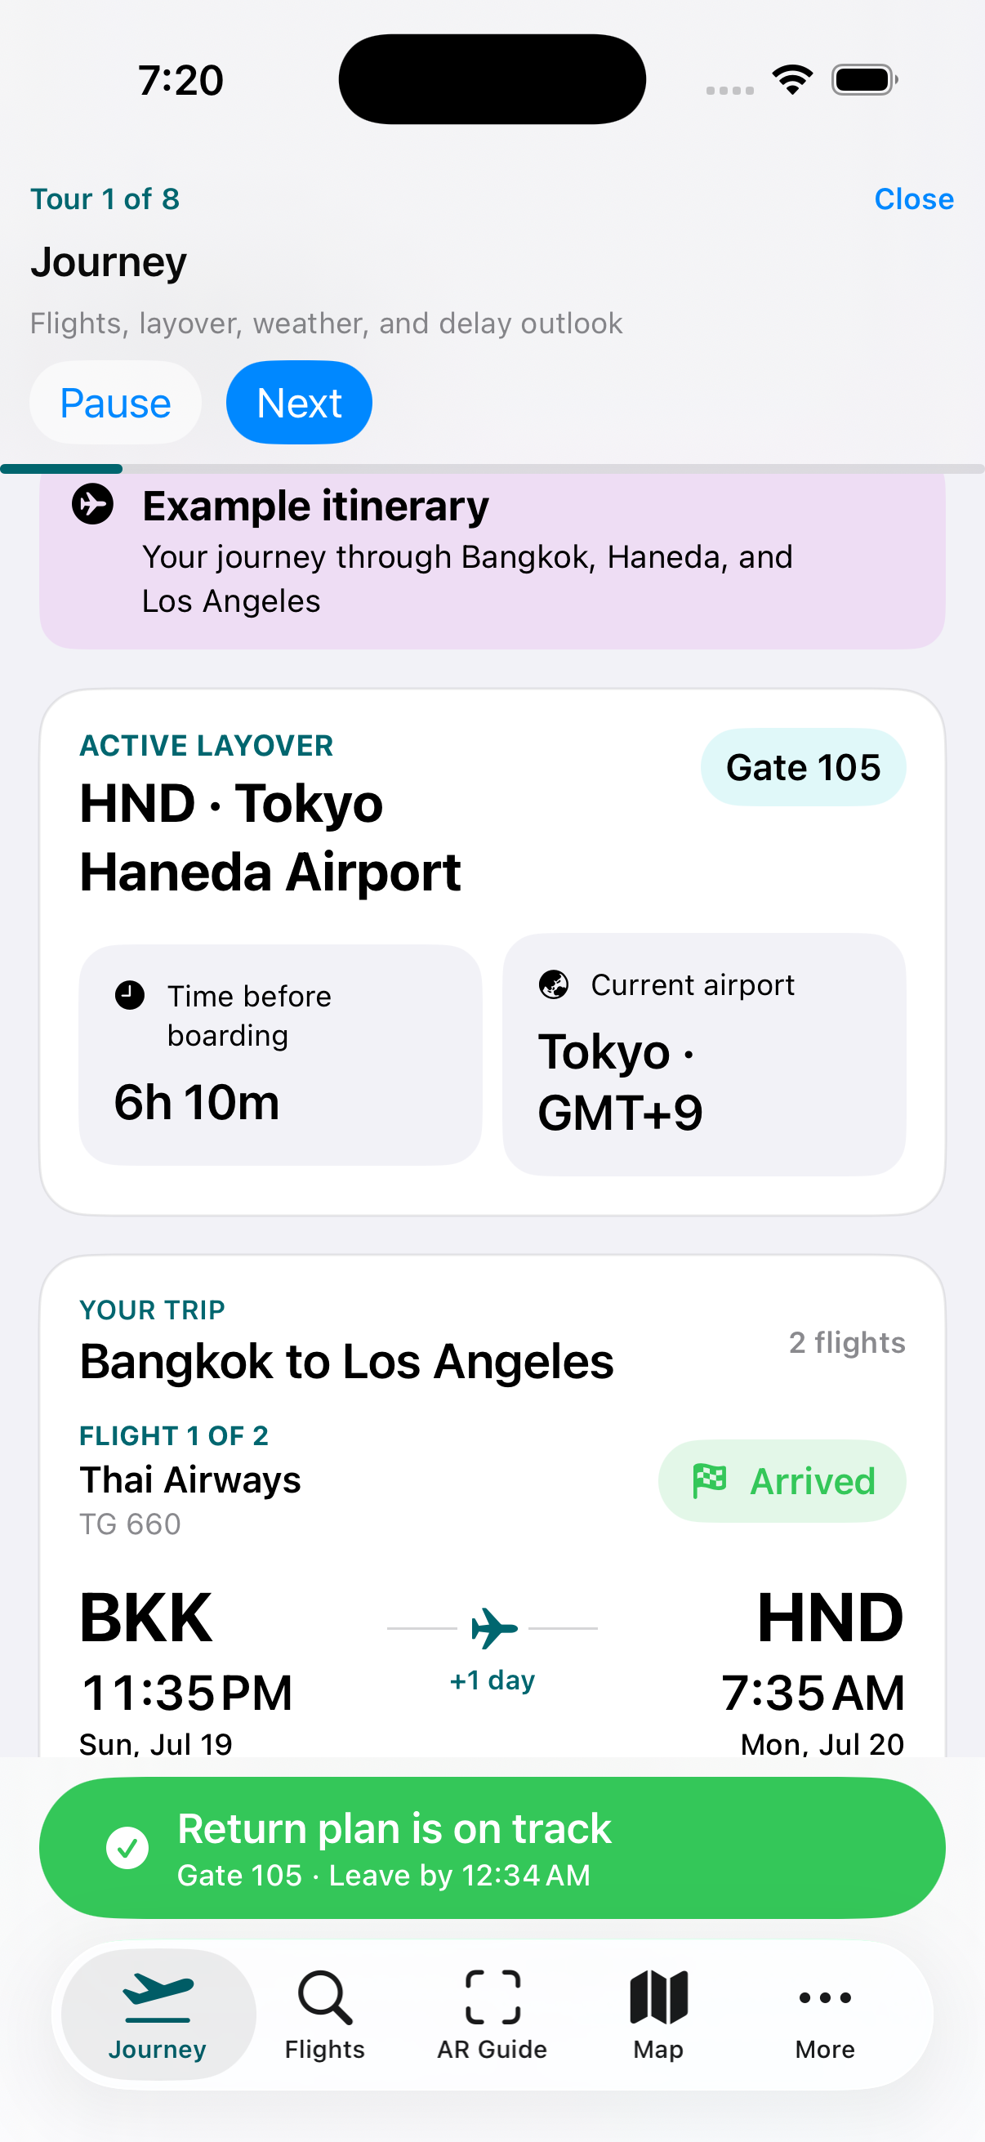
AIRBORDER
Demo mode walks through the system without manual setup
Terminal launch
See Build-and-Device-Test.md
What it shows
Imported ticket route, baggage direction, self-transfer or automatic transfer, global airport map guidance, AR preview, and return-to-gate behavior.
Why it helps
The repository includes a sample BKK → HND → NRT → LAX ticket and instructions for Simulator or an iPhone build.

Slide 9
AIRBORDER
Wireframes organize the app around traveler jobs
Journey
Flights
Layover
Map / AR
Profile
Flight timeline
Gate + boarding
Return route
Weather outlook
Add / scan ticket
Book & bags
Connection steps
Provider refresh
Airport services
Nearby hotels
Food + shops
City visit options
Venue route
Indoor steps
Direction arrows
Back-to-gate
Nationality text
Documents
Budget
Accessibility
Open
Open
Open
Open
Open

Slide 10
AIRBORDER
Design choices follow airline-app conventions and usability principles
Day-of-travel hierarchy
Visible system status
Clear exit path
Delta, American, and Singapore Airlines all foreground trip status, boarding passes, gate changes, and alerts. AirBorder makes the active layover the home screen.
The interface explains current gate, route state, weather, and refresh state in user language so passengers know what changed.
A persistent return-to-gate action acts like an emergency exit: it gets the user back to the main travel objective from any screen.
Sources: Delta mobile app, American Airlines app, SingaporeAir app, Nielsen Norman Group usability heuristics.

Slide 11
AIRBORDER
Algorithms turn ticket facts into a connection plan
Itinerary
Traveler profile
Provider proxy
On-device cache
Route, airport changes, transfer type, baggage direction, and boarding deadline
Walking preference, accessibility needs, budget, and traveller time buffer
AirportDirectory, MapKit search, time-dependent routes, weather, and places
Saved tickets, offline fixtures, personal preferences, and timing observations
Parse ticket
Estimate time
Rank routes
Update plan
Connection slack: S = T(board) − [T(transfer) + T(bags) + T(entry) + T(security) + T(walk) + buffer]. A plan is feasible when S ≥ 0; route ranking minimises time, transfers, walking, and disruption.

Slide 12
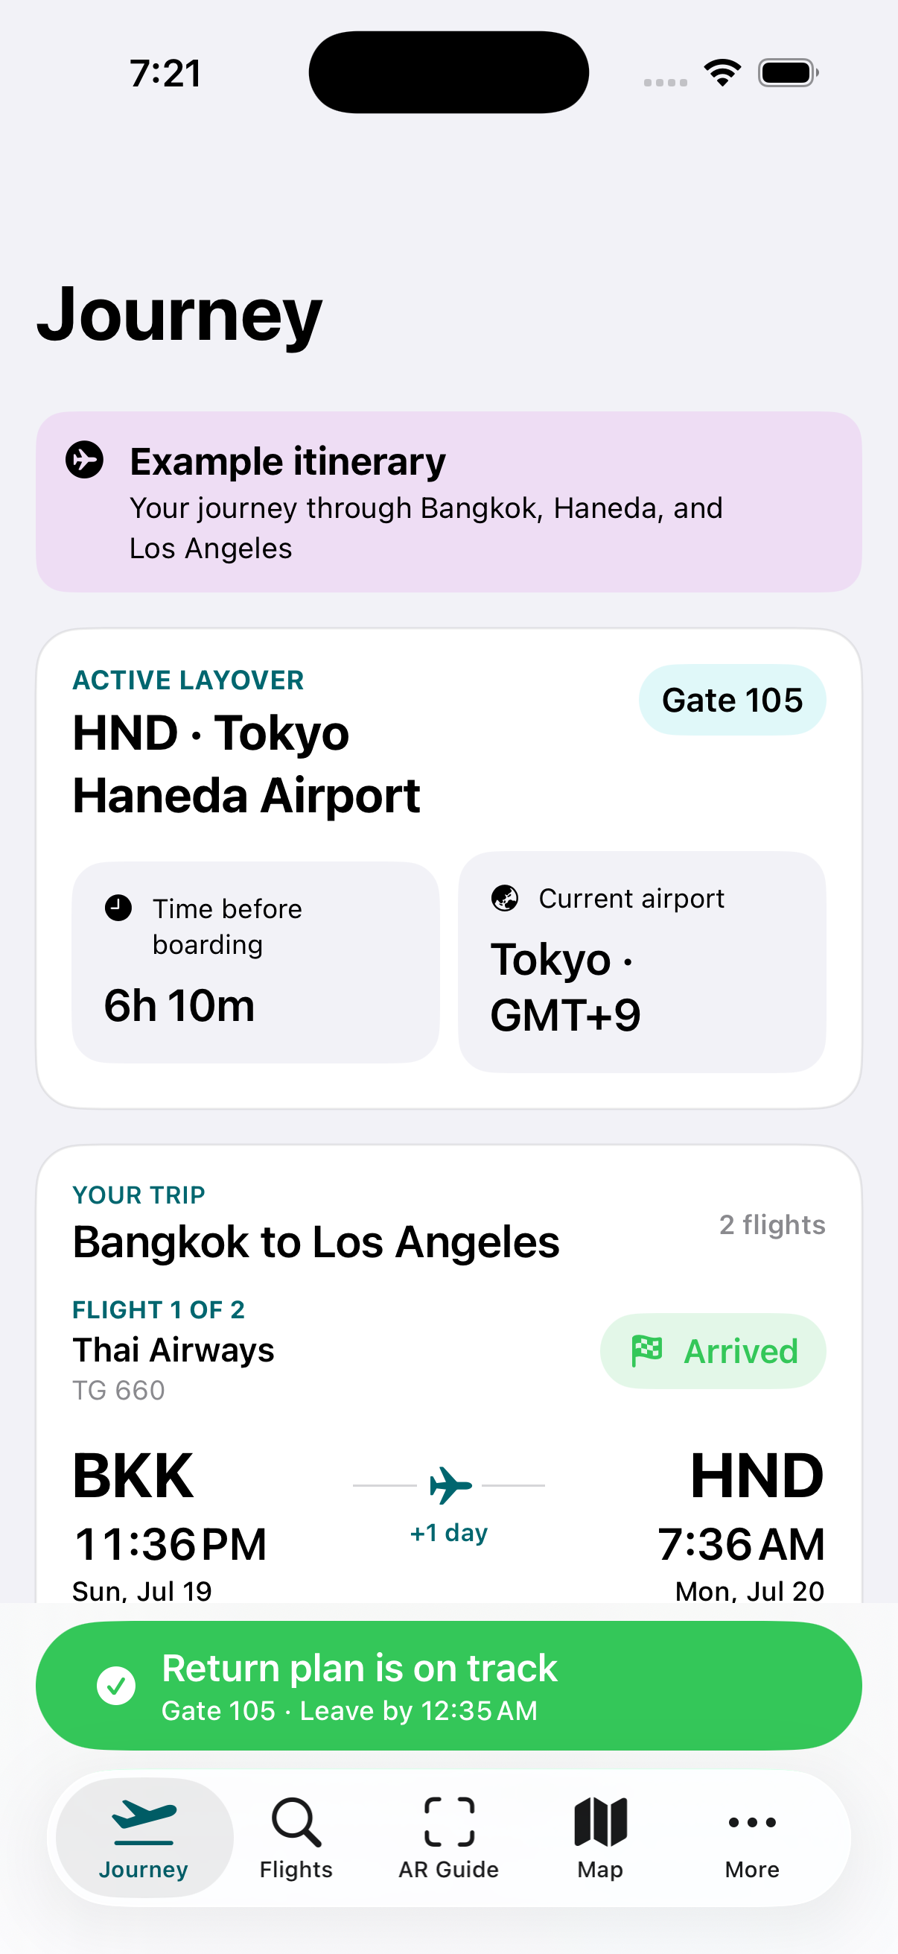
AIRBORDER
Validation and research pathway
Launch commands
Ticket fixture · Simulator walkthrough · AR preview · city map
Automated checks
106 automated tests passed. The fixture verifies BKK → HND → NRT → LAX, ticket-derived baggage handling, and airport-transfer behaviour.
Next build priorities
Research next: model transfer components as probability distributions, estimate P(on time), calibrate against observed journeys, and optimise reliability, walking, cost, and accessibility together.

Slide 13
AirBorder turns a stressful layover into a clear travel plan.
AirBorder turns an imported itinerary into a clear connection plan with transfer, baggage, maps, globe, AR, and return-to-gate guidance.
Build: GitHub → Build-and-Device-Test.md

