Slide 1
CSSSKL 342: Programming Issues With Object-Oriented Languages
Kelvin Sung
Email: ksung@uw.edu

Slide 2
You are …
First quarter at UWB?
First quarter as CSS student?
Java or C#
Linux, C++
All taking CSS342?
Do well in 342 and … good things will come >$100K job!

Slide 3
We are
Jun Zhen: who has taken CSS342SKL (used to be CSS332)
Office: UW1-260 Common area, please NOT LOUD
Jaishun Gou: 1st year grad students
Office: UW1-260 Common area, please NOT LOUD
Kelvin Sung: Old dude never leaves
My background
Graphics + Videogames
My faculty page
My research, need: Mainly CSS342!

Slide 4
Learning Goals [big to small]
Learn how to learn programming languages
Learn a [new] OS
Learn C++

Slide 5
Approach to learning
How to learn programming languages: Syllabus of this class
Tools ➔ Format ➔ I/O + Arrays (Nuances: memory management)
Classes: how to: subclass, override,
Templates, iterator [advanced features in the language]
APIs (e.g., Vectors, Lists, Maps)
Stuff you learn in CSS342
Learn OS
Work in the environment
Constant compare to Windows or MACs ➔THEY ARE THE SAME!

Slide 6
Learn C++
Smallest goal, but most important for now
Do the Labs
Ask Questions, ASK QUESTIONS
When done with labs
Try variations, invent new problems to try out
Do Java exercise you have done in CS142/143 in C++
Create the positive feedback look
More you do ➔ better you do ➔becomes fun ➔want to do more

Slide 7
About the course
Canvas
https://canvas.uw.edu/courses/1342191
Syllabus
Class meets once a week: Friday 1:15pm to 5:15pm
Video tutorials, assignments, and the course evaluation
Maybe helpful for Mac and Linux users
I am not responsible for your laptop, if your laptop does not work, please go work in the Linux Lab!
C++
www.cplusplus.com
Books listed in the syllabus
Goals – applying what you have learned about data structures and algorithms in C++
Pick up an existing project written in C++
Start a new project using C++
Transform a project from other programming languages to C++

Slide 8
Grades
Pass/Fail: do not count towards GPA, do not affect your graduation
So, how about it? Let’s learn without worries!
You MUST participate!
You must SUBMIT every assignment
You must show an honest effort has been made
“An honest effort” some/most things work.
We will download, compile, run, examine

Slide 9
Our remote machine
csslabx.uwb.edu where 1 < x < 12
In our labs, ALWAYS compile with:
g++ -std=c++11 all small case!

Slide 10
Important Resources
Go to this page: off our course canvas site
Make sure you know how to connect to our Linux machines
Look at the videos made by Professor Pisan
Make sure you know the basics of working on Linux
Follow the links of CSS342 Guidemap
Know how to login, create/navigate among directories (folders)
Have access to at least one text editor (e.g., nano, or pico): edit/save files

Slide 11
Linux Basic
File system: Absolute vs Relative
Shell and Commands
Folder/Directory: mkdir, rmdir, ls
Navigation: cd
Remove file: rm
Editor: vim [KEY: modes + save and exit]
Compile
g++ -std=c++11 <-E -S -c -o>
-E: include
-S: include + compile
-c: include + compile + assemble
-o: include + compile + assemble + link

Slide 12
C++ 101

Slide 13
Development Environment
Windows
IDEs: Visual studio 2012, 2013, and 2015, Eclipse CDT, etc.
Create a solution
Create/Add projects
Add items: .cpp, .h, .txt, etc.
Set breakpoint for debugging
Execute your program with or without debugging
Linux
IDEs: Eclipse CDT, NetBeans, etc.
GNU toolchains (What to do when there is no IDE)
g++: e.g., g++ -o CompiledFileName.o SourceFileName.cpp
gdb: e.g., gdb CompiledFileName.o
Mac
IDE: Xcode
GNU toolchains

Slide 14
Main program – The entry point
void main() ⬅NOT TRUE in general.
when you don’t care about arguments and exit code
int main()
when you care about the exit code
return 0 by default
int main(int argc, char* argv[])
when you care about arguments and the exit code
argc: number of arguments
argv: actual arguments
The program name is actually the first argument
int main()
{
}

Slide 15
iostream
C++
#include <iostream>
Using namespace std;
cin, cout, cerr, clog
cin vs. std::cin
cout vs. std::cout
cout vs. cerr: different output streams, cout is buffered
cout << “string xxxx” << variable << “string xxxxx” <<endl;
cerr << “string xxxx” << variable << “string xxxxx” <<endl;
cin >> variable1 >> variable2;
JAVA
System.out.print(“hello ”);
System.out.println(“world”);
BufferedReader in = new BufferedReader(new
InputStreamReader(System.in));
String text = in.readLine();

Slide 16
Type Conversion

Slide 17
Explicit Conversions
C++ is a strong-typed language
C-like casting
Functional
Casting Operators
new_type variable = static_cast <new_type> (old_type_expression)
new_type variable = dynamic_cast <new_type> (old_type_expression)
new_type variable = const_cast <new_type> (old_type_expression)
new_type variable = reinterpret_cast <new_type> (old_type_expression)
double x = 1.1;
int y = (int) x
int y = int (x)
More about const_cast:
https://www.geeksforgeeks.org/casting-operators-in-c-set-1-const_cast/

Slide 18
Pass by Reference

Slide 19
“Pass by reference” vs. “Pass by value”
Reference
Aliases only
No storage need be allocated
Can only be initialized
Can never be changed later
Cannot be null
No need to dereference
C++: “pass by value” is the default behavior
Advantages? Easy coding, easy management, protection, etc.
Disadvantages? A copy in stack will be created

Slide 20
File Operation

Slide 21
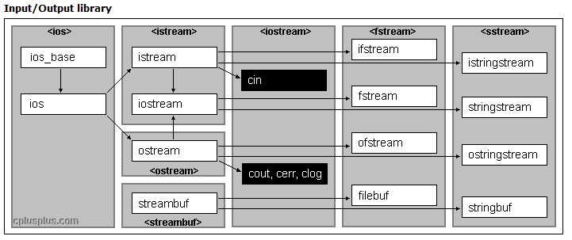
File I/O
#include <fstream>
outFileStream << variable
inFileSteam >> variable

Slide 22
What to submit in your .zip file
Primitive3.cpp – write by yourself
FileOperationPractice.cpp – write by yourself
AnswersToReferenceDemo.txt – answer all questions
AnswersToFileDemo.txt – answer all questions
Zip All!

