Slide 1

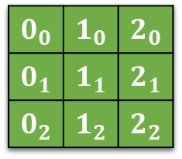
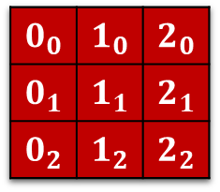
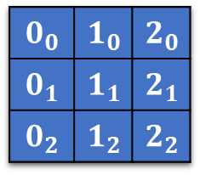
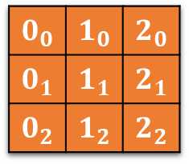

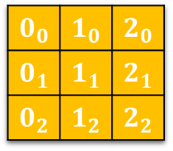

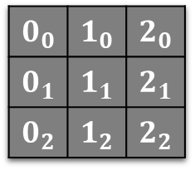

$$0_{2}$$ | $$1_{2}$$ | $$2_{2}$$
$$0_{0}$$ | $$1_{0}$$ | $$2_{0}$$
$$0_{1}$$ | $$1_{1}$$ | $$2_{1}$$
$$0_{2}$$ | $$1_{2}$$ | $$2_{2}$$
$$2_{0}$$
$$2_{1}$$
$$2_{2}$$
$$0_{0}$$ | $$1_{0}$$ | $$2_{0}$$
$$0_{1}$$ | $$1_{1}$$ | $$2_{1}$$
$$0_{2}$$ | $$1_{2}$$ | $$2_{2}$$
$$0_{0}$$ | $$1_{0}$$ | $$2_{0}$$
$$0_{1}$$ | $$1_{1}$$ | $$2_{1}$$
$$0_{2}$$ | $$1_{2}$$ | $$2_{2}$$
$$0_{0}$$ | $$1_{0}$$ | $$2_{0}$$
$$0_{1}$$ | $$1_{1}$$ | $$2_{1}$$
$$0_{2}$$ | $$1_{2}$$ | $$2_{2}$$
$$0_{0}$$
$$0_{1}$$
$$0_{2}$$
$$0_{0}$$ | $$1_{0}$$ | $$2_{0}$$
$$0_{1}$$ | $$1_{1}$$ | $$2_{1}$$
$$0_{2}$$ | $$1_{2}$$ | $$2_{2}$$
$$0_{0}$$ | $$1_{0}$$ | $$2_{0}$$
$$0_{1}$$ | $$1_{1}$$ | $$2_{1}$$
$$0_{2}$$ | $$1_{2}$$ | $$2_{2}$$
$$0_{0}$$ | $$1_{0}$$ | $$2_{0}$$

Slide 2
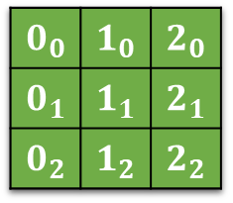
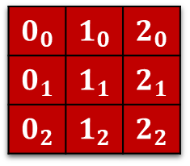
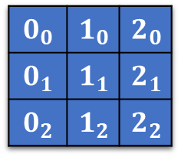
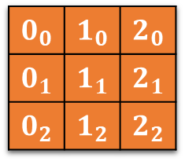
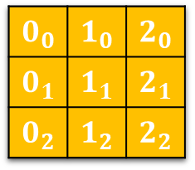

$$0_{0}$$ | $$1_{0}$$ | $$2_{0}$$
$$0_{1}$$ | $$1_{1}$$ | $$2_{1}$$
$$0_{2}$$ | $$1_{2}$$ | $$2_{2}$$
$$0_{0}$$ | $$1_{0}$$ | $$2_{0}$$
$$0_{1}$$ | $$1_{1}$$ | $$2_{1}$$
$$0_{2}$$ | $$1_{2}$$ | $$2_{2}$$
$$0_{0}$$ | $$1_{0}$$ | $$2_{0}$$
$$0_{1}$$ | $$1_{1}$$ | $$2_{1}$$
$$0_{2}$$ | $$1_{2}$$ | $$2_{2}$$
$$0_{0}$$ | $$1_{0}$$ | $$2_{0}$$
$$0_{1}$$ | $$1_{1}$$ | $$2_{1}$$
$$0_{2}$$ | $$1_{2}$$ | $$2_{2}$$
$$0_{0}$$ | $$1_{0}$$ | $$2_{0}$$
$$0_{1}$$ | $$1_{1}$$ | $$2_{1}$$
$$0_{2}$$ | $$1_{2}$$ | $$2_{2}$$
$$0_{0}$$ | $$1_{0}$$ | $$2_{0}$$
$$0_{1}$$ | $$1_{1}$$ | $$2_{1}$$
$$0_{2}$$ | $$1_{2}$$ | $$2_{2}$$

