Slide 1

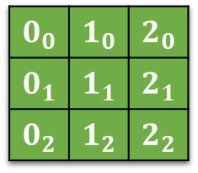
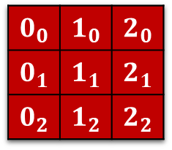
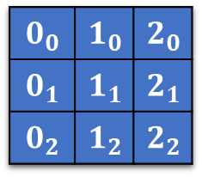
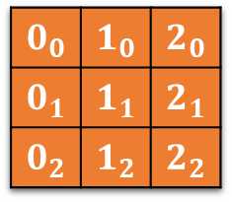

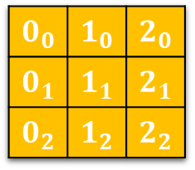

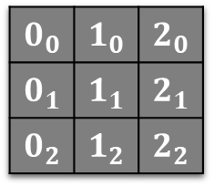

$$0_{2}$$ | $$1_{2}$$ | $$2_{2}$$
$$0_{0}$$ | $$1_{0}$$ | $$2_{0}$$
$$0_{1}$$ | $$1_{1}$$ | $$2_{1}$$
$$0_{2}$$ | $$1_{2}$$ | $$2_{2}$$
$$2_{0}$$
$$2_{1}$$
$$2_{2}$$
$$0_{0}$$ | $$1_{0}$$ | $$2_{0}$$
$$0_{1}$$ | $$1_{1}$$ | $$2_{1}$$
$$0_{2}$$ | $$1_{2}$$ | $$2_{2}$$
$$0_{0}$$ | $$1_{0}$$ | $$2_{0}$$
$$0_{1}$$ | $$1_{1}$$ | $$2_{1}$$
$$0_{2}$$ | $$1_{2}$$ | $$2_{2}$$
$$0_{0}$$ | $$1_{0}$$ | $$2_{0}$$
$$0_{1}$$ | $$1_{1}$$ | $$2_{1}$$
$$0_{2}$$ | $$1_{2}$$ | $$2_{2}$$
$$0_{0}$$
$$0_{1}$$
$$0_{2}$$
$$0_{0}$$ | $$1_{0}$$ | $$2_{0}$$
$$0_{1}$$ | $$1_{1}$$ | $$2_{1}$$
$$0_{2}$$ | $$1_{2}$$ | $$2_{2}$$
$$0_{0}$$ | $$1_{0}$$ | $$2_{0}$$
$$0_{1}$$ | $$1_{1}$$ | $$2_{1}$$
$$0_{2}$$ | $$1_{2}$$ | $$2_{2}$$
$$0_{0}$$ | $$1_{0}$$ | $$2_{0}$$

Slide 2
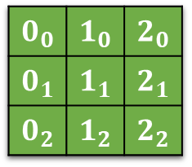
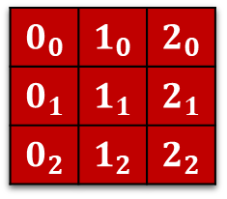
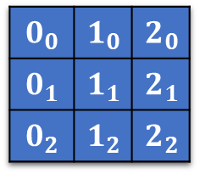
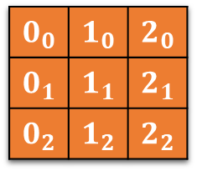
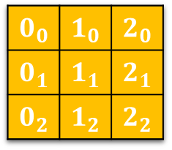

$$0_{0}$$ | $$1_{0}$$ | $$2_{0}$$
$$0_{1}$$ | $$1_{1}$$ | $$2_{1}$$
$$0_{2}$$ | $$1_{2}$$ | $$2_{2}$$
$$0_{0}$$ | $$1_{0}$$ | $$2_{0}$$
$$0_{1}$$ | $$1_{1}$$ | $$2_{1}$$
$$0_{2}$$ | $$1_{2}$$ | $$2_{2}$$
$$0_{0}$$ | $$1_{0}$$ | $$2_{0}$$
$$0_{1}$$ | $$1_{1}$$ | $$2_{1}$$
$$0_{2}$$ | $$1_{2}$$ | $$2_{2}$$
$$0_{0}$$ | $$1_{0}$$ | $$2_{0}$$
$$0_{1}$$ | $$1_{1}$$ | $$2_{1}$$
$$0_{2}$$ | $$1_{2}$$ | $$2_{2}$$
$$0_{0}$$ | $$1_{0}$$ | $$2_{0}$$
$$0_{1}$$ | $$1_{1}$$ | $$2_{1}$$
$$0_{2}$$ | $$1_{2}$$ | $$2_{2}$$
$$0_{0}$$ | $$1_{0}$$ | $$2_{0}$$
$$0_{1}$$ | $$1_{1}$$ | $$2_{1}$$
$$0_{2}$$ | $$1_{2}$$ | $$2_{2}$$

Slide 3
0 | 1 | 2
3 | 4 | 5
6 | 7 | 8
Rotate left:
Row 1
9 – 20: shiftLeft x 3
0 – 8: rotate CW 90 degrees
Row 2
21 – 32 shiftLeft x 3
Row 3
33 – 44 shiftLeft x 3
45 – 53 rotate CCW 90 degrees
9 | 10 | 11
21 | 22 | 23
33 | 34 | 35
12 | 13 | 14
24 | 25 | 26
36 | 37 | 38
15 | 16 | 17
27 | 28 | 29
39 | 40 | 41
18 | 19 | 20
30 | 31 | 32
42 | 43 | 44
Rotate right:
Row 1
9 – 20: shiftRight x 3
0 – 8: rotate CCW 90 degrees
Row 2
21 – 32 shiftRight x 3
Row 3
33 – 44 shiftRight x 3
45 – 53 rotate CW 90 degrees
45 | 46 | 47
48 | 49 | 50
51 | 52 | 53

Slide 4
UP:
Green left:
0 3 6 12 24 36 45 48 51 shiftUp x 3
9 – 11, 21 – 23, 33 – 35 rotate CCW 90 degrees
Green Middle:
1 4 7 13 25 37 46 49 52 shiftUp x 3
0 | 1 | 2
3 | 4 | 5
6 | 7 | 8
9 | 10 | 11
21 | 22 | 23
33 | 34 | 35
12 | 13 | 14
24 | 25 | 26
36 | 37 | 38
15 | 16 | 17
27 | 28 | 29
39 | 40 | 41
18 | 19 | 20
30 | 31 | 32
42 | 43 | 44
45 | 46 | 47
48 | 49 | 50
51 | 52 | 53

