Slide 1
DOMINO
A
Family Resilience Intelligence System
K
“When one thing changes, everything connects.”
Y
6th Annual COE STEM Programming with AI Competition · AI for Family
N
May Ahmed Mourad · Grade 12
Shamsa Faris Almazrouei · Grade 12
Fatima Mohamed Almazrouei · Grade 11
ADNOC Schools — Madinat Zayed
Concept rendering: entities of the fictional Amina household
Notes:
Opening (20 seconds). DOMINO is a Family Resilience Intelligence System: it models a household as a connected system and calculates how a family can recover when a plan breaks. Our line is: when one thing changes, everything connects.
We are May Ahmed Mourad and Shamsa Faris Almazrouei from Grade 12, and Fatima Mohamed Almazrouei from Grade 11, from ADNOC Schools — Madinat Zayed. The project is built for the theme AI for Family in Cycle 3.
RECOMMENDED SHORTER ORAL PATH (no extra slides needed): 1 cover, 2 problem, 3 hidden system, 5 solution, 9 computational recovery, 11 architecture, 17 cascade, 18 recovery, 23 verification, 25 when recovery is impossible, 26 evidence, 28 impact, 30 close. That is thirteen slides and fits a five to seven minute pitch. The remaining slides are for judges reading the submission independently.
Evidence basis: see EVIDENCE_LEDGER.md in the presentation folder.

Slide 2
One disruption, multiple consequences
ACT I · THE PROBLEM
At 2:30 PM, Amina becomes
unavailable until 6:00 PM.
DISRUPTION · 14:30
Original plan (fixture) · shaded = available · hatched = unavailable
14:30
15:00
15:30
16:00
16:30
17:00
17:30
18:00
18:30
19:00
Amina
School pickup
Grocery
Homework
adult
Khalid
Dinner
adult
Noura
teen
School pickup · Tier 0 · essential
Homework assistance · Tier 1
Grocery collection · Tier 3
Dinner (Khalid) is not obviously affected.
Source: data/households/amina.json (fictional household). Times are Asia/Dubai, simulated date 29 Oct 2026.
Notes:
Start with a moment, not a technology. It is 2:30 in the afternoon. Amina, one of two adults in this fictional family, becomes unavailable until 6 PM.
Look at what the original plan asked of her: school pickup at 14:45, groceries at 15:55 and homework help at 16:45. Three responsibilities that looked independent in a calendar are suddenly all broken at once. Dinner belongs to Khalid, so it is not obviously affected.
The important point is that the three broken tasks are not equal. Collecting a nine-year-old from school is essential; groceries can wait. A calendar shows three red boxes. It does not tell the family which one matters most, who is legally and practically able to replace Amina, or what depends on what. That is the gap DOMINO addresses.
Data: every time, task and person on this slide comes from the Amina household fixture (data/households/amina.json). Transition: so what is the hidden structure behind those three boxes?
Evidence basis: see EVIDENCE_LEDGER.md in the presentation folder.

Slide 3
The hidden system behind family life
ACT I · THE PROBLEM
3 responsibilities → 1 caregiver
Amina
adult · 41
Khalid
adult · 43
Noura
teen · 16
Yusuf
dependent
Pickup, groceries and homework are all assigned to Amina.
School pickup
14:45–15:25
Family sedan
vehicle · 5
A shared vehicle
Child restraint
cap 1
Pickup and groceries both need the same sedan, one at a time.
Grocery
15:55–16:30
Yusuf arrived home
milestone M01
Homework area
cap 1
Homework
16:45–17:15
A gating milestone
Homework can only happen after “Yusuf arrived home”.
Home kitchen
cap 1
Dinner
17:30–18:00
solid = assigned to / enables dashed = uses resource dotted arrow = depends on / serves dependent
Source: Amina fixture; edge types from backend/app/services/dependency_graph.py. Native, editable diagram.
Notes:
This is the same household drawn as a system. People at the top, responsibilities below the person who owns them, shared resources on the right, and one milestone: Yusuf arrived home.
The lines are not decoration. Each one has a type with a defined meaning in the software: assigned-to, uses-resource, enables, depends-on, serves-dependent. School pickup enables the milestone Yusuf arrived home; homework assistance depends on that milestone. So homework is linked to Amina twice: directly, because she is assigned, and indirectly, because it can only happen after pickup.
Also notice the shared things. One sedan and one child restraint are needed for pickup; groceries need the same sedan. Time is a resource too: nobody can do two things at once.
That is why a single unavailable caregiver can affect several dependent responsibilities. Transition: a normal calendar stores none of these relationships — let us compare.
Evidence basis: see EVIDENCE_LEDGER.md in the presentation folder.

Slide 4
Why calendars and task lists are not enough
ACT I · THE PROBLEM
Function | Typical calendar / task list | DOMINO | Slide
Records scheduled events | Yes — its core purpose | ✓ Household model with baseline schedule | S07
Models dependency relationships | Typically limited or absent | ✓ Typed graph: assigned-to, enables, depends-on … | S12
Detects cascading consequences | Typically limited or absent | ✓ Direct and downstream impact with causal paths | S17
Calculates feasible alternatives | Typically limited or absent | ✓ CP-SAT optimization with priority tiers | S21
Verifies constraints | Typically limited or absent | ✓ Independent 18-rule verifier | S23
Supports counterfactual comparison | Typically limited or absent | ✓ Recomputed what-if side by side | S19
This compares common scheduling functions with the broader requirements of recovering from a disruption. Individual products vary; no claim is made about any specific product.
Notes:
We are careful here: we are not saying every product lacks these features. This compares common scheduling functions — a shared calendar or a to-do list — with what a disruption actually requires.
A calendar is excellent at recording that something is scheduled. What it typically does not do is know that the school pickup enables the homework session, detect that moving one task threatens another, calculate a legal alternative, check that alternative against permissions and resources, or let you ask what if Khalid is also unavailable.
The right-hand column is not a claim of perfection; each row points to the slide where we demonstrate it and to a test in our benchmark suite. Transition: so what is DOMINO, in one sentence?
Evidence basis: see EVIDENCE_LEDGER.md in the presentation folder.

Slide 5
The DOMINO solution
ACT I · THE PROBLEM → THE SOLUTION
DOMINO calculates how a family can recover when its original plan becomes impossible.
1 Understand
2 Analyze
3 Optimize
4 Verify
5 Review
Text, preset or form becomes a structured event. A human confirms it.
A typed dependency graph finds direct and downstream consequences.
CP-SAT searches legal reassignments; essential tasks first.
A separate module re-checks every rule from raw data.
A human approves — or sees exactly what still needs them.
Gemini + built-in parser
NetworkX graph
OR-Tools CP-SAT
Independent verifier
Human in the loop
DOMINO simulates the consequences of specified, hypothetical events. It does not predict the probability of emergencies.
Notes:
Here is the whole product in under thirty seconds. DOMINO calculates how a family can recover when its original plan becomes impossible.
Five steps. One: understand — a sentence, a preset or a form becomes a structured event, and a human confirms it. Two: analyze — a dependency graph finds what is directly broken and what is threatened downstream. Three: optimize — Google OR-Tools CP-SAT searches for legal reassignments, protecting essential tasks first. Four: verify — a separate module that shares no code with the solver re-checks every rule. Five: review — a human approves, and anything that cannot be covered is shown as unresolved rather than hidden.
Two design decisions matter for responsible AI. Language AI only interprets text; it never produces a schedule. And DOMINO simulates hypothetical events; it does not predict how likely an emergency is. Transition: first, who are the families we tested on?
Evidence basis: see EVIDENCE_LEDGER.md in the presentation folder.

Slide 6
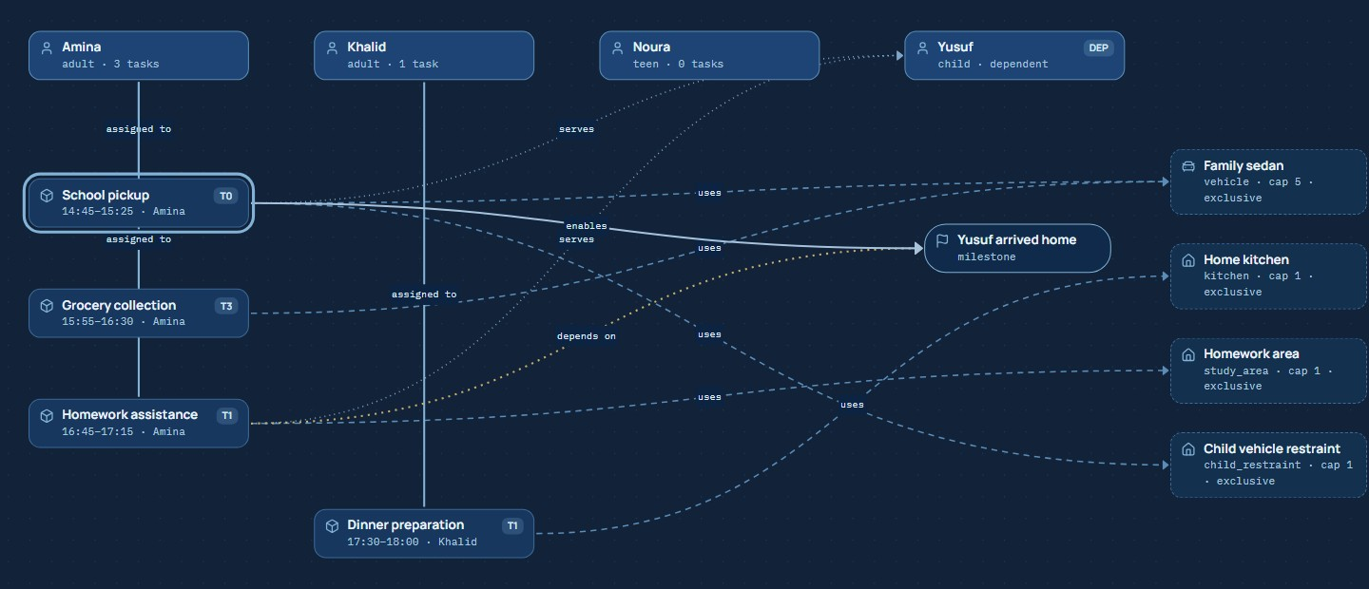
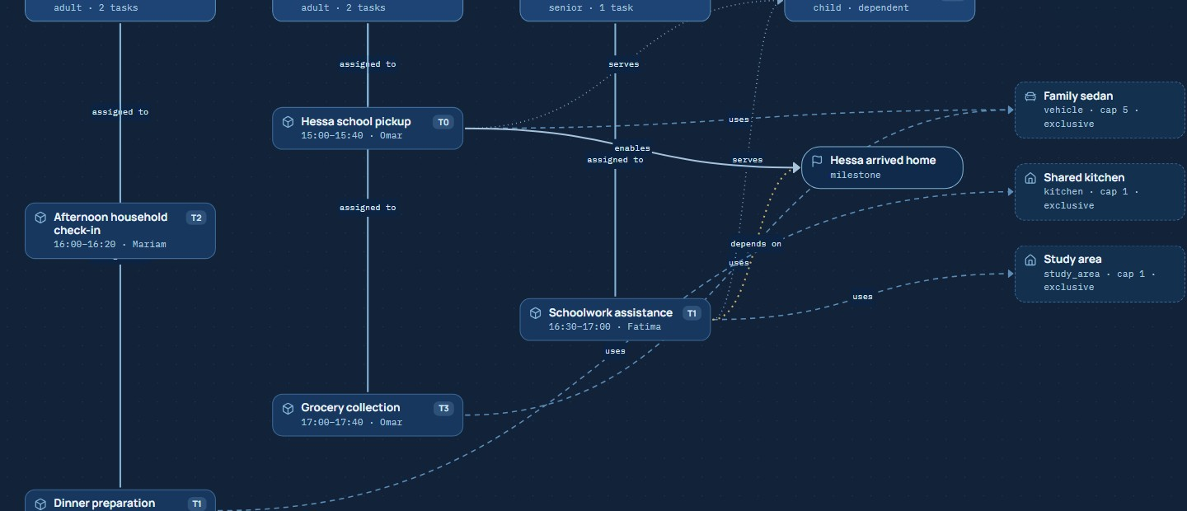
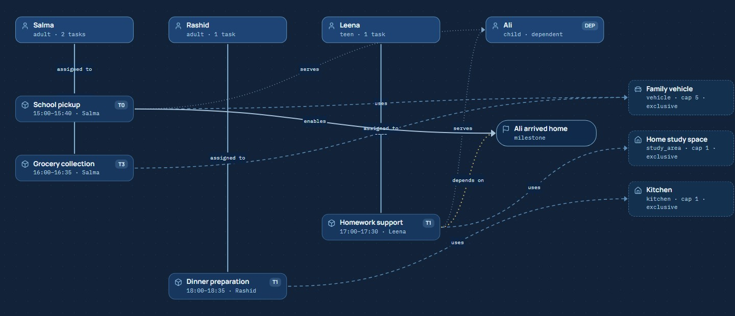
Three households, different constraints
ACT I · TEST HOUSEHOLDS
The Amina Family
The Al-Mansoori Multigenerational Family
The Salma Family
4 members · 4 tasks · 4 resources
4 members · 5 tasks · 3 resources
4 members · 4 tasks · 3 resources
Two authorized adult drivers; a teen who may help with homework but cannot drive; a 9-year-old dependent.
Three generations; a 70-year-old grandmother helps with schoolwork and check-ins but holds no driving permission.
One licensed driver, one vehicle: losing either leaves school pickup without a legal replacement.
Exercises: clean reassignment
Exercises: several valid alternatives
Exercises: honest infeasibility
Source: data/households/{amina, multigenerational, restricted-transport}.json — fictional; screenshots from the published prototype, 28 Oct 2026.
Notes:
A solver that works for one scripted family proves little, so we built three fictional households with deliberately different structures. All three are real files in the repository and are loaded through the same validated pipeline; the screenshots are their actual Family Network views.
The Amina family has two authorized adult drivers, a teenager who may help with homework but is explicitly not allowed to drive, and a nine-year-old dependent. The Al-Mansoori family has three generations: two working adults, a grandmother who can help with schoolwork and check-ins but holds no driving permission, and a twelve-year-old. We deliberately did not assume she is incapable because she is older — permissions are explicit data. The Salma family has exactly one licensed driver and one vehicle.
Why this matters: each household exercises a different behaviour of the solver — clean reassignment, real alternatives between several valid plans, and honest infeasibility when the only legal driver disappears. All data is fictional; no real family information is used.
Evidence basis: see EVIDENCE_LEDGER.md in the presentation folder.

Slide 7
The Amina family baseline
ACT I · THE FLAGSHIP HOUSEHOLD
A
Amina · 41 · adult
Responsibility | Tier | Baseline | Time | Needs
School pickup | 0 | Amina | 14:45–15:25 | drive, pickup_authorized, sedan, child restraint
Grocery collection | 3 | Amina | 15:55–16:30 | shopping, sedan
Homework assistance | 1 | Amina | 16:45–17:15 | homework_assist, study area, milestone M01
Dinner preparation | 1 | Khalid | 17:30–18:00 | meal_prep, kitchen
drive · pickup_authorized · homework_assist · shopping
K
Khalid · 43 · adult
drive · pickup_authorized · shopping · meal_prep
N
Noura · 16 · teen
homework_assist only · restrictions: drive, pickup_authorized
T01 pickup ──enables──▶ M01 “Yusuf arrived home”
T03 homework ──depends on──▶ M01
Y
Yusuf · 9 · dependent
never assigned tasks · authorized carers: Amina, Khalid, Noura
The dependency is stored in the household model, not inferred from a picture. Baseline check: 18 verifier rules, 0 violations (test T01).
Source: data/households/amina.json; benchmark case T01 “Amina baseline”.
Notes:
This is the baseline for the demonstration, exactly as stored in the fixture. Four people. Amina and Khalid are adults with explicit driving and pickup-authorization permissions. Noura is sixteen: she can help with homework, but her record lists driving and pickup as restrictions — so age never grants permission. Yusuf is nine and a dependent: he is never assigned responsibilities, he is the person they care for.
Four responsibilities with their priority tiers: school pickup is Tier 0, essential, and needs a licensed authorized driver, the sedan and the child restraint. Homework and dinner are Tier 1. Groceries are Tier 3, deferrable. Homework depends on the milestone Yusuf arrived home, which pickup enables.
The baseline itself passes our verifier with zero violations — that is a unit test, not an assumption.
Evidence basis: see EVIDENCE_LEDGER.md in the presentation folder.

Slide 8
The cascade begins
ACT I · THE PROBLEM → ANALYSIS
Entity | Before | After
Amina | available | unavailable
School pickup | valid | direct
Grocery | valid | direct
Homework | valid | direct + risk
Yusuf arrived home | satisfiable | at risk
Yusuf | served | at risk
Dinner, Khalid, Noura | valid | unaffected
Amina
out 14:30–18:00
Khalid
adult · 43
Noura
teen · 16
Yusuf
dependent
School pickup
14:45–15:25
Family sedan
vehicle · 5
Yusuf arrived home
milestone M01
Child restraint
cap 1
Grocery
15:55–16:30
Homework area
cap 1
Homework
16:45–17:15
Home kitchen
cap 1
Real causal path (engine output):
Disruption → Amina → School pickup → Yusuf arrived home → Homework
[disrupted_by › assigned_to › enables › depends_on]
Dinner
17:30–18:00
4 direct · 2 indirect · depth 3 · weighted coverage 100% → 25%
Source: POST /v1/simulations on the live API, 28 Oct 2026; direct = Amina + 3 tasks, indirect = milestone + Yusuf.
Notes:
This is the output of the dependency analysis for the flagship event, redrawn natively from the real result. Red means directly disrupted; amber means at risk through a dependency; faded means unaffected.
The analysis starts from the disruption, reaches Amina, and from her to the three tasks whose baseline assignments actually overlap her unavailable window — pickup, groceries and homework. Then it follows only valid dependency edges: pickup enables the milestone Yusuf arrived home, so the milestone is at risk, and so is Yusuf, the dependent that the pickup serves. The cascade depth is three.
Two things we want you to notice. First, dinner, Khalid, Noura and every resource are untouched — DOMINO does not exaggerate the damage. Second, the causal path is kept, not just the colour: homework has two paths, one through Amina and one through the pickup milestone. The table on the right is the before-and-after state, with the actual path text from the engine.
Evidence basis: see EVIDENCE_LEDGER.md in the presentation folder.

Slide 9
From confirmed event to reviewed recovery
ACT II · THE INTELLIGENCE
LANGUAGE
GRAPH
GRAPH
CP-SAT
VALIDATOR
HUMAN
1
2
3
4
5
6
Confirmed event
Dependency analysis
Candidate generation
Constraint optimization
Independent validation
Recovery review
1 event · Amina · 14:30–18:00 · confirmed by user
4 direct · 2 indirect · depth 3
56 candidates after static filtering
OPTIMAL · 5 lexicographic passes
56 checks · 18 rules · 0 violations
approval needed · pickup consent pending
The language model never sees the solver. The solver never marks its own homework.
Language AI interprets text only. Everything that decides or checks an assignment is deterministic, tested code.
Source: live flagship run (POST /v1/recovery-plans), 28 Oct 2026. Counts are measured outputs, not targets.
Notes:
Here is the complete processing chain, with the boundary between language AI and deterministic computation made explicit.
Step one, a confirmed event: it may start as text interpreted by Gemini or our built-in parser, but nothing proceeds until the user confirms the structured fields. Step two, dependency analysis: pure graph code finds direct and indirect effects. Step three, candidate generation: for each task we generate every legal member, start time and resource combination, removing only static impossibilities such as missing permissions. For the flagship scenario that produces 56 candidates. Step four, CP-SAT chooses among them under hard constraints and lexicographic priorities; five passes, status OPTIMAL in tens of milliseconds. Step five, the independent validator re-checks the result from scratch: 56 individual checks across 18 rules, no violations. Step six, human review, where consent for the pickup assignee is still pending.
The design principle: the language model never sees the solver, and the solver never marks its own homework.
Evidence basis: see EVIDENCE_LEDGER.md in the presentation folder.

Slide 10
What makes DOMINO distinctive
ACT II · THE INTELLIGENCE
1
Structured family digital twin
2
Graph-based cascade analysis
Members, skills, explicit permissions, time windows, resources and milestones as validated data.
Typed edges show what a change touches directly and downstream, with causal paths.
Household
digital twin
3
Mathematical recovery optimization
4
Independently verified decisions
CP-SAT searches legal arrangements; essential responsibilities are protected first.
A separate validator re-checks every rule; unresolved tasks stay visible.
The value is in the combination: a chatbot cannot guarantee a permission; a solver without a model does not know what to re-plan.
Notes:
Four capabilities, and the value is in combining them.
One: a structured family digital twin — people, permissions, resources, time windows and dependencies stored as validated data. Two: graph-based cascade analysis — it tells you what a change actually touches. Three: mathematical optimization — instead of suggestions, a solver searches the space of legal arrangements and proves optimality for its formulation. Four: independently verified decisions — a second implementation checks the result.
Why together? A chatbot can suggest a plan but cannot guarantee it respects a permission. A solver without a model of dependencies would not know what to re-plan. And an optimizer that checks itself can repeat its own mistakes. We are not claiming to be the first system of its kind — we are claiming this particular combination, implemented and tested end to end.
Evidence basis: see EVIDENCE_LEDGER.md in the presentation folder.

Slide 11
System architecture
ACT II · THE INTELLIGENCE
Browser
FastAPI backend (Python) · Pydantic validation · Docker on Render
React + TypeScript + Vite
React Flow graph (custom nodes)
Motion layout transitions
Zustand store: household + scenario versions, abort, stale-response discard
Hosted on GitHub Pages
Interpreter
LANGUAGE AI · Gemini + rule parser
Household model
Pydantic schemas · integrity checks
Google Gemini API
structured JSON
Dependency graph
NetworkX · typed edges · BFS
Candidate generation
skills · permissions · windows
HTTPS · JSON
JSON fixtures
3 fictional households
CP-SAT optimizer
Google OR-Tools · lexicographic
Independent verifier
no shared code with the optimizer
Language AI
Deterministic
Explanations
generated from computed records
Benchmarks + baselines
51 cases · greedy · no-recovery
Independent check
Source: repository structure (backend/app/services/*, frontend/src/*); deployment per render.yaml and pages.yml. Native, editable diagram.
Notes:
This is the real architecture, color coded by trust. The browser side is React and TypeScript built with Vite. The graph is React Flow with custom nodes, Motion handles the layout transitions, and a small Zustand store keeps household and scenario versions so that a late response can never overwrite a newer scenario. It is hosted as a static site on GitHub Pages.
It talks over HTTPS and JSON to a FastAPI backend, which validates every request with Pydantic. Inside the backend, soft-blue marks the only language-AI layer: the interpreter, which calls Gemini for structured JSON and falls back to a built-in rule parser. Cobalt marks deterministic computation: household validation, the NetworkX dependency graph, candidate generation and the OR-Tools CP-SAT optimizer. Green marks the independent verifier, which imports nothing from the optimizer. Benchmarks and baselines run the same engine for evaluation.
The deployed backend runs in Docker on Render; Gemini credentials exist only on the server, never in browser code.
Evidence basis: see EVIDENCE_LEDGER.md in the presentation folder.

Slide 12
The household digital twin
ACT II · THE INTELLIGENCE
FamilyMember
HouseholdTask
HouseholdResource
id · name · age · role · isDependent
skills[] · permissions[] · restrictions[]
availability[ {startMin,endMin} ]
authorizedDependentIds[]
id · tier 0–3 · priorityWeight · durationMin
earliestStart · latestEnd · fixedStart?
requiredSkills[] · requiredPermissions[]
requiredResourceTypes[] · requiredConsent
predecessorTaskIds[] · requiredMilestoneIds[]
id · name · type · capacity · exclusive
availability[] · unavailableWindows[]
allowedMemberIds? (vehicle, kitchen, …)
Assignment
Milestone
Disruption (5 types)
taskId → memberId
startMin · endMin · resourceIds[]
changedFromBaseline
id · title
enabledByTaskIds[]
dependentId? e.g. “Yusuf arrived home”
member_unavailable · resource_unavailable
task_rescheduled · availability_changed
resource_capacity_changed
affectedEntityIds[] · window · confirmed
P01 Amina · adult · skills [driving, shopping, homework_assist] · permissions [drive, pickup_authorized] · authorized for P04 · available 14:30–18:30
Source: backend/app/models/domain.py; example from data/households/amina.json. Simplified diagram: fields abbreviated.
Notes:
The twin is just data, but carefully typed. A FamilyMember has skills, explicit permissions, restrictions, availability windows and which dependents they are authorized to care for. A HouseholdTask has a tier from zero to three, a priority weight, a duration, an allowed time window, required skills, permissions and resource types, prerequisites, and whether it needs the assignee's consent. Resources have a capacity and may be exclusive, like the sedan. A Milestone records which tasks satisfy it. An Assignment links a task, a member, a time and resources. A Disruption is one of five supported types — member unavailable, resource unavailable, task rescheduled, availability changed, capacity changed — and it only counts once confirmed.
Example at the bottom is real: Amina is forty-one, can drive, is authorized for pickup and for Yusuf, and is available from 14:30 to 18:30. Times are integer minutes on one simulated day, in the Asia/Dubai time zone, and intervals are half-open.
Evidence basis: see EVIDENCE_LEDGER.md in the presentation folder.

Slide 13
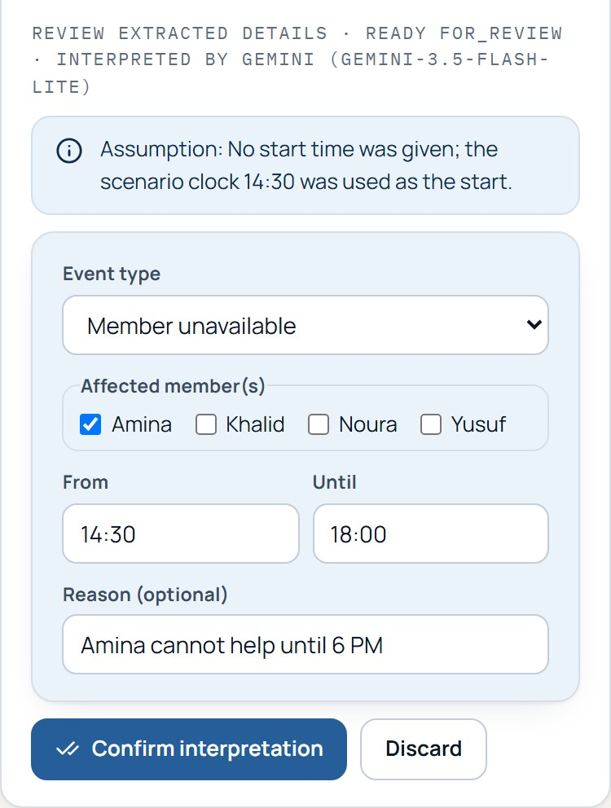
Natural-language interpretation
ACT II · THE INTELLIGENCE
1
Natural-language description
Observed output (live API)
“Amina cannot help
until 6 PM”
│ clock 14:30
▼
{
"type": "member_unavailable",
"affectedEntityIds": ["P01"],
"startMin": 870, // 14:30
"endMin": 1080, // 18:00
"confirmed": false
}
engine: gemini-3.5-flash-lite
assumption: start = scenario
clock 14:30
2
Structured interpretation
3
Entity resolution
4
Time extraction
5
Schema validation
6
Human confirmation
Gemini: step 2 only
Gemini interprets. It never authorizes or schedules.
Source: backend/app/services/interpreter.py + rule_parser.py; live probe 28 Oct 2026; accuracy in TESTING.md (12-sentence sets).
Notes:
Families do not think in forms, so DOMINO accepts a sentence like Amina cannot help until 6 PM. The important thing is what the language model is allowed to do.
The workflow: text goes in; Gemini, called through the official Google SDK with a JSON schema, returns only mentions and clock times. Then deterministic code resolves those mentions against the current household — an unknown name is flagged and never invented, a duplicate name becomes an ambiguity. Times are validated, and a phrase like until 6 PM with no start time and no scenario clock is sent back for clarification instead of guessed. Finally the structured event is shown for editing and a human must confirm it. The event is created unconfirmed and cannot reach the solver otherwise.
Gemini does not authorize assignments and does not produce schedules. We also built a deterministic rule parser that needs no key: in auto mode Gemini is tried first and any failure falls back to the parser, and the screen says which engine answered.
Observed evidence on 28 Oct 2026: the hosted backend called Gemini (model gemini-3.5-flash-lite) and returned member_unavailable for Amina, 14:30 to 18:00, unconfirmed. On our 12 annotated sentences Gemini matched all 12; on 12 held-out sentences it matched 11, missing a case that needs the task's baseline time. The rule parser scored 12 of 12 on both sets, but its held-out score was 11 of 12 on its first run and was fixed afterwards, so that number is not an independent measurement. These are small sanity checks, not general accuracy claims.
Evidence basis: see EVIDENCE_LEDGER.md in the presentation folder.

Slide 14
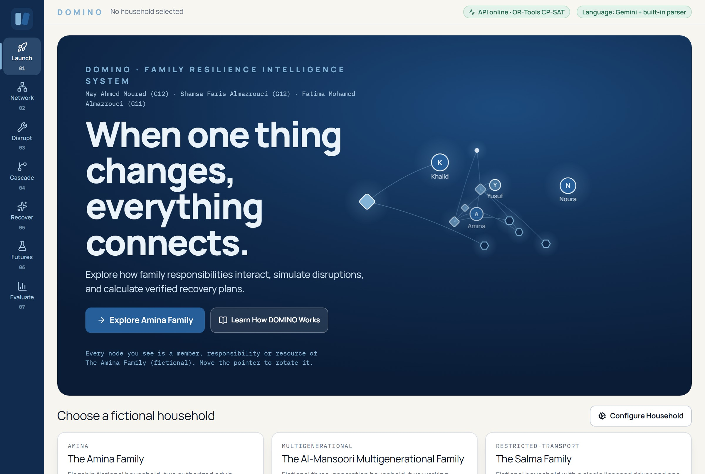
System launch
ACT III · THE PROTOTYPE · SCREEN 1 OF 7
4
1
Central proposition; project identity and the team credited under the title
2
Interactive constellation: real entities of the selected household
1
2
3
Navigation across the seven screens
3
4
Live status: API online · OR-Tools CP-SAT · language engines
Below the hero: three fictional households and Configure Household (editing with live validation).
Real screenshot of https://maymourad.github.io/DOMINO/ captured 28 Oct 2026. Status chips show the state at capture time only.
Notes:
The published launch screen. The headline is our proposition. The constellation on the right is not an illustration: every node is a real member, responsibility, resource or milestone of the selected household, projected into a restrained 3D space; it rotates with the pointer, and reduced-motion users get a static frame.
Below the hero are the three fictional households and a Configure Household workflow with live validation. The top bar shows the connection state to the backend — in this capture the API was online and reporting OR-Tools CP-SAT, and the language layer was Gemini plus the built-in parser. That indicator tells you the state at capture time; it does not promise permanent uptime.
The app has seven screens connected by the left rail, which we go through next. Everything is public at the URL on the final slide.
Evidence basis: see EVIDENCE_LEDGER.md in the presentation folder.

Slide 15
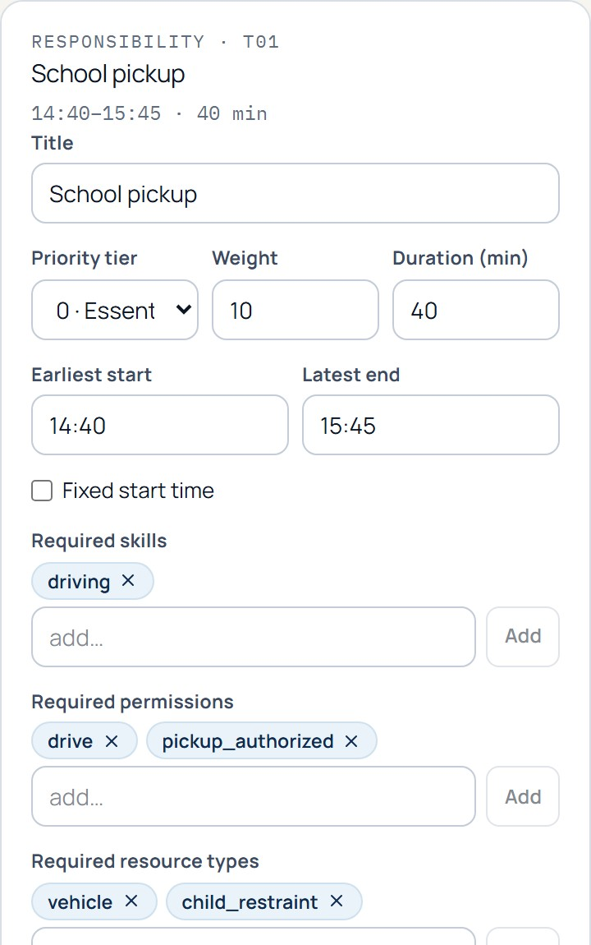
Family Network
ACT III · THE PROTOTYPE · SCREEN 2 OF 7
1
Custom typed nodes: people, tasks, resources, milestone
2
Typed edges: assigned to, uses, enables, depends on, serves
3
Inspector edits tier, window, skills, permissions, prerequisites
4
Editing bumps the household version and invalidates old plans
Toolbar: add task · add member · add resource · remove · undo · reset to the validated baseline. Select School pickup (T01) to edit it; the household is re-validated by the backend after every edit.
5
Backend validation blocks invalid households
Real screenshot of the published prototype, 28 Oct 2026. Amina household, School pickup (T01) selected.
Notes:
The Family Network is the digital twin made visible and editable. Custom nodes show people, tasks with their tier badges, resources and the milestone; edges are typed and styled differently — solid, dashed, dotted. Here I have selected the school pickup task and the inspector on the right shows its editable fields: tier, duration, time window, required skills and permissions, resource types, prerequisites and whether consent is needed.
Edits change the canonical household in the browser. The household version is incremented, any earlier simulation or plan is invalidated and aborted, and the backend re-validates the household — for example it rejects an unknown reference or a dependency cycle. You can add and remove members, resources and tasks, undo, or reset to the validated baseline. The graph has pan, zoom, fit, and a text alternative for screen readers.
This is also where the baseline schedule is displayed as a timeline strip, so you can see the plan before breaking it.
Evidence basis: see EVIDENCE_LEDGER.md in the presentation folder.

Slide 16
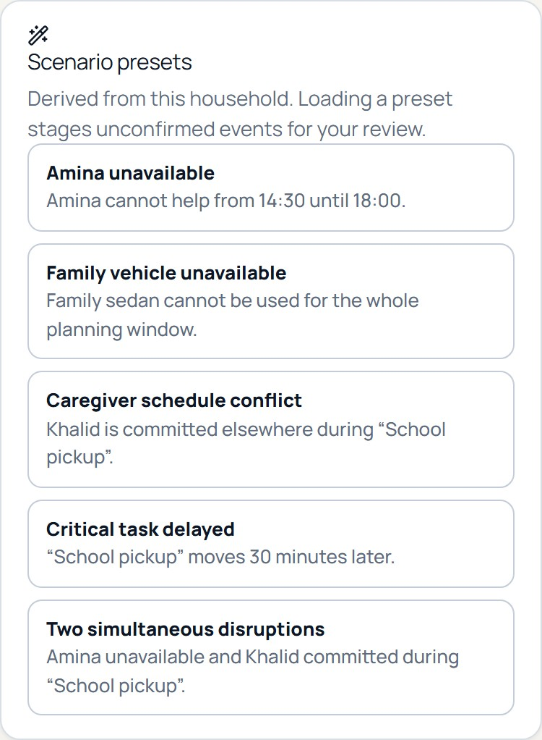
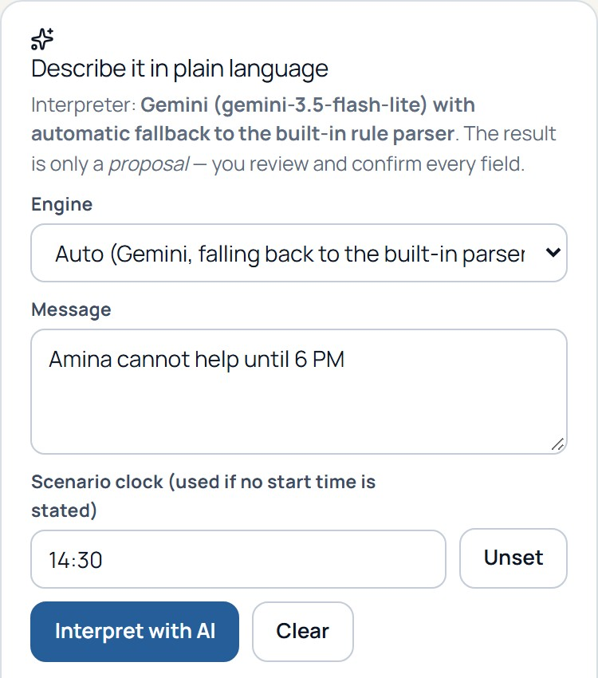
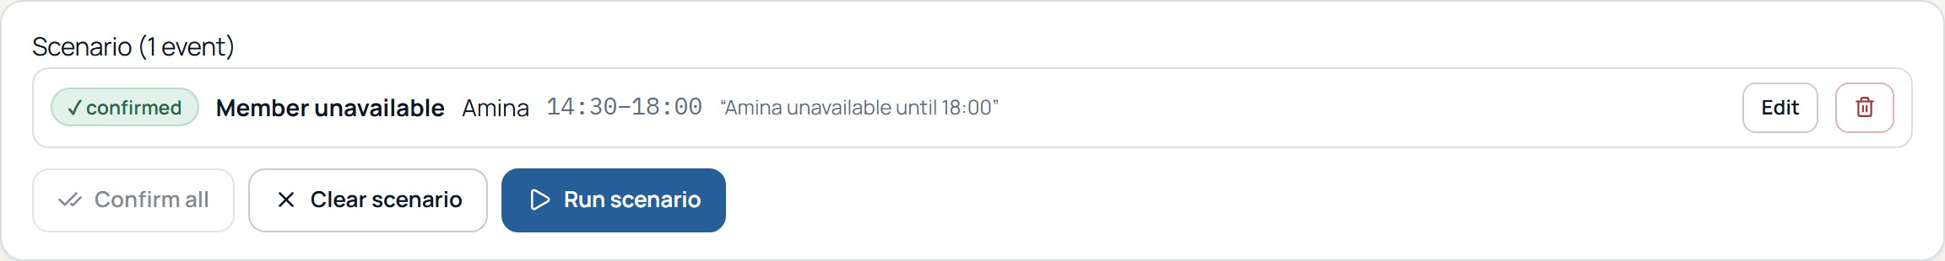
Disruption Injection Studio
ACT III · THE PROTOTYPE · SCREEN 3 OF 7
1
Presets are derived from the household itself
2
Manual form works with no AI at all
3
Interpretation → review → confirm: Gemini or the built-in parser
4
Run is disabled until every event is confirmed
Why confirm first? A mistaken interpretation should never silently become a computed plan.
Real screenshots of the published prototype, 28 Oct 2026.
Notes:
This is where a disruption is created, three ways. Presets are derived from the household itself — Amina unavailable, vehicle unavailable, caregiver conflict, critical task delayed, two simultaneous disruptions. The manual form lets you choose an event type, entities and times. And the natural-language panel interprets a sentence.
In the screenshot the Amina preset has been staged and confirmed. Look at the status trail at the top — draft, interpreting, needs review, confirmed, calculating — and at the confirmed badge on the event card. The Run button is disabled until every event is confirmed; an unconfirmed event can never reach the solver, even by accident. That is the human-in-the-loop principle applied at the very beginning of the pipeline.
The small panel on the right is the natural-language review: the structured fields are editable, assumptions are listed, unknown names are flagged, and the engine that produced the proposal is shown.
Evidence basis: see EVIDENCE_LEDGER.md in the presentation folder.

Slide 17
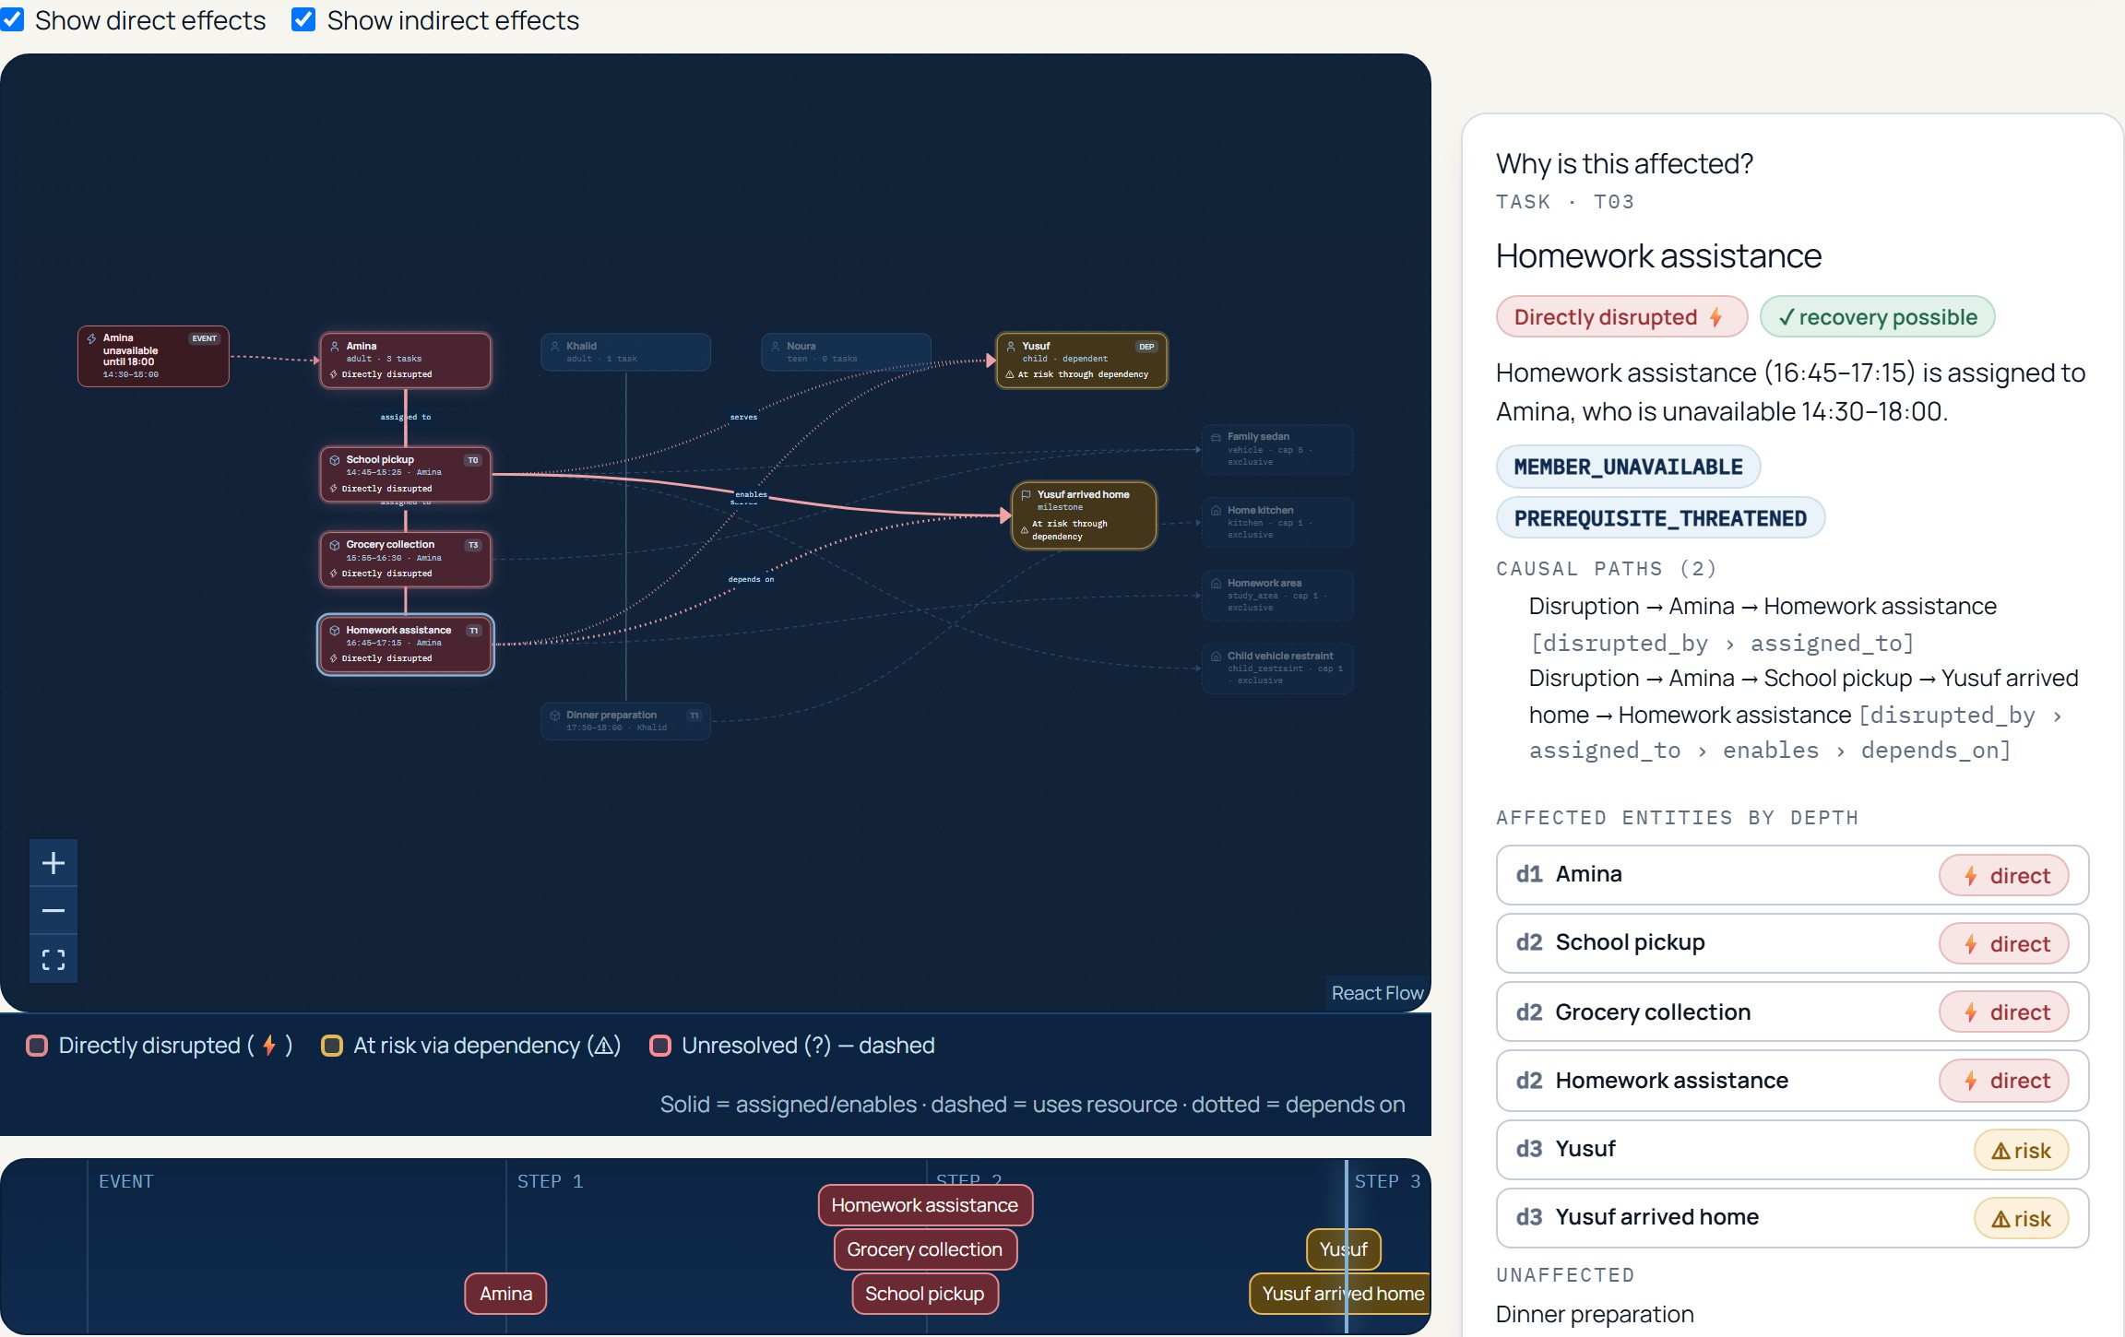
Cascade Laboratory
ACT III · THE PROTOTYPE · SCREEN 4 OF 7
4
directly disrupted
(Amina + 3 tasks)
2
at risk through
dependency
3
cascade depth
(scrubbable)
Inspect any node: category, reason codes, every causal path.
Real screenshot of the published prototype, 28 Oct 2026. Homework assistance (T03) selected; both causal paths shown.
Notes:
This is the real impact graph after the flagship event, computed by the backend and played back as an animation. The timeline at the bottom is scrubbable: at step zero only the event is visible, at step one Amina, at step two the three directly disrupted tasks, at step three the milestone and Yusuf. Because the playback is driven by the engine's own depth ordering, nothing unaffected ever lights up — dinner, Khalid and Noura stay dim.
The inspector on the right answers why is this affected. Homework assistance is directly disrupted because it is assigned to Amina, who is unavailable 14:30 to 18:00, and the engine lists both causal paths with their edge types. A banner can also show whether recovery is possible; here the solver probe says yes for each affected task.
Counters at the top of the real screen report the direct and indirect numbers; toggles let you show direct effects only or indirect only, and playback speed is adjustable. If a scenario affects nothing, the screen says so honestly instead of animating something.
Evidence basis: see EVIDENCE_LEDGER.md in the presentation folder.

Slide 18
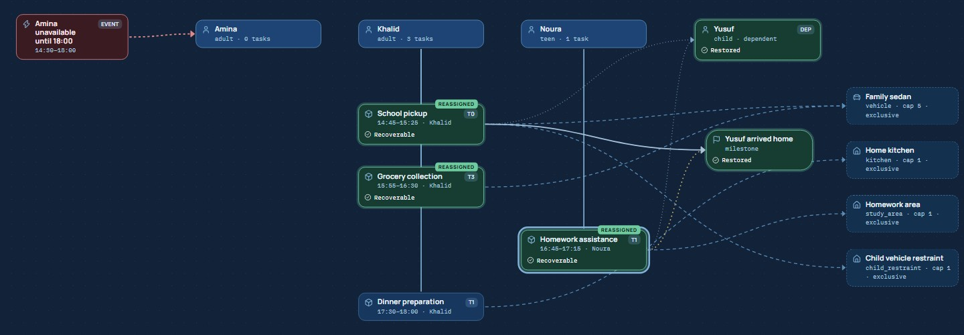
Recovery Studio
ACT III · THE PROTOTYPE · SCREEN 5 OF 7
ORIGINAL SCHEDULE
14:30
15:00
15:30
16:00
16:30
17:00
17:30
18:00
18:30
Amina
Pickup
Grocery
Homework
Khalid
Dinner
Noura
✓ Verified complete recovery
AFTER OPTIMIZATION · OPTIMAL
3 reassigned (pickup, groceries → Khalid; homework → Noura) · dinner unchanged · 0 min displacement
Solver OPTIMAL · 51.26 ms (hosted run) · independent check 56/56 passed · 3 strategies agree on 1 arrangement
14:30
15:00
15:30
16:00
16:30
17:00
17:30
18:00
18:30
Amina
Khalid
Pickup
Grocery
Dinner
Noura
Homework
Green = reassigned and verified
Source: POST /v1/recovery-plans (live), 28 Oct 2026; graph is a real screenshot, schedules redrawn from the returned assignments.
Notes:
The output of the optimizer. On the left, the same schedule before and after, drawn natively from the result. Above is the original plan. Below is the recovery: Amina's row is hatched because she is unavailable; school pickup and groceries moved to Khalid, homework moved to Noura, and dinner did not change at all. On the right is the real Recovery Studio graph, where the three affected task nodes slide from Amina's lane to their new assignees — we call it the magnetic transition — and each reassigned node carries a badge.
How it was produced: for the flagship run on 28 Oct 2026 all three strategies — priority first, minimum change and balanced workload — gave the same single arrangement, so the app shows one plan labelled with all three, and says so, instead of fabricating three different-looking plans. The solver status was OPTIMAL and it took 51.26 milliseconds on the hosted server in this run; across ten repeated hosted runs it ranged from 42.97 to 166.63 milliseconds. The plan then passed independent verification.
The user can reject or pin any assignment, which triggers a fresh solve, ask for another distinct arrangement, compare plans, and approve only a verified plan.
Evidence basis: see EVIDENCE_LEDGER.md in the presentation folder.

Slide 19
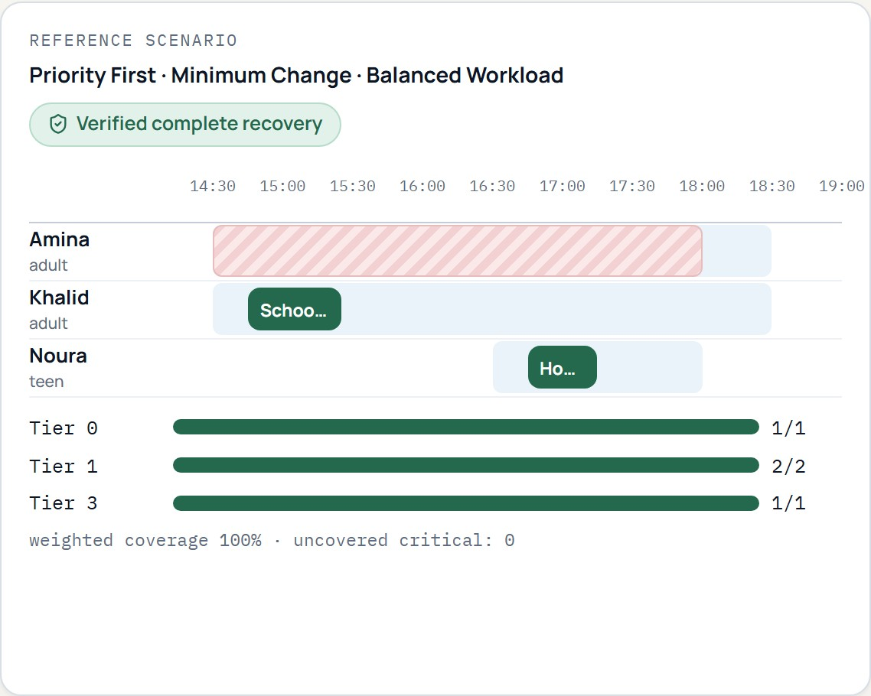
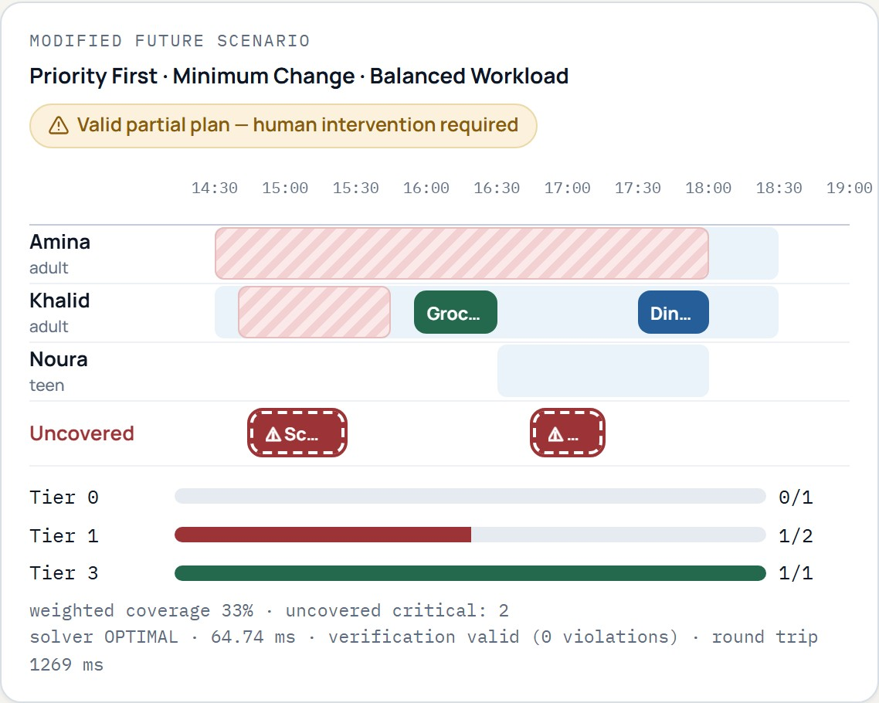
Family Futures Laboratory
ACT III · THE PROTOTYPE · SCREEN 6 OF 7
Change one variable
Caregiver availability
mark a member unavailable
Vehicle availability
take the sedan out
Resource capacity
e.g. seats 5 → 1
Task priority
change a task’s tier
Time-window flexibility
widen or narrow by ± minutes
Every change re-runs graph analysis → CP-SAT → independent verification. Nothing here is a stored alternative.
Real screenshot of the published prototype, 28 Oct 2026: fresh recalculation (solver OPTIMAL, verification 0 violations). Reference preserved on the left.
Notes:
Counterfactual intelligence: what if? The Futures Laboratory clones the current scenario, applies your change, and then runs the entire pipeline again — graph analysis, CP-SAT, independent verification — so the right-hand result is computed, not predetermined. The original reference scenario stays untouched on the left until you choose Apply scenario.
You can change caregiver availability, vehicle availability, resource capacity, task priority tier, time-window flexibility, remove a permission, or add one of the preset secondary disruptions. In this capture we added the caregiver-conflict preset: Khalid is unavailable during school pickup while Amina stays unavailable.
The result is shown side by side: coverage fell from 100 to 33 percent, two critical responsibilities are now uncovered, reassignments dropped from three to one, and the table at the bottom of the real screen lists exactly which tasks differ. The solver status was still OPTIMAL — it found the best possible arrangement for what is actually possible — and verification reported zero violations, in about 14 milliseconds of solving and under a second round trip. We will come back to what this result means two slides from now.
Evidence basis: see EVIDENCE_LEDGER.md in the presentation folder.

Slide 20
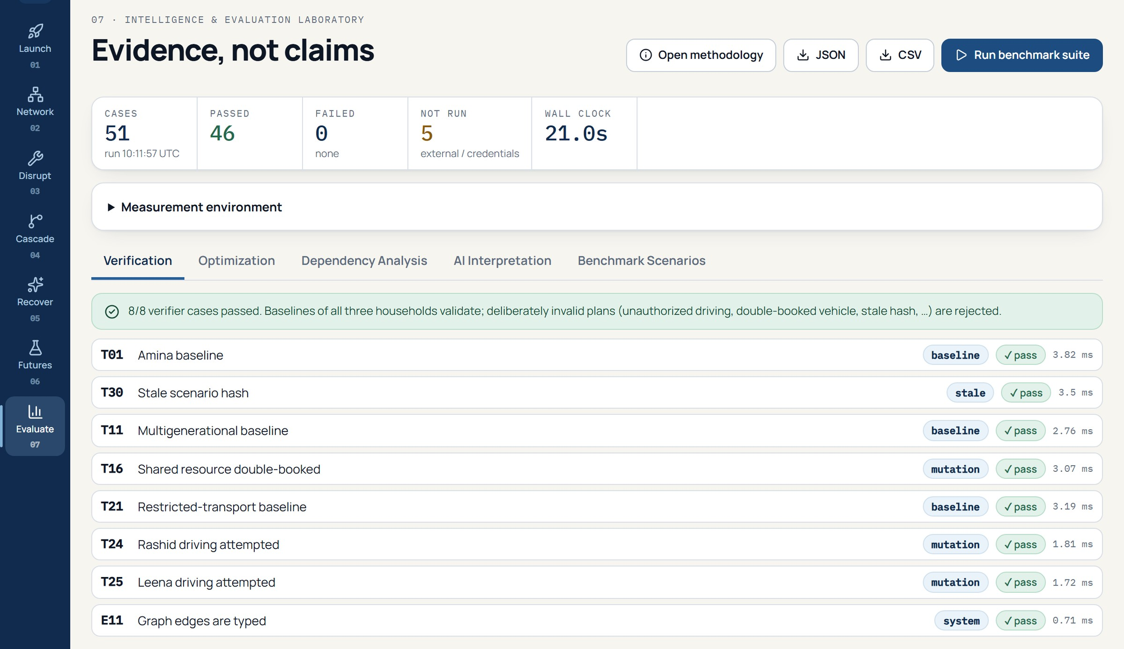
Intelligence & Evaluation Laboratory
ACT III · THE PROTOTYPE · SCREEN 7 OF 7
51
cases defined and processed
46
0
passed
failed
5
not run (external / key configured)
Defined ≠ passed: every number comes from a run, never a static page.
Real screenshot of the published prototype after pressing “Run benchmark suite”, 28 Oct 2026 (hosted API, Linux, OR-Tools 9.15.6755).
Notes:
The seventh screen is about evidence rather than features. Before anything is run it says benchmark not yet executed — it never ships invented statistics. After pressing Run benchmark suite, the backend loads each case from data files, executes the real engine, checks declared invariants with the independent verifier, and returns measured results.
What you see is the run we executed on 28 Oct 2026 against the hosted API: fifty-one cases are defined, fifty-one were processed, forty-six passed, zero failed, and five were not run — four are executed by the browser test suite or the build instead of the backend runner, and one is skipped because a Gemini key is configured. Failures would be shown in red; there were none to show, and we say that plainly.
The tabs cover verification, optimization, dependency analysis, AI interpretation and the full scenario list, where every case can be inspected for expected versus observed behaviour and replayed. Results can be exported as JSON or CSV, and the methodology is one click away. The wall clock for this run was about twenty-two seconds.
Evidence basis: see EVIDENCE_LEDGER.md in the presentation folder.

Slide 21
Mathematical optimization with CP-SAT
ACT IV · THE EVIDENCE
x[t,p,s,r] ∈ {0,1} (task, person, start, resources)
Flagship instance (live run)
VARIABLE
T01 pickup · Tier 0
Khalid × 6
14:45
COVERAGE
covered[t] = Σ x[t,p,s,r] ≤ 1 (never forced)
T02 grocery · Tier 3
Khalid × 24
15:55
T03 homework · Tier 1
Noura × 13
16:45
PEOPLE
NoOverlap( { [s, s+dur_t) : x[t,p,s,r]=1 } ) ∀ p
T04 dinner · Tier 1
Khalid × 13
17:30
RESOURCES
exclusive → NoOverlap shared → Cumulative(capacity)
56 candidates → chosen start shown →
T01 candidate start times (Khalid)
PRECEDENCE
covered[t] ⇒ covered[π] ∧ start[t] ≥ end[π]
14:40
14:45
14:50
14:55
15:00
15:05
lexicographic: max Σ w_t·covered[t] over Tier 0 → fix →
Tier 1 → Tier 2 → Tier 3 → then min displacement, changes
passes: Tier0=10 → Tier1=12 → Tier3=2 → displacement=0 → changes=3
status OPTIMAL · 1 worker · seed 1
OBJECTIVE
Source: backend/app/services/{candidate_generation,optimizer}.py; candidate counts and objective values from the live flagship run. Simplified formulation.
Notes:
Now the mathematics, simplified. Constraint programming with Google's CP-SAT solver. For every task t, every member p who is statically eligible, every start time s on a five-minute grid, and every compatible resource arrangement r, we create one binary variable x of t, p, s, r. It equals one if that exact assignment is chosen.
The constraints are: each task is covered at most once — the sum of its x variables equals its covered flag, and we never force coverage, which is what allows honest infeasibility. A member cannot do two things at once, modeled with optional fixed-size intervals and a no-overlap constraint. An exclusive resource such as the sedan is also a no-overlap; a shared resource is a cumulative constraint with its capacity. Precedence: if a task is covered, its prerequisite must be covered and must end before it starts. And optimization is lexicographic: maximize weighted coverage of Tier 0, fix that optimum, then Tier 1, then Tier 2, then Tier 3, and only then minimize displacement and changes. That prevents several small tasks from ever outweighing an essential one.
The flagship numbers: after static filtering only 56 candidates remain — school pickup has six legal start times for Khalid, groceries twenty-four, homework thirteen for Noura, dinner thirteen. Five passes, status OPTIMAL, objective values Tier 0 ten, Tier 1 twelve, Tier 3 two, displacement zero, three changes. The solver uses one worker and a fixed seed so results are reproducible.
Evidence basis: see EVIDENCE_LEDGER.md in the presentation folder.

Slide 22
Priorities and constraints
ACT IV · THE EVIDENCE
HARD CONSTRAINTS — never violated
SOFT OBJECTIVES — after coverage
REJECTED CANDIDATE — reason codes
✓
Authorized assignments (skills + explicit permissions)
Tier 0 essential safety & dependent care
Noura → School pickup ✗
MISSING_SKILL
lacks skill 'driving'
MISSING_PERMISSION
lacks 'drive'
lacks 'pickup_authorized'
RESTRICTED
restriction 'drive'
restriction 'pickup_authorized'
✓
Member availability for the full interval
Tier 1 important caregiving
✓
No overlapping responsibilities
Tier 2 routine commitments
✓
Resource availability and capacity
Tier 3 deferrable convenience
✓
Dependent safety: only authorized carers
then preserve assignments · least displacement · balance
Yusuf: DEPENDENT_MEMBER — never assigned responsibilities.
✓
Prerequisites complete before dependents
Lexicographic: optimize Tier 0, fix it, then Tier 1 … so low tiers can never outweigh essentials.
DOMINO will not invent a caregiver, permission or resource.
Source: candidate_generation.py / explanations.py; reason codes copied from the solver’s explanation records (live run).
Notes:
How does DOMINO choose safe and useful plans? It separates what is forbidden from what is merely preferred.
Hard constraints can never be violated. Assignments must be authorized — skills and explicit permissions, and for dependents the carer must be specifically authorized. The member must be available for the whole interval. A member never does two things at once. Resources must be available and within capacity. Dependent safety: the dependent is never assigned tasks and care is only given by an authorized person. And prerequisites must complete first.
Soft objectives only matter after the essential coverage is secured: keep original assignments, minimize schedule displacement, balance workload, and reduce unnecessary changes. The lexicographic ladder means Tier 0 coverage is optimized first and fixed; a pile of Tier 3 tasks can never outweigh a school pickup.
The red card is a real rejected candidate. Noura is sixteen and present, but the model says she lacks the driving skill and the drive and pickup-authorized permissions and carries restrictions on both. Yusuf is a dependent and cannot be assigned. So DOMINO rejects them with explicit reason codes, and these come from computed records.
Evidence basis: see EVIDENCE_LEDGER.md in the presentation folder.

Slide 23
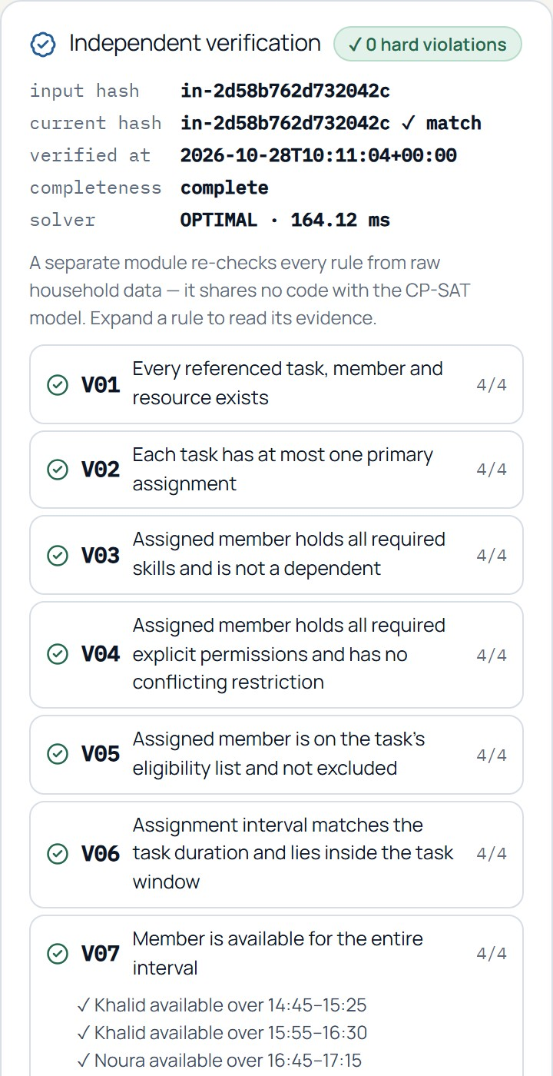
Independent verification
ACT IV · THE EVIDENCE
CP-SAT optimizer
proposes assignments
What it checks
✓
Eligibility and skills
✓
Explicit permissions & restrictions
no shared code
✓
Member availability
Independent verifier
recomputes every rule from raw data
✓
Scheduling conflicts and travel gaps
✓
Resource availability, exclusivity, capacity
✓
Dependent-person authorization
56 / 56
✓
Prerequisite / dependency completion
✓
Scenario version (hash) consistency
checks passed · 18 rules · 0 hard violations
(flagship plan, re-run live)
✓
Human consent remains pending
✓
Critical coverage reported accurately
Source: backend/app/services/verifier.py; panel is a real screenshot (28 Oct 2026). Negative tests: backend/tests/unit/test_optimizer_verifier.py, benchmark T16, T24, T25, T30.
Notes:
This is our credibility slide. The optimizer proposes a plan; a different module decides whether the plan is acceptable. The verifier is a standalone Python module that imports nothing from the optimizer or the candidate generator. It re-computes every rule straight from the household data, the confirmed disruptions and the proposed assignments with plain interval arithmetic.
It checks eligibility and skills, explicit permissions, task windows, member availability, overlaps including travel gaps, resource availability and capacity, resource types, dependent authorization, prerequisite completion, that the plan matches the current scenario hash, that critical-task coverage is reported accurately, that consent-dependent actions are still pending, and that user rejections are honored. That is eighteen rules.
Observed on 28 Oct 2026 for the flagship plan: 56 individual checks across those 18 rules, all passed, zero hard violations — I re-ran it fresh before finalizing this slide. We also test the verifier against deliberately wrong plans — an unauthorized driver, a double-booked vehicle, a stale hash, a missing prerequisite — and it rejects every one. Verification status, recovery completeness and human approval are three separate fields, so a valid plan can still be partial.
Evidence basis: see EVIDENCE_LEDGER.md in the presentation folder.

Slide 24
The recovery result
ACT IV · THE EVIDENCE
Original schedule
After Amina’s disruption
After optimization
4 / 4
1 / 4
4 / 4
responsibilities covered
still valid (dinner)
covered · 3 reassigned
100%
weighted coverage
25%
weighted coverage
100%
weighted coverage
Tier 0
Tier 0
Tier 0
Tier 1
Tier 1
Tier 1
Tier 3
Tier 3
Tier 3
Coverage ≠ approval
Solver, 10 hosted runs: 43–167 ms
median 133 ms · status OPTIMAL · 0 violations
Round trip incl. network:
0.5 s simulate · 0.9 s recover
A human must still approve. School pickup needs the new assignee’s consent (pending). Approval records an internal simulation receipt only — no one is notified.
Source: live API runs on 28 Oct 2026 (evidence/live_flagship.json). Free-tier hosting: timings vary; they are measurements, not guarantees.
Notes:
Three states of the same household, with measured numbers. The original schedule: all four responsibilities are assigned and valid, weighted coverage 100 percent. Right after Amina's disruption, before any recovery, only dinner is still valid: one of four tasks, and weighted coverage drops to 25 percent because the pickup, homework and groceries carry most of the weight. Three tasks are directly affected, and two more entities, the milestone and Yusuf, are at risk.
After optimization all four responsibilities are covered, weighted coverage is back to 100 percent with three assignments changed and zero minutes of displacement. That result came from the solver and passed independent verification with no violations.
Coverage is not approval. A person still has to approve. The school pickup requires its new assignee's consent, which stays pending, and approval only records an internal simulation receipt — DOMINO never notifies anyone.
Timings from a documented fresh execution: ten consecutive hosted solves of this scenario took between 42.97 and 166.63 milliseconds of solver time, median about 133. The variation reflects the free-tier server's CPU, not the model. One end-to-end request, simulation plus recovery, took about 0.5 and 0.9 seconds including network.
Evidence basis: see EVIDENCE_LEDGER.md in the presentation folder.

Slide 25
When recovery is impossible
ACT IV · THE EVIDENCE
Amina out
Verified complete recovery
4/4 covered · 100%
56/56 checks · 0 violations
Amina + Khalid out 14:40–15:45
Valid partial plan — human intervention required
Why not give the pickup to Noura?
✗ Noura lacks the driving skill
✗ Noura lacks drive and pickup_authorized permissions
2 critical uncovered: pickup, homework
33% coverage · 30/30 checks
solver OPTIMAL
✗ Noura carries restrictions on drive and pickup
✗ Yusuf is a dependent — never assigned
Source: real screenshot + live run 28 Oct 2026. An uncovered critical task is never presented as a complete recovery.
Notes:
This slide shows the principle we are proudest of. Add a second disruption: Khalid is unavailable during school pickup, 14:40 to 15:45, while Amina remains unavailable. The Amina household has exactly two authorized adult pickup drivers, so no one who is allowed to drive is left.
The tempting wrong answer is to give the pickup to Noura. DOMINO refuses, and the screenshot shows why in the engine's own words: Noura lacks the driving skill, lacks the drive and pickup-authorized permissions and has restrictions on both; Yusuf is a dependent. Assigning anyone else would violate the model's declared permissions.
So the solver does the honest thing: it covers what it can — groceries and dinner with Khalid after his unavailable window — and leaves school pickup and homework uncovered. Homework is also uncovered because its prerequisite, Yusuf arriving home, cannot be satisfied, even though Noura is free. The status is valid partial plan, human intervention required. All thirty checks passed — the plan is valid; it is just not complete. Weighted coverage fell to 33 percent and two critical tasks remain unresolved. The solver status is still OPTIMAL: it found the best possible answer to a problem that has no complete one.
DOMINO never labels an incomplete recovery as a complete one, and approval of this plan requires explicit acknowledgement of the unresolved critical tasks.
Evidence basis: see EVIDENCE_LEDGER.md in the presentation folder.

Slide 26
Benchmarking and test evidence
ACT IV · THE EVIDENCE
Method | Mean weighted coverage | Cases with uncovered critical | Mean changes
DOMINO | 71.5% | 10 / 21 | 2.48
Greedy first-fit | 71.1% | 10 / 21 | 3.14
No recovery | 36.6% | 20 / 21 | 0
DOMINO tied greedy on critical coverage in all 21 cases; it made fewer changes. All baseline outputs also passed the independent verifier.
Dependency detection: 11 cases
P 1 · R 1 · F1 1
Solver per case (n=27): median 187 ms · max 393 ms · case wall: median 801.7 ms, p95 1699.8 ms
Categories covered: baseline validation · overlaps · missing permissions · resource unavailability · conflicting schedules · dependent restrictions · secondary disruptions · stale scenario versions.
Source: POST /v1/benchmarks/run on the hosted API, 28 Oct 2026 (Linux, Python 3.12.16, OR-Tools 9.15.6755, 1 worker, seed 1). Synthetic, hand-authored cases; targets are not results.
Notes:
All numbers here come from the run we executed on 28 Oct 2026 on the hosted API (Linux, Python 3.12, OR-Tools 9.15.6755, single solver worker, fixed seed) and are saved in the repository.
Fifty-one cases are defined. Fifty-one were processed: forty-six passed, none failed, five were not run — four are checked by the browser test suite and the build, and one is the missing-credentials test, skipped because a Gemini key is configured. The chart shows what the forty-six passes cover: twenty-two recovery scenarios across the three households, safety and AI-logic checks, baseline validation, rejection of deliberately invalid plans such as unauthorized drivers and double-booked vehicles, determinism, input validation, reset, rejection re-solve, stale-scenario handling and distinct-alternative search.
Dependency detection was scored against hand-written expected sets: eleven cases, precision, recall and F1 all 1.0. That is a small, hand-authored set, so it supports correctness on these cases, not generality.
We also compared with two baselines. Greedy first-fit tied DOMINO on critical coverage in all twenty-one disruption cases — we report that plainly — while DOMINO made fewer changes on average, 2.5 against 3.1, and carries the lexicographic guarantee. Doing nothing left a critical task uncovered in twenty of the twenty-one cases. Timing: per recovery case, solver time had a median of 187 milliseconds; the whole case including three strategies, analysis, verification and baselines had a median of 801.7 milliseconds and a 95th percentile of 1699.8. Engineering targets are separate from these measurements: for example two seconds per strategy is a configured limit, not a result.
Evidence basis: see EVIDENCE_LEDGER.md in the presentation folder.

Slide 27
Security, responsible AI and deployment
ACT V · THE IMPACT
✓
Synthetic data only
Browser
any device
three fictional households
Secrets stay on the server: the browser never sees the Gemini key, and CORS accepts only the published site.
✓
Server-side secrets
no keys in browser code
✓
Input validation
GitHub Pages
React + TypeScript (static)
FastAPI on Render
Docker · Pydantic · CP-SAT
Gemini API
language only
Pydantic · size & rate limits · CORS allow-list
HTTPS
✓
Permission-aware assignment
age never grants permission
✓
Human approval
simulation receipt; no one is notified
Google OR-Tools
local solver
✓
Independent verification
18 rules, 0 violations required
✓
Transparent limitations
single day · fictional · no prediction
Status snapshot 28 Oct 2026: /v1/health → ok · OR-Tools CP-SAT · language engines: Gemini + built-in parser. Not an uptime guarantee.
Source: render.yaml, Dockerfile, pages.yml, backend/app/main.py (middleware, CORS, limits). No credentials or private URLs are shown anywhere in this deck.
Notes:
Responsible design is built into the product. All household data is synthetic. Gemini credentials live only on the server as environment variables, never in browser code — we scanned the published JavaScript for key patterns and found none. Every request is validated by Pydantic, with request-size limits, rate limits on the AI and benchmark endpoints, a CORS allow-list that accepts only our published site, bounded solver concurrency and structured errors without stack traces.
On the AI side: assignments are permission-aware by construction, language AI only proposes a structured event that a human confirms, the plan is verified independently, a human approves, and the limitations are documented.
Deployment: the React frontend is a static site on GitHub Pages; the FastAPI backend runs in a Docker container on Render and calls Google OR-Tools locally and the Gemini API for language interpretation. At capture time on 28 Oct 2026 the health endpoint reported status ok with OR-Tools CP-SAT. A status check is a snapshot, not a promise of uptime: the free tier sleeps when idle and the first request can be slow, and if the backend is unreachable the interface says so and disables computation rather than showing canned results. We never show keys, project numbers or dashboard links.
Evidence basis: see EVIDENCE_LEDGER.md in the presentation folder.

Slide 28
Family wellbeing and UAE relevance
ACT V · THE IMPACT
Potential contribution (not yet measured with real families)
A
1
More reliable family coordination when plans change
2
Clearer sharing of responsibilities
K
3
Better understanding of interdependencies
4
Less uncertainty when something goes wrong
Y
N
5
Transparent decision support, with a human in charge
2026 is the UAE Year of Family. DOMINO relates to the theme only; it is not sponsored or endorsed by any government body. No clinical, psychological or population-level claims are made.
Conceptual illustration — not data
Reference: https://u.ae/en/Year-of-family/Family-year-2026 (UAE Government portal). Benefits are design-level potential, not demonstrated outcomes.
Notes:
The UAE has designated 2026 as the Year of Family, which puts family stability, shared responsibility and cohesion at the centre of national attention. DOMINO connects to that theme; it is not sponsored or endorsed by any government body.
What DOMINO could contribute is practical: clearer coordination when plans change, a visible picture of who is responsible for what, a better understanding of interdependencies, less uncertainty in the moment a plan fails, and transparent decision support in which a human stays in charge. Notice the word could. Everything on the right-hand side is potential benefit that follows from the design; it has not been measured with real families. We have not run user studies, so we make no claims about stress, wellbeing or population-level outcomes, and DOMINO makes no clinical or psychological claims.
What we can show is that the computation works on three fictional households, that it is verifiable, and that it refuses to hide what it cannot solve. Reference: u.ae Year of Family 2026. The graphic on the left is a conceptual illustration of a household network, not a measurement.
Evidence basis: see EVIDENCE_LEDGER.md in the presentation folder.

Slide 29
Development status and future potential
ACT V · THE IMPACT
IMPLEMENTED AND TESTED | FUTURE POTENTIAL — NOT BUILT
✓
Interactive household modeling and validation
○
More complex households and constraint types
✓
Disruption analysis with causal paths
○
Real travel-time models, multi-day planning
✓
CP-SAT optimization-based recovery
○
Broader accessibility work and audits
✓
Independent 18-rule validation
○
Expanded bilingual (Arabic / English) support
✓
Counterfactual (what-if) recalculation
○
Real-world usability studies with families
✓
Evaluation infrastructure: 51 cases · 46 passed in our run
○
Privacy-preserving data management
✓
Natural language: Gemini + built-in parser, human-confirmed
Before real-family use: user studies with consent · privacy & data-protection design · security review · accessibility audits · validation of model assumptions · expert review. Today: a research-grade prototype on fictional data.
Source: TESTING.md and 28 Oct 2026 benchmark run; future items are plans, not features.
Notes:
We separate what exists from what we hope to build. On the left, everything is implemented and tested in the published prototype: interactive household modeling with validation, working disruption analysis with causal paths, optimization-based recovery with CP-SAT, independent validation, counterfactual simulation and evaluation infrastructure with fifty-one defined cases of which forty-six passed in our run. Natural-language input works two ways — Gemini and a built-in parser — with human confirmation.
On the right is future potential, clearly labelled as not built: larger and more complex households, more constraint types such as real travel times and multi-day planning, broader accessibility work beyond what we tested, full bilingual Arabic and English support, real-world usability studies with families, and stronger privacy-preserving data management.
Before this could be used by real families we would need much more: user studies and consent, a privacy and data-protection design for real personal data, a security review, accessibility audits, validation of the model's assumptions against real routines, and professional review of any safety-related assumptions. Today it is a research-grade prototype on fictional data.
Evidence basis: see EVIDENCE_LEDGER.md in the presentation folder.

Slide 30

DOMINO
A
K
“When one thing changes, everything connects.”
Y
DOMINO helps families understand disruption and calculate a verified way forward.
N
May Ahmed Mourad · Grade 12
Shamsa Faris Almazrouei · Grade 12
Fatima Mohamed Almazrouei · Grade 11
ADNOC Schools — Madinat Zayed · Abu Dhabi University 6th Annual COE STEM Programming with AI Competition · AI for Family
maymourad.github.io/DOMINO
Scan the QR code or open the link — the live prototype is public
Notes:
Close with the idea, then the invitation. When one thing changes, everything connects. DOMINO helps families understand disruption and calculate a verified way forward — and when no valid way forward exists, it says so honestly and hands the decision back to a person.
The prototype is public: scan the QR code or open maymourad.github.io/DOMINO, choose the Amina family, inject Amina's unavailability, and then add Khalid's. You will see the full journey: cascade, optimized recovery, independent verification, and an honest unresolved result. The code, tests and the saved benchmark results are in the public repository.
Thank you from May Ahmed Mourad, Shamsa Faris Almazrouei and Fatima Mohamed Almazrouei, ADNOC Schools — Madinat Zayed. We are happy to take questions on any slide: the solver formulation, how dependents are protected, how we tested, or the limitations.
Likely questions and where to answer them: how is it different from a shared calendar — slide 4; what makes it AI — slides 13 and 21 (language AI plus constraint optimization); why CP-SAT — slide 21; how eligibility works — slides 12 and 22; can the solver return an impossible assignment — slide 23; what if no recovery exists — slide 25; how dependents are protected — slide 22; how it was tested — slide 26; limitations and real-family use — slide 29.
Evidence basis: see EVIDENCE_LEDGER.md in the presentation folder.

