Slide 1
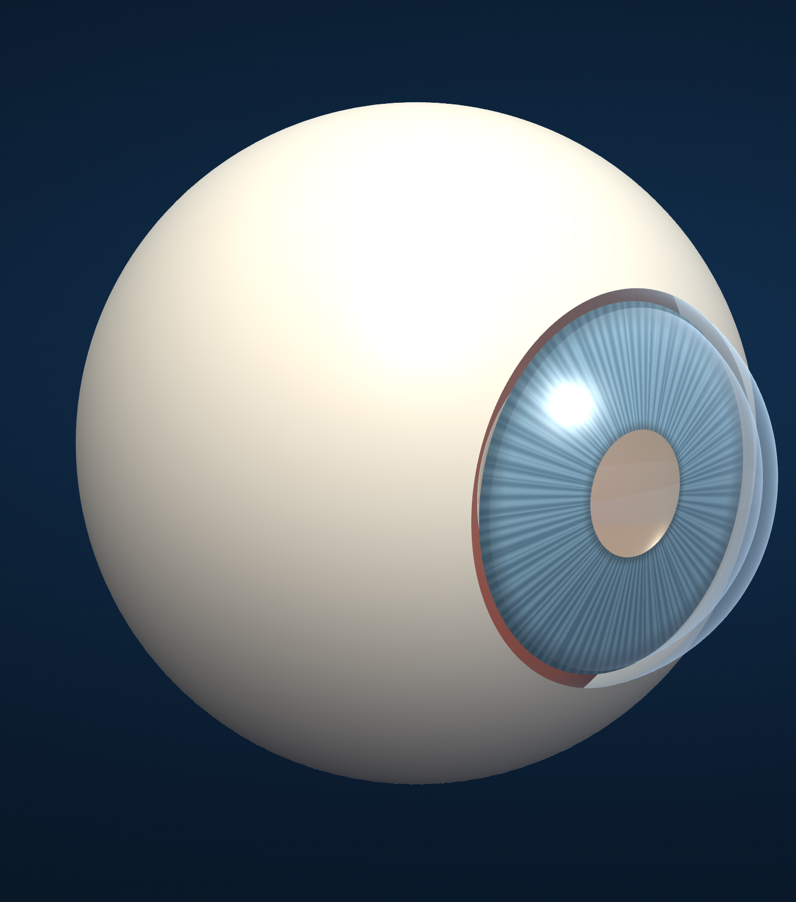
AL DHAFRA HEALTH FORUM · ACCURATE DIAGNOSIS — التشخيص الدقيق
Diagnostic
Intelligence
Lab
“Before we trust a diagnosis, we must understand how it was reached.”
May Ahmed Mourad · Grade 12
Shamsa Faris Almazrouei · Grade 12
Fatima Mohamed Almazrouei · Grade 11
ADNOC Schools — Madinat Zayed
FIG. 01 · original WebGL eye · schematic, not to scale
Notes:
SPEAKER: May Ahmed Mourad (Grade 12) · target 30 s · slide 1/12
Good morning. We are May, Shamsa and Fatima, from ADNOC Schools, Madinat Zayed, and this is Diagnostic Intelligence Lab, our entry in the Accurate Diagnosis category. Before we trust a diagnosis, we must understand how it was reached. Ours is a student research prototype that asks a harder question than “can AI diagnose?”: when a diagnosis is read from an image, how accurately is it read, and how would anyone know? The eye behind us is a three-dimensional model we built ourselves. A schematic, not a patient.

Slide 2
01 · THE PROBLEM
A prediction is not proof.
EVIDENCE
What is actually visible
The challenge is not producing a diagnostic label.
It is establishing whether that label can be trusted.
HUMAN OVERSIGHT
Who is accountable
IMAGE QUALITY
Blur, light, field
Can this label be trusted?
UNCERTAINTY
Ungradable · borderline
INTERPRETATION
Who read it, how
ERRORS
Missed · over-referred
22.3%
of adults with diabetes worldwide have diabetic retinopathy (95% CI 19.7–25.0)
Teo et al., Ophthalmology 2021 · 59 studies
≈ 1.3 M
adults (20–79) with diabetes in the UAE in 2024
IDF Diabetes Atlas · UAE country report
DIAGNOSTIC INTELLIGENCE LAB · AL DHAFRA HEALTH FORUM · EDUCATIONAL PROTOTYPE · NOT A MEDICAL DEVICE
02
Notes:
SPEAKER: May Ahmed Mourad (Grade 12) · target 40 s · slide 2/12
Here is the problem. A medical prediction can be wrong, uncertain, or built on a poor image or too little evidence. So the challenge is not producing a label. It is knowing whether the label can be trusted. The scale shows why. About one in five people with diabetes has diabetic retinopathy, roughly one hundred and three million adults in 2020, and the UAE has around one point three million adults with diabetes. Screening at that scale only works if its accuracy is understood. A confident prediction is not necessarily an accurate diagnosis.

Slide 3
02 · OUR RESEARCH QUESTION
How accurately is a diagnosis read — and how can we measure that?
01
02
03
04
05
06
Retinal case
Evidence inspection
Human interpretation
Reference comparison
Reliability evaluation
Human review
Workbench · 16 synthetic cases
EvidenceLens
Diagnostic Duel · lock
Diagnostic Duel · reveal
Quality & Uncertainty · Accuracy Lab
Review Queue · Clinician approval
THE PLATFORM INVESTIGATES
Diagnostic interpretation
Evidence inspection
Error detection
Reliability
Accuracy evaluation
Accountability
DIAGNOSTIC INTELLIGENCE LAB · AL DHAFRA HEALTH FORUM · EDUCATIONAL PROTOTYPE · NOT A MEDICAL DEVICE
03
Notes:
SPEAKER: May Ahmed Mourad (Grade 12) · target 28 s · slide 3/12
Our research question is: how accurately is a diagnosis read, and how can we measure that accuracy? Diagnostic Intelligence Lab is an interactive research environment for exactly that. A retinal case enters on the left. The reader inspects the evidence, records an interpretation, and only then compares it with a reference. We then ask how reliable the evidence was, and a human reviews the decision. Every box on this slide is a real module of our published prototype.

Slide 4
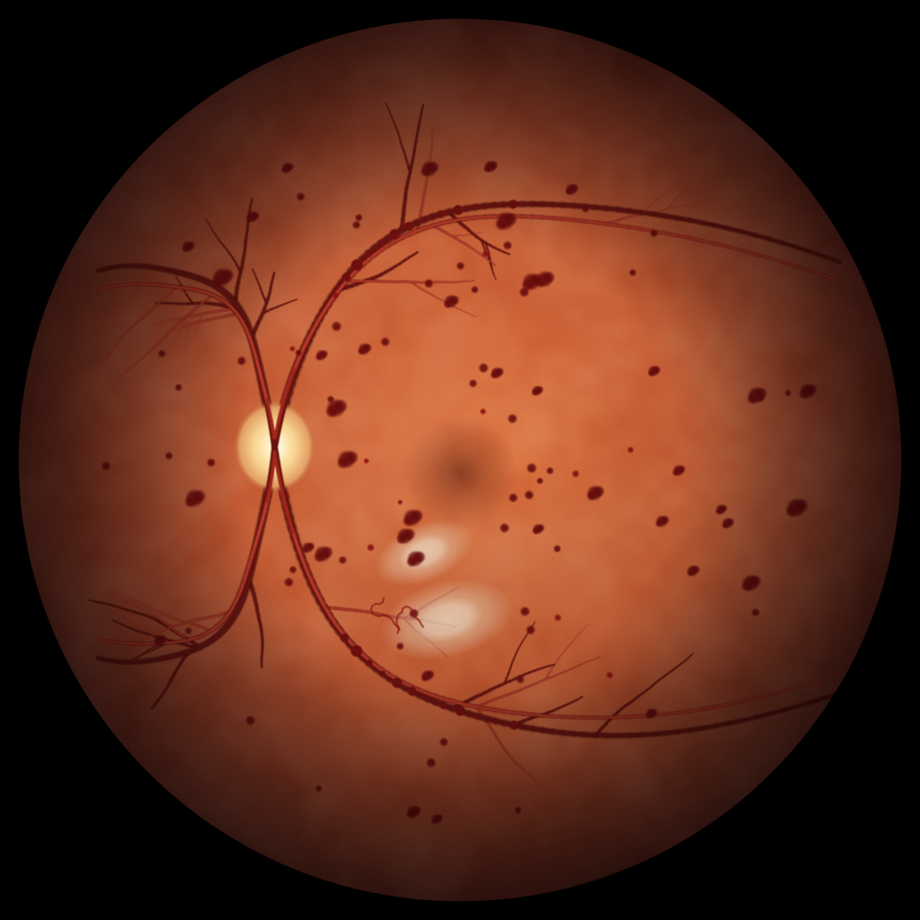
03 · WHY RETINAL SCREENING?
Retinal imaging gives diagnosis a structured case study.
4
Visible evidence. Lesions can be seen, counted, located.
A clear question. Refer — or re-screen.
Two unequal errors. False negative · false positive.
1
2
1 OPTIC DISC · nasal to the macula
2 MACULA · FOVEA · sharpest vision
3 HAEMORRHAGE · authored reference annotation
4 VENOUS BEADING · a severe-grade sign
3
ICDR SEVERITY · AUTHORED REFERENCE LABELS
0
1
2
3
4
NON-REFERABLE
REFERABLE · or suspected DME
Retinal screening is the first research use case — not the limit of the platform.
SYNTHETIC ILLUSTRATION · NOT A PATIENT
ICDR: Wilkinson et al., Ophthalmology 2003 · ETDRS Report 10, 1991
DIAGNOSTIC INTELLIGENCE LAB · AL DHAFRA HEALTH FORUM · EDUCATIONAL PROTOTYPE · NOT A MEDICAL DEVICE
04
Notes:
SPEAKER: May Ahmed Mourad (Grade 12) · target 32 s · slide 4/12
Why the retina? A retinal photograph makes disease visible. Lesions can be seen, counted and located, and the screening question is clear: refer, or re-screen. That creates two different errors. A false negative sends disease home. A false positive sends a healthy person to a clinic. Our reference labels follow the ICDR scale. This image is a synthetic teaching illustration drawn by our own code. It is not a patient. Retinal screening is our first use case, not the limit of the platform.
HAND-OVER: Shamsa will now show how the platform lets you inspect the evidence.

Slide 5
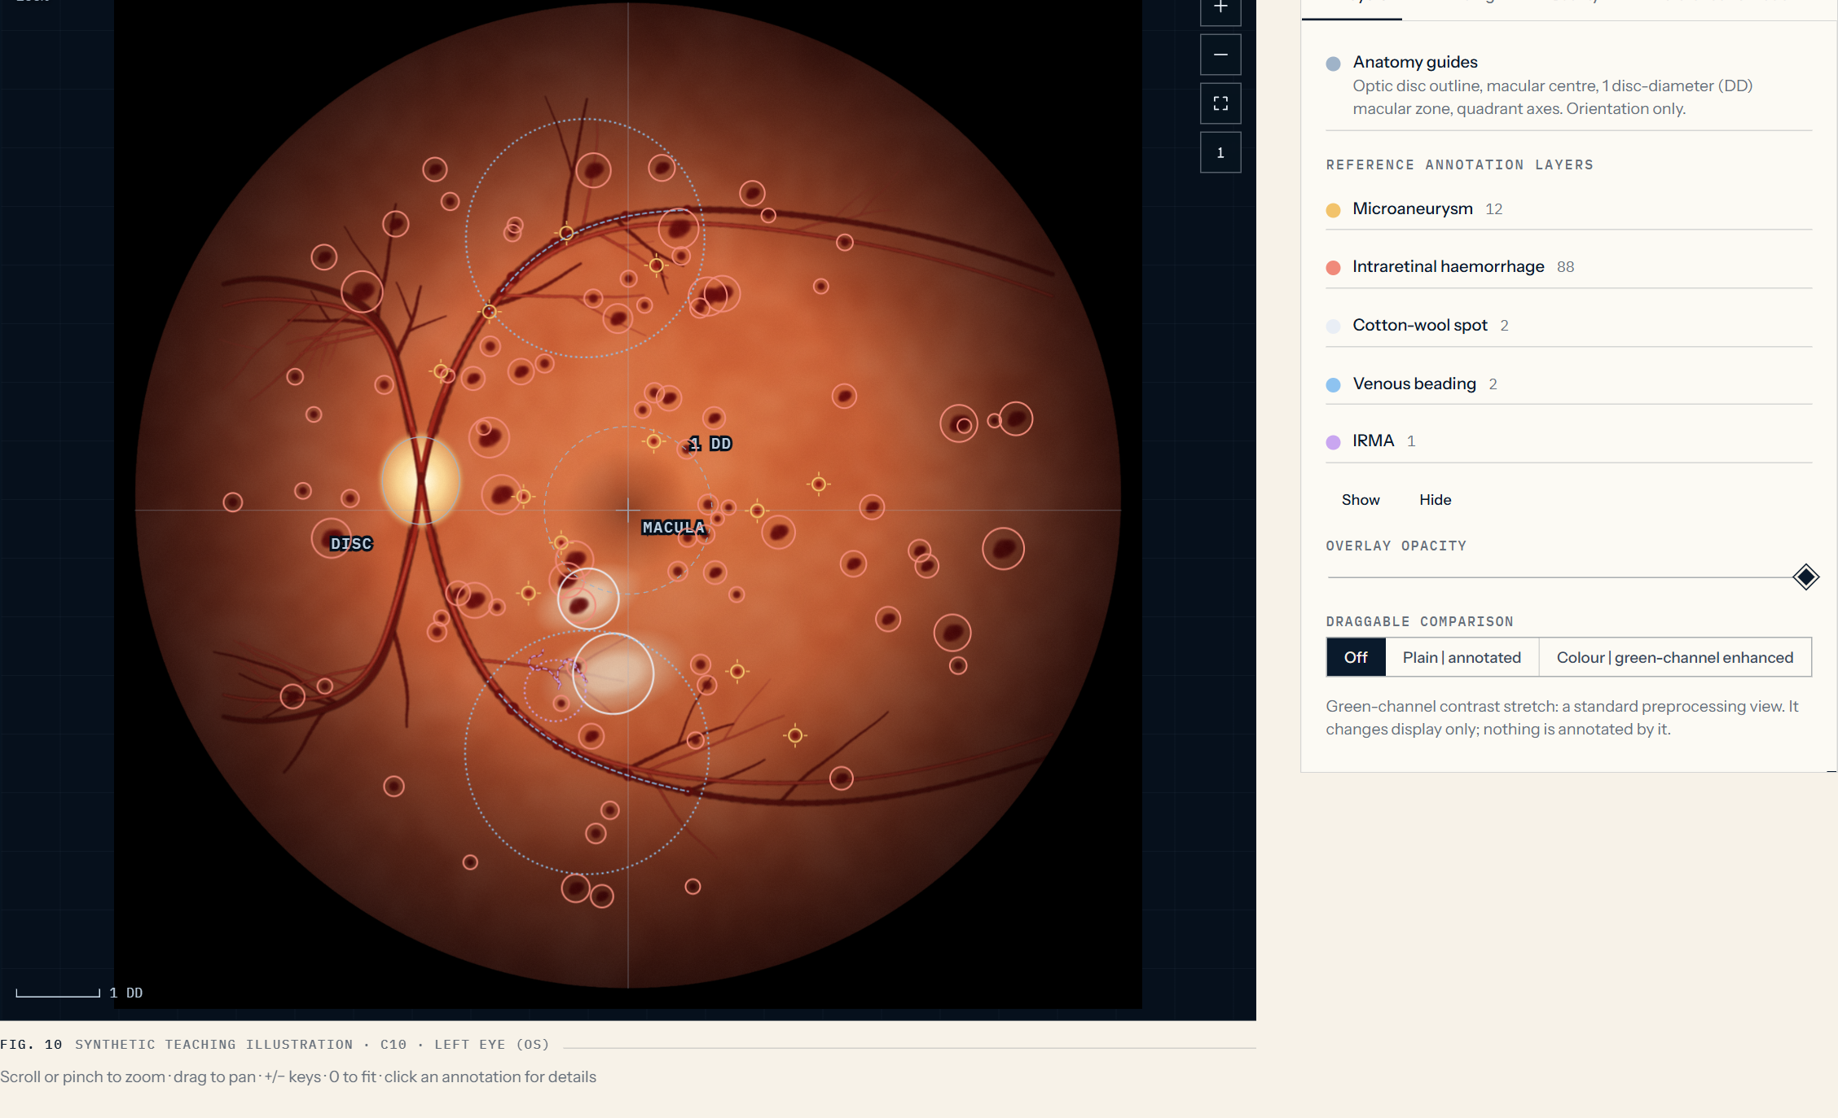
04 · EVIDENCELENS — SEE BEYOND THE IMAGE
Evidence first. Answer later.
ZOOM · PAN · NATIVE RES.
Wheel, pinch or keys; zoom level shown
ANATOMY GUIDES
Disc outline · 1-DD macular zone · quadrants
LAYERS + OPACITY
Annotation layers revealed one at a time
GREEN-CHANNEL COMPARISON
Draggable plain | enhanced divider
BLIND-FIRST SAFEGUARD
Reference annotations stay locked until the interpretation is locked.
Reduces anchoring in the educational reading. Early access = Study Mode = practice only.
LIVE APPLICATION · EvidenceLens · synthetic case C10 opened in Study Mode
DIAGNOSTIC INTELLIGENCE LAB · AL DHAFRA HEALTH FORUM · EDUCATIONAL PROTOTYPE · NOT A MEDICAL DEVICE
05
Notes:
SPEAKER: Shamsa Faris Almazrouei (Grade 12) · target 35 s · slide 5/12
Thank you, May. This is EvidenceLens, and it is not a standard image viewer. You can zoom and pan smoothly, switch on anatomical guides such as the optic disc outline and a one-disc-diameter zone around the macula, control layers and their opacity, and compare against a green-channel view. The most important design decision is the locked panel on the right. The reference annotations stay hidden until you lock your interpretation. If you see the answer first, you cannot honestly test your own reading. Good interpretation begins with careful evidence inspection.
KEY LINE: Good interpretation begins with careful evidence inspection.

Slide 6
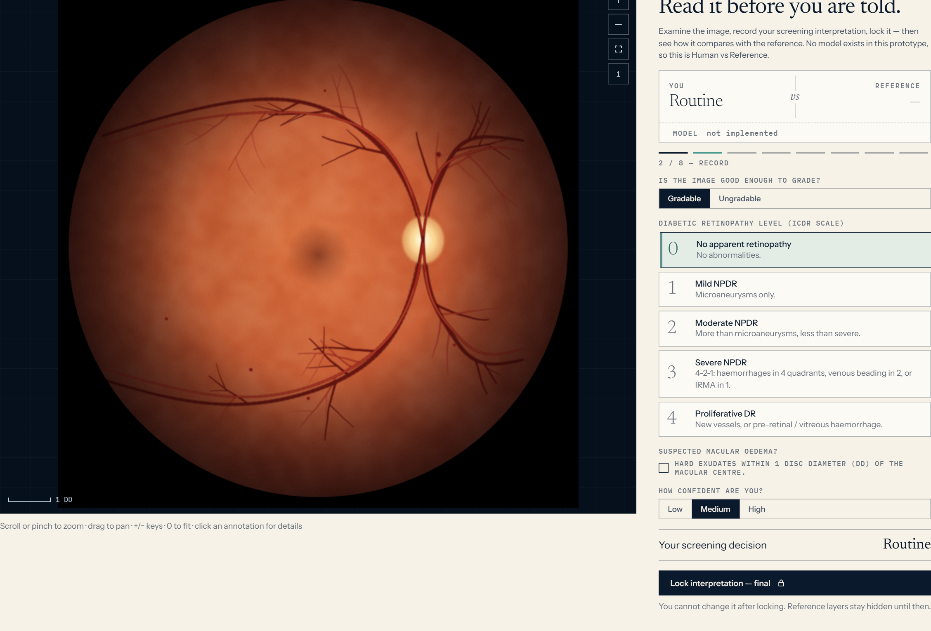
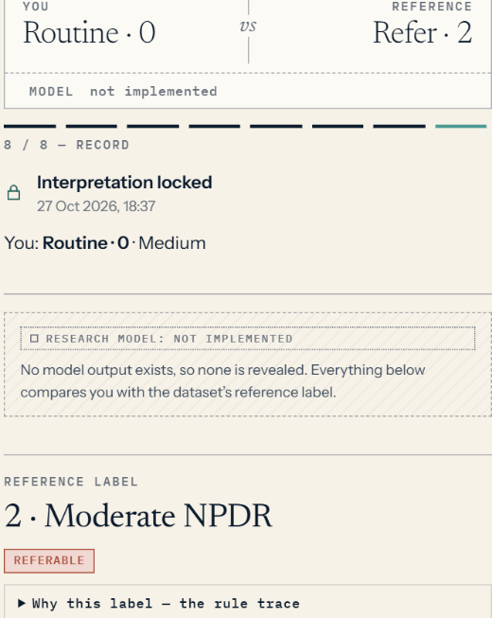
05 · DIAGNOSTIC DUEL
Read. Lock. Reveal.
EDUCATIONAL HUMAN-VERSUS-REFERENCE COMPARISON. No trained diagnostic AI model is involved.
READ
LOCK
REVEAL
1 Observe · 2 Gradability · 3 Confidence · 4 Interpret
5 Lock — final, no edits
6 Reference · 7 Discrepancies
The interpretation comes first. The reference comes afterward.
DIAGNOSTIC INTELLIGENCE LAB · AL DHAFRA HEALTH FORUM · EDUCATIONAL PROTOTYPE · NOT A MEDICAL DEVICE
06
Notes:
SPEAKER: Shamsa Faris Almazrouei (Grade 12) · target 40 s · slide 6/12
That safeguard leads into the Diagnostic Duel: read, lock, reveal. Read: you observe a synthetic case, decide whether the image can be graded, choose a retinopathy level, and state your confidence. Lock: you cannot change your answer. Reveal: only now does the authored reference appear, with the rule behind it, a table of agreements and disagreements, and what the outcome means. For example, why a false negative is the costly error. To be exact: this is an educational human-versus-reference comparison. No trained diagnostic AI model is involved. The interpretation comes first. The reference comes afterward. Let us show you.
KEY LINE: The interpretation comes first. The reference comes afterward.
LIVE DEMONSTRATION: switch to the prototype here — see DEMO_SCRIPT.md (90–120 s). Backup screenshots: presentation/backup-screenshots/.

Slide 7
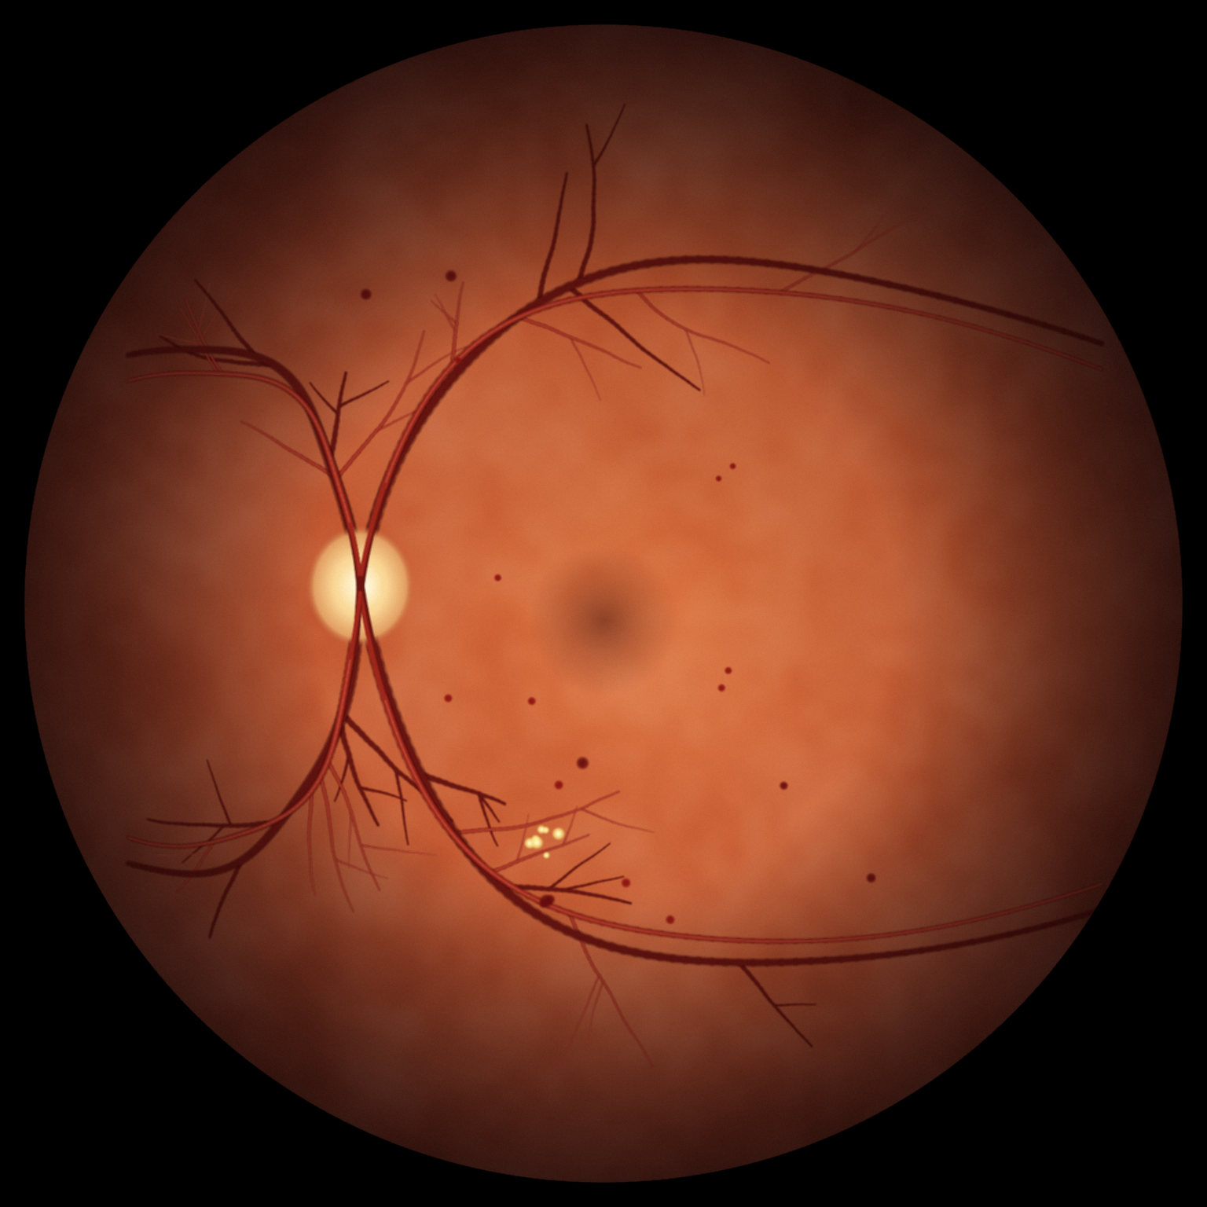
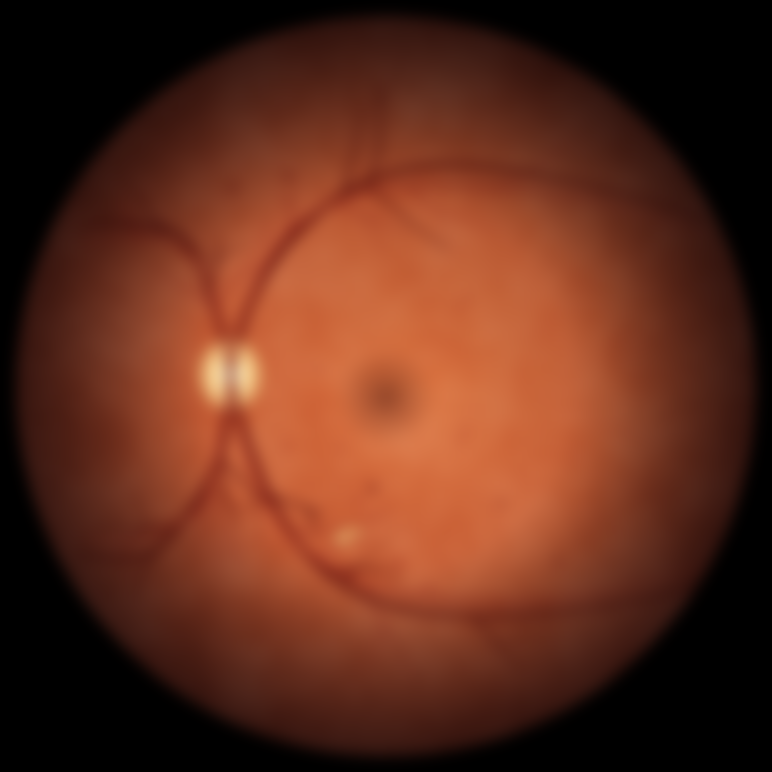
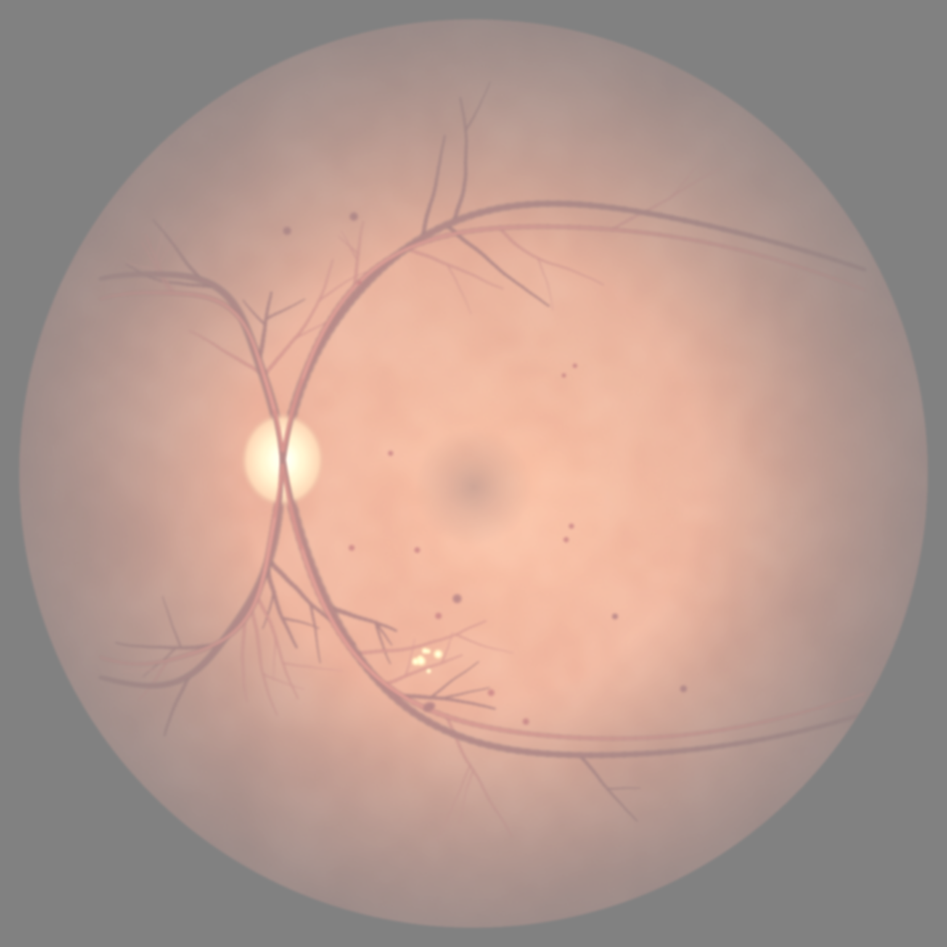
06 · QUALITY & UNCERTAINTY — RELIABILITY UNDER PRESSURE
Judge the evidence before the interpretation.
MEASURED FROM PIXELS
Sharpness · brightness · contrast · evenness · field coverage
NO INVENTED CONFIDENCE
No model, so no model response to degradation is shown.
NO-RESULT PATHWAY
Insufficient quality → no grade → recapture.
HEURISTICS
Tuned on 16 teaching images; not clinically validated.
ORIGINAL
BLUR σ = 7 px
WASHED-OUT PRESET
ORIGINAL
BLUR σ 7
WASHED-OUT
Sharpness
3.48
0.98
1.91
Brightness
76.58
76.54
171.12
Contrast
32.58
31.83
17.87
Verdict
ADEQUATE
INSUFFICIENT
BORDERLINE
Values: the prototype’s own quality functions on case C06 (768 px analysis render), recorded by capture.mjs
DIAGNOSTIC INTELLIGENCE LAB · AL DHAFRA HEALTH FORUM · EDUCATIONAL PROTOTYPE · NOT A MEDICAL DEVICE
07
Notes:
SPEAKER: Shamsa Faris Almazrouei (Grade 12) · target 30 s · slide 7/12
Before judging an interpretation, we judge the evidence. In Quality and Uncertainty, three sliders (blur, brightness and contrast) change the image in real time, and the platform measures sharpness, brightness and contrast directly from the pixels. These are the real measurements for these images. It never invents a confidence score, because there is no model to produce one, and our thresholds are heuristics that have not been clinically validated. If quality is insufficient, the answer is no result: recapture the image.
KEY LINE: Before evaluating an interpretation, we must consider the quality of the evidence.

Slide 8
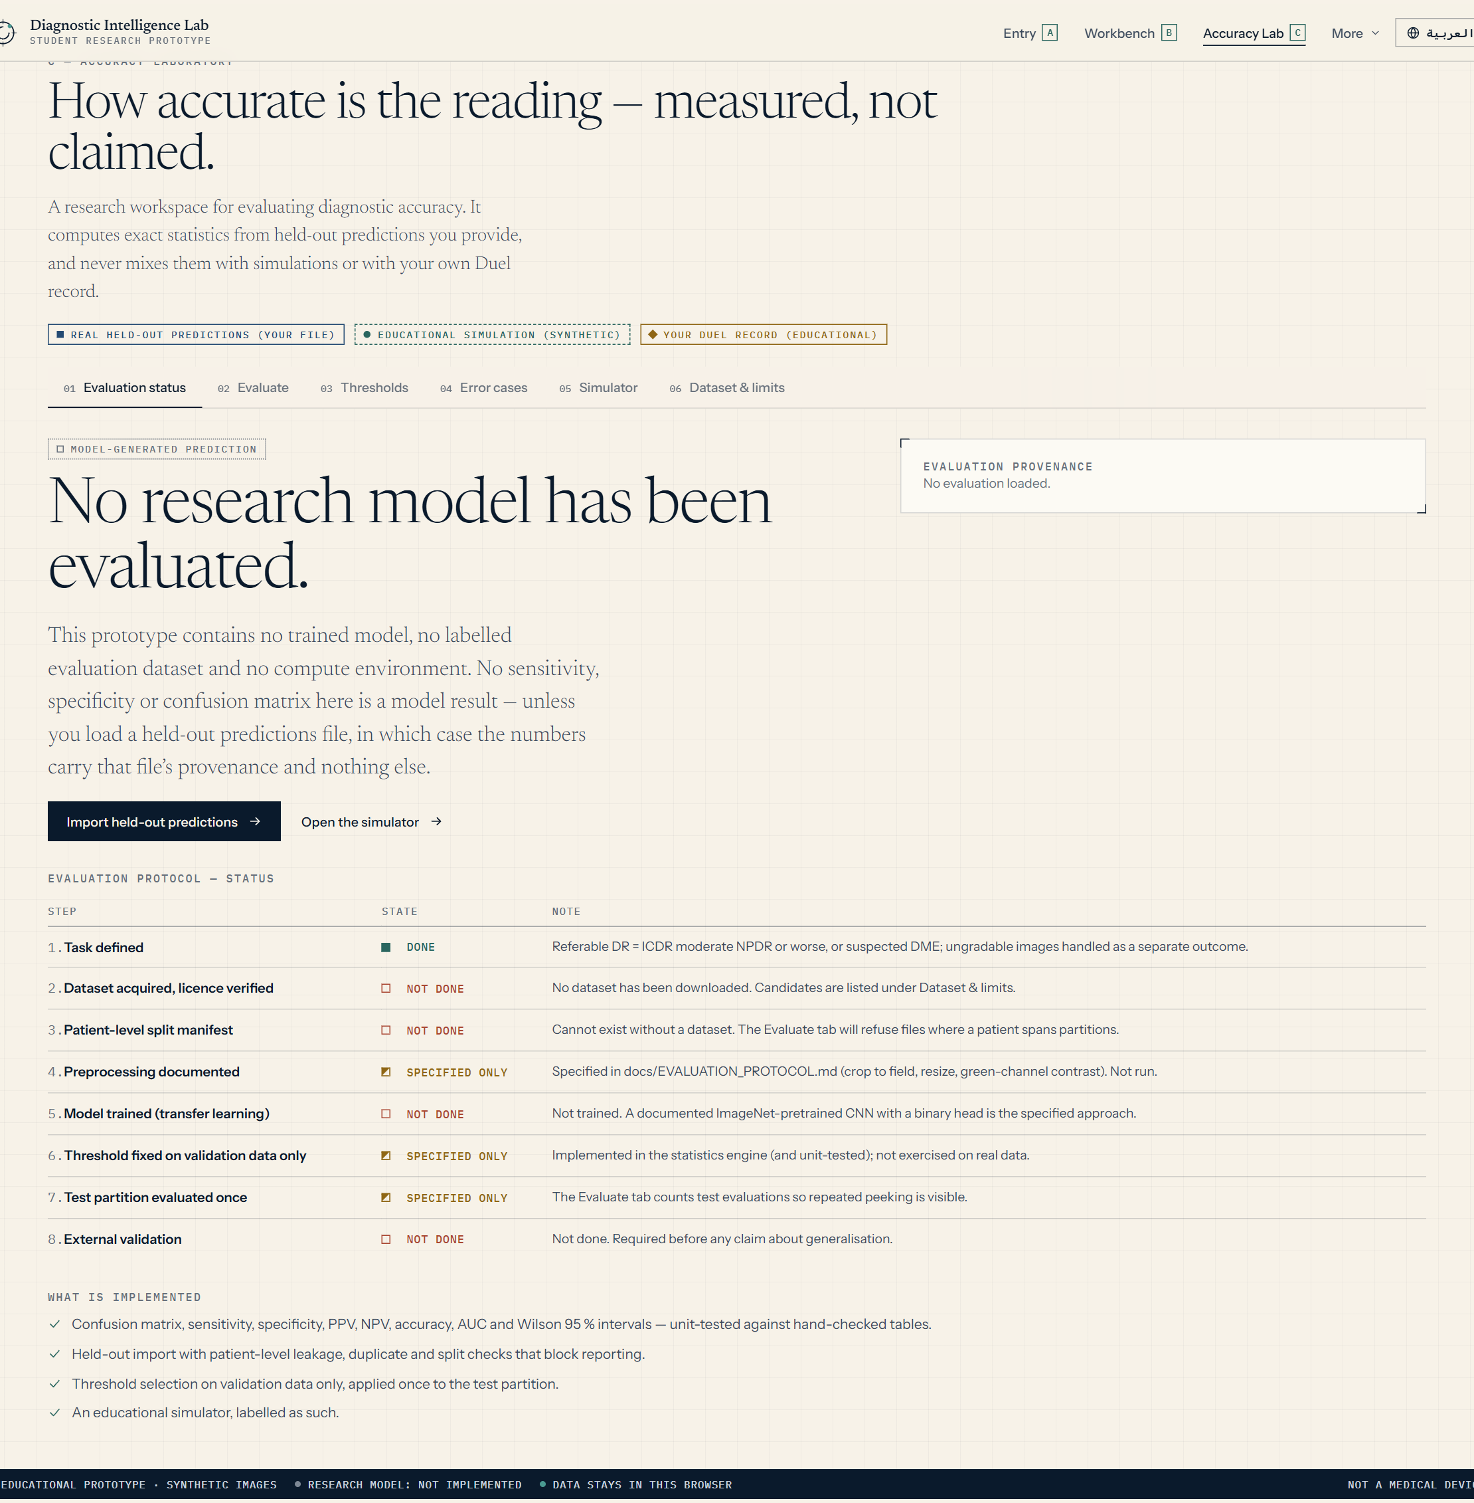
07 · ACCURACY LABORATORY — THE TECHNICAL CENTREPIECE
Measured, not claimed.
PREDICTED
THE LABORATORY COMPUTES
Referable
Non-referable
Sensitivity
Specificity
Referable
TP
FN
PPV · NPV
Accuracy
TRUE POSITIVE
FALSE NEGATIVE · MISSED
REFERENCE
ROC · AUC
Wilson 95% CI
Non-ref.
FP
TN
Threshold analysis
Error cases
FALSE POSITIVE · OVER-REFERRAL
TRUE NEGATIVE
AND IT PROTECTS THE EVALUATION
Patient-level leakage refused
Threshold chosen on validation only
Test evaluated once · counted
Provenance: file SHA-256 + declared metadata
DIAGRAM — NOT A RESULT. NO MODEL HAS BEEN EVALUATED.
LIVE APPLICATION · actual state: no research model evaluated
“The platform does not ask users to believe an accuracy claim. It establishes how that claim should be tested.”
DIAGNOSTIC INTELLIGENCE LAB · AL DHAFRA HEALTH FORUM · EDUCATIONAL PROTOTYPE · NOT A MEDICAL DEVICE
08
Notes:
SPEAKER: Shamsa Faris Almazrouei (Grade 12) · target 40 s · slide 8/12
Quality is one part of reliability. The other is measurement, and this is our technical centrepiece. From four counts, true and false positives and negatives, the Accuracy Laboratory computes sensitivity, specificity, predictive values, ROC area and Wilson confidence intervals, with threshold analysis and error cases. It also protects the evaluation: a file is refused if one patient appears in more than one partition, thresholds are chosen on validation data only, and the test set is used once. Now the honest part, on the right. The real state of the application is that no research model has been evaluated. The matrix here is a diagram, not a result. The platform does not ask you to believe an accuracy claim. It establishes how that claim should be tested.
HAND-OVER: Fatima will explain who stays accountable.
KEY LINE: The platform does not ask users to believe an accuracy claim. It establishes how that claim should be tested.

Slide 9
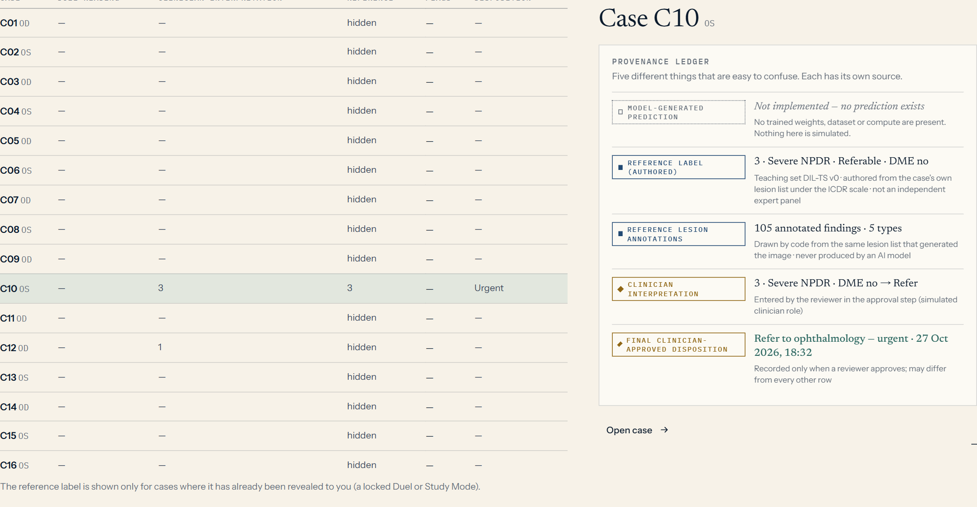
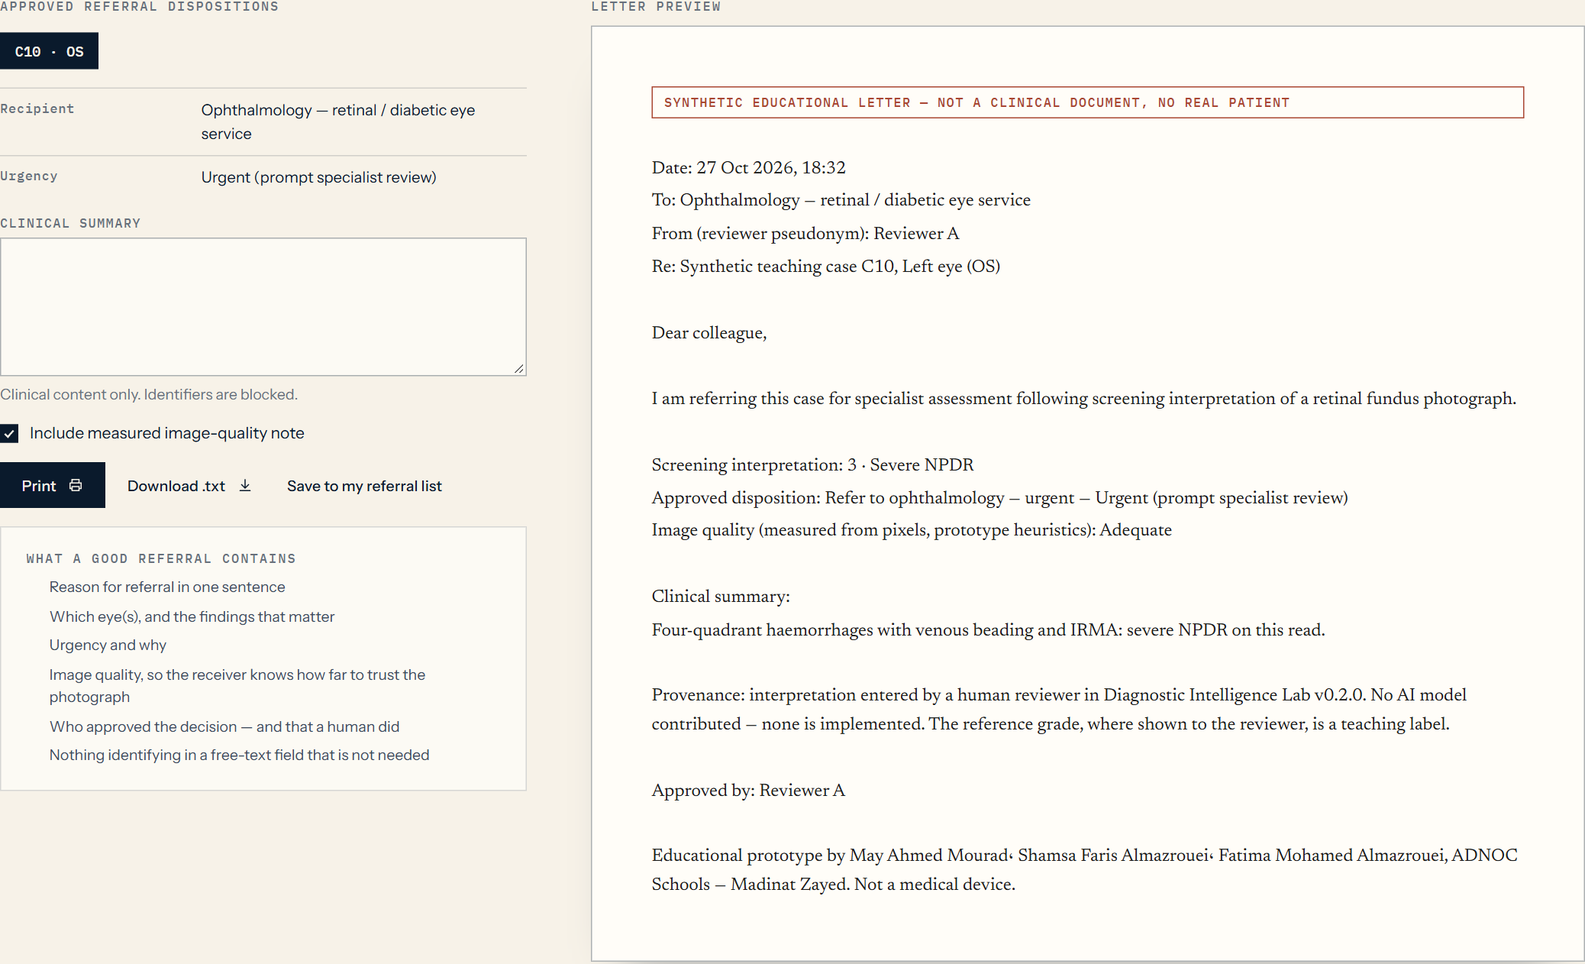
08 · HUMAN OVERSIGHT AND CAREBRIDGE
The decision stays human.
01
Interpretation
02
Review
03
Approval
04
Conditional referral draft
LIVE APPLICATION · Review Queue · discrepancy flags (sample records)
LIVE APPLICATION · CareBridge · drafted only after approval
It drafts a referral only after an eligible disposition is approved. It does not decide urgency or treatment.
DIAGNOSTIC INTELLIGENCE LAB · AL DHAFRA HEALTH FORUM · EDUCATIONAL PROTOTYPE · NOT A MEDICAL DEVICE
09
Notes:
SPEAKER: Fatima Mohamed Almazrouei (Grade 11) · target 30 s · slide 9/12
Thank you, Shamsa. A measured claim still needs a responsible human decision. Our workflow is: interpretation, review, approval, and only then a conditional referral draft. In the Review Queue, a reviewer sees discrepancies, for example when an interpretation differs from the reference label. In the approval step, the clinician role must acknowledge any discrepancy, and free text is scanned so identifiers cannot be typed in. CareBridge drafts a referral letter only after a human has approved an eligible disposition. It never decides urgency or treatment. AI-assisted healthcare must preserve human responsibility.
KEY LINE: AI-assisted healthcare must preserve human responsibility for clinical decisions.

Slide 10
09 · RESPONSIBLE AI BY DESIGN
Safeguards that are already built.
SAFETY
TRANSPARENCY
ACCOUNTABILITY
01
02
03
Synthetic cases only
No real patient uploads
No fabricated AI predictions
Image-quality awareness
Blind-first interpretation
Defined, attributed reference labels
Evaluation provenance recorded
Limitations stated on the page
English and Arabic interface
Human approval of every disposition
Records stay in local browser storage
Leakage checks protect evaluation
Review workflows
References, interpretations and decisions kept separate
NOT CLINICALLY APPROVED · NOT A MEDICAL DEVICE · NOT FOR REAL PATIENT CARE
DIAGNOSTIC INTELLIGENCE LAB · AL DHAFRA HEALTH FORUM · EDUCATIONAL PROTOTYPE · NOT A MEDICAL DEVICE
10
Notes:
SPEAKER: Fatima Mohamed Almazrouei (Grade 11) · target 30 s · slide 10/12
Responsible AI is built in, not added at the end. Safety: synthetic cases only, no patient uploads, no fabricated AI predictions, and awareness of image quality. Transparency: blind-first reading, defined and attributed reference labels, recorded evaluation provenance, limitations written on the page, and an interface in English and Arabic. Accountability: human approval, records that stay in the browser, leakage checks, review workflows, and a strict separation of references, interpretations and decisions. And to be equally clear: this prototype is not clinically approved and not ready for real patient care.

Slide 11
10 · FROM PROTOTYPE TO CLINICAL RESEARCH
The next step is not deployment.
It is rigorous validation.
TODAY
PHASE 1
PHASE 2
PHASE 3
PHASE 4
PHASE 5
Prototype
Representative data
Research model
External validation
Clinician-supervised research
Prospective evaluation
16 synthetic cases
Evidence inspection
Interpretation workflow
Evaluation engine
Human review
Licensed retinal dataset
Patient-separated train / validation / test
Train and evaluate
Document architecture, training, limits
External dataset
Subgroups · calibration
Quality robustness · errors
Performance · workflow
Automation bias
Human–AI collaboration
Prospective studies
Governance · security
Regulatory requirements
Solid = implemented in the published prototype. Dashed = future research, not built.
DIAGNOSTIC INTELLIGENCE LAB · AL DHAFRA HEALTH FORUM · EDUCATIONAL PROTOTYPE · NOT A MEDICAL DEVICE
11
Notes:
SPEAKER: Fatima Mohamed Almazrouei (Grade 11) · target 35 s · slide 11/12
So what comes next? Today, in teal, is the prototype and its evaluation tools. Phase one: obtain a properly licensed retinal dataset, split by patient into training, validation and test sets. Phase two: train and evaluate a real research model, and document it. Phase three: external validation, with other datasets, subgroups, calibration, image-quality robustness and error analysis. Phase four: clinician-supervised research on performance, workflow, automation bias and human–AI collaboration. Phase five: prospective studies, governance, security and regulation before any real-world use. The next step is not deployment. It is rigorous validation.
KEY LINE: The next step is not deployment. It is rigorous validation.

Slide 12
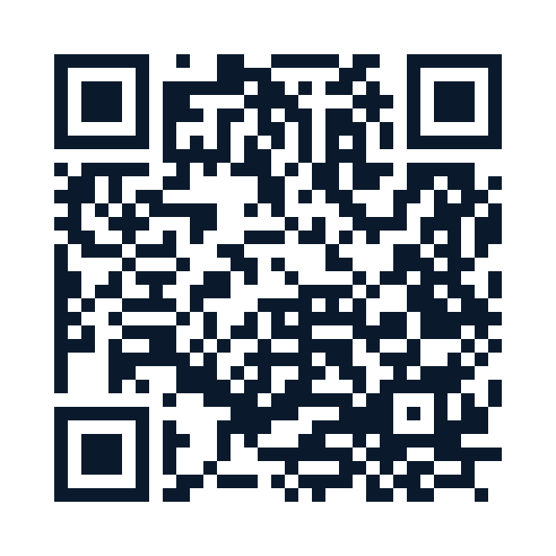
11 · INTELLIGENCE REQUIRES EVIDENCE
“The future of diagnostic AI should not be judged by how confidently it predicts — but by how reliably its accuracy can be demonstrated.”
SCAN · LIVE PROTOTYPE
maymourad.github.io/Diagnostic-Intelligence-Lab
TRANSPARENT EVIDENCE
MEASURABLE ACCURACY
Open source · MIT · github.com/MayMourad/Diagnostic-Intelligence-Lab
RESPONSIBLE DEVELOPMENT
HUMAN OVERSIGHT
Diagnostic Intelligence Lab
May Ahmed Mourad (G12) · Shamsa Faris Almazrouei (G12) · Fatima Mohamed Almazrouei (G11)
ADNOC Schools — Madinat Zayed · Al Dhafra Health Forum · Accurate Diagnosis — التشخيص الدقيق
DIAGNOSTIC INTELLIGENCE LAB · AL DHAFRA HEALTH FORUM · EDUCATIONAL PROTOTYPE · NOT A MEDICAL DEVICE
12
Notes:
SPEAKER: Fatima Mohamed Almazrouei (Grade 11) — then all three for “Thank you” · target 25 s · slide 12/12
To close: the future of diagnostic AI should not be judged by how confidently it predicts, but by how reliably its accuracy can be demonstrated. EvidenceLens makes evidence visible. Diagnostic Duel makes interpretation measurable. Quality and Uncertainty shows how reliable the evidence is. The Accuracy Laboratory shows how performance must be tested. And human oversight keeps accountability where it belongs. Intelligence requires evidence. The prototype is live: scan the code. Thank you. We would be glad to take your questions.

Slide 13
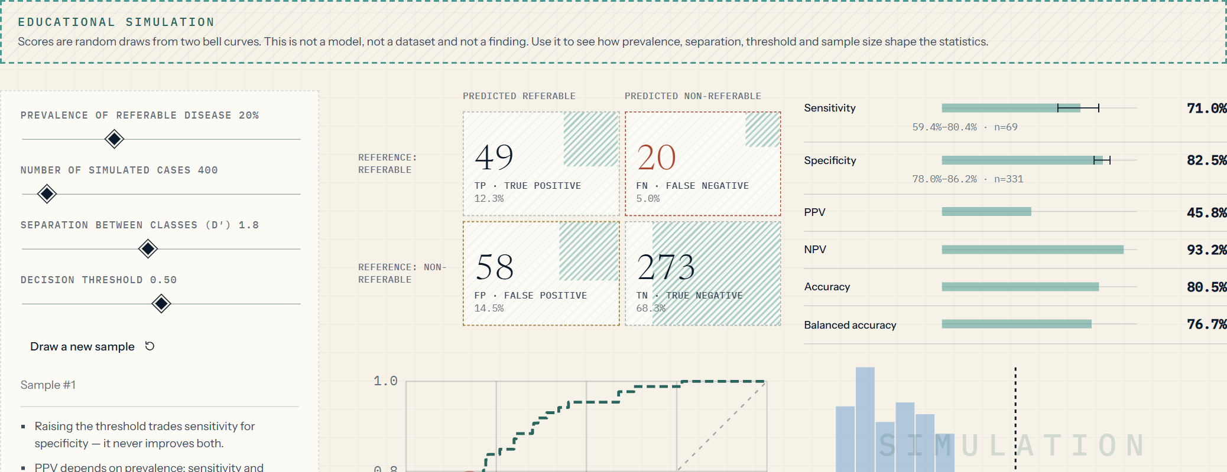
APPENDIX A · DIAGNOSTIC EVALUATION MATHEMATICS
Four counts. Everything else follows.
Sensitivity
TP ÷ (TP + FN)
Specificity
TN ÷ (TN + FP)
Of the truly referable, the share found. Misses are FN.
Of the truly non-referable, the share correctly cleared.
PPV
TP ÷ (TP + FP)
NPV
TN ÷ (TN + FN)
When it says “refer”, how often it is right — depends on prevalence.
When it says “routine”, how often it is right — depends on prevalence.
Accuracy
(TP + TN) ÷ all
Wilson 95% CI
p̂ ± z·√(p̂(1−p̂)/n + z²/4n²) ÷ (1+z²/n)
Overall agreement; can hide a poor sensitivity when disease is rare.
Interval for a proportion; wide when n is small.
THRESHOLD TRADE-OFF
Raising the decision threshold trades sensitivity for specificity — it never improves both. The simulator at right is stamped SIMULATION and uses random scores, not a model.
DIAGNOSTIC INTELLIGENCE LAB · AL DHAFRA HEALTH FORUM · EDUCATIONAL PROTOTYPE · NOT A MEDICAL DEVICE · APPENDIX
A1
Notes:
APPENDIX A (for Q&A). Sensitivity = TP/(TP+FN): of the truly referable, how many were found. Specificity = TN/(TN+FP). Raising the threshold trades sensitivity for specificity; it never improves both. PPV and NPV depend on prevalence, so they change with the screened population even when sensitivity and specificity do not. Wilson intervals show how little a small sample can say. The simulator picture is stamped SIMULATION: random scores, not a model.

Slide 14
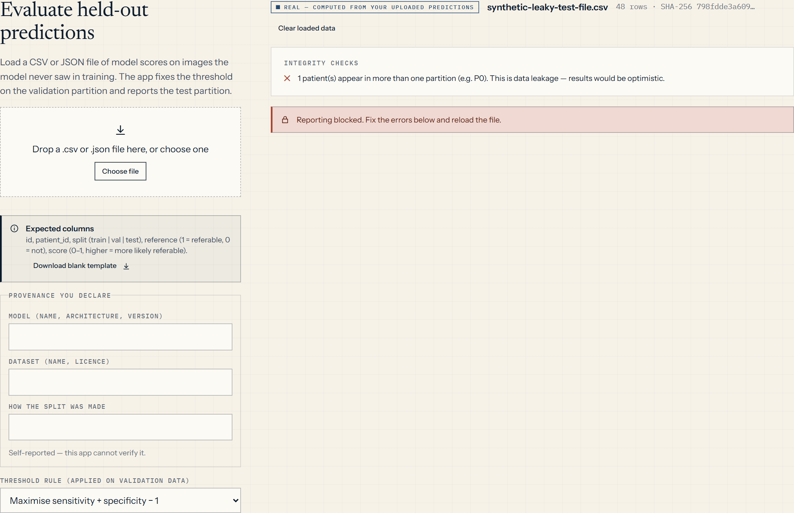
APPENDIX B · DATASET INTEGRITY
A good result on bad data is a bad result.
Held-out file
Integrity checks
Threshold
Test, once
Provenance
id · patient · split · reference · score
leakage · duplicates · class balance
validation data only
evaluations are counted
SHA-256 · declared metadata
Patient-level leakage: one patient, one partition.
Separation: train fits, validation selects, test reports once.
Provenance: who made the model, on what data — declared, hashed.
External validation: a different site or camera.
Reproducibility: fixed seeds, unit-tested engine, CI.
LIVE APPLICATION · synthetic test file with a deliberate leak → reporting blocked
DIAGNOSTIC INTELLIGENCE LAB · AL DHAFRA HEALTH FORUM · EDUCATIONAL PROTOTYPE · NOT A MEDICAL DEVICE · APPENDIX
A2
Notes:
APPENDIX B (for Q&A). If the same patient appears in both training and test data, performance looks better than it is. The Accuracy Laboratory refuses a predictions file when a patient spans partitions. The screenshot is a synthetic test file we built to show the refusal; it contains no results. Provenance: the application records the SHA-256 of the file and the declared model and dataset, labelled self-reported because it cannot verify them. Thresholds are chosen on validation data only; the test partition is used once.

Slide 15
APPENDIX C · CURRENT STATUS AND LIMITATIONS
Exactly what exists — and what does not.
IMPLEMENTED
SYNTHETIC · EDUCATIONAL
EVALUATION INFRASTRUCTURE
NOT IMPLEMENTED
Entry, Workbench, EvidenceLens
Diagnostic Duel · quality and stress test
Clinician approval · review · CareBridge
English and Arabic interface
16 retinal teaching illustrations
Authored lesions → ICDR-derived labels
Statistics simulator (stamped)
Educational duel score
Confusion matrix, sens/spec, PPV/NPV, AUC, Wilson CI
Held-out import · leakage checks
Validation-only thresholds
31 unit + 35 browser tests · CI
Any trained diagnostic model
Real-dataset evaluation
Validated sensitivity / specificity
Evidence of improved clinician accuracy
REQUIRED BEFORE ANY CLINICAL USE
Licensed data and ethics approval
External and prospective validation
Clinician-supervised research
Governance, security, regulatory review
WHY IT IS NOT A MEDICAL DEVICE
No validated performance claim
Synthetic cases only; no patient data
Never produces a diagnosis or treatment advice
Every decision is a human’s
DIAGNOSTIC INTELLIGENCE LAB · AL DHAFRA HEALTH FORUM · EDUCATIONAL PROTOTYPE · NOT A MEDICAL DEVICE · APPENDIX
A3
Notes:
APPENDIX C (for Q&A). Be direct. Implemented: the workflows and evaluation tools. Synthetic: the cases and their authored reference labels. Infrastructure: the evaluation engine that can score a future model. Not implemented: any model training. Required before any clinical use: licensed data and ethics approval, external and prospective validation, clinician-supervised research, governance and regulatory review. It is not a medical device.

