Slide 1
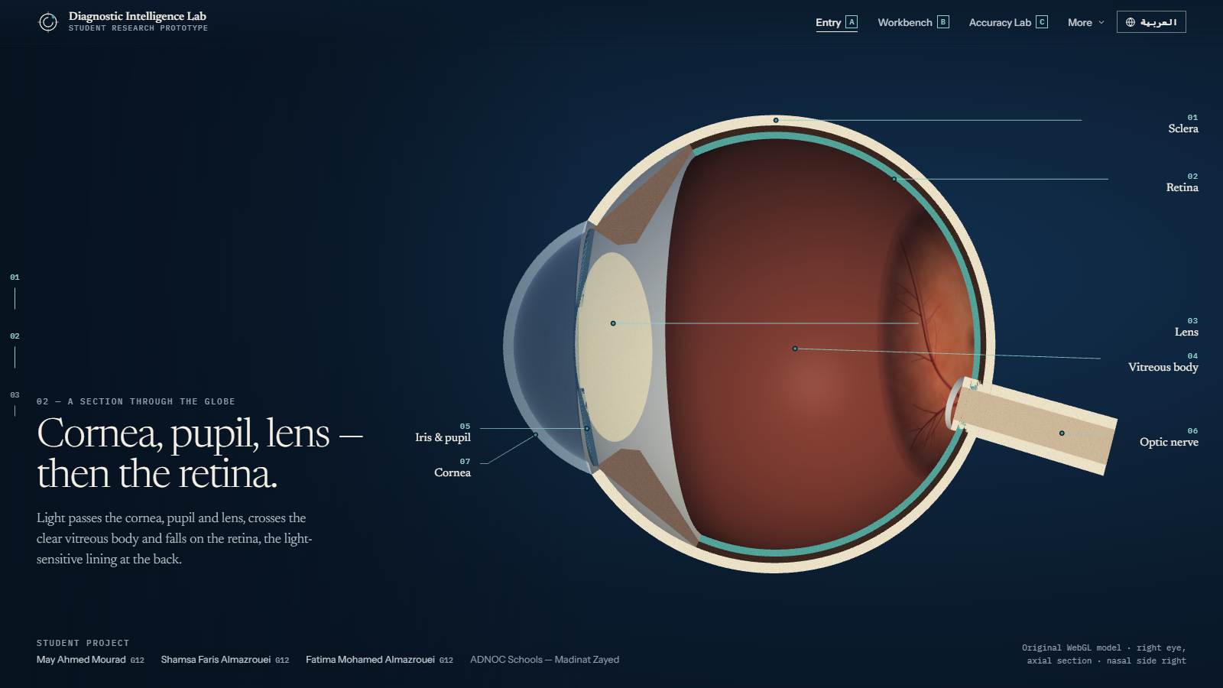
STUDENT RESEARCH PROTOTYPE · ADNOC SCHOOLS — MADINAT ZAYED
Diagnostic
Intelligence
Lab
How accurately is a diagnosis read — and how would we know?
May Ahmed Mourad · G12
Shamsa Faris Almazrouei · G12
Fatima Mohamed Almazrouei · G12
Screenshot · original WebGL eye, schematic and not to scale
Provisional project title · a final brand has not been chosen
Notes:
Opening. This is a student research prototype by May Ahmed Mourad, Shamsa Faris Almazrouei and Fatima Mohamed Almazrouei (Grade 12, ADNOC Schools - Madinat Zayed). The name is provisional. The question we ask is not "can AI diagnose?" but "how accurately is a diagnosis read, and how would we know?" The eye on the right is our own 3D model - a schematic, not clinical evidence.

Slide 2
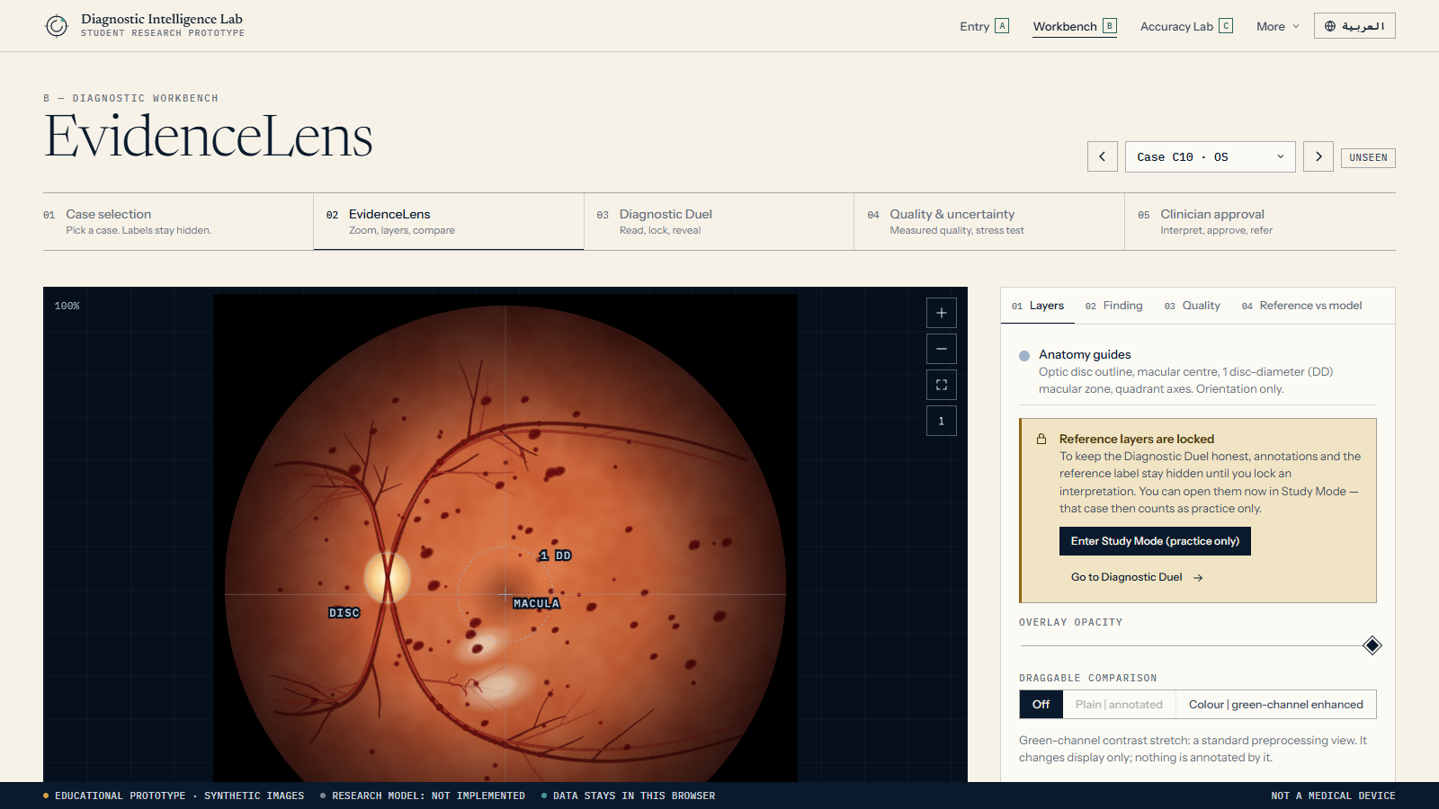
01 · THE DIAGNOSTIC PROBLEM
A photograph is only as useful as its reading.
Screening asks one question per image: refer, or re-screen?
The answer rests on small signs — a few microaneurysms, a haemorrhage near the edge — and on whether the image can be read at all.
Readers disagree, and cases near a boundary are where errors cluster.
Screenshot · the viewer in blind mode: labels and annotations are locked
FALSE NEGATIVE
Disease sent home as normal.
The costly error: treatment is delayed and sight-threatening disease can progress unseen.
FALSE POSITIVE
A needless referral.
Cost, worry and queue pressure — usually the safer error, but at scale it can overwhelm a service.
DIAGNOSTIC INTELLIGENCE LAB (PROVISIONAL TITLE) · EDUCATIONAL PROTOTYPE · SYNTHETIC IMAGES · NO RESEARCH MODEL IMPLEMENTED
02
Notes:
The problem. Diabetic retinopathy can damage sight before symptoms appear, so screening programmes photograph the retina and a reader decides: refer, or re-screen. That decision rests on small signs and on whether the image can be read at all. Two errors matter and they are not equal: a false negative sends disease home; a false positive causes an unnecessary referral. The screenshot is our viewer with the answer deliberately hidden.

Slide 3
02 · RESEARCH HYPOTHESIS
Reading accuracy can be measured — case by case.
H1
H2
H3
DEMONSTRATED · EDUCATIONAL
SPECIFIED · ENGINE BUILT
FUTURE · NOT CLAIMED
Readings can be scored against a reference.
The same protocol can test any AI aid, honestly.
Does an AI aid improve clinicians?
On a defined set, each human reading is compared with a reference label: sensitivity, specificity — and where the errors cluster.
Patient-level split, threshold fixed on validation data only, one test pass. No model has been evaluated yet.
That needs a controlled reader study. This project makes no such claim and the app says so.
DIAGNOSTIC INTELLIGENCE LAB (PROVISIONAL TITLE) · EDUCATIONAL PROTOTYPE · SYNTHETIC IMAGES · NO RESEARCH MODEL IMPLEMENTED
03
Notes:
The research hypothesis in three parts, each tagged honestly. H1 we demonstrate educationally: a reading can be scored against a reference. H2 is specified and the statistics engine is built and unit-tested, but no model has been evaluated. H3, whether an AI aid improves clinician accuracy, is future work and needs a controlled reader study - we make no such claim.

Slide 4
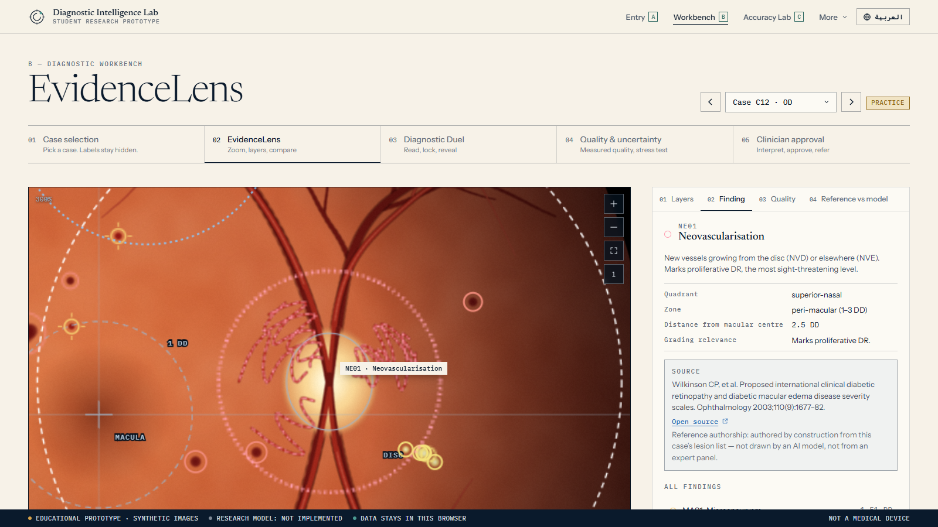
03 · EXPERT REFERENCE STANDARDS
What counts as the truth?
0
1
2
3
4
None
Mild
Moderate
Severe
Proliferative
NON-REFERABLE
REFERABLE · or suspected DME
ICDR scale, 5 levels. Referable = moderate NPDR or worse, or suspected macular oedema.
4-2-1 rule for severe: haemorrhages in 4 quadrants, venous beading in 2, or IRMA in 1.
Here the reference is authored from each case’s lesion list and re-derived by an automated test — a teaching reference, not an expert panel.
A real study needs several graders, adjudication, and disclosed disagreement.
Screenshot · every annotation links to its grading source and states who authored it
Source: Wilkinson CP et al., Ophthalmology 2003;110(9):1677–82 · ETDRS Report 10 (1991).
DIAGNOSTIC INTELLIGENCE LAB (PROVISIONAL TITLE) · EDUCATIONAL PROTOTYPE · SYNTHETIC IMAGES · NO RESEARCH MODEL IMPLEMENTED
04
Notes:
Expert reference standards. We use the ICDR five-level scale (Wilkinson et al., Ophthalmology 2003). Referable means moderate NPDR or worse, or suspected macular oedema. The 4-2-1 rule defines severe disease. Important honesty point: in this prototype the reference label is authored from each case's own lesion list and re-derived by an automated test - it is a teaching reference, not an independent expert panel. A real study needs several graders and adjudication.

Slide 5
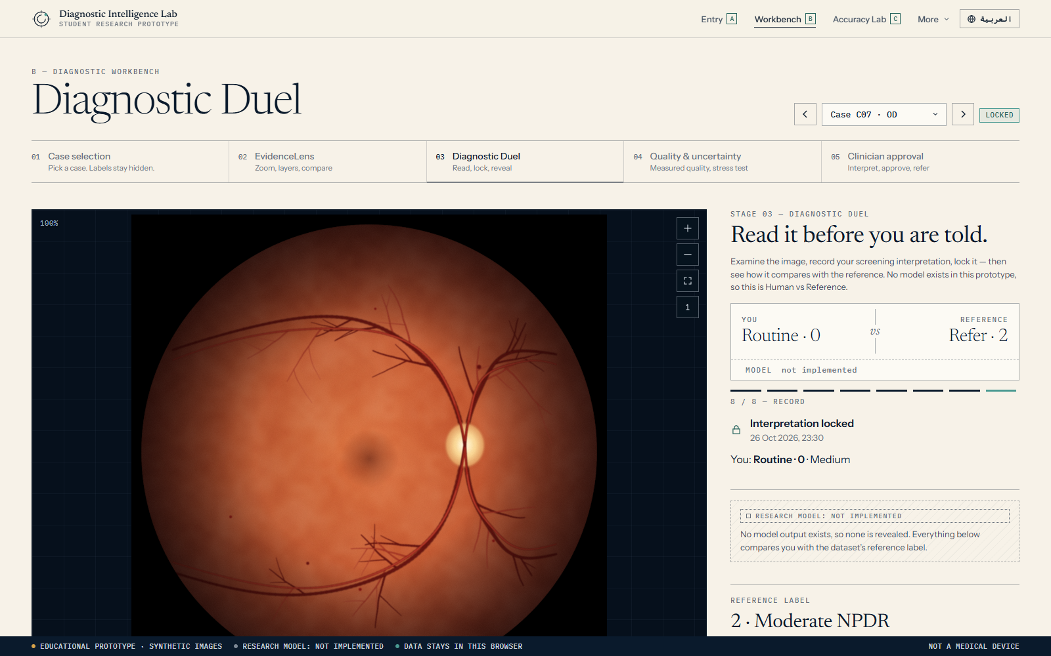
04 · DIAGNOSTIC DUEL
Read it before you are told.
1 Observe
2 Record
3 Lock
4 Model
5 Reference
6 Compare
7 Meaning
8 Record
Human vs Reference. No model exists, so the model seat says “not implemented” — never “Human vs AI”.
Locked first. Opening reference layers earlier makes a case practice-only.
Why it matters. A false negative is explained as the costly error; a false positive as a trade-off.
Educational score with 95% intervals — not validated clinical performance.
Screenshot · a locked reading beside the reference; model seat: not implemented
DIAGNOSTIC INTELLIGENCE LAB (PROVISIONAL TITLE) · EDUCATIONAL PROTOTYPE · SYNTHETIC IMAGES · NO RESEARCH MODEL IMPLEMENTED
05
Notes:
The Diagnostic Duel. The reader sees an image with no label, records an interpretation, locks it, and only then sees what the reference says. Because no model exists, the duel is Human vs Reference and is never labelled Human vs AI. The score is educational - a small synthetic set, not validated clinical performance - and it does not show that AI improves clinicians. If a reader opens the reference first, that case becomes practice-only and is excluded from the score.

Slide 6
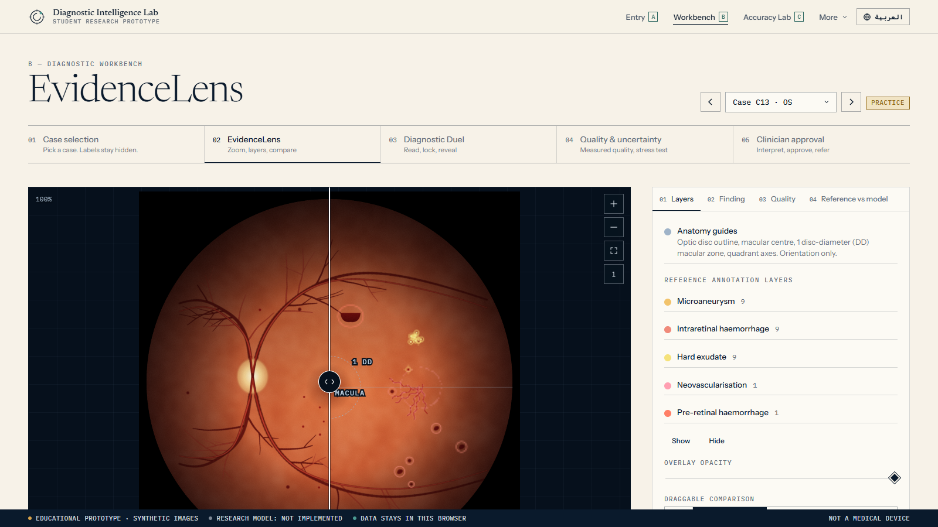
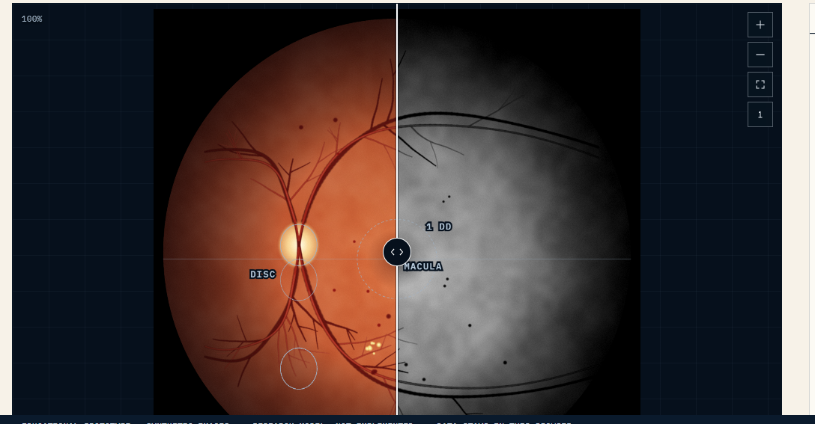
05 · EVIDENCELENS
Every annotation has an author and a source.
Zoom, pan, fit and native resolution; keyboard operable.
Layered reference annotations, revealed one layer at a time, with an opacity control.
Draggable before / after: plain | annotated, and colour | green-channel enhanced.
Lesion panels with location in disc diameters, grading relevance and source links.
Image-quality indicators measured from pixels — not authored.
Reference vs model side by side; the model column reads “not implemented”.
Screenshot · draggable divider: plain | annotated
Screenshot · colour | green-channel enhanced
DIAGNOSTIC INTELLIGENCE LAB (PROVISIONAL TITLE) · EDUCATIONAL PROTOTYPE · SYNTHETIC IMAGES · NO RESEARCH MODEL IMPLEMENTED
06
Notes:
EvidenceLens. A retinal viewer with smooth zoom and pan, layered reference annotations that reveal one layer at a time, an opacity control, a draggable before/after comparison, lesion information panels with source links, image-quality indicators measured from the pixels, and a side-by-side of reference versus model output where the model column reads not implemented. The annotations are drawn from the same lesion list that generated the synthetic image - never produced by an AI model - and we say so in the interface.

Slide 7
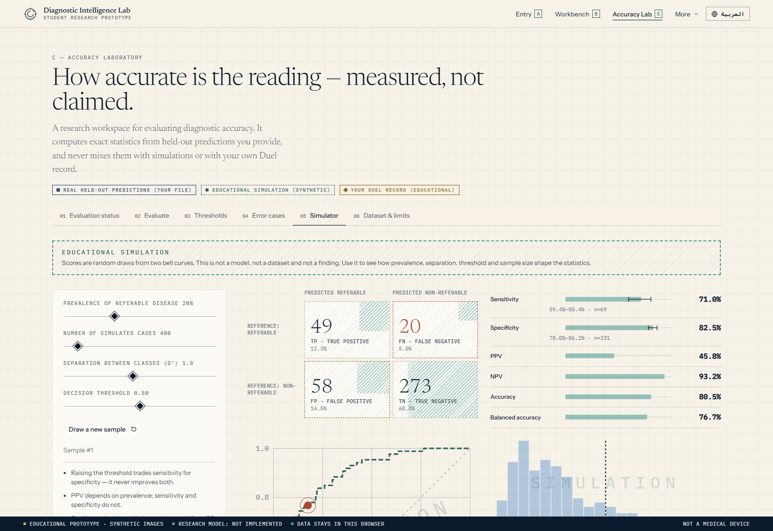
06 · ACCURACY LABORATORY
Measured, not claimed.
Confusion matrix, sensitivity, specificity, PPV, NPV, AUC, 95% intervals.
Threshold chosen on validation data only; test partition counted so repeated peeking shows.
Held-out file import refuses patient-level leakage.
Error cases listed with image ids.
REAL
Held-out predictions you supply
SIMULATED
Educational, synthetic, stamped
LEARNER
Your duel record, educational
Screenshot · the simulator — stamped SIMULATION; not a research result
DIAGNOSTIC INTELLIGENCE LAB (PROVISIONAL TITLE) · EDUCATIONAL PROTOTYPE · SYNTHETIC IMAGES · NO RESEARCH MODEL IMPLEMENTED
07
Notes:
The Accuracy Laboratory. Confusion matrix, sensitivity and specificity with Wilson intervals, threshold exploration, error-case inspection and research limits. The statistics are exact and unit-tested. Three provenance treatments can never be confused: real held-out predictions in solid navy, educational simulation in dashed teal with a stamp, and the learner's own duel record in ochre. What you see in the screenshot is the simulator - stamped SIMULATION - not a research result.

Slide 8
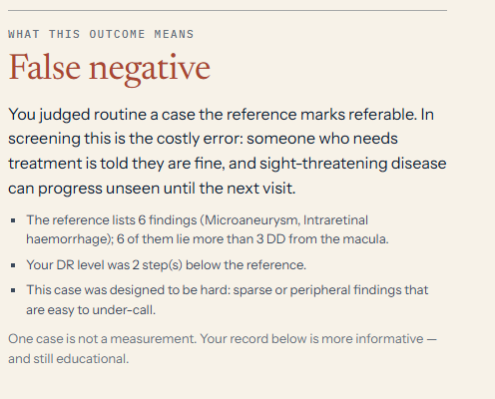
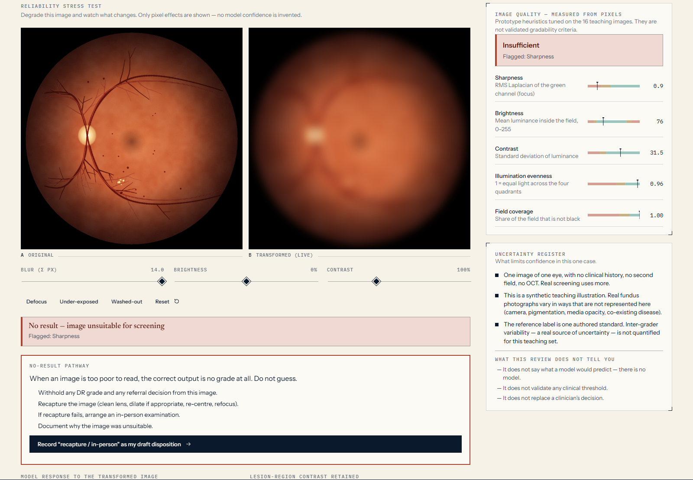
07 · FALSE NEGATIVES AND DIAGNOSTIC UNCERTAINTY
The costly error is the quiet one.
Screenshot · duel outcome after a false negative
Uncertainty is shown, not hidden: measured quality, a no-result pathway, and a register of what limits confidence.
Screenshot · blur σ = 14: measured quality “insufficient” → no result, no confidence value
DIAGNOSTIC INTELLIGENCE LAB (PROVISIONAL TITLE) · EDUCATIONAL PROTOTYPE · SYNTHETIC IMAGES · NO RESEARCH MODEL IMPLEMENTED
08
Notes:
False negatives and diagnostic uncertainty. On the left, what the Duel says after a false negative: the costly error, the consequence, and a hint drawn from the reference lesion list. On the right, the Reliability Stress Test: blur, brightness and contrast change the image in real time and the quality indicators are measured from the pixels. When the image becomes unsuitable the app gives no result and shows a recapture pathway. It never invents a model confidence - there is no model.

Slide 9
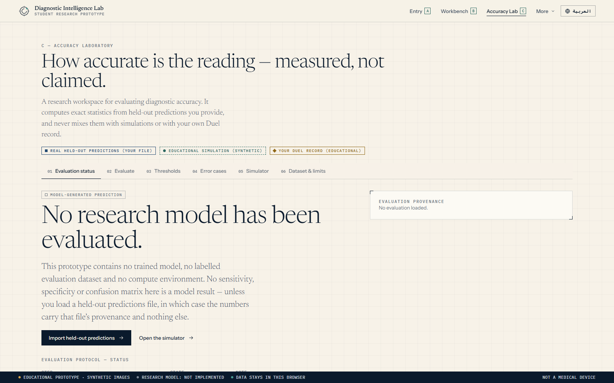
08 · ACTUAL RESEARCH-MODEL EVALUATION
No model has been evaluated — and the app says so.
1. Task defined (referable DR)
DONE
2. Dataset acquired, licence verified
NOT DONE
3. Patient-level split manifest
NOT DONE
4. Preprocessing documented
SPECIFIED ONLY
5. Model trained (transfer learning)
NOT DONE
6. Threshold fixed on validation only
SPECIFIED · ENGINE BUILT
7. Test partition evaluated once
SPECIFIED · ENGINE BUILT
Screenshot · the Laboratory’s status page
8. External validation
NOT DONE
WHAT WOULD CHANGE THIS
A licensed dataset, a patient-level split, a trained baseline and one pre-registered test pass.
DIAGNOSTIC INTELLIGENCE LAB (PROVISIONAL TITLE) · EDUCATIONAL PROTOTYPE · SYNTHETIC IMAGES · NO RESEARCH MODEL IMPLEMENTED
09
Notes:
Actual research-model evaluation. The honest answer: there is none. This machine has no Python environment, no GPU and no licensed research dataset, and training a toy model on sixteen synthetic drawings would be meaningless. So the protocol is specified in full, the statistics engine is implemented and tested, and the Laboratory will compute real results the moment a held-out predictions file is supplied. Until then every empty state says not implemented.

Slide 10
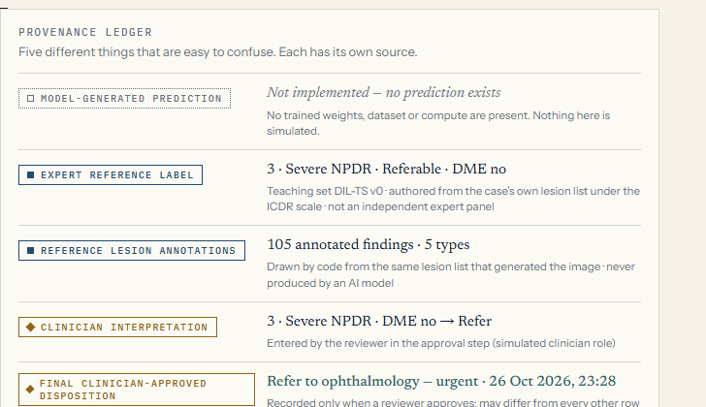
09 · RESPONSIBLE CLINICAL INTEGRATION
A path with stops — and this prototype stops first.
01
Retrospective validation
02
Silent prospective run
03
Assisted-reading study
04
Regulated deployment + monitoring
This prototype stops before step 1.
Human in the loop: a person chooses and approves every disposition.
Five-way provenance: model, reference, annotations, clinician, disposition — never merged.
No fabrication: no invented confidence, no simulated scanning.
No-result pathway and leakage control; privacy by design, identifiers blocked.
Screenshot · the provenance ledger
DIAGNOSTIC INTELLIGENCE LAB (PROVISIONAL TITLE) · EDUCATIONAL PROTOTYPE · SYNTHETIC IMAGES · NO RESEARCH MODEL IMPLEMENTED
10
Notes:
Responsible clinical integration. Before any clinical use there is a path: retrospective validation on a locally representative, patient-split dataset; silent prospective evaluation; an assisted-reading study that measures accuracy, time and automation bias; and regulated deployment with monitoring. This prototype stops before step one. Inside the prototype the safeguards are a human in the loop, a blind-first duel, five-way provenance, no fabrication, a no-result pathway, leakage control and privacy by design. The ledger on the right shows the five things we never merge.

Slide 11
10 · IMPLEMENTED, SIMULATED, FUTURE
What is real, what is a stand-in, what is not built.
IMPLEMENTED
SIMULATED · EDUCATIONAL
FUTURE · NOT BUILT
3D eye, guided entry, static fallback
EvidenceLens: zoom, layers, compare
Diagnostic Duel (Human vs Reference)
Quality indicators, stress test, no-result path
Metrics engine, leakage-safe import
Clinician approval, CareBridge, privacy guard
English and Arabic (RTL)
Statistics simulator (stamped)
Synthetic teaching images
Authored reference labels (ICDR-derived)
Duel score — educational, not validated
Trained research model
Real-dataset evaluation
Patient-level split, external validation
Reader study of AI assistance
Clinical Arabic proof-reading
Accessibility audit
TESTS 35 of 35 browser tests passing in real Chrome · 31 unit tests passing · results in docs/TEST_RESULTS.json
DIAGNOSTIC INTELLIGENCE LAB (PROVISIONAL TITLE) · EDUCATIONAL PROTOTYPE · SYNTHETIC IMAGES · NO RESEARCH MODEL IMPLEMENTED
11
Notes:
Feature status, in three columns. Implemented means working and tested. Simulated means a clearly labelled educational stand-in. Future means not built. Test results: 35 browser tests in real Chrome (35 passing) plus unit tests for the statistics engine, ICDR reference consistency, bilingual parity and the identifier scanner.

Slide 12
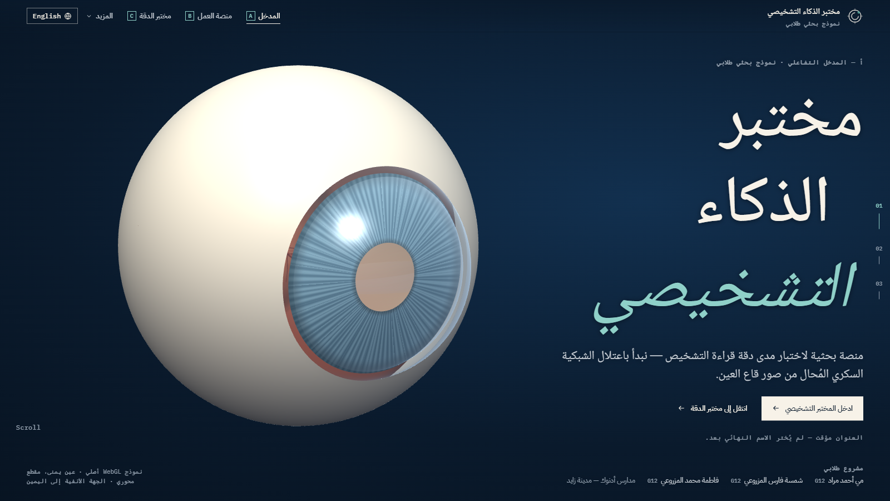
11 · NEXT STEPS AND CREDITS
The next step is data, not decoration.
01
Secure a licensed dataset (APTOS, EyePACS, Messidor-2 or IDRiD) and record its terms
02
Build a patient-level split manifest and remove near-duplicates
Screenshot · Arabic (RTL) — same caveats in both languages
03
Train a documented transfer-learning baseline with an abstain output
MAY AHMED MOURAD · G12
SHAMSA FARIS ALMAZROUEI · G12
FATIMA MOHAMED ALMAZROUEI · G12
ADNOC Schools — Madinat Zayed
A student project. No endorsement by ADNOC or ADNOC Schools is implied. Not a medical device.
04
Fix the threshold on validation data; spend the test partition once
05
Only then: a controlled reader study of AI assistance
Sources: Wilkinson et al., Ophthalmology 2003 (ICDR) · ETDRS Report 10, 1991
DIAGNOSTIC INTELLIGENCE LAB (PROVISIONAL TITLE) · EDUCATIONAL PROTOTYPE · SYNTHETIC IMAGES · NO RESEARCH MODEL IMPLEMENTED
12
Notes:
Next steps and credits. The next scientific step is to obtain a licensed dataset and run the specified protocol - training a baseline, fixing the threshold on validation data and spending the test partition once - and only then think about a reader study. Thank the team and the school. Sources: ICDR and ETDRS grading criteria.

