Slide 1
AL DHAFRA HEALTH FORUM · DEVELOPING HEALTHCARE SERVICES
SAYR
08:00
10:00
10:50
12:00
14:00
16:00
AI
REG-1
REG-2
Care in Motion.
VIT-1
VIT-2
Every minute matters.
Every decision moves the system.
GP-1
GP-2
OUTAGE · 10:30–13:30
A simulation-driven healthcare operations decision-support prototype. Synthetic data only.
GP-3
Lujain Ahmed Mourad 8D
Yosr Amgad 8D
LAB-1
Precious Fuentes 8D
Maryam Ammara Jelita 8D
CHK-1
Eleen Amr 8D
Shaden Ahmed Mourad 6D
One clinician unavailable: the lane is lost, the queue grows, the plan must move.
ADNOC Schools, Madinat Zayed
FLOW CANVAS · ILLUSTRATION OF THE IDEA, NOT DATA
Notes:
SPEAKER: Lujain
Every minute matters. Every decision moves the system. We are the SAYR AI team from ADNOC School in Madinat Zayed, and this is Care in Motion, our entry for Developing Healthcare Services. "Sayr" is an Arabic word for movement and progression. We looked at a clinic in a different way: not one patient at a time, but the whole clinic moving together as one connected system.
VOCABULARY: Decision-support: a tool that helps a person decide. It does not decide for them.

Slide 2
When one delay becomes everyone's delay
THE PROBLEM
ONE CLINICIAN UNAVAILABLE
IF NEEDED
Registration
Vital signs
Consultation
Laboratory
Checkout
01
02
03
04
05
CONSULTATION QUEUE AT 11:45 · SAME PATIENTS, SAME SEED
Normal day
4 waiting
longest wait 16 min
Healthcare delays are rarely isolated.
One clinician out
10 waiting
longest wait 40 min
QUEUES GROW
THE DELAY TRAVELS
JOURNEYS LENGTHEN
11 waiting vs 5
37 patients
60 → 74 min
Everyone behind the missing clinician waits. Longest wait 40 min vs 16 min at 11:45.
delayed 3+ min across 26 hops. Laboratory and checkout feel it later (+76 and +15 min).
Average time from arrival to departure. 59 of 60 patients finish by 16:00 instead of 60.
Hypothetical outpatient journey; figures from SAYR's simulation of a fictional clinic (seed 7, staff-unavailability scenario, 10:30–13:30). No claim is made about any Al Dhafra facility.
Notes:
SPEAKER: Lujain
Picture a clinic visit: register, vital signs, see the clinician, maybe a lab test, then check out. Now one clinician becomes unavailable. It sounds small. But everyone waiting for that clinician waits longer, and the lab and checkout feel it later. In our simulated clinic, one clinician missing for three hours added 890 waiting minutes across 37 patients. That is a simulation of a fictional clinic, not data from any real hospital. The lesson is simple: healthcare delays are rarely isolated.
VOCABULARY: Simulation: a computer model that plays out a day many times, so we can test ideas without touching real patients.

Slide 3
What if we could test operational decisions before they affect real patients?
OUR RESEARCH QUESTION
SAYR is a simulation-driven healthcare operations decision-support prototype.
01
02
03
04
05
06
07
Model a clinic
Simulate operations
Introduce a disruption
Trace consequences
Optimize a plan
Review and approve
Measure the result
CONTROL ROOM
CONTROL ROOM
STRESS CONTROLS
RIPPLE TRACE
REFLOW STUDIO
ACTION DESK
MINUTES LEDGER
ONE DETERMINISTIC SIMULATION STATE · EVERY SCREEN READS THE SAME DATA
Synthetic clinic
Discrete-event simulation
Forecast baseline
Reflow
Explanations
Person approves
›
›
›
›
›
seeded patients, 9 resources
queues, services, outages, event log
hourly arrivals, evaluated
constraint-aware local search
from the event log, no language model
then the Ledger measures
No trained machine-learning model is used. Methods: simulation, a forecasting baseline evaluated against two simpler ones, and a heuristic optimizer. Source: SAYR About, methods & credits.
Notes:
SPEAKER: Yosr
So we asked: what if we could test operational decisions before they affect real patients? SAYR is a simulation-driven decision-support prototype. The workflow has seven steps: model a clinic, simulate its day, introduce a disruption, trace the consequences, optimize a plan, let a person review and approve it, and measure the result. We want to be clear about the methods. It uses a simulation, a simple forecasting baseline and a search-based optimizer. It does not use a trained machine-learning model.
VOCABULARY: Optimizer: a program that searches for a better plan under rules. Here it is a heuristic search, not a guarantee of the best plan.

Slide 4
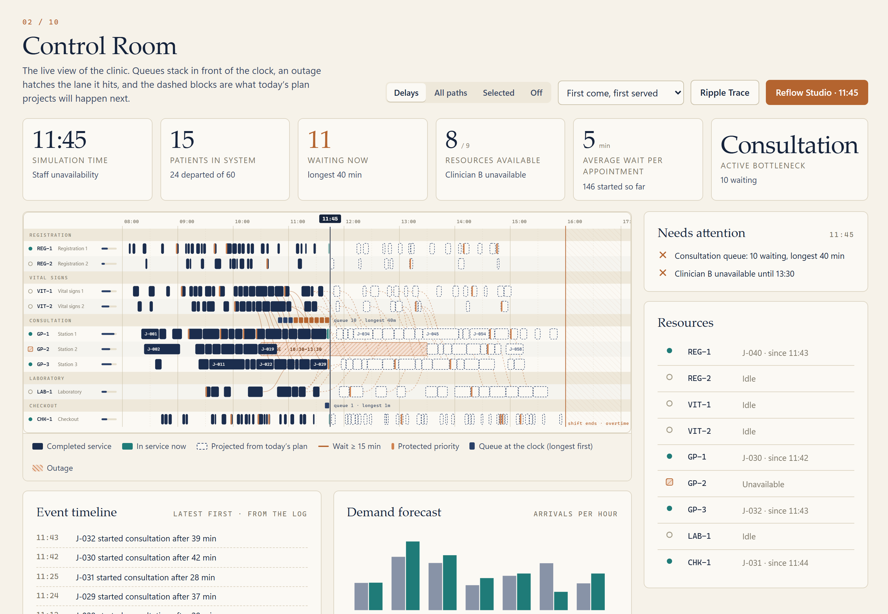
A digital twin of the clinic
THE SIMULATION · WOW 1: THE SYSTEM BREAKS
READING THE CANVAS
1
Patient pathways dotted links from a patient's stage to the next
2
Resource lanes nine lanes; the hatched block is the outage
3
Queues chips stacked in front of the clock, longest first
4
4
Clock movable; the sim recalculates from it
1
3
5
Utilisation small bar on each lane: busy share so far
2
5
6
Operational events timeline written from the event log
DISCRETE-EVENT SIMULATION, IN PLAIN WORDS
The simulator jumps from event to event (arrive, wait, start, finish, transfer, outage) and logs each one. A fixed seed regenerates the same day, so differences come from what we change.
6
Default clinic: 60 synthetic patients (48 scheduled, 12 walk-in); 2 registration, 2 vital-sign, 3 consultation stations (clinician + room), 1 laboratory, 1 checkout; 08:00–16:00. Shot: seed 7, staff scenario, clock 11:45.
Notes:
SPEAKER: Yosr
This is our Control Room. It is a digital twin of a fictional clinic: sixty synthetic patients, forty-eight with appointments and twelve walk-ins, nine resources, and a day from eight to four. The engine is a discrete-event simulation. In plain words, it jumps from event to event: someone arrives, waits, starts, finishes, moves on. It records every event in a log. Because we fix a random seed, the same seed always creates the same day, so any difference we see is caused by what we changed.
VOCABULARY: Seed: a starting number for the random generator. Same seed, same synthetic day.

Slide 5
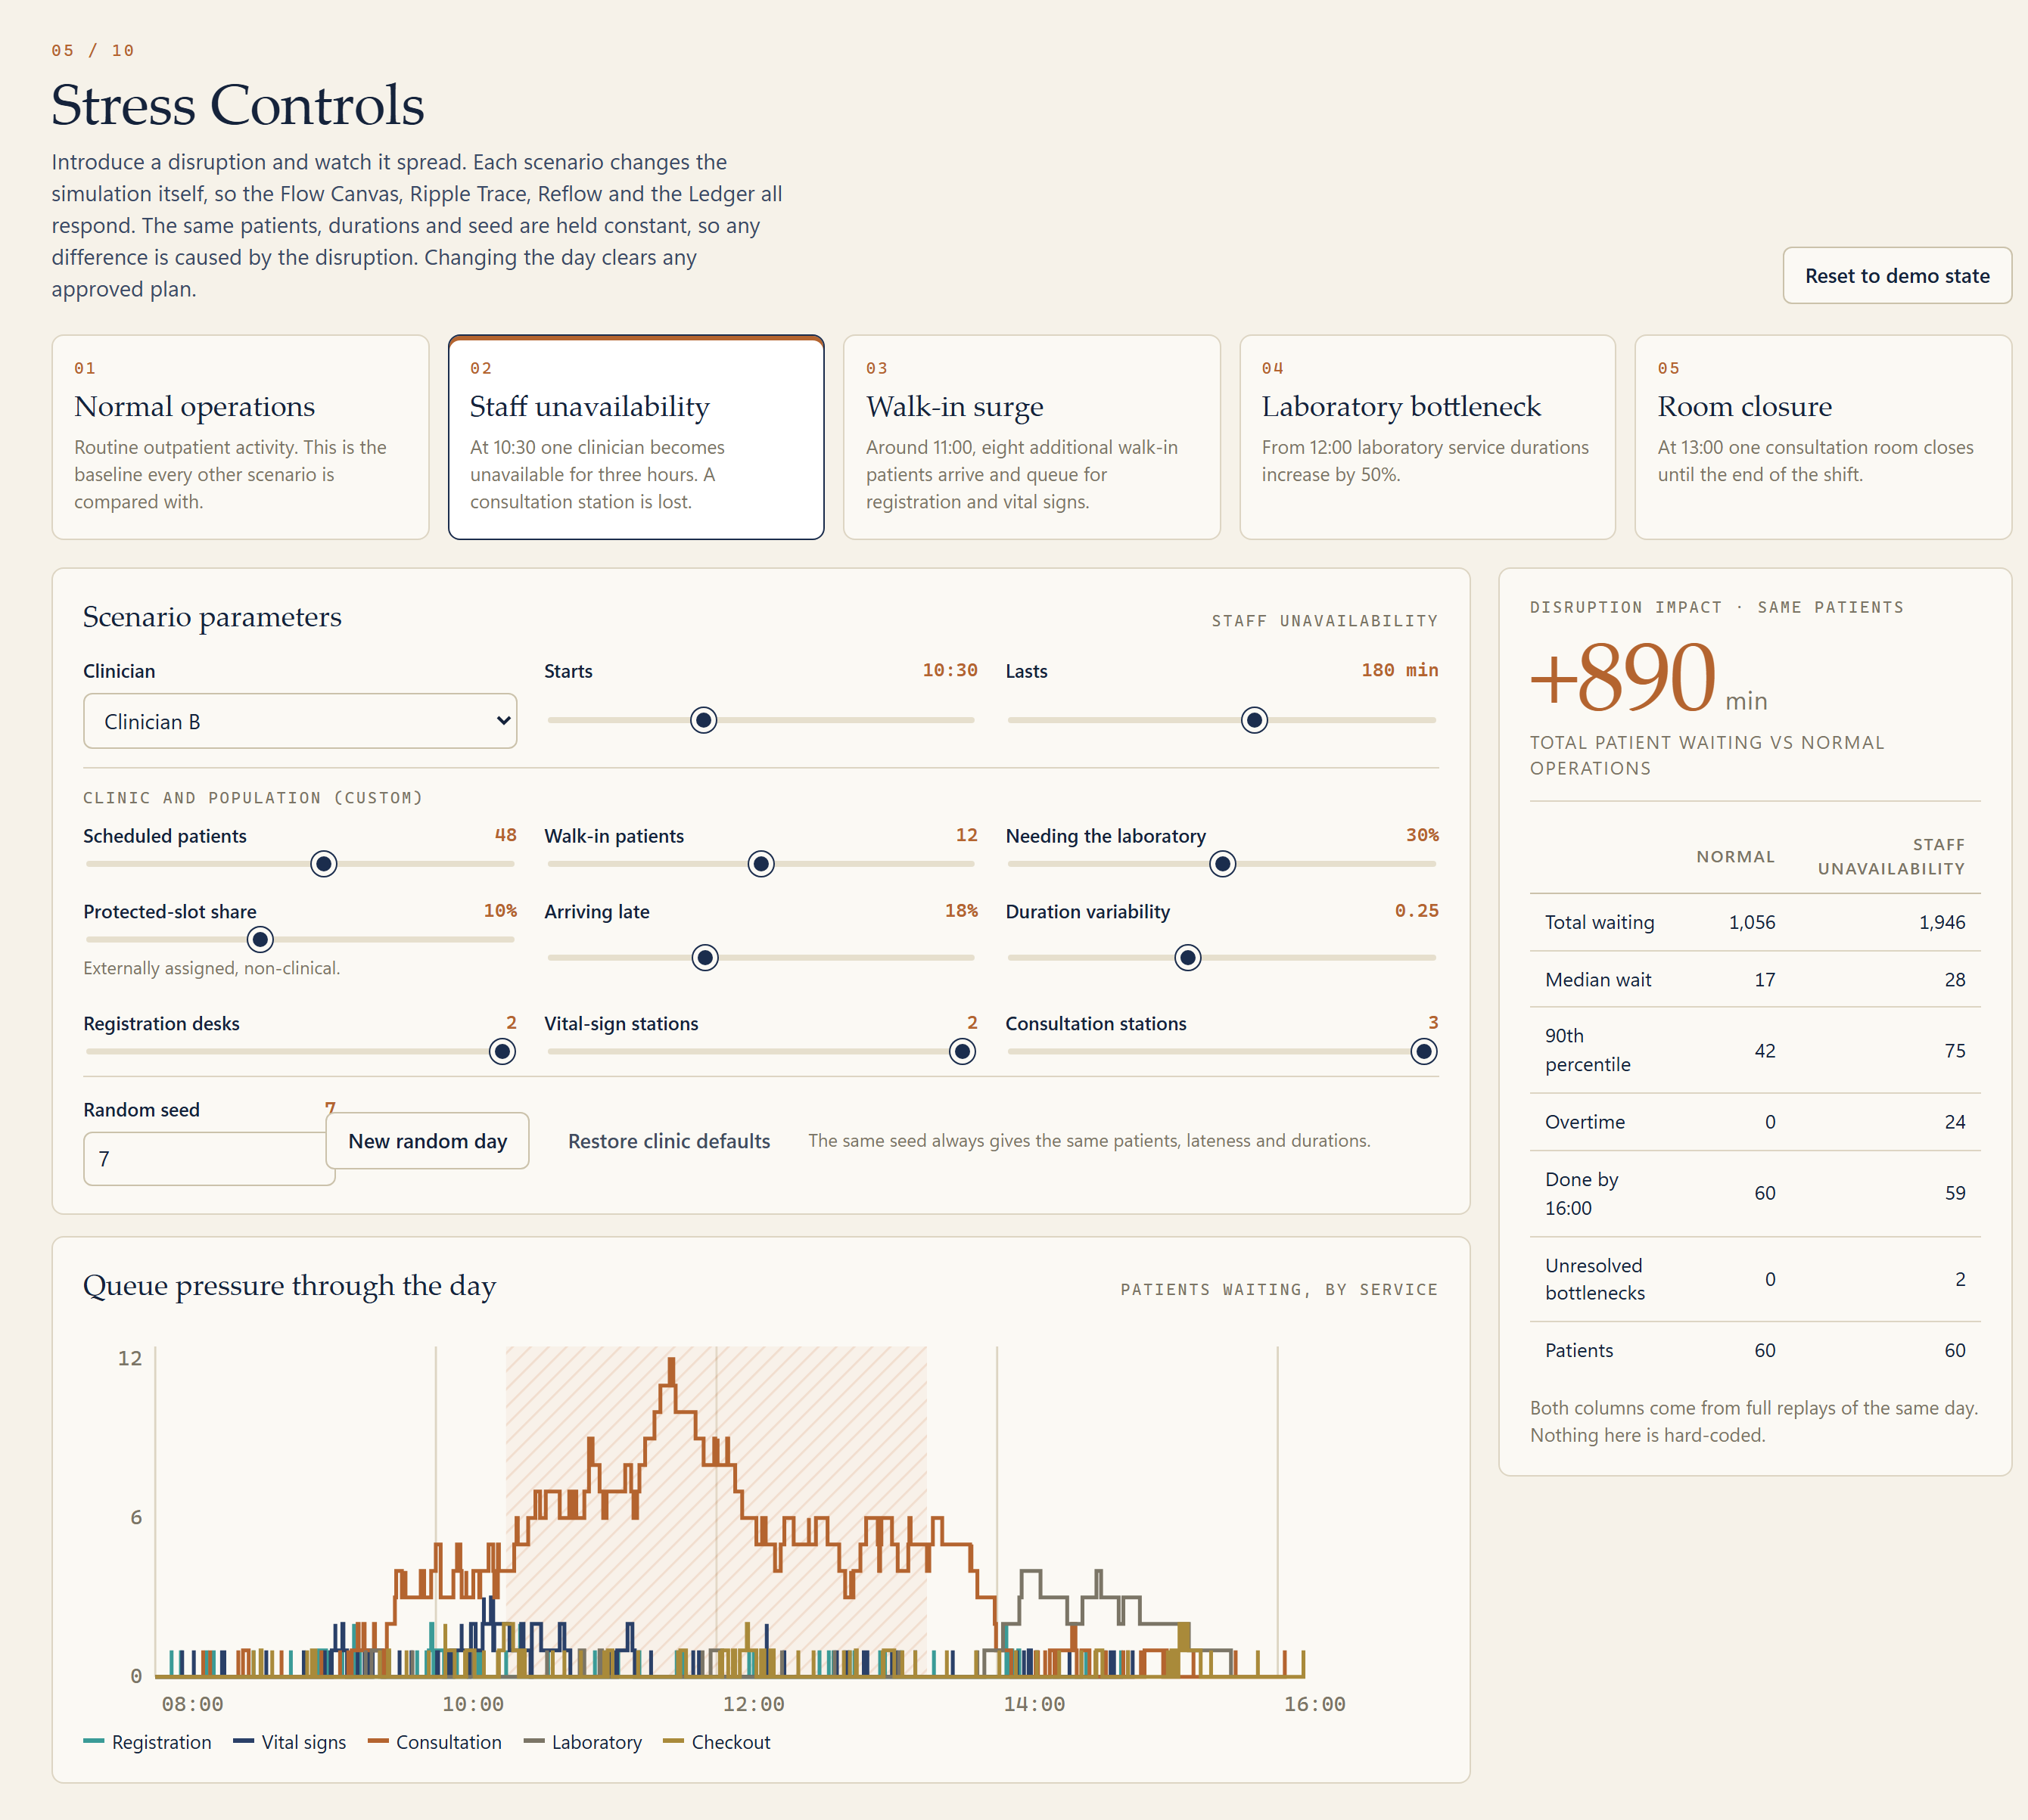
The disruption experiment
STRESS CONTROLS
FOUR IMPLEMENTED SCENARIOS · ONE DAY, 08:00–16:00
Staff unavailability
FEATURED
Walk-in surge
8 patients around 11:00
Laboratory slowdown
+50% from 12:00
Room closure
from 13:00 to end
8:00
10:00
12:00
14:00
16:00
SAME 60 PATIENTS · SEED 7 | NORMAL | STAFF OUT
Total waiting (min) | 1,056 | 1,946
Median wait (min) | 17 | 28
90th-percentile wait (min) | 42 | 75
Staff overtime (min) | 0 | 24
Journeys done by 16:00 | 60 | 59
We can investigate operational pressure without experimenting on real patients.
Source: SAYR Stress Controls, "Disruption impact · same patients", full replays of the same day. The other three scenarios are implemented but are not quantified in this deck.
Notes:
SPEAKER: Precious
In Stress Controls we bend the day. There are four scenarios: a clinician becomes unavailable, a walk-in surge, a slow laboratory, or a closed consultation room. Our main experiment is staff unavailability: one clinician is out from 10:30 for three hours. The simulator recalculates the whole day for the same patients and the same seed. Total waiting rises from 1,056 minutes to 1,946, and the 90th-percentile wait rises from 42 to 75 minutes. We can study pressure on the system without experimenting on a single real patient.
VOCABULARY: 90th percentile: the wait that nine out of ten patients stay under. It describes the worst-off tenth.

Slide 6
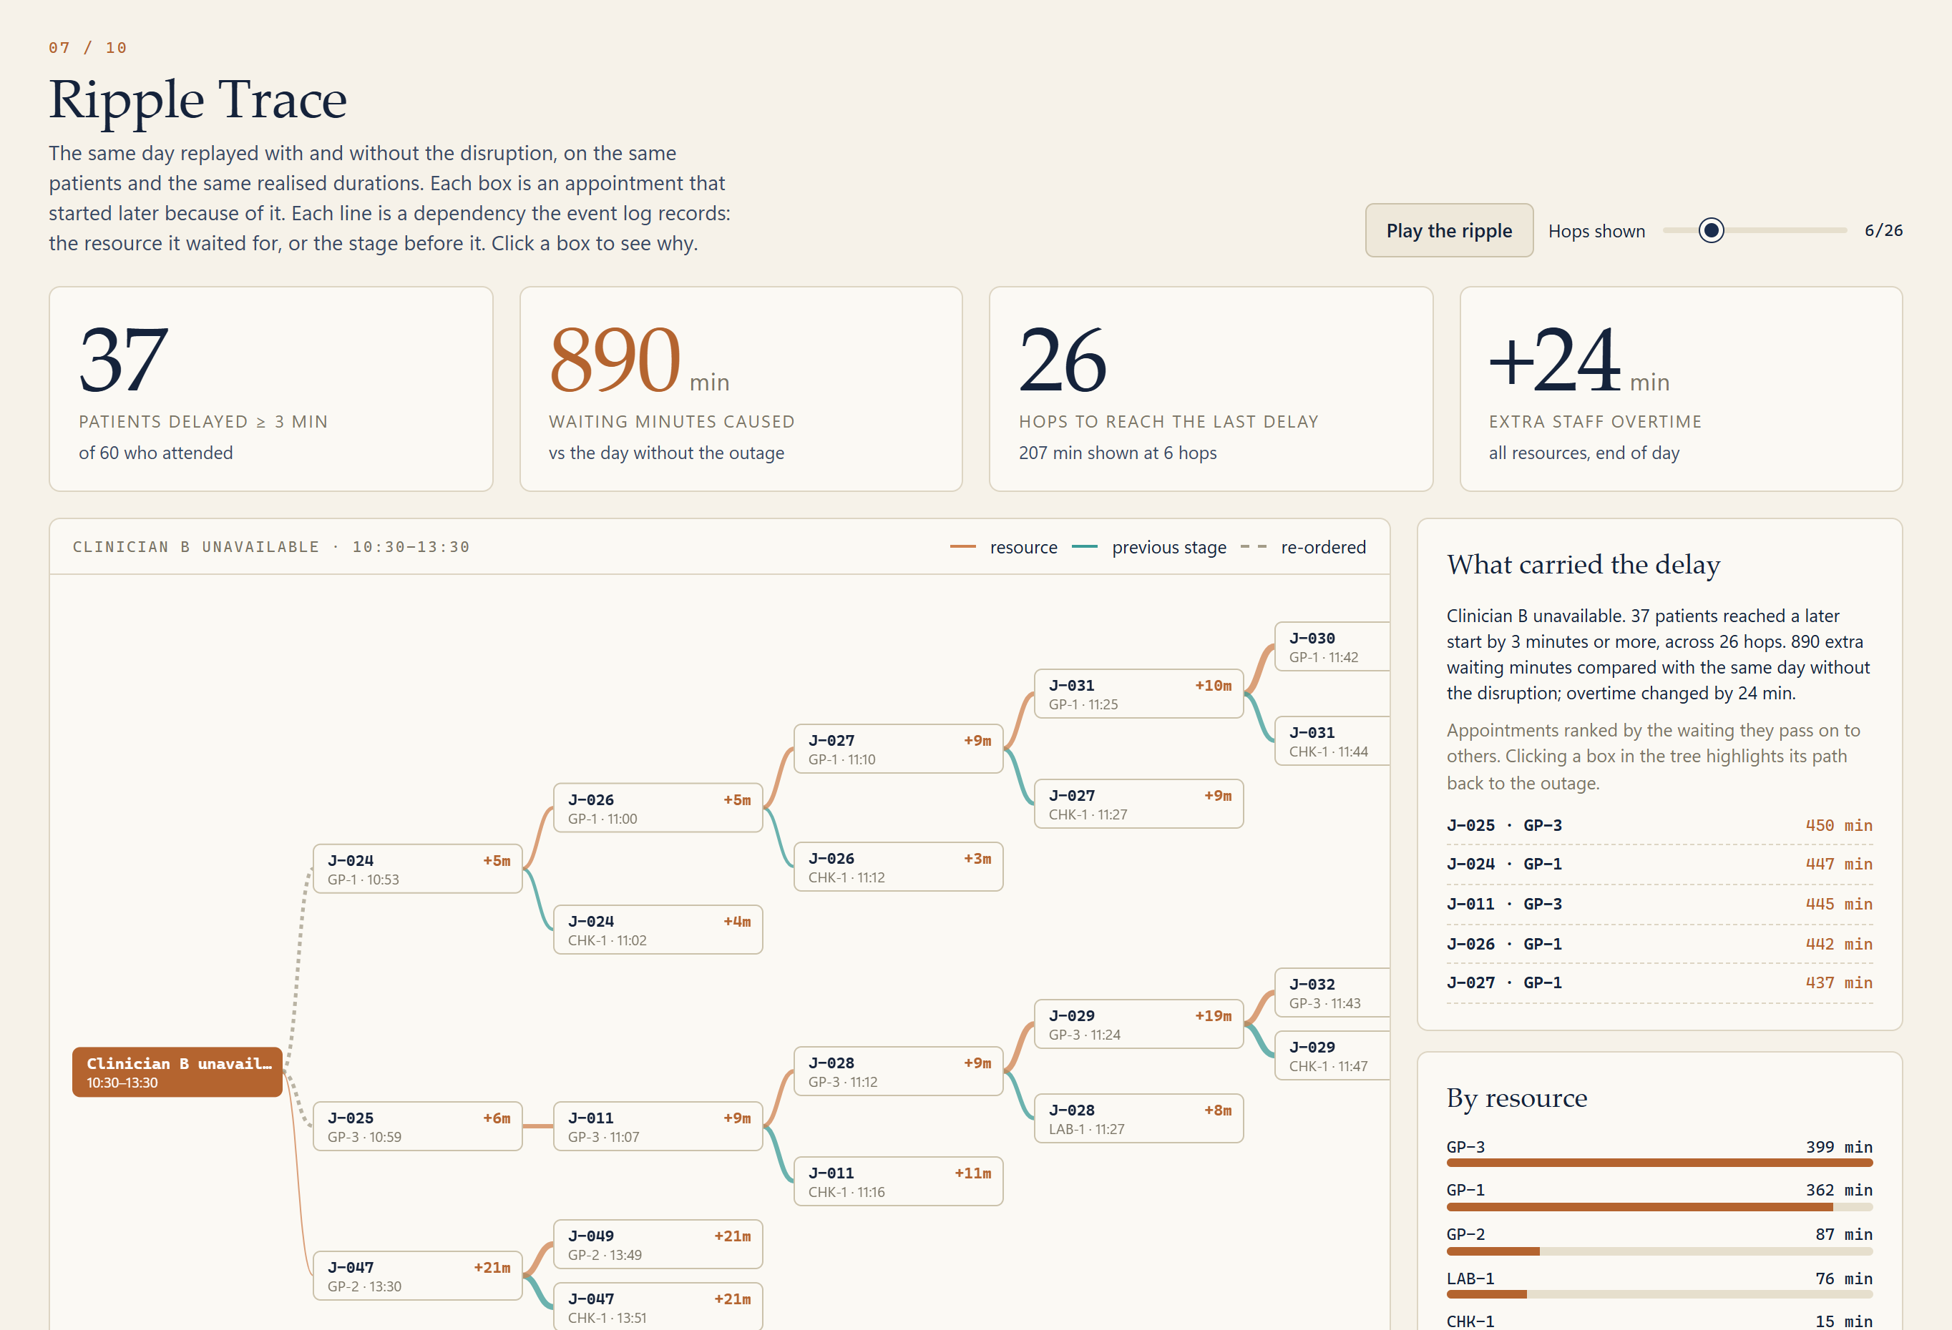
Ripple Trace: following the consequences
WOW 2 · TRACE
THE CHAIN, READ FROM THE TREE · +N MIN = LATER START THAN THE SAME DAY WITHOUT THE OUTAGE
Clinician B unavailable
10:30–13:30 · station GP-2 lost
J-025 · GP-3 · 10:59
+6 min · waited for a station
J-011 · GP-3 · 11:07
+9 min · waited for GP-3
J-028 · LAB-1 11:27
+8 min · previous stage
J-028 · GP-3 · 11:12
+9 min · waited for GP-3
J-029 · GP-3 · 11:24
+19 min · waited for GP-3
J-032 · GP-3 · 11:43
+19 min · waited for GP-3
37
890
26
+24
PATIENTS
DELAYED ≥ 3 MIN
WAITING MIN
CAUSED
HOPS TO THE
LAST DELAY
MIN EXTRA
OVERTIME
SAYR explains not just where a delay occurs, but how it spreads. Every link is a record in the event log (resource the appointment waited for, or its previous stage). Seed 7, staff scenario.
Notes:
SPEAKER: Precious
Ripple Trace explains how a delay spreads. We replay the same day twice, with and without the outage, and compare. Each box is an appointment that started later, and each line is a link the event log records: either the resource it waited for, or the stage before it. Here it traced 37 delayed patients over 26 hops, costing 890 extra minutes. For example, a patient waiting for station three at 10:59 delays the next one at 11:07, then 11:12, then 11:24. We are not only saying where a delay is. We show how it spreads.
VOCABULARY: Hop: one step along a chain of "this waited for that".

Slide 7
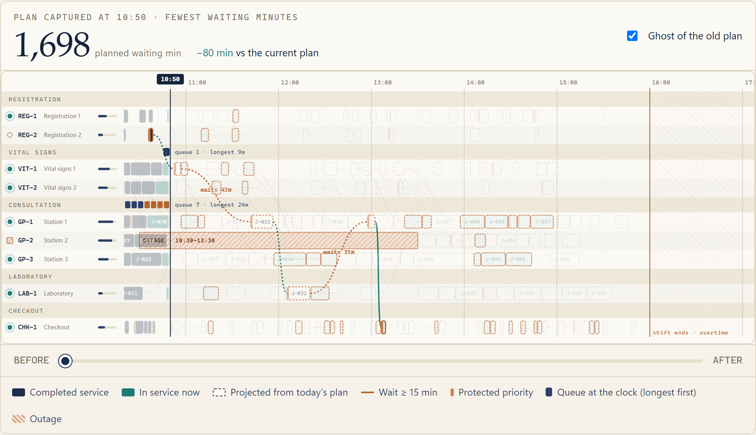
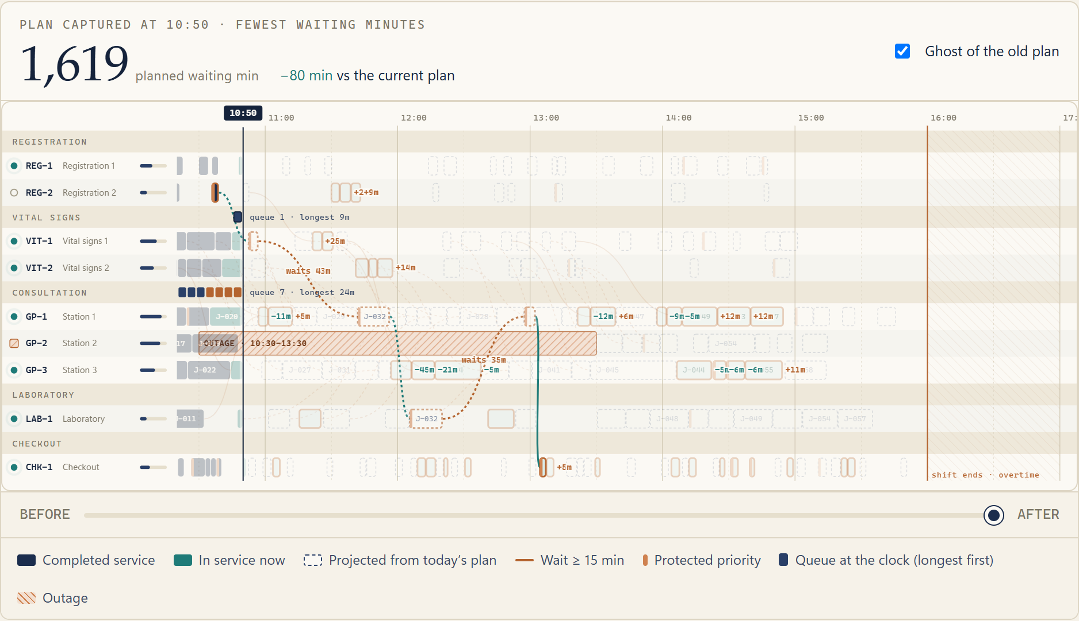
Reflow Studio: from disruption to decision
WOW 2 · THE SYSTEM REFLOWS
→
4
3
2
1
CURRENT PLAN
PROPOSED PLAN
1,698 planned waiting min
1,619 planned waiting min (−80)
43 appointments still expected to wait 15 min or more
42 changes: 6 reassigned, 36 re-sequenced · 9 of 9 constraints kept
1 reassignment 2 outage constraint 3 re-sequenced (wait change) 4 remaining delay
ONE REAL MOVE · J-036 ON GP-3 · START 12:18 → 11:57 · −45 MIN WAIT
DECISION CONTROLS · NOTHING APPLIES UNTIL A PERSON CHOOSES
11:57
12:18
Accept in the simulation
Reject
GP-3
J-036
11:45
12:00
12:15
12:30
Heuristic search: no guarantee of a global optimum.
Source: SAYR Reflow Studio and Action Desk, seed 7, staff scenario, plan captured at 10:50, objective "Fewest waiting minutes". Planned values use booked lengths; the Ledger measures the realised result.
Notes:
SPEAKER: Maryam
This is the heart of the project. Reflow looks at the plan at 10:50, finds the appointments that have not started, and searches for a better arrangement that respects nine constraints, such as no overlaps, nobody placed on an unavailable clinician, and nobody waiting more than thirty extra minutes. It uses a constraint-aware local search, so we do not claim a perfect answer. On the left is the current plan, on the right the proposal. Forty-two appointments change, six move to a different station, and the plan projects eighty fewer waiting minutes. Nothing is applied yet.
VOCABULARY: Constraint: a rule a plan must never break. Local search: try small changes, keep the ones that help and stay legal.

Slide 8
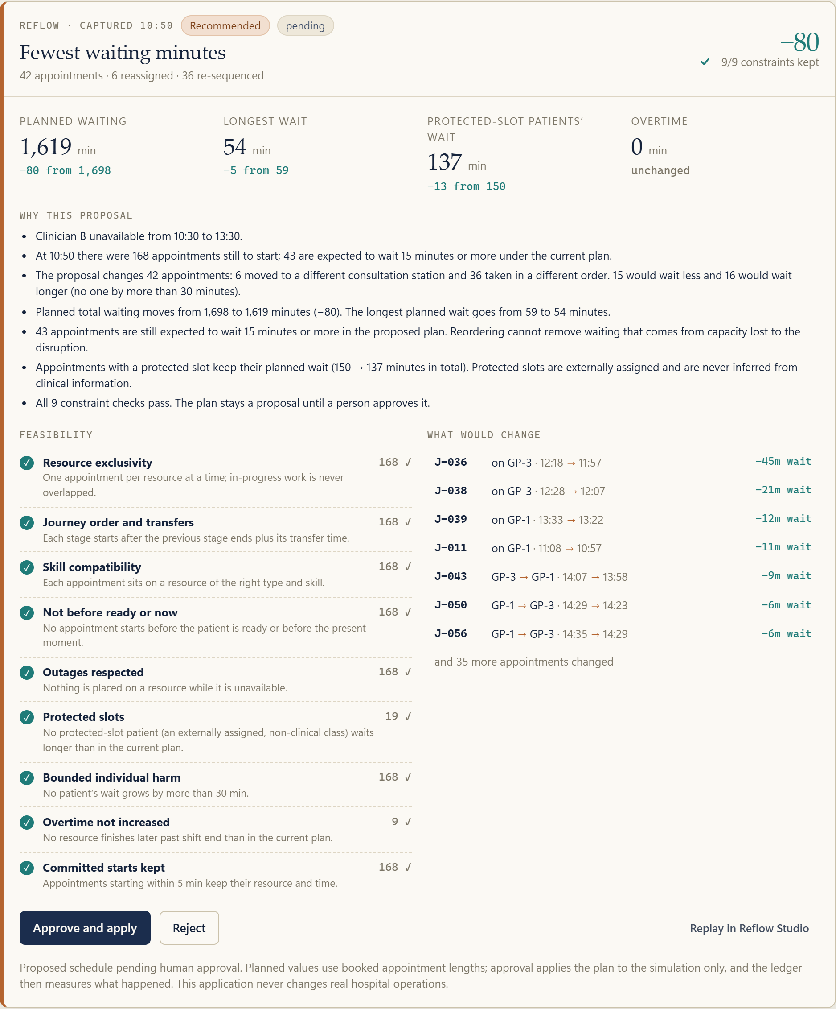
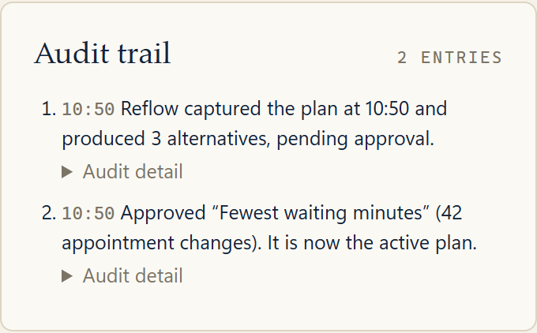
The human remains in control
ACTION DESK · WOW 2
Reflow proposes
A person reviews
Approve and apply
Audit trail
Ledger measures
up to 3 alternatives
changes, constraints, trade-offs
to the simulation only
entry is written
what actually happened
Reject leaves today's plan untouched.
AUDIT TRAIL (AFTER APPROVAL)
Proposed changes
42 appointments: 6 reassigned, 36 re-sequenced. The card lists each move, e.g. J-036 on GP-3, 12:18 → 11:57.
Constraints satisfied
9 of 9 checks pass, each with evidence (for example 168 appointments checked for resource exclusivity).
Trade-offs
15 appointments wait less, 16 wait longer, none by more than 30 min. 43 still expected to wait 15 min or more.
Intelligent recommendations should support accountability, not replace it.
Accountability
The audit trail records each situation and decision. Protected slots are assigned externally and never inferred from clinical information.
Source: SAYR Action Desk. SAYR does not autonomously determine clinical priorities. Approval applies a plan to the simulation only; the app never changes real hospital operations.
Notes:
SPEAKER: Maryam
Every proposal waits in the Action Desk. A person sees the changes, the nine constraint checks, and the trade-offs: here fifteen patients would wait less, sixteen would wait longer, and nobody by more than thirty minutes. They can approve or reject, and the decision is written to an audit trail. SAYR never decides clinical priorities. Protected slots are assigned from outside the system and are never inferred from medical information. Intelligent recommendations should support accountability, not replace it.
VOCABULARY: Audit trail: a permanent record of what was proposed and who decided what.

Slide 9
Minutes Ledger: measured, not assumed
WOW 3 · THE MINUTES ARE ACCOUNTED FOR
−48
MEASURED CHANGE IN WAITING
−2.5% · approved plan, realised durations
METRIC | NORMAL | DISRUPTED | OPTIMIZED | Δ
Total waiting (min) | 1,056 | 1,946 | 1,898 | −48
Mean wait per patient | 18 | 32 | 32 | −0.8
Median wait per patient | 17 | 28 | 29 | +1.3
90th-percentile wait | 42 | 75 | 71 | −3.6
Throughput by 16:00 | 60 | 59 | 59 | ±0
Incomplete at 16:00 | 0 | 1 | 1 | ±0
Resource utilisation | 47% | 49% | 49% | ±0
Staff overtime (min) | 0 | 24 | 22 | −1.5
Rescheduled appointments | 0 | 0 | 42 | +42
Constraint violations | 0 | 0 | 0 | 0
min
−80
min WHAT THE PLANNER PROJECTED (booked lengths)
2,060
Total patient waiting minutes · axis starts at 870 · each bar is a separate replay
+890
−27
±0
−5
−19
+3
1,898
1,763
1,465
1,168
1,056
870
Normal
operations
Disruption:
staff out
Hold current
plan fixed
Re-seq.
CHK-1
Re-seq.
GP-1
Re-seq.
GP-3
Other
With the
proposal
Δ = optimized − disrupted. The 90th percentile improved while the median rose: the Ledger reports trade-offs, not one score.
COMPARISON CONDITIONS
Scenario: staff unavailability (Clinician B, 10:30–13:30) · Seed 7 · 60 synthetic patients
Baseline policy: first come, first served · Reflow at 10:50, objective "fewest waiting minutes"
Same patients, arrivals and realised durations in all three runs; the bars add up exactly
SAYR evaluates whether an intervention helped, what it cost, and what trade-offs remain.
Source: SAYR Minutes Ledger (published app). Waiting = ready to start of service. Simulated, operational measures only; fewer waiting minutes is not evidence of better clinical care.
Notes:
SPEAKER: Eleen
After approval, the Minutes Ledger measures what really happened when the plan is replayed on the realised durations. Under seed 7, the staff scenario, and first-come-first-served as the baseline, the planner projected eighty fewer minutes, but the measured change is forty-eight: 1,946 down to 1,898, about two and a half percent. The 90th-percentile wait fell by 3.6 minutes, the median rose by 1.3, and no constraint was violated. This is an operational measure only, not evidence of better care.
VOCABULARY: Realised duration: how long a visit actually took in the simulated day, which can differ from the booked length.

Slide 10
Efficiency without overlooking fairness
WOW 3 · WHO MAY BE MADE WORSE OFF
WAIT AT THE 90TH PERCENTILE, BY GROUP (MIN)
SCHEDULING POLICIES · SAME DISRUPTED DAY
POLICY | TOTAL MIN | P90 | INVERSIONS
First come, first served | 1,946 | 75 | 48
Priority with aging | 1,973 | 67 | 23
Shortest task first (aged) | 1,616 | 65 | 45
Different objectives, different trade-offs: shortest-first needs the fewest minutes but starts a less urgent patient first 45 times.
ACROSS EIGHT SYNTHETIC DAYS · MINUTES SAVED BY REFLOW (10:45)
10
7
43
WAIT LONGER
(≥ 5 min)
WAIT LESS
(≥ 5 min)
ABOUT
THE SAME
Optimized vs disrupted, same patients. Largest increases: J-054 +18 min, J-049 +16, J-045 (walk-in) +14, J-048 +14. Priority inversions 48 → 46.
A better average does not automatically mean a fairer system.
Helped on 7 of 8 days; worse on 1 (seed 64, +5 min). Mean saving 59.8 min, median 51.5. Nothing is cherry-picked.
Source: SAYR Minutes Ledger: fairness table, patients made worse off, scheduling policies and "Evidence across seeds". Synthetic fairness evaluation does not establish fairness in real clinical operations.
Notes:
SPEAKER: Eleen
A better average does not mean a fairer system. In the same run, ten patients wait at least five minutes longer, seven wait less, and forty-three stay about the same. Walk-in patients got slightly worse: their 90th-percentile wait went from 73 to 77 minutes. Policies also trade off: shortest-first needs fewer total minutes but starts less urgent patients first more often. Across eight synthetic days, Reflow helped on seven and made one day slightly worse. Fairness on synthetic data does not establish fairness in a real clinic.
VOCABULARY: Priority inversion: a less urgent patient is started before a more urgent one.

Slide 11
From simulation to real healthcare research
ROADMAP
PROTOTYPE TODAY → VALIDATION → SUPERVISED RESEARCH
PHASE 1
PHASE 2
PHASE 3
PHASE 4
PHASE 5
Current prototype
Operational research collaboration
Authorized real-world data
External validation
Controlled deployment research
Synthetic patient journeys, deterministic simulation, scheduling optimization and operational evaluation.
Work with healthcare operations professionals to evaluate assumptions and refine scheduling constraints.
Investigate data access, privacy protection, data quality and integration requirements.
Compare simulator predictions with observed service patterns; assess recommendations.
Supervised prospective testing, security assessment, workflow integration and approvals before any real use.
WHERE WE ARE
AL DHAFRA CONTEXT
The next step is validation, not deployment by assumption.
Al Dhafra is a wide region, so coordinating services across places is a research question worth studying with local healthcare partners. We have not used, and do not state, any regional or facility performance data.
Roadmap is a proposal for future research, not a record of work done. Real-world use would require validation with healthcare operations specialists, authorized data, and privacy and security review (SAYR, Responsible AI).
Notes:
SPEAKER: Shaden
Where do we go next? Phase one is today: synthetic journeys, simulation, optimization and evaluation. Phase two is working with healthcare operations professionals to check our assumptions. Phase three is investigating authorized real data, with privacy and data quality first. Phase four is external validation against observed service patterns. Phase five is supervised testing with security review and approvals before any real use. Al Dhafra is a wide region, so coordinating services across places is an interesting question, but we have not used any regional performance data. The next step is validation, not deployment by assumption.
VOCABULARY: Validation: checking, with real evidence, that a model's results match reality.

Slide 12

AL DHAFRA HEALTH FORUM · DEVELOPING HEALTHCARE SERVICES
Healthcare does not operate one appointment at a time.
It operates as an interconnected system, and every minute matters.
Visibility
Coordination
Explainability
Measurable outcomes
Human oversight
CONTROL ROOM
REFLOW
RIPPLE TRACE
MINUTES LEDGER
ACTION DESK
SCAN TO TRY SAYR
maymourad.github.io/SAYR-AI-Care-In-Motion
Behind every healthcare schedule is a patient waiting for care.
Synthetic data only. A decision-support prototype, not a clinical tool.
SAYR AI Care in Motion
Lujain Ahmed Mourad 8D
Yosr Amgad 8D
Precious Fuentes 8D
Maryam Ammara Jelita 8D
Eleen Amr 8D
Shaden Ahmed Mourad 6D
ADNOC Schools, Madinat Zayed
Notes:
SPEAKER: Shaden, then all
Healthcare does not operate one appointment at a time. It operates as an interconnected system, and every minute matters. Ripple Trace explains the problem. Reflow investigates the solution. Minutes Ledger measures the consequences. And a person stays in control. Behind every healthcare schedule is a patient waiting for care. Thank you. You can scan the code to try SAYR yourself. [All together:] SAYR AI. Care in Motion.

Slide 13
Appendix A · How the simulation works
TECHNICAL APPENDIX
1 Next event
2 Update state
3 Write to log
4 Schedule follow-ups
earliest time in the event queue
patients, resources, queues
time, event, cause pointer
finish, release, transfer, next stage
EVENT TYPES
arrival
queue
service start
service finish
release
transfer
outage
ONE APPOINTMENT, TIMESTAMPS THE ENGINE KEEPS
DETERMINISM AND REPRODUCIBILITY
next stage ready
ready
service starts
service ends
Seed 7 always creates the same 60 patients, lateness, no-shows and durations. Baseline, disrupted and optimized runs share the same base patients, so any difference is caused by the change.
wait = start of service − ready
waiting
service
transfer
Waiting excludes transfers and service time. Total waiting sums waits over all appointments; mean, median and 90th percentile are per patient.
Verified for this deck: the full demonstration path was run twice on the published app and produced identical figures (the optimizer examined 36,850 plans both times).
Planning uses booked lengths; the replay uses realised ones (variability 0.25), which is why projected and measured savings differ.
Source: SAYR About, methods & credits (Discrete-event simulation); Minutes Ledger methodology (seed 7). Known limits: a clinician is tied to a room; no breaks, equipment, multiple sites or clinical variation.
Notes:
SPEAKER: Appendix
Use only if asked. The simulation keeps a queue of future events ordered by time. It takes the next event, updates the state of patients and resources, writes it to the log, and schedules what follows. Waiting is measured from "ready" to "start of service"; transfers and service time are excluded. The seed makes it reproducible: we ran the whole demonstration path twice and got identical figures.

Slide 14
Appendix B · How Reflow works
TECHNICAL APPENDIX
SEARCH
CONSTRAINTS
OBJECTIVES
Constraint-aware local search with seeded perturbation. It captures every appointment not yet started, tries moving it to another resource or position, keeps only legal changes and the better plan. Three runs, three objectives. A heuristic: no guarantee of a global optimum, and it may find no improvement.
Hard rules: one appointment per resource; journey order and transfers; right resource type; not before ready or now; nothing on an unavailable resource; protected slots no worse; starts within 5 min kept. Limits by design: no one waits more than 30 min longer; overtime not increased.
Fewest waiting minutes: −80 planned, 42 changes (recommended). Protect priority and the longest waits: −40, 33 changes. Fewest changes: −11, 11 changes. Different objectives give different trade-offs, which is why a person chooses.
SEVEN REAL MOVES FROM THE PROPOSAL (ACTION DESK) · CHIP = APPOINTMENT START TIME · DASHED = PROPOSED POSITION
GP-1
J-011
J-039
J-050
Station 1
J-056
GP-2
OUTAGE 10:30–13:30
Clinician B out
GP-3
J-036
Station 3
J-038
J-043
11:00
12:00
13:00
14:00
Source: SAYR Action Desk, "What would change", 10:50 proposal, seed 7. Chips mark start times only (durations not drawn). J-043, J-050, J-056 change station.
Notes:
SPEAKER: Appendix
Use only if asked. Reflow captures every appointment not yet started, then does a local search over which resource and in which order. Candidates are checked by an independent validator against nine rules. It runs three times with different objectives and shows up to three alternatives. It can find no improvement, and in one of our eight test days it did worse than doing nothing.

Slide 15
Appendix C · Evaluation and limitations
TECHNICAL APPENDIX
Waiting time
FORECAST BASELINES · HELD-OUT ERROR (PATIENTS / HOUR)
Minutes between becoming ready and starting service. Transfers and service excluded. Percentages use patients who attended.
90th percentile
The wait that nine in ten patients stay under: it describes the worst-off tenth, so it can move differently from the mean.
Utilisation
Busy minutes divided by available minutes within the shift (resources that are down are not counted as available).
Seasonal hourly profile chosen on 6 held-out synthetic days (14 train). Forecast 57 vs 60 actual. A baseline, not machine learning; the history is synthetic and generated from the simulator's own pattern.
Fairness
Mean and 90th-percentile waits for scheduled vs walk-in and morning vs afternoon; priority inversions; protected-slot waits; patients made worse off by ≥ 5 min.
LIMITS OF SIMULATED OUTCOMES
All patients and data are synthetic; nothing is validated against a real clinic.
Planned and measured savings differ (−80 vs −48).
A clinician is tied to a room; no breaks, equipment, sites or clinical variation.
Improvement is not guaranteed (1 of 8 days got worse).
Fewer waiting minutes does not mean better care.
Repeated seeds
The same scenario on 8 other synthetic days, Reflow at 10:45. One run is a demonstration; the spread is the evidence.
Source: SAYR About, methods & credits (Demand forecasting); Minutes Ledger definitions and methodology.
Notes:
SPEAKER: Appendix
Use only if asked. Waiting minutes, mean, median and 90th percentile are computed from the event log. Utilisation is busy time divided by available time within the shift. The forecast is a seasonal hourly baseline chosen from three simple methods using six held-out synthetic days; it is not machine learning, and because the history is synthetic it says little about real demand. Everything here is simulated under stated assumptions.

