Slide 1
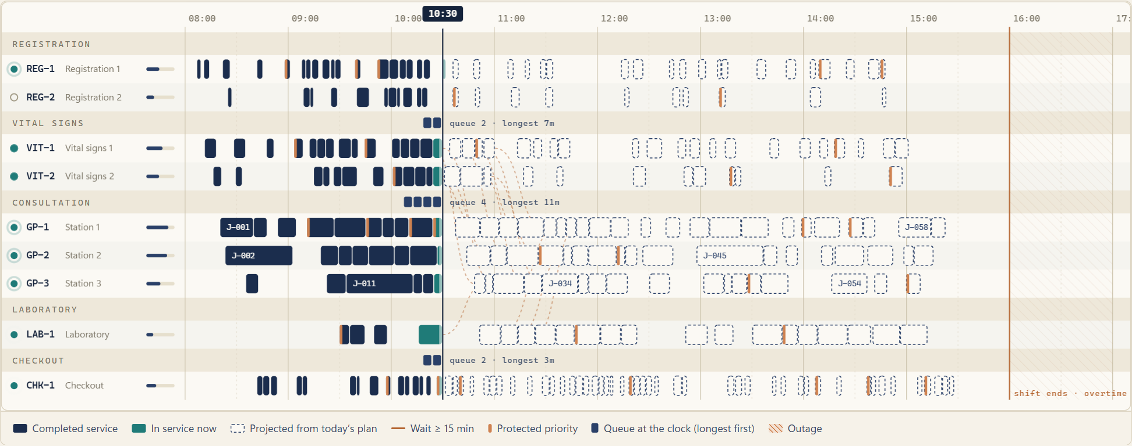
AL DHAFRA HEALTH FORUM · DEVELOPING HEALTHCARE SERVICES
SAYR
AI
Care in Motion.
When the day overloads, the schedule reorganises.
A simulation-driven healthcare operations prototype. Synthetic data, human approval, no clinical claims.
Lujain Ahmed Mourad 8D · Yosr Amgad 8D · Precious Fuentes 8D
Maryam Ammara Jelita 8D · Eleen Amr 8D · Shaden Ahmed Mourad 6D
ADNOC School – Madinat Zayed
Notes:
SAYR in one sentence: a precision-engineered healthcare operations interface. The picture is the Flow Canvas, captured from the running application.

Slide 2
Disruption → Ripple → Reflow → Measured outcome
01 · DISRUPTION
02 · RIPPLE
03 · REFLOW
04 · MEASURED
180
890
42
−48
min
min
moves
min
Clinician B is unavailable from 10:30 to 13:30, so one consultation station is lost.
of extra waiting across 37 patients, 26 hops downstream, traced from the event log.
appointments re-planned at 10:50. Nine constraints re-checked. Planned saving 80 min.
waiting minutes when the approved plan is replayed on realised durations (−2.5%).
Planned and measured values are reported separately: the planner knows booked lengths, the day uses real ones.
Notes:
The whole story in four numbers, from one seeded synthetic day of 60 patients under scenario 2, staff unavailability. Every figure is computed by the simulator.

Slide 3
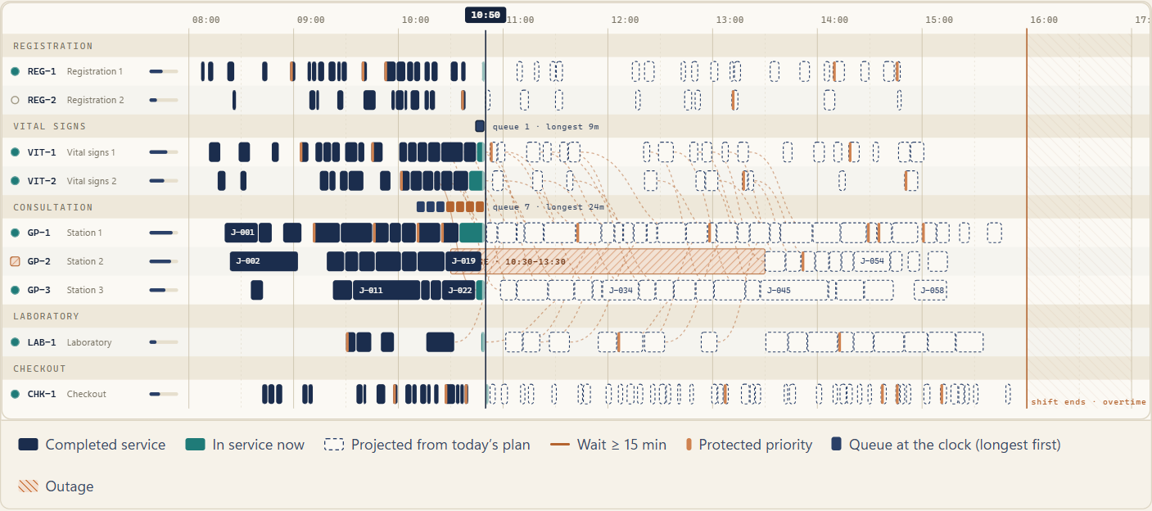
The Flow Canvas: a day drawn from its own state
Patient
an anonymous journey line
Resource
a labelled lane with live status
Appointment
a time block, urgent ones notched
Queue
chips stacked at the clock, longest first
Capacity
shift-end line and hatched overtime
Delay
a copper line when a wait is long
Clock
a movable indicator you can drag
Notes:
Every element on the canvas is generated from simulation state. The legend is the visual grammar: lanes, blocks, queues, limits, delays, and a movable clock.

Slide 4
Three layers of intelligence, one shared state
Synthetic data
Event simulator
Reflow optimizer
Human approval
Seeded population: 48 scheduled, 12 walk-in, 3 stations, lab, checkout
→
Deterministic queue, resources, outages, audit of every timestamp
→
Constraint-aware local search, nine checks, three objectives
→
Approve, reject, compare, restore baseline. Audit trail
Layer 1 · Demand forecasting
Layer 2 · Constraint optimization
Layer 3 · Operational explanation
Three evaluated baselines on simulated history, scored on held-out days by mean absolute error. Not machine learning.
The computational core: a heuristic search, with its limits stated, never presented as machine learning.
Deterministic sentences generated from real events and plan changes. No language model, no paid API.
Notes:
Forecasting, constraint optimization and explanation sit on one deterministic simulation. Every screen reads the same state, so no two pages can disagree. None of the layers is a trained clinical model.

Slide 5
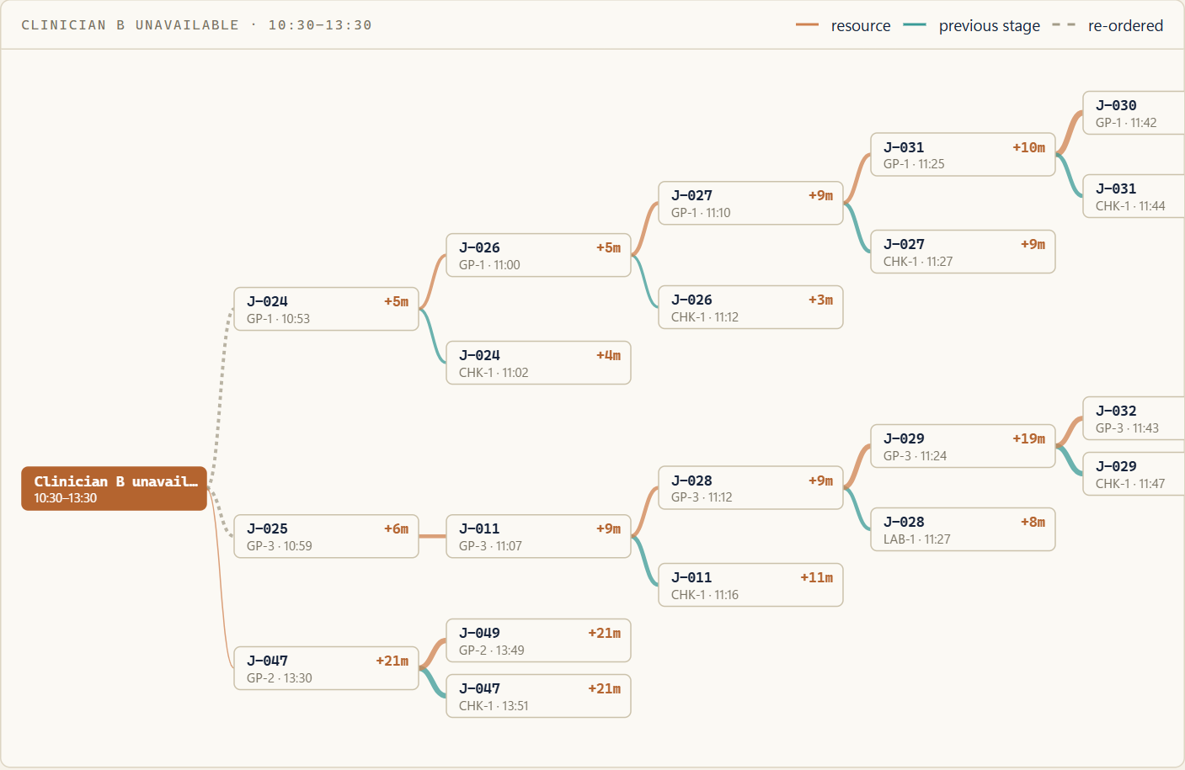
Ripple Trace: from one absence to 37 delayed patients
37
patients delayed 3 min or more
890
waiting minutes caused
26
hops to the last delay
Notes:
Calculated from the event log. The same day is replayed without the outage on the same patients and durations; each delayed appointment is linked to the lane or earlier stage that held it.

Slide 6
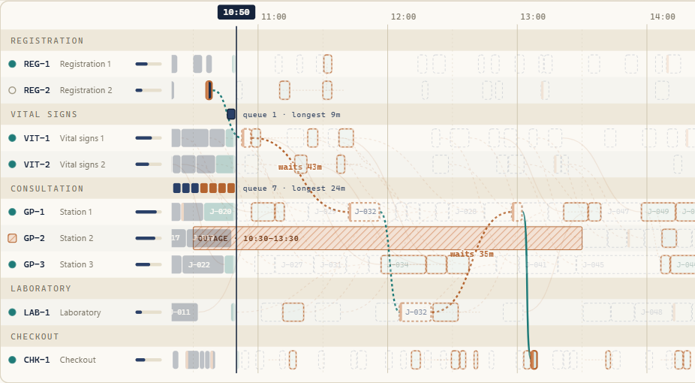
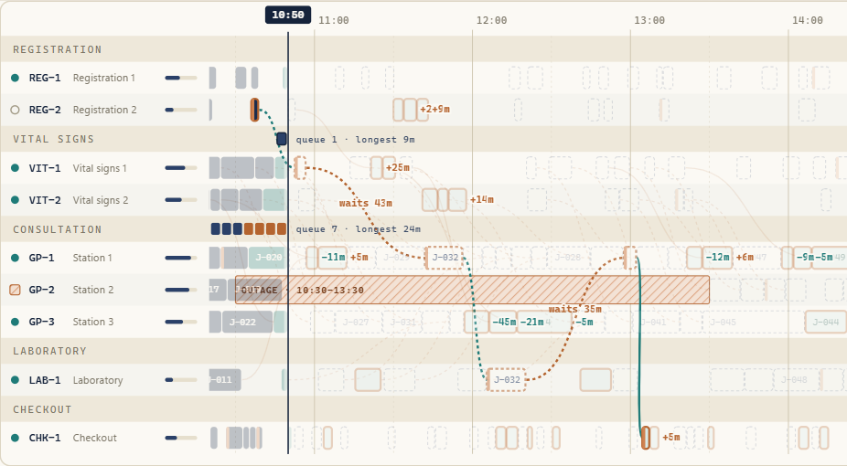
Reflow: the overloaded plan reorganises
BEFORE
AFTER
1,698 planned waiting min
1,619 planned waiting min
The plan today’s policy projects at 10:50
Feasible, nine constraints re-checked. Waits shown per moved appointment.
Notes:
The defining moment. The same screen at three positions of the Before to After control. Blocks move because the optimizer assigned them new positions; the ghost outlines are where they were.

Slide 7
How Reflow earns the right to move your schedule
1
Capture
2
Search
3
Validate
4
Propose
The unstarted appointments, resources in use and outage end times at the clock
Relocate and resequence appointments; keep only moves that stay feasible
An independent checker re-tests all nine rules on every candidate
Three alternatives, one recommended, with every change listed
Constraints preserved
Refusal is a feature
✓
Resource exclusivity
✓
Protected slots kept
Accept and Reject sit beside the evidence. A proposal that breaks a rule cannot be accepted.
✓
Journey order and transfers
✓
Bounded individual harm (≤ 30 min)
✓
Skill compatibility
✓
Overtime not increased
✓
Not before ready or now
✓
Committed starts kept
✓
Outages respected
Notes:
The search is a constraint-aware local search with seeded perturbation, run three times with different objectives. Progress shown in the app is real: counts, objective values and rule checks, not timed placeholders.

Slide 8
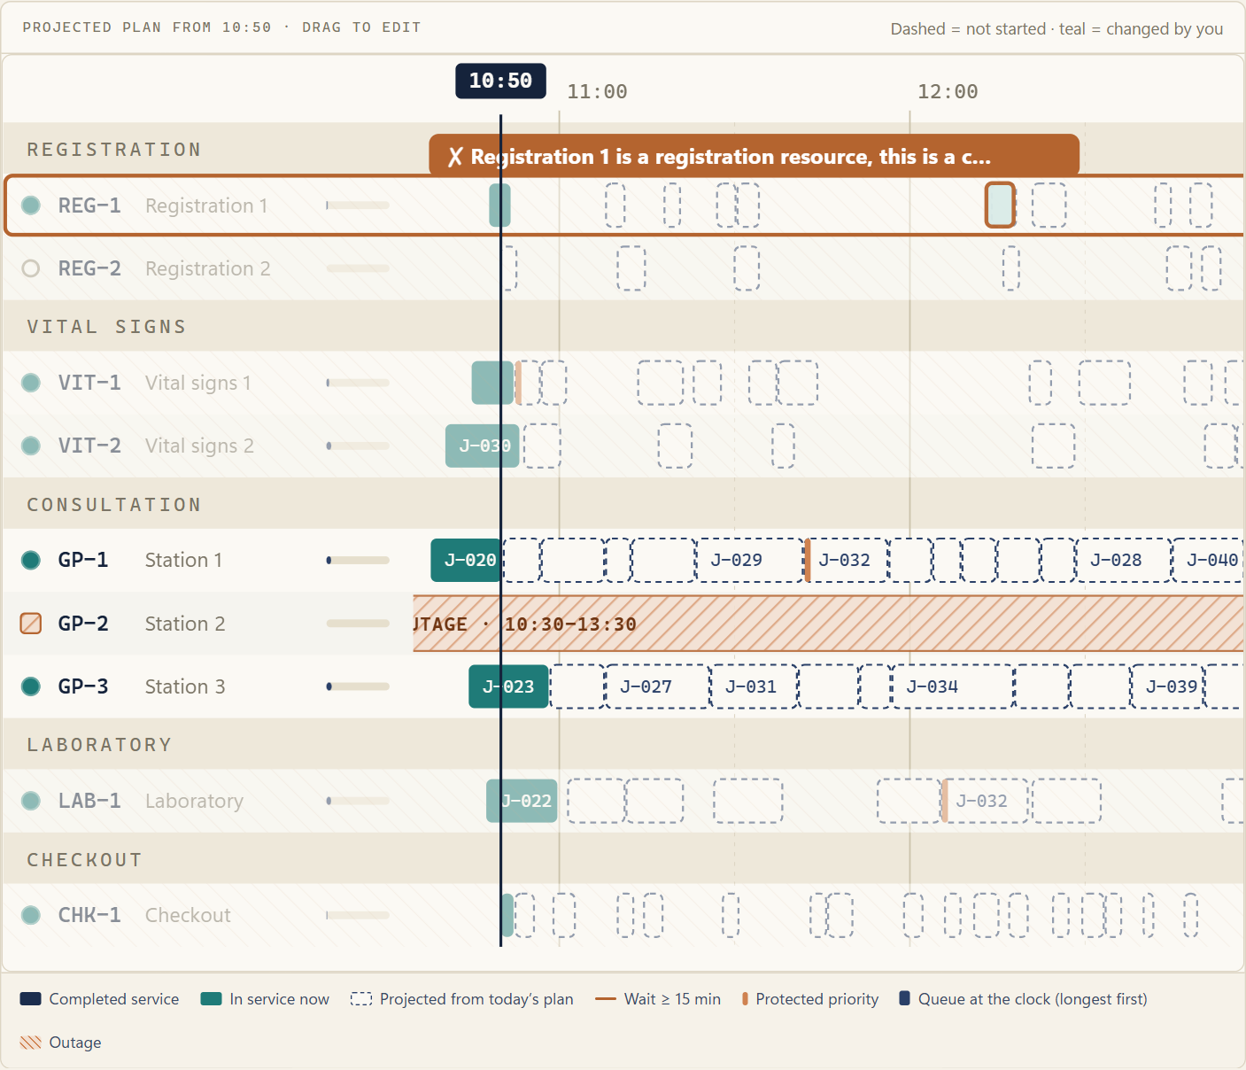
Resource Board: drag it, and the rules answer
Refused, with the reason
Incompatible lanes are hatched while you drag. Compatible lanes show the effect on waiting before you drop.
Journey order, protected slots, outages and the 30-minute harm limit refuse drops the same way.
A keyboard form offers the same check without a pointer.
Notes:
Drag-and-drop uses the same decoder and checker as the optimizer. In this capture a consultation appointment was dragged onto a registration desk and refused with the reason. Other drops are refused by journey order, protected priority, outages or the 15-minute harm cap.

Slide 9
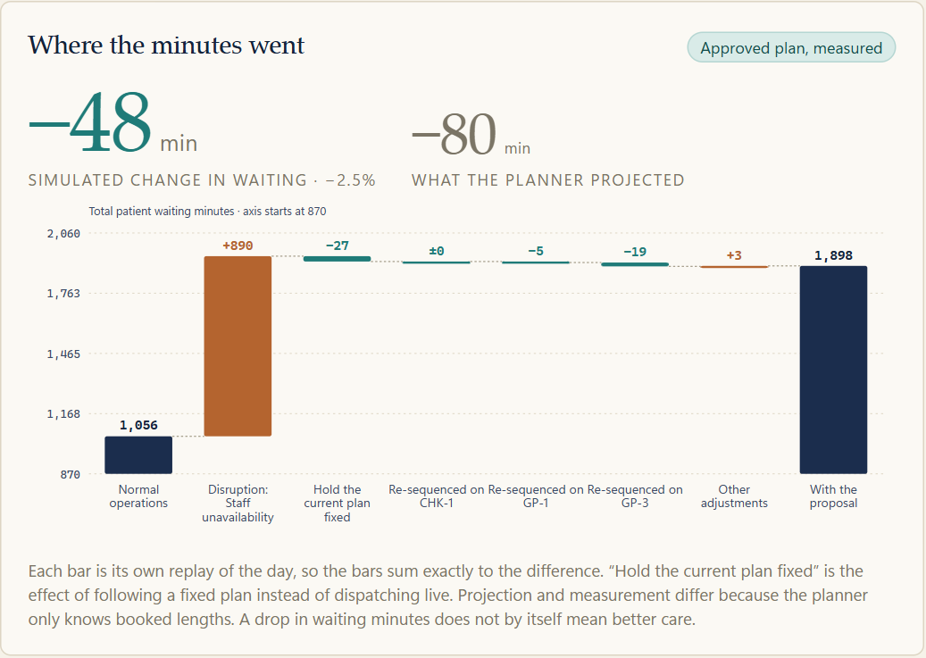
Minutes Ledger: an accountable balance of time
−48
waiting minutes, simulated (1,946 → 1,898, −2.5%). Normal day: 1,056
75 → 71
p90 wait, min
28 → 29
median wait, min: slightly worse
24 → 22
overtime, min · 0 rule violations
Notes:
The primary results slide. The waterfall bars are real replays: the plan applied one operational change at a time, so they sum exactly to the measured difference. No claim of clinical benefit is made.

Slide 10
Fewest minutes is not the same as fairest
Live policy | Total wait (min) | p90 wait (min) | Protected-slot median (min) | Priority inversions
First come, first served | 1,946 | 75 | 17 | 48
Priority with aging | 1,973 | 67 | 8 | 23
Shortest task first (aged) | 1,616 | 65 | 9 | 45
What the table shows
Why Reflow is constrained
Shortest-first needs the fewest minutes, yet starts a less urgent patient ahead of a more urgent one 45 times. Priority-with-aging has the fewest inversions and the best protected-slot median, at the highest total.
Reflow may not worsen any protected-slot patient or lengthen anyone’s wait by more than 30 minutes, so it saves fewer minutes than an unconstrained rule. That is a choice, and the Ledger shows it.
Notes:
Computed from three full replays of the same day under three live scheduling policies. The aged shortest-task-first policy has the lowest total but the most priority inversions.

Slide 11
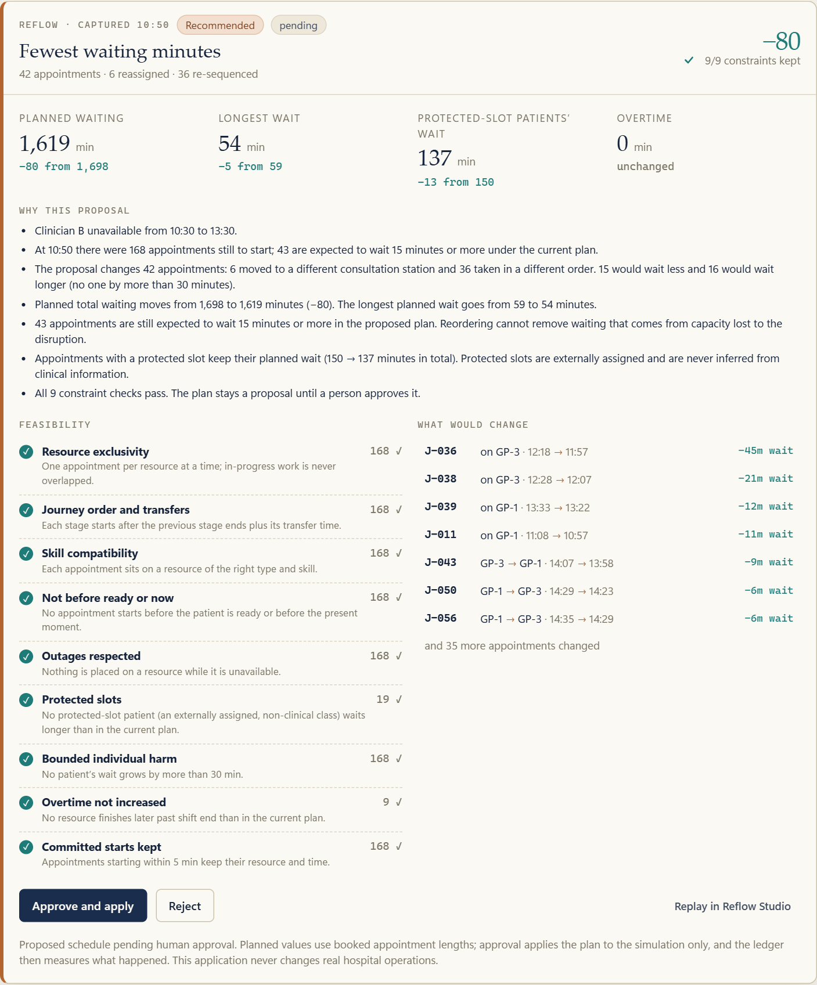
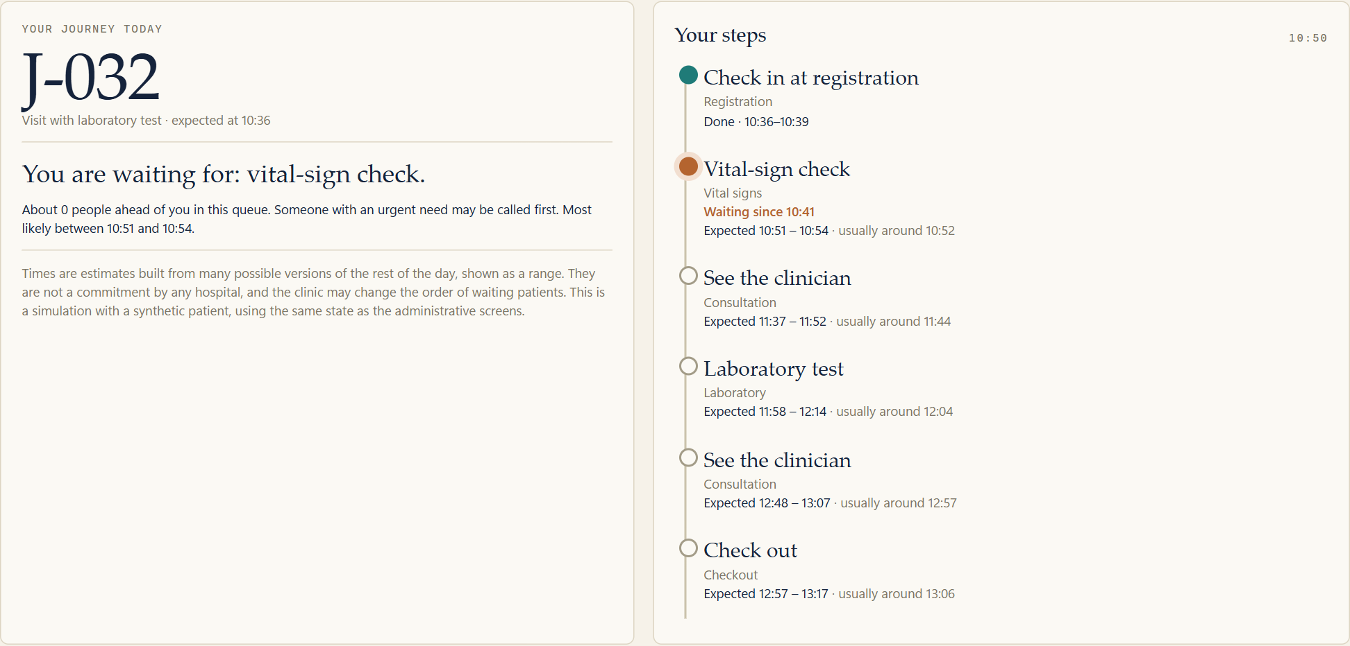
Decide on evidence, and see it from the patient’s side
Action Desk
My Journey
Expandable proposals, nine constraint checks, approve or reject, and a decision log.
An anonymous code, plain-language steps and ranges from many plausible futures.
Notes:
Action Desk: proposals with feasibility evidence and approval controls. My Journey: the same simulation for one anonymous patient, with ranges rather than false precision.

Slide 12
What this does and does not show
1
2
3
Planned is not measured
Plan-following has a cost
Minutes are not outcomes
Reflow plans with booked appointment lengths. The Ledger replays with realised ones. Here the plan projected −80 min and measured −48 min. Across other seeds the result varies, and some days Reflow finds nothing.
Executing a fixed plan instead of dispatching live is itself a bar in the waterfall (−27 min here). It is shown, not hidden.
Fewer waiting minutes is an operational measure. It is not evidence of a clinical benefit, and all patients here are synthetic.
Notes:
Honest limits, stated on the Ledger and the About panel.

Slide 13
An identity built for dispatch, not diagnosis
Studied for principles, not reused
Spline Hana · interactive vector states
Charts with hover animation · @marinach (CC BY 4.0)
Flow · @vladkolokolnikov (CC BY 4.0)
Auto Layout 3D List · Spline UI
Animated Icons · Spline UI
Thumbnail Grid Transition · C. Bernadou
Spacing Tips · M. Filipiuk
iOS Gesture Studies · Juliette
Krea loading state · A. Larionov
Animated Icon Set · J. McDonald
Warm paper
Navy ink
Teal: flow
Copper: deviation
Aa 1,477
Serif numerals, tabular figures and hairline grids carry the hierarchy. The only motion is state made visible.
No third-party design service is needed at runtime. No Spline or Hana embed is shipped: none was exported, and none was invented.
Notes:
SAYR is deliberately different from the separate diagnostic project: no 3D, no anatomy, no evidence-inspection motifs. All ten design references were used for principles only; nothing was reused. Details are in DESIGN_REFERENCES.md.

Slide 14
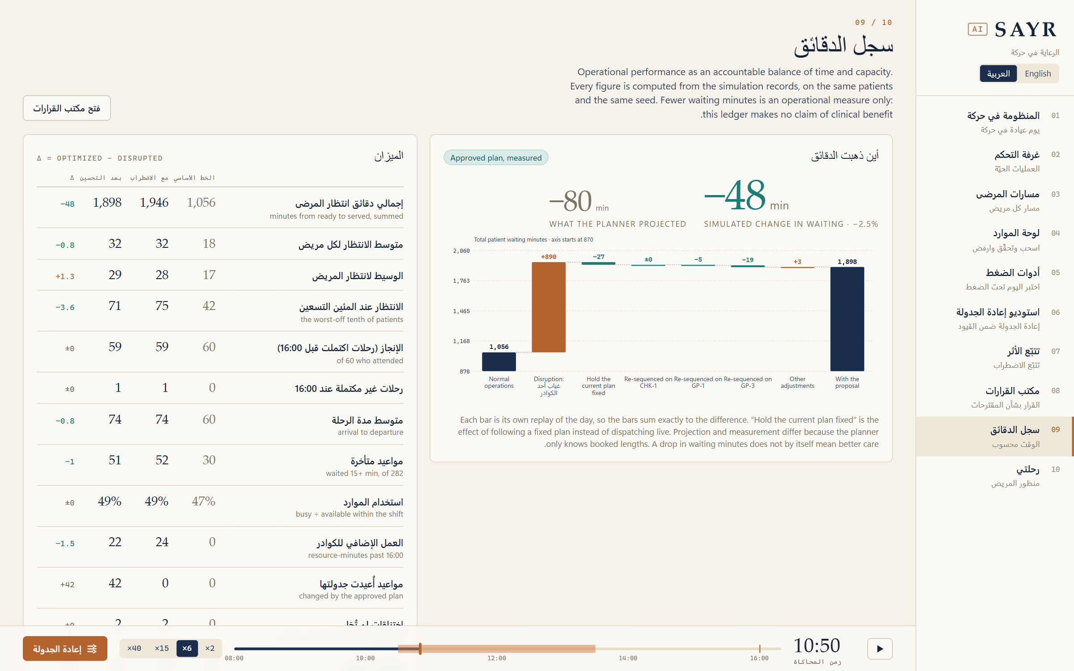
English and Arabic, left-to-right and right-to-left
Same state, two languages
The Minutes Ledger in Arabic: the same computed figures, the layout mirrored, the waterfall axis unchanged.
Translated: navigation, metric labels, scenario descriptions, actions, approval states, responsible-AI disclosures.
Notes:
The interface mirrors in Arabic. Navigation, metric labels, scenarios, actions, approval states and the responsible-AI text are translated; the timeline and charts keep their left-to-right time axis; numbers stay readable. Long explanatory paragraphs remain in English and are listed as a limitation.

Slide 15
SAYR
Lujain Ahmed Mourad · 8D
Yosr Amgad · 8D
Precious Fuentes · 8D
Maryam Ammara Jelita · 8D
Eleen Amr · 8D
Shaden Ahmed Mourad · 6D
The defining moment is the instant an overloaded schedule visibly reorganises into a feasible, explainable plan.
ADNOC School – Madinat Zayed
Notes:
Thank you.

