Slide 1

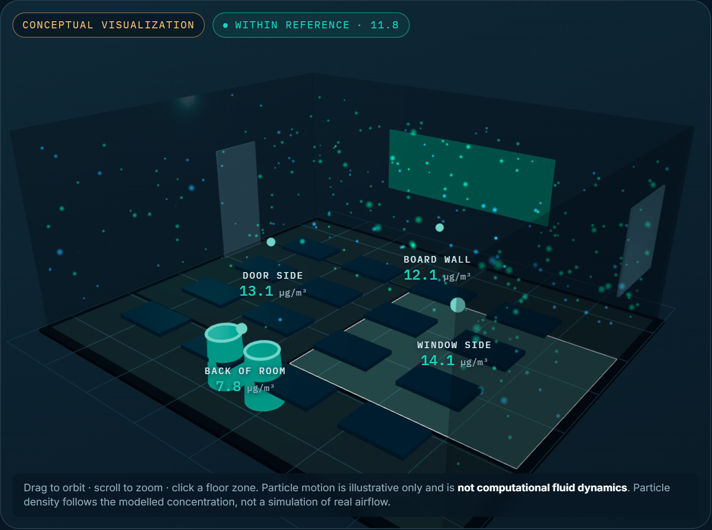
YOUNG PLANET LEADERS · VISION TO ACTION 2026
AIRSHIFT
What if you could see the air you breathe?
Making the Invisible Visible. Turning Awareness into Action.
→
→
→
DETECT
DECIDE
VERIFY
REPLICATE
Screenshot of the working prototype · Air Lab · simulated demonstration data
May Ahmed Mourad · Grade 12 · ADNOC Schools Madinat Zayed, Al Dhafra, UAE · Solo participant
A proposed student-led pilot, subject to school approval. Prototype uses simulated demonstration data.
01 / 10
Notes:
OPEN (about 30 seconds). Start with the question on the screen: what if you could see the air you breathe? Pause. Then: "Most of us can't. Neither can most schools." I'm May Ahmed Mourad, a Grade 12 student at ADNOC Schools Madinat Zayed in Al Dhafra. AIRSHIFT is a student-led clean-air initiative with a simple loop: Detect, Decide, Verify, Replicate. It is a proposal for a pilot, subject to my school's approval. Nothing has been measured yet, and I will be clear throughout about what is a plan, what is a target, and what is a hypothetical example. The prototype you will see is a demonstration tool built to show how the method would work. It runs on clearly labeled simulated data.

Slide 2
THE GLOBAL PROBLEM
Almost everyone breathes air above WHO guideline limits.
PROBLEM STATEMENT · PART 1 OF 2
99%
of the world’s population breathe air that exceeds WHO guideline limits
Air pollution is one of the world's most significant environmental health challenges. The World Health Organization reports that almost all of the global population (99%) breathe air that exceeds its guideline limits, and associates ambient and household air pollution with about 7 million premature deaths each year. Fine particles known as PM2.5, smaller than 2.5 micrometres, are a leading concern. But these are global, outdoor statistics. They do not tell a student what is in the air of their own classroom, where they spend much of the day. Most schools have no affordable way to measure indoor air, interpret the readings, choose a fix within budget, or check that it worked.
WHO
~7 million
premature deaths a year associated with ambient and household air pollution combined
WHO
5 µg/m³
WHO 2021 annual guideline for PM2.5. Particles are smaller than 2.5 micrometres
Outdoor and global ≠ indoor and local. That gap is the problem AIRSHIFT starts with.
WHO AQG 2021
Sources: WHO, Air pollution (who.int/health-topics/air-pollution); WHO Global air quality guidelines 2021. Global and outdoor figures; they are not measurements of any classroom.
AIRSHIFT · YPL Changemaker Academy 2026 · May Ahmed Mourad
02 / 10
Notes:
PROBLEM STATEMENT, PART 1 (about 45 seconds). Read the first paragraph on the slide. Key points: the 99% and the roughly 7 million premature deaths are WHO figures, both global. WHO's 2021 guideline for PM2.5 is 5 micrograms per cubic metre as an annual average. Be careful with wording: these are outdoor and global numbers. They do not describe the inside of any classroom, and that is exactly the gap. A school that wants to act needs to measure, interpret, choose, and check, and most have no affordable way to do that. Sources: WHO Air pollution page (who.int/health-topics/air-pollution); WHO global air quality guidelines 2021.

Slide 3
THE LOCAL CHALLENGE
The gap: no school can see its own air.
PROBLEM STATEMENT · PART 2 OF 2
WHAT WE KNOW · OUTDOOR, REGIONAL
AIRSHIFT begins in Al Dhafra, in the UAE's desert interior. Published monitoring work describes wind-blown desert dust as a major particulate source across Abu Dhabi emirate, but that is an outdoor, regional picture. Whether classroom air at ADNOC Schools Madinat Zayed is affected is simply unknown, because no one has measured it. Indoor particles can come from outdoor dust entering through doors and gaps, foot traffic, chalk, cleaning products and ageing filters. Students, teachers and staff share that air. Our proposed pilot, subject to school approval, starts with a measured baseline instead of assuming a problem.
Desert dust is a major natural particulate source in Abu Dhabi emirate (peer-reviewed monitoring study).
UAE annual outdoor PM2.5 in 2025: 36.4 µg/m³, 7.3× the WHO annual guideline (IQAir). National, not local.
In that study PM2.5 was generally under half of PM10, pointing to coarse natural dust rather than fine particles.
WHAT NOBODY KNOWS YET
Indoor PM2.5 in Madinat Zayed classrooms
Not measured. No baseline exists. The pilot measures first, and acts only if the data justifies it.
207 words across both parts (target: about 200)
Sources: Alhebsi et al. 2025, ISPRS Archives XLVIII-4/W17 (doi 10.5194/isprs-archives-XLVIII-4-W17-2025-13-2026); IQAir UAE 2025 (national, outdoor, private provider).
AIRSHIFT · YPL Changemaker Academy 2026 · May Ahmed Mourad
03 / 10
Notes:
PROBLEM STATEMENT, PART 2 (about 45 seconds). Why Al Dhafra? Because it is where I live and learn, and because published monitoring work for Abu Dhabi emirate describes wind-blown desert dust as a major natural source of particles. Important honesty point: that evidence is outdoor and regional, and the same study found the PM2.5-to-PM10 ratio was generally below 0.5, which points to coarse natural dust rather than fine particles. So I am not claiming my school's classrooms have a problem. I am saying nobody knows, and the pilot starts with a baseline. The UAE-wide 36.4 micrograms per cubic metre figure is a 2025 outdoor annual average from IQAir, 7.3 times the WHO annual guideline. It is national and outdoor, so I show it as context only. Sources: Alhebsi et al. 2025, ISPRS Archives; IQAir.

Slide 4
OUR MISSION
See it. Fix it. Prove it. Share it.
To empower schools to understand their air quality, implement affordable evidence-based improvements, and measure their impact. Beginning with a student-led pilot in Al Dhafra, AIRSHIFT aims to create an accessible, replicable model that enables young changemakers worldwide to turn environmental awareness into measurable community action.
01
Baseline
02
Test
03
Share
Document PM2.5 in one or two classrooms with dates, windows and sensor caveats.
Try one affordable, evidence-based intervention and verify its effect transparently.
Publish a toolkit another school can understand and reuse.
THEORY OF CHANGE
Students measure
affordable monitors, matched windows
Options compared
costs, maintenance, limits
Effect verified
with outdoor air and a comparison room
School decides
with evidence, not guesses
Others replicate
free toolkit and templates
Objectives are proposed targets for the pilot, not results.
AIRSHIFT · YPL Changemaker Academy 2026 · May Ahmed Mourad
04 / 10
Notes:
MISSION (about 40 seconds). Read the mission aloud, slowly. It is 45 words. Then the three objectives: a documented baseline, one verified intervention test, and a toolkit another school can reuse. The theory of change on the right is a chain: if students can measure their own air with affordable devices, and compare options with costs, and verify the result honestly, then the school has evidence to act on and other schools have a method to copy. The word "measurable" matters: we will report numbers with their limits, including when the result is inconclusive.

Slide 5
THE AIRSHIFT SOLUTION
Detect → Decide → Verify → Replicate
01
02
03
04
DETECT
DECIDE
VERIFY
REPLICATE
Measure PM2.5 and record room conditions, sensor limitations and sampling times.
Compare source control, portable HEPA filtration and a facilities review, with costs and maintenance.
Measure again under matched conditions. Report change with outdoor air and uncertainty.
Publish the method, templates, budget variants and lessons learned.
OUTPUT
OUTPUT
OUTPUT
OUTPUT
Documented baseline
Site-specific action plan
Transparent impact summary
School implementation toolkit
OBSERVED measured values with dates and windows
ESTIMATED modelled ranges with stated assumptions
HYPOTHETICAL illustrative scenarios, never results
Intervention guidance: US EPA, Guide to Air Cleaners in the Home; US CDC/NIOSH, Ventilation in Schools and Childcare Programs.
AIRSHIFT · YPL Changemaker Academy 2026 · May Ahmed Mourad
05 / 10
Notes:
THE SOLUTION (about 50 seconds). Walk left to right. DETECT: measure PM2.5 with affordable sensors, record sampling times and room conditions, and note sensor limitations. Output: a documented baseline. DECIDE: compare portable HEPA filtration, source control and a facilities-reviewed ventilation or filtration check, with costs and maintenance. Output: a site-specific action plan, chosen only after the baseline. VERIFY: measure again under matched conditions and compare. Output: a transparent impact summary. REPLICATE: publish the method, templates, budget variants and lessons. Output: a school toolkit. The bottom strip is the discipline of the project: every number is labeled observed, estimated, or hypothetical. We do not claim health outcomes from PM2.5 readings.

Slide 6
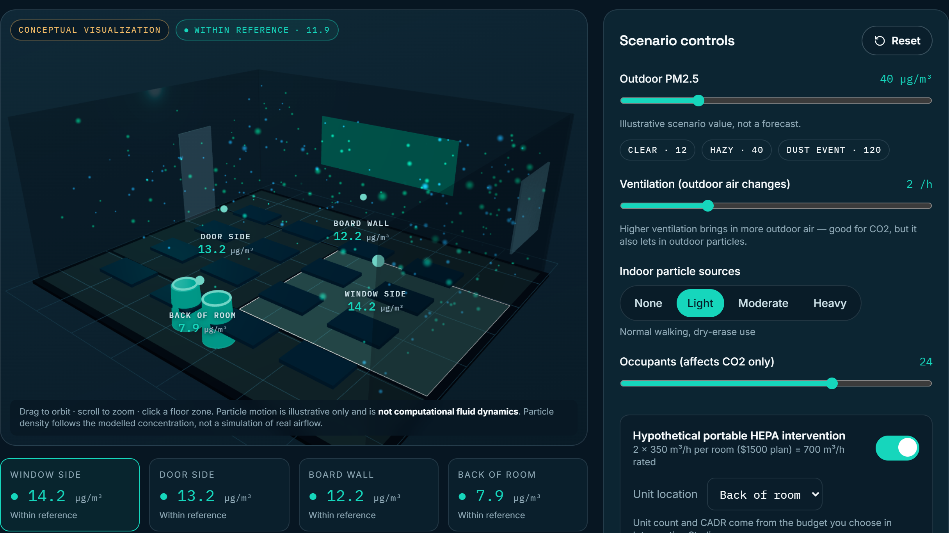
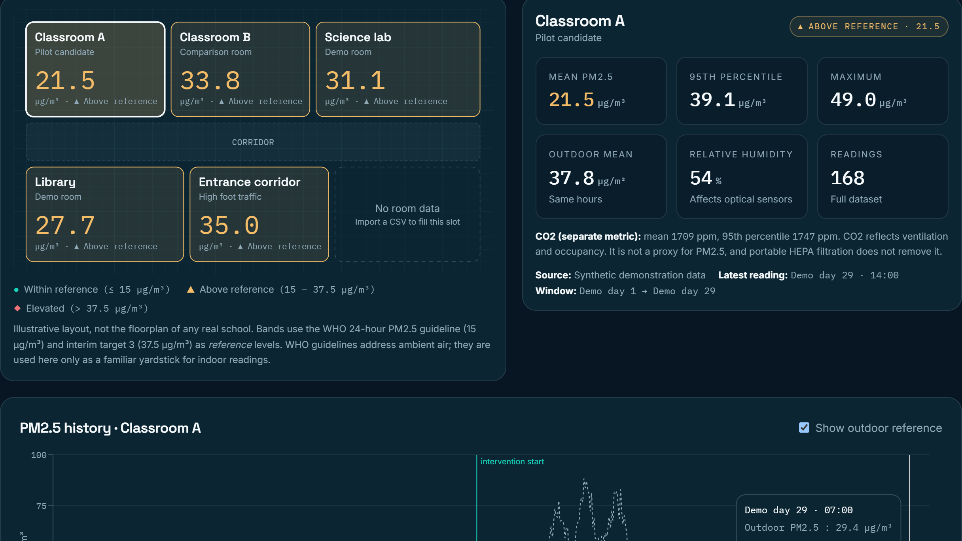
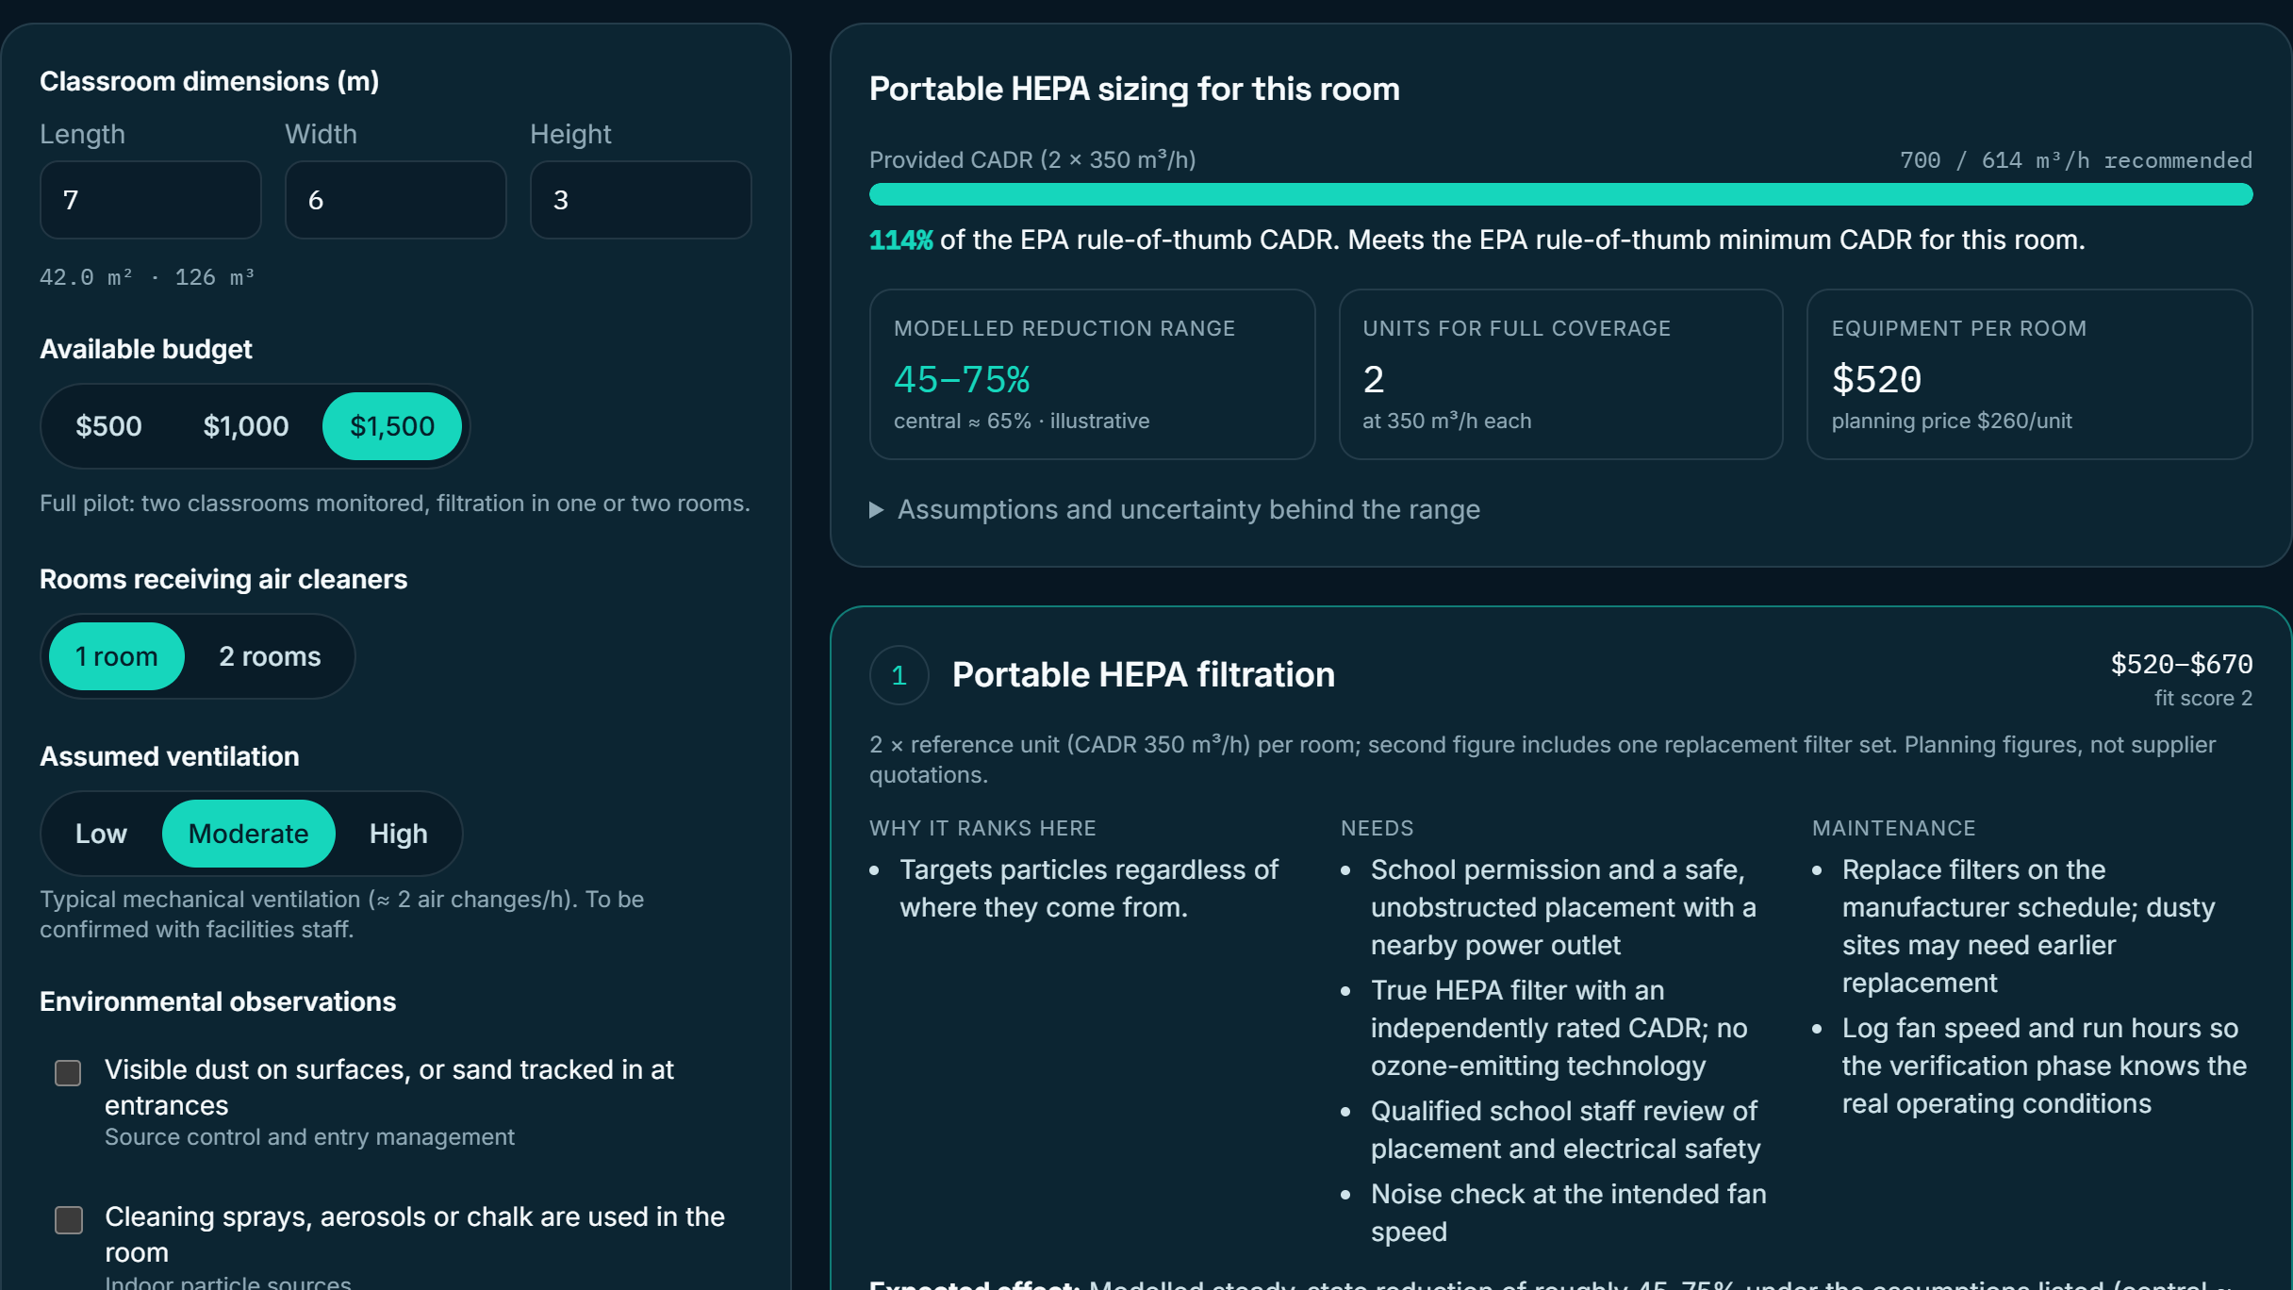
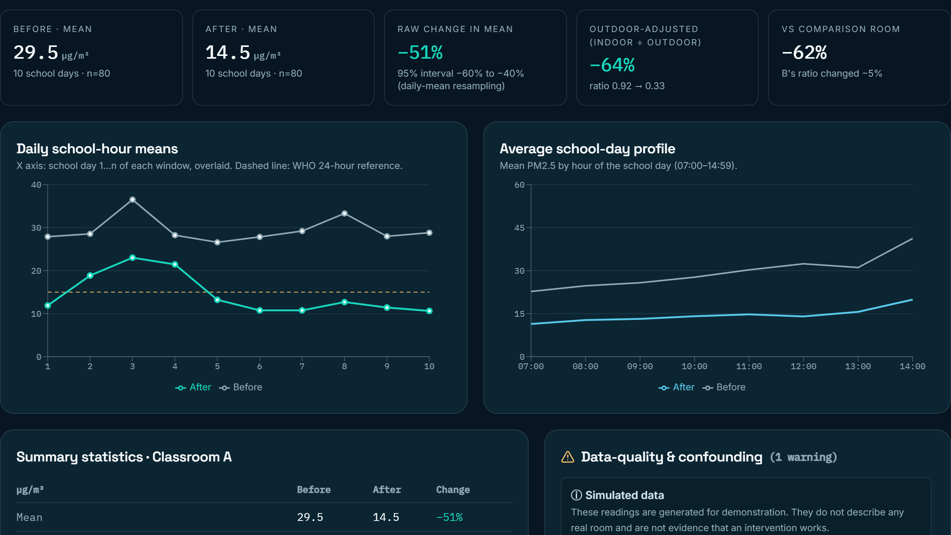
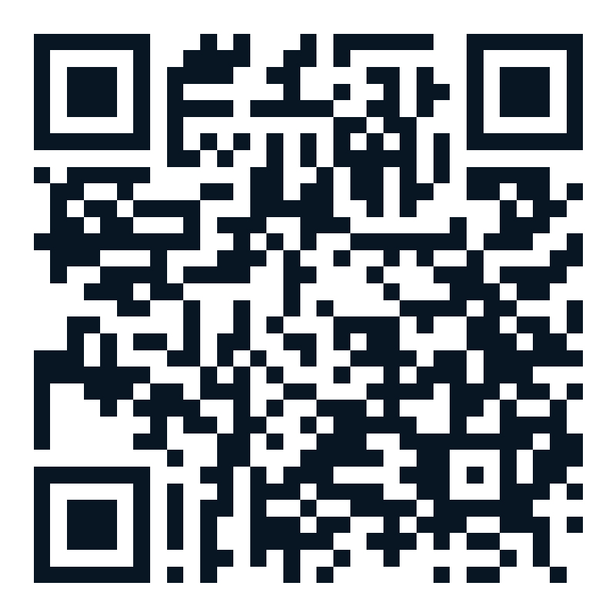
INTERACTIVE PROTOTYPE
A working decision tool, not a mockup.
SIX MODULES
Cinematic landing page
Air Lab (3D)
School Air Map + CSV import
Intervention Studio ($500 / $1,000 / $1,500)
Evidence Lab + report export
Global Replication + toolkit
AIR LAB · 3D classroom + scenario controls
SCHOOL AIR MAP · rooms + time series
BUILT WITH
React, TypeScript, Vite, Three.js, Recharts. Offline, no API keys. Keyboard accessible, reduced-motion aware, responsive.
LIVE DEMO
maymourad.github.io
/airshift
Scan to open
INTERVENTION STUDIO · sizing + options
EVIDENCE LAB · before/after + warnings
Screenshots are from the built application. All readings shown are synthetic demonstration data. Particle animation is conceptual, not computational fluid dynamics.
AIRSHIFT · YPL Changemaker Academy 2026 · May Ahmed Mourad
06 / 10
Notes:
THE PROTOTYPE (about 60 seconds). These are real screenshots of the working application, not mockups. Top left, the Air Lab: a 3D classroom where you change outdoor air, ventilation, indoor sources and occupancy and switch a hypothetical HEPA cleaner on; the particle animation is conceptual, not computational fluid dynamics, and the numbers come from a single-zone mass-balance model with listed assumptions. Top right, the School Air Map with a labeled synthetic dataset. Bottom left, the Intervention Studio: it sizes a cleaner against the EPA rule of thumb, compares three options and shows $500, $1,000 and $1,500 budgets. Bottom right, the Evidence Lab: before-and-after statistics, outdoor adjustment, a comparison room, and data-quality warnings. Everything here is simulated demonstration data. The live link goes here once the site is published; I have not published it yet.

Slide 7
PROJECT STRUCTURE
One student lead. A school community. Eight weeks.
MAIN GOALS
KEY ACTIVITIES
ROLES & RESOURCES
Establish a documented PM2.5 baseline for one or two classrooms
Choose and test one affordable intervention, only if the baseline justifies it
Verify the effect transparently, with limits
Publish a reusable school toolkit
Request school permission and agree the protocol
Measure school-hour PM2.5 with matched windows
Record sources, ventilation and cleaning routines
Implement the approved intervention with staff review
Analyze, report and share with the community
Lead (solo): research, tool, measurement, analysis, education, reporting, outreach
School staff: review placement and infrastructure concerns
Equipment from the grant (see funding)
About 8 weeks of student time outside class
Free open-source software
POTENTIAL STAKEHOLDERS · TO BE ASKED, NONE CONFIRMED
SCHOOL LEADERSHIP
FACILITIES & HVAC STAFF
TEACHERS OF THE ROOMS
CLEANING STAFF
STUDENT PEERS (OUTREACH)
Stakeholders listed are people who would need to be asked; none has agreed yet. No student-identifiable data is collected.
AIRSHIFT · YPL Changemaker Academy 2026 · May Ahmed Mourad
07 / 10
Notes:
PROJECT STRUCTURE (about 50 seconds). Main goals on the left, key activities in the middle, roles and resources on the right. I lead the whole project as the sole YPL participant: research, the digital tool, the measurement plan, data analysis, educational materials, reporting and outreach. Qualified school staff would review equipment placement and any infrastructure concern; I do not touch building systems. The stakeholders listed are people I would need to ask. None has agreed yet. Resources: the grant for equipment, school permission and space, about eight weeks of my time outside class, and free open-source software for the prototype. No student-identifiable data is collected at any point.

Slide 8
IMPLEMENTATION ROADMAP
Eight weeks from funding to published toolkit.
W1
W2
W3
W4
W5
W6
W7
W8
Approve & plan
Approved site and protocol
Detect: baseline
Baseline and action choice
Decide & implement
Intervention dataset
Verify & replicate
Impact report and toolkit
Dependencies: school approval → baseline review → intervention (only if justified) → matched follow-up → report
CHALLENGE | MITIGATION
School approval is delayed or declined | Ask in week 1; fall back to one teacher-approved classroom or a space the school nominates.
Sensors fail or a dust event dominates a window | Two monitors, side-by-side check, spare days in schedule. Record the event rather than discarding it.
Baseline is already within guideline levels | Report it as a finding. Do not buy equipment that is not justified; use funds for outreach and toolkit.
Results are inconclusive or confounded | Publish with caveats; use outdoor air, humidity and a comparison room. Inconclusive evidence still helps the next school.
Planned activities and proposed targets. Dates start when funding is confirmed. Planning prices will be replaced by supplier quotations before any purchase.
AIRSHIFT · YPL Changemaker Academy 2026 · May Ahmed Mourad
08 / 10
Notes:
IMPLEMENTATION ROADMAP (about 55 seconds). Eight weeks after funding. Weeks 1 to 2: ask for permission, choose rooms, agree the protocol, replace planning prices with real quotations. Deliverable: an approved site and protocol. Weeks 3 to 4: collect the baseline, at least ten school days, compare the two monitors side by side, record observations, and decide. Weeks 5 to 6: implement only the intervention the baseline justifies, with staff review, and collect follow-up with the same sensors. Weeks 7 to 8: analyze matched windows, document uncertainty, share what students learned and publish the toolkit. Dependencies run left to right: nothing starts without approval, and nothing is chosen before the baseline. The table shows the four biggest risks and what I would do. Note the fallback: if the baseline is already within guideline levels, that is reported as a finding and we do not buy equipment we do not need.

Slide 9
FUNDING AND IMPACT
$1,500 buys a complete, honest pilot.
FULL REQUEST · $1,500
$1,000
$500
Focused pilot
Single-room demo
Particulate monitoring (2 devices)
$360
One treated and one comparison room. Two lower-cost monitors, two air cleaners. Thin contingency, lighter outreach.
One monitor, one smaller air cleaner. No simultaneous comparison; coverage of recommended airflow is partial.
Portable HEPA filtration
$520
Replacement filters & maintenance
$150
PROPOSED SUCCESS INDICATORS (TARGETS)
Data-logging & technical supplies
$110
≥ 10 school days of baseline and of follow-up per room, ≥ 90% complete
PM2.5 summaries in µg/m³ with dates, windows and sensor caveats
Equipment run-hours, maintenance and cost per classroom recorded
Toolkit read-through by ≥ 3 outside educators or student groups
Comparative measurement supplies
$100
Education & outreach
$90
EVALUATION PROTOCOL
Contingency
$170
Same sensors, placement and school hours · outdoor air alongside · comparison room · transition day excluded · uncertainty and data-quality warnings reported · no health claims.
Total
$1,500
Preliminary planning figures, not supplier quotations; to be checked against local quotes, room size and school approvals before purchase. Indicators are proposed targets, not results.
AIRSHIFT · YPL Changemaker Academy 2026 · May Ahmed Mourad
09 / 10
Notes:
FUNDING AND IMPACT (about 60 seconds). The full request is $1,500: two monitors $360, portable HEPA filtration $520, replacement filters and maintenance $150, data-logging and technical supplies $110, comparative measurement supplies $100, education and outreach $90, and $170 contingency. These are preliminary planning figures, not supplier quotations; they will be checked against local quotes, room size and school approval before any purchase. At $1,000 the pilot keeps one treated room and one comparison room with lower-cost monitors. At $500 it becomes a single-room demonstration with one monitor and one smaller cleaner, which will cover less than the recommended airflow. The indicators on the right are proposed targets, not results. The evaluation protocol is the heart of it: same sensors, same placement, same school hours, outdoor air alongside, a comparison room, and a report that states the limits.

Slide 10
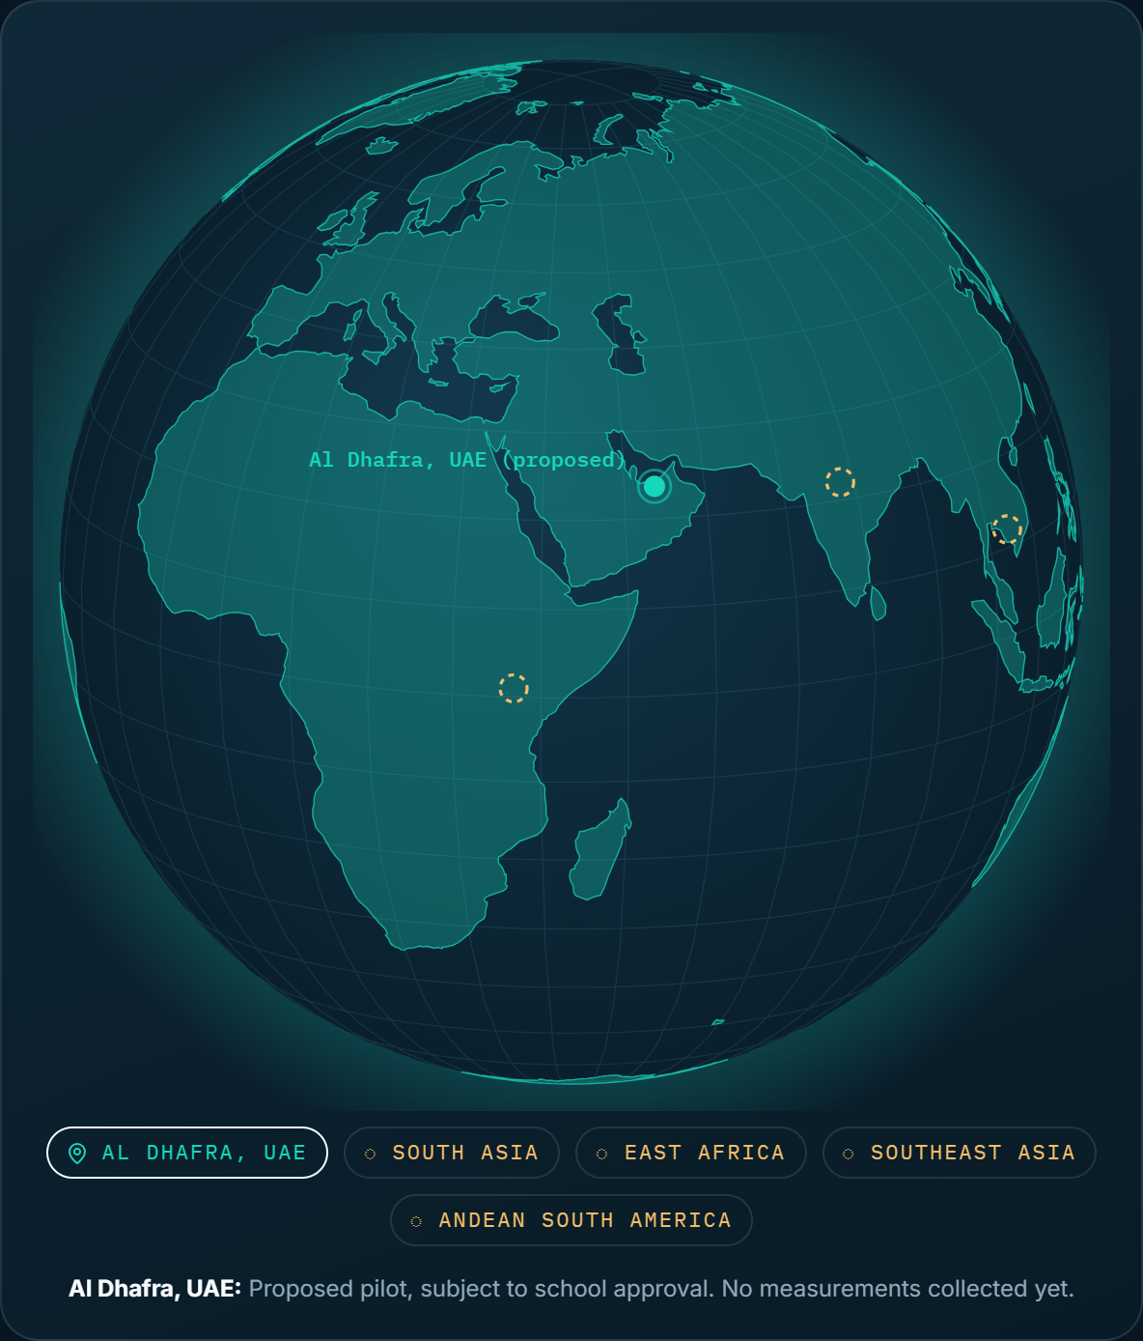
GLOBAL VISION AND CLOSING
From one classroom to a method others can copy.
PUBLISH
Method, templates and budget variants, free to use.
TEST
Can outside educators follow it without help?
SUPPORT
Peer schools repeat it with their own approved equipment.
THE ASK
The $1,500 first-place award funds the full pilot. $1,000 or $500 funds a smaller, equally honest version.
You can’t fix what you can’t see.
AIRSHIFT makes the air visible, measures whether the fix worked, and shares it.
Globe markers other than Al Dhafra are hypothetical regions for illustration only. No partners, sites or deployments exist outside the proposed pilot.
AIRSHIFT · YPL Changemaker Academy 2026 · May Ahmed Mourad
10 / 10
Notes:
GLOBAL VISION AND CLOSE (about 50 seconds). The globe shows the pilot in Al Dhafra and four dashed markers for regions where a school might one day adapt the toolkit. Those are hypothetical. There are no partners, sites or plans there. Replication is a strategy, not a claim: publish the method for free, test whether outside educators can follow it, and only then support peer schools who fund their own equipment. The ask: the $1,500 first-place award funds the full pilot; smaller awards fund a smaller, honest version. Close with the line on the slide: you can't fix what you can't see. AIRSHIFT starts by making the air visible, then measures whether the fix worked, and shares it so the next school doesn't start from zero. Thank you.

