Slide 1
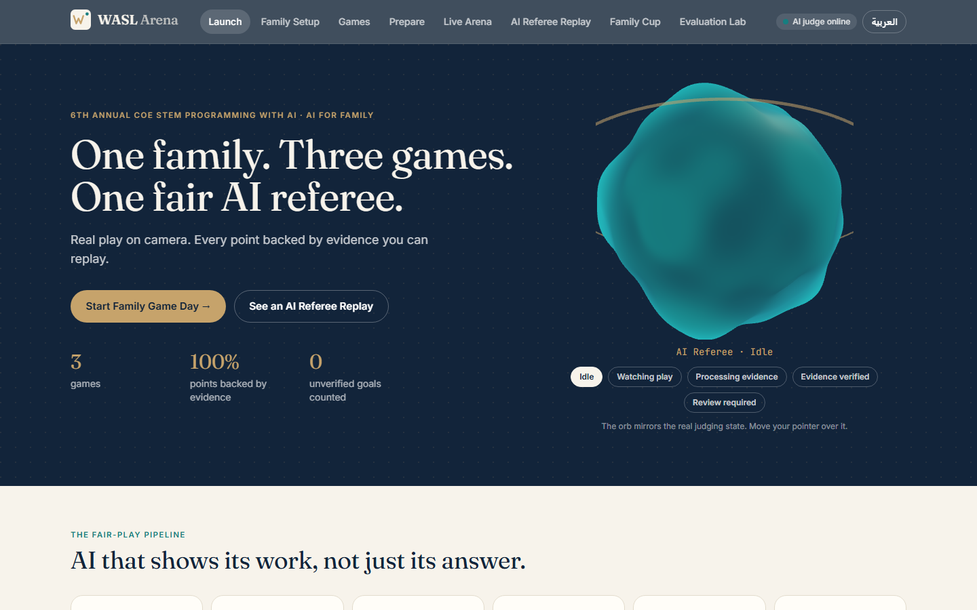
6TH ANNUAL COE STEM PROGRAMMING WITH AI · CYCLE 3 · AI FOR FAMILY
WASL Arena
One family. Three games. One fair AI referee.
Family AI Game Day · Football AI · Falaj Flow · Souq Signal
Team 204 · Team code AYUCK · Track: Cycle 3 (grades 9-12)
May Ahmed Mourad (G12) · Shamsa Faris Almazrouei (G12) · Fatima Mohamed Almazrouei (G11)
WASL Arena · Team 204 · Code AYUCK · Cycle 3 (grades 9-12) · May Ahmed Mourad, Shamsa Faris Almazrouei, Fatima Mohamed Almazrouei
1
Notes:
Open with the promise: one family, three games, one fair AI referee. WASL means connection: the app connects physical family play to digital judging. This is our Cycle 3 entry for AI for Family: Family AI Game Day.

Slide 2
VISION
A fair referee for every family game
◆ Real physical play: ball, board, cards, voices
◆ An AI that watches and listens, then applies written rules
◆ Every point linked to replayable evidence
◆ A human host always has the final word
◆ Culture built in: falaj irrigation and the souq market
Fair play = evidence + doubt
If the AI cannot see it, it does not score it. Uncertain calls wait for the host.
WASL Arena · Team 204 · Code AYUCK · Cycle 3 (grades 9-12) · May Ahmed Mourad, Shamsa Faris Almazrouei, Fatima Mohamed Almazrouei
2
Notes:
Our vision is that any family can play physical games at home and get a judge they can trust. Trust comes from evidence, not from confidence.

Slide 3
PROBLEM
Family games end in arguments
“Was that a goal?”
“You said it after!”
“Is the score right?”
Nobody agrees what the camera saw.
Speech and action are hard to line up by memory.
Manual tallies drift; nobody can check them.
◆ Black-box AI scoring fails the trust test
◆ An AI that guesses is worse than no AI
◆ Families need explanations, not just answers
WASL Arena · Team 204 · Code AYUCK · Cycle 3 (grades 9-12) · May Ahmed Mourad, Shamsa Faris Almazrouei, Fatima Mohamed Almazrouei
3
Notes:
Everyone has had the 'was that a goal' argument. Existing apps either need manual scoring or give black-box answers. Families will not trust a judge that cannot explain itself.

Slide 4
CONTEXT
Why family gaming matters
◆ Shared play builds connection across generations
◆ Physical games keep families moving and talking
◆ Heritage games pass on culture (falaj, souq)
◆ Fair, simple judging lets children and adults compete together
◆ Screens act as host and referee, not the entertainment
Our principle
Technology should make the family game more fun and more fair, never take it over.
WASL Arena · Team 204 · Code AYUCK · Cycle 3 (grades 9-12) · May Ahmed Mourad, Shamsa Faris Almazrouei, Fatima Mohamed Almazrouei
4
Notes:
Shared play builds connection across generations. The UAE Year of Family theme makes this timely. We keep screens as a host and judge, not as the entertainment itself: the fun is physical.

Slide 5
FAMILY AI GAME DAY
The official challenge
◆ Working website/app for family games inspired by culture, heritage or sports
◆ AI observes real play through video and audio, applies rules, keeps score
◆ Cycle 3: football + 2 original games (team and individual)
◆ Football: track players and ball, goals, possession, MVP
◆ Upload video or record by camera + microphone
◆ Human host sets up, runs rounds/turns/timers, shows reasons
Excluded examples
Heritage guessing · cup stacking · ring toss · copy-the-rhythm. Our games are original.
WASL Arena · Team 204 · Code AYUCK · Cycle 3 (grades 9-12) · May Ahmed Mourad, Shamsa Faris Almazrouei, Fatima Mohamed Almazrouei
5
Notes:
These are the requirements from the Cycle 3 question: working website or app, AI observing real play through video and audio, three games with football, team and individual play, host sets up and runs, shows results with reasons.

Slide 6
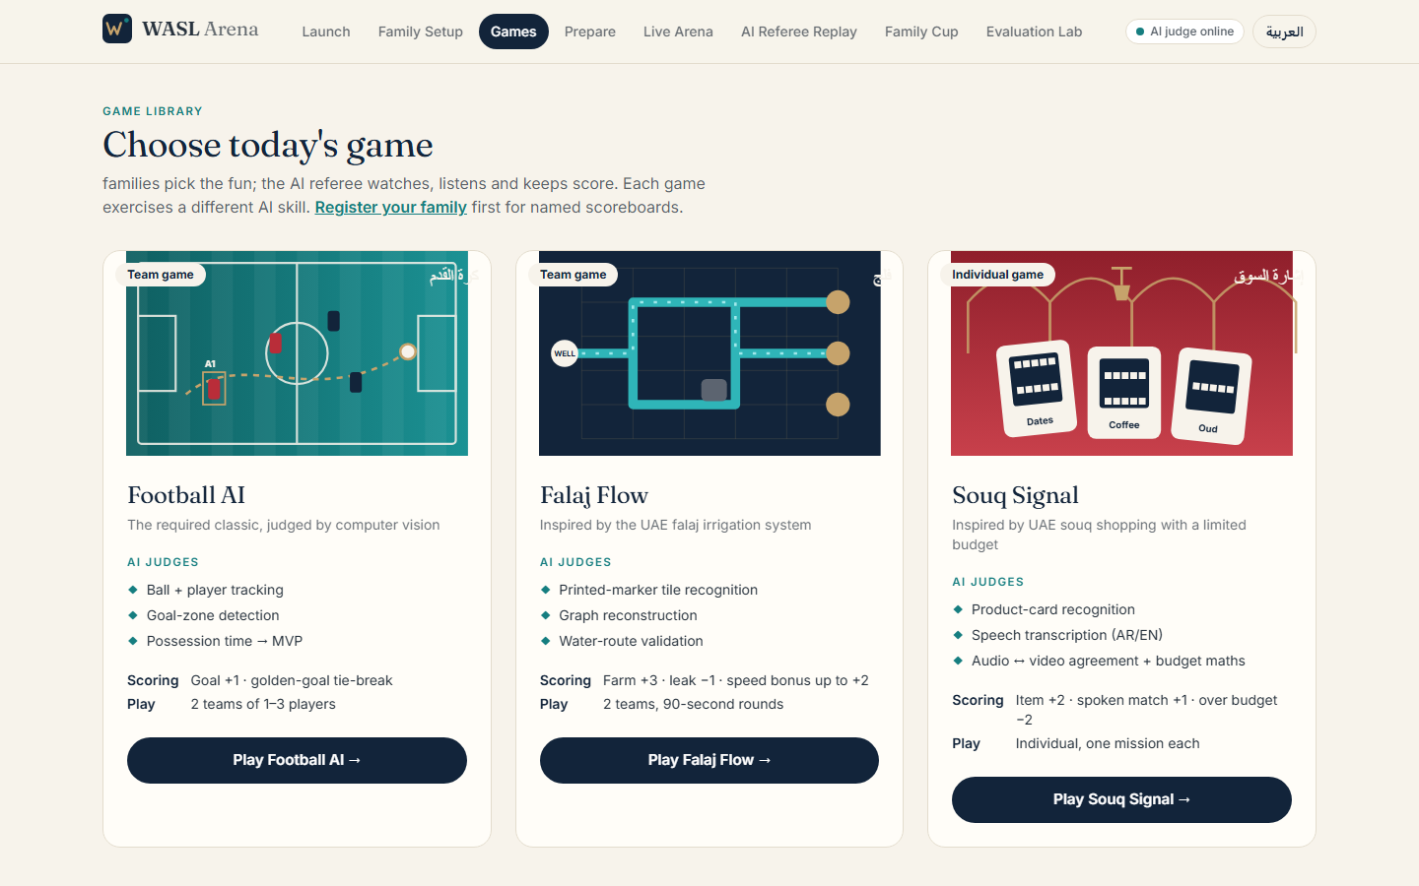
SOLUTION
Our solution: WASL Arena
Football AI
Falaj Flow
Souq Signal
Team · tracking, goals, possession, MVP
Team · board vision + graph reasoning
Individual · vision + speech + budget
◆ 8 screens, bilingual EN/AR
◆ Real video/audio judging
◆ Host review + audit trail
WASL Arena · Team 204 · Code AYUCK · Cycle 3 (grades 9-12) · May Ahmed Mourad, Shamsa Faris Almazrouei, Fatima Mohamed Almazrouei
6
Notes:
WASL Arena is a complete host-and-judge application. Eight screens take a family from registration to the final cup. Three games each show a different AI skill.

Slide 7
WHY IT WINS
Value proposition
Families
Hosts
Judges
Fair, fast scoring that everyone can replay and understand.
Setup, rounds, timers, review and results in one console.
Real pipelines, tests and honest limits you can inspect.
◆ Explainable: rule, frames, timestamps, score change
◆ Honest: NEEDS_REVIEW instead of guessing
◆ Tamper-evident: hashes + signatures + audit chain
WASL Arena · Team 204 · Code AYUCK · Cycle 3 (grades 9-12) · May Ahmed Mourad, Shamsa Faris Almazrouei, Fatima Mohamed Almazrouei
7
Notes:
Each audience gets something: families get fair play, hosts get control, judges get proof. The AI is useful because it is accountable.

Slide 8
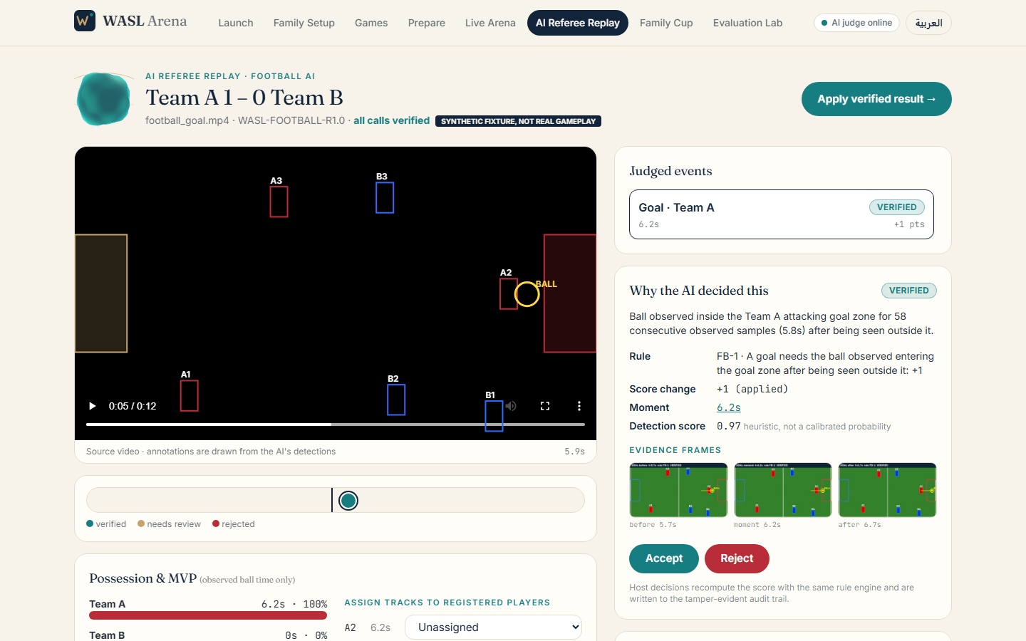
INNOVATION
Signature innovation: AI Referee Replay
◆ Source video with live annotations
◆ Timestamps and evidence frames
◆ Rule applied and score change
◆ Verification status + uncertainty
◆ Human review accept / reject
WASL Arena · Team 204 · Code AYUCK · Cycle 3 (grades 9-12) · May Ahmed Mourad, Shamsa Faris Almazrouei, Fatima Mohamed Almazrouei
8
Notes:
This is the idea we want judges to remember. Every judgment can be replayed with the video, the detections drawn on top, the rule applied, the score change and a status. Click any event, see exactly why.

Slide 9
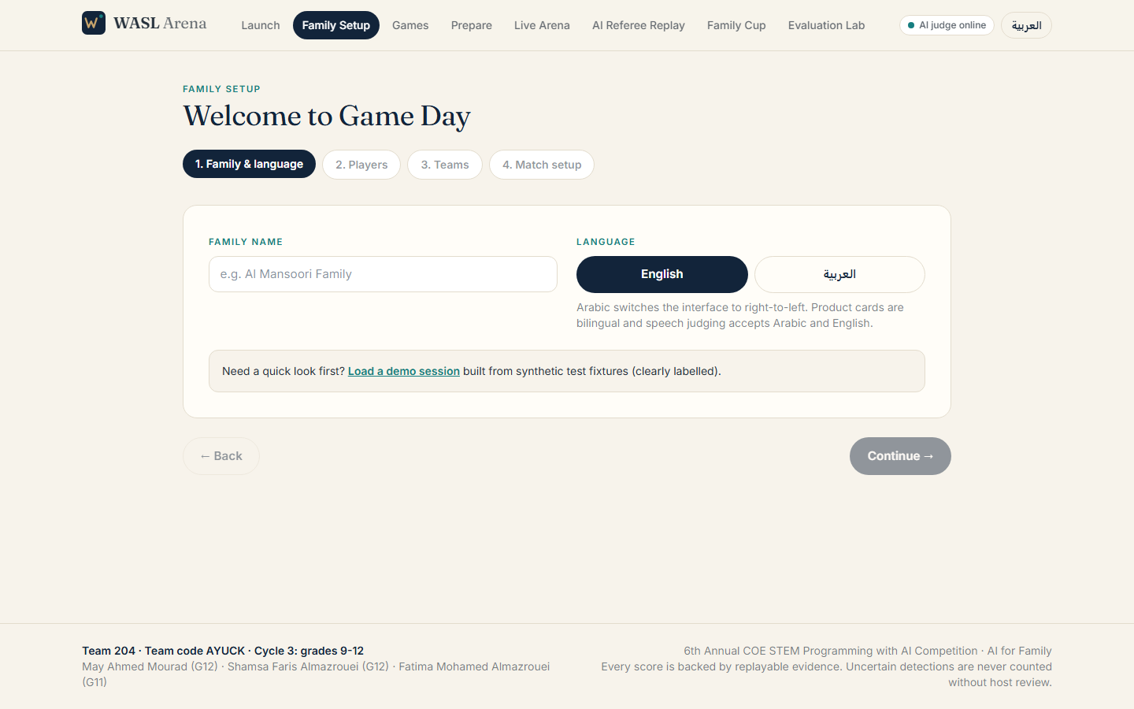
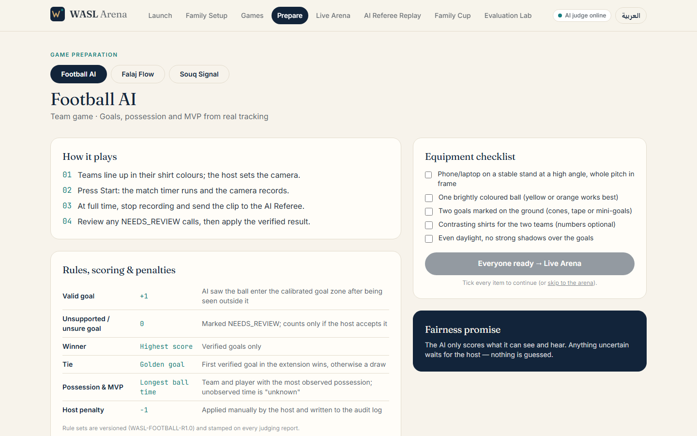
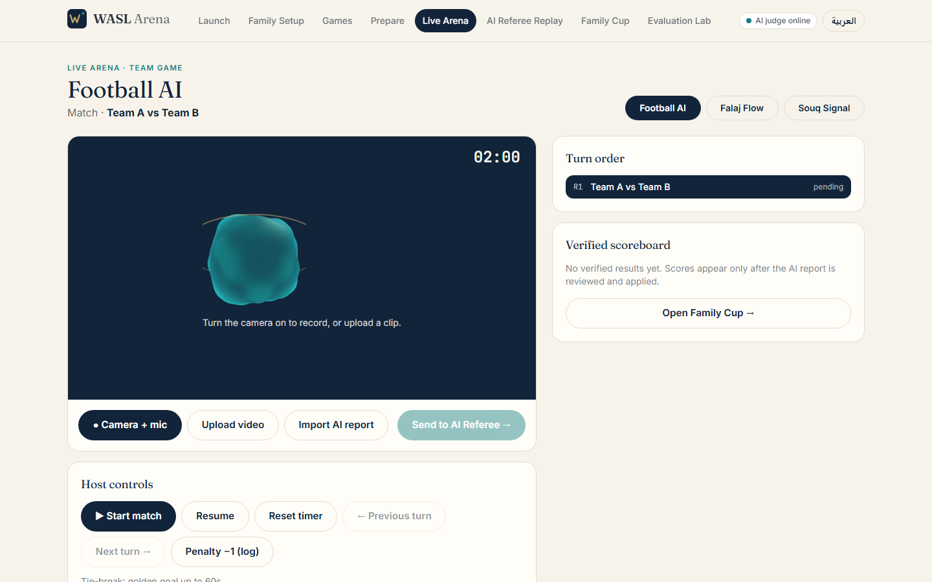
HOST FLOW
User journey
1
Choose game
2
Players & teams
3
Rules & ready
4
Round in play
5
AI judges
6
Final results
Family setup
Preparation
Live arena
WASL Arena · Team 204 · Code AYUCK · Cycle 3 (grades 9-12) · May Ahmed Mourad, Shamsa Faris Almazrouei, Fatima Mohamed Almazrouei
9
Notes:
The flow mirrors the brief: choose a game, players and teams, rules and ready, round in play, AI judge results, final results, then choose another game.

Slide 10
GAMES
The three-game collection
Football AI · Team
Falaj Flow · Team
Souq Signal · Individual
Tracking, goal zones, possession, MVP
ArUco tile reading, graph, water routes
Cards + speech + budget agreement
◆ Team and individual play
◆ No excluded example games
◆ Printable boards and cards included
WASL Arena · Team 204 · Code AYUCK · Cycle 3 (grades 9-12) · May Ahmed Mourad, Shamsa Faris Almazrouei, Fatima Mohamed Almazrouei
10
Notes:
Exactly three games, as Cycle 3 requires: football plus two originals. Team and individual play are both covered. Each game uses a different AI capability.

Slide 11
GAME 1 · TEAM
Football AI: overview
◆ Mini-match, fixed camera, bright ball, marked goals
◆ Valid goal +1; unsupported goal 0
◆ Winner: highest verified score
◆ Tie: configurable golden goal
◆ MVP = longest verified possession
◆ Host penalty −1 (audit-logged)
Goal-zone calibration in Game Preparation
WASL Arena · Team 204 · Code AYUCK · Cycle 3 (grades 9-12) · May Ahmed Mourad, Shamsa Faris Almazrouei, Fatima Mohamed Almazrouei
11
Notes:
Teams of one to three play a mini match on camera. Fixed camera, bright ball, contrasting shirts, calibrated goals. The AI tracks, detects goals and measures possession. The official brief says the MVP is the player with the most ball time.

Slide 12
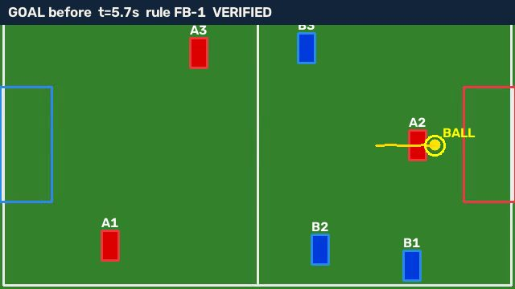
HOW IT SEES
Football AI: tracking
◆ Frames sampled at 10 fps
◆ Ball = best circular contour in a calibrated colour range
◆ Players = team-colour blobs, tracked frame to frame
◆ Only observed positions count: no interpolation
◆ Players are tracks; the host maps tracks to names
Tracked ball trail and player boxes (synthetic fixture)
WASL Arena · Team 204 · Code AYUCK · Cycle 3 (grades 9-12) · May Ahmed Mourad, Shamsa Faris Almazrouei, Fatima Mohamed Almazrouei
12
Notes:
Classical, explainable computer vision. HSV colour segmentation finds ball and shirts; contour shape and area filter noise; nearest-neighbour tracking follows players; we only use positions that were actually observed.

Slide 13
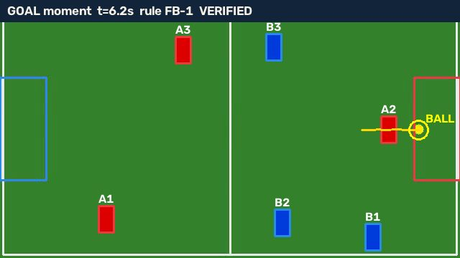
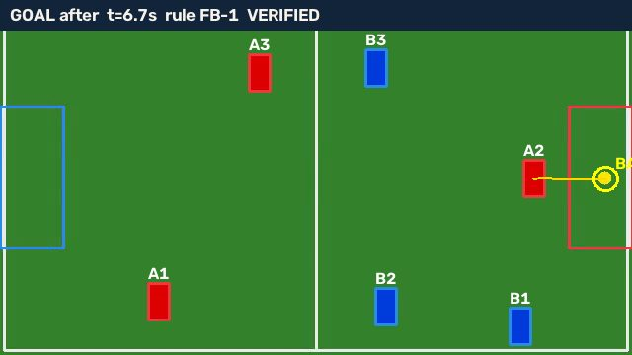
EVIDENCE
Football AI: referee replay
The moment
After
◆ Rule FB-1: ball observed entering the goal zone after being seen outside: +1 · Ball lost near the goal → POSSIBLE_GOAL, 0 points until the host decides
WASL Arena · Team 204 · Code AYUCK · Cycle 3 (grades 9-12) · May Ahmed Mourad, Shamsa Faris Almazrouei, Fatima Mohamed Almazrouei
13
Notes:
Here is a verified goal: the AI saw the ball outside the zone, then inside for several consecutive samples. The evidence frames before, at and after the moment are attached. A goal whose entry was not observed becomes needs review.

Slide 14
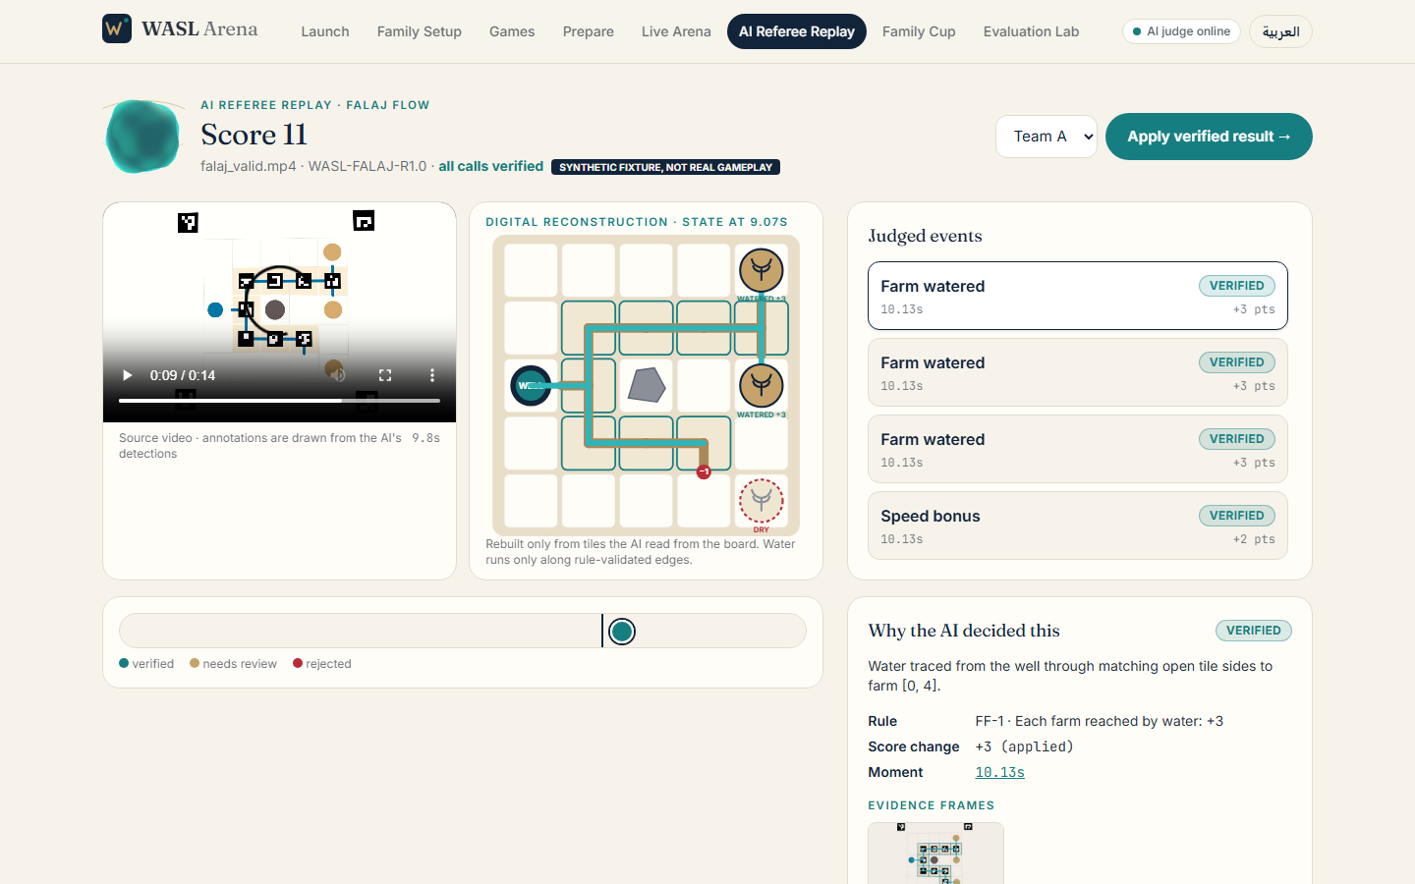
GAME 2 · TEAM
Falaj Flow: overview
◆ Inspired by the UAE falaj irrigation system
◆ Printed 5×5 board: well, three farms, a rock
◆ Teams place channel tiles for 90 seconds
◆ Farm +3 · leak −1 · speed bonus up to +2
◆ Tie: shortest valid network, then time
Split screen: physical board and digital twin
WASL Arena · Team 204 · Code AYUCK · Cycle 3 (grades 9-12) · May Ahmed Mourad, Shamsa Faris Almazrouei, Fatima Mohamed Almazrouei
14
Notes:
Falaj is the traditional UAE irrigation system. Teams build a channel network with printed tiles on a 5 by 5 board. Three farms need water; a rock blocks the middle; 90 seconds per round.

Slide 15
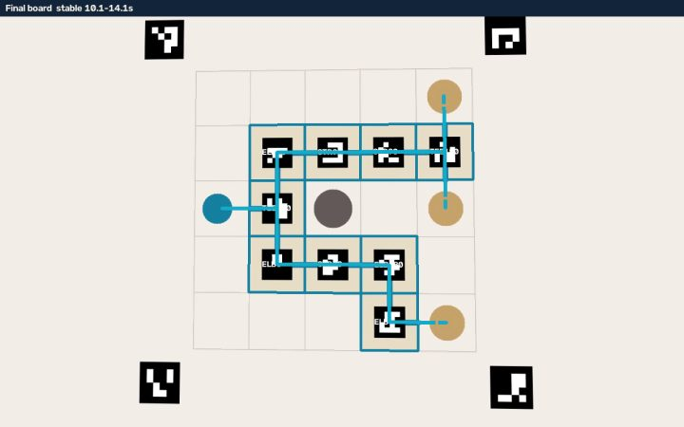
HOW IT THINKS
Falaj Flow: graph intelligence
1 Calibrate
2 Read tiles
3 Stabilise
4 Trace water
4 corner markers → board homography
marker id = type, rotation = 90° steps
state must hold 1 s: hands ignored
BFS over matching open sides; leaks found
◆ Exact tile types and rotations recovered in testing
◆ Leaks: edge, rock, gap, closed side
Board read from video, water path in teal
WASL Arena · Team 204 · Code AYUCK · Cycle 3 (grades 9-12) · May Ahmed Mourad, Shamsa Faris Almazrouei, Fatima Mohamed Almazrouei
15
Notes:
Four corner markers give us a homography. Each tile has a marker whose id gives its type and whose rotation gives its orientation. We build a graph and run breadth first search from the well, following only matching open sides. Anything else is a leak.

Slide 16
RULES
Falaj Flow: scoring
Farm watered
+3
Tested outcomes
falaj_valid: 11 pts
falaj_partial: 5 pts
falaj_rock: 10 pts
Leak
−1
All farms ≤ 45 s
+2
All farms ≤ 70 s
+1
Complete route 11 · partial network 5 · blocked by rock 10 (synthetic fixtures, matching ground truth).
Tie-break
shortest network → time
WASL Arena · Team 204 · Code AYUCK · Cycle 3 (grades 9-12) · May Ahmed Mourad, Shamsa Faris Almazrouei, Fatima Mohamed Almazrouei
16
Notes:
Scores are deterministic. Three farms is nine points, each leak costs one, and a fast finish adds up to two. The tie break prefers the shortest valid network.

Slide 17
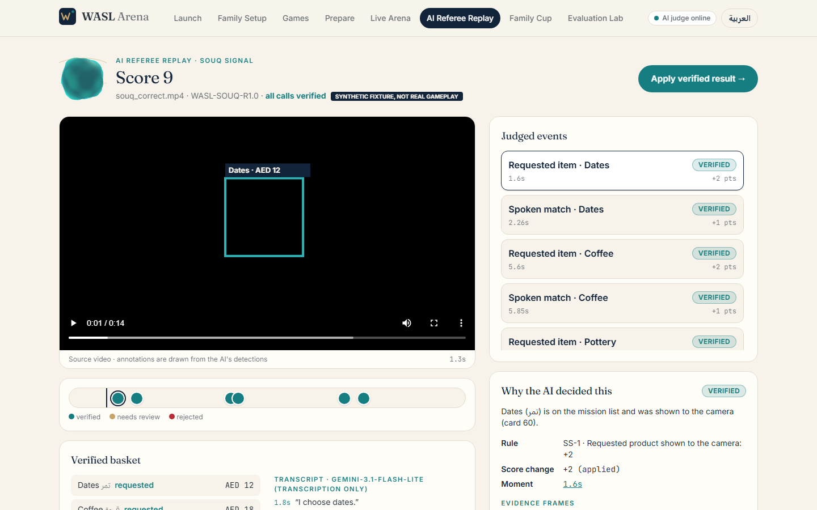
GAME 3 · INDIVIDUAL
Souq Signal: overview
◆ Shopping mission + budget in AED
◆ Pick product cards: dates, coffee, spices, pottery, textile, oud…
◆ Show each card to the camera and say its name
◆ Item +2 · spoken match +1 · over budget −2
◆ Duplicate = no points · Tie: lower spend, then time
Verified basket and transcript
WASL Arena · Team 204 · Code AYUCK · Cycle 3 (grades 9-12) · May Ahmed Mourad, Shamsa Faris Almazrouei, Fatima Mohamed Almazrouei
17
Notes:
An individual game inspired by UAE markets. The host gives a shopping mission and budget. The player picks product cards, shows each to the camera and says its name. Different from a guessing game: it is about choosing, speaking and staying in budget.

Slide 18
VISION + SPEECH
Souq Signal: multimodal AI
See
Hear
Agree?
Score
Card markers decoded per frame → presentation intervals
Arabic/English speech → timed transcript
Said ≈ shown within ±5 s, else host review
Deterministic rules + budget maths
◆ Transcription model never decides points
◆ Silent audio is rejected by an energy gate (no hallucinated speech)
◆ No transcript → spoken-match points stay NEEDS_REVIEW
WASL Arena · Team 204 · Code AYUCK · Cycle 3 (grades 9-12) · May Ahmed Mourad, Shamsa Faris Almazrouei, Fatima Mohamed Almazrouei
18
Notes:
Cards are recognised by printed markers; speech is transcribed by an AI model, server side. The model only produces text. Matching and scoring are deterministic code, so the AI can never invent points.

Slide 19
BASKET
Souq Signal: transaction verification
◆ Distinct card prices are summed
◆ Over budget → −2 (once)
◆ Duplicate cards earn 0 and are not paid twice
◆ Audio ≠ video → host review
◆ Test: correct basket = 9 pts, spend AED 55 of 60
WASL Arena · Team 204 · Code AYUCK · Cycle 3 (grades 9-12) · May Ahmed Mourad, Shamsa Faris Almazrouei, Fatima Mohamed Almazrouei
19
Notes:
The basket shows each verified card with price, remaining budget and the transcript with timestamps. Mismatches between what is said and what is shown are flagged for the host.

Slide 20
LIVE ARENA
Family host console
◆ Camera + mic recording or upload
◆ Round timer, turn order, skip/next
◆ Import a sealed AI report
◆ Verified scoreboard
◆ Host penalty with audit log
WASL Arena · Team 204 · Code AYUCK · Cycle 3 (grades 9-12) · May Ahmed Mourad, Shamsa Faris Almazrouei, Fatima Mohamed Almazrouei
20
Notes:
The host console covers camera or microphone recording, upload, importing an external AI report, timer, turn order, penalties and the verified scoreboard.

Slide 21
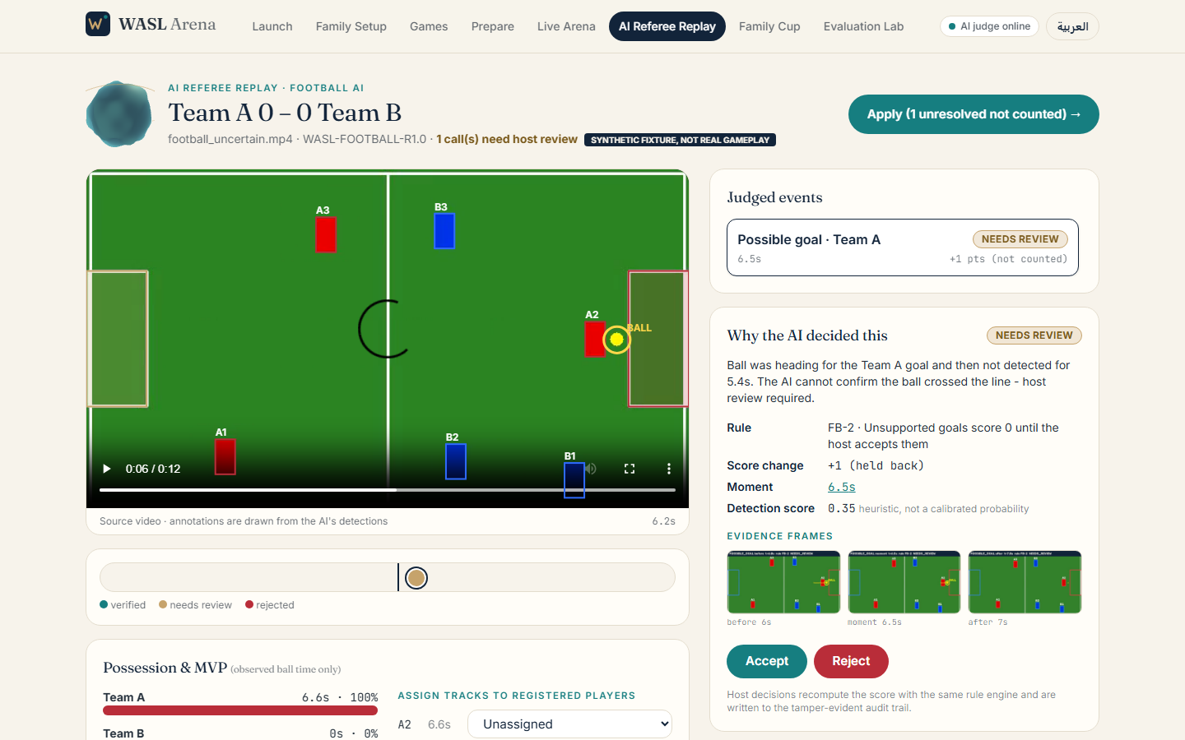
EXPLAIN EVERY CALL
AI Referee Replay
◆ Event timeline on the video
◆ Why the AI decided this
◆ Evidence frames + audio transcript
◆ Accept / Reject → score recomputed
◆ Audit trail entry for every decision
A call that needs review: ball lost near the goal
WASL Arena · Team 204 · Code AYUCK · Cycle 3 (grades 9-12) · May Ahmed Mourad, Shamsa Faris Almazrouei, Fatima Mohamed Almazrouei
21
Notes:
This is the screen to remember. Select an event and the video jumps to the moment. You see the rule, the points, the status and the evidence frames. The host can accept or reject, and the score is recomputed by the same rule engine.

Slide 22
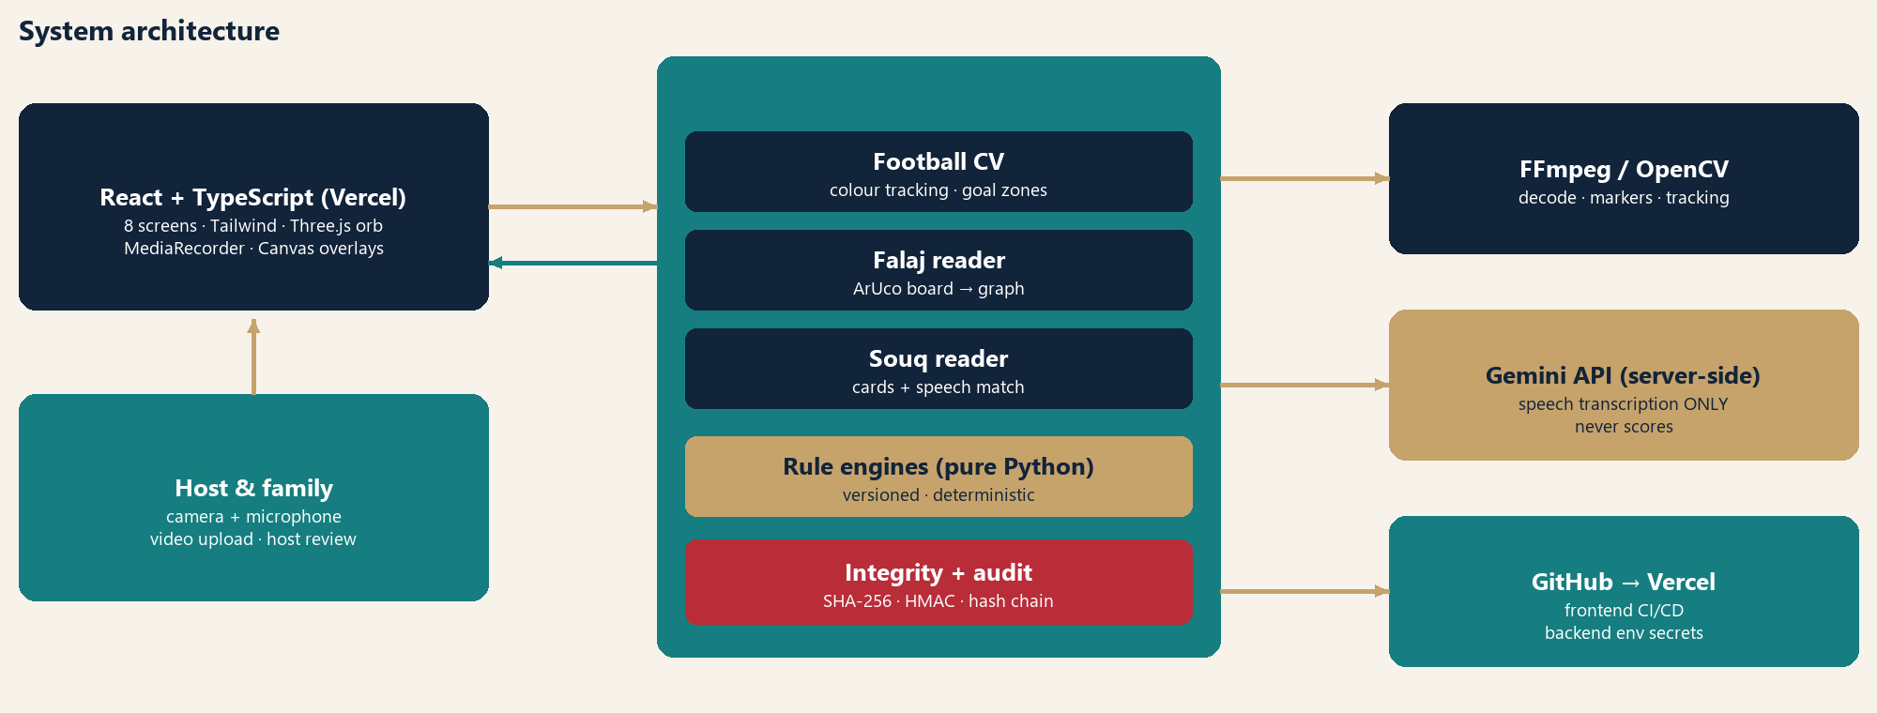
SYSTEM
Technical architecture
WASL Arena · Team 204 · Code AYUCK · Cycle 3 (grades 9-12) · May Ahmed Mourad, Shamsa Faris Almazrouei, Fatima Mohamed Almazrouei
22
Notes:
React frontend on Vercel, FastAPI judge on Render with FFmpeg and OpenCV. Rule engines are pure Python. The transcription key lives only on the server.

Slide 23
METHODS
AI models and algorithms
Football
HSV segmentation, contours, nearest-neighbour tracking, goal-zone logic
Falaj Flow
ArUco markers, homography, rotation estimation, BFS on tile graph
Souq Signal
ArUco card sightings, speech transcription, alias matching, budget maths
Scoring
Versioned deterministic rule engines (FB / FF / SS)
Integrity
SHA-256, HMAC-SHA256, hash-chained audit log
WASL Arena · Team 204 · Code AYUCK · Cycle 3 (grades 9-12) · May Ahmed Mourad, Shamsa Faris Almazrouei, Fatima Mohamed Almazrouei
23
Notes:
We deliberately use explainable methods. Classical vision for tracking and markers, graph search for Falaj, a speech model for transcription only, and deterministic rule engines for scoring.

Slide 24
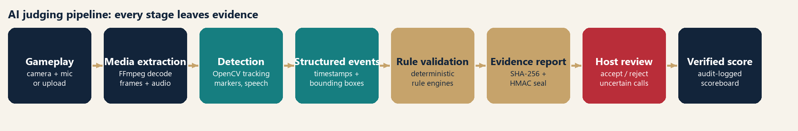
TRUST
Evidence integrity
◆ Source file SHA-256 and rule-version id on every report
◆ Report sealed with SHA-256 + HMAC; import of an edited report is rejected (tested)
◆ Host actions in a hash-chained audit log; tampering detected (tested)
◆ Stand-alone Python judge produces the same sealed report
WASL Arena · Team 204 · Code AYUCK · Cycle 3 (grades 9-12) · May Ahmed Mourad, Shamsa Faris Almazrouei, Fatima Mohamed Almazrouei
24
Notes:
Source videos are hashed on upload. Reports are sealed with a digest and an HMAC signature. Edit any character and verification fails. Host decisions re-seal the report, but keep the original AI seal.

Slide 25
RESPONSIBLE AI
Fairness and privacy
Fairness
Privacy & security
Rules are written and versioned
Uncertain = NEEDS_REVIEW, never guessed
Unobserved ball time is 'unknown'
Every call can be accepted / rejected
Arabic + English, team + solo
No face identification or biometrics
Credentials only in server environment
Audio sent only for transcription
Consent from everyone filmed
Reports signed against tampering
WASL Arena · Team 204 · Code AYUCK · Cycle 3 (grades 9-12) · May Ahmed Mourad, Shamsa Faris Almazrouei, Fatima Mohamed Almazrouei
25
Notes:
Fairness: deterministic rules, visible uncertainty, contestable calls. Privacy: no face identification, players are colour tracks mapped to names the host types; keys stay server side; families should film only their own game with consent.

Slide 26
HOW WE TEST
Evaluation methodology
Rule engines
Pipelines
API & integrity
Unit tests per game: valid, invalid, edge, tie-break
Synthetic fixtures with known ground truth → video → events → score
Upload → job → report → host review → tamper rejection
Honest scope: fixtures are rendered by code, not real family gameplay. They prove the pipelines work; they do not measure real-world accuracy. Real clips are the next step.
WASL Arena · Team 204 · Code AYUCK · Cycle 3 (grades 9-12) · May Ahmed Mourad, Shamsa Faris Almazrouei, Fatima Mohamed Almazrouei
26
Notes:
We test three layers: the rule engines in isolation, the full video-to-score pipelines on fixtures with known ground truth, and the API flow including review and tampering. We are explicit that fixtures are synthetic.

Slide 27
VERIFIED BY RUNNING
Actual test results
46/46
9/9
0
automated tests passed
synthetic fixtures match ground truth
real family clips analysed yet
football_goal ✓
football_nogoal ✓
football_uncertain ✓
goals_A=1, goals_B=0, verified_goal_events=1
goals_A=0, goals_B=0, verified_goal_events=0
goals_A=0, goals_B=0, verified_goal_events=0
falaj_valid ✓
falaj_partial ✓
falaj_rock ✓
destinations=3, leaks=0, time_bonus=2
destinations=2, leaks=1, time_bonus=0
destinations=3, leaks=1, time_bonus=2
souq_correct ✓
souq_mismatch ✓
souq_budget_dup ✓
total=9, spend=55, mismatch=False
total=2, spend=12, mismatch=True
total=7, spend=55, mismatch=False
WASL Arena · Team 204 · Code AYUCK · Cycle 3 (grades 9-12) · May Ahmed Mourad, Shamsa Faris Almazrouei, Fatima Mohamed Almazrouei
27
Notes:
These numbers are read from the evaluation file that the test run generates. Forty six of forty six tests passed. All nine synthetic fixtures matched ground truth. The speech check used a live transcription model call.

Slide 28
DELIVERY
GitHub and Vercel deployment
GitHub
Vercel · frontend
Render · AI judge
MayMourad/wasl-arena (private): frontend, backend, tests, docs, AI-usage records
frontend-three-fawn-47.vercel.app · VITE_API_URL points at the judge
wasl-arena.onrender.com · FastAPI + FFmpeg + OpenCV · secrets as env vars
◆ Verified live: all routes load, badge shows “AI judge online”, a Falaj clip judged on the live backend = 11 pts, seal valid
◆ CORS locked to the Vercel origin · no secrets in the repository (.env git-ignored)
◆ Free tier: first request after idle can take ~30 s
WASL Arena · Team 204 · Code AYUCK · Cycle 3 (grades 9-12) · May Ahmed Mourad, Shamsa Faris Almazrouei, Fatima Mohamed Almazrouei
28
Notes:
The frontend is deployed from GitHub to Vercel; the judge runs on Render because video processing needs Python, FFmpeg and OpenCV. The frontend reaches the judge through an environment variable and all credentials stay on the server. We verified the live deployment: routes load, the header badge says AI judge online, a Falaj clip uploaded to the live judge was scored 11 with a valid seal, and CORS accepts only the Vercel origin. Free tier hosting sleeps when idle, so the first request can take about 30 seconds.

Slide 29
NEXT
Limitations and future development
Limitations
Future development
No real family footage evaluated yet
Controlled setup: fixed camera, bright ball
Colour segmentation is lighting-sensitive
Printed markers can be hidden or damaged
Speech timing ±~1 s; scores are heuristics
Evaluate real footage for each game
Pretrained detectors + jersey numbers
Whistle / 'goal!' audio cues
Host-defined games from the rule template
More heritage games and languages
WASL Arena · Team 204 · Code AYUCK · Cycle 3 (grades 9-12) · May Ahmed Mourad, Shamsa Faris Almazrouei, Fatima Mohamed Almazrouei
29
Notes:
We are upfront about limits. Next steps are real footage evaluation, pretrained detectors, jersey number reading, and audio cues.

Slide 30
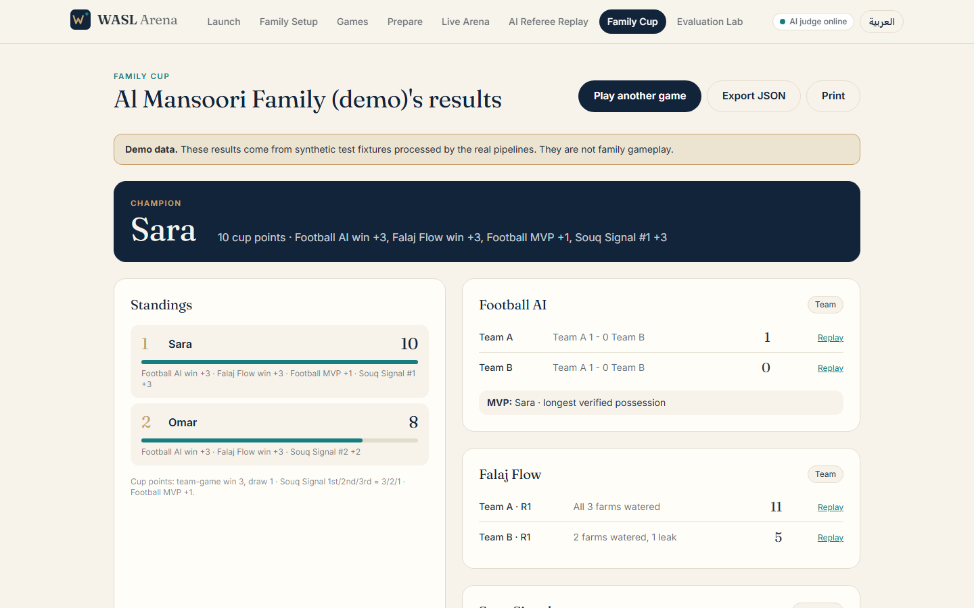
WASL Arena
A fair referee shows its evidence, admits doubt, and lets people decide.
◆ Three games · team and individual
◆ Real video/audio judging, explainable results
◆ Interactive, inclusive, culturally meaningful, transparently fair
Team 204 · Code AYUCK · Cycle 3 (grades 9-12)
May Ahmed Mourad (G12) · Shamsa Faris Almazrouei (G12) · Fatima Mohamed Almazrouei (G11)
WASL Arena · Team 204 · Code AYUCK · Cycle 3 (grades 9-12) · May Ahmed Mourad, Shamsa Faris Almazrouei, Fatima Mohamed Almazrouei
30
Notes:
Close on the idea: a fair referee shows its evidence, admits doubt and lets people decide. WASL Arena does that for three games.

