Slide 1
Salesforce1 Lightning Components
Leveraging Salesforce’s User-Base To Deliver
Enterprise-Level, Mobile-Friendly Applications

Slide 2


> whoami
Nathan Pepper, @sforcebewithyou
Senior Software Engineer, FinancialForce.com
Organizer, Los Angeles Salesforce Developer Group
Experience with Salesforce since 2010
= = =
YouTube?? youtube.com/MayTheSForceBWithYou

Slide 3
Safe Harbor Statement
“Safe harbor” statement under the Private Securities Litigation Reform Act of 1995:
This website and other items we publish, including through social media outlets, may contain forward-looking statements, the achievement or success of which involves risks, uncertainties, and assumptions. If any such risks or uncertainties materialize or if any of the assumptions proves incorrect, the results of salesforce.com, inc. could differ materially from the results expressed or implied by the forward-looking statements we make.
The risks and uncertainties referred to above include – but are not limited to – risks associated with possible fluctuations in our financial and operating results; our rate of growth and anticipated revenue run rate, including our ability to convert deferred revenue and unbilled deferred revenue into revenue and, as appropriate, cash flow, and our ability to grow deferred revenue and unbilled deferred revenue; errors, interruptions or delays in our service or Web hosting; breaches of our security measures; the financial impact of any previous and future acquisitions; the nature of our business model; our ability to continue to release, and gain customer acceptance of, new and improved versions of our service; successful customer deployment and utilization of our existing and future services; changes in our sales cycle; competition; various financial aspects of our subscription model; unexpected increases in attrition or decreases in new business; our ability to realize benefits from strategic partnerships; reliance on third-party computer hardware and software; the emerging markets in which we operate; unique aspects of entering or expanding in international markets; our ability to hire, retain and motivate employees and manage our growth; changes in our customer base; technological developments; regulatory developments; litigation related to intellectual property and other matters, and any related claims, negotiations and settlements; unanticipated changes in our effective tax rate; factors affecting our outstanding convertible notes and credit facility; fluctuations in the number of shares we have outstanding and the price of such shares; foreign currency exchange rates; collection of receivables; interest rates; factors affecting our deferred tax assets and ability to value and utilize them, including the timing of achieving profitability on a pre-tax basis; the potential negative impact of indirect tax exposure; the risks and expenses associated with our real estate and office facilities space; and general developments in the economy, financial markets, and credit markets.
Further information on these and other factors that could affect the financial results of salesforce.com, inc. is included in the reports on Forms 10-K, 10-Q and 8-K and in other filings we make with the Securities and Exchange Commission from time to time, including our most recent Form 10-K. These documents are available on the SEC Filings section of the Investor Information section of our website at www.salesforce.com/investor.
Any unreleased services or features referenced in this or other presentations, press releases or public statements are not currently available and may not be delivered on time or at all. Customers who purchase our services should make their purchase decisions based upon features that are currently available.

Slide 4
What is Salesforce?
Founded in by 2 people in 1999 – San Francisco
Marc Benioff
Parker Harris
Employs ~12,000 people in 2015 – Global
US, Canada, Mexico, Brazil, Switzerland, France, U.K., Ireland, Italy, Finland, The Netherlands, Sweden, Denmark, Belgium, Spain, Germany, Israel, Australia, Singapore, Japan, Korea, Hong Kong, China, India (24)
Forbes Most Innovative Company since 2011

Slide 5
What is Salesforce, really?
Multi-tenant MVC architecture initially targeting the CRM/Sales product space
Java and Oracle web product tracked in Perforce
~2007-2008: SaaS → PaaS with Force.com
Apex (subset-of-Java-esque)
VisualForce (XML markup that transforms into HTML/CSS/JS)
Force.com Sites (available to people outside the company)
It is SO much more today, just for the core product

Slide 6
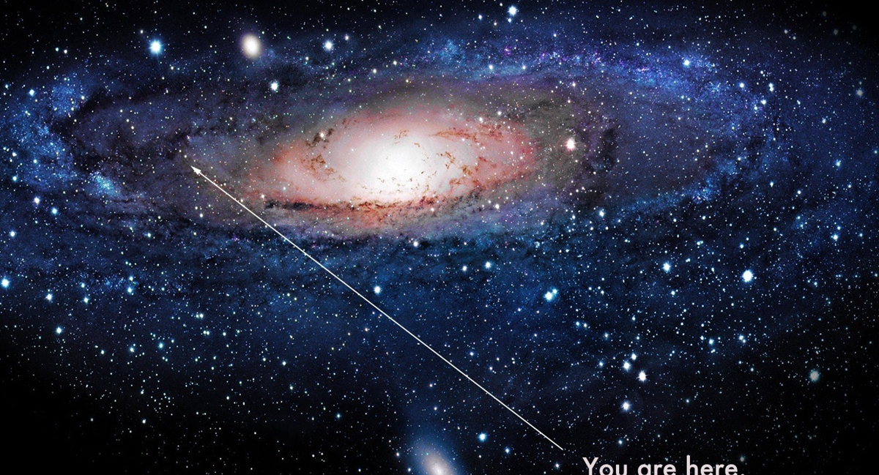



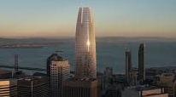

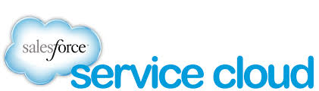

Where In The Universe Are We?

Slide 7
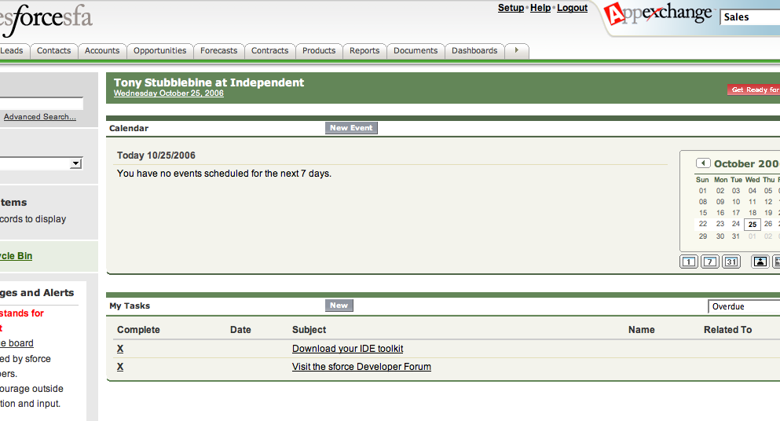
How It Used To Be…

Slide 8
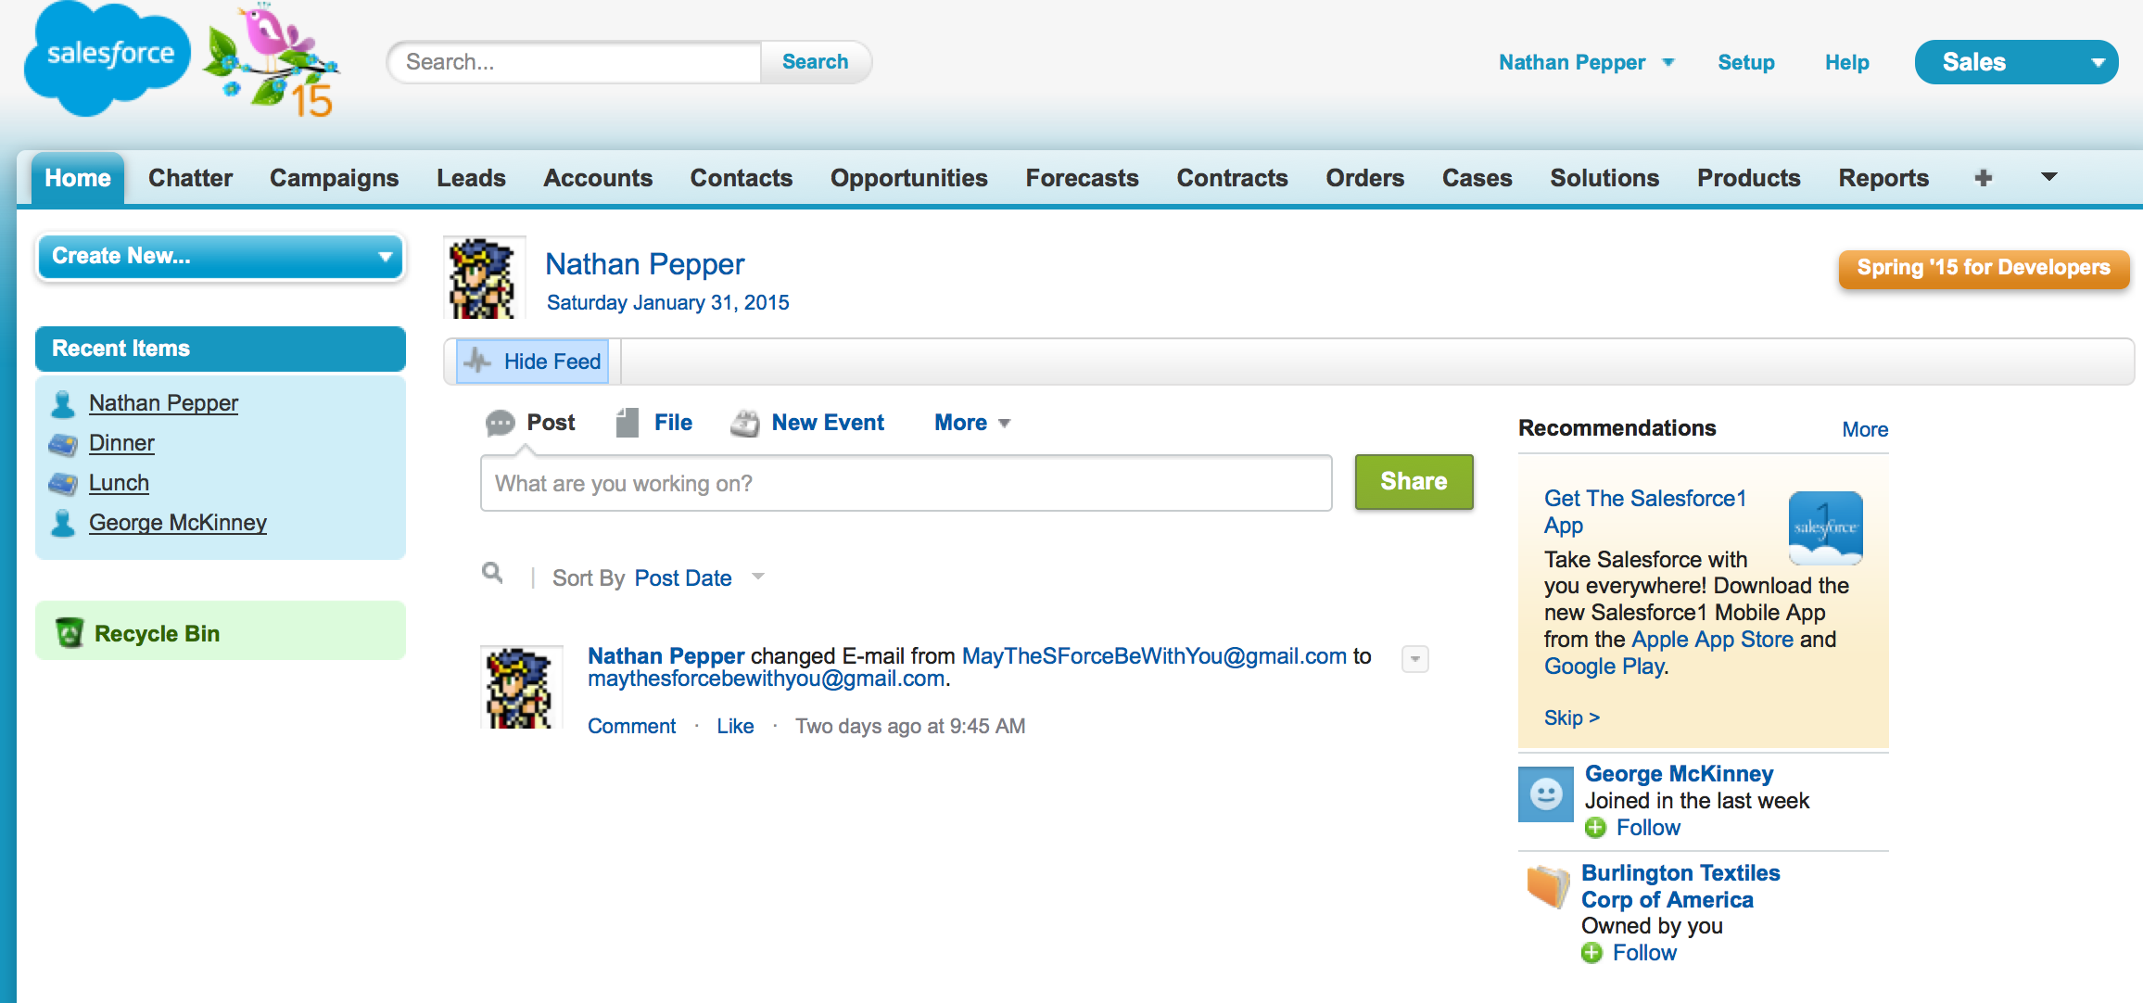
How It Is Today…

Slide 9
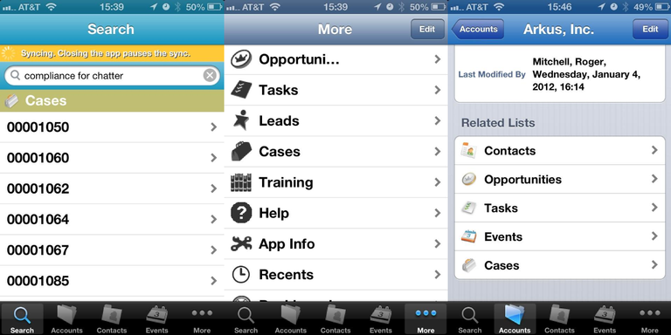
How Mobile Used To Be…

Slide 10
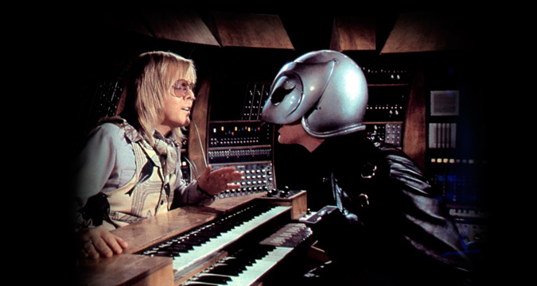
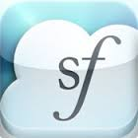
Touch? I Remember Touch…

Slide 11
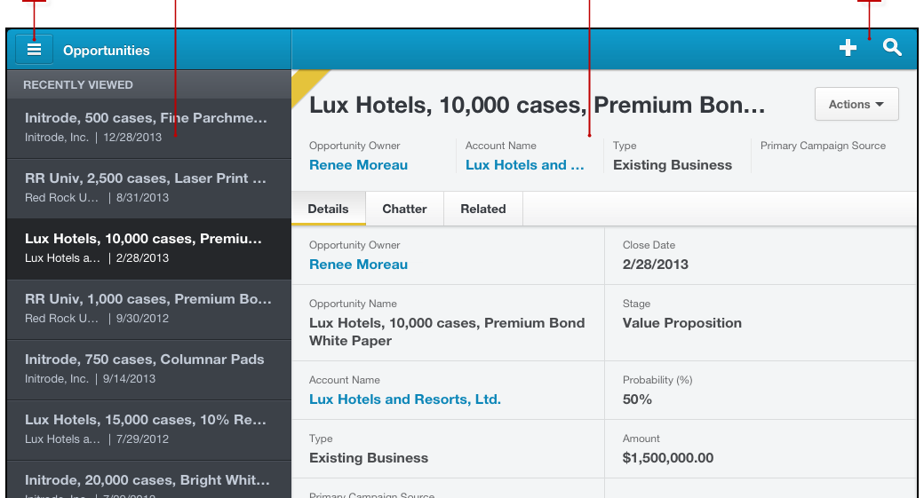
Salesforce Touch

Slide 12
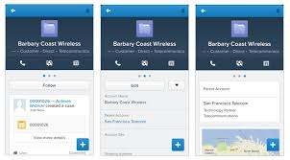
How Mobile Is Today

Slide 13
What is Salesforce1?
NOT the Salesforce1 platform (which also includes a whole slew of other tech and marketing stuff)
Mobile-friendly, responsive-design view that is driven by controller technologies that are designed for more than just a 13”+ monitor with a QWERTY
Replaced Salesforce Classic Mobile and Salesforce Touch
Uses Aura for its visual magic

Slide 14
What is Salesforce Aura?
BOOM. First organic search result.
https://github.com/forcedotcom/aura
Aura is a UI framework for developing dynamic web apps for mobile and desktop devices, while providing a scalable long-lived lifecycle to support building apps engineered for growth. It supports partitioned multi-tier component development that bridges the client and server.
To find out more about Aura, see the Aura Documentation site.
http://documentation.auraframework.org/auradocs

Slide 15
What is Lightning?
A Salesforce branding exo-skeleton that encompasses many things
New mobile friendly UI
External object connection
Lots of other stuff

Slide 16
Lightning Components
Leverage pre-built components from Salesforce and AppExchange Partners, or have your developers write their own components for anyone to use and build apps. Build dynamic apps for mobile and desktop devices with drag-and-drop tools on an open, multi-tier framework. Event-driven architecture, stateful client and stateless server, and Model-View-Controller architecture provides a modern framework for building apps, fast.

Slide 17

Lightning Components??
It’s a bundle…
Component
.cmp file (Static Markup)
Controller
.js file
Style
.css file
Helper
.js file
Renderer
.js file
Documentation
.auradoc file

Slide 18
Show Me The Code!
It’s all yours…
https://github.com/MayTheSForceBeWithYou/DuelingListBoxes
Slide is there as well, coming soon to other places

Slide 19
People Who Do It Right
The documentation!
https://developer.salesforce.com/docs/atlas.en-us.lightning.meta/lightning/
Peter Knolle!
http://peterknolle.com/lightning-component-autocomplete/
Jeff Douglas!
http://blog.jeffdouglas.com/2014/10/14/tutorial-build-your-first-lightning-component/

