Slide 1
VIM
Tips and tricks for vim mastery and creating an effective workflow

Slide 2
What is VIM and why use it?
Robust program
Lightweight and fast
Great user key mapping for speed
Highly customizable
Opensource!
*REGEX, in app async command line execution,
*Low system resource usages; fast linting/error correction
*Home row keys for typing and navigation save you time
*Massive selection of useful linting, compiling, mapping, and theme plugins that make your workflow exactly how you like

Slide 3
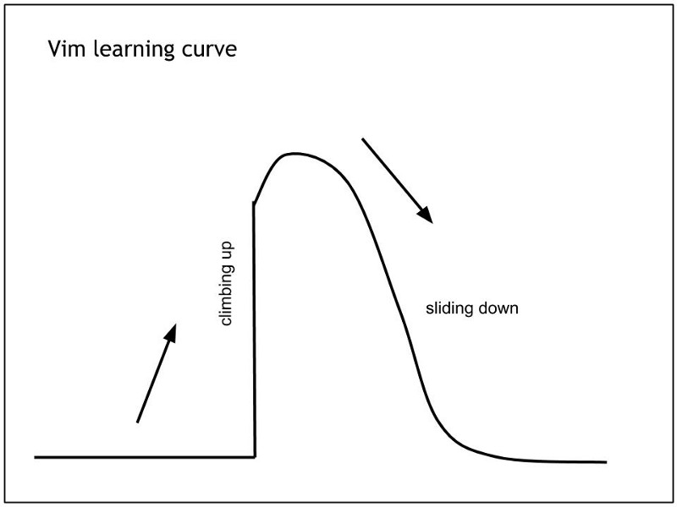

Slide 4
The Basics

Slide 5
Basics
Modifying files without shortcuts
Save:
Quit or quit without saving:
Open a new file to edit:
:w
:q or q! (! will not save your work)
:e <filename>

Slide 6
Basics
More useful than you might think
Movement:
^
k
< h l >
j
v
Modes:
Insert mode
i (at char), a (after char)
Command mode (access vim tools)
ESC,
ctrl + [
ctrl + c

Slide 7
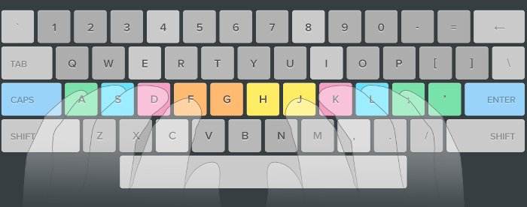
Basics

Slide 8
Basics
Copy
yy (yanks current line)
Paste
P (Pastes before the cursor- recommended)
p (Pastes after the cursor)
:set paste
Copy & Paste
Garbled results from cp/paste?
Use paste mode:

Slide 9
Basics
Ways to quickly navigate:
ctrl + d, ctrl + u
number of lines + direction
20 + k
Moving for programmers is painful
Navigation should be swift, avoid holding buttons down
Navigate half a page
Move cursor n x direction

Slide 10
Basics
Motions
4 x move up = 4 k
(4 x the motion you want to perform)
Repeat last edit:
In command mode:
4J Four lines down
4x Cut 4 chars
8P Paste 8 times before current char
. (period key)

Slide 11
Basics
Top of file:
Bottom of file
Quickly go from start of line:
And the end of the line:
gg
G
0
$

Slide 12
Basics
Go to matching {}:
Useful in finding where a loop or conditional ends
Ex.)
if(expr) {
statement;
}
%

Slide 13
Basics
Reformat your code:
Keys pressed in succession, at any speed
gg=G

Slide 14
Basics
Three ways to use visual mode
Visual mode:
Visual line:
Visual block:
v (starting from char to …)
Shift + v (selects entire lines, good for indentation or moving blocks of code)
Ctrl + v (finest control over horizontal and vertical char selection)
(can’t do visual block if you have ctrl + v for your prompt)

Slide 15
Basics
Example for Visual Select
I have a text file of names that I want to insert into a vector, but I need to remove the bad data
422 sam
883 bob
324 tim
Maybe hundreds of entries, maybe 5.
What’s the fastest way?
Methods:
Delete word and repeat
d + w then “.” for each line after
Visual Block and delete selected content
ctrl + v, select and delete with “x”

Slide 16
Workflow
Fast navigation to compile errors
vim main.cc +67
or
:67

Slide 17
Workflow
Undo and redo
Undo history amount can be changed inside .vimrc
Undo:
u
Redo:
ctrl + r

Slide 18
Workflow
Search a string
Search up or down
Command mode, (</> key)
/stringvalue
Next in queue: n
Search up: shift + n

Slide 19
Workflow
Search a string and replace
.../gc
:s instead of :%s
.../g
.../i
:%s/SearchString/ReplaceString/gc
(y/n to change)
Confirm each change (Recommended)
Replace current line vs entire file
Replace all
Replace all (case insensitive)

Slide 20
Workflow
Markers:
Useful to quickly jump from point a to b
A marker with a number are constant regardless of closing vim while letters won’t.
This makes numbers more suitable for multiple files or frequently exiting vim
Jump:
m + <letter/number>
‘ + <letter/number>

Slide 21
Workflow
Windows!
Great for programming with a side of README
Open a tab and speedily get to your file :E (file explorer)
Get from right to left, respectively
Change active window
:tabe (tabs like firefox)
:vsplit (horizontal split :split)
gt
gT
ctrl + w + direction (h,j,k,l)
Ctrl + <> (change size)

Slide 22
Workflow
Never leave your document:
Command mode ->
Or just bind it to a key!
<c-m>
ctrl + m
:!g++ main.cc
:!./a.out
:make
Advanced users (.vimrc):
noremap <silent> <c-m> :make<cr>
noremap <silent> <c-m> :!g++ -g -Wall -fsanitize=address -std=c++17 -O3 main.cc<cr>
noremap <silent> <c-m> :!compile main.cc<cr>
noremap <silent> <c-n> :!./a.out<cr>

Slide 23
Workflow
Auto complete:
ctrl + n or p (continue pressing to alternate through options)

Slide 24
Workflow
List all the undo’s available:
:undolist
:earlier <time>
:later <time>
Time n number + s, m, h, d

Slide 25
Workflow
I’ve created a bug and can’t find it.
You can list your changes and move through the code you’ve recently changed.
:changes
Older change:
g;
Newer change:
g,

Slide 26
Workflow
Want more?
See history through recent files
:jumps

Slide 27

Workflow
Unix suspension:
List background jobs:
Bring to foreground:
Ctrl + z (Sends program to the background)
jobs
fg
or
fg %2 (Brings job [2] from the background)

Slide 28
Fun tricks
Check out the ascii data for the char your cursors is on
Info for “h”
g + a

Slide 29
CSCI26
Mergesort, count your result between {}:
{
some chars;
}
Is 13 bytes: 12 chars
g + ctrl + g
Grabs word count and byte size of char
-1 byte gives count for ASCII

Slide 30
Resources
vimtutor in CLI
https://vim.rtorr.com/ (great searchable cheat sheet)
https://github.com/kevinSuttle/learn-vim (plethora of resources)

