Slide 1
Demand Management Using Historical Product Demand Data
Presented by:
Louis Odinkemelu
May Zin Ko
Zainab Nashitah
Notes:
"Good morning. Our project is titled Demand Management Using Historical Product Demand Data.
The core idea is simple — can we use past order data to predict future demand more accurately, so that warehouses can plan inventory better and avoid both stockouts and overstock situations.
My name is ??? , presenting together with Louis ??? and Nashitah ?? (May??)."

Slide 2
Table of Contents
Introduction
Objectives, Milestones, Deliverables
Business Case
Business Understanding
Theoretical Background
Dataset
Overview, Description
Understanding & Preparation
Analysis
ML Algorithms
Next Steps
Notes:
"Good morning everyone. My name is ???? and I am responsible for the Dataset part of this project.
Let me quickly walk you through what I will cover today.
I will start with a brief overview of the dataset — its structure and key features. Then I will explain how we understood and prepared the data — including cleaning steps. After that I will show the analysis findings — demand trends, warehouse behavior, and stationarity testing.
Finally I will give a short overview of the ML algorithms we considered for this dataset.
Let's begin."

Slide 3
Introduction

Slide 4
IDEA & Scope
What are we trying to solve?
What is our scope?
How many products should we produce?
When should we stock them?
Where should we store them?
Demand analysis by product category across multiple warehouses to support inventory planning
Notes:
"The core business problem we are trying to solve comes down to three questions.
How many products should we produce? When should we stock them? And where should we store them?
These are classic inventory planning challenges. If you produce too much — you waste storage space and money. If you produce too little — you run out of stock and lose customers.
Our scope is to analyze demand patterns by product category across four central warehouses, and use that historical data to build forecasting models that help answer these questions more accurately."

Slide 5
Objectives
Analyze historical demand patterns
Identify intermittent demand behavior
Support better replenishment decisions
Improve inventory planning using demand insights
Notes:
"Our project has four main objectives.
First — analyze historical demand patterns across all four warehouses and product categories.
Second — identify demand behavior, meaning understanding how demand changes over time, whether it trends up, down, or stays stable.
Third — use these insights to support better replenishment decisions, so warehouses know when to reorder before stock runs out.
And fourth — ultimately improve inventory planning by turning raw data into actionable demand forecasts.
All four objectives connect together — you analyze first, then understand, then decide, then plan better."

Slide 6
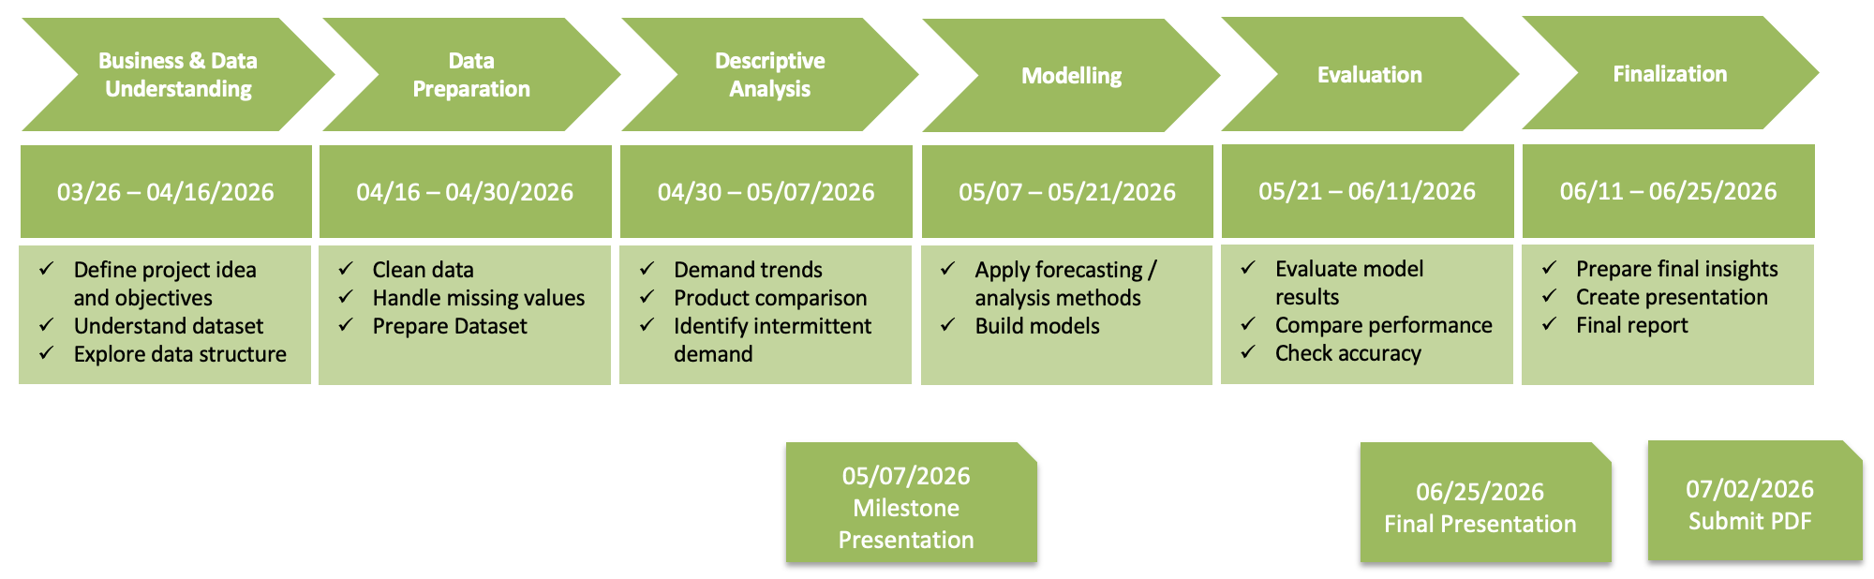
Tasks & Milestones
Notes:
"This slide shows our project timeline from start to finish.
We started with Business and Data Understanding in late March, followed by Data Preparation through April. We are currently in the Descriptive Analysis phase — which is exactly what today's milestone presentation covers.
After today, we move into Modelling from May 7th, then Evaluation, and finally Finalization with the Final Presentation on June 25th and PDF submission on July 2nd.
So today — May 7th — is our first major milestone. We are right on schedule."

Slide 7
What are we deliver?
Clean dataset
Demand analysis report
Insights for inventory planning.
Notes:
"For this milestone, we are delivering three things.
First — a clean, preprocessed dataset ready for modelling, with over one million rows after removing missing values, cancellations, and duplicates.
Second — a demand analysis report covering warehouse behavior, product category distribution, and stationarity testing.
And third — actionable insights for inventory planning, such as which warehouses need the most attention and which product categories drive the majority of demand.
These three deliverables form the foundation for the modelling phase that comes next.” So, now I handover to my teammate Nashitah

Slide 8
Business Case

Slide 9
Business Understanding
Real-World scenario:
Demand is Unpredictable
Some rarely needed
Some frequently requested
Demand varies across different warehouses
This creates challenges in balancing availability and cost

Slide 10
Problem Statement
Overstocking leads to high inventory holding costs
Understocking leads to stockouts and operational delays
Irregular (intermittent) demand makes planning difficult
Lack of demand insights results in inefficient replenishment decisions

Slide 11
Goal
Improve demand understanding to support better inventory and replenishment planning

Slide 12
Why this Matters?
Inventory cost reduction
Improved service level
Better operational efficiency

Slide 13
Stakeholders
Inventory Managers
Operations and production teams
Sales Team
Management and Decision-Makers

Slide 14
Theoretical Background

Slide 15
What is Demand Management?
Demand Management is the process of analyzing, forecasting, and influencing demand
It helps align supply with customer needs
Goal: balance availability and cost
Ensures the right product is available at the right time

Slide 16
Importance of Demand Management
Reduces stockouts and lost sales
Minimizes excess inventory and holding costs
Improves customer satisfaction
Supports better production and inventory planning

Slide 17
Forecasting vs Demand Planning
Forecasting: Predict future demand based on historical data
Demand Planning: Uses forecasts + business knowledge to make decisions
Forecast = data-driven
Planning = decision-making process

Slide 18
Intermittent Demand
Demand occurs irregularly over time
Many periods have zero demand
Common in products that are not ordered regularly
Difficult to forecast using standard methods

Slide 19
Characteristics of Intermittent Demand
High number of zero-demand periods
Sudden spikes in demand
Unpredictable timing
High variability

Slide 20
Time Series Data
Data collected over time intervals
Example: daily or weekly demand
Used to identify patterns and trends
Important for demand analysis and forecasting

Slide 21
Trend and Seasonality
Trend: Long-term increase or decrease in demand
Seasonality: Repeating patterns over time (e.g., weekly, yearly)
Helps understand demand behavior

Slide 22
Demand Variability
Demand does not stay constant
Can change due to:
Customer behavior
External factors (weather, economy)
High variability increases planning difficulty

Slide 23
Inventory Concepts: Safety Stock
Extra inventory kept to avoid stockouts
Used when demand is uncertain
Helps maintain service level
Too much → high cost
Too little → risk of shortage

Slide 24
Inventory Concepts: Lead Time
Time between ordering and receiving products
Includes production and delivery time
Important for planning replenishment
Longer lead time = higher uncertainty

Slide 25
Dataset

Slide 26
Dataset Overview
Title: Forecasts for Product Demand
Source: https://www.kaggle.com/datasets/felixzhao/productdemandforecasting
Content: Historical Product Demand.csv
Notes:
"Now moving to my section — the Dataset.
The dataset we used is titled Forecasts for Product Demand, published on Kaggle by Felix Zhao. It is publicly available and licensed under GPL 2, which allows free use for research and analysis.
The dataset contains over one million rows — specifically 1,048,575 records — across 5 columns, covering order history from 2012 to 2016.
It includes product codes, warehouse locations, product categories, order dates, and order quantities — everything we need to analyze demand patterns over time."

Slide 27
Dataset Description
Historical product demand from a global manufacturing company
Thousands of products across multiple product categories
Four central warehouses responsible for regional distribution
Products are shipped globally with long lead times (over one month)
Accurate demand forecasting helps improve planning and reduce costs
Notes:
"This dataset comes from a global manufacturing company that produces thousands of products across 33 product categories.
Distribution is handled through four central warehouses, each serving its own region — Warehouse J, S, C, and A.
An important business context here is the lead time — products are shipped internationally, meaning it takes over one month before stock arrives at the warehouse. This is exactly why accurate demand forecasting is so critical. By the time you realize stock is running low, it is already too late to reorder quickly.
So the better we can predict future demand, the more efficiently the company can plan production and reduce unnecessary costs."

Slide 28
Data Understanding
Features
Characteristics
Product_Code
Warehouse (4 warehouses)
Product_Category
Date
Order_Demand
Demand values show high variability
Seasonal patterns exist
Demand is highly concentrated (top 20% of products = 80% of demand )
Demand differs across warehouses
Notes:
"Our dataset contains 5 features: Product Code, Warehouse, Product Category, Date, and Order Demand.
After we do some data Analysis , we found , demand values show high variability, meaning the gap between minimum and maximum order quantities is very large, which makes forecasting challenging.
Second — seasonal patterns exist across all four warehouses, with repeating 12-month cycles.
Third — demand is highly concentrated. Our ABC analysis showed that the top 20% of products account for 80% of total demand.
And finally — demand differs significantly across warehouses. Warehouse J alone handles around 73% of all orders, while the other three warehouses share the remaining 27%.” Note: ABC analysis meaning : prioritize products by importance based on how much demand they generate.
Class A, B, C

Slide 29
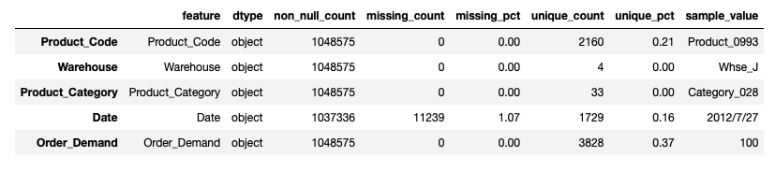
Data Quality & Structure
Presence of missing values in some records
Inconsistent formatting in demand values (e.g., spaces)
Requires data cleaning and pre-processing
Notes:
"This slide shows the data quality issues we found before cleaning.
Looking at the feature table, all 5 columns are stored as object type — meaning everything is treated as text, including Date and Order Demand which need to be numeric for analysis.
The Date column has 11,239 missing values — about 1% of the dataset. These rows had to be removed because without a date, we cannot place that order in the time series.
The Order Demand column also had inconsistent formatting — some values were written with parentheses like (100), which in accounting notation means negative. These represent order cancellations, so we removed them before modeling.
After handling these issues, the dataset was ready for analysis."

Slide 30
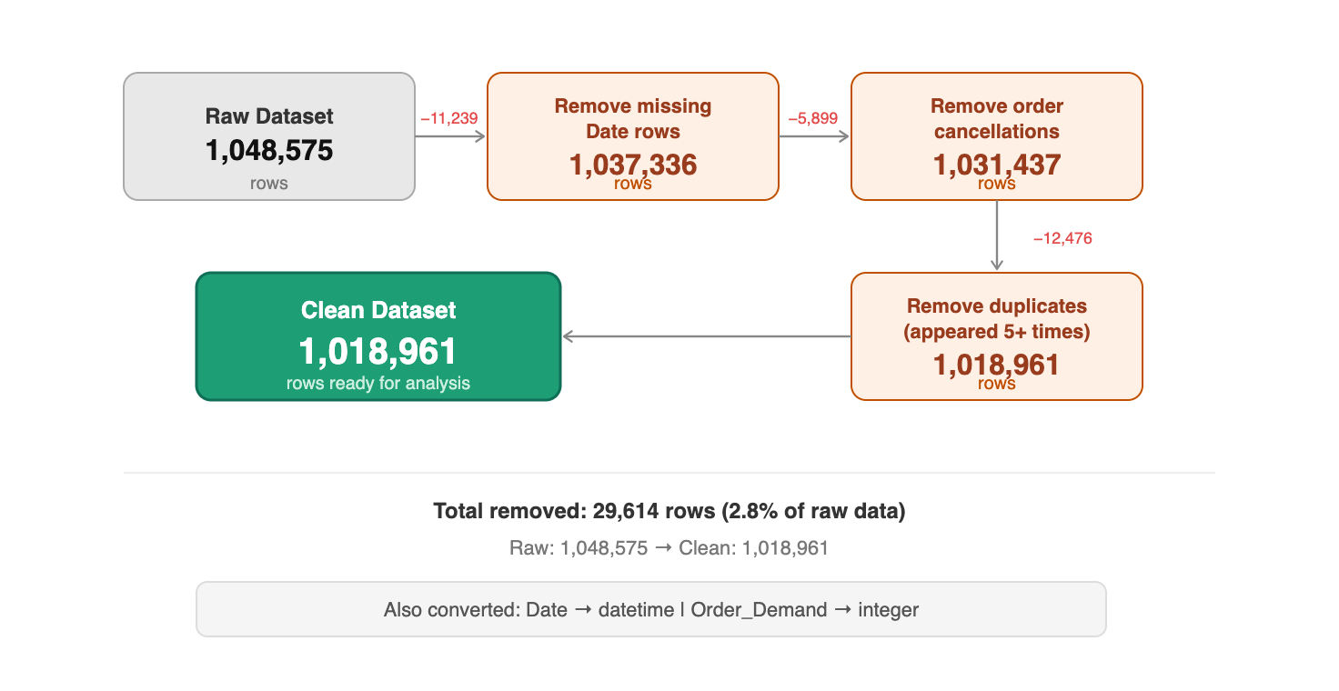
Data Preparation: Cleaning
Removed 11,239 rows with missing Date values
Removed 5,899 parentheses values e.g. (100) order cancellations
Converted Date to datetime, Order_Demand to numeric (integer)
Removed duplicates appearing 5 or more times - likely system errors
Notes:
"This slide shows our data cleaning steps with the exact row counts at each stage.
We started with 1,048,575 rows in the raw dataset.
First, we removed 11,239 rows that had missing Date values — without a date, we cannot place that order in the time series.
Second, we removed 5,899 entries with parentheses formatting like (100), which represent order cancellations. These are not real fulfilled demand so we excluded them.
Third, we converted the Date column to datetime format and Order Demand to integer — this is required before any time-based analysis can be done.
Finally, we removed duplicates that appeared 5 or more times with identical values — these are likely system errors, not real orders.
After all cleaning steps, our final dataset has 1,018,961 rows — we removed about 2.8% of the raw data in total."

Slide 31
Descriptive Analysis
Overall Demand Trend
Demand by Warehouse
Demand by Product Category
Stationarity Test (ADF)
Notes:
"Now moving into the analysis section.
I will walk through four areas. First — the overall demand trend across all warehouses over time. Second — how demand is distributed by warehouse. Third — which product categories drive the most demand. And finally — the stationarity test, where we use the ADF test to determine which forecasting model is appropriate for each warehouse.
This last point connects directly to our ML algorithms slide that follows."

Slide 32
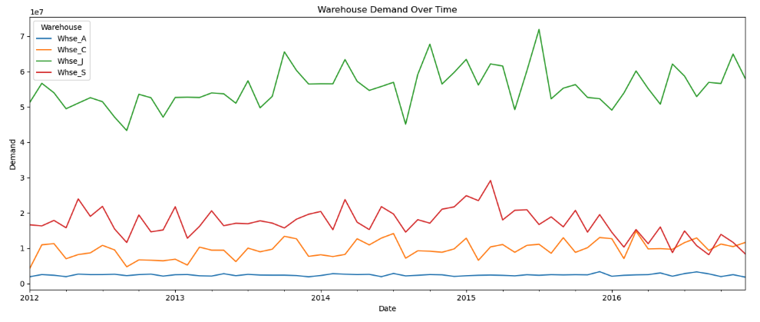
Analysis: Overall Demand Trend
Whse_J dominates - accounting for ~73% of all orders
Whse_J shows upward trend, Whse_S shows downward trend
Whse_C and Whse_A remain relatively stable throughout
Notes:
"This chart shows monthly demand for all four warehouses from 2012 to 2016.
The green line — Warehouse J — sits far above the others, handling around 73% of all orders. It also shows a slight upward trend over time.
The red line — Warehouse S — starts high but clearly declines toward 2016, suggesting a drop in regional demand.
The orange line — Warehouse C — and the blue line — Warehouse A — both stay low and relatively flat throughout the entire period.
This difference in behavior between warehouses is exactly why we need to test each one separately before choosing a forecasting model — which we will see in the following slides."

Slide 33
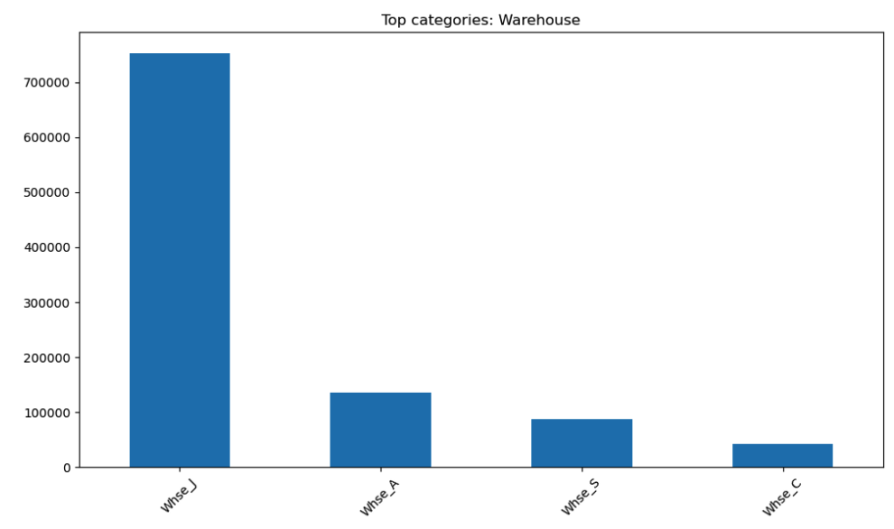
Analysis: Demand by Warehouse
Whse_J handles ~764,000 orders - 73% of total demand
Whse_A second with ~153,000, Whse_S ~88,000, Whse_C ~42,000
Demand is highly concentrated - one warehouse dominates
Notes:
"This bar chart shows the total number of orders handled by each warehouse.
Warehouse J is by far the largest — with around 764,000 orders, it handles 73% of all demand in the entire dataset. This makes it the most critical warehouse for forecasting accuracy.
Warehouse A comes second with about 153,000 orders, followed by Warehouse S with 88,000, and Warehouse C with the fewest at around 42,000.
This huge imbalance tells us that demand is not evenly spread — it is heavily concentrated in one warehouse. This is important context before we look at how each warehouse behaves over time."

Slide 34
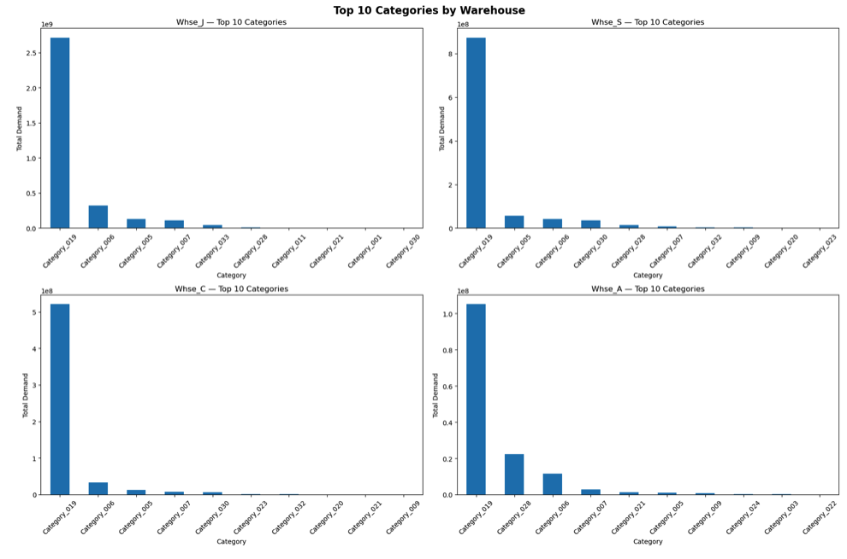
Analysis: Demand by Product Category
Category_019 dominates in every single warehouse
One category drives most demand - others are significantly lower
Supports ABC analysis - focus forecasting on top categories
Notes:
"This chart shows the top 10 product categories by demand for each warehouse separately.
The pattern is the same across all four warehouses — Category_019 is by far the tallest bar every time. It dominates regardless of which warehouse you look at.
After Category_019, the remaining categories drop off sharply — the gap between first and second is huge in every chart.
This confirms our ABC analysis finding — demand is not spread evenly across categories. A small number of categories, especially Category_019, drive the majority of demand. This means we don't need to forecast all 33 categories equally — we should focus our effort on the top ones."

Slide 35
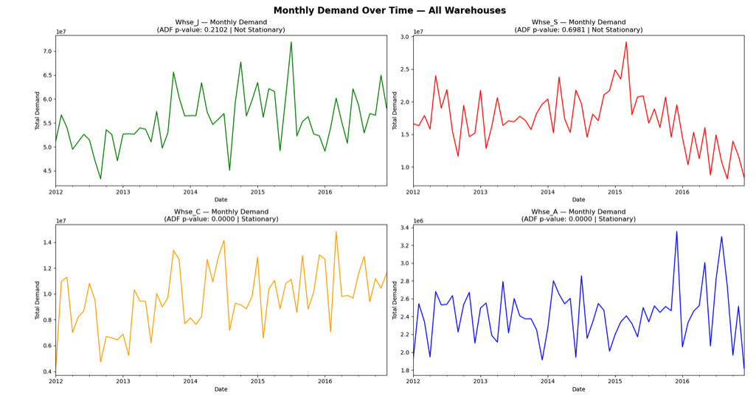
Analysis: Stationarity Test (ADF)
Whse_J and Whse_S — Not Stationary (p > 0.05) → require ARIMA
Whse_C and Whse_A — Stationary (p ≤ 0.05) → can use ARMA directly
Notes:
"This chart shows the ADF stationarity test result for each warehouse — the p-value is shown directly in each chart title.
Warehouse J and Warehouse S both have p-values above 0.05 — meaning they are not stationary. You can see why visually — Warehouse J trends upward and Warehouse S trends downward over time.
Warehouse C and Warehouse A both have p-values of 0.000 — clearly stationary. Their demand fluctuates but stays around the same level.
This result directly determines which forecasting model we use. Stationary warehouses can use ARMA directly. Non-stationary ones need differencing first — which is what ARIMA does."

Slide 36
ML Algorithms

Slide 37
ML Algorithms (Overview)
(ARMA vs ARIMA) & (Random Forest)
Nashitah ??
Louis ??

Slide 38
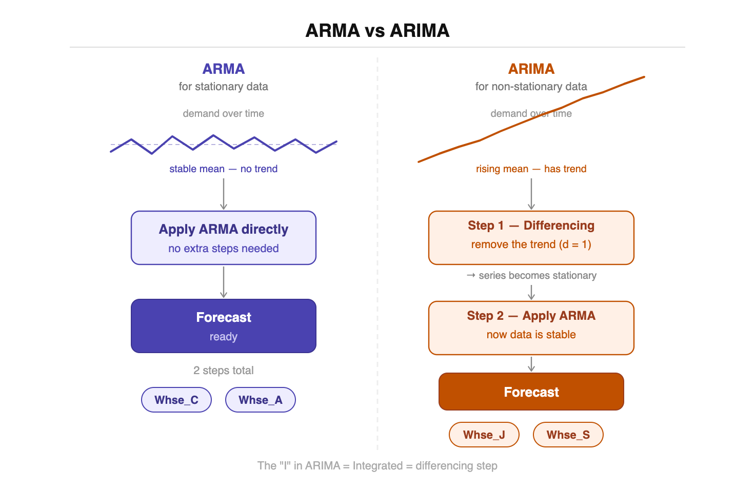
ML Algorithm: ARMA vs ARIMA
Notes:
"This slide explains the two forecasting models we selected based on our stationarity test results.
On the left — ARMA. This is used for stationary data, where demand fluctuates around a stable mean with no trend. We apply it directly to Warehouse C and Warehouse A — no extra steps needed, straight to forecast.
On the right — ARIMA. This is used for non-stationary data that has a clear trend. For Warehouse J and Warehouse S, we first apply a differencing step — this removes the trend and makes the data stationary. Then we apply ARMA on top. That is what the I in ARIMA stands for — Integrated, meaning the differencing step.
So the key difference is simple — ARMA is two steps, ARIMA is three steps because it needs to remove the trend first.
Our hypothesis is that these time series models will outperform Random Forest for this dataset, because our data has clear time-based structure and seasonal patterns — which is exactly what ARMA and ARIMA are designed for."

Slide 39
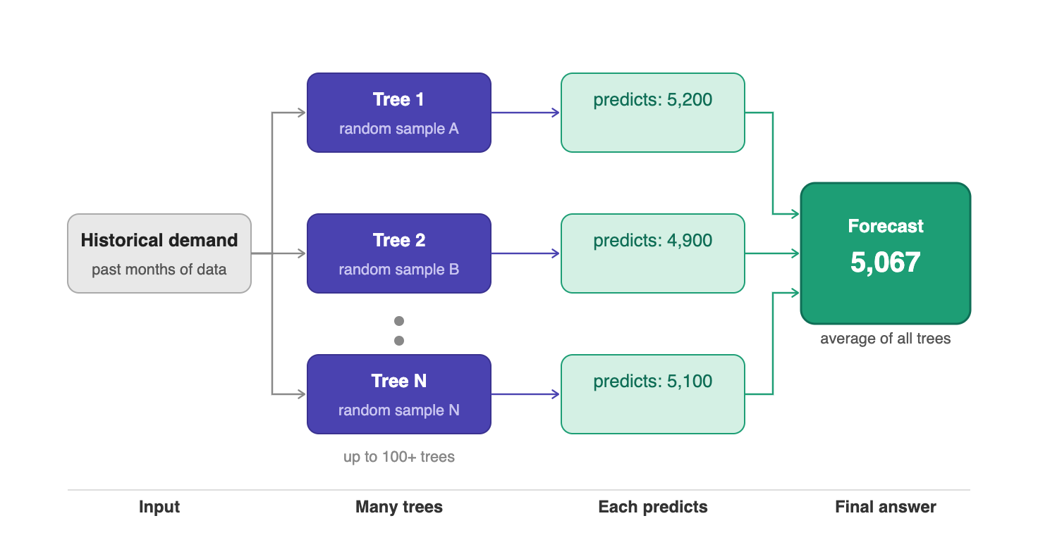
Random Forest
Notes:
"This slide shows the second ML algorithm — Random Forest, which is a true machine learning approach.
The idea is simple. Instead of building one model, Random Forest builds many decision trees — up to 100 or more. Each tree is trained on a different random sample of the historical demand data.
Every tree makes its own independent prediction — Tree 1 predicts 5,200, Tree 2 predicts 4,900, Tree N predicts 5,100, and so on.
The final forecast is simply the average of all predictions — in this case 5,067.
The reason this works well is that no single tree decides alone. By averaging many trees, the model becomes more stable and less sensitive to noise or outliers in the data.
However — compared to ARIMA and ARMA — Random Forest does not naturally understand time or seasonality. It would need extra feature engineering to capture those patterns. This is why for our dataset, we believe ARIMA and ARMA are the more appropriate choice."

Slide 40
Nashitah??

Slide 41
Louis Odinkemelu ??

Slide 42
Next Steps

Slide 43
Next Steps
Short-Term (Next Phase)
Apply advanced forecasting models
Improve accuracy of demand prediction
Mid-Term
Develop better inventory and replenishment strategies
Optimize stock levels across warehouses
Long-Term
Integrate real-time demand data
Support continuous and data-driven decision making
Notes:
"Finally, our next steps are organized into three phases.
In the short term — which is our next phase starting from May 7th — we will apply the forecasting models we discussed today. ARIMA for Warehouse J and S, ARMA for Warehouse C and A, and we will measure accuracy using MAE, RMSE, and MAPE.
In the mid term, we will use those forecast results to develop better inventory strategies — specifically optimizing stock levels across all four warehouses to reduce both overstock and stockouts.
And in the long term, the goal is to integrate real-time demand data so the system can update forecasts automatically and support continuous data-driven decision making.
Thank you — that concludes our milestone presentation. We are happy to answer any questions."

Slide 44
Thank you.

