Slide 1
Demand Management Using Historical Product Demand Data
Presented by:
Louis Odinkemelu
May Zin Ko
Zainab Nashitah
Notes:
"Good morning. Our project is titled Demand Management Using Historical Product Demand Data.
The core idea is simple — can we use past order data to predict future demand more accurately, so that warehouses can plan inventory better and avoid both stockouts and overstock situations.
My name is ??? , presenting together with Louis ??? and Nashitah ?? (May??)."

Slide 2
Table of Contents
Introduction
Objectives, Milestones, Deliverables
Business Case
Business Understanding
Theoretical Background
Dataset
Overview, Description
Understanding & Preparation
Analysis
ML Algorithms
Next Steps
Notes:
"Good morning everyone. My name is ???? and I am responsible for the Dataset part of this project.
Let me quickly walk you through what I will cover today.
I will start with a brief overview of the dataset — its structure and key features. Then I will explain how we understood and prepared the data — including cleaning steps. After that I will show the analysis findings — demand trends, warehouse behavior, and stationarity testing.
Finally I will give a short overview of the ML algorithms we considered for this dataset.
Let's begin."

Slide 3
Introduction

Slide 4
IDEA & Scope
What are we trying to solve?
What is our scope?
How many products should we produce?
When should we stock them?
Where should we store them?
Demand analysis by product category across multiple warehouses to support inventory planning
Notes:
"The core business problem we are trying to solve comes down to three questions.
How many products should we produce? When should we stock them? And where should we store them?
These are classic inventory planning challenges. If you produce too much — you waste storage space and money. If you produce too little — you run out of stock and lose customers.
Our scope is to analyze demand patterns by product category across four central warehouses, and use that historical data to build forecasting models that help answer these questions more accurately."

Slide 5
Objectives
Analyze historical demand patterns
Identify intermittent demand behavior
Support better replenishment decisions
Improve inventory planning using demand insights
Notes:
"Our project has four main objectives.
First — analyze historical demand patterns across all four warehouses and product categories.
Second — identify demand behavior, meaning understanding how demand changes over time, whether it trends up, down, or stays stable.
Third — use these insights to support better replenishment decisions, so warehouses know when to reorder before stock runs out.
And fourth — ultimately improve inventory planning by turning raw data into actionable demand forecasts.
All four objectives connect together — you analyze first, then understand, then decide, then plan better."

Slide 6
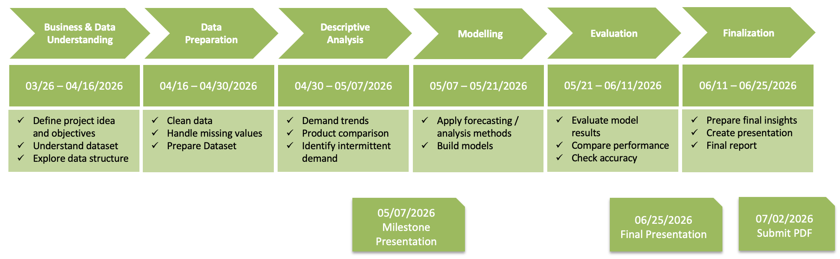
Tasks & Milestones
Notes:
"This slide shows our project timeline from start to finish.
We started with Business and Data Understanding in late March, followed by Data Preparation through April. We are currently in the Descriptive Analysis phase — which is exactly what today's milestone presentation covers.
After today, we move into Modelling from May 7th, then Evaluation, and finally Finalization with the Final Presentation on June 25th and PDF submission on July 2nd.
So today — May 7th — is our first major milestone. We are right on schedule."

Slide 7
What are we deliver?
Clean dataset
Demand analysis report
Insights for inventory planning.
Notes:
"For this milestone, we are delivering three things.
First — a clean, preprocessed dataset ready for modelling, with over one million rows after removing missing values, cancellations, and duplicates.
Second — a demand analysis report covering warehouse behavior, product category distribution, and stationarity testing.
And third — actionable insights for inventory planning, such as which warehouses need the most attention and which product categories drive the majority of demand.
These three deliverables form the foundation for the modelling phase that comes next.” So, now I handover to my teammate Nashitah

Slide 8
Business Case

Slide 9
Business Understanding
Real-World scenario:
Demand is Unpredictable
Some rarely needed
Some frequently requested
Demand varies across different warehouses
This creates challenges in balancing availability and cost

Slide 10
Problem Statement
Overstocking leads to high inventory holding costs
Understocking leads to stockouts and operational delays
Irregular (intermittent) demand makes planning difficult
Lack of demand insights results in inefficient replenishment decisions

Slide 11
Demand is unpredictable and changes over time
across products and warehouses.
Some products are intermittent,
with rare but important demand spikes.
Some products are fast-moving
and require consistent replenishment.
Demand patterns differ by warehouse,
which creates uneven stock pressure.
This creates a trade-off between
product availability and inventory cost.
Without demand visibility,
firms risk overstock in one warehouse and stockouts in another.

Slide 12
Goal
Improve demand understanding to support better
inventory and replenishment planning.
Identify category-wise, product-wise,
and warehouse-wise demand patterns.
Support decisions on how much to stock,
when to replenish, and where to position inventory.
Build a foundation for demand forecasting and
data-driven supply chain planning.

Slide 13
Why this Matters?
Inventory cost reduction through better stock alignment.
Improved service level by reducing stockouts in high-demand items.
Better operational efficiency in replenishment and warehouse planning.
Reduced excess inventory for low-demand or intermittent products.

Slide 14
Data-driven opportunity
Use historical order demand to identify monthly
and seasonal demand patterns.
Compare demand concentration across
product categories and warehouses.
Detect fast-moving, slow-moving,
and intermittent products.
Support better replenishment timing
and stock positioning decisions.
Create a bridge from descriptive analytics
to forecasting and inventory planning.

Slide 15
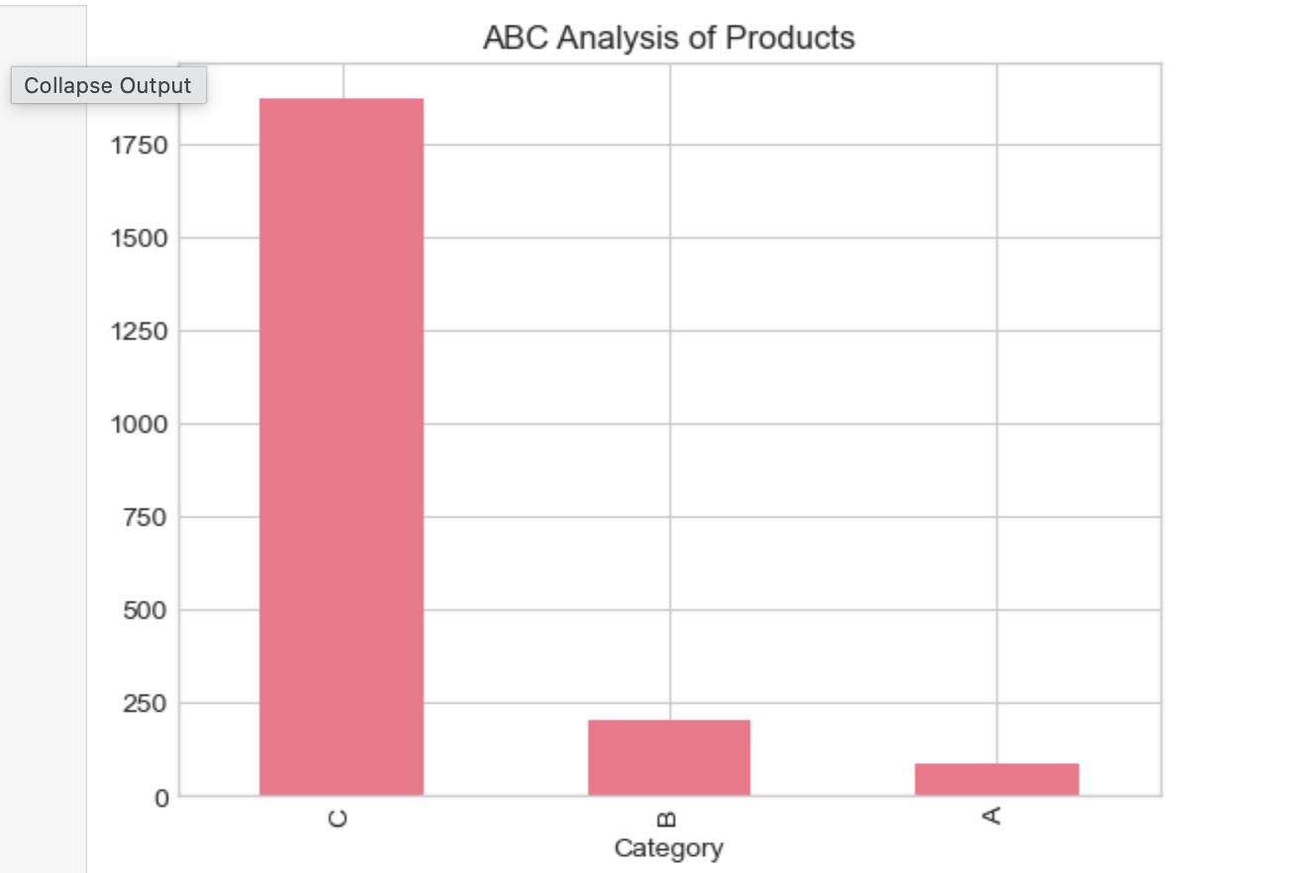
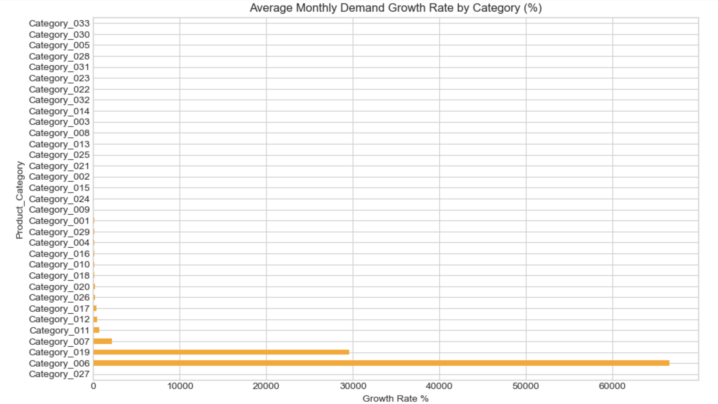
Some insights from data

Slide 16
High-demand categories may justify tighter review cycles
and higher service targets.
Slow-moving products may require lower stock levels or
alternative replenishment strategies.
Warehouse demand imbalance may indicate opportunity
for stock reallocation.
Products with unstable demand may need higher safety stock
than products with stable demand.
Monthly demand patterns can support pre-season replenishment
instead of last-minute reaction.
Product-code-level analysis helps identify which items drive most
of the operational workload.

Slide 17
Stakeholders
Inventory Managers(need better stock level decisions and safety stock planning)
Operations and production teams(need visibility into expected demand to plan production and replenishment)
Sales Team(need product availability to avoid lost opportunities and improve customer satisfaction)
Management and Decision-Makers(need clear KPIs, risk visibility, and business impact estimates)

Slide 18
Theoretical Background

Slide 19
What is Demand Management?
Demand Management is the process of analyzing, forecasting, and influencing demand
It helps align supply with customer needs
Goal: balance availability and cost
Ensures the right product is available at the right time

Slide 20
Importance of Demand Management
Reduces stockouts and lost sales
Minimizes excess inventory and holding costs
Improves customer satisfaction
Supports better production and inventory planning

Slide 21
Forecasting vs Demand Planning
Forecasting: Predict future demand based on historical data
Demand Planning: Uses forecasts + business knowledge to make decisions(Sensing , planning and coordination)
Forecast = data-driven
Planning = decision-making process

Slide 22
Intermittent Demand
Demand occurs irregularly over time
Many periods have zero demand
Common in products that are not ordered regularly
Difficult to forecast using standard methods
Intermittent demand products should not be managed with the same logic as fast-moving products.

Slide 23
Characteristics of Intermittent Demand
High number of zero-demand periods
Sudden spikes in demand
Unpredictable timing
High variability

Slide 24
Time Series Data
Data collected over time intervals
Example: daily or weekly demand
Used to identify patterns and trends
Important for demand analysis and forecasting

Slide 25
Trend and Seasonality
Trend: Long-term increase or decrease in demand
Seasonality: Repeating patterns over time (e.g., weekly, yearly)
Helps understand demand behavior

Slide 26
Demand Variability
Demand does not stay constant
Can change due to:
Customer behavior
External factors (weather, economy)
High variability increases planning difficulty.
directly affects inventory risk and service performance.

Slide 27
Inventory Concepts: Safety Stock
Extra inventory kept to avoid stockouts
Used when demand is uncertain
Helps maintain service level
Too much → high cost
Too little → risk of shortage

Slide 28
Inventory Concepts: Lead Time
Time between ordering and receiving products
Includes production and delivery time
Important for planning replenishment
Longer lead time = higher uncertainty

Slide 29
Dataset
Notes:
"Good morning. I'm May Zin Ko, presenting the Dataset section."

Slide 30
Dataset Overview
Title: Forecasts for Product Demand
Source: https://www.kaggle.com/datasets/felixzhao/productdemandforecasting
Content: Historical Product Demand.csv
Notes:
"Our dataset is Forecasts for Product Demand from Kaggle. Over one million rows, 5 columns, covering 2012 to 2016."

Slide 31
Dataset Description
Historical product demand from a global manufacturing company
Thousands of products across multiple product categories
Four central warehouses responsible for regional distribution
Products are shipped globally with long lead times (over one month)
Accurate demand forecasting helps improve planning and reduce costs
Notes:
"It comes from a global manufacturing company with four central warehouses. Key context — shipping takes over one month, so accurate forecasting is critical. You can't reorder last minute."

Slide 32
Data Understanding
Features
Characteristics
Product_Code
Warehouse (4 warehouses)
Product_Category
Date
Order_Demand
Demand values show high variability
Seasonal patterns exist
Demand is highly concentrated (top 20% of products = 80% of demand )
Demand differs across warehouses
Notes:
"Five features. Key characteristics — high demand variability, clear seasonal patterns, and demand is heavily concentrated — top 20% of products drive 80% of demand." Note: ABC analysis meaning : prioritize products by importance based on how much demand they generate.
Class A, B, C

Slide 33
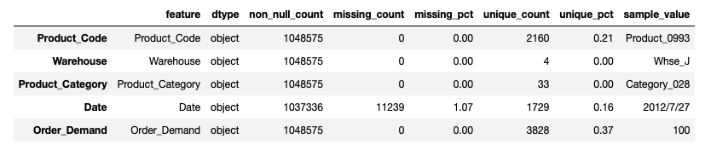
Data Quality & Structure
Presence of missing values in some records
Inconsistent formatting in demand values (e.g., spaces)
Requires data cleaning and pre-processing
Notes:
"Before cleaning — all columns were stored as text, 11,239 missing dates, and Order Demand had parentheses formatting , which meaning cancellations in accounting world."

Slide 34
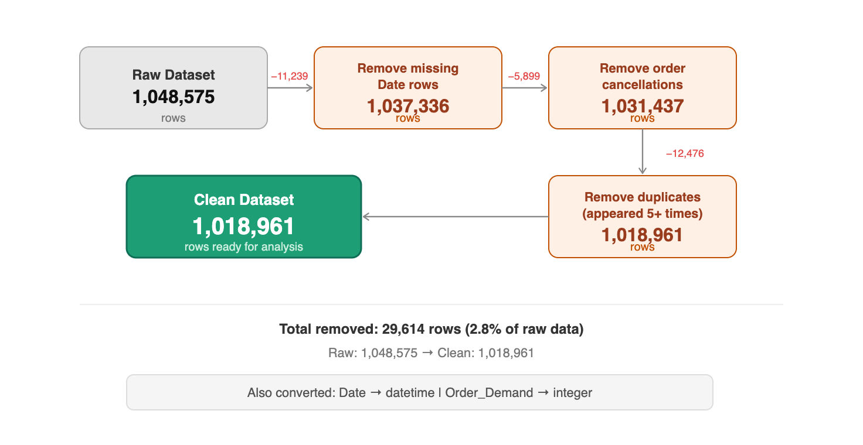
Data Preparation: Cleaning
Removed 11,239 rows with missing Date values
Removed 5,899 parentheses values e.g. (100) order cancellations
Converted Date to datetime, Order_Demand to numeric (integer)
Removed duplicates appearing 5 or more times - likely system errors
Notes:
"After cleaning — removed missing dates, cancellations, converted data types, and removed duplicate system errors. Final dataset: 1,018,961 rows — 2.8% removed in total."

Slide 35
Descriptive Analysis
Overall Demand Trend
Demand by Warehouse
Demand by Product Category
Stationarity Test (ADF)
Notes:
"Now moving into the analysis section.
"Analysis covers four areas — demand trend, by warehouse, by category, and ADF stationarity test.”

Slide 36
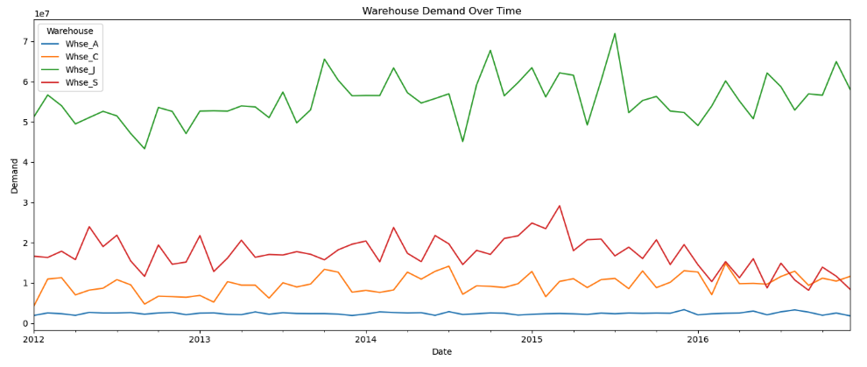
Analysis: Overall Demand Trend
Whse_J dominates - accounting for ~73% of all orders
Whse_J shows upward trend, Whse_S shows downward trend
Whse_C and Whse_A remain relatively stable throughout
Notes:
"This chart shows monthly demand for all four warehouses from 2012 to 2016.
"Warehouse J dominates at 73%. J trends upward, S trends downward. C and A stay stable. Each warehouse behaves differently — which is why we test each one separately."

Slide 37
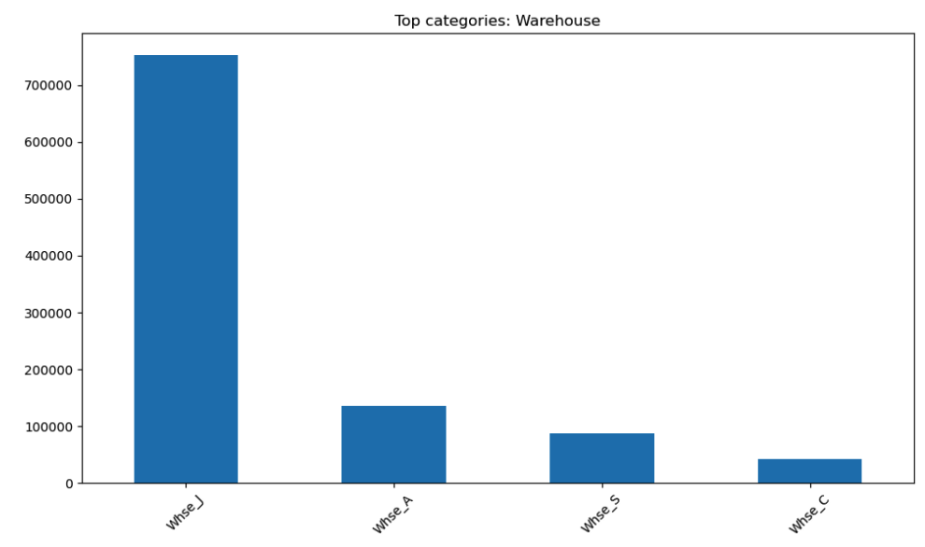
Analysis: Demand by Warehouse
Whse_J handles ~764,000 orders - 73% of total demand
Whse_A second with ~153,000, Whse_S ~88,000, Whse_C ~42,000
Demand is highly concentrated - one warehouse dominates
Notes:
"This bar chart shows the total number of orders handled by each warehouse.
Warehouse J is by far the largest - it handles 73% of all demand in the entire dataset.
Warehouse A comes second , followed by Warehouse S and Warehouse C
This huge imbalance tells us that demand is not evenly spread — it is heavily concentrated in one warehouse. “

Slide 38
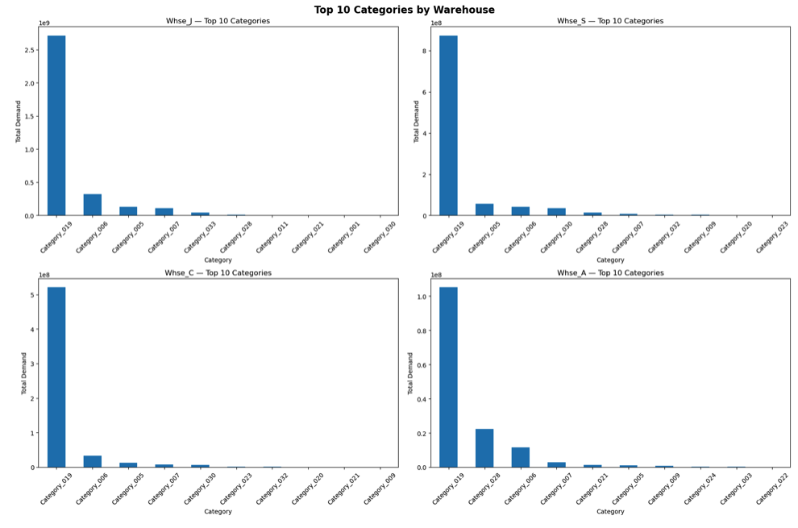
Analysis: Demand by Product Category
Category_019 dominates in every single warehouse
One category drives most demand - others are significantly lower
Supports ABC analysis - focus forecasting on top categories
Notes:
"Category_019 dominates every single warehouse. One category drives most demand — supports our ABC analysis finding.”

Slide 39
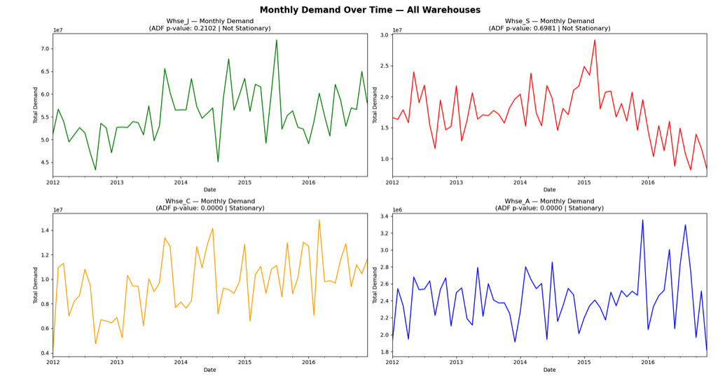
Analysis: Stationarity Test (ADF)
Whse_J and Whse_S — Not Stationary (p > 0.05) → require ARIMA
Whse_C and Whse_A — Stationary (p ≤ 0.05) → can use ARMA directly
Notes:
"This chart shows the ADF stationarity test result for each warehouse — the p-value is shown directly in each chart title.
"ADF test results — J and S have p-value above 0.05, not stationary, require ARIMA. C and A have p-value of 0.000, stationary, use ARMA directly. This determines our model choice."

Slide 40
ML Algorithms

Slide 41
ML Algorithms (Overview)
ARMA vs ARIMA
Random Forest

Slide 42
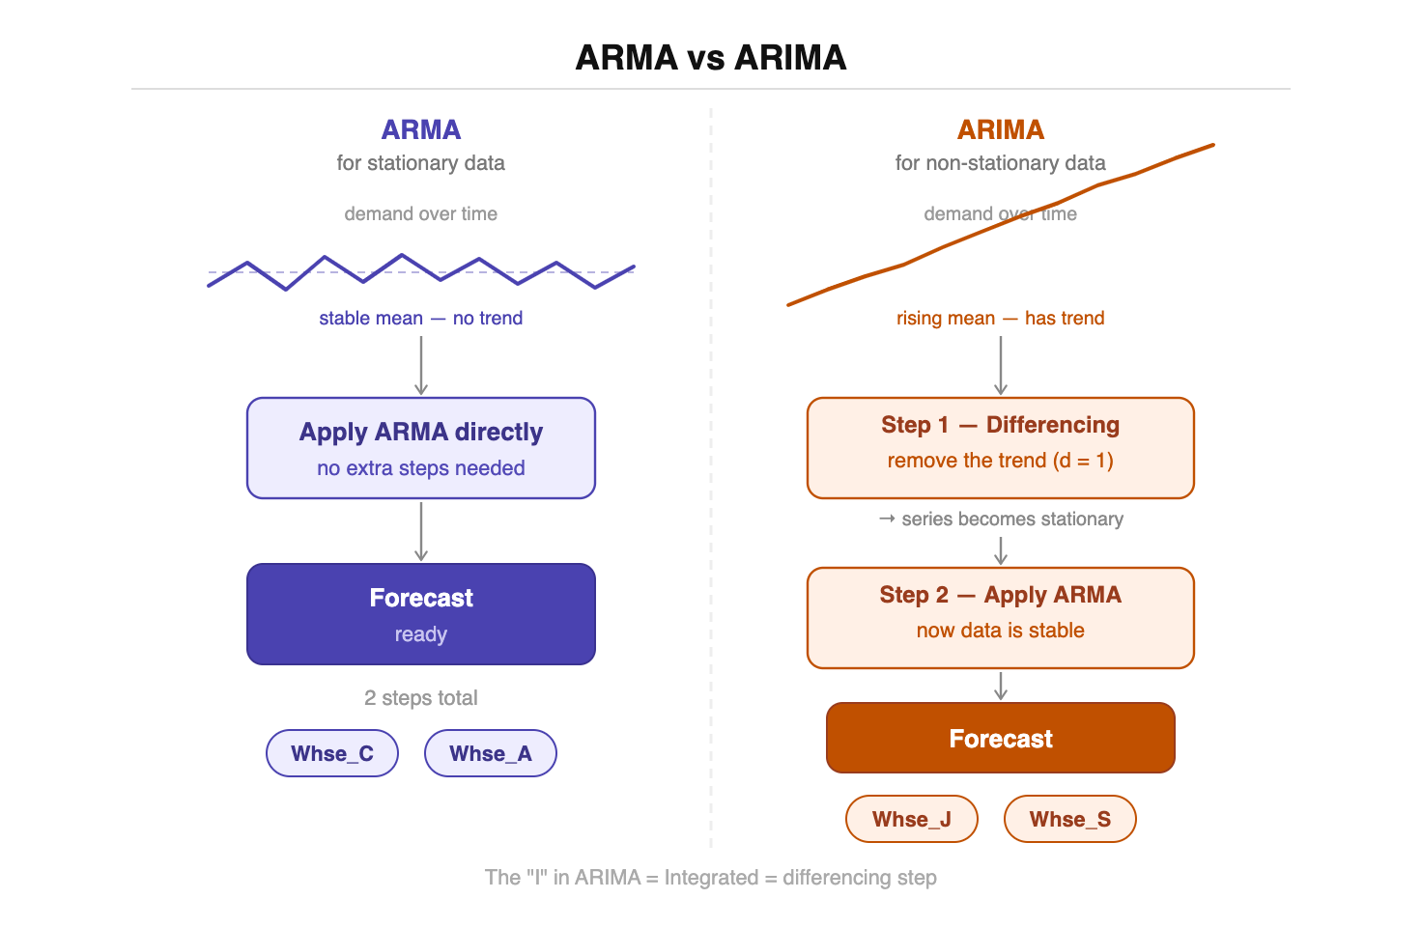
ML Algorithm: ARMA vs ARIMA
Notes:
"This slide explains the two forecasting models we selected based on our stationarity test results.
On the left — ARMA. This is used for stationary data, We apply it directly to Warehouse C and Warehouse A — no extra steps needed, straight to forecast.
On the right — ARIMA. This is used for non-stationary data like For Warehouse J and Warehouse S
, we first apply a differencing step — this removes the trend and makes the data stationary. Then we apply ARMA on top.
My hypothesis is that these time series models will outperform Random Forest for this dataset, because our data has clear time-based structure and seasonal patterns — which is exactly what ARMA and ARIMA are designed for.”

Slide 43
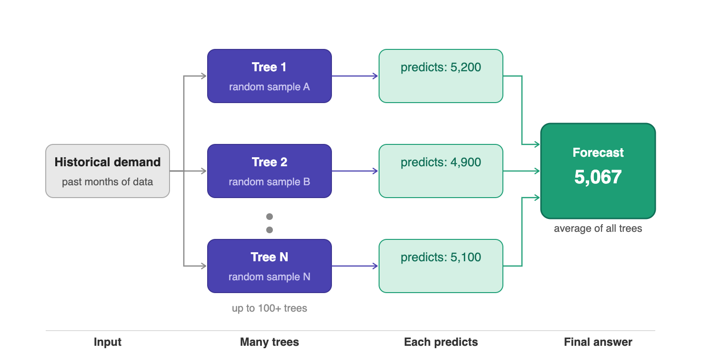
Random Forest
Notes:
"This slide shows the second ML algorithm — Random Forest, which is a true machine learning approach.
The idea is simple. Random Forest builds 100+ decision trees, each on a different data sample. Each predicts independently, final answer is the average. More stable than one model alone — but unlike ARIMA, it doesn't naturally understand time or seasonality.”
Random Forest does not naturally understand time or seasonality. It would need extra feature engineering to capture those patterns. This is why for our dataset, we believe ARIMA and ARMA are the more appropriate choice."

Slide 44
Next Steps

Slide 45
Next Steps
Short-Term (Next Phase)
Apply advanced forecasting models
Improve accuracy of demand prediction
Mid-Term
Develop better inventory and replenishment strategies
Optimize stock levels across warehouses
Long-Term
Integrate real-time demand data
Support continuous and data-driven decision making
Notes:
"Finally, our next steps are organized into three phases.
In the short term — which is our next phase starting from May 7th — we will apply the forecasting models we discussed today. ARIMA for Warehouse J and S, ARMA for Warehouse C and A, and we will measure accuracy using MAE, RMSE, and MAPE.
In the mid term, we will use those forecast results to develop better inventory strategies — specifically optimizing stock levels across all four warehouses to reduce both overstock and stockouts.
And in the long term, the goal is to integrate real-time demand data so the system can update forecasts automatically and support continuous data-driven decision making.
Thank you — that concludes our milestone presentation. We are happy to answer any questions."

Slide 46
Thank you.

