Slide 1
FIFA_WORLDCUP_STORY
File created on: 6/20/2024 7:34:31 AM

Slide 2
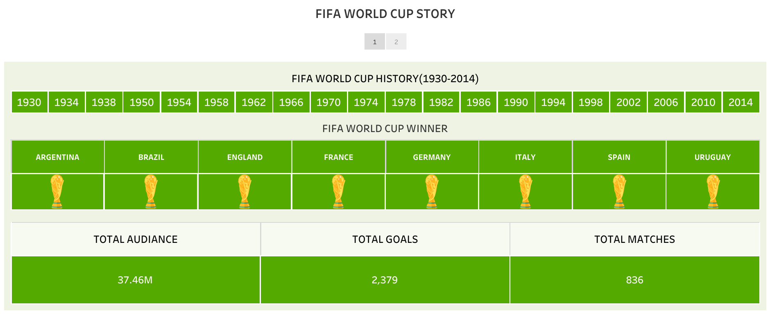

Slide 3
