Slide 1


Titanic Survival Prediction
Internship Machine Learning Classification Project
Python | Pandas | Scikit-learn | Seaborn | Machine Learning
Maya Murali
23/05/2026
01

Slide 2
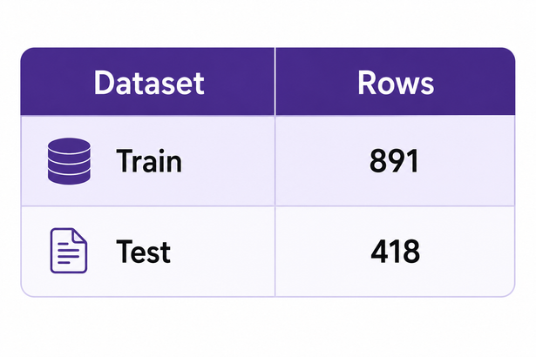
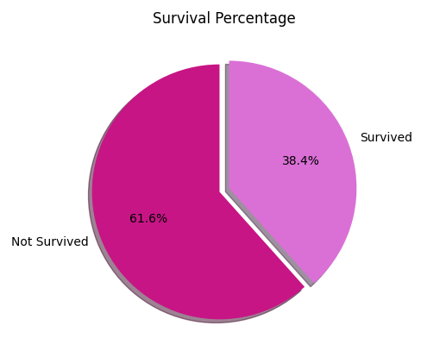
Dataset Overview
Dataset Source:
Kaggle Titanic Dataset
Key Features:
Passenger Class
Age
Gender
Fare
Family Information
Embarkation Port
Problem Type:
Binary Classification
0 = Did Not Survive
1 = Survived
02

Slide 3
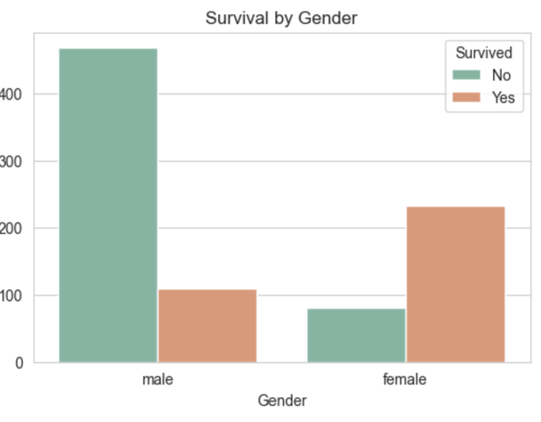
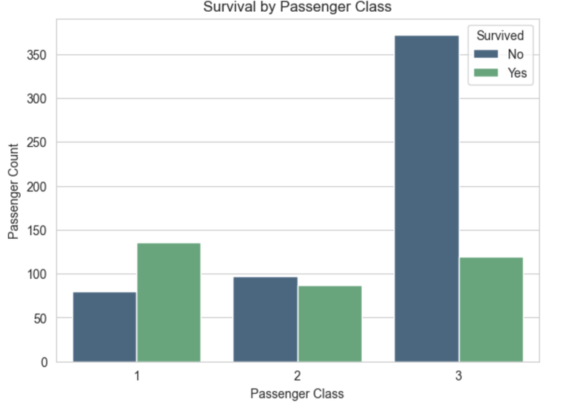
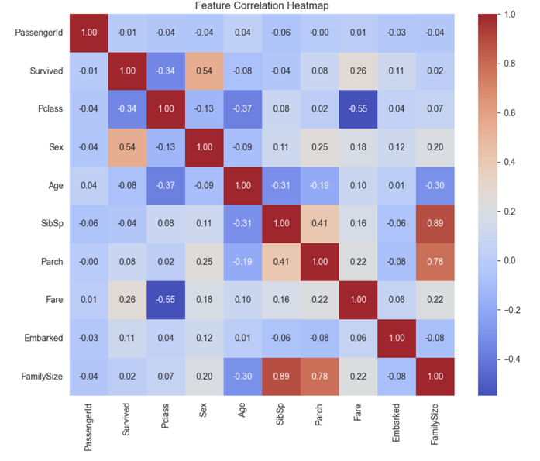
Exploratory Data Analysis
Key Insights
Female passengers had significantly higher survival rates
First-class passengers showed better survival probability
Fare and passenger class strongly influenced survival
Family-related features impacted survival outcomes
03

Slide 4
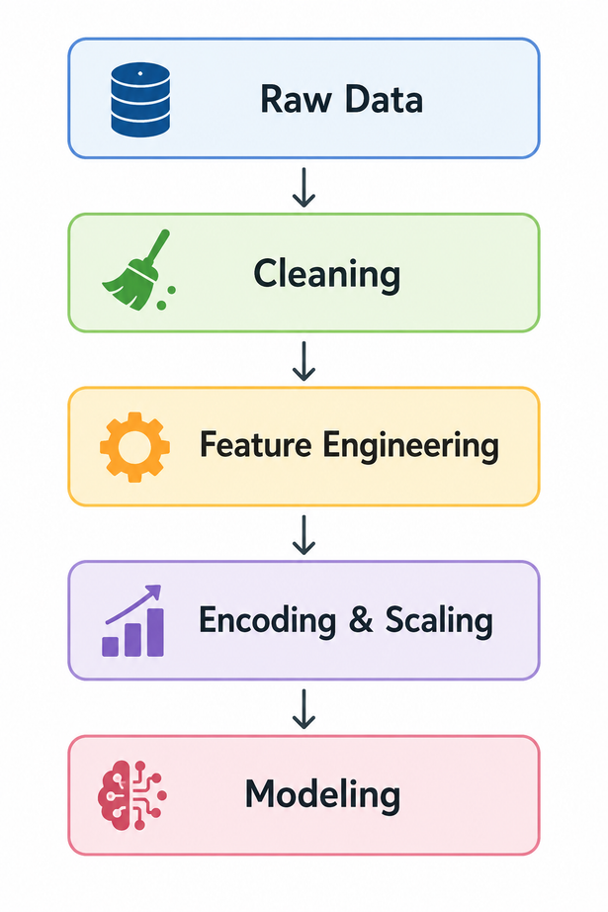
Data Cleaning & Feature Engineering
Age - grouped median imputation
Embarked - mode
Fare - median
FamilySize
IsAlone
Title
MISSING VALUE HANDLING
ENGINEERED FEATURES
ENGINEERED FEATURES
AgeGroup
FarePerPerson
HasCabin
WORKFLOW DIAGRAM
04

Slide 5
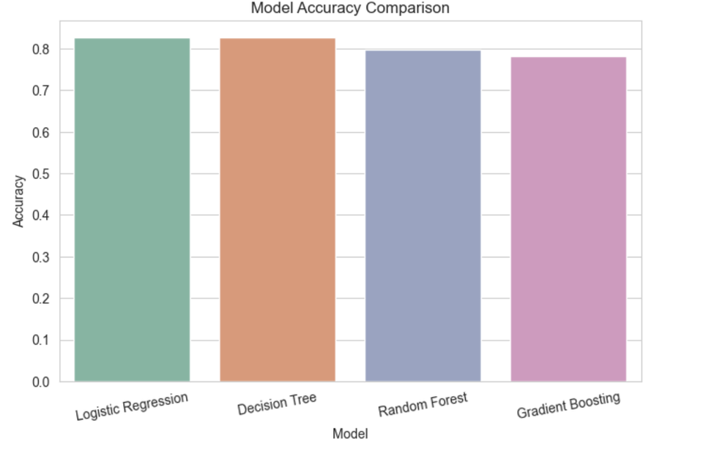
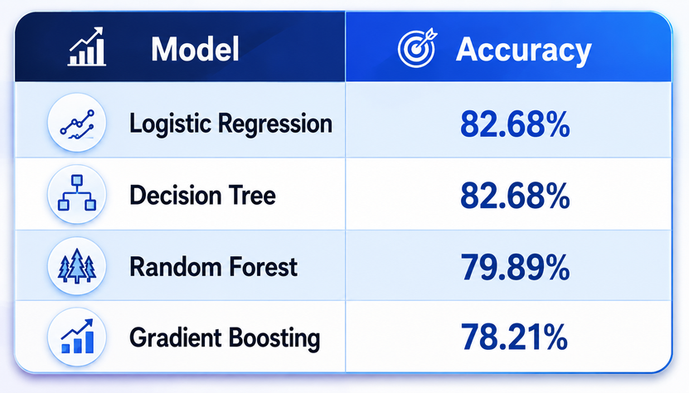
Modeling & Evaluation
Models Used:
Key Insights:
Logistic Regression achieved the strongest balance between accuracy and generalization.
05

Slide 6
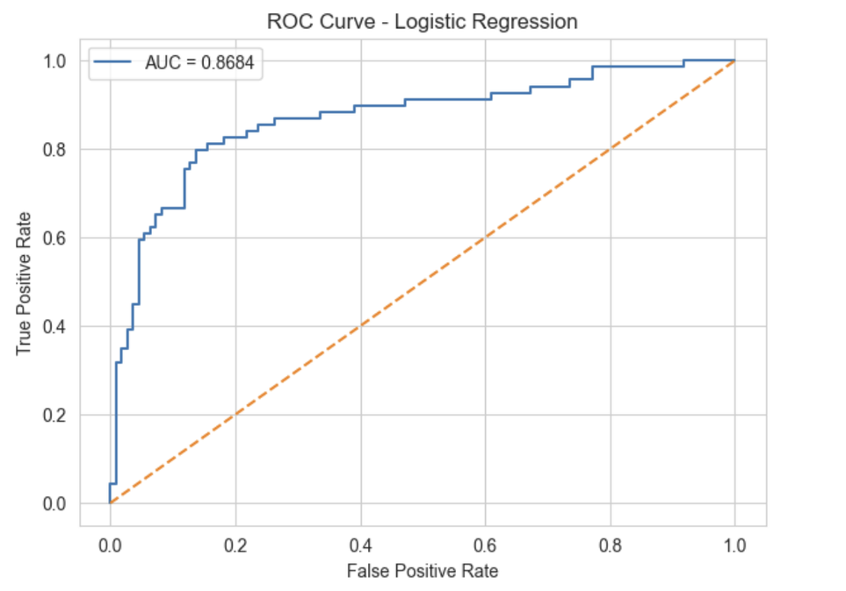
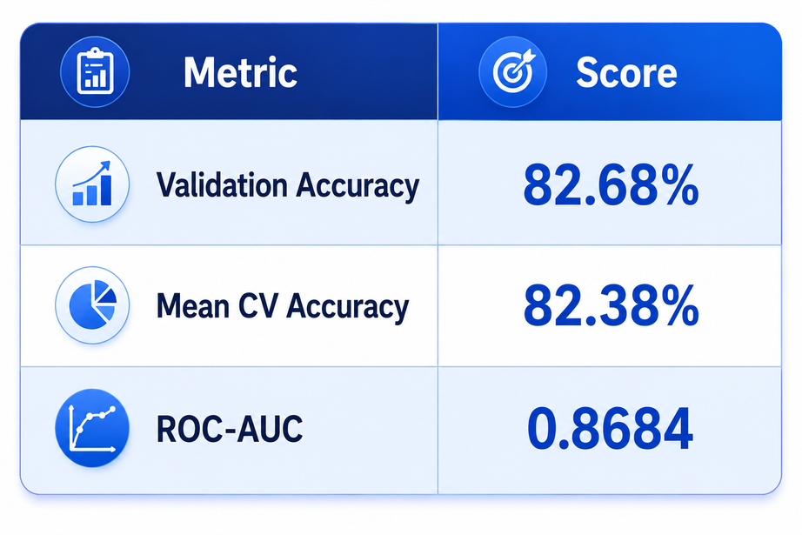
ROC Curve & Final Model
Cross Validation Results:
The Logistic Regression model achieved consistent performance across all cross-validation folds.
The average cross-validation accuracy was approximately 82.4%.
Hyperparameter tuning was performed on Random Forest, but Logistic Regression remained the best-performing and most stable model.
06

Slide 7
Conclusion & Key Learnings
CONCLUSION
KEY LEARNINGS
Successfully developed an end-to-end ML classification pipeline
EDA and feature engineering significantly improved understanding
Logistic Regression demonstrated strong and stable performance
Project followed industry-standard ML workflow
Data preprocessing is critical
Feature engineering strongly impacts performance
Simpler models can outperform complex models
Cross-validation improves reliability
FUTURE IMPROVEMENTS
XGBoost / CatBoost
Advanced feature engineering
Ensemble learning
07

Slide 8
Thank You.
08

