Slide 1


Spiking Neural network accelerator in a heterogenous system with CNN and SNN
Training of CNN-SNN system using SnnTorch and RTL implementation of SNN Inference
Supervisor : Prof. Alberto Garcia-Ortiz
Presented by : Maya Ambalapat

Slide 2

Contents
Motivation
Goals
Background
Spiking Neural Network
Spiking neuron models
Spike encoding techniques
SNN Training
Implementation
Training CNN-SNN complementary network using PyTorch and SnnTorch
RTL Design of SNN core
RTL Simulation Result
Conclusion
Scope
References

Slide 3
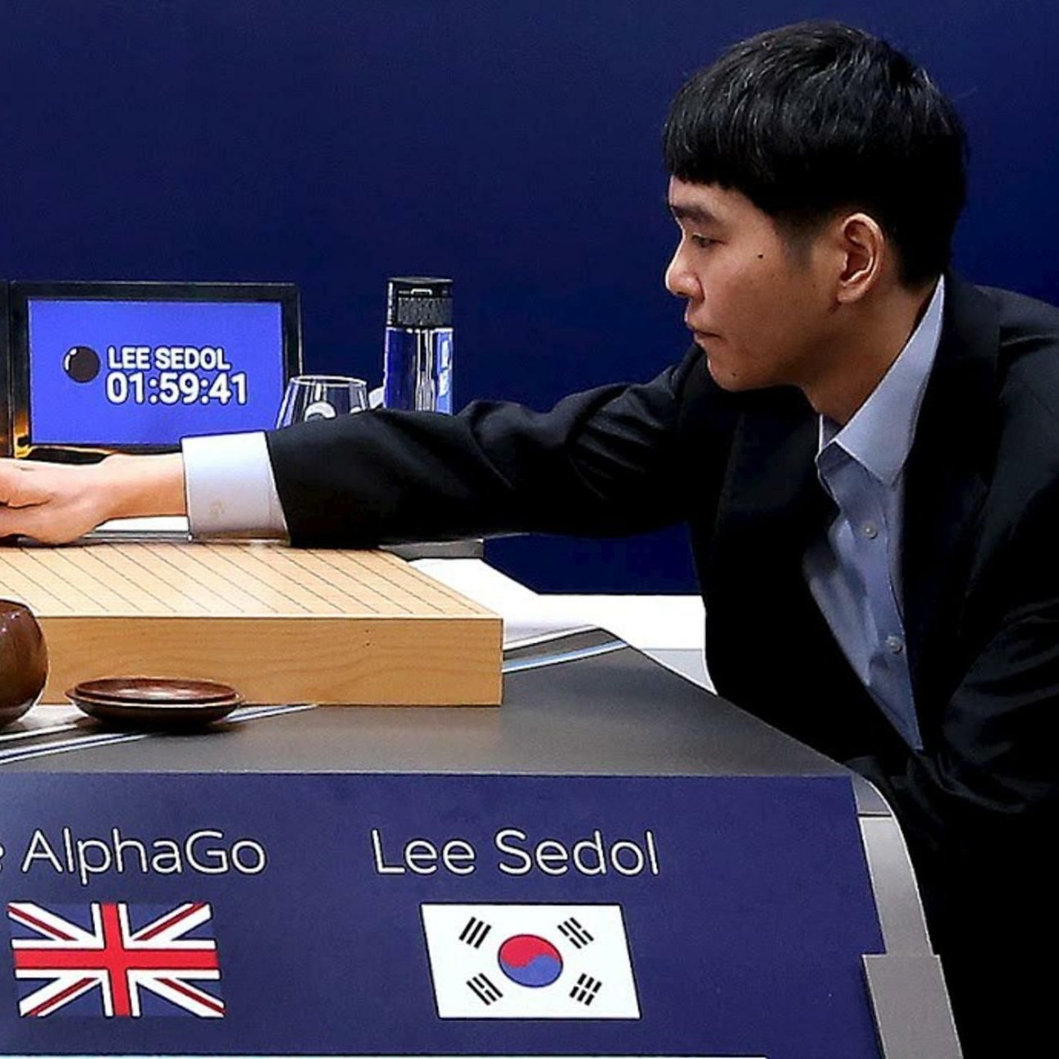
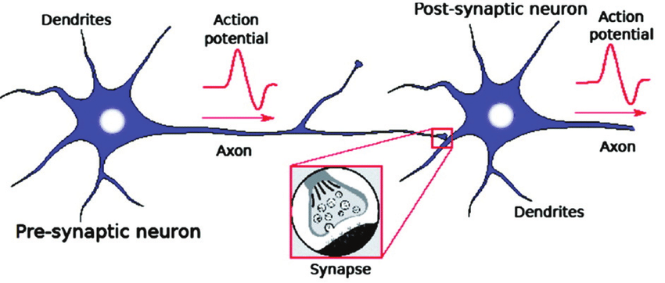
Motivation
State-of-the-Art AI has high power consumption
Brain consumes only 20W of power
Bridge this difference in power consumption
Biologically inspired spiking neural Networks
Low power, dynamic Applications

Slide 4
Motivation
Data is transmitted as spikes instead
of high precision values.
Accumulation operations replace MAC operations
Online learning possible
Low accuracy compared to CNN

Slide 5
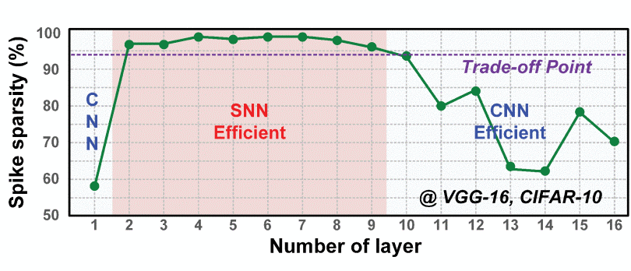
Motivation
Take advantage of complementary
properties of SNN and CNN
Workload division based on sparsity
SNN efficient when
spike sparsity > 97.7%

Slide 6
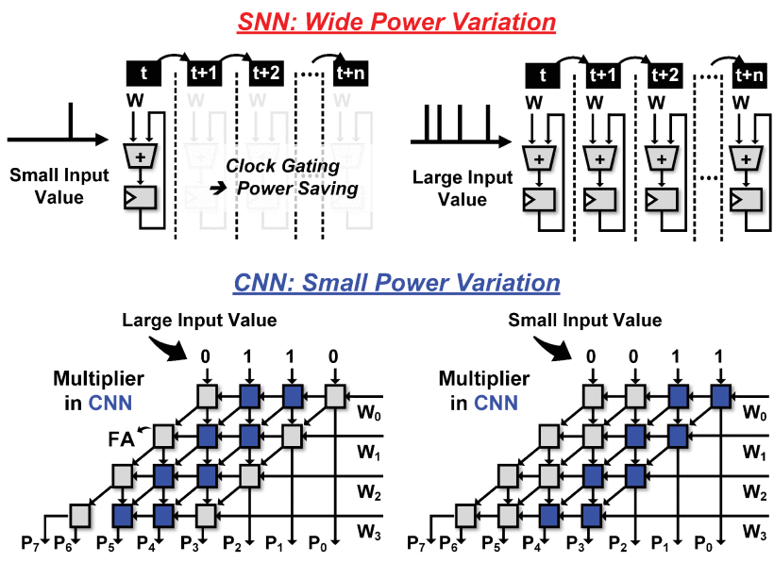
Motivation
CNN has spatially arranged full adders
even if the operand is small, a large number of full adders are operated, and the computational power remains constant.
For large amount of small data, SNN with low computational power consumption is useful.
For a lot of large-magnitude data, CNN with low-power variation is useful.

Slide 7
Goals
Implement RTL design of SNN inference module and scratchpad controller.
Training of SNN-CNN heterogenous system using PyTorch and SnnTorch
Verify the RTL design functionality
Synthesis of RTL design

Slide 8
Spiking Neural Network
Sparsification over time
Less computation
Fewer memory lookups
Event driven processing
Asynchronous
Training is difficult
Tradeoff between Accuracy and power consumption

Slide 9
Neuron models
Leaky Integrate and Fire Neuron model(LIF)
Simple and commonly used
Fits data better than the realistic models
[1] shows that the simpler IF model is more energy-efficient than the Leaky IF and temporal continuous synapse models. Moreover, SNNs with the IF model can compete with efficient ANN implementations when there is a very high spike sparsity,
Hodgkin-Huxley model
biophysically accurate models
complexity makes them difficult to use

Slide 10
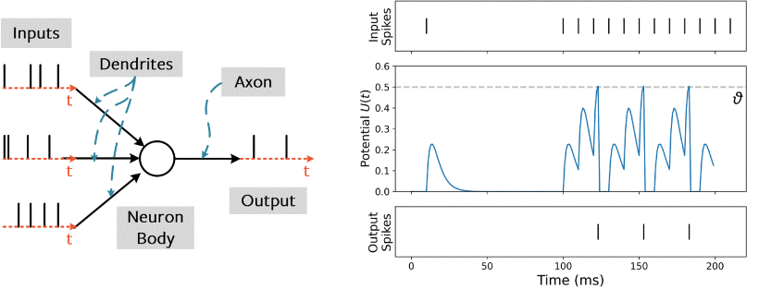
Leaky Integrate and Fire (LIF) neuron
For each time period t:
Update Neuron Voltage(V)
Process any incoming spike
if V crossed the V_{th}, emit a spike and reset V
V[t+1] = β*V[t] + W*X[t+1]-S[t]V_{th}
S[t] = 0 if V[t] > Vth else 1

Slide 11
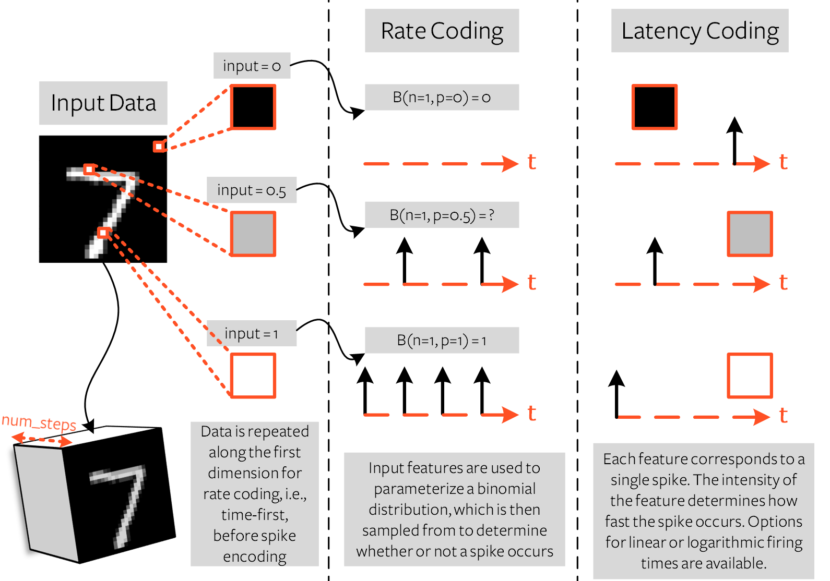
SNN encoding techniques
Static Non-spiking dataset
time-varying sequence of spikes
Rate encoding
Latency encoding

Slide 12
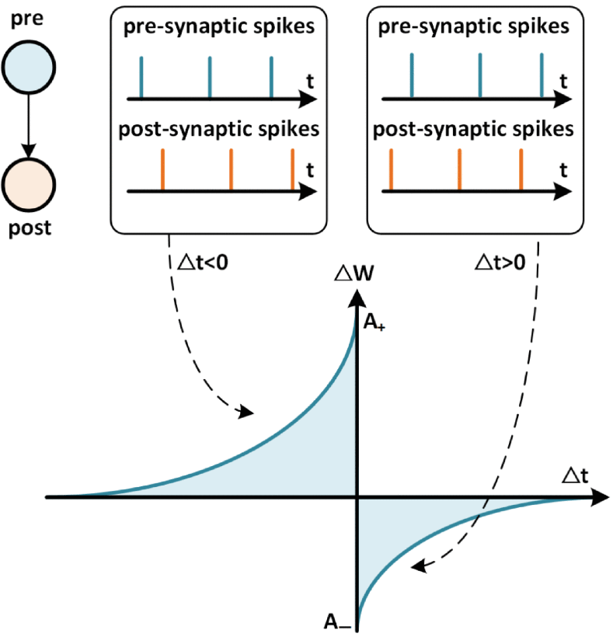
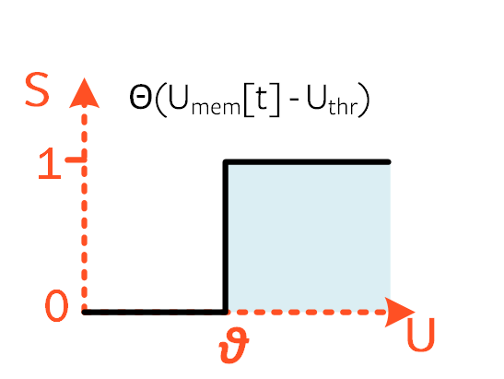
SNN Training
STDP
Works for shallow models
Hardware friendly
ANN to SNN conversion
Appropriate threshold selection
Backpropagation using surrogate gradient

Slide 13
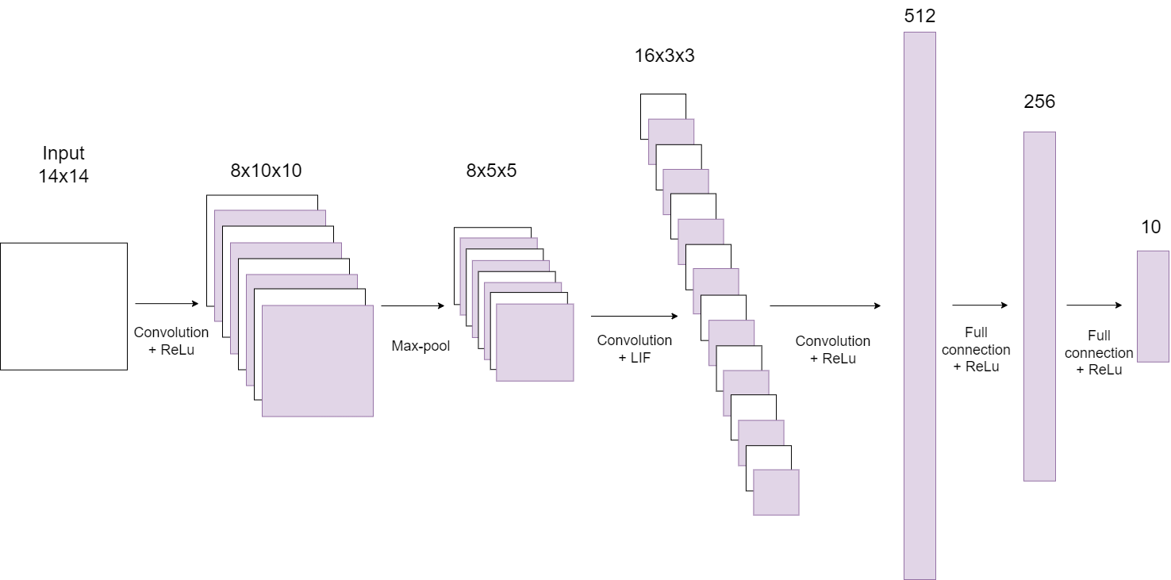
Training CNN-SNN complementary network using PyTorch and SnnTorch

Slide 14
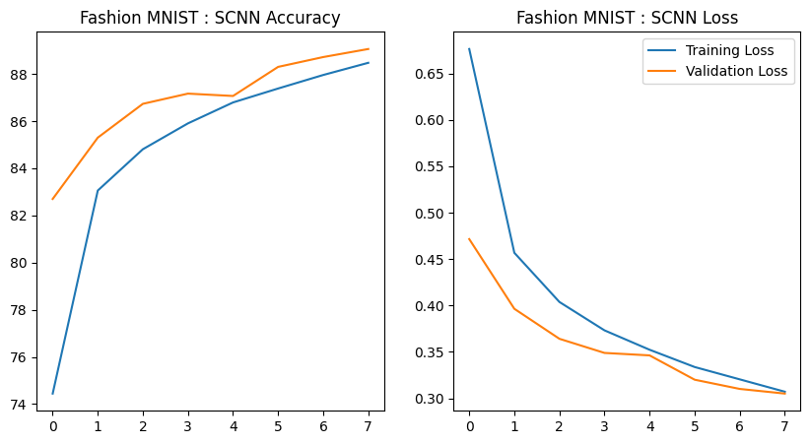
Training CNN-SNN complementary network using PyTorch and SnnTorch
Google collab
CNN only model ,
Accuracy of 90.63%
CNN-SNN model,
Accuracy of 89.7%
Leaky neuron properties
Beta = 1 , no Leak in Voltage
Threshold = 1 (default value)
Time steps = 12

Slide 15
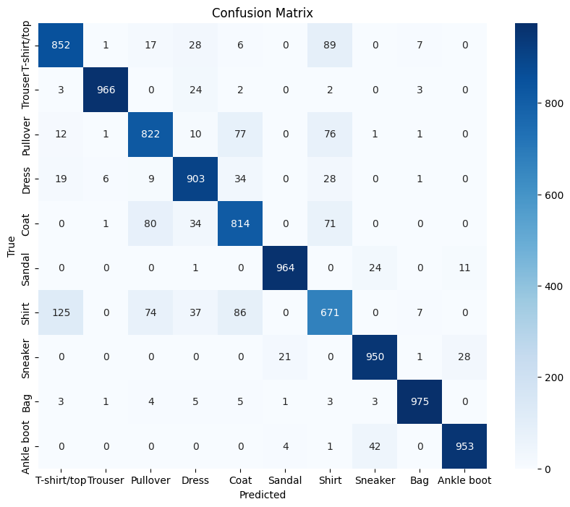
CNN-SNN complementary model

Slide 16

Training CNN-SNN complementary network using PyTorch and SnnTorch
Collect data from trained model
INT8 Quantization of weights using Brevitas
Input and output spikes of SNN layer is stored to a file

Slide 17
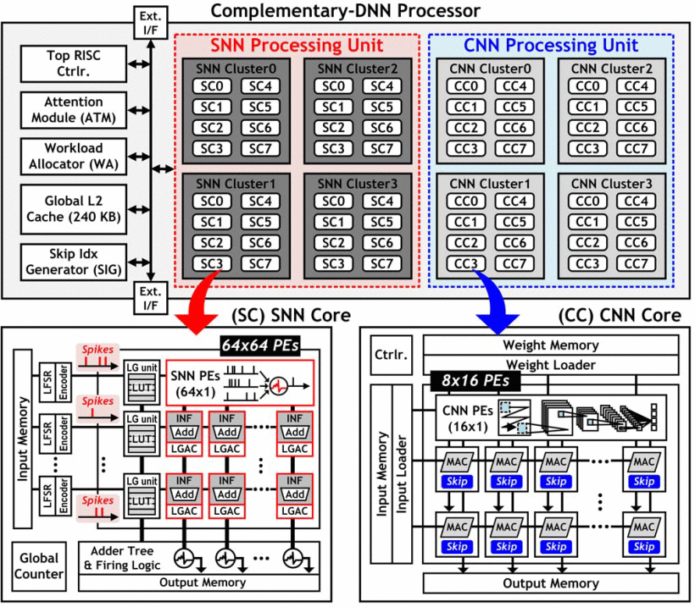
CNN-SNN complementary system
SNN Core
Distributed cache system
Spike encoding
Accumulator to add weights based on input spikes

Slide 18
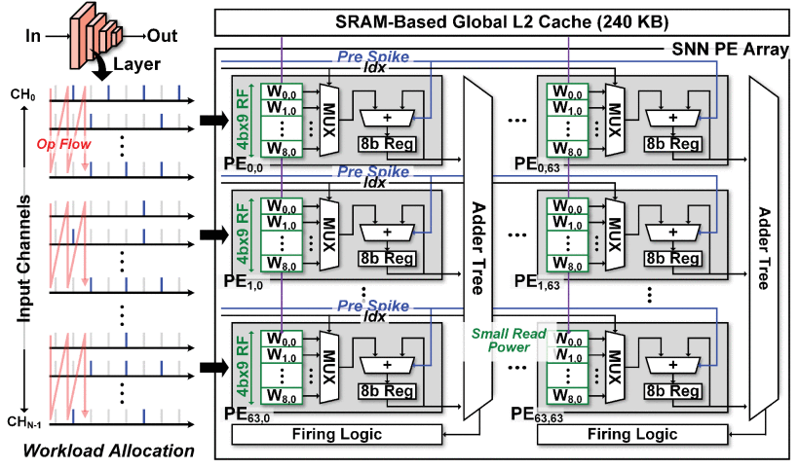
RTL Design of SNN core

Slide 19
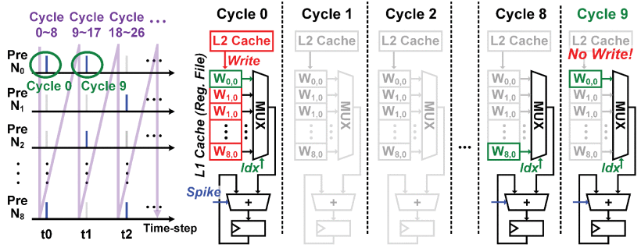
Advantages
Weight Reuse
Distributed cache system
the power consumption of the SNN
core decreases by 42.2% and 49.1%
for ImageNet classification with ResNet-18 and MobileNet

Slide 20
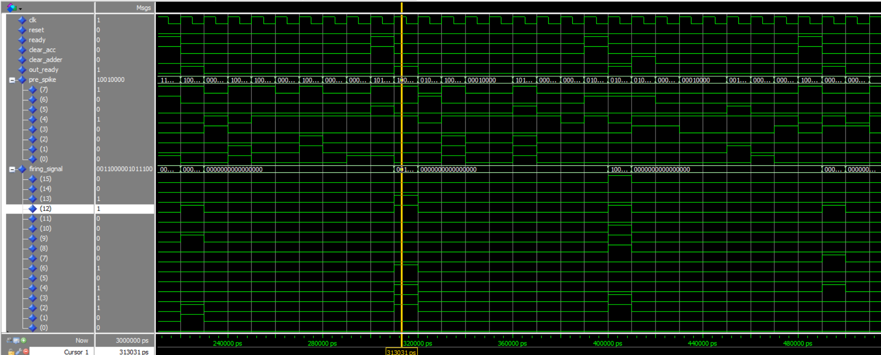
RTL Simulation Result

Slide 21
Result Verification
Output spike of VHDL simulation is stored to a file.
It is then compared with the output spikes of SNN layer in PyTorch using a Python script.

Slide 22
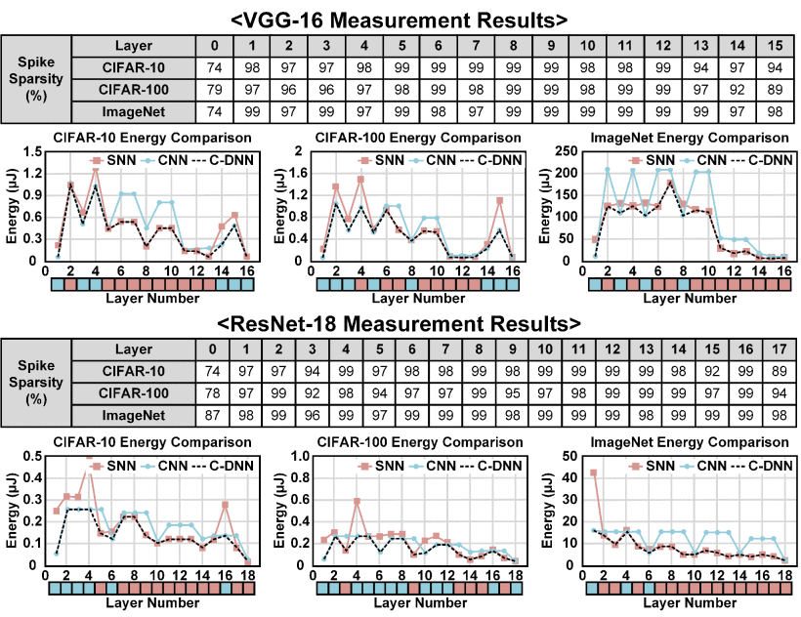
Conclusion
Energy efficiency:
15%–31% for CIFAR-10
15%–38% for CIFAR-100
11%–50% for ImageNet

Slide 23
Conclusion
Low power inference using heterogenous systems has higher energy efficiency than SNN-only or CNN-only mode.
RTL design of SNN inference module have been implemented.

Slide 24
Scope
Implementation of online learning in hardware
The RTL design of inference module can replace the CNN core in Gemmini accelerator
Thus the system can be configured to work as a heterogenous SNN-CNN accelerator

Slide 25

Questions

Slide 26
References
Manon Dampfhoffer, Thomas Mesquida, Alexandre Valentian, Lorena Anghel. Are SNNs really more energy-efficient than ANNs? An in-depth hardware-aware study. IEEE Transactions on Emerging Topics in Computational Intelligence, 2022, 2022, pp.1-11. ff10.1109/TETCI.2022.3214509ff. Ffcea03852141f
J. K. Eshraghian et al., "Training Spiking Neural Networks Using Lessons From Deep Learning," in Proceedings of the IEEE, vol. 111, no. 9, pp. 1016-1054, Sept. 2023, doi: 10.1109/JPROC.2023.3308088.
S. Kim et al., "C-DNN: An Energy-Efficient Complementary Deep-Neural-Network Processor With Heterogeneous CNN/SNN Core Architecture," in IEEE Journal of Solid-State Circuits, vol. 59, no. 1, pp. 157-172, Jan. 2024, doi: 10.1109/JSSC.2023.3330483.

Slide 27
Images
Gosciniak, Jacek. (2021). Plasmonic nonvolatile memory crossbar arrays for artificial neural networks. 10.48550/arXiv.2107.05424.
Huang, Anping & Zhang, Xinjiang & Li, Runmiao & Chi, Yu. (2018). Memristor Neural Network Design. 10.5772/intechopen.69929.

Slide 28
Thank you

