Slide 1
NAYA COLLEGE · CLOUD BIG DATA ENGINEERING · FINAL PROJECT 2026
Flight Cancellation
Risk Pipeline
A real-time data engineering system that predicts flight cancellation risk using live weather forecasts.
Re-scored every 30 minutes across 5 major airports.
Maya Babadganov, Michael Sidorov
Apache Kafka
PostgreSQL
MinIO
Airflow
Streamlit
Docker
1 / 14

Slide 2
THE PROBLEM
Weather causes billions in flight disruptions
45%
of all flight delays are directly caused by weather conditions
$30B
annual economic impact of flight delays in the US alone
0
existing free tools that continuously re-score live risk every 30 minutes
Our take: We continuously re-score every upcoming flight — pulling live weather for both departure and arrival airports, before delays are even announced.
2 / 14

Slide 3
OUR SOLUTION
A fully automated, local pipeline
One docker-compose up — 9 services, 0 cloud costs
STREAM
SCORE
STORE
VIEW
Real-time Streaming
Live Weather Scoring
Dual Storage
Live Dashboard
Apache Kafka carries every flight and weather update — two dedicated topics with 3 partitions each.
Open-Meteo queried once per unique airport — wind & rain matched to the exact departure hour.
PostgreSQL for the live risk view, MinIO for a Hive-partitioned historical archive — never delete.
Streamlit auto-refreshes every 60 seconds — filterable table, risk counters, airport bar chart.
3 / 14

Slide 4
SYSTEM ARCHITECTURE
End-to-End Data Flow
Every stage is independently runnable — swap any component without rewriting the rest.
APIS
KAFKA
WORKERS
STORAGE
DASHBOARD
AeroDataBox Open-Meteo
raw-flights weather-data
fetch · load enrich · score
PostgreSQL MinIO
Streamlit Power BI
ORCHESTRATION
Airflow — schedule_dag
Airflow — risk_dag
Daily 06:00 · fetches flight schedules for 5 airports → raw-flights → flights_schedule
Every 30 min · fetch weather → enrich → score → PostgreSQL + MinIO snapshot
9 Docker services
5 ETL scripts
2 Airflow DAGs
5 Airports
4 / 14

Slide 5
TECH STACK
All free. All Docker.
Change one line in .env to switch to AWS S3 or RDS — no code rewrites
SCHEDULES
WEATHER
STREAMING
ORCHESTRATION
AeroDataBox
Open-Meteo
Apache Kafka
Airflow 2.8
RapidAPI · ~300/500 calls/month
Unlimited · no API key needed
2 topics
2 DAGs
WAREHOUSE
OBJECT STORE
DASHBOARD
BI REPORT
PostgreSQL
MinIO
Streamlit
Power BI Desktop
Idempotent UPSERT
Local S3 · Hive partitioning
Auto-refresh 60s · port 8501
Connects to PostgreSQL · free
5 / 14

Slide 6
DAG 1 OF 2
schedule_dag — Daily 06:00
Fetches upcoming flight schedules for 5 monitored airports and loads them into PostgreSQL.
STEP 1
KAFKA TOPIC
STEP 2
POSTGRESQL
fetch_schedule.py
raw-flights
load_schedule_pg.py
flights_schedule
Calls AeroDataBox via RapidAPI per ICAO airport. Publishes JSON to Kafka raw-flights.
Key: flight_iata
Consumes Kafka, upserts into Postgres flights_schedule table.
3-day rolling window ON CONFLICT DO NOTHING
Airports: KJFK · EGLL · EDDF · OMDB · KATL
Free tier: ~300 / 500 calls/month
Rate-limit fix: sleep(1) between airports
6 / 14

Slide 7
DAG 2 OF 2
risk_dag — Every 30 Minutes
Fetches fresh weather, re-scores every flight, writes to PostgreSQL and MinIO.
STEP 1
STEP 2
STEP 3
STEP 4
STEP 5
fetch_weather.py
enrich_flights.py
transform_risk.py
load_postgres.py
load_minio.py
Open-Meteo called once per unique airport (5-12 API calls).
Join flight × weather on scheduled departure hour and arrival hour.
Publishes JSON to Kafka enriched-flights.
Consumes Kafka. Score DEP & ARR independently — worst score wins.
UPSERT into flight_risk.
Append snapshot to Hive- partitioned archive.
Result per run: flights re-scored · live view updated in PostgreSQL · full snapshot appended to MinIO (never deleted)
7 / 14

Slide 8
RISK ENGINE
How We Score Risk
Scored independently for both departure and arrival airports — worst score wins.
wind > 50 km/h OR precipitation > 5 mm/h
HIGH
wind > 30 km/h
MEDIUM
Clear conditions — no thresholds exceeded
LOW
The triggering airport is stored in risk_airport (DEP/ARR), and the reason in risk_reason — e.g. "wind 62.3 km/h".
8 / 14

Slide 9
STORAGE STRATEGY
Why Two Databases?
Different problems require different write patterns — and different access patterns.
CURRENT STATE
HISTORICAL ARCHIVE
PostgreSQL
MinIO (local S3)
Write pattern
UPSERT — always current
Write pattern
Append-only, never delete
Content
Latest risk per flight
Content
Every snapshot, forever
Used by
Streamlit · Power BI
Partitioning
year / month / day / hour
Key
(flight_iata, scheduled_dep)
Format
Newline-delimited JSON
Analogy: Current balance screen
Analogy: Complete transaction ledger
9 / 14

Slide 10
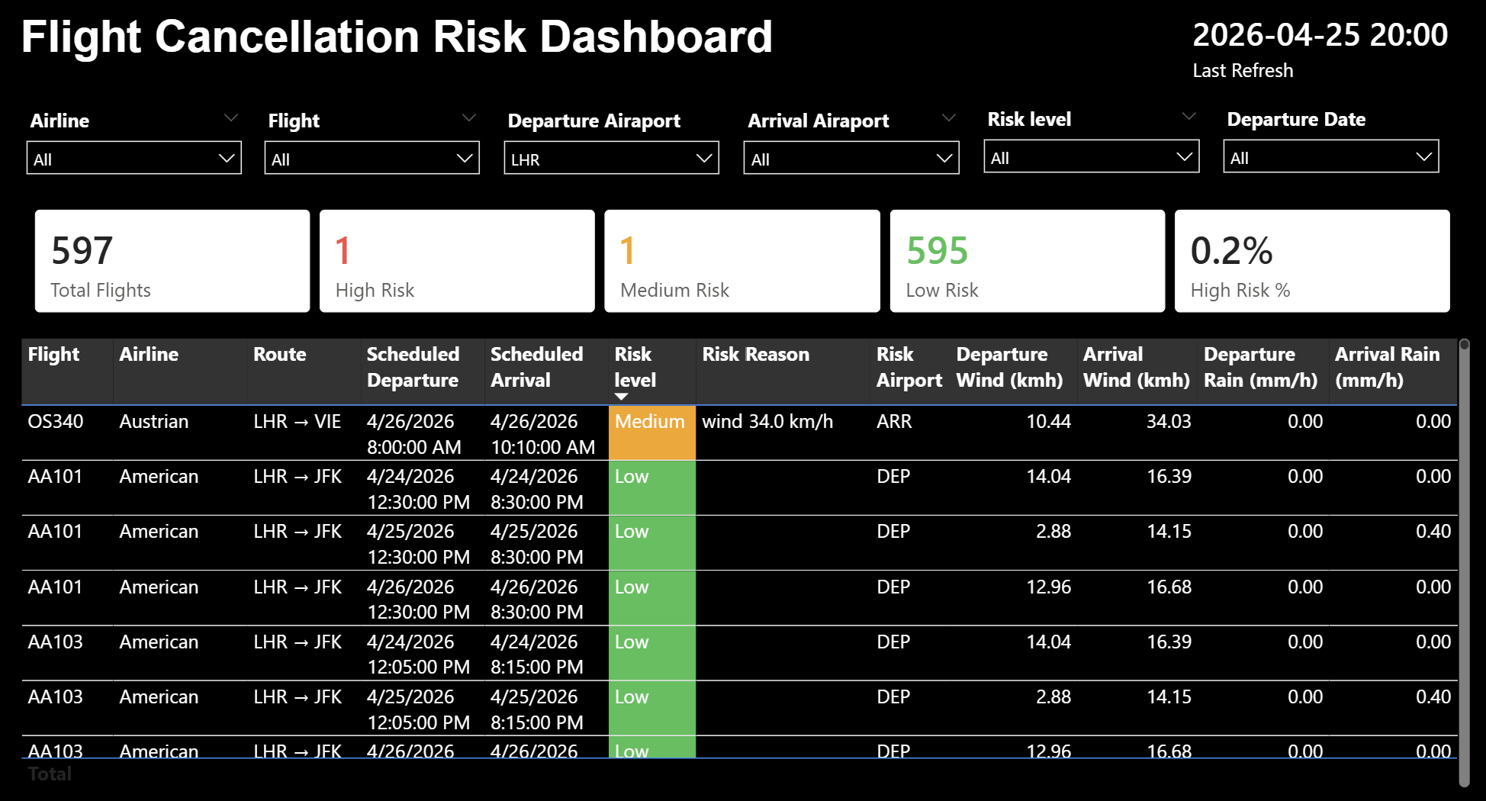
LIVE DASHBOARD
Power-BI Desktop
10 / 14

Slide 11
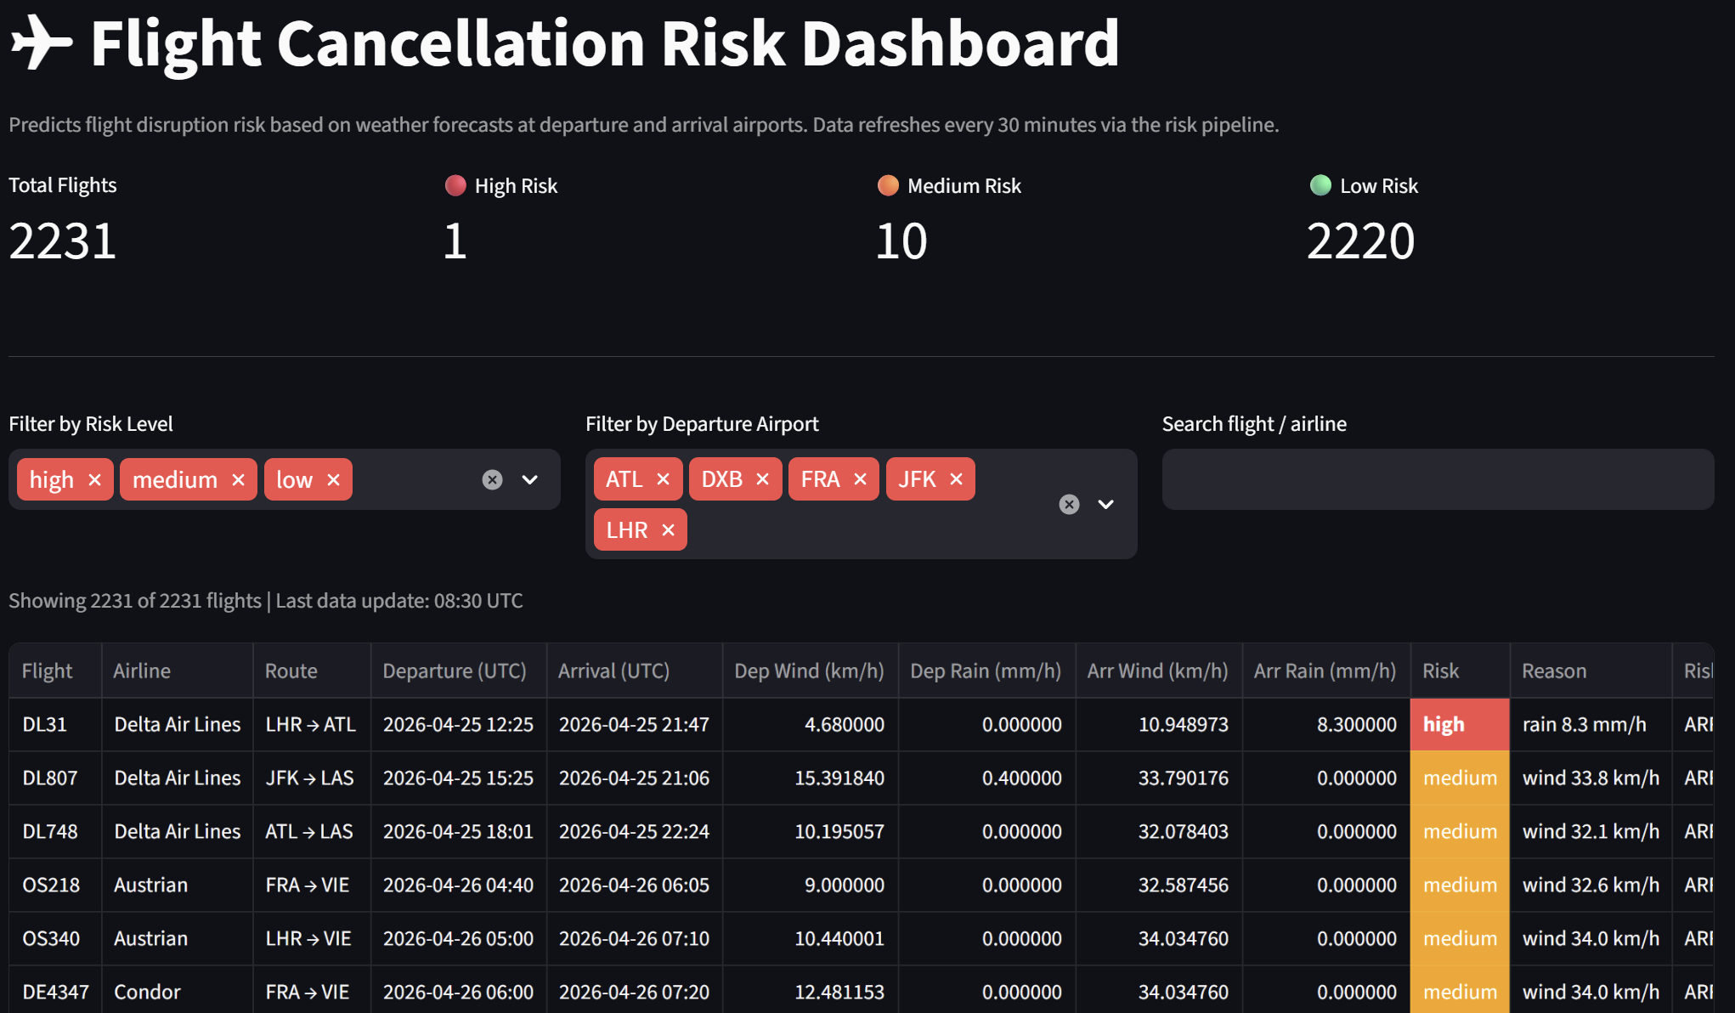
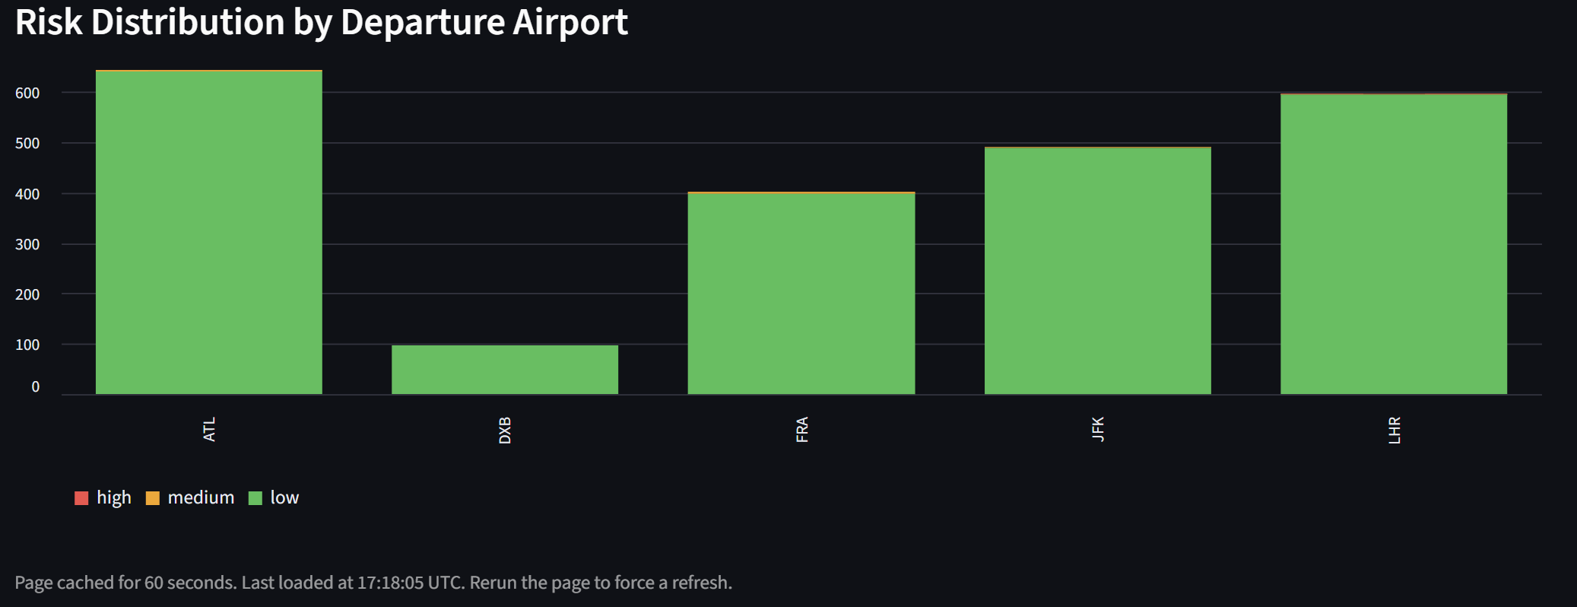
LIVE DASHBOARD
Streamlit — localhost:8501
Auto-refreshes every 60 seconds · filterable by risk, airport, airline
10 / 14

Slide 12
ENGINEERING DECISIONS
What We Built & Why
Every decision keeps the system explainable, debuggable, and production-upgradeable.
K
Kafka as the Transport Layer
↻
Safe data Loads
Every hop goes through a Kafka topic. Scripts are independently runnable — swap any stage without touching the others.
All inserts use ON CONFLICT DO NOTHING / UPDATE — safe to re-run any script at any time, zero duplicates.
✦
API Deduplication
☁
One-Line Cloud Upgrade
Open-Meteo called once per unique airport, not per flight — 838 flights become only 5-12 weather API calls per run.
Switching to AWS S3 or RDS requires changing one line in .env — no code rewrites, fully portable design.
12 / 14

Slide 13
WHAT WAS HARD
Challenges We Solved
Every bug taught us something about real production pipelines.
Select Services
API
API Rate Limits
Services
Problem: There are many providers in the market.
Problem: AeroDataBox 429 Too Many Requests when querying airports back-to-back.
Fix: We select open/free providers that will allow as to change to large scale Easley
Fix: Fixed with sleep(1) between calls.
War
War
Problem: we worked on the project during War, hard to schedule meetings.
Fix: Long nights.
11 / 14

Slide 14
WHAT'S NEXT
Taking This to the Next Level
The architecture is already cloud-ready — these are the natural next steps.
01
Move to AWS
Replace MinIO with S3, PostgreSQL with RDS, Airflow with MWAA — one .env change each.
02
Expand Coverage
Add more airports; upgrade to a paid AeroDataBox plan for 7-day forecasts and global coverage.
03
ML Risk Model
Replace rule-based scoring with a trained ML model using historical MinIO data — predict probability, not just thresholds.
04
Alerts & Observability
Real-time email/Slack alerts when high-risk flights are detected, plus ELK stack for full observability.
13 / 14

Slide 15
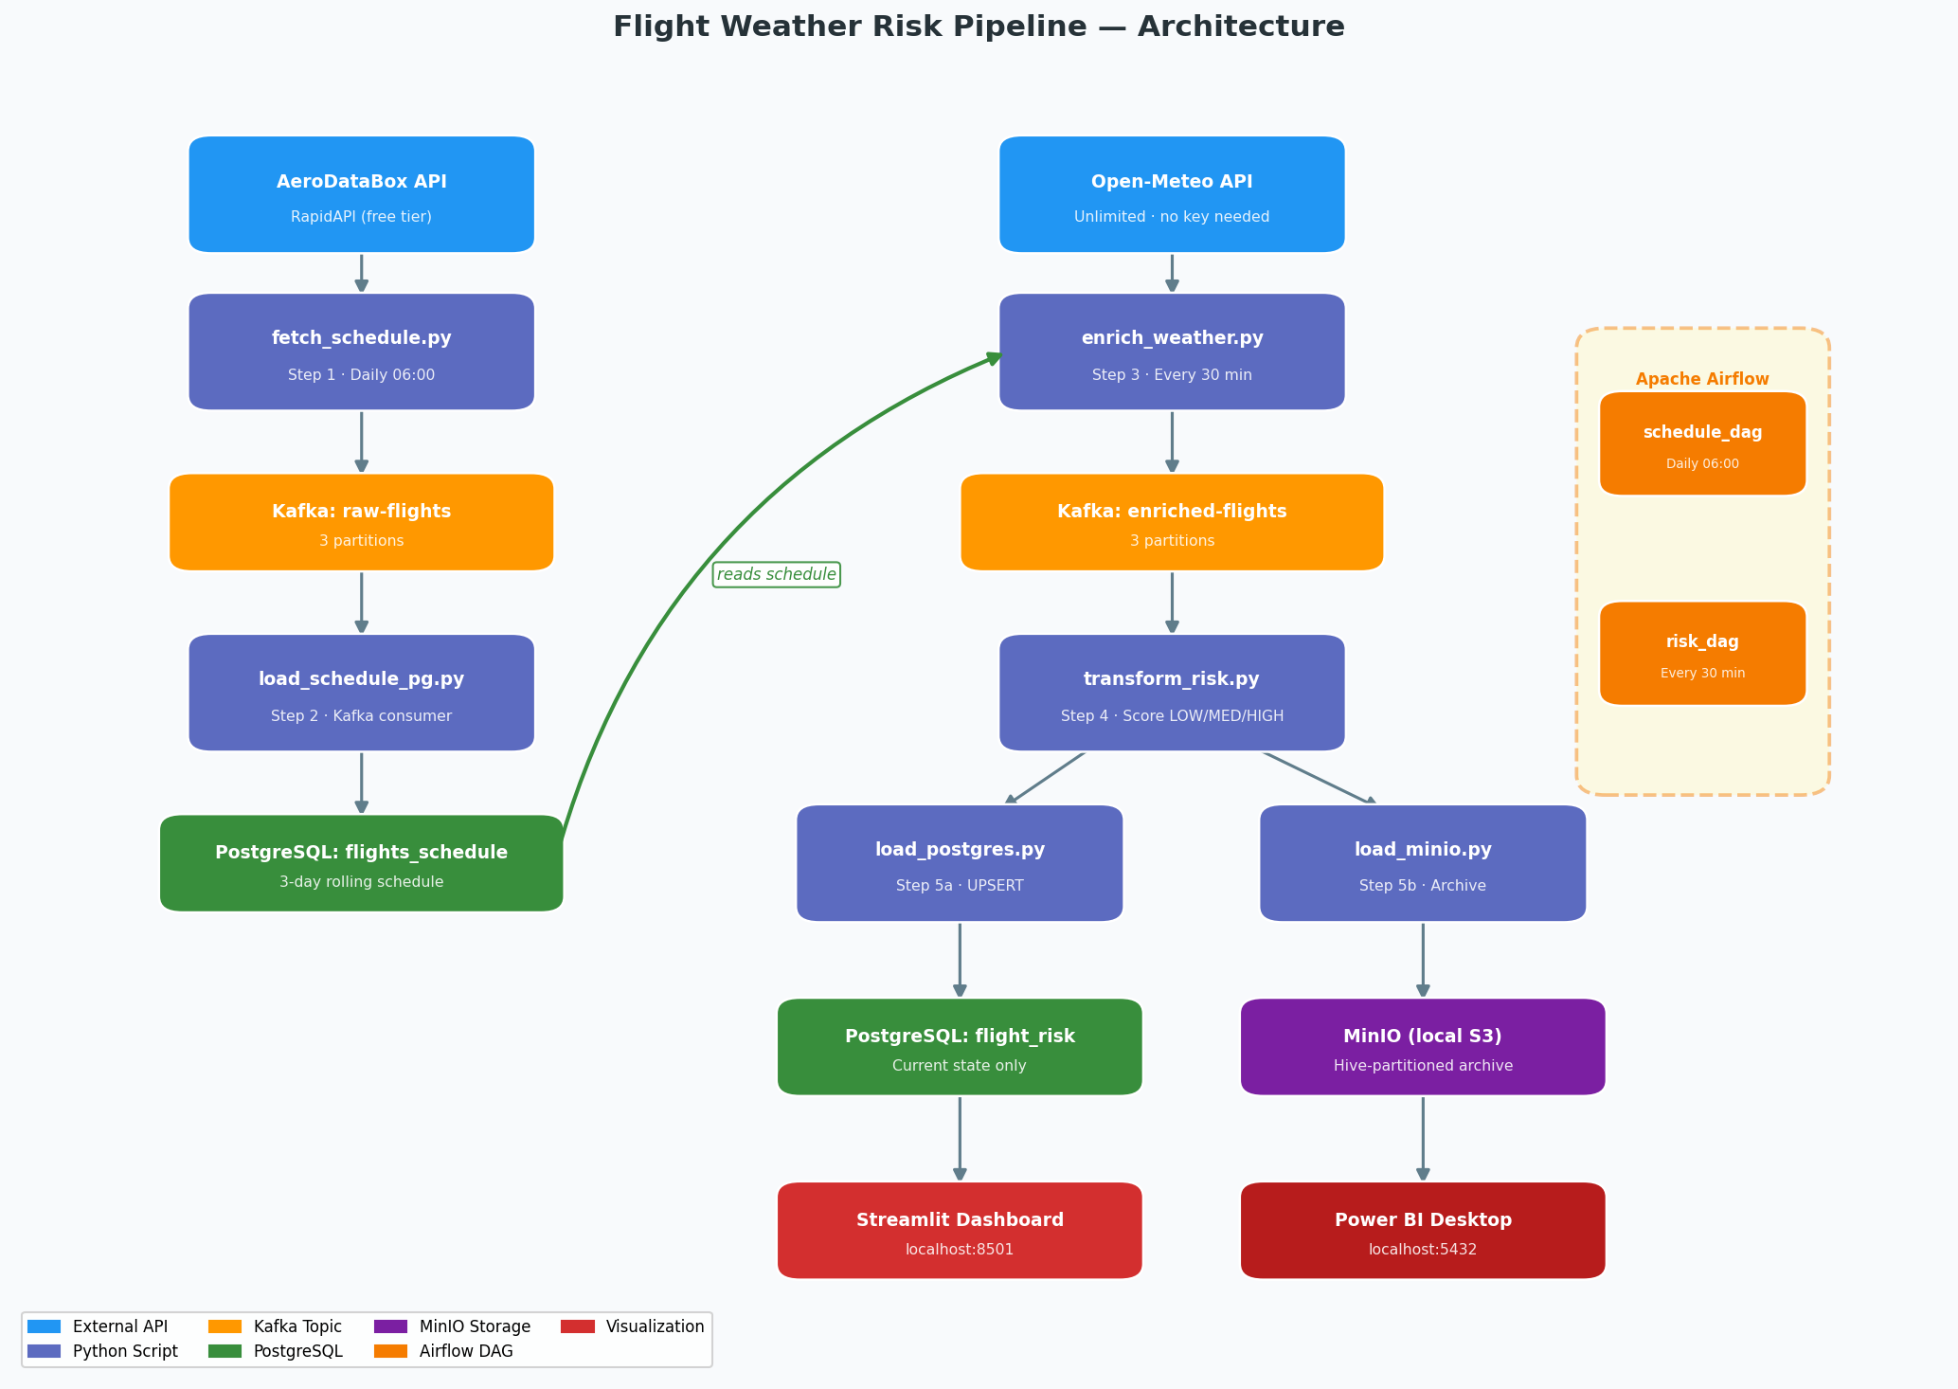
PROJECT ARCHITECTURE
Project Architecture
*** Power BI desktop is also pulling data from Postgres and not MinIO.
13 / 14

Slide 16
NAYA COLLEGE · CLOUD BIG DATA ENGINEERING · FINAL PROJECT 2026
Thank You
Questions welcome.
Live pipeline running at localhost:8501
9
5
838
DOCKER SERVICES
ETL SCRIPTS
FLIGHTS SCORED
Kafka · Zookeeper · PostgreSQL · MinIO · Airflow · Streamlit · init workers
fetch → load_pg → enrich_weather → transform_risk → load_postgres + load_minio
KJFK · EGLL · EDDF · OMDB · KATL — re-scored every 30 min, archived forever
14 / 14

