Slide 1
Visual Stylist
Maya Boradzhieva 62335
Lyubka Angelinina 62342
Nikoleta Valchinova 62322

Slide 2
Content
Product Scope, Product Perspective and Intended Audience
Functional Requirements
Nonfunctional Requirements
User Interfaces
Use case diagrams
Sequence diagrams
Activity diagrams
Package and class diagrams
Future directions for development

Slide 3
Product Scope, Product Perspective and Intended Audience
Product Scope
Visual Stylist is web application that shows people outfit ideas and gives them the opportunity to create their own outfits.
Product Perspective
The product is a new, self-contained product. It is not a follow-on member of a product family.
Intended Audience
The product’s target group are users who want to dress well, but don’t have time to try on outfits or match their clothes.

Slide 4
Functional Requirements
Users must be registered in order to enter the system.
Entering the system requires username and password.
In order to achieve more accurate representation of his own figure, the registered user can scan himself and provide information about his measurements.
If the user does not provide information about his measurements, there will be default 3D figure.
The registered user has an option to upload a picture of his face which will be placed on the user’s 3D figure.

Slide 5
Functional Requirements
The system will detect the registered user’s favorite style and favorite color from what he/she has worn the most.
The system uses information about the weather from AccuWeather.com
The system provides the user the opportunity to add clothes. It separates them in different categories, such as tops, jackets, bottoms, shoes, dresses, bras and etc.
The system provides the user the opportunity to see added clothes by categories and to search for a piece of clothing.

Slide 6
Functional Requirements
The system provides the user the opportunity to create outfits. The user can choose from options, such as color, occasion, style and the recommender’s random pick.
The system provides the user the opportunity to save favorite outfits and to select whether the outfit is worn or not.
The system saves how many times a piece of clothing is worn and displays message when it is worn 3 times.
The system provides the user the opportunity to check laundry basket to see used clothes or to remove them if they are washed.
A hologram option is available when the device is supported by MDH Hologram technology.

Slide 7
Nonfunctional Requirements
Performance Requirements
The platform must perform equally fast nonetheless the workload.
The system should response within 3 milliseconds.
The system should be capable of supporting 40 000 customers concurrently.
The platform will remain supported through monthly quality updates.
Safety Requirements
Information transmission should be securely transmitted to server without any changes in information.
Security Requirements
System should have login mechanism in order to avoid hacking.
System should notify the user when other device logs into the system.

Slide 8
Nonfunctional Requirements
Software Quality Attributes
If the Internet service gets disrupted while sending information to the server, the information can be send again for verification.
Guaranteed compatibility with iOS, Android and Windows.
The system should provide direct access to the main functionalities of the system (such as login, create outfits, see clothes, etc.)
System’s recovery should be provided within 24 hours.
The system provides suitable interface for different devices, such as mobile devices, PC, tablets.
The system provides database support: the system’s functionality is guaranteed and is able to recover in critical situations.
Business Rules
The system should consider General Data Protection Regulation (GDPR).

Slide 9
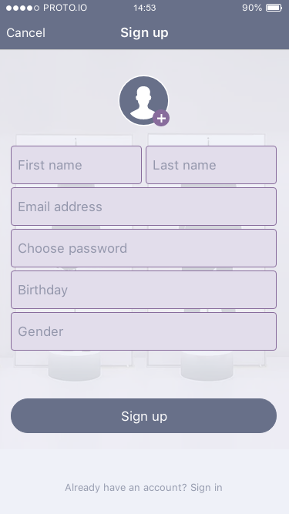
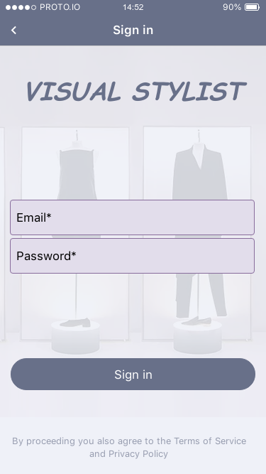
User Interfaces

Slide 10
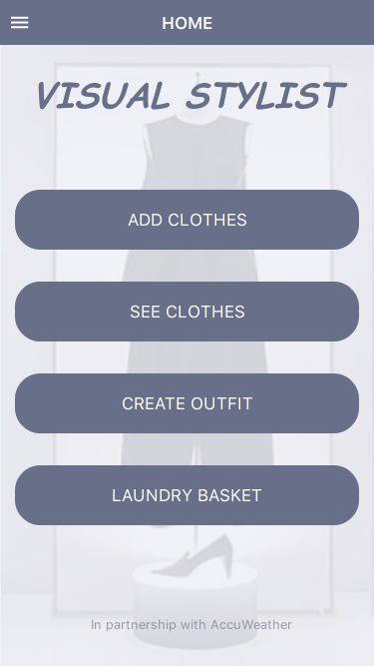
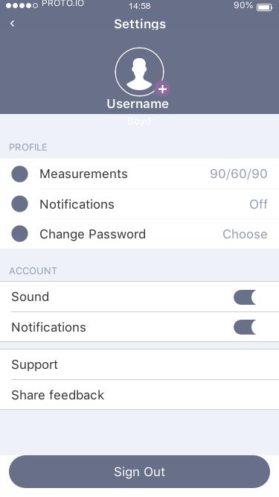
User Interfaces

Slide 11
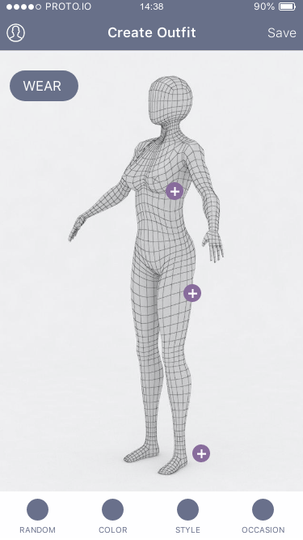
User Interfaces

Slide 12
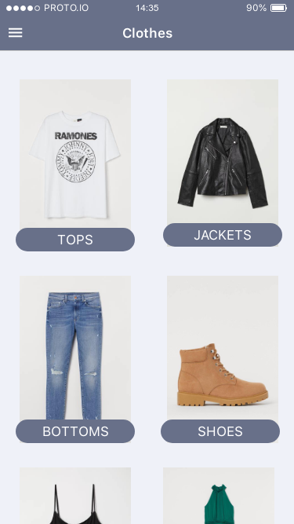
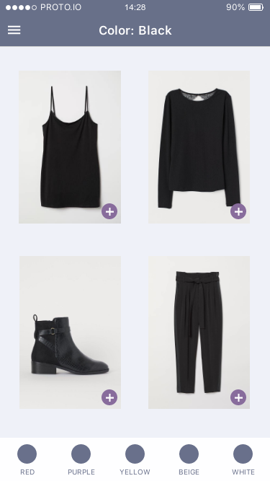
User Interfaces

Slide 13
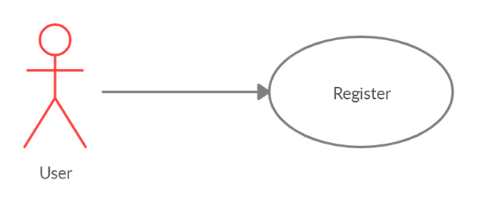
Use case diagrams

Slide 14
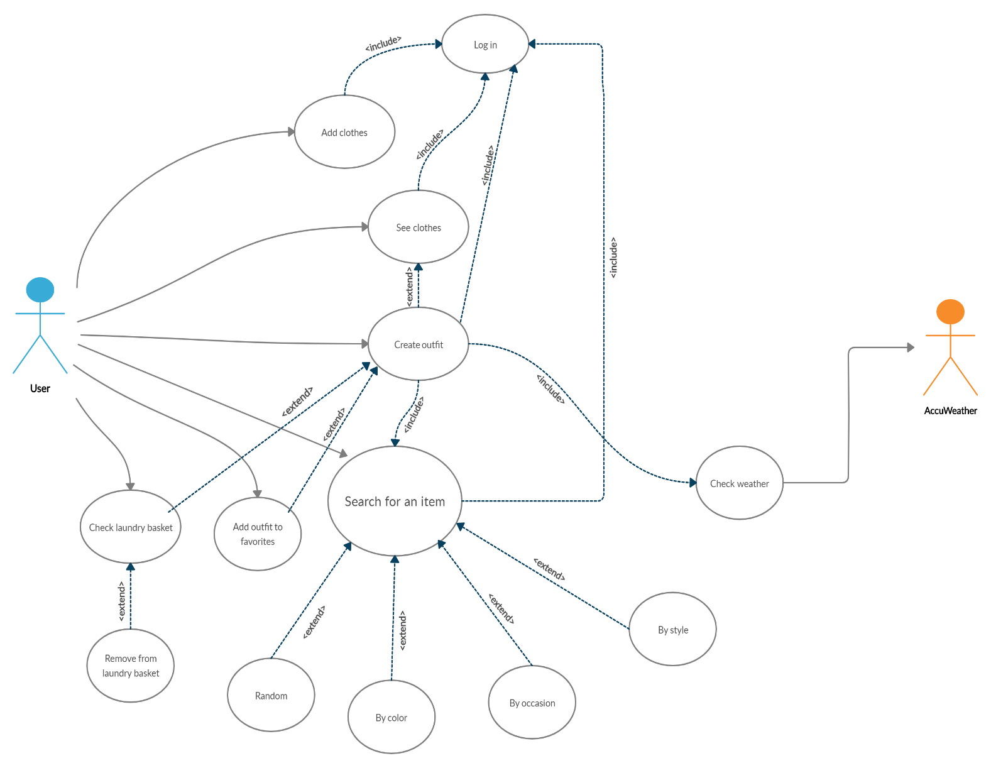
Use case diagrams

Slide 15
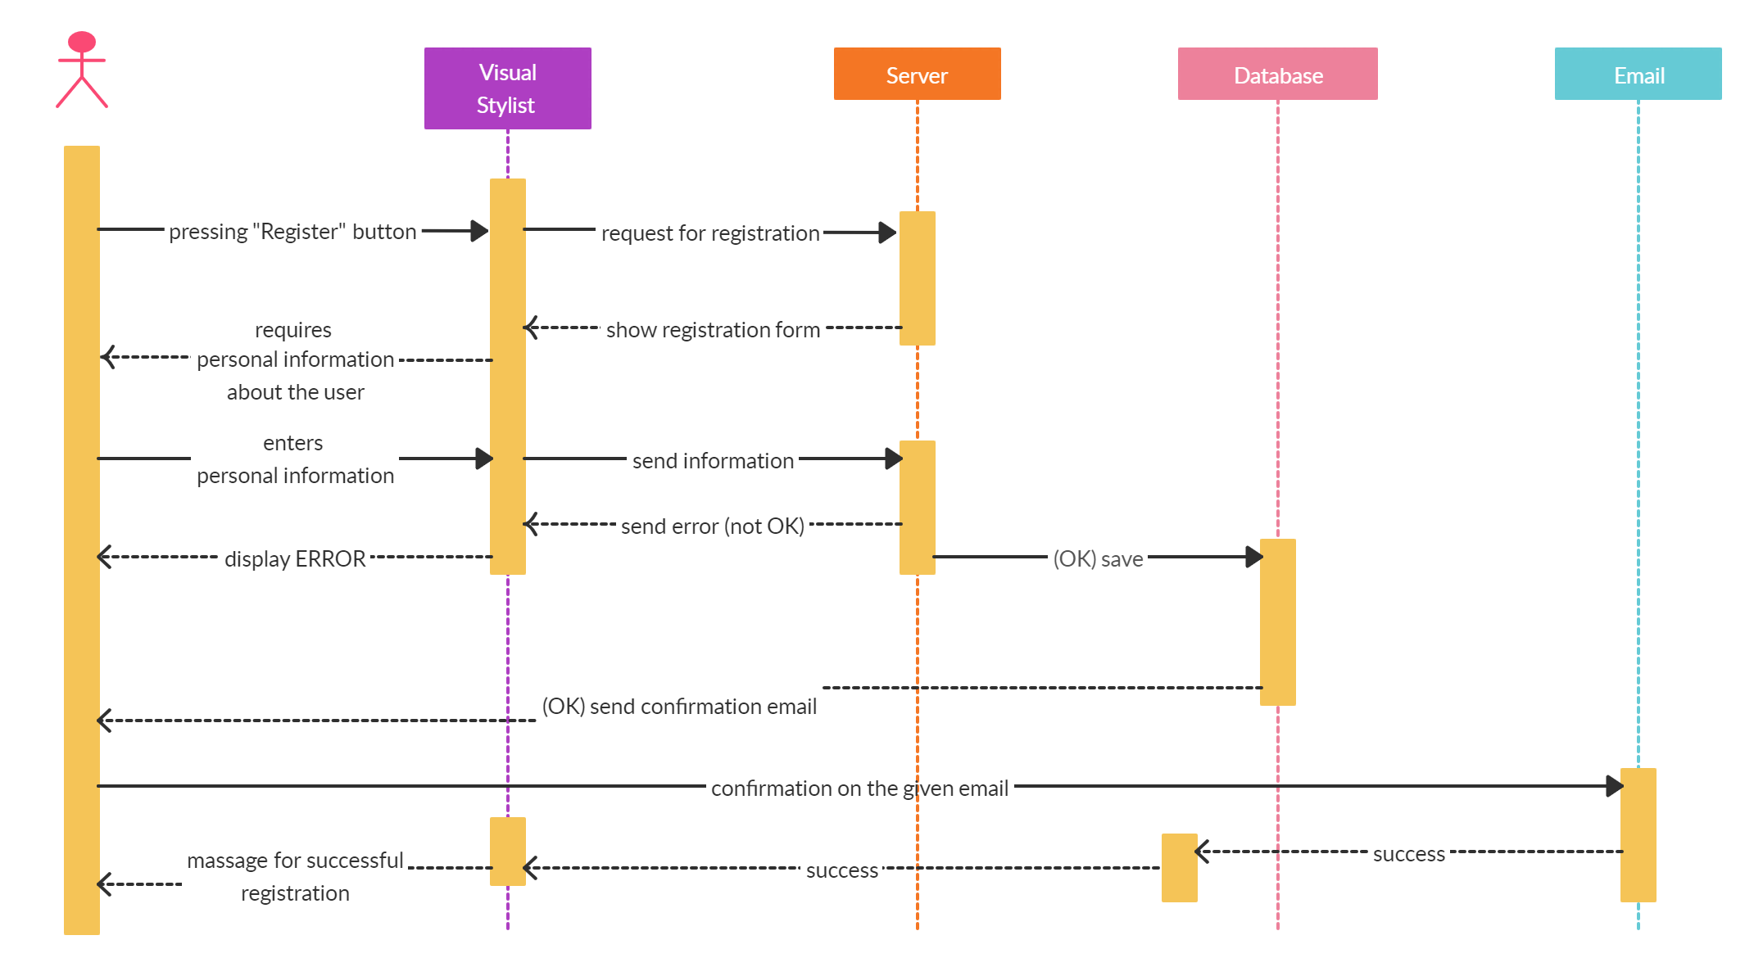
Sequence diagrams

Slide 16
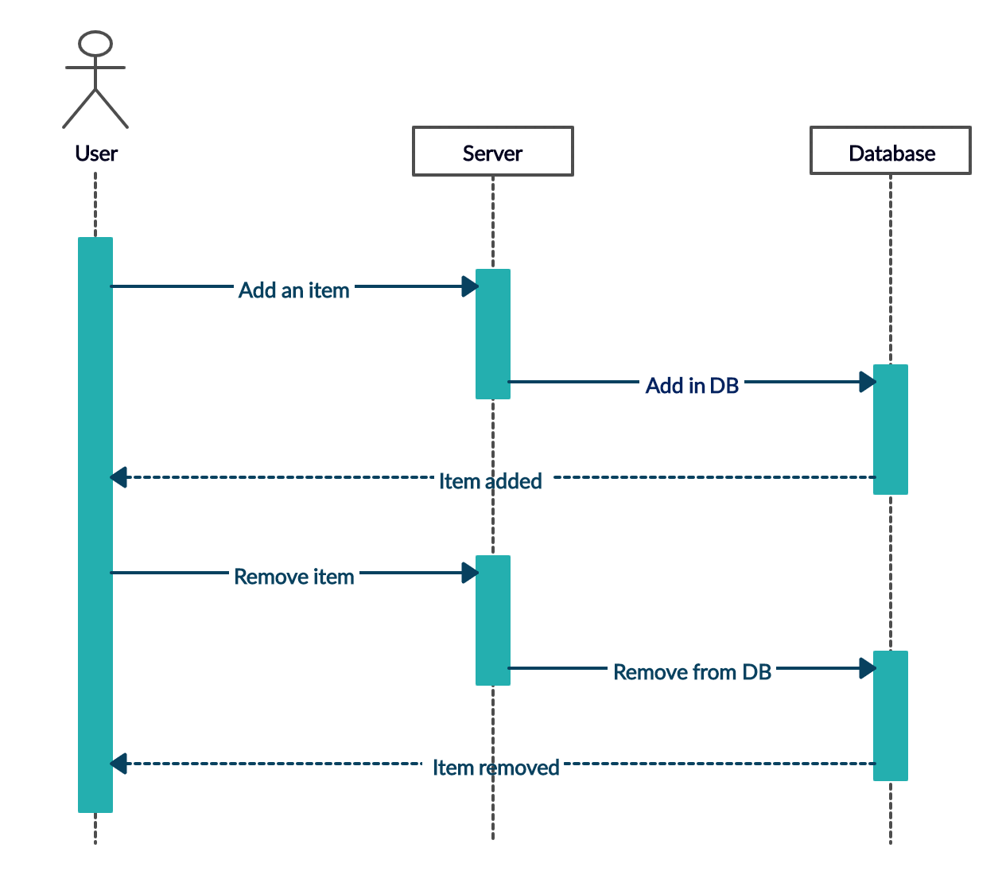

Sequence diagrams

Slide 17
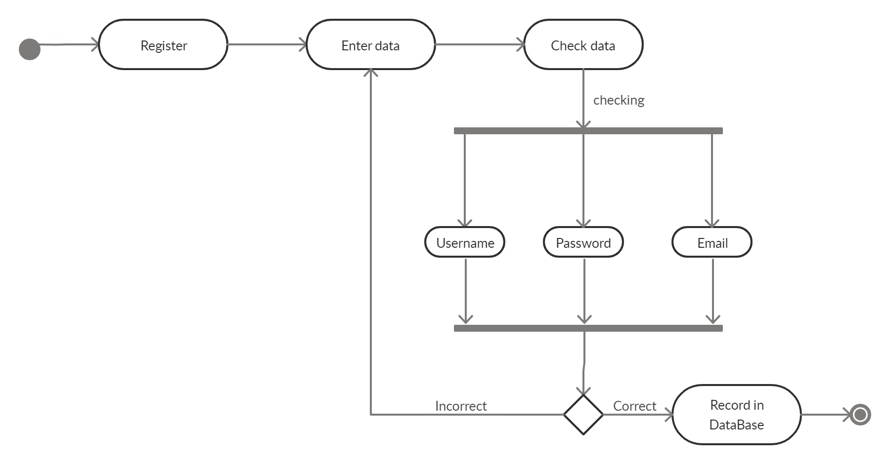
Activity diagrams

Slide 18
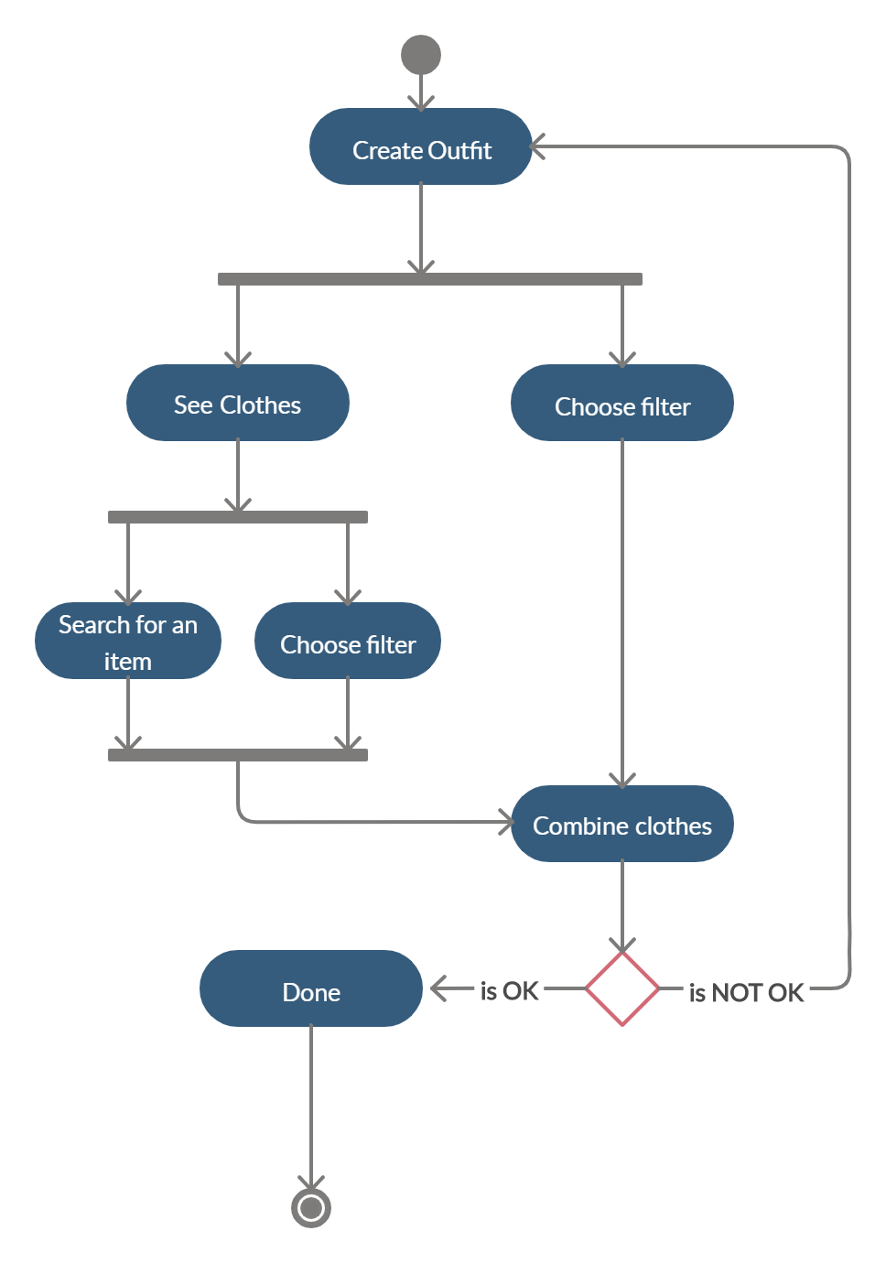
Activity diagrams

Slide 19
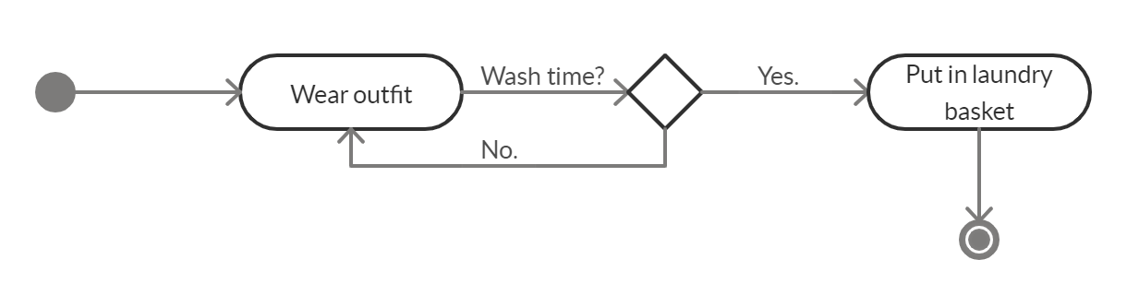
Activity diagrams

Slide 20
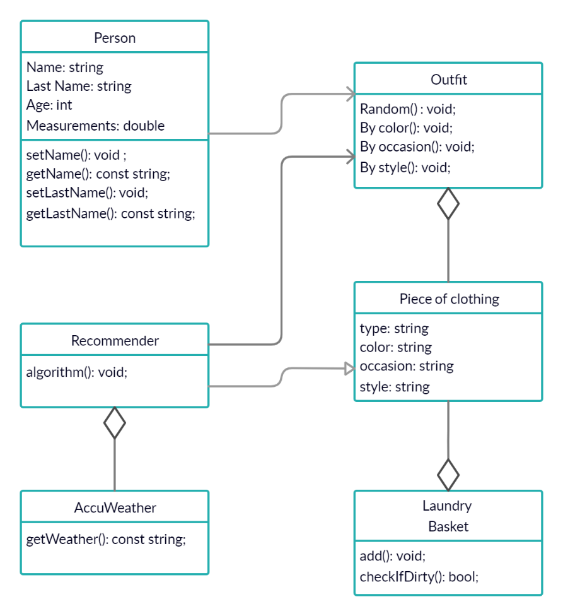
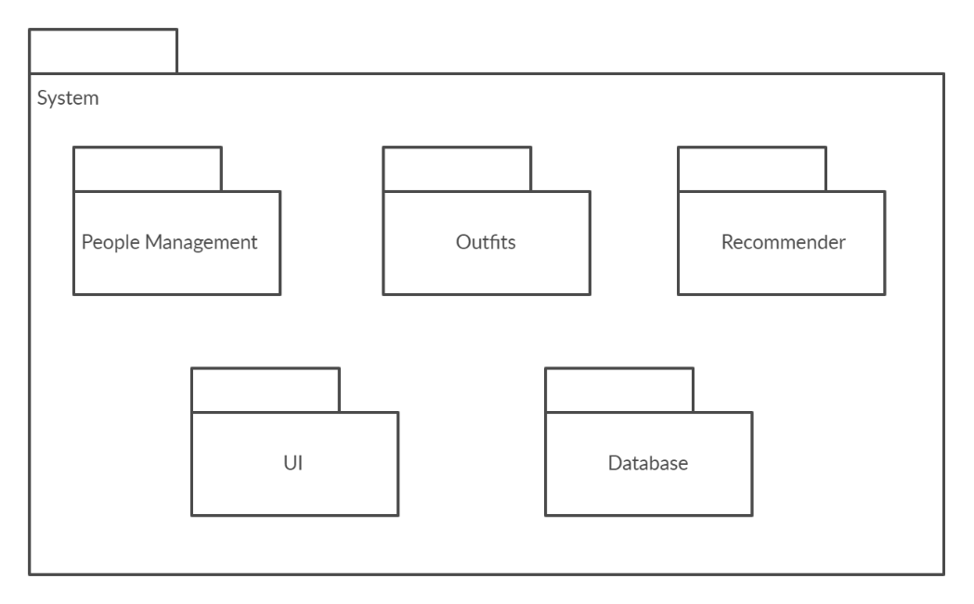
Package and class diagrams

Slide 21
Future directions for development
Make Visual Stylist part of people’s agenda.
Even more realistic 3D figure view.
Offer more options to the user.

