Slide 1
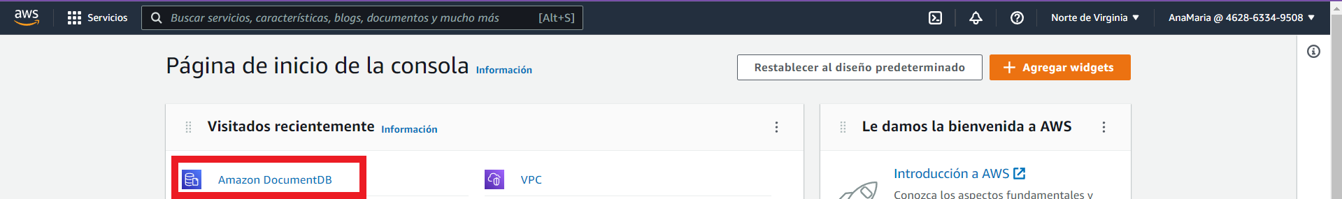
AWS SECRET MANAGER + SPRING BOOT.

Slide 2
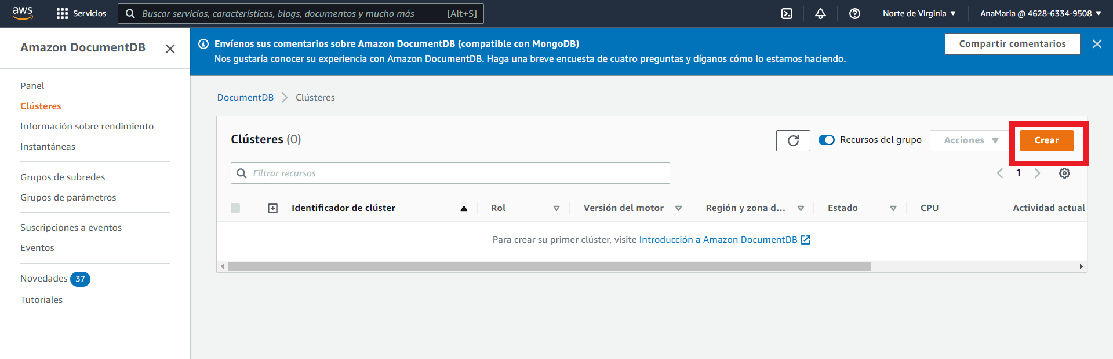

Slide 3
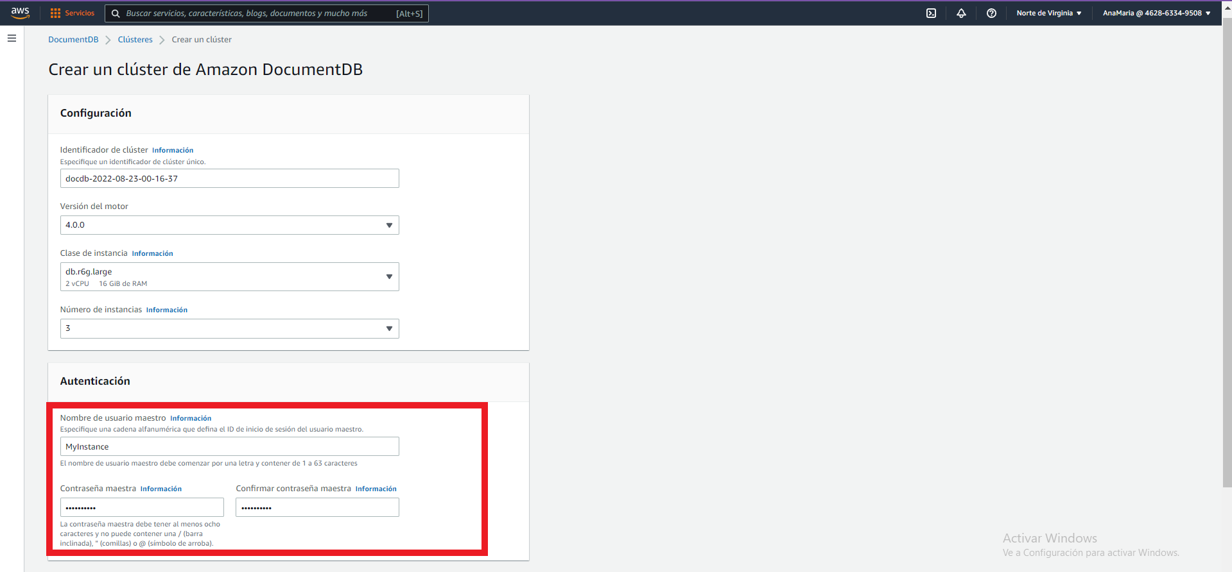

Slide 4
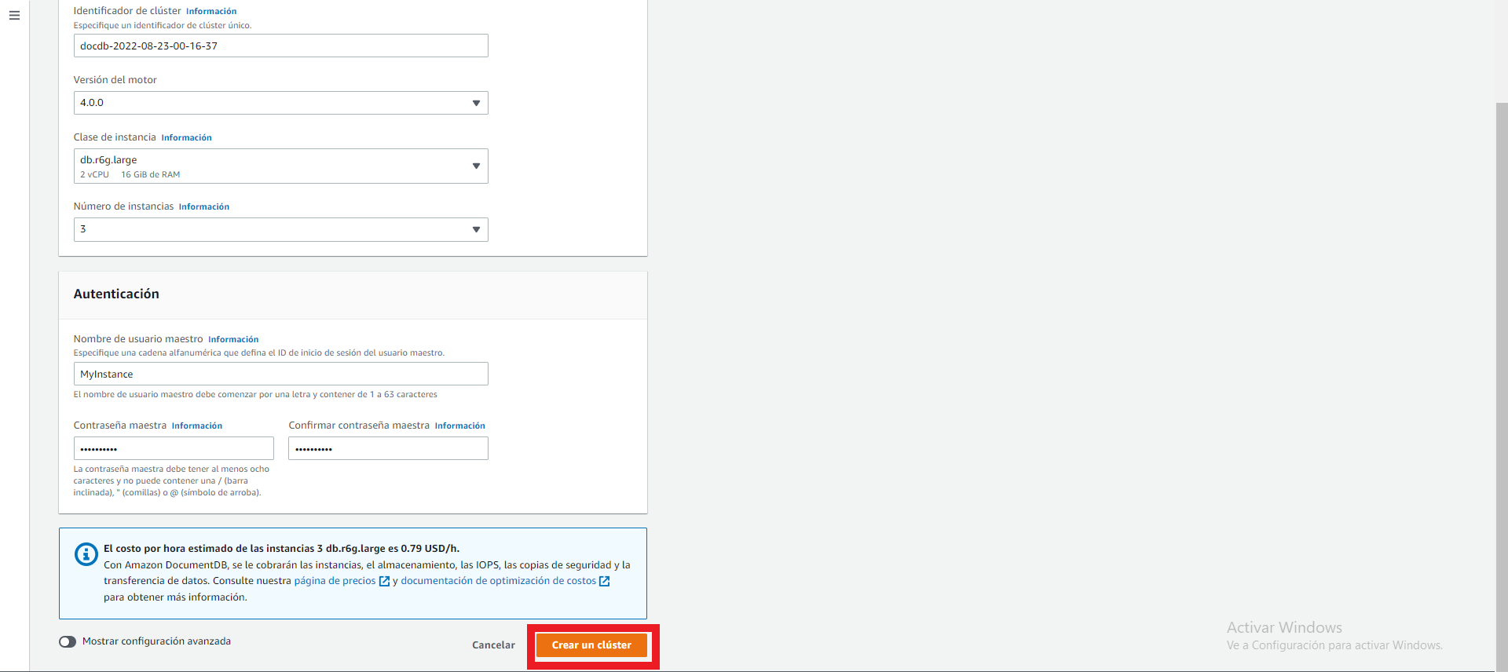

Slide 5
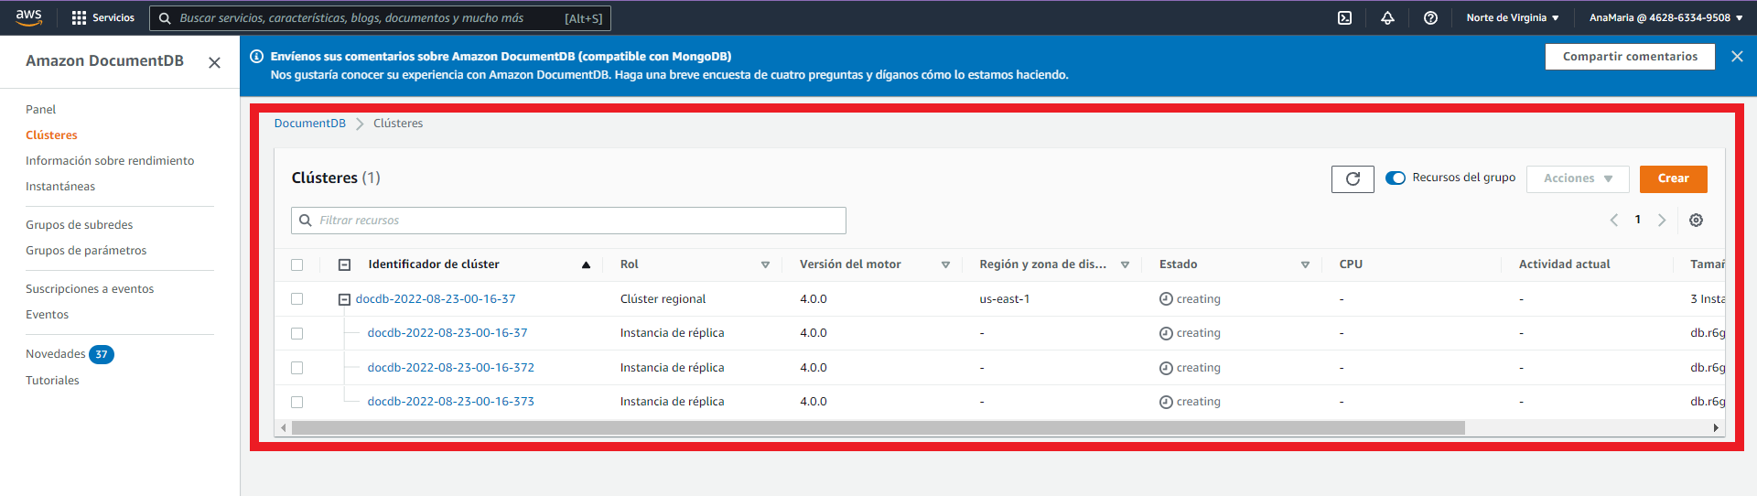

Slide 6
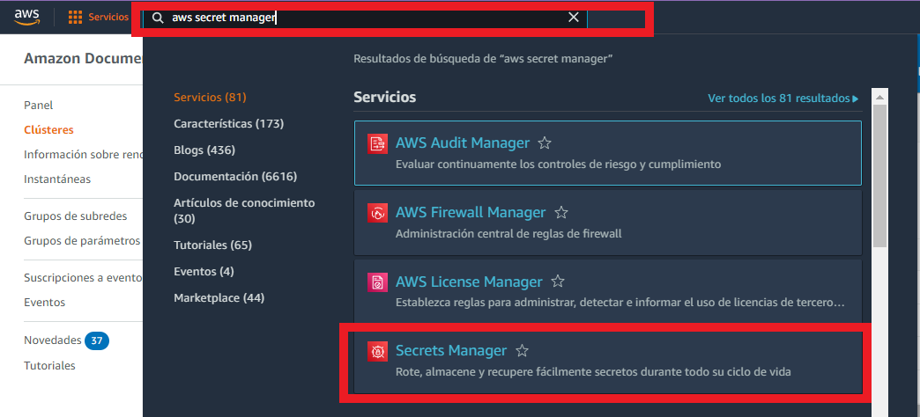

Slide 7
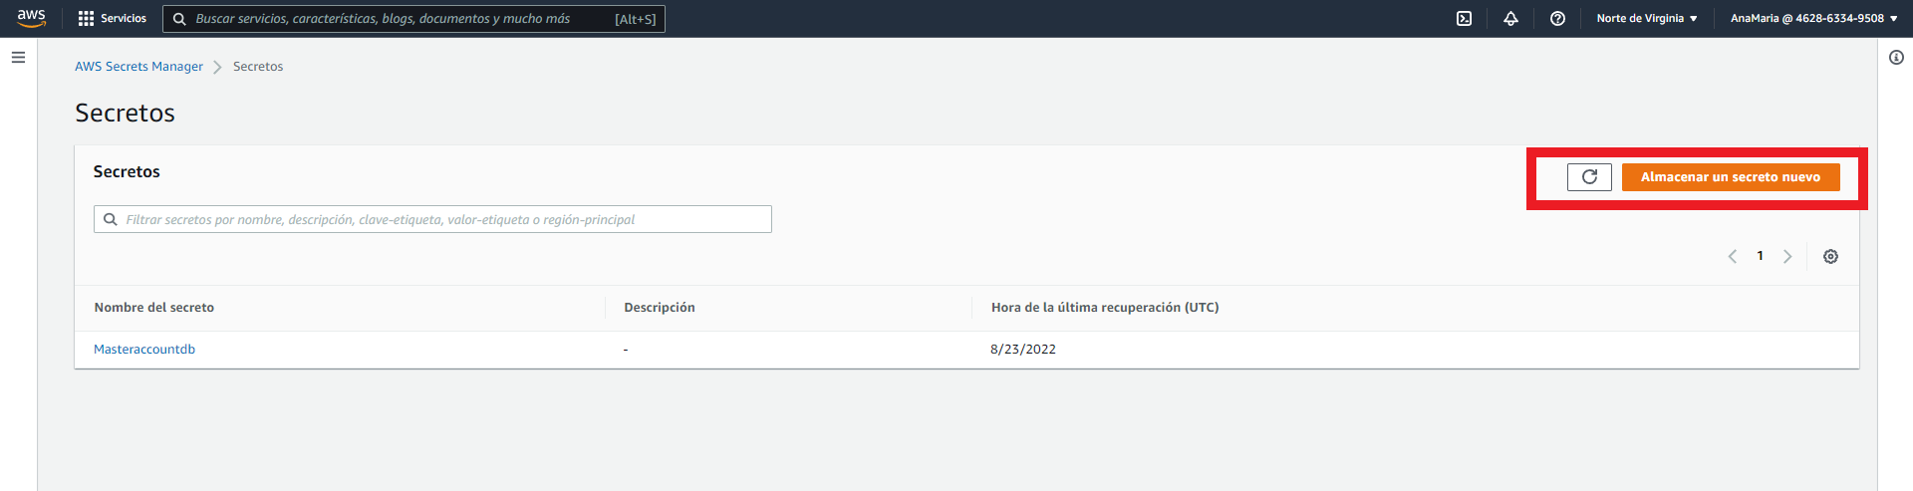

Slide 8
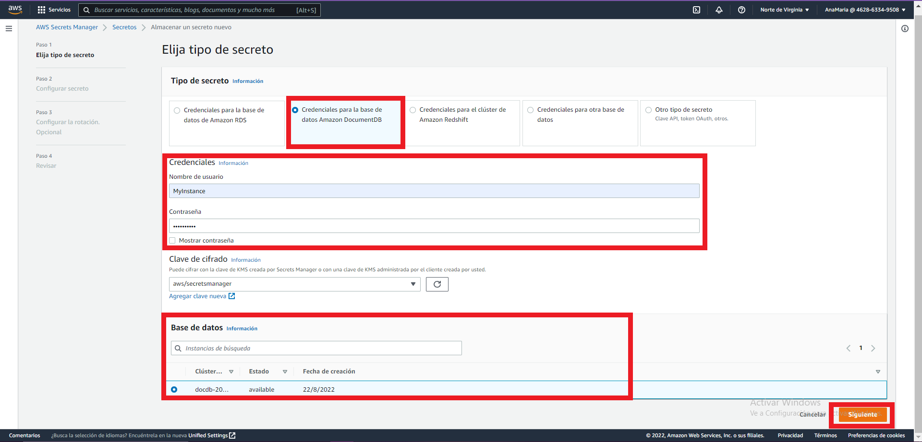

Slide 9
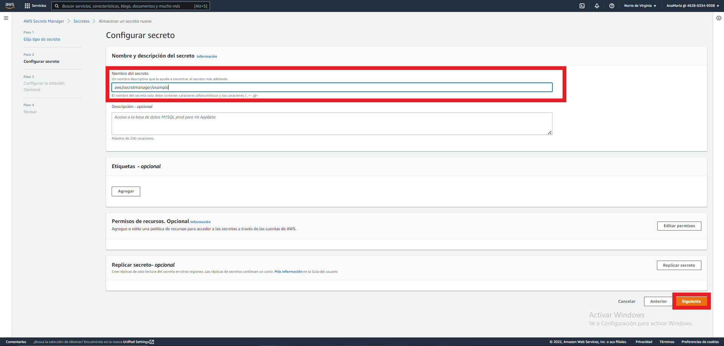

Slide 10
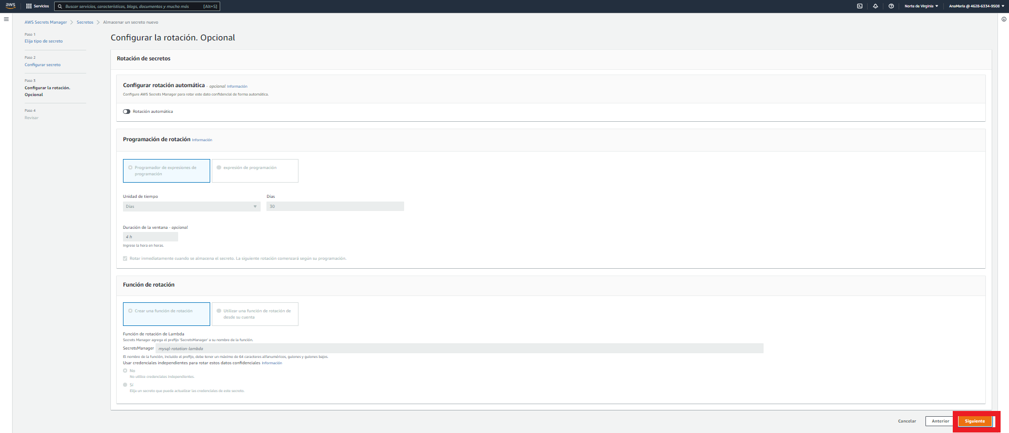

Slide 11
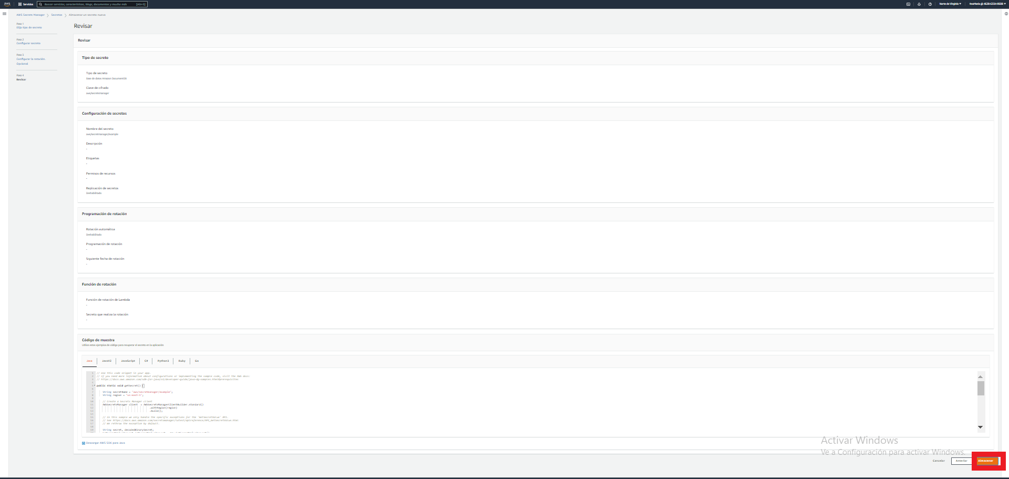

Slide 12
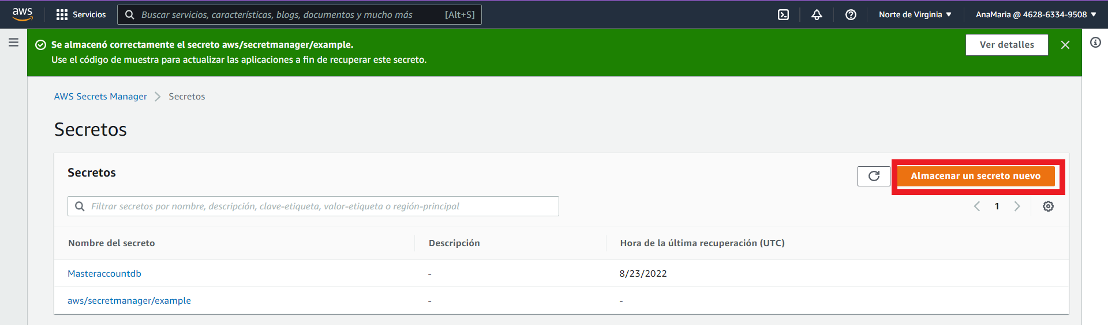

Slide 13
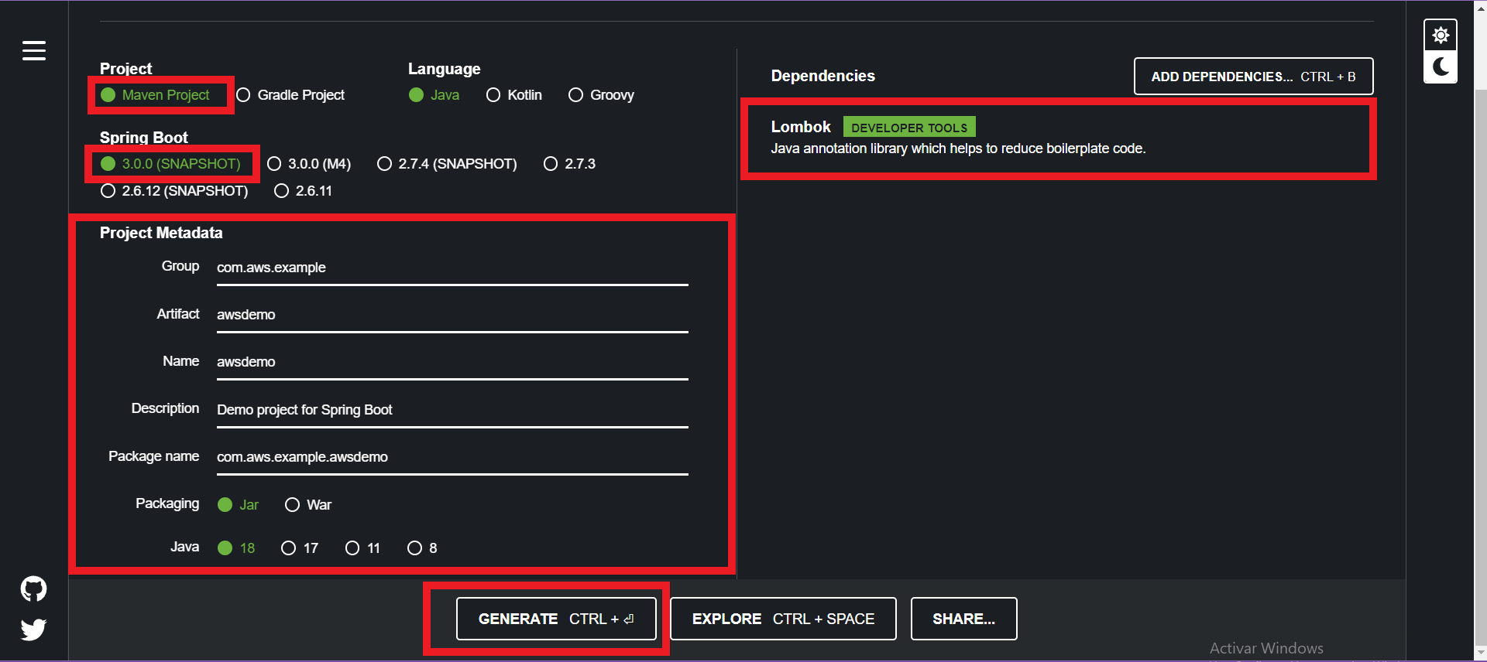
https://start.spring.io/

Slide 14
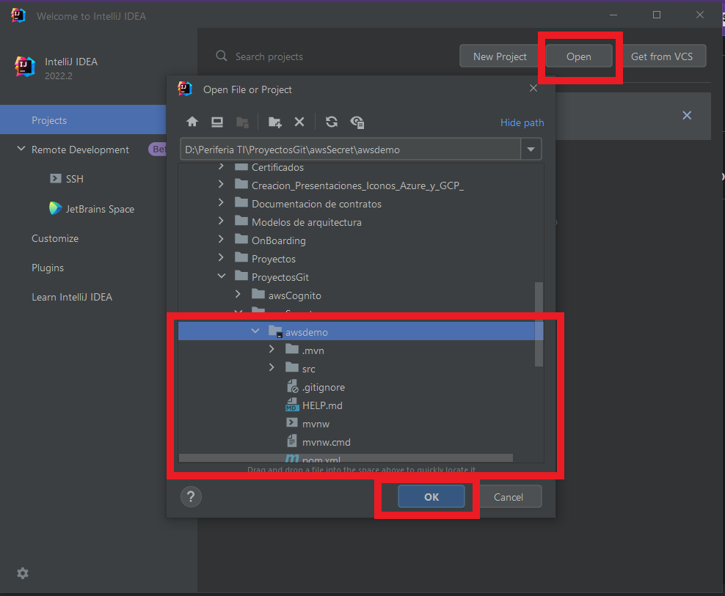

Slide 15
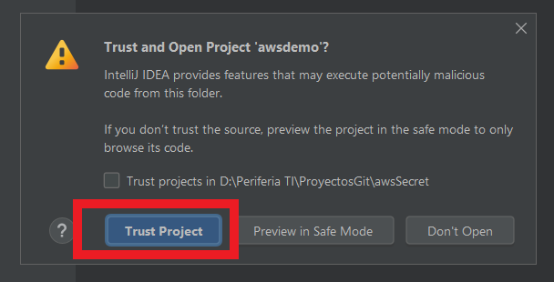

Slide 16
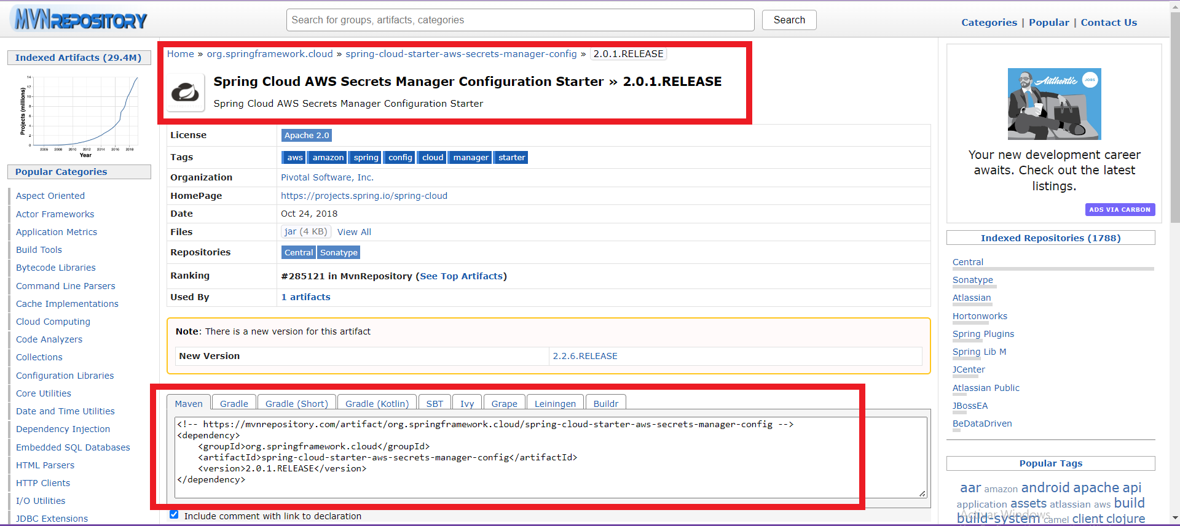
https://maven.apache.org/configure.html
https://mvnrepository.com/artifact/io.awspring.cloud/spring-cloud-starter-aws-secrets-manager-config
https://mvnrepository.com/artifact/org.springframework.cloud/spring-cloud-starter-aws-secrets-manager-config/2.0.1.RELEASE
https://mvnrepository.com/artifact/org.springframework.cloud/spring-cloud-aws-core/2.2.6.RELEASE

Slide 17
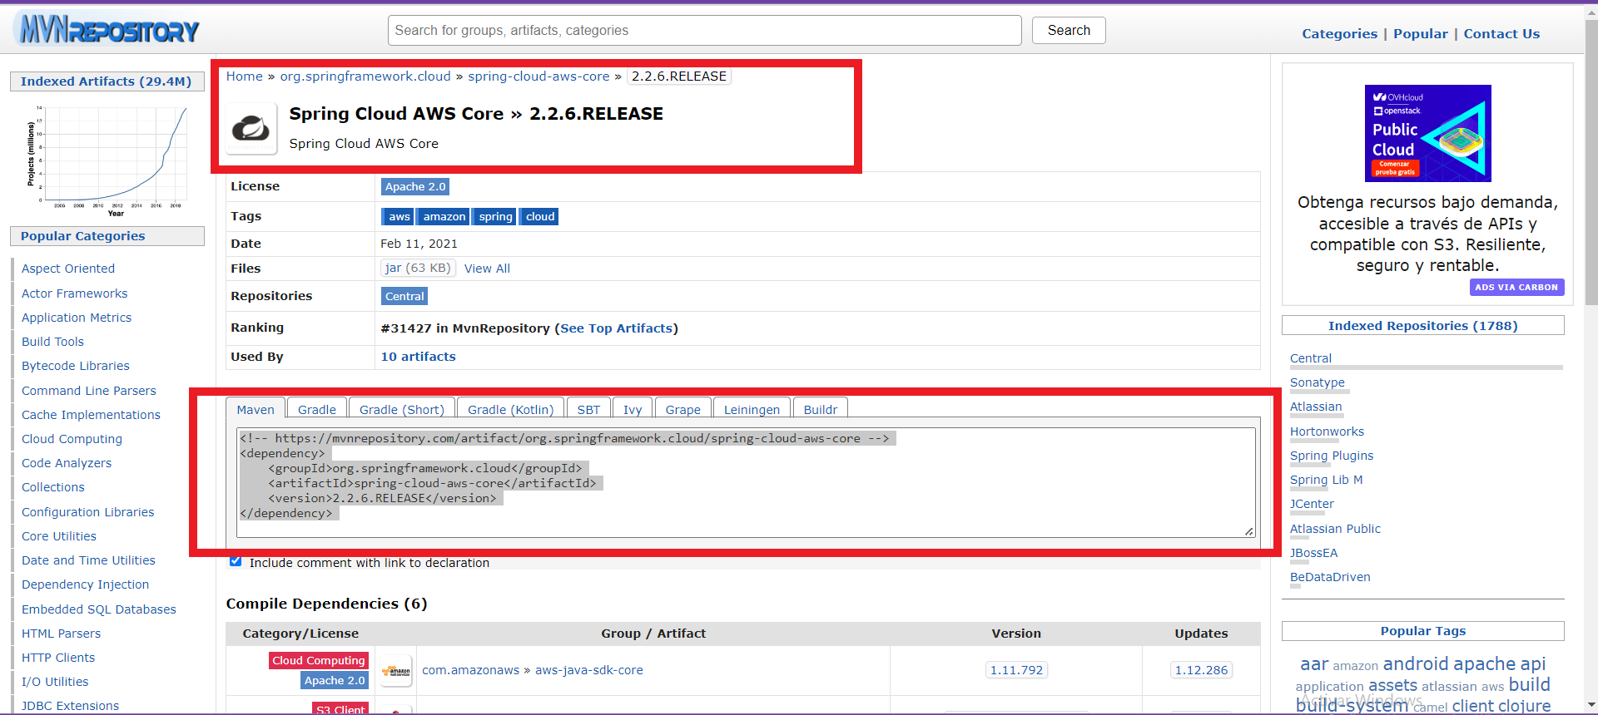

Slide 18
<?xml version="1.0" encoding="UTF-8"?> <project xmlns="http://maven.apache.org/POM/4.0.0" xmlns:xsi="http://www.w3.org/2001/XMLSchema-instance" xsi:schemaLocation="http://maven.apache.org/POM/4.0.0 https://maven.apache.org/xsd/maven-4.0.0.xsd"> <modelVersion>4.0.0</modelVersion> <parent> <groupId>org.springframework.boot</groupId> <artifactId>spring-boot-starter-parent</artifactId> <version>3.0.0-SNAPSHOT</version> <relativePath/> <!-- lookup parent from repository --> </parent> <groupId>com.aws.example</groupId> <artifactId>awsdemo</artifactId> <version>0.0.1-SNAPSHOT</version> <name>awsdemo</name> <description>Demo project for Spring Boot</description> <properties> <java.version>18</java.version> </properties> <dependencies> <dependency> <groupId>org.springframework.boot</groupId> <artifactId>spring-boot-starter</artifactId> </dependency> <dependency> <groupId>org.projectlombok</groupId> <artifactId>lombok</artifactId> <optional>true</optional> </dependency> <dependency> <groupId>org.springframework.boot</groupId> <artifactId>spring-boot-starter-test</artifactId> <scope>test</scope> </dependency> <!-- https://mvnrepository.com/artifact/org.springframework.cloud/spring-cloud-starter-aws-secrets-manager-config --> <dependency> <groupId>org.springframework.cloud</groupId> <artifactId>spring-cloud-starter-aws-secrets-manager-config</artifactId> <version>2.0.1.RELEASE</version> </dependency> <!-- https://mvnrepository.com/artifact/org.springframework.cloud/spring-cloud-aws-core --> <dependency> <groupId>org.springframework.cloud</groupId> <artifactId>spring-cloud-aws-core</artifactId> <version>2.2.6.RELEASE</version> </dependency> </dependencies> <build> <plugins> <plugin> <groupId>org.springframework.boot</groupId> <artifactId>spring-boot-maven-plugin</artifactId> <configuration> <excludes> <exclude> <groupId>org.projectlombok</groupId> <artifactId>lombok</artifactId> </exclude> </excludes> </configuration> </plugin> </plugins> </build> <repositories> <repository> <id>spring-milestones</id> <name>Spring Milestones</name> <url>https://repo.spring.io/milestone</url> <snapshots> <enabled>false</enabled> </snapshots> </repository> <repository> <id>spring-snapshots</id> <name>Spring Snapshots</name> <url>https://repo.spring.io/snapshot</url> <releases> <enabled>false</enabled> </releases> </repository> </repositories> <pluginRepositories> <pluginRepository> <id>spring-milestones</id> <name>Spring Milestones</name> <url>https://repo.spring.io/milestone</url> <snapshots> <enabled>false</enabled> </snapshots> </pluginRepository> <pluginRepository> <id>spring-snapshots</id> <name>Spring Snapshots</name> <url>https://repo.spring.io/snapshot</url> <releases> <enabled>false</enabled> </releases> </pluginRepository> </pluginRepositories> </project>

Slide 19
En todos los archivos que se encuentran en rojo, se deberá entrar a cada uno e instalar pugins

