Slide 1





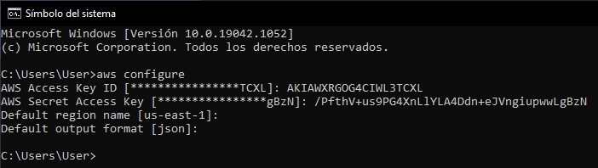

Slide 2
https://registry.terraform.io/providers/hashicorp/aws/latest/docs/resources/iam_role_policy
resource "aws_iam_role_policy" "test_policy" { name = "test_policy" role = aws_iam_role.test_role.id # Terraform's "jsonencode" function converts a # Terraform expression result to valid JSON syntax. policy = jsonencode({ Version = "2012-10-17" Statement = [ { Action = [ "ec2:Describe*", ] Effect = "Allow" Resource = "*" }, ] }) } resource "aws_iam_role" "test_role" { name = "test_role" assume_role_policy = jsonencode({ Version = "2012-10-17" Statement = [ { Action = "sts:AssumeRole" Effect = "Allow" Sid = "" Principal = { Service = "ec2.amazonaws.com" } }, ] }) }
https://awspolicygen.s3.amazonaws.com/policygen.html

Slide 3
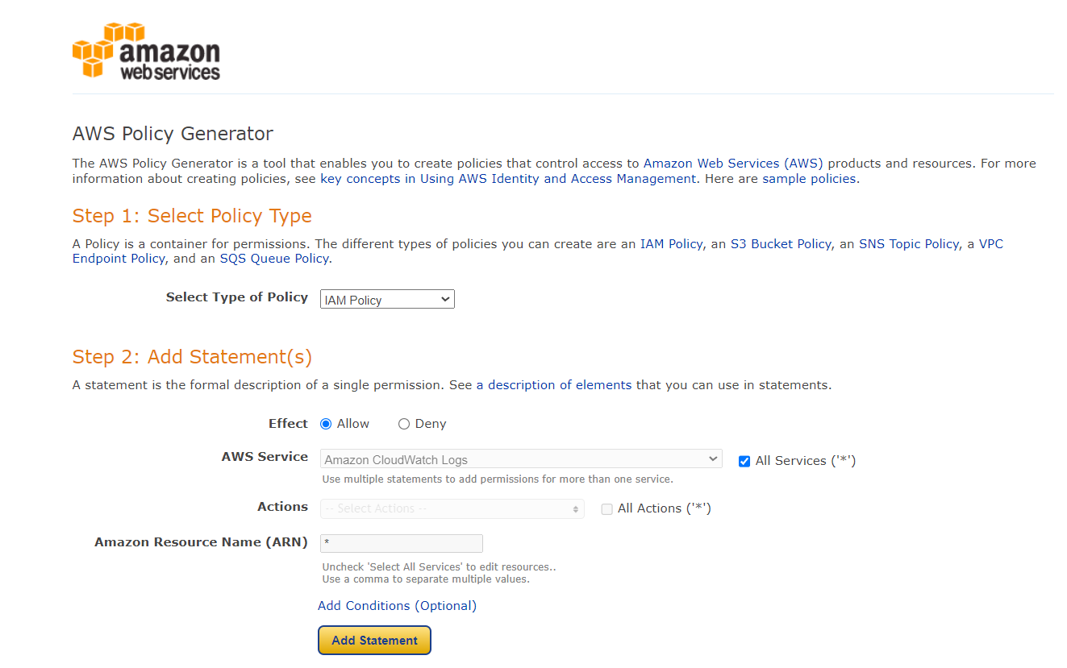
{ "Version": "2012-10-17", "Statement": [ { "Sid": "Stmt1664308685372", "Action": "*", "Effect": "Allow", "Resource": "*" } ] }

Slide 4
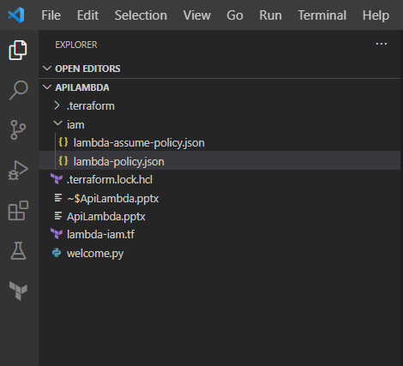

Slide 5
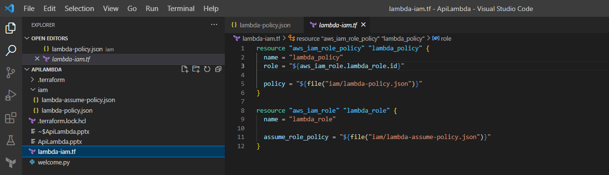
resource "aws_iam_role_policy" "lambda_policy" {
name = "lambda_policy"
role = "${aws_iam_role.lambda_role.id}"
policy = "${file("iam/lambda-policy.json")}"
}
resource "aws_iam_role" "lambda_role" {
name = "lambda_role"
assume_role_policy = "${file("iam/lambda-assume-policy.json")}"
}

Slide 6
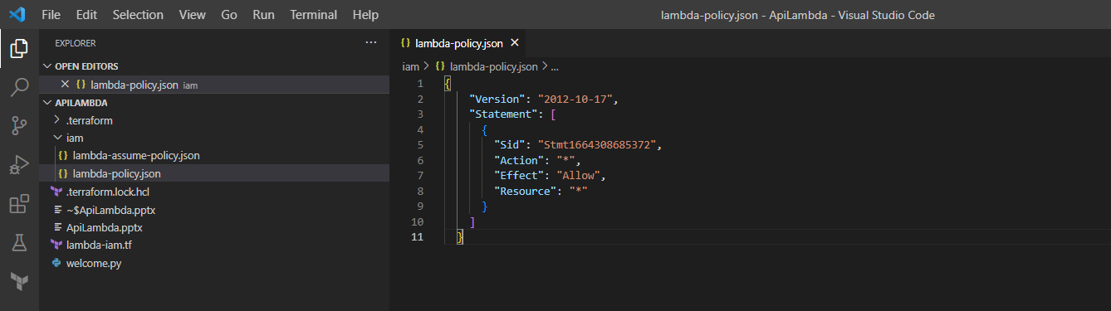
{
"Version": "2012-10-17",
"Statement": [
{
"Sid": "Stmt1664308685372",
"Action": "*",
"Effect": "Allow",
"Resource": "*"
}
]
}

Slide 7
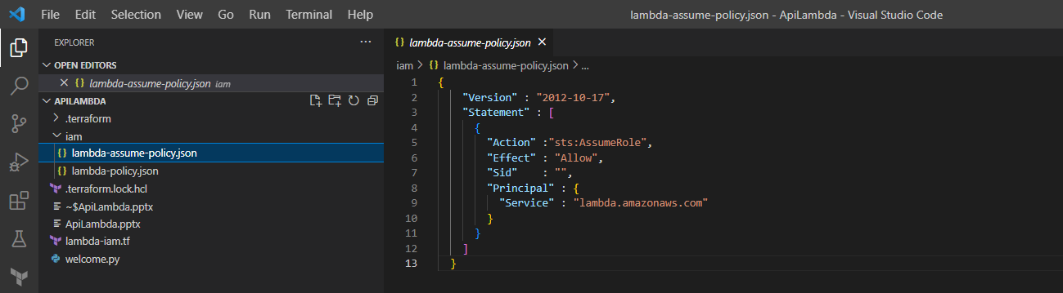
{
"Version" : "2012-10-17",
"Statement" : [
{
"Action" :"sts:AssumeRole",
"Effect" : "Allow",
"Sid" : "",
"Principal" : {
"Service" : "lambda.amazonaws.com"
}
}
]
}

Slide 8
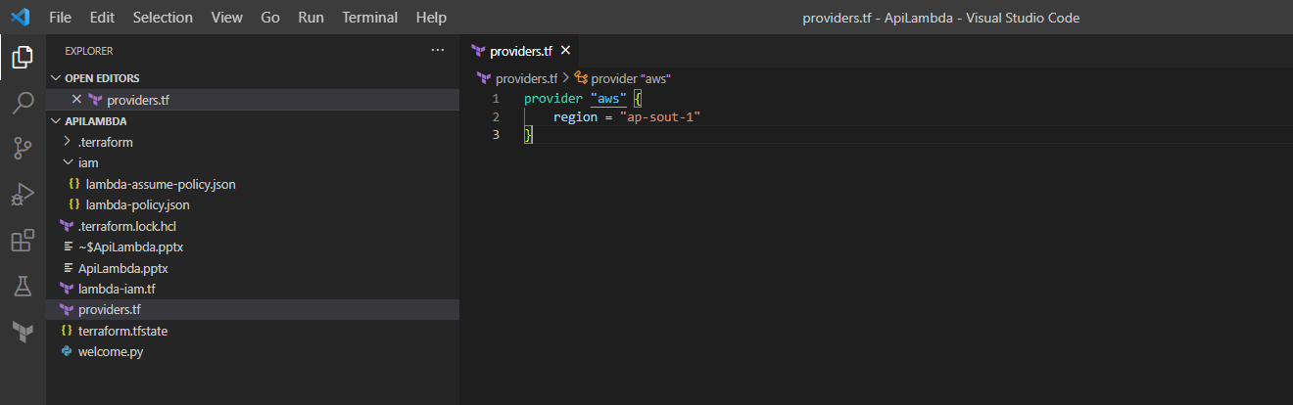
terraform apply -auto-approve

Slide 9
https://registry.terraform.io/providers/hashicorp/aws/latest/docs/resources/lambda_function
resource "aws_lambda_function" "test_lambda" { # If the file is not in the current working directory you will need to include a # path.module in the filename. filename = "lambda_function_payload.zip" function_name = "lambda_function_name" role = aws_iam_role.iam_for_lambda.arn handler = "index.test" # The filebase64sha256() function is available in Terraform 0.11.12 and later # For Terraform 0.11.11 and earlier, use the base64sha256() function and the file() function: # source_code_hash = "${base64sha256(file("lambda_function_payload.zip"))}" source_code_hash = filebase64sha256("lambda_function_payload.zip") runtime = "nodejs12.x" environment { variables = { foo = "bar" } } }

Slide 10
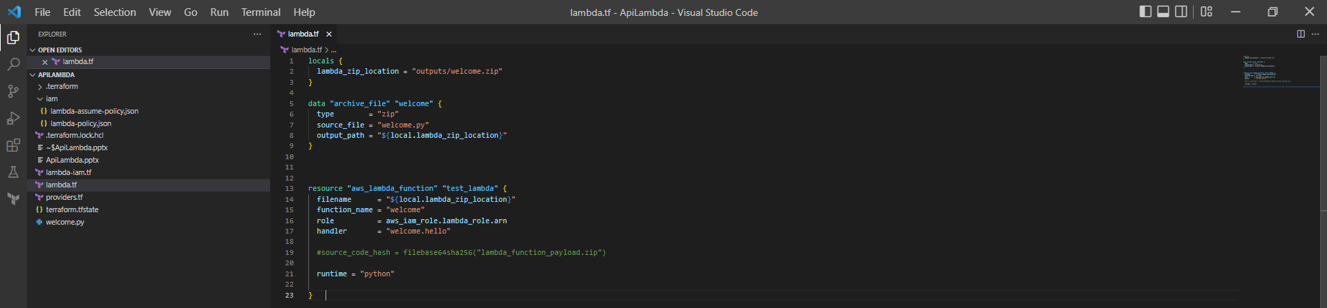
locals {
lambda_zip_location = "outputs/welcome.zip"
}
data "archive_file" "welcome" {
type = "zip"
source_file = "welcome.py"
output_path = "${local.lambda_zip_location}"
}
resource "aws_lambda_function" "test_lambda" {
filename = "${local.lambda_zip_location}"
function_name = "welcome"
role = aws_iam_role.lambda_role.arn
handler = "welcome.hello"
#source_code_hash = filebase64sha256("lambda_function_payload.zip")
runtime = "python3.7"
}

Slide 11
https://registry.terraform.io/providers/hashicorp/archive/latest/docs/data-sources/archive_file
data "archive_file" "init" { type = "zip" source_file = "${path.module}/init.tpl" output_path = "${path.module}/files/init.zip" }
terraform apply -auto-approve

Slide 12
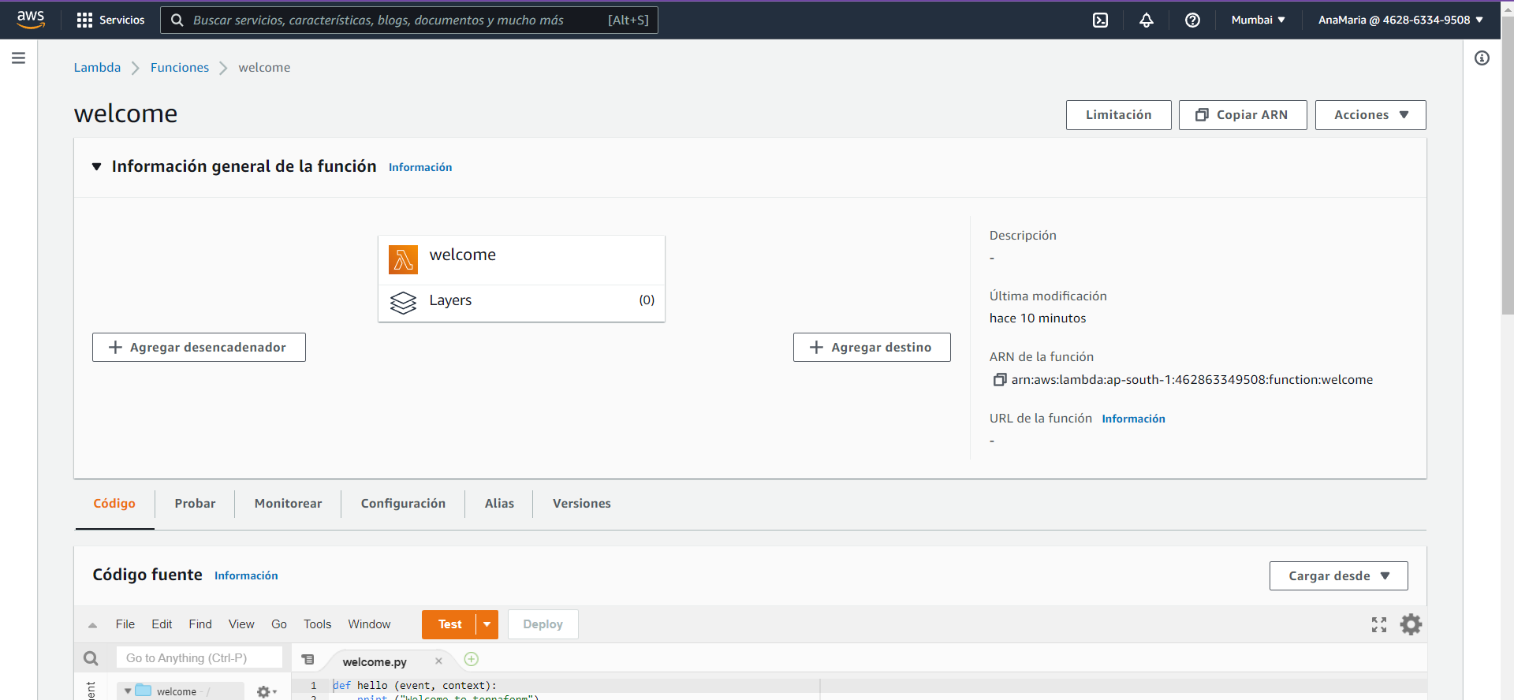

Slide 13
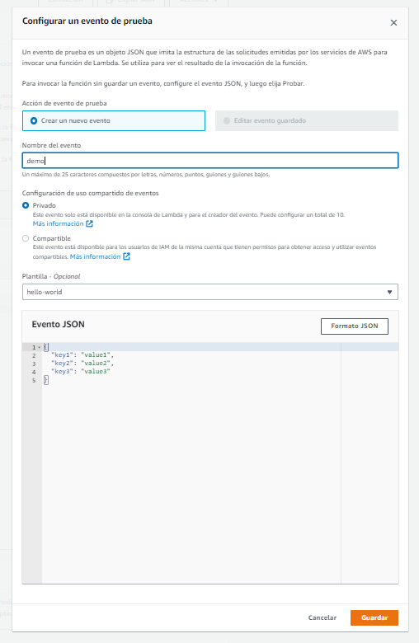

Slide 14
