Slide 1
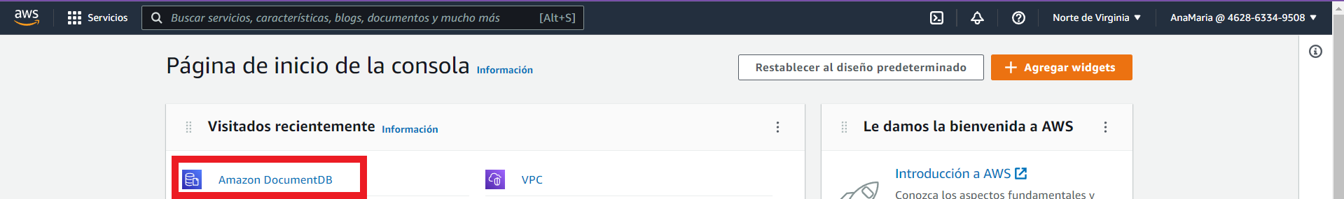
AWS SECRET MANAGER + SPRING BOOT.

Slide 2
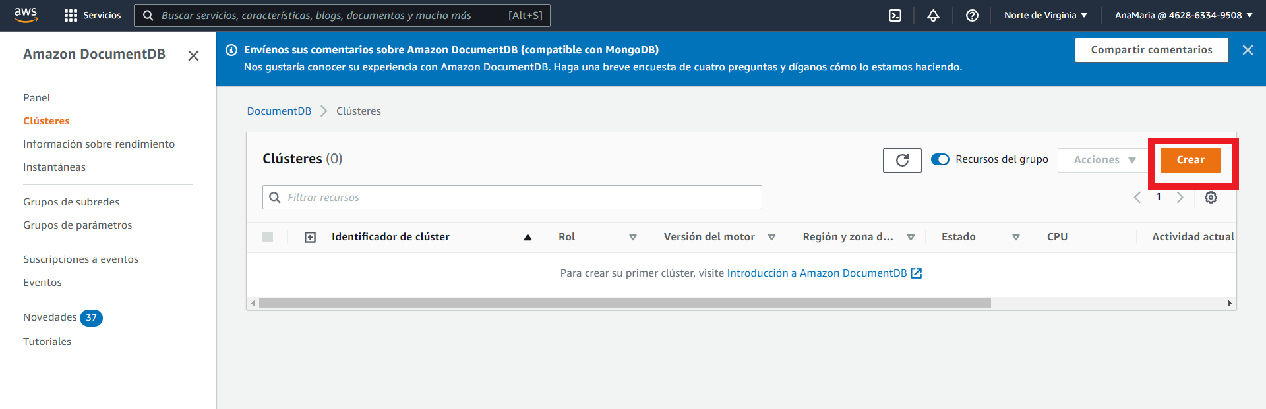

Slide 3
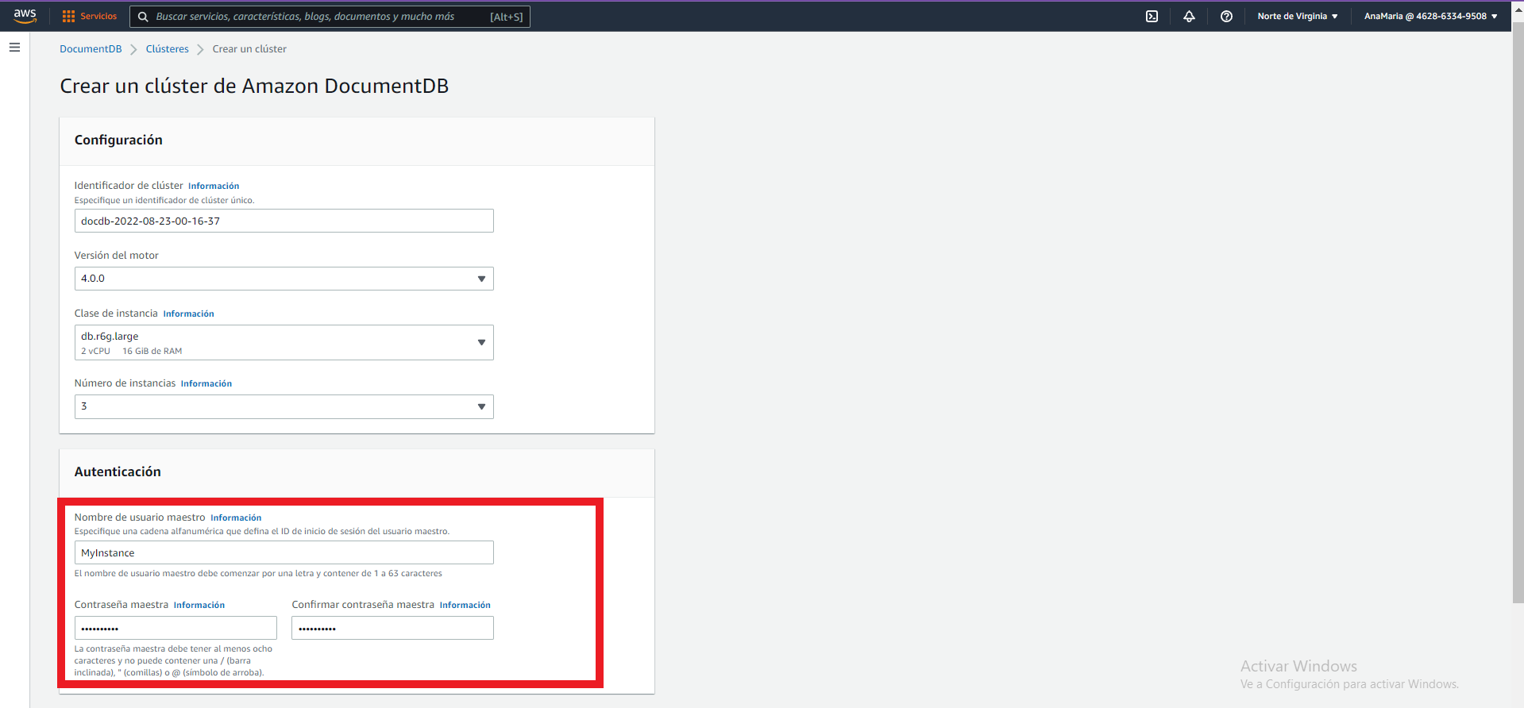

Slide 4
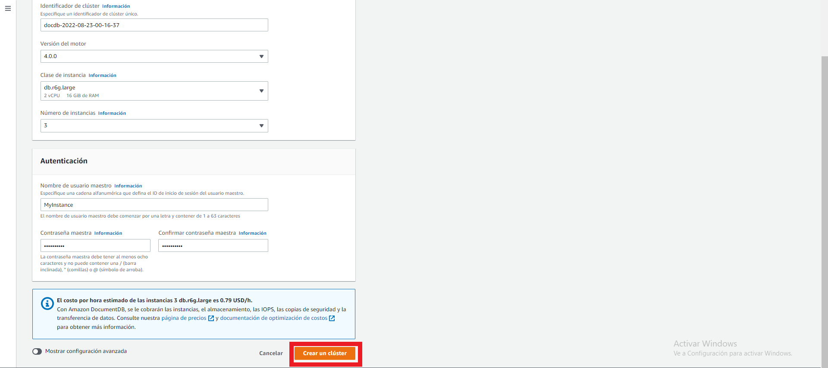

Slide 5
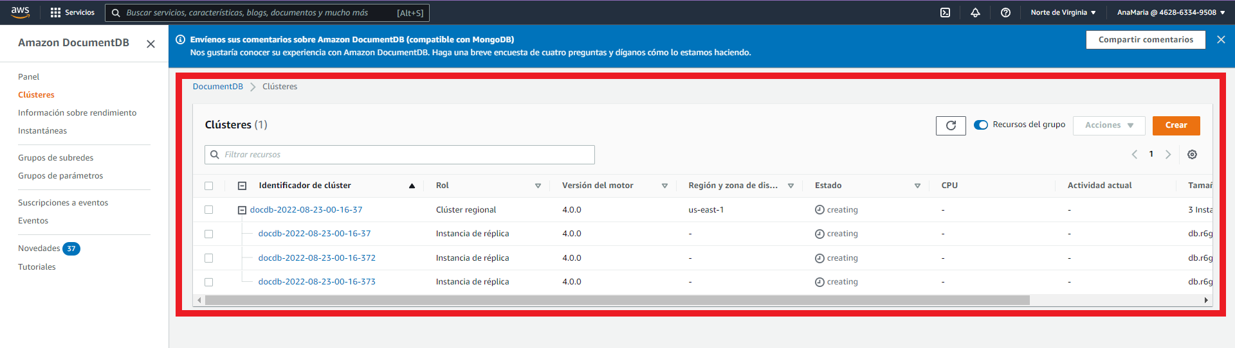

Slide 6
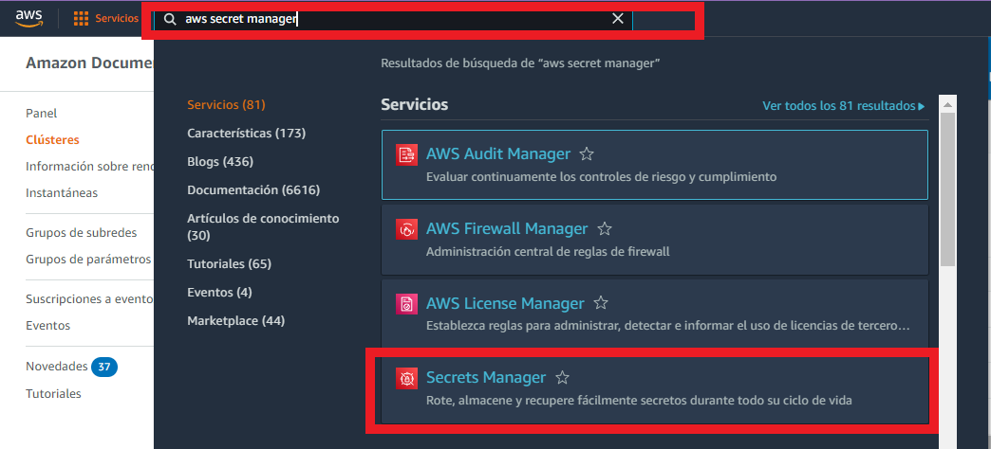

Slide 7
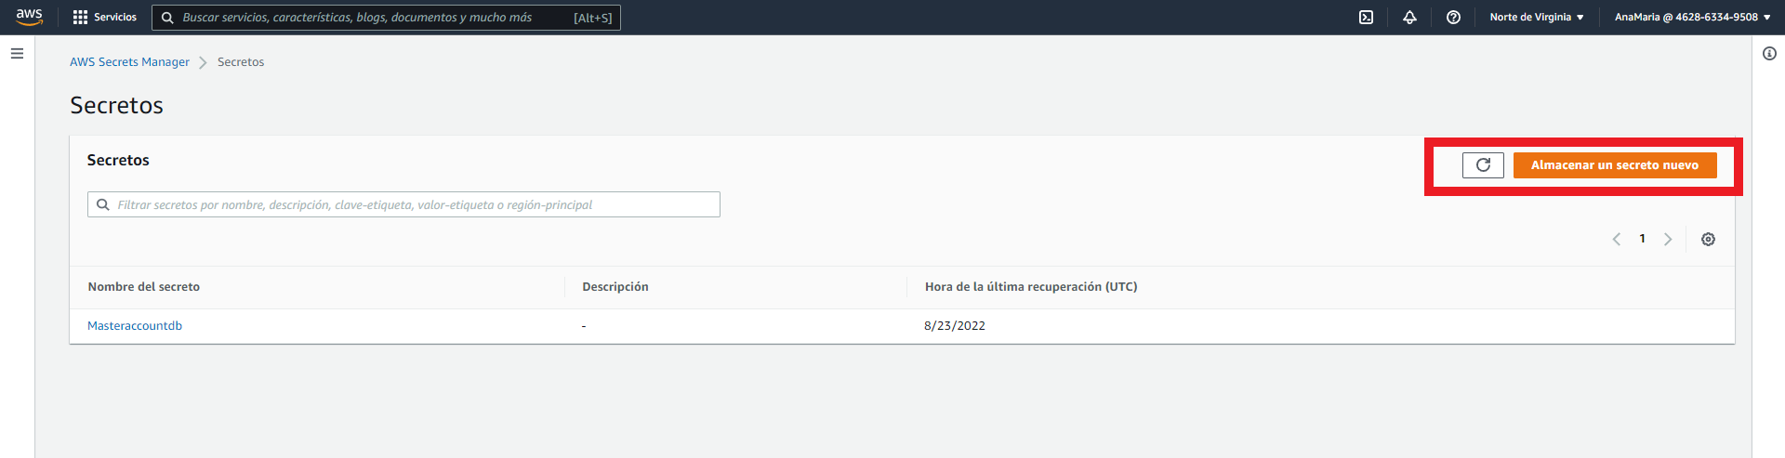

Slide 8
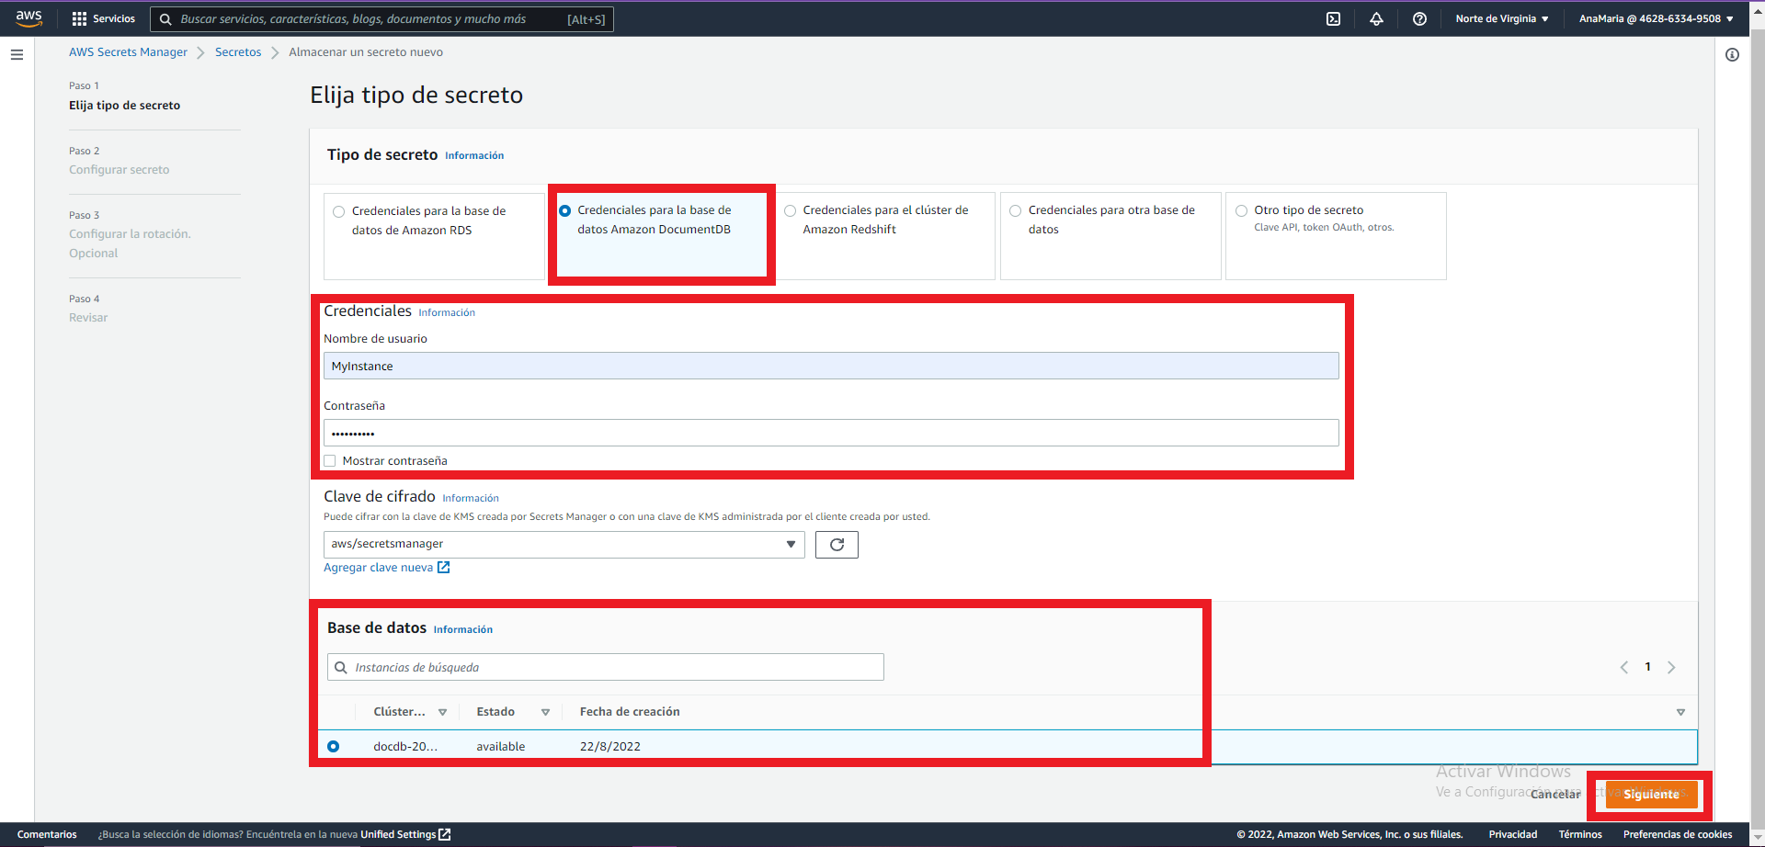

Slide 9
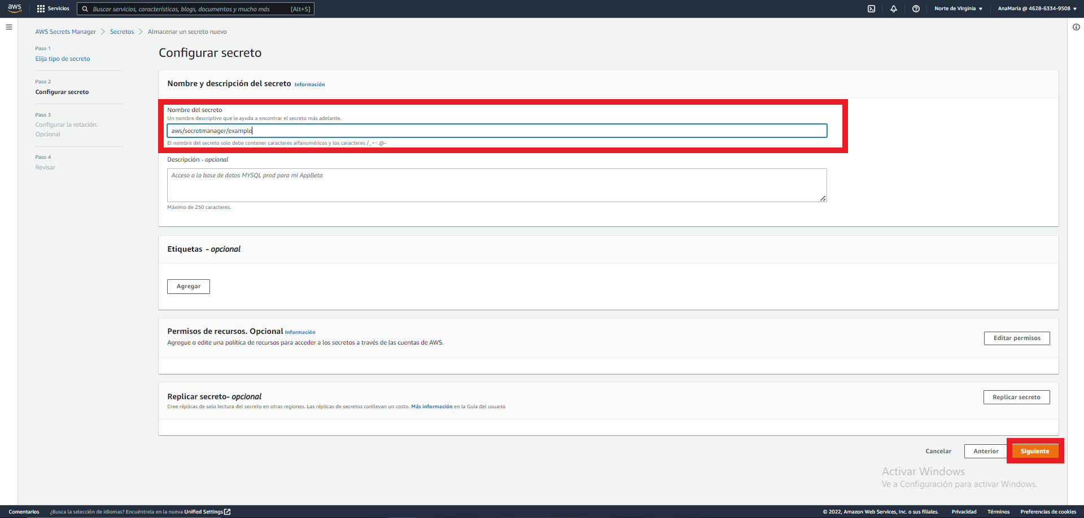

Slide 10
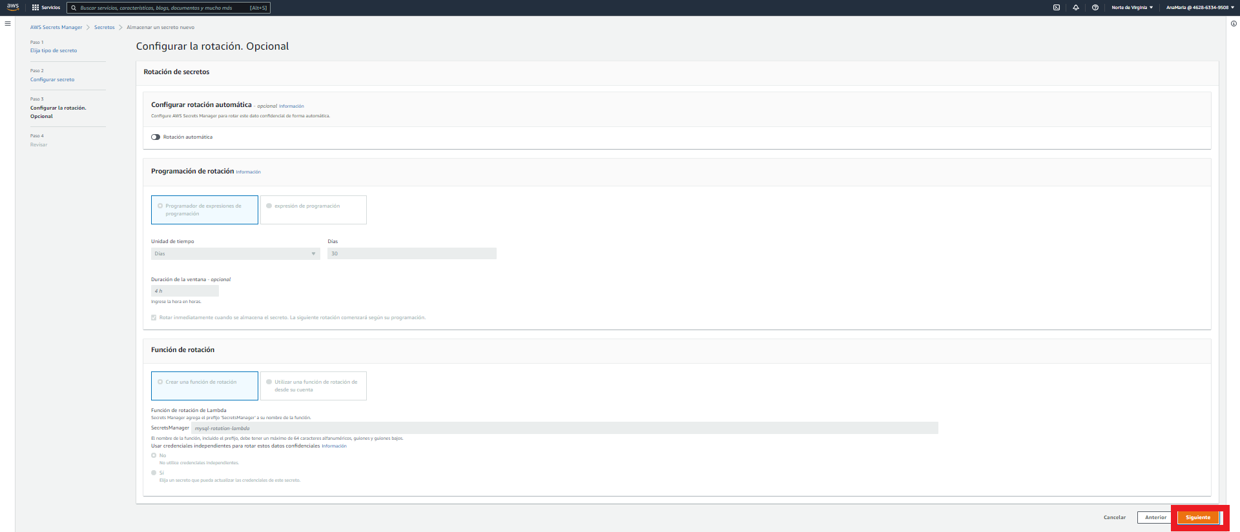

Slide 11
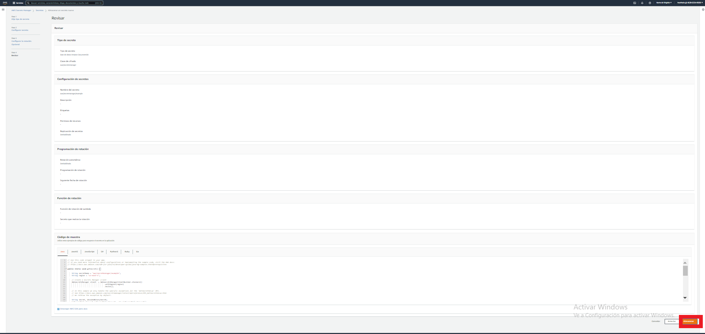

Slide 12
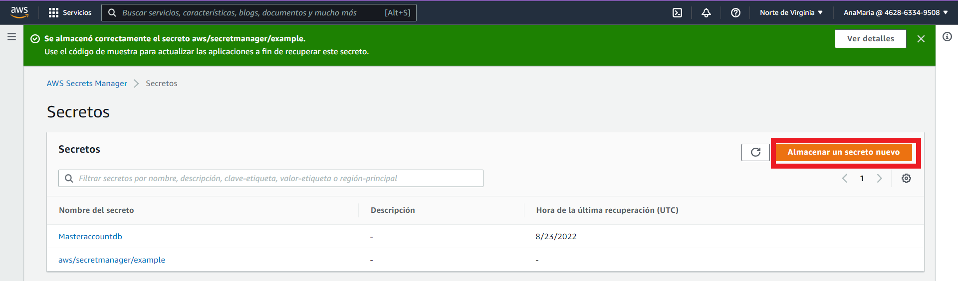

Slide 13
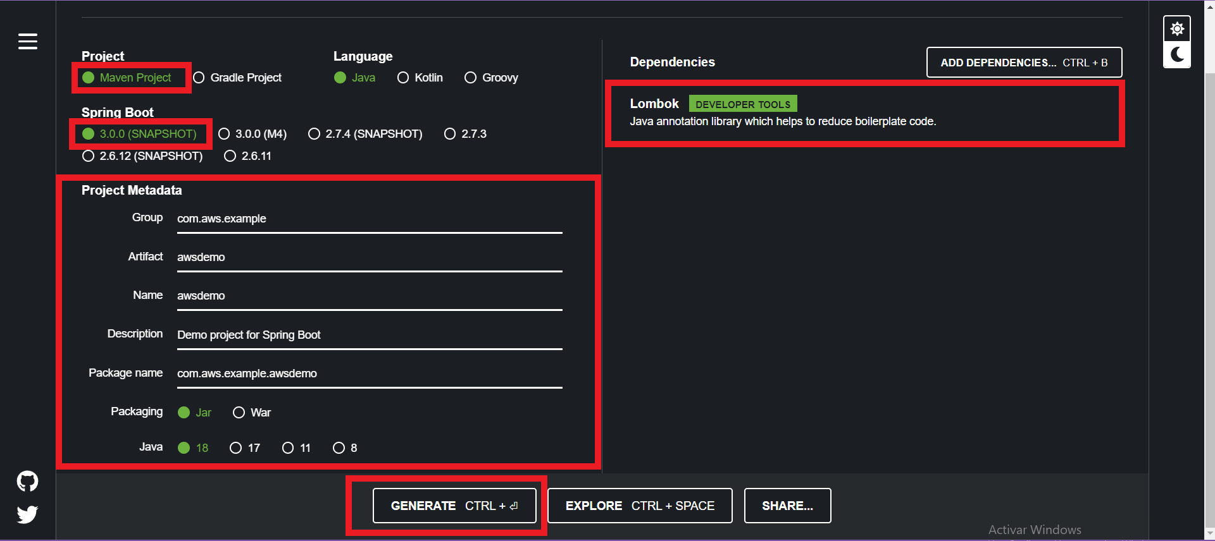
https://start.spring.io/

Slide 14
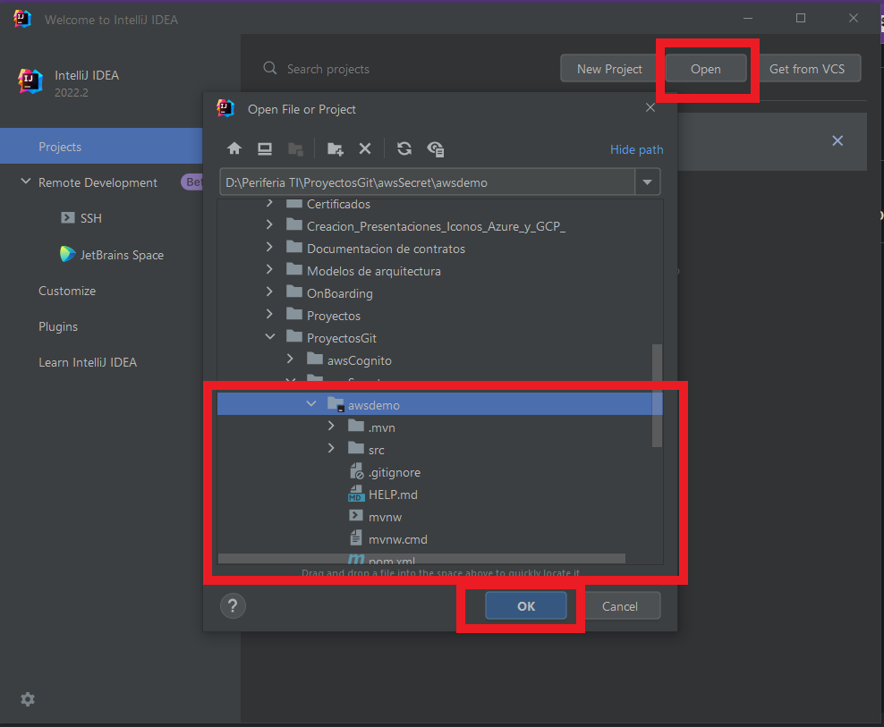

Slide 15
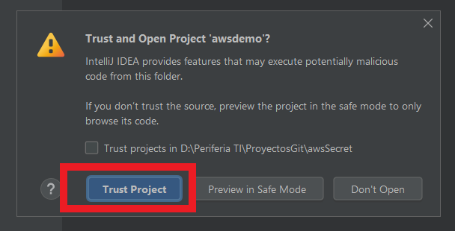

Slide 16
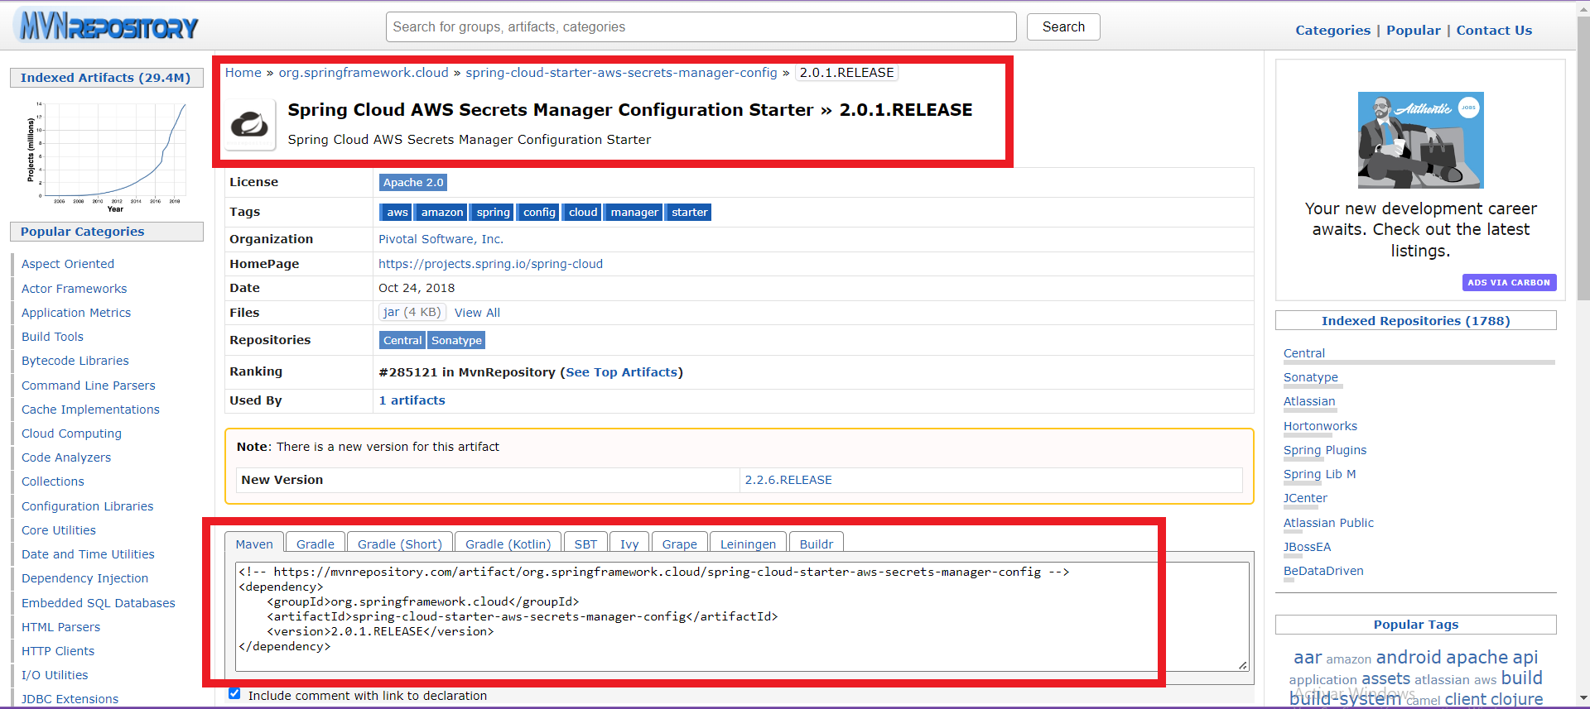
https://maven.apache.org/configure.html
https://mvnrepository.com/artifact/io.awspring.cloud/spring-cloud-starter-aws-secrets-manager-config
https://mvnrepository.com/artifact/org.springframework.cloud/spring-cloud-starter-aws-secrets-manager-config/2.0.1.RELEASE
https://mvnrepository.com/artifact/org.springframework.cloud/spring-cloud-aws-core/2.2.6.RELEASE

Slide 17
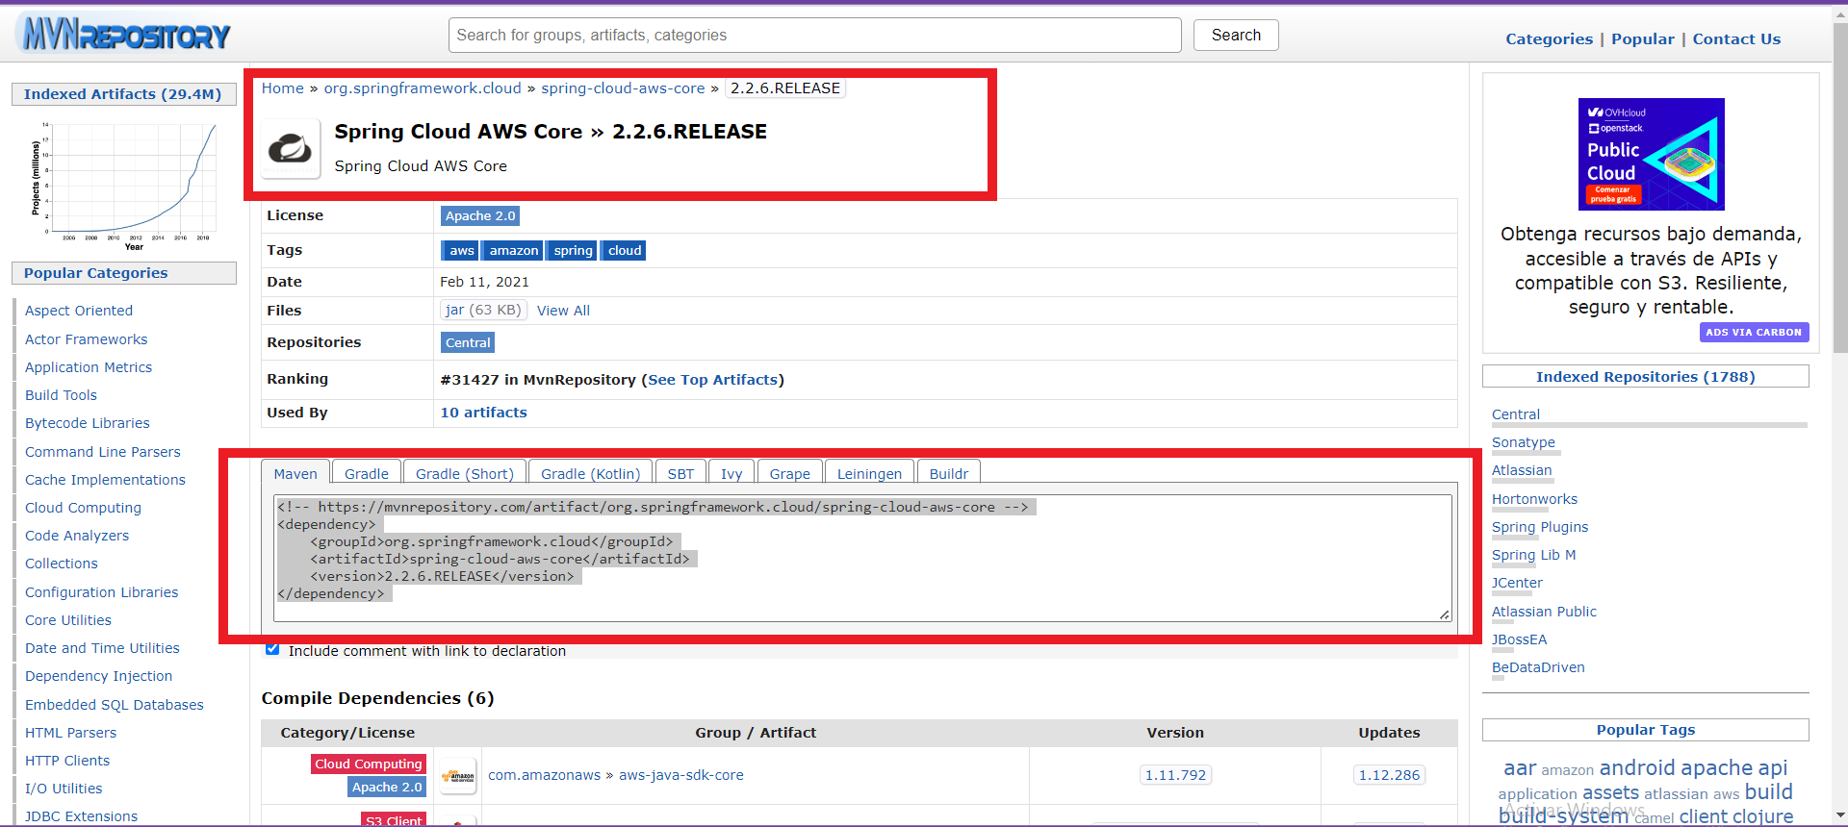

Slide 18
<?xml version="1.0" encoding="UTF-8"?> <project xmlns="http://maven.apache.org/POM/4.0.0" xmlns:xsi="http://www.w3.org/2001/XMLSchema-instance" xsi:schemaLocation="http://maven.apache.org/POM/4.0.0 https://maven.apache.org/xsd/maven-4.0.0.xsd"> <modelVersion>4.0.0</modelVersion> <parent> <groupId>org.springframework.boot</groupId> <artifactId>spring-boot-starter-parent</artifactId> <version>2.3.3.RELEASE</version> <relativePath/> <!-- lookup parent from repository --> </parent> <groupId>com.aws.example</groupId> <artifactId>awsdemo</artifactId> <version>0.0.1-SNAPSHOT</version> <name>awsdemo</name> <description>Demo project for Spring Boot</description> <properties> <java.version>1.8</java.version> <repackage.classifier/> <spring-native.version>0.10.3</spring-native.version> <spring-cloud.version>Hoxton.SR5</spring-cloud.version> </properties> <dependencies> <dependency> <groupId>org.springframework.boot</groupId> <artifactId>spring-boot-starter</artifactId> </dependency> <dependency> <groupId>org.springframework.cloud</groupId> <artifactId>spring-cloud-starter-aws-secrets-manager-config</artifactId> </dependency> <dependency> <groupId>org.springframework.cloud</groupId> <artifactId>spring-cloud-aws-core</artifactId> </dependency> <dependency> <groupId>org.springframework.boot</groupId> <artifactId>spring-boot-starter-web</artifactId> </dependency> <dependency> <groupId>org.projectlombok</groupId> <artifactId>lombok</artifactId> </dependency> </dependencies> <dependencyManagement> <dependencies> <dependency> <groupId>org.springframework.cloud</groupId> <artifactId>spring-cloud-dependencies</artifactId> <version>${spring-cloud.version}</version> <type>pom</type> <scope>import</scope> </dependency> </dependencies> </dependencyManagement> <build> <plugins> <plugin> <groupId>org.springframework.boot</groupId> <artifactId>spring-boot-maven-plugin</artifactId> </plugin> </plugins> </build> <repositories> <repository> <id>spring-releases</id> <name>Spring Releases</name> <url>https://repo.spring.io/release</url> <snapshots> <enabled>false</enabled> </snapshots> </repository> </repositories> <pluginRepositories> <pluginRepository> <id>spring-releases</id> <name>Spring Releases</name> <url>https://repo.spring.io/release</url> <snapshots> <enabled>false</enabled> </snapshots> </pluginRepository> </pluginRepositories> </project>

Slide 19
En todos los archivos que se encuentran en rojo, se deberá entrar a cada uno e instalar pugins

Slide 20
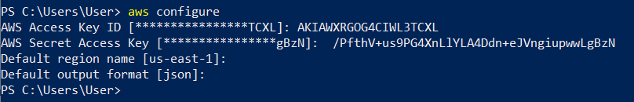
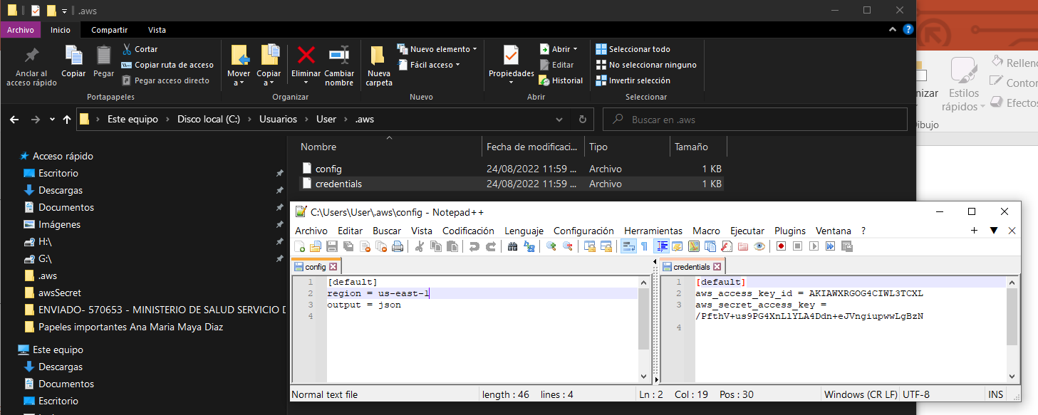
https://docs.aws.amazon.com/es_es/cli/latest/userguide/getting-started-install.html
https://awscli.amazonaws.com/AWSCLIV2.msi

Slide 21
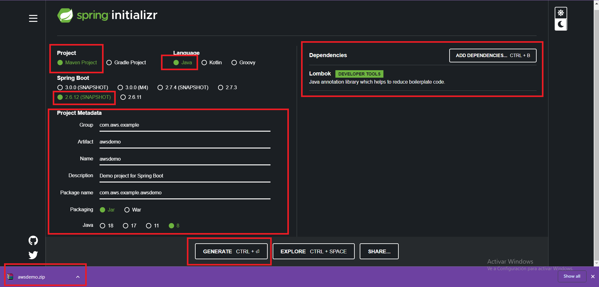

Slide 22
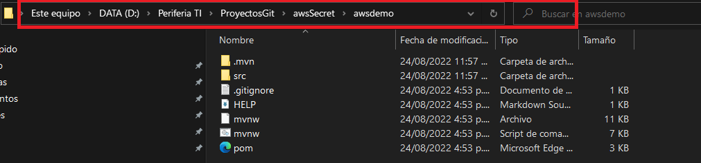

Slide 23
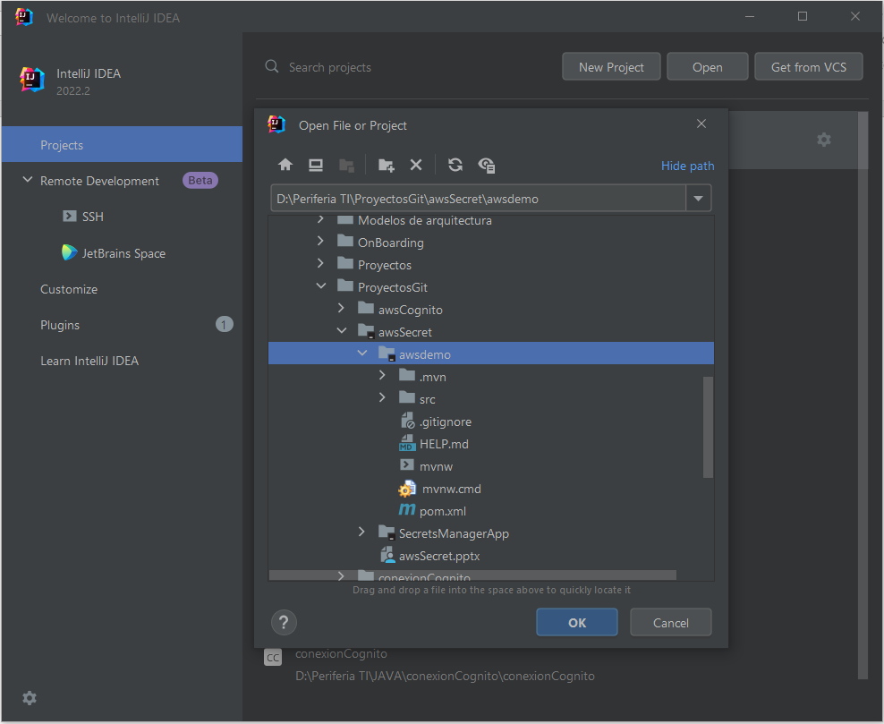

Slide 24
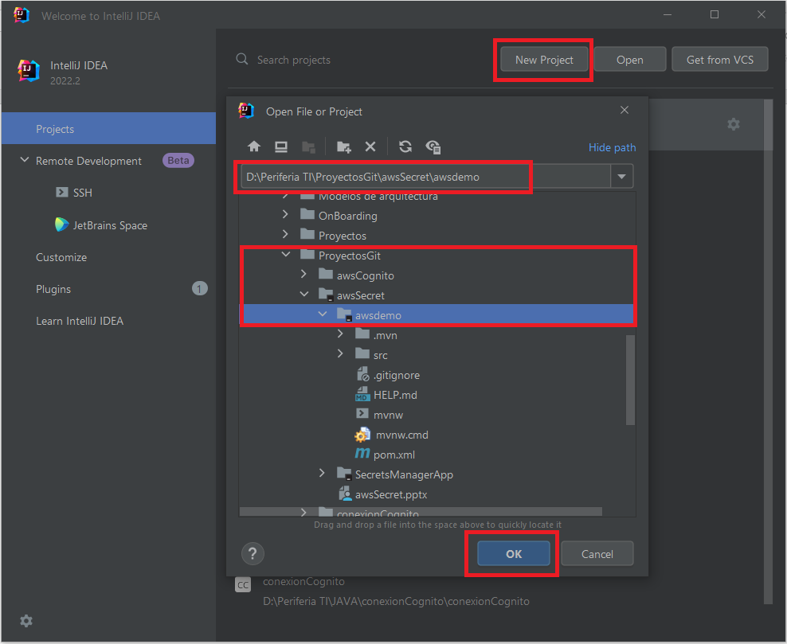

Slide 25
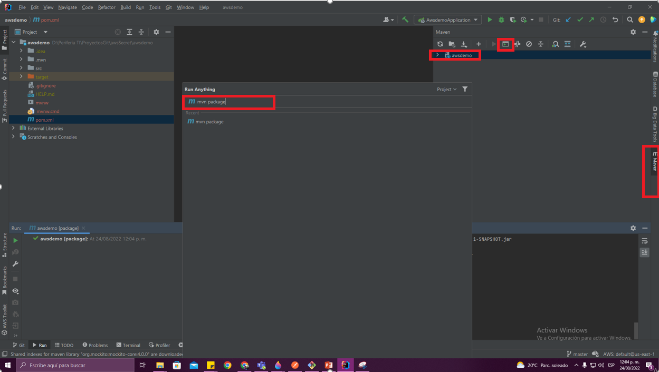

Slide 26
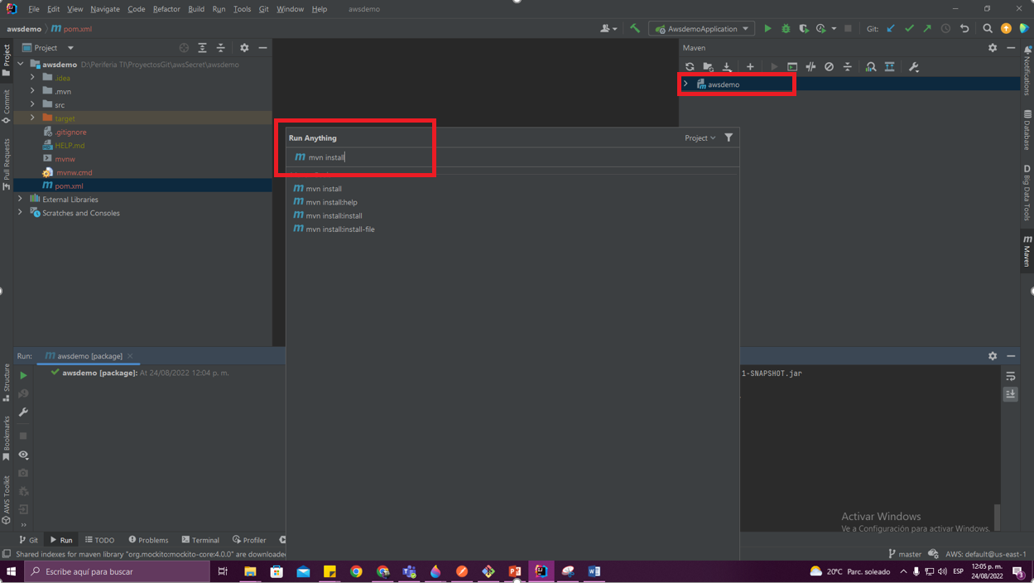

Slide 27
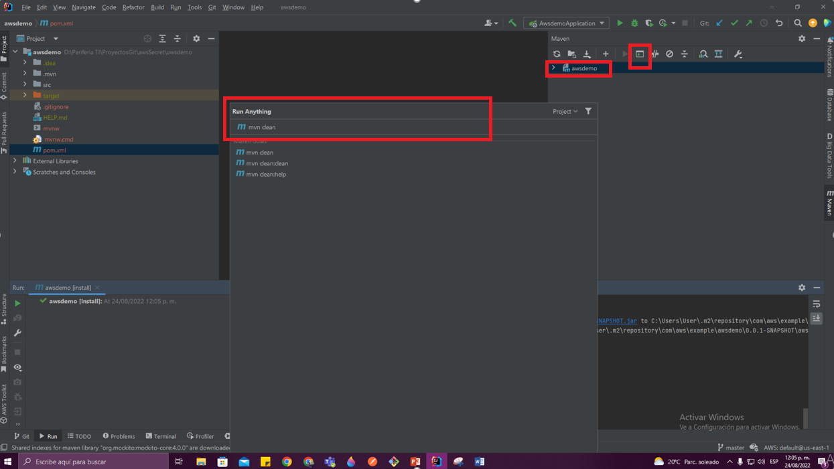

Slide 28
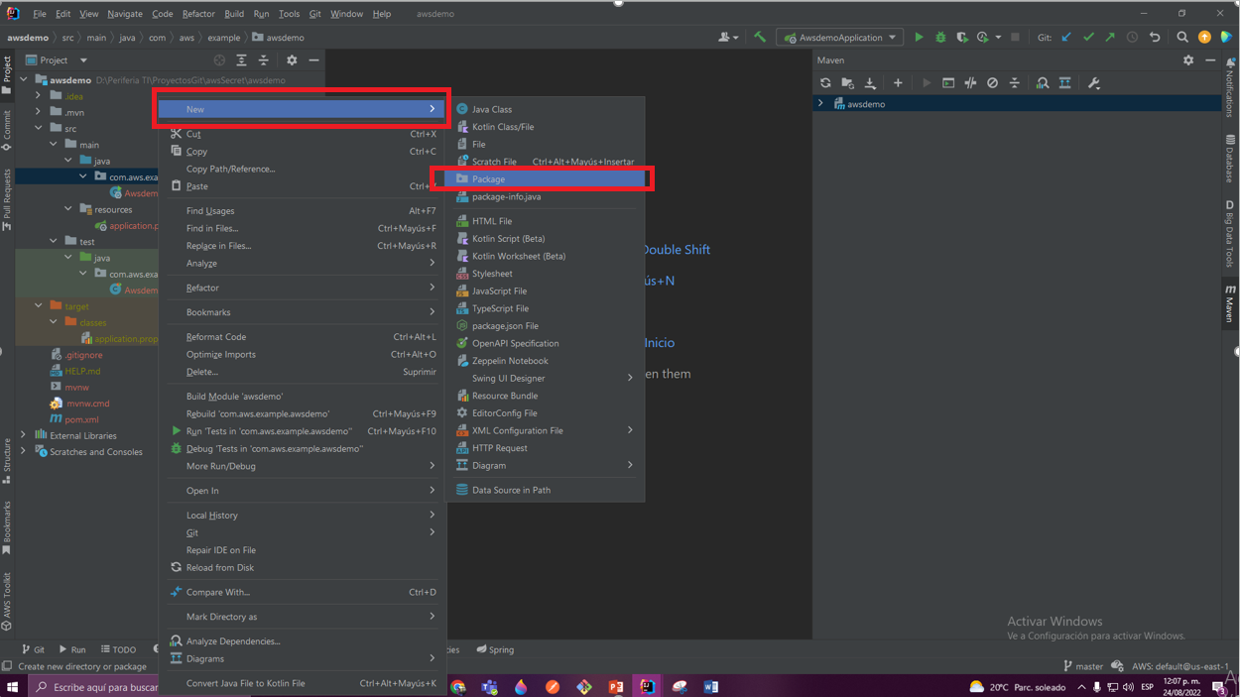

Slide 29
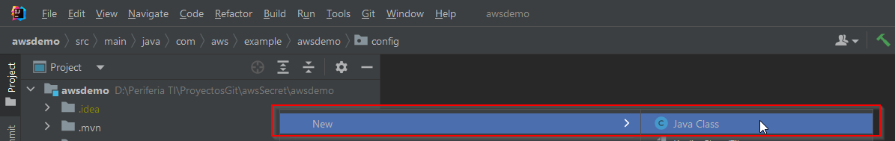

Slide 30
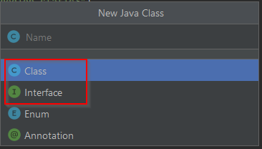

Slide 31
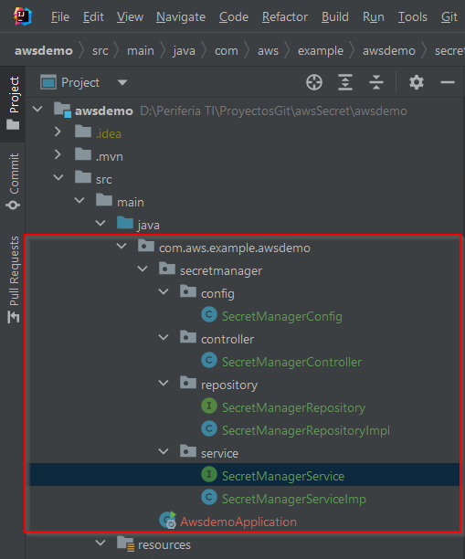

Slide 32
<?xml version="1.0" encoding="UTF-8"?> <project xmlns="http://maven.apache.org/POM/4.0.0" xmlns:xsi="http://www.w3.org/2001/XMLSchema-instance" xsi:schemaLocation="http://maven.apache.org/POM/4.0.0 https://maven.apache.org/xsd/maven-4.0.0.xsd"> <modelVersion>4.0.0</modelVersion> <parent> <groupId>org.springframework.boot</groupId> <artifactId>spring-boot-starter-parent</artifactId> <version>2.3.3.RELEASE</version> <relativePath/> <!-- lookup parent from repository --> </parent> <groupId>com.aws.example</groupId> <artifactId>awsdemo</artifactId> <version>0.0.1-SNAPSHOT</version> <name>awsdemo</name> <description>Demo project for Spring Boot</description> <properties> <java.version>1.8</java.version> <repackage.classifier/> <spring-native.version>0.10.3</spring-native.version> <spring-cloud.version>Hoxton.SR5</spring-cloud.version> </properties> <dependencies> <dependency> <groupId>org.springframework.boot</groupId> <artifactId>spring-boot-starter</artifactId> </dependency> <dependency> <groupId>org.springframework.cloud</groupId> <artifactId>spring-cloud-starter-aws-secrets-manager-config</artifactId> </dependency> <dependency> <groupId>org.springframework.cloud</groupId> <artifactId>spring-cloud-aws-core</artifactId> </dependency> <dependency> <groupId>org.springframework.boot</groupId> <artifactId>spring-boot-starter-web</artifactId> </dependency> <dependency> <groupId>org.projectlombok</groupId> <artifactId>lombok</artifactId> </dependency> </dependencies> <dependencyManagement> <dependencies> <dependency> <groupId>org.springframework.cloud</groupId> <artifactId>spring-cloud-dependencies</artifactId> <version>${spring-cloud.version}</version> <type>pom</type> <scope>import</scope> </dependency> </dependencies> </dependencyManagement> <build> <plugins> <plugin> <groupId>org.springframework.boot</groupId> <artifactId>spring-boot-maven-plugin</artifactId> </plugin> </plugins> </build> <repositories> <repository> <id>spring-releases</id> <name>Spring Releases</name> <url>https://repo.spring.io/release</url> <snapshots> <enabled>false</enabled> </snapshots> </repository> </repositories> <pluginRepositories> <pluginRepository> <id>spring-releases</id> <name>Spring Releases</name> <url>https://repo.spring.io/release</url> <snapshots> <enabled>false</enabled> </snapshots> </pluginRepository> </pluginRepositories> </project>
C:/Users/User/.m2/repository | Local | 15/08/2022 | WAITING

Slide 33
SecretManagerConfig
package com.aws.example.awsdemo.secretmanager.config; import com.amazonaws.client.builder.AwsClientBuilder; import com.amazonaws.services.secretsmanager.AWSSecretsManager; import com.amazonaws.services.secretsmanager.AWSSecretsManagerClientBuilder; import org.springframework.beans.factory.annotation.Value; import org.springframework.context.annotation.Bean; import org.springframework.context.annotation.Configuration; @Configuration public class SecretManagerConfig { @Value("${cloud.aws.region.static}") private String region; @Value("$cloud.aws.region.static") private String endpoints; @Bean public AWSSecretsManager smCliente(){ AWSSecretsManagerClientBuilder clientBuilder = AWSSecretsManagerClientBuilder.standard(); AwsClientBuilder.EndpointConfiguration config = new AwsClientBuilder.EndpointConfiguration(endpoints, region); clientBuilder.setEndpointConfiguration(config); return clientBuilder.build(); } }

Slide 34
SecretManagerService
package com.aws.example.awsdemo.secretmanager.service; public interface SecretManagerService { String getSecretValue(String secretName); }

Slide 35
SecretManagerRepository
package com.aws.example.awsdemo.secretmanager.repository; public interface SecretManagerRepository { String getSecretValue(String secretName); }

Slide 36
Agregar pluggis
Agregar AWS Tooltip

Slide 37
SecretManagerRepositoryImpl
package com.aws.example.awsdemo.secretmanager.repository; import com.amazonaws.services.secretsmanager.AWSSecretsManager; import com.amazonaws.services.secretsmanager.model.GetSecretValueRequest; import com.fasterxml.jackson.databind.JsonNode; import com.fasterxml.jackson.databind.ObjectMapper; import org.slf4j.Logger; import org.slf4j.LoggerFactory; import org.springframework.beans.factory.annotation.Autowired; public class SecretManagerRepositoryImpl { private static final Logger log = LoggerFactory.getLogger(SecretManagerRepositoryImpl.class); private AWSSecretsManager secretsManager; @Autowired public String getSecretValue(String secretName){ try { GetSecretValueRequest getSecretValueRequest = new GetSecretValueRequest().withSecretId(secretName); secretsManager.getSecretValue(getSecretValueRequest); ObjectMapper objectMapper = new ObjectMapper(); String secretValue= secretsManager.getSecretValue(getSecretValueRequest).getSecretString(); JsonNode secretJson = objectMapper.readTree(secretValue); String username = secretJson.get("username").textValue(); String password = secretJson.get("password").textValue(); String engine = secretJson.get("engine").textValue(); String host = secretJson.get("host").textValue(); String port = secretJson.get("port").textValue(); String ssl = secretJson.get("ssl").textValue(); String dbClusterIdentifier = secretJson.get("dbClusterIdentifier").textValue(); return secretValue; } catch (Exception e){ log.error("The requested secret " + secretName + " was not found"); return "The requested secret " + secretName + "was not found"; } } }

Slide 38
SecretManagerService
package com.aws.example.awsdemo.secretmanager.service; public interface SecretManagerService { String getSecretValue(String secretName); }

Slide 39
SecretManagerServiceImpl
package com.aws.example.awsdemo.secretmanager.service; import com.aws.example.awsdemo.secretmanager.repository.SecretManagerRepository; import org.springframework.beans.factory.annotation.Autowired; public class SecretManagerServiceImpl implements SecretManagerService{ private SecretManagerRepository secretManagerRepository; @Autowired public SecretManagerServiceImpl(SecretManagerRepository secretManagerRepository){ this.secretManagerRepository = secretManagerRepository; } @Override public String getSecretValue(String secretName){ return secretManagerRepository.getSecretValue(secretName); } }

Slide 40
SecretManagerController
package com.aws.example.awsdemo.secretmanager.controller; import org.springframework.http.HttpStatus; import com.aws.example.awsdemo.secretmanager.service.SecretManagerService; import org.springframework.beans.factory.annotation.Autowired; import org.springframework.http.ResponseEntity; import org.springframework.web.bind.annotation.GetMapping; import org.springframework.web.bind.annotation.RequestParam; import java.io.IOException; public class SecretManagerController { private SecretManagerService awsService; @Autowired public SecretManagerController(SecretManagerService awsService){ this.awsService = awsService; } @GetMapping("/getSecretValue") public ResponseEntity<String> getSecretValue(@RequestParam(value = "secretName") String secretName) throws IOException { return new ResponseEntity<>(awsService.getSecretValue(secretName), HttpStatus.OK); } }

Slide 41
https://plugins.jetbrains.com/plugin/11349-aws-toolkit/versions

Slide 42
Application.yaml
cloud: aws: secretsmanager: endpoint: secretsmanager.us-east-1.amazonaws.com region: us-east-1 credentials: access-key: secret-key: region: static: us-east-1 stack: auto: false

