Slide 1
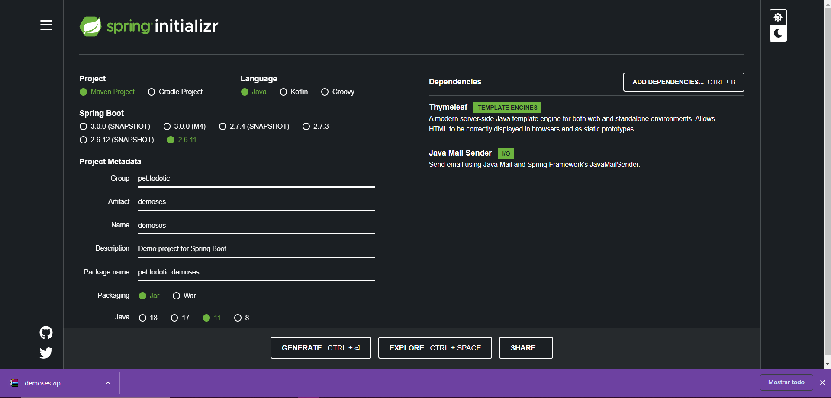
https://start.spring.io/

Slide 2
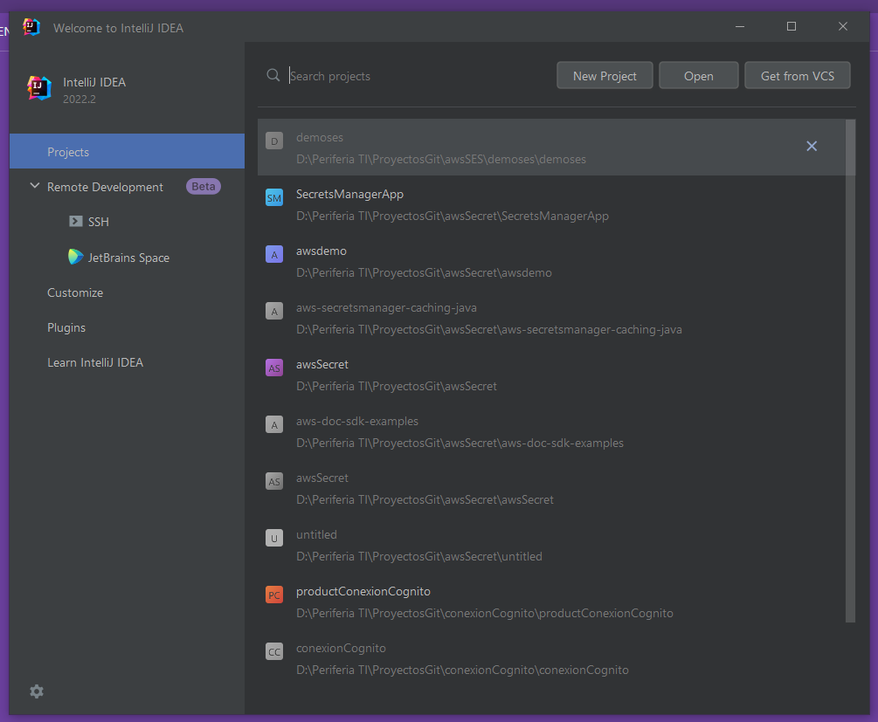

Slide 3
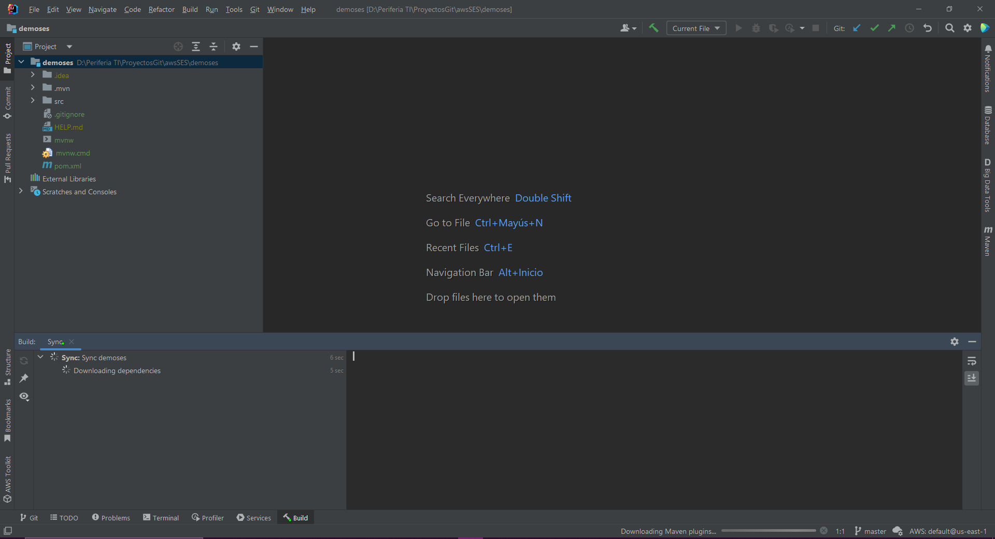

Slide 4
https://spring.io/blog/2021/03/17/spring-cloud-aws-2-3-is-now-available
<dependency> <groupId>io.awspring.cloud</groupId> <artifactId>spring-cloud-starter-aws-ses</artifactId> </dependency>
<dependencyManagement> <dependencies> <dependency> <groupId>io.awspring.cloud</groupId> <artifactId>spring-cloud-aws-dependencies</artifactId> <version>2.3.0</version> <type>pom</type> <scope>import</scope> </dependency> </dependencies> </dependencyManagement>
Maven dowloand source
Maven reload

Slide 5
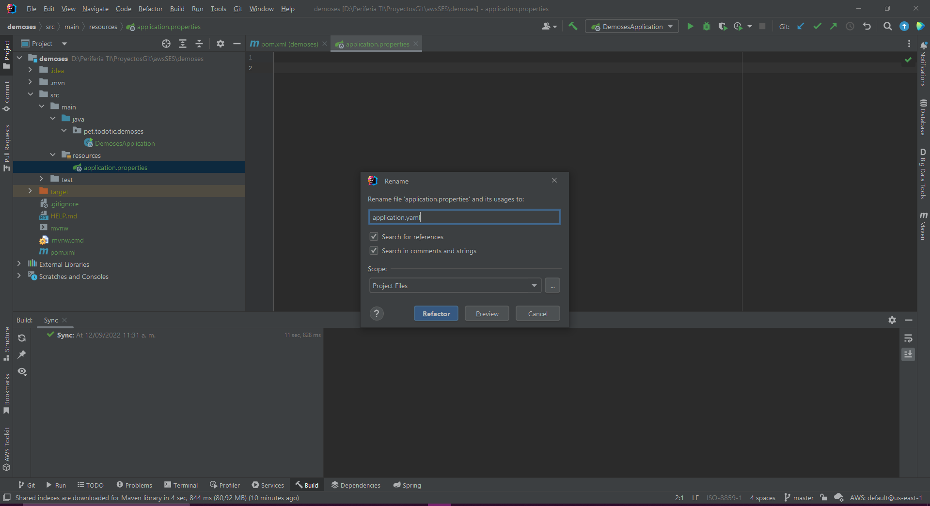
Renombrar application.properties por application.yaml

Slide 6
https://docs.aws.amazon.com/ses/latest/dg/send-personalized-email-api.html

Slide 7
{
"Template": {
"TemplateName": "MyTemplate",
"SubjectPart": "Greetings, {{name}}!",
"HtmlPart": "<h1>Hello {{name}},</h1><p>Your favorite animal is {{favoriteanimal}}.</p>",
"TextPart": "Dear {{name}},\r\nYour favorite animal is {{favoriteanimal}}."
}
}
aws ses create-template --cli-input-json file://mytemplate.json

