Slide 1
Capstone Project
Segmentation and Clustering of neighborhoods in Berlin

Slide 2
Segmentation of Berlin’s neighborhoods is valuable for:
Any contractor or entrepreneur who is aiming to open new business (e.g. hotel, restaurant, cafe), and while looking for the right location has to take into consideration factors such as target group or possible surrounding businesses and competitors. Tourist visit ratio and most common venues of given area are important parameters
Investors in commercial real estate. Investing in the right property includes understanding of local demographics, having overview of the type of successful businesses in the area or it attractiveness for tourism.
City planners when developing the design and monitoring the development of public spaces, parks, transport, community infrastructure in each neighborhood

Slide 3
Various data sources have been used for data acquisation
Official Berlin Census Data
Project of Ideation & Prototyping Labs
Foursquare API
OpenDataSoft

Slide 4
Data cleaning and preparation
Data downloaded from Official Berlin Census Data and from OpenDataSoft was saved locally and the excel tables were manually changed so that desired data format has been reached, namely three csv files with following information:
Berlin_data.csv: Berlin’s population and age (for each postal area)
Berlin_tourist_2019.csv: tourist numbers for each district of Berlin
berlin_geocoordinates.csv: longitude and latitude data for each postal code area of Berlin
After loading those tables into panda dataframes, additional data cleaning and wrangling of missing, incorrect or not required data was performed.

Slide 5
Usage of Foursqare API
Foursquare API was used for retrieving most common venues of each search area
search criteria: 100 as limit for number of venues returned and 300 m as search radius
The end result of the search was 1746 venues which I grouped according to the districts they belong to.

Slide 6
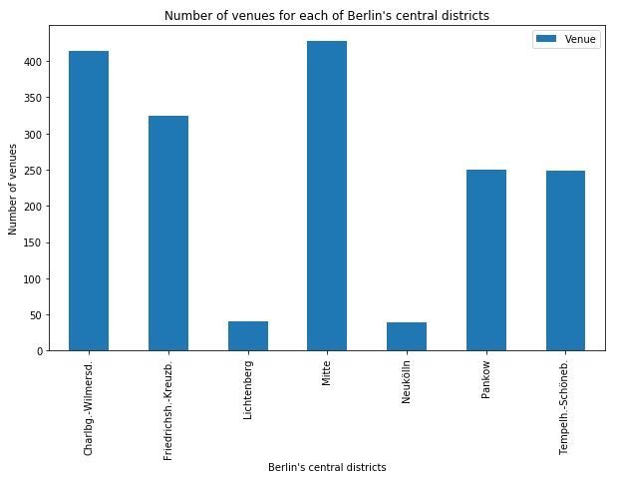
Three districts have the majority of venues, while Lichtenburg and Neukölln have the fewest

Slide 7
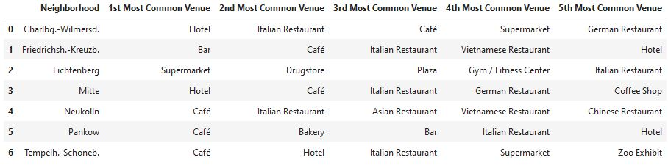
Overview of the top 5 venues for each district area

Slide 8
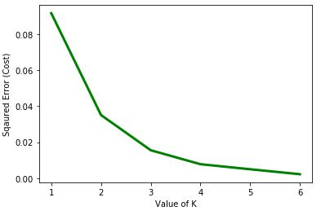
Choose K Value for K-Means Clustering Algorithm
Using the Elbow Method, K should be set to value 4

Slide 9
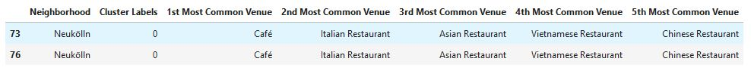
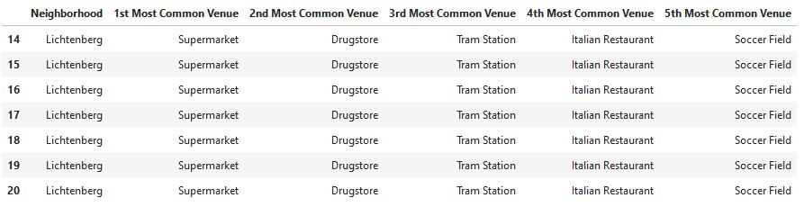
Most common venues in Cluster 1 and Cluster 2

Slide 10
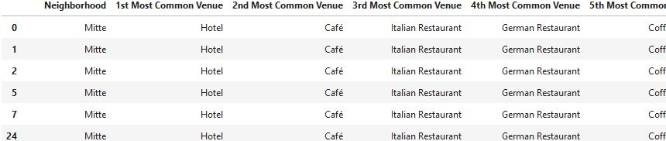
Most common venues in Cluster 3 and Cluster 4

Slide 11
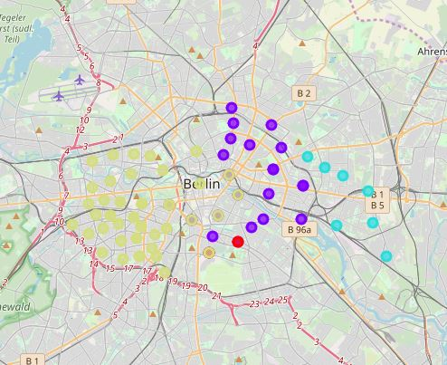
Cluster Map of Berlin
Cluster 1 (food/restaurants) is red
Cluster 2 (night and social life) is purple
Cluster 3 (hotels, touristic and social venues) is yellow Cluster 4 (residential area) is blue

Slide 12
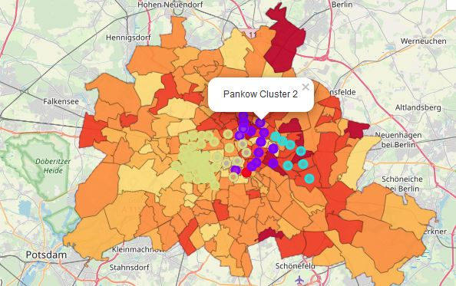
Choropleth map of Berlin’s population density, combined with cluster labels
Cluster 2 (dark blue colour: Night life and social venues) and Cluster 3 (light blue colour: Residential area) are located in areas with higher population density, while cluster 4 (yellow colour: venues that are most attractive for tourists) is with much less population density.

Slide 13
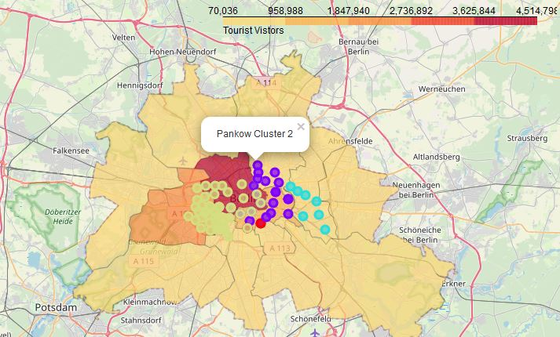
Choropleth map of Berlin’s tourist visitors combined with cluster labels
Cluster 4 (yellow colour) is covering the area with biggest tourist density while cluster 2 (dark blue) and especially cluster 3 (light blue: residential area) are covering area with much less tourist visitors.

Slide 14
Conclusions and future directions
Central West Berlin is the most attractive part for tourists, while Central East Berlin is attractive for nightlife, or that the outskirts of East Berlin are mostly residential.
Foursquare has limitations (user-generated data might not be complete and up-to-date and does not take into account venue’s size)
If popular venues are retrieved from more popular apps such as Google, the analysis will be more precise and expand to bigger area

