Slide 1
Priority-Based
Process Management
Supervised by: Professor Reem Ibrahim Al Halwani
xv6 Operating System Project
Modifying the xv6 scheduler to support process priorities, aging, preemption, and dynamic scheduling modes
Operating System Project
presented by: Maya Anwar - 231000241

Slide 2
01
02
03
THE PROBLEM
WHAT CHANGED
SCHEDULER DESIGN
04
05
06
TEST CASES
NEW SYSTEM CALLS
IMPLEMENTATION DETAILS

Slide 3
01
THE PROBLEM

Slide 4

Round-Robin (Before)
Priority Scheduler (After)
Every process gets equal CPU time
No concept of importance
Critical processes wait in line
No preemption of low-priority processes
No starvation prevention
Processes have priority 0–19
Lower number = higher priority
Scheduler always picks the best first
Children inherit parent priority
4 modes, including preemption and aging

Slide 5
02
WHAT CHANGED

Slide 6
What did I build?
Priority-aware scheduler — always runs highest priority process first
4 scheduling modes switchable at runtime
Aging — low priority processes eventually get their turn
Priority inheritance — children inherit parent priority in fork()
Preemption — high priority process interrupts running one
3 new system calls for runtime process management
4 test programs proving every feature works

Slide 7
What did I change?
kernel/proc.h
Added int priority and int waited_ticks to struct proc
kernel/syscall.c
Registered all new syscalls in the dispatch table
kernel/proc.c
Rewrote scheduler() with 4 modes + aging, priority inheritance in fork()
kernel/sysproc.c
Implemented sys_setpriority(pid,p), sys_getpriority(pid), sys_setsched()
kernel/trap.c
Added preemption logic for Mode 1 in usertrap and kerneltrap
user/user.h
Declared setpriority(int,int), getpriority(int), setsched(), sleep()
kernel/syscall.h
Added SYS_setpriority (22), SYS_sleep (23), SYS_getpriority (24), SYS_setsched (25)
user/usys.pl
Added user-space stubs for all new syscalls

Slide 8
03
SCHEDULER DESIGN

Slide 9
REVIEWING CONCEPTS IS A GOOD IDEA
Mode 0
Mode 1
Mode 2
Mode 3
Non-Preemptive
Preemptive
Round-Robin
Aging (Default)
Runs highest priority
process to completion
Higher priority process
preempts running one via trap.c
Equal priority processes
take fair turns
Priority + boost after 50 ticks
to prevent starvation
Preemption (Mode 1): On every timer interrupt in the trap.c, if a higher priority process is RUNNABLE, the current process yields immediately.

Slide 10
NEW SYSTEM CALLS
04

Slide 11
setpriority(int pid, int p)
getpriority(int pid)
setsched(int mode)
p->priority = priority;
SYS #22
Sets priority of any process by PID (0–19). Lower = higher priority.
return p->priority;
SYS #24
Returns the priority of any process by PID.
SYS #25
sched_mode = mode;
Switches scheduler mode at runtime (0=non-preemptive, 1=preemptive, 2=round-robin, 3=aging).

Slide 12
IMPLEMENTATION DETAILS
05

Slide 13
Implementation Details
setpriority works on any process
Priority Inheritance in fork()
setpriority(pid, 5);
np->priority = p->priority;
The parent can set the child priority by PID right after fork — enables precise control.
Children inherit their parent's priority automatically when forked.
Preemption in trap.c
Aging prevents starvation
if(best->priority < p->priority) yield();
if(waited_ticks >= 50) priority--;
On every timer interrupt, checks if a higher priority process is waiting and yields.
Low priority processes gradually get boosted so they never wait forever.

Slide 14
TEST CASES
06

Slide 15
Test Cases
priotest
$ priotest
[A] My priority is: 5
HIGH running: 0
[B] My priority is: 15
LOW running: 0...
HIGH (prio 5) vs LOW (prio 15) — set via setpriority(getpid(), x)
HIGH always runs before LOW ✓
schedtest
$ schedtest
HIGH (priority 5) running
HIGH: 0 → LOW: 0
P1 (prio 5): 0 → P2: 0...
Mode 3 (aging) + Mode 2 (round-robin) using setsched()
Aging + round-robin both work ✓
finaltest
$ finaltest
[A] priority: 3 → HIGH step 1
[B] priority: 18 → LOW step 1
All tests passed!
Full demo: A (prio 3) vs B (prio 18), then C vs D equal priority
getpriority(pid) correct, all modes work ✓
preempttest
$ preempttest
[LOW] started, running...
[HIGH] started — preempting!
[HIGH] steps 1-5 done
[LOW] finished
Mode 1 preemption: HIGH (prio 2) interrupts LOW (prio 15) mid-execution
HIGH preempted LOW successfully ✓

Slide 16
Project pipline
07

Slide 17
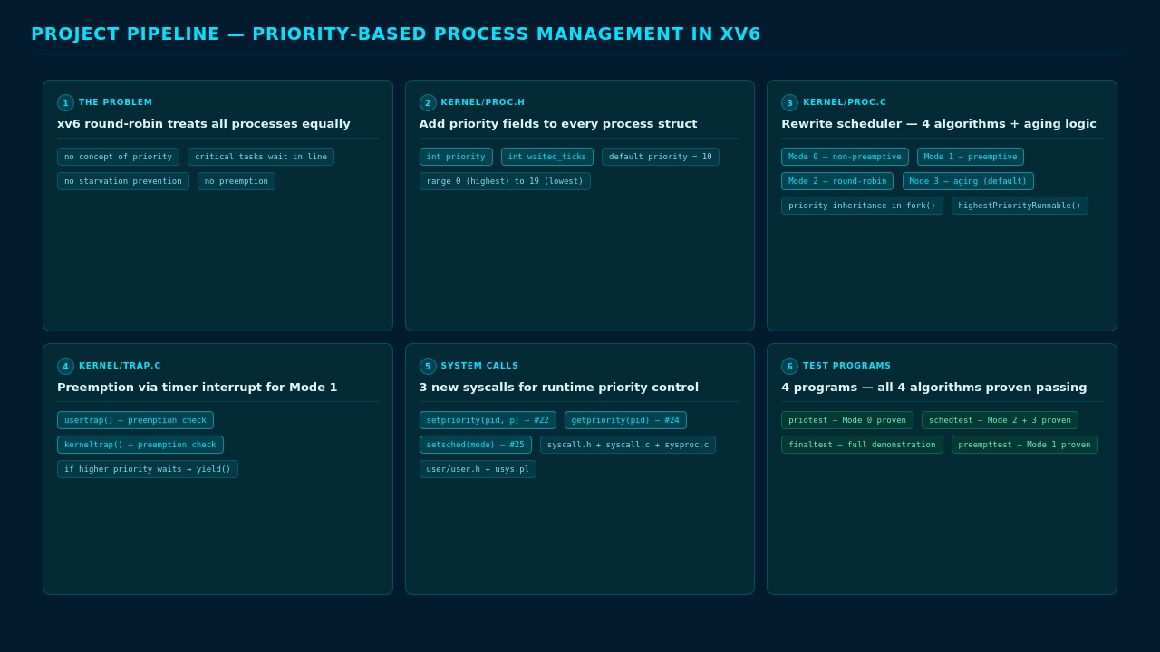

Slide 18
Thank you!
Any questions?

