Slide 1
Effects of Vorinostat in Cancer Treatment
Project Proposal:

Slide 2
NCI Transcriptional Pharmacodynamics Workbench
Cell lines
NCI-60
15 anticancer agens
12.704
genes
Changes in gene expression in correlation with molecular pathways, drug target and durg sensitivity

Slide 3
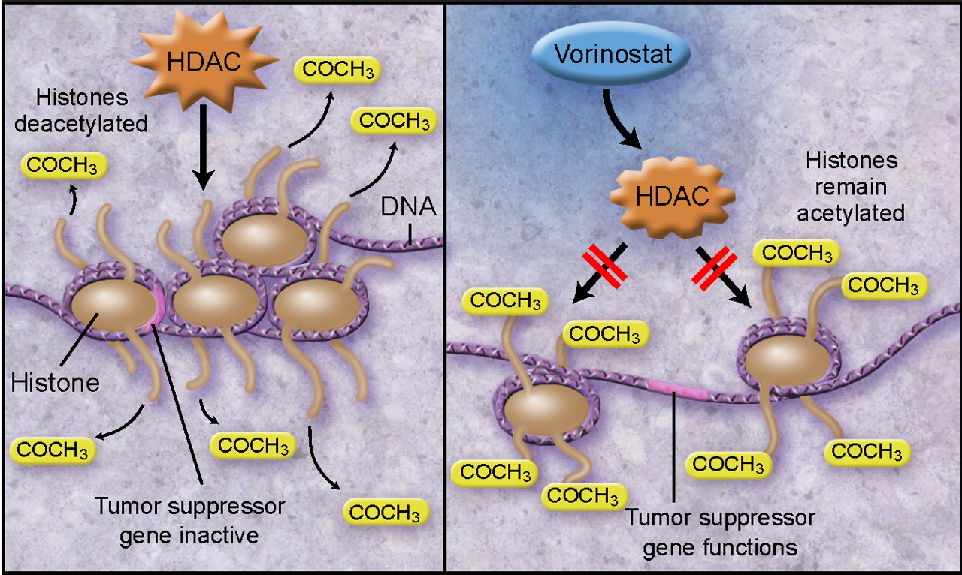
Our focus: Vorinostat
tardust.bio

Slide 4



Project Steps

Slide 5
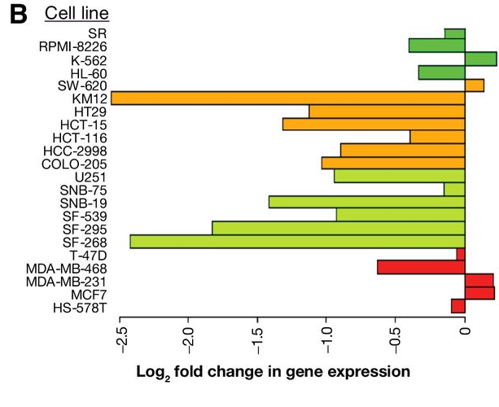

Broad Analysis
Gene expression profiles

Slide 6
Specific analysis
Bio-markers

Slide 7
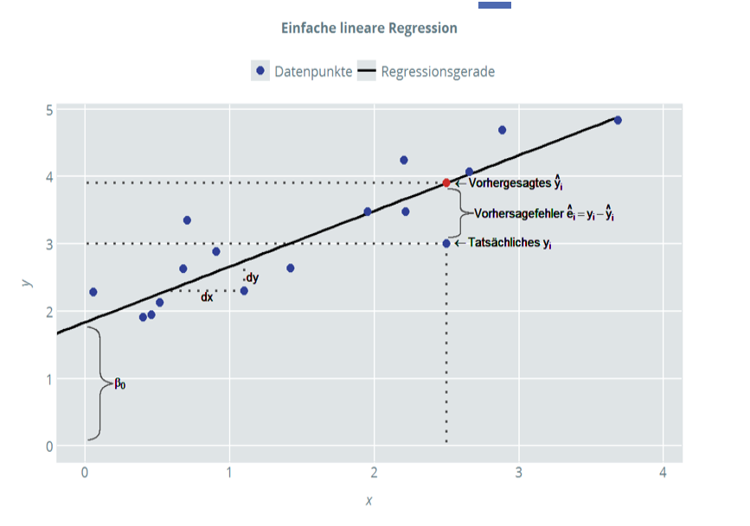
Specific analysis
Is there a correlation between drug sensitivity and the influence on gene expression ?
Copy number → expression change
Lineare Regression
Über Mean oder für jedes Gen einzeln
Vorhersage drug sensitivity → Wirkung auf Genexpression ?
Which biomarker(s) have the biggest effects over all cell lines and could be used for therapy?
Drug sensitvity

Slide 8
Is there a connection between the effectiveness of the drug and the cell line? For which types of cancer can Vorinostat possibly be used?
Scatter plot über mean und angefärbt
Heatmap → dendrogram
K means oder PCA
Cancer types

Slide 9
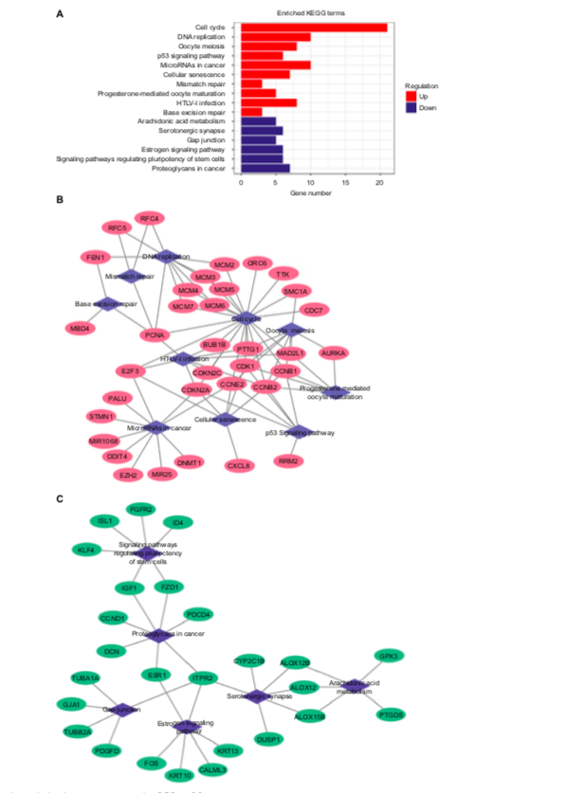
Which pathways does Vorinostat interfere with? Are the pathways connected?
https://www.ncbi.nlm.nih.gov/pmc/articles/PMC6145638/
Cytoscape
Pathway enrichment analysis
KEGG
Pathways

Slide 10
Timeline
2 Weeks
2 Weeks
3 Weeks
1 Week
Cancer types
Pathways
Drug sensitvity
Biomarkers
Gene expression profiles

Slide 11

Effects of Vorinostat in Cancer Treatment

