Slide 1
Effects of Vorinostat in Cancer Treatment
Project Proposal:

Slide 2

The NCI Transcriptional Pharmacodynamics Workbench: A Tool to Examine Dynamic Expression Profiling of Therapeutic Response in the NCI-60 Cell Line Panel Monks et al.
Our Basis

Slide 3
NCI Transcriptional Pharmacodynamics Workbench
Cell lines
NCI-60
15 anticancer agens
12.704
genes
Changes in gene expression in correlation with molecular pathways, drug target and durg sensitivity

Slide 4
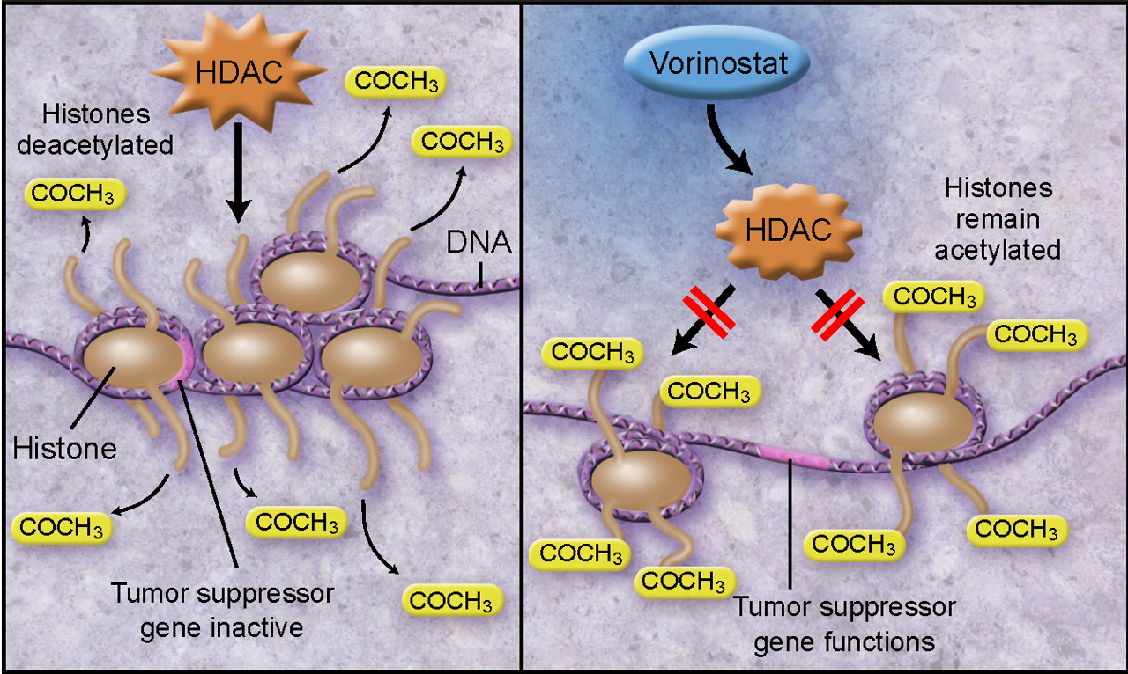
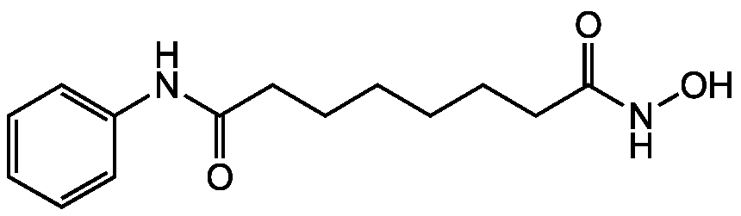
Our focus: Vorinostat
www.biomol.com
tardust.bio

Slide 5
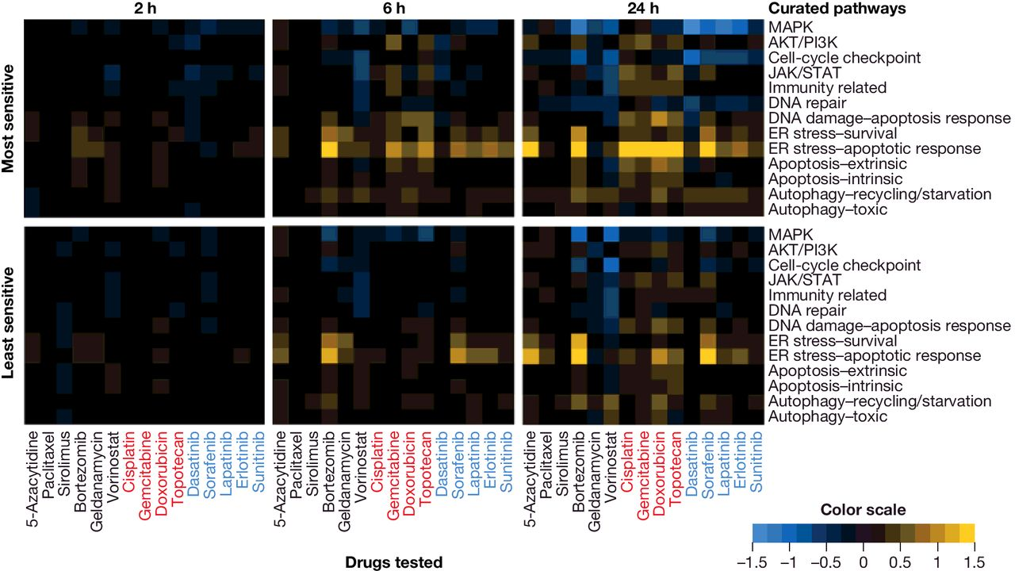


Previous findings
Monks et al., 2018

Slide 6

Project steps
Exploring the gene expression: Comparison of treated and untreated
Analyis steps
Density plots
Fold change
Gene reanking
Goals
How strong is the expression overall?
Find stronger or lower expressed genes
Which genes are
Interesting target genes
Notes:
Grenzen 2,-2

Slide 7
Project steps
2. Dimensionality reduction
Analyis steps
PCA
Check Quality of PCA
Goals
Which genes act in a similar and are correlated way?
Reduce data size

Slide 8
Which pathways are most affected by vorinostat?
How are the genes related to each other?
10 -15 most sensitve genes
Can we subdivide the genes in different groups?
Can we expect similar effects in vivo?

Slide 9
Project steps
3. Exploring expression of single genes
Analyis steps
Boxplots
T-test, compare to basal expression
Heatmap with pathways
Goals
How big are the changes in expression?
Are the expression changes significant?
Changes in gene expression and involved pathways

Slide 10

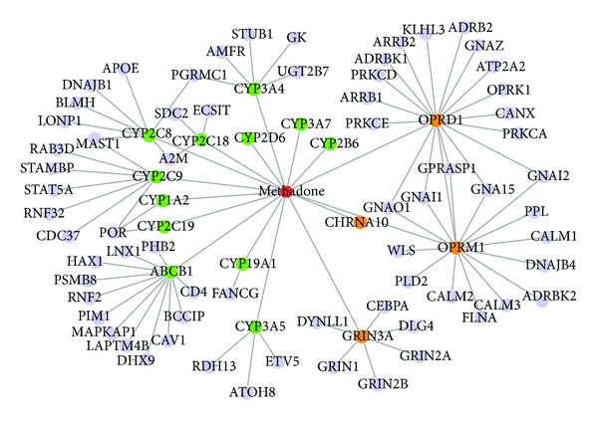
Final results: Effects of Vorinostat in Cancer Treatment
Drug –target network
(Xiao et al., 2017)

Slide 11
Timeline
3 Weeks
2 Weeks
Drug –target network
3 Weeks
Changes in gene expression and involved pathways
10 -15 most sensitve genes
Reduce data size
Interesting target genes

