Slide 1
Angular 2.0
- Mayadhar Sankhua

Slide 2
ABOUT
Angular JS is an open source framework built over JavaScript. It was built by the developers at Google.
Angular 2 has better event-handling capabilities, powerful templates, and better support for mobile devices.
FEATURES
Components (Components help to build the applications into many modules. This helps in better maintaining the application over a period of time)
Typescript (This is a superset of JavaScript and is maintained by Microsoft)
Services (Services are a set of code shared by different components of an application)
COMPONENTS
Modules (This is used to break up the application
into logical pieces of code. Each piece of code
or module is designed to perform a single task.
Component (used to bring the modules together)
Templates (used to define the views of an
Angular JS application)
Metadata (used to add more data to an Angular class)
Service (used to create components which can be
shared across the entire application)
TypeScript
Angular 2.0
TypeScript (Types, Annotations)
ES6 (Classes, Modules)
ES5

Slide 3
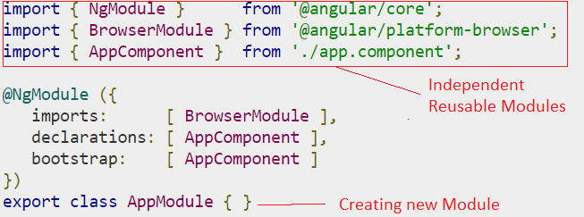
MODULES
Modules are used in Angular to put logical boundaries in your application.
Instead of coding everything into one application, you can instead build everything into separate modules to separate the functionality of your application.
Example(In this Screenshot)
“NgModule” is used to define imports, declarations,
bootstrapping options.
“BrowserModule” is used for any web based angular application.
A module is made up with “Bootstrap Array”, “Export Array” &
“Import Array”.
Bootstrap Array helps to identify which components are need to be loaded.
Export Array helps to export Angular components, directives & pipes for future used in applications.
Import Array helps to import existing Angular modules.

Slide 4
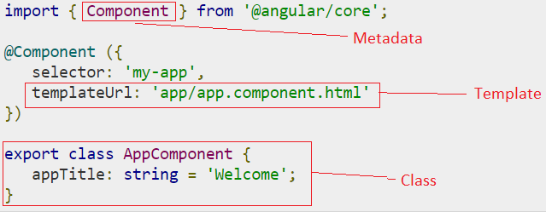
COMPONENT
Component is a logical boundary of functionality for the application.
A component is consists of “Class”, “Metadata” & “Template”.
Class contains properties & methods which will used by the component for satisfying business or application flow.
Metadata used to decorate the class and extend the functionality of the class.
Template used to define the HTML view which is going to render in browser.
Class
Class decorator is defines in Typescript and in angular we needs to use “class” keyword to define a class.
Class parameters are class_name (name given to class), property_name(name given to property), property_type(type given to class property as Typescript is strongly typed) and value(data given to a property).
The “export” keyword is used so that the component can be used in other modules in the Angular JS application.
Component
Class
Metadata
Template

Slide 5
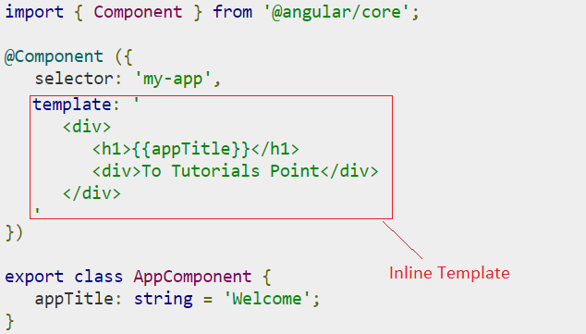
Template
Template is nothing but piece of HTML tags which will render
in the browser and it uses the class properties to display
dynamic contents.
Parameters are HTML Code(which needs to render in browser),
& Class properties(which can be referenced in the template).
Metadata
Metadata is used to decorate Angular Class with additional information.
We can decorate a angular class using “import” keyword, means we can import some other component into our angular class and that component is called as a metadata in current class.
There are different parts of metadata like Annotations, Parameters

Slide 6
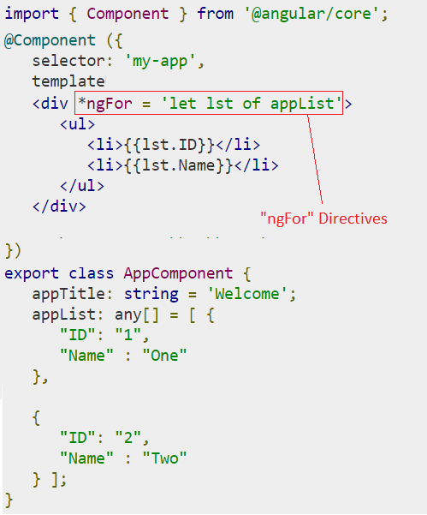
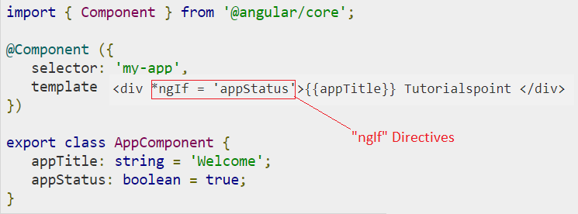
DIRECTIVES
Directive is a custom HTML element that is used to extend the power of HTML.
Example : ngIf, ngFor

Slide 18
Thank You

