Slide 1
Music Retail Insight
Analyzing store growth through SQL data insights.

Slide 2
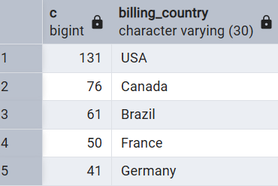
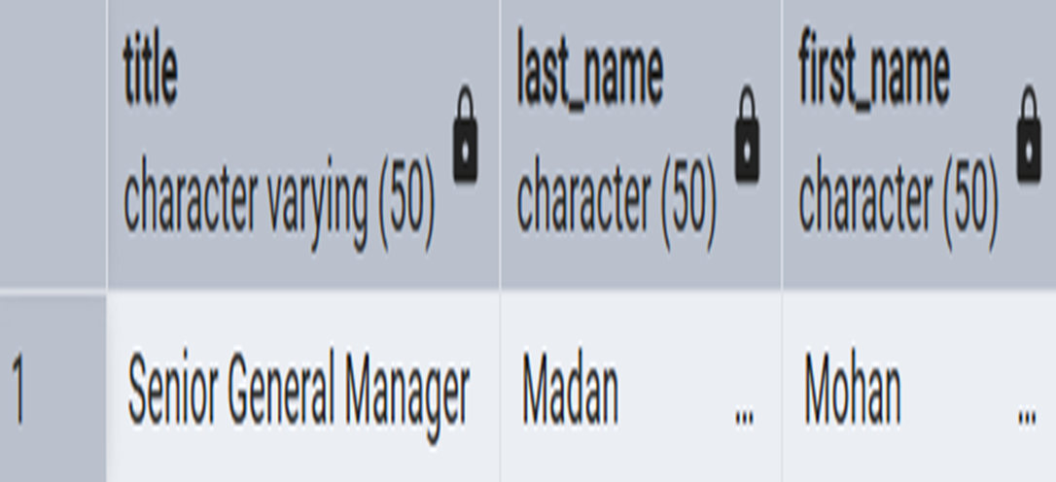
Basic Insights
Countries have the most Invoices
The senior-most employee based on job title

Slide 3
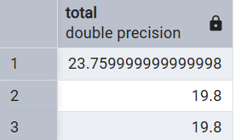
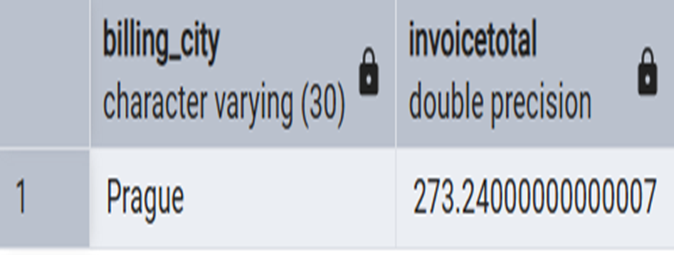

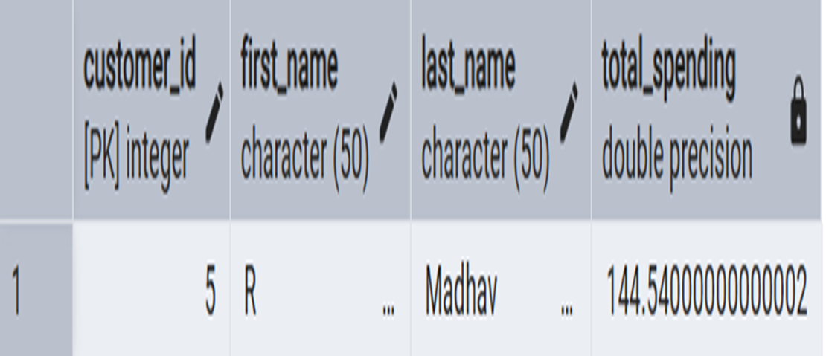
Basic Insights
top 3 values of total invoice –
The city that has best customer & sum of all invoice totals –
The person who has spent the most money-

Slide 4
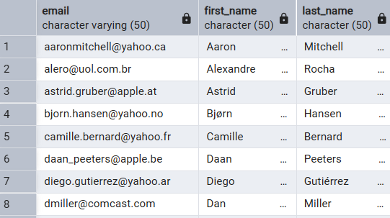
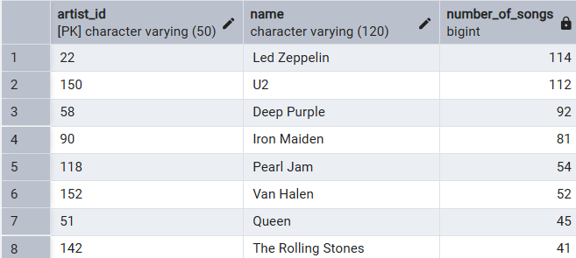
More Practical Insights
The email, first name, last name, & Genre of all Rock Music listeners.
The artist name who have written the most rock music and the total track count of the top 10 rock bands

Slide 5
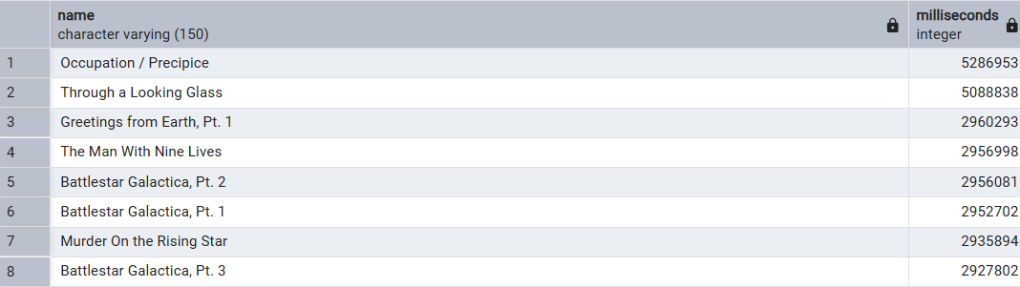
More Practical Insights
The track names that have a song length longer than the average song length

Slide 6
Thank You

