Slide 1
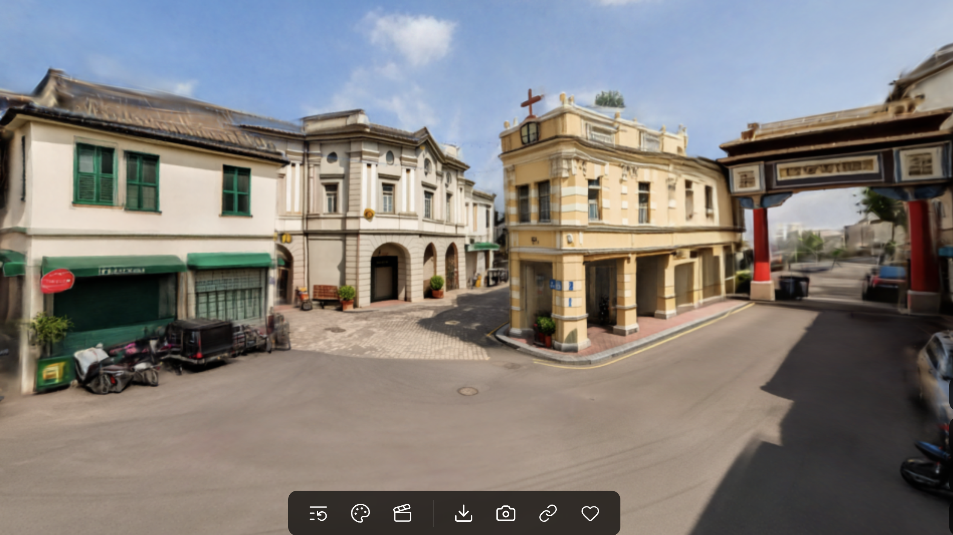
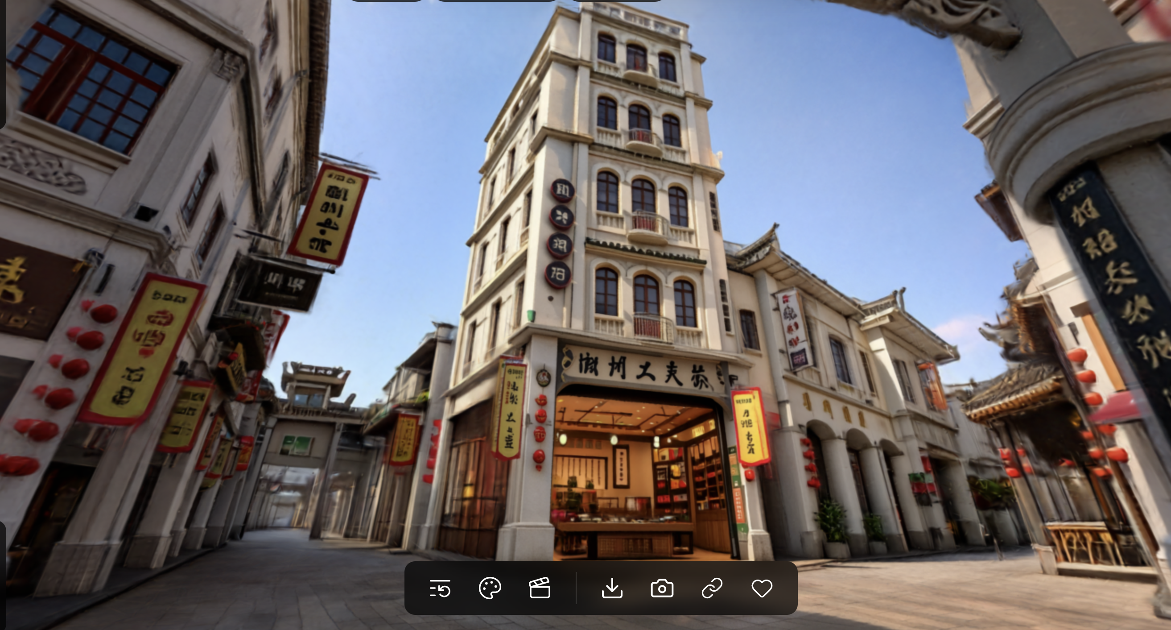
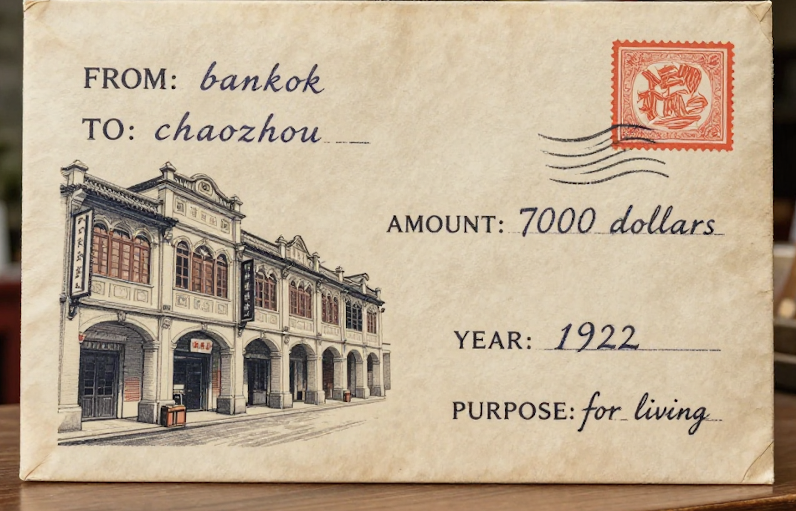
Qiaopi Bridge: Architectural Exchange and Economic Connection between Chaoshan and Nanyang in Modern China AI Visual Work: Connecting Two Architectural Worlds through Qiaopi AI tool：Image2，Dify and Marble
Economic Civilization × Architectural Civilization
Nanyang world model
AI Chaoshan World Model
Ai Qiaopi Generator
Weitong Li 2330034028

Slide 2
1. The ai visual work overview and demo
AI Visual Work: An AI system Connecting Two Architectural Worlds through Qiaopi
Visual Structure: Nanyang world model → Ai Qiaopi Generator → AI Chaoshan World Model
By Image2, Marble
By Dify
By Image2, Marble
AI Nanyang world model
AI Chaoshan World Model
Ai Qiaopi Generator
Weitong Li 2330034028

Slide 3
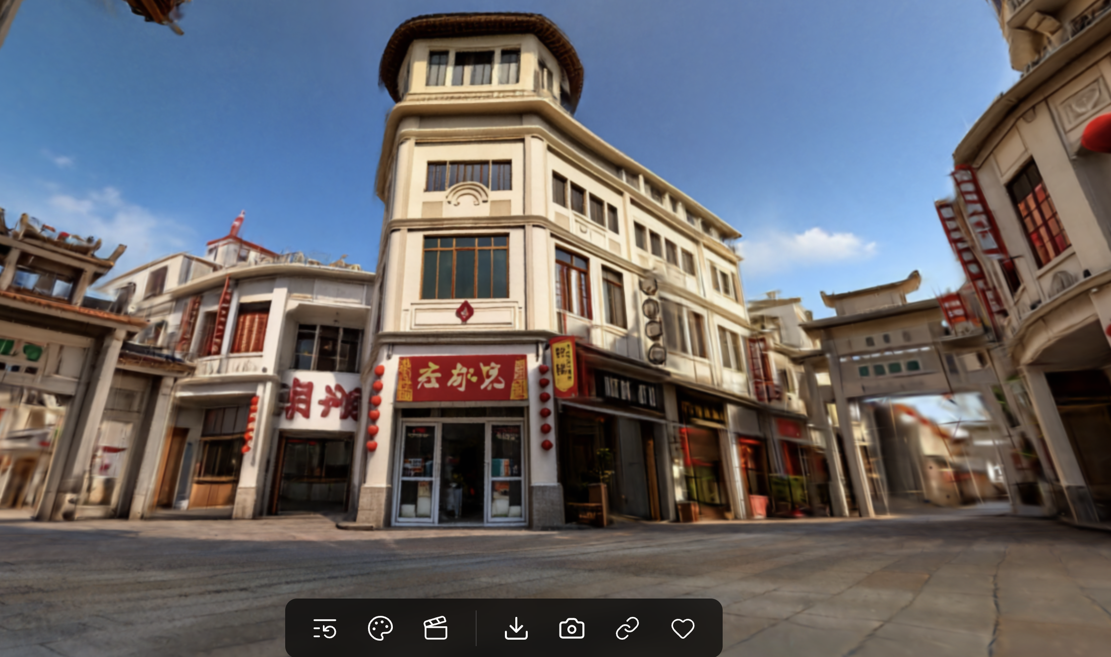
2. Similartity Between Nanyang and Chaoshan Architectural
Same Street Function
Both have covered walkways and shops on the first floor, so people can walk, stop, and buy things easily.
Same Commercial Look
Both use upper floors, balconies, shop signs, and building long street to create a busy shopping street.
Fig. Chaoshan qilou
Fig. Nanyang qilou

Slide 4
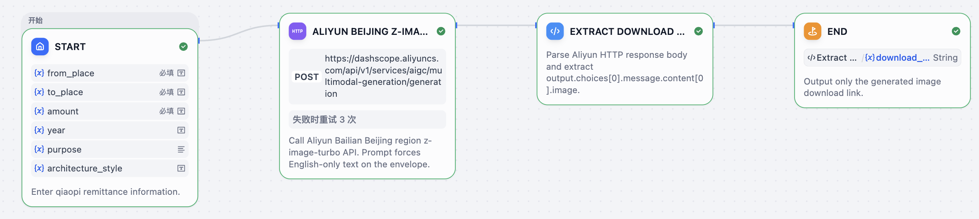
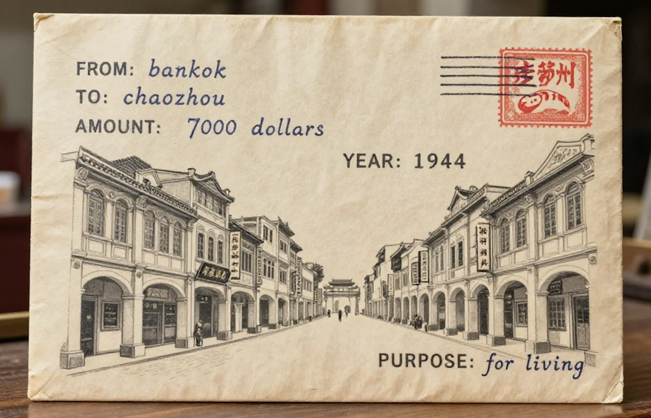
3. Why use image2, marble and Dify ？？？
Image2
it is one of the newest image generator in the world
Convert photos into 3d image for Marble visual inputs and improve architectural details
Marble
it is also one of the best world model by LI Feifei
Visualize Chaoshan and Southeast Asian architecture create walkable 3D spaces
Dify + Alibaba Multimodal AI
Build a Qiaopi Generator workflow that turn user input into visual output
The User-customized Qiaopi Generator by Dify

Slide 5
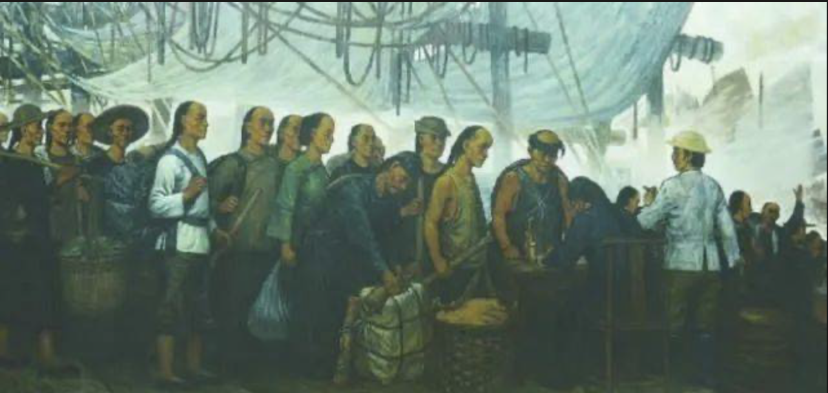
4.Why choose Modern China, late 17th century–1945 ？？？
This Period Connected Chaoshan and Nanyang
Many Chaoshan people went to Nanyang for work and business. They helped Nanyang’s economy and supported Chaoshan through qiaopi.
This Period Brought Qilou Ideas Back
Economic and cultural exchange brought Nanyang-style qilou ideas back to Chaoshan. These ideas shaped Chaoshan commercial streets and later became local heritage.
Fig. Chaoshan people go to Nanyang for earning
Weitong Li 2330034028

Slide 6
5. What Happened? Economic Flow
Local Pressure Pushed People Overseas
Limited land and jobs pushed Chaoshan people overseas. About 2.94 million went overseas from 1864–1911.
Nanyang Offered Better Work
Nanyang ports offered jobs in trade, shops, agriculture, mining, and shipping. Southeast Asian areas had higher income levels than China.
Teochew Networks Grew in Thailand
Over half of Thai Chinese trace their roots to Chaoshan / Teochew areas.
Qiaopi Sent Money Home
Qiaopi carried money and letters back to families in Chaoshan.
Fig. Qiaopi generated by Dify
Weitong Li 2330034028

Slide 7
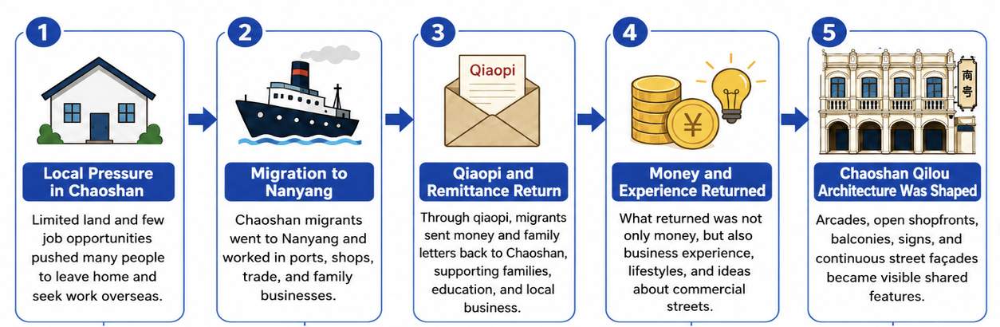
6. What Happened? Architectural Change
Returned Money Supported Building
Qiaopi money and helped families build houses, shops, and local commercial spaces.
Nanyang Experience Shaped Qilou
Migrants brought back business experience and Nanyang-style shop-house ideas.
Qilou Served Street Business
Qilou used covered arcades, open shopfronts, and upstairs living space to support trade.
Paifang Street is an example of Nanyang Influence
Arcades, balconies, shopfronts, and signs show Chaoshan–Nanyang influence.
Weitong Li 2330034028

Slide 8
7. What Does It Mean Today?
Heritage Beyond Tourism
Paifang Street is not only a tourist street, but a space of migration, trade, and family memory.
Economy Beyond Money
Qiaopi shows that economy is not only about money. It is also about trust, family duty, migration, and cross-border connection.
AI as a Cultural Bridge
AI can visualize hidden historical networks, but human judgment is needed to protect cultural meaning.
Weitong Li 2330034028

