Slide 1



Technology of Sanxingdui Civilization
Mutual Learning of Technologies and Exchanges of Civilizations
Zane XIA 2430005079

Slide 2


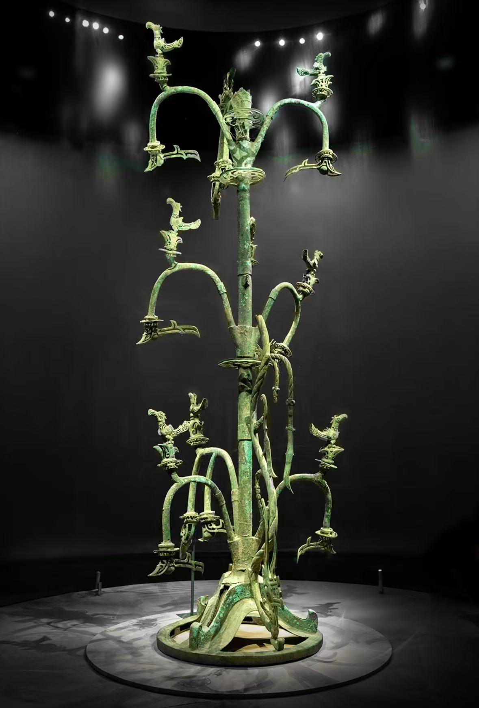
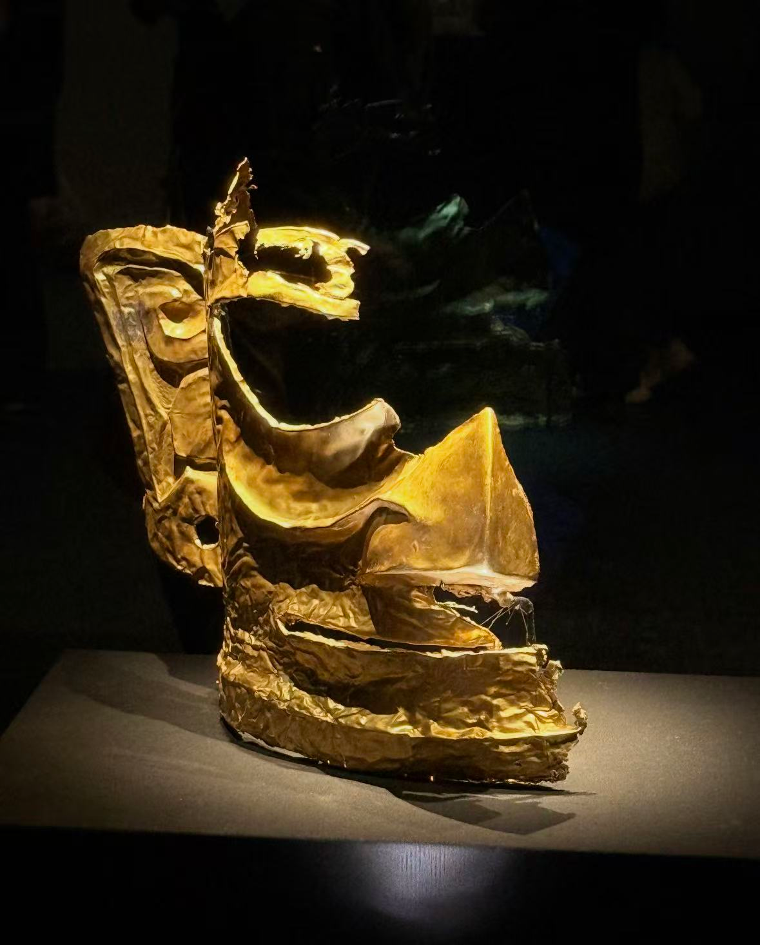
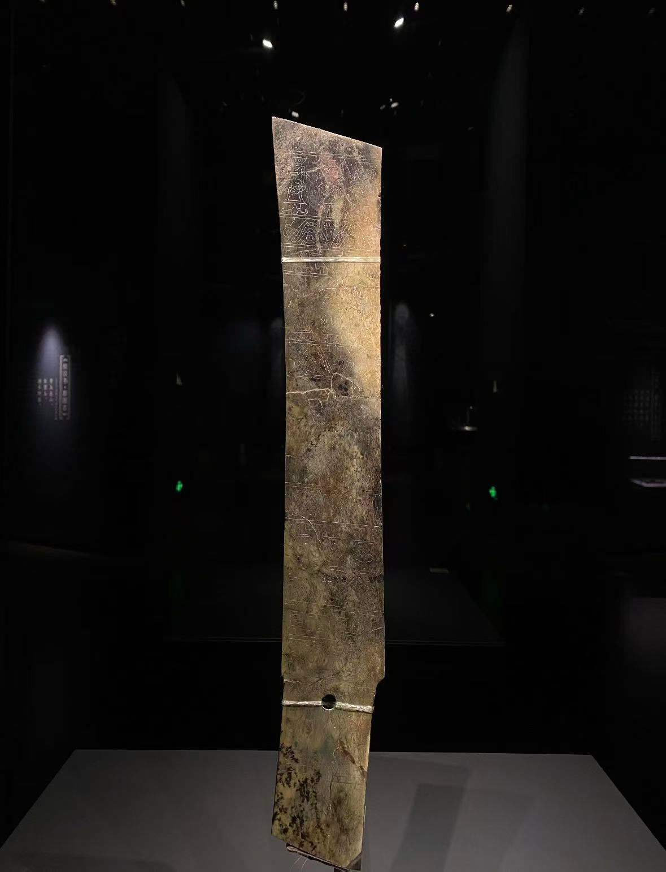


Typical Cases of Sanxingdui Technologies
Comprehensive Business Assessment
These technologies were world-leading more than 3,000 years ago, fully demonstrating the extraordinary creativity and technical strength of the ancient Shu civilization.

Slide 3
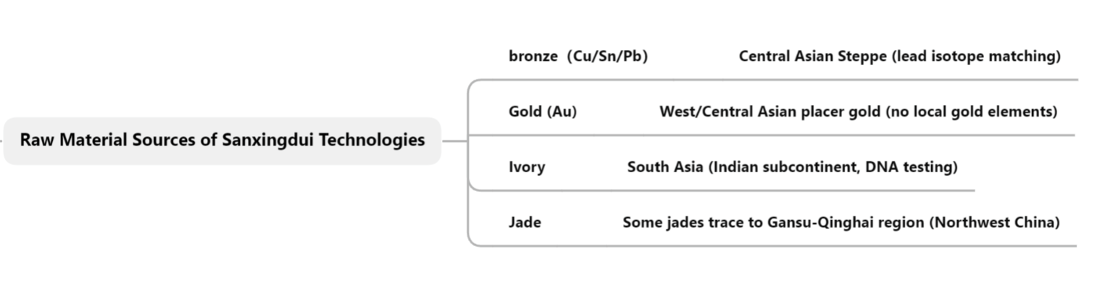

Analysis of Sanxingdui's Cross-Civilization Exchanges
from a Scientific and Technological Perspective
Sanxingdui was a pivotal node in the early cross-civilization network of technological and material exchanges across East Asia, Central Asia and West Asia.

Slide 4




The History of Sanxingdui Civilization
Today’s Technological Civilization
Strengths
Threats
First, technology diffusion has never been one-way.
Second, technology shapes cultural identity.
Thirdly, ancient technological exchanges were mutually beneficial and respectful.

Slide 5

Strengths
Threats

Slide 6
Conclusion
From an archaeological perspective, bronze, gold, ivory and other Sanxingdui relics prove the advanced technology of ancient Shu civilization. Modern tests confirm that Sanxingdui was never isolated, but a key part of early cross-civilization exchanges, witnessing material circulation, technological learning and cultural integration. This history tells us that technological progress relies on open communication, mutual learning and independent innovation. Archaeology uncovers ancient wisdom and offers valuable insights into modern technological development and cultural communication.
Threats

