Slide 1



The Sound of Freedom?
Jazz Diplomacy
In The Cold War
MAJOR
Musicology
THEME
Political Civilization
Cold War,1945-1991
2430031228 Wang Junbo

Slide 2
Content
1.Why this AI tool?
2.Why this period(s)
3.What happened?
4.What does it mean today?

Slide 3


田Why Kling AI? (可灵AI）
How did Kling AI shape my work
Kling AI, with its powerful cinematic picture quality and suitable because it could transform abstract ideas such as sound, diplomacy, and contradiction into symbolic moving images.has become the best choice for expressing such grand and abstract themes
Fluid morphing: Turns Cold War maps into musical staff lines, showing music crossing political borders.
Cinematic motion: Visualizes jazz as movement, not static history.
Lighting contrast: Separates “freedom abroad” from “inequality at home,” making the contradiction visible.

Slide 4








Central Argument
"Music can act as political diplomacy,but it also reveals the deeply rooted contradictions inside
the political civilization it represents. "
Jazz
Cultural Diplomacy
Racial Contradiction
Freedom Image

Slide 5

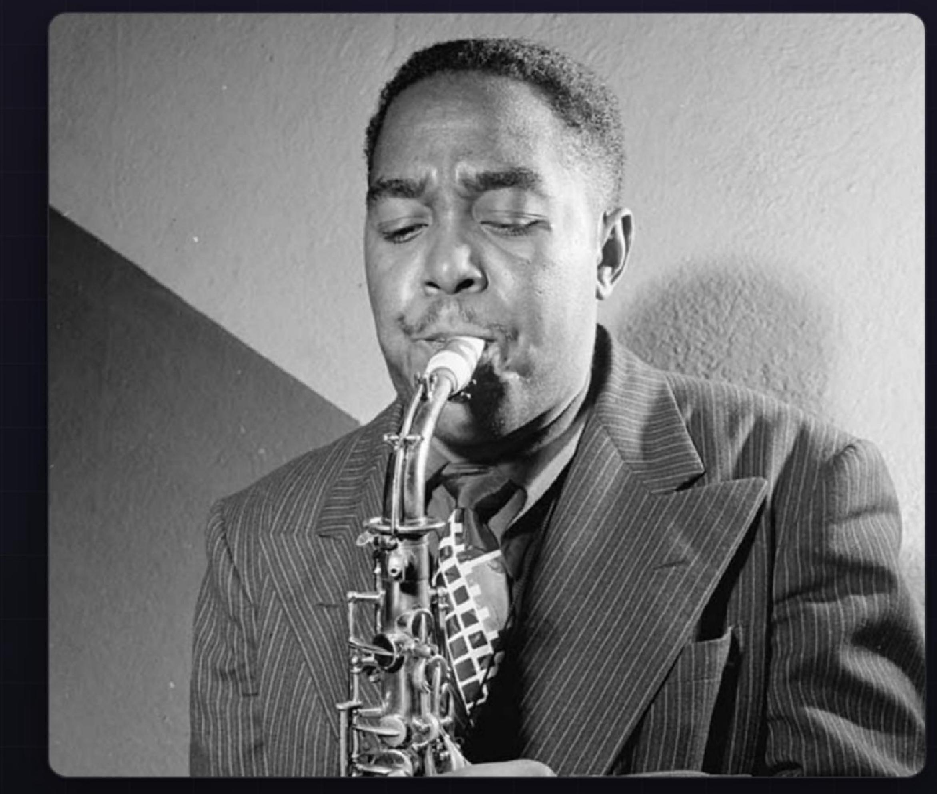
Why the Cold War?
Beyond Military Might:The Cold War was not only a military competition between global superpowers.
Ideological Battleground:It was fundamentally an ideological and cultural competition for global
influence and moral superiority.
The Sound of Democracy:Jazz became politically
useful because its improvisational nature sounded like freedom, openness, and untethered creativity.

Slide 6
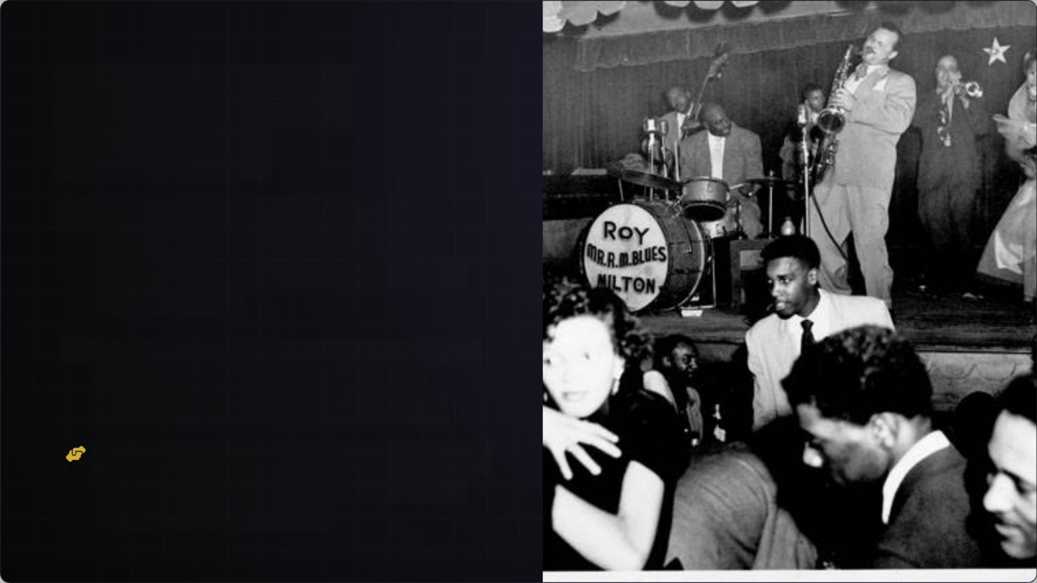
Jazz as Cultural Diplomacy
Cultural Ambassadors: The U.S. State
Department actively sent renowned jazz
musicians abroad as official representatives of
American culture.
Diplomatic Communication:Overseas concerts
transformed musical performances into a
sophisticated form of soft-power diplomacy.
Cross-Civilizational Encounter: Jazz concerts brought American political ideals into foreign cultural spaces, where overseas audiences could listen, respond, and reinterpret them.

Slide 7



How Musical Features Became Political Meanings
Musical form → Listener’s feeling → Political meaning
L
Syncopation
Represented the breaking of
rigid order,contrasting
sharply with Soviet
authoritarian structure.
Improvisation
In jazz, improvisation means that musicians do not simply follow a fixed script. They create in the moment..
Call & Response
Embodied democratic
dialogue,demonstrating how
diverse voices interact to
create harmony.

Slide 8
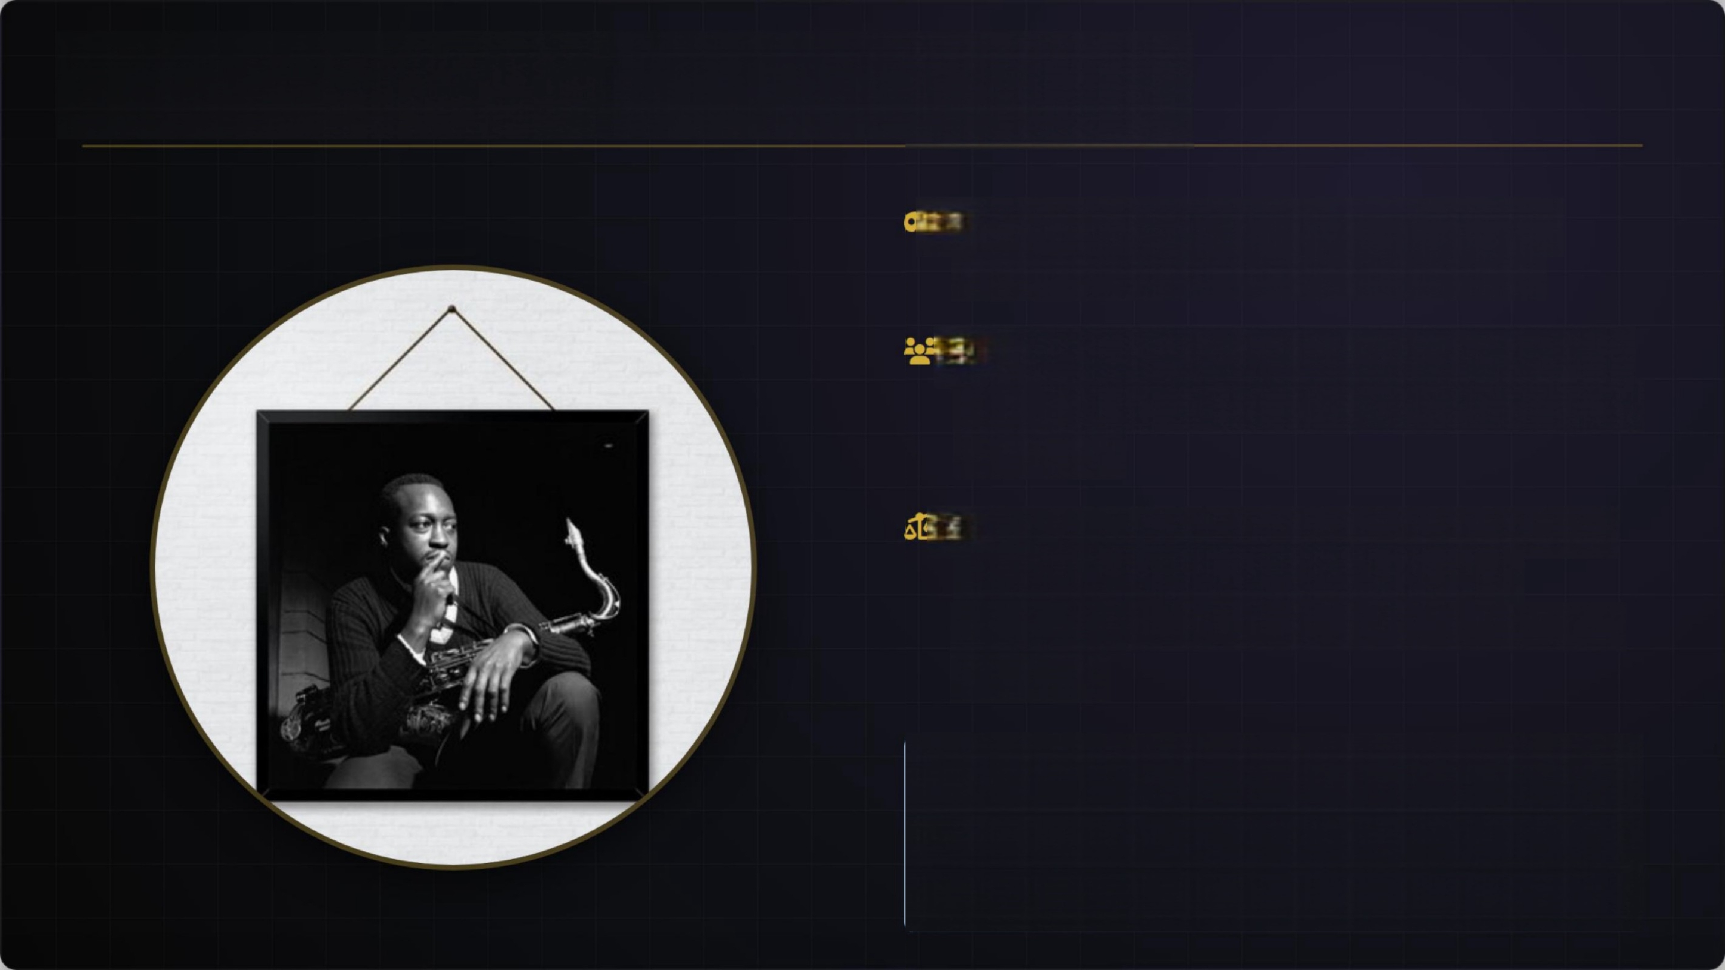
Freedom Abroad,Inequality at Home
The Facade:Jazz represented the pinnacle of
American freedom and democracy overseas.
The Messengers:Yet,many of these easteeemed jazz ambassadors were Black Americans facing systemic oppression.
The Exposure:Their physical presence inherently
exposed the glaring contradiction between
America’s democratic ideals and its domestic racial inequality.
Today:Cultural diplomacy still heavily shapes how
nations present their narratives of freedom , diversity , and political legitimacy on theglobal stage.

Slide 9
What does it mean today
Today’s Cultural Diplomacy
The Contemporary Tension
Nations still use music, film, sports, and media to shape global image.
Culture can present values such as freedom, diversity, democracy, and openness.
Soft power often works emotionally, not only politically.
A nation’s cultural image may not fully match its political reality.
Cultural diplomacy can promote values, but it may also hide unresolved problems.
Cultural Diplomacy
Racial Contradiction
Freedom Image

Slide 10
Thanks For Watching

