Slide 1


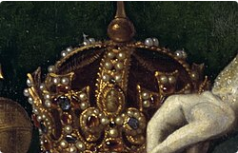

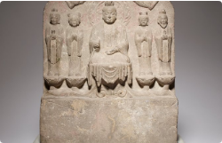
The One Truth and Harmony in Diversity
The Different Impacts of the Relationship Between Religion and Politics in the East and West
23 AI Junming Hu

Slide 2

Tools
SeeDance
Positive
Negative
Seedance was invented by ByteDance Group, which has many video materials, so the quality of works created is very high
A video can only be generated for a maximum of 20 seconds, which means that creating a long video requires a lot of parameters to adjust transitions and overall effects
Seedance's strength lies in its high-precision motion capture and AI-powered movement analysis, which effectively aids dance training and posture assessment, but its weakness is that, as a niche tool, its user base and content ecosystem still lag far behind mainstream short-video platforms.

Slide 3
Why have the East and West
developed different paths of civilization?
Eastern
China
Religion has long been deeply involved in politics, and through their interplay and conflict, ecclesiastical and secular authorities have reshaped the social contract and the foundations of the rule of law.
Political power has long held primacy over religion, and religion, serving as a complement to social governance, has shaped a unique secular foundation for civilization.
How has the relationship between religion and politics profoundly influenced social processes and the course of history?

Slide 4

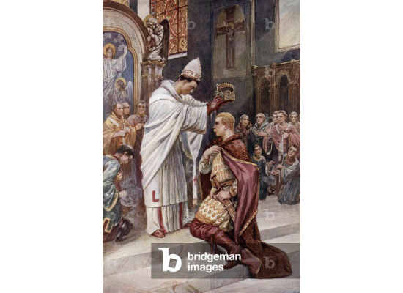
The “fusion of church and state” in the Middle Ages
The Christianization of Rome: From the Edict of Milan to Christianity becoming the state religion, the Church entered the seat of power.
The Coronation of Charlemagne: The pope crowned the emperor, thereby establishing the legitimacy of the “divine right of kings.”
Key feature: The Church wields immense secular power in the political, judicial, and intellectual spheres.

Slide 5
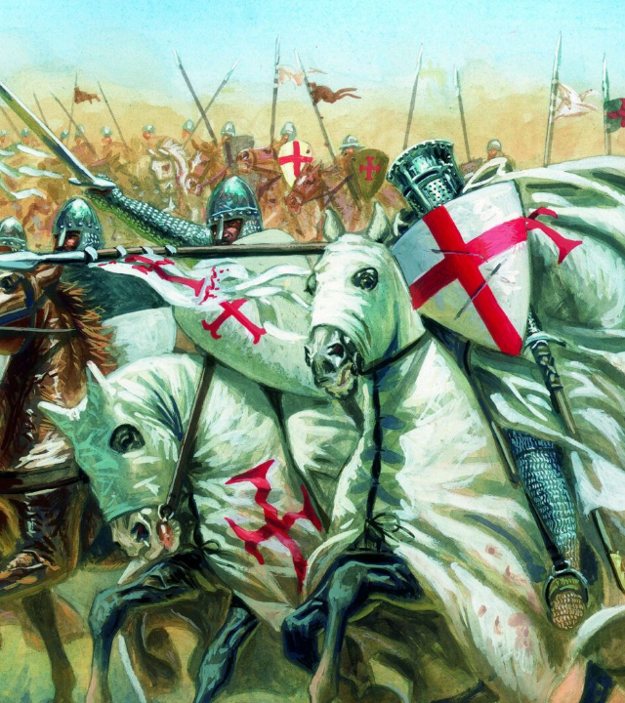
Religion and War: The Crusades
From 1096 to 1291, religion served as the most powerful tool for political and military mobilization.
The Pope issued a call to action, and religious redemption became a rallying cry.
The long-standing conflict between Christian and Islamic civilizations.
Impact: It reinforced the notion of “heretics” and heightened awareness of religious boundaries.

Slide 6
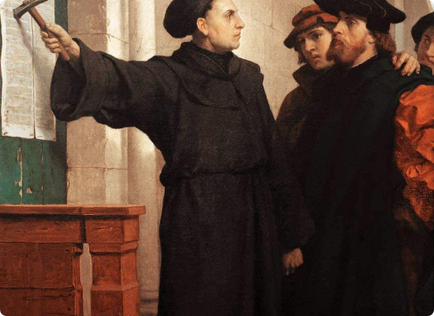
A Political Earthquake Triggered by Religious Divisions
Martin Luther and the Rise of Protestantism
The emergence of Lutheranism, Calvinism, and the Church of England broke the Catholic Church’s monopoly.
Political consequences: The collapse of Europe’s unified religious system, with feudal lords using religion to achieve political independence.
National Identity: Religious beliefs are becoming deeply intertwined with ethnic and national identity.

Slide 7
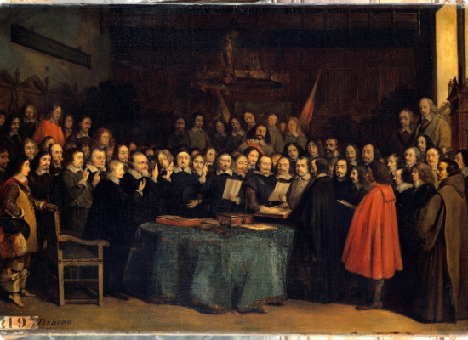
The Cost and Consequences of Europe’s Emergence from the Religious Wars
1648
Treaty of Westphalia
The true beginning of the modern system of nation-states.
National sovereignty: Sovereign states have replaced the church as the supreme authority.
The Decline of Ecclesiastical Power: The Pope's influence in international politics has significantly diminished.
Secularization: The emergence of the separation of church and state, and a societal shift toward the rule of law and rationality.

Slide 8
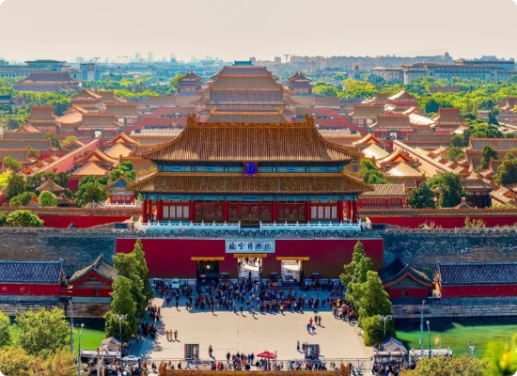
China: The State Takes Precedence Over Religion
Governing the Country According to Confucian Principles: Secular Ethics at the Core
Since the Qin and Han dynasties, China has established a powerful imperial political system, and religion has always occupied a passive or subordinate position.
Confucianism provided the ethical framework, ritual system, and social order for state governance.
Religions (Buddhism and Taoism) primarily serve the purpose of popular belief and spiritual comfort.
Key difference: There is no independent church system that stands above the authority of the emperor.

Slide 9

The Localization and Rebirth of Foreign Religions
Introduction and Development: Introduced during the Han Dynasty, it reached its peak during the Sui and Tang Dynasties, when Chan Buddhism began to undergo a process of complete Sinicization.
Integration and Compliance: Embracing Confucian concepts of loyalty and filial piety, and accepting government administration (the system of monk-officials).
Characteristics: It strikes a balance between religious doctrine and secular authority, becoming a form of “Sinicized Buddhism.”

Slide 10
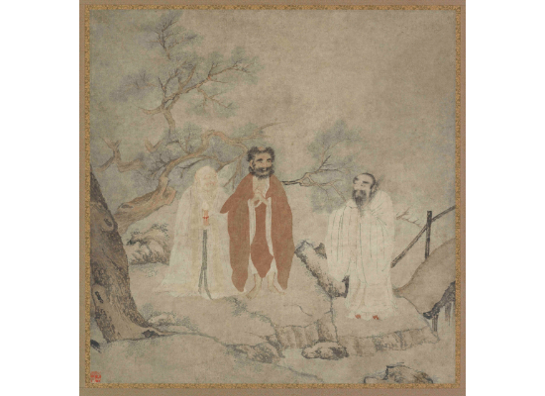

The Convergence of the Three Religions
“Harmony without Uniformity” in the Post-Song and Ming Periods
A typical example of Chinese cultural landscape: ordinary people simultaneously honor their ancestors (Confucianism), worship Buddha, and seek enlightenment through Daoism. These three distinctly different philosophies achieve a perfect harmony under the banner of “Chinese pragmatism.”
“红花白藕青荷叶，三教原来是一家。”

Slide 11

The Steady-State Structure of the Chinese Model
Strengthen national authority
Few religious conflict
Political authority ensures social order, and all religions must operate within the legal framework.
Religious pluralism reduces exclusivity, promotes greater social stability, and minimizes internal friction within a society.
Impact: It has supported the long-term unity and prosperity of a vast, multi-ethnic, and unified nation.

Slide 12

How Do Relationships Shape Civilization?
China's long-term stability and prosperity
The Pains of Western Modernization
Long-standing religious conflicts gave rise to international law.
Multicultural integration has eliminated the potential for division.
The power struggle within the church evolved into a civil rights awakening.
maintained political unity over an exceptionally long period.
Achieve a leap toward secularization through the separation of church and state.
The principle of putting people first and prioritizing order has been established.

Slide 13
Different relationships between religion and politics have shaped different paths of civilization.
Eastern
China
The separation of religion and politics put an end to the wars sparked by disputes over truth.
Through the tolerant governance of religion by the state, cultural unity has been maintained for over a thousand years.

Slide 14
Reference
Yao, X. (2015). Regional study: Confucianism and the state. In C. Benjamin (Ed.), The Cambridge World History (pp. 435–456). Cambridge University Press.
Haynes, J. (Ed.). (2016). Religion and politics in Europe, the Middle East and North Africa. Routledge.
Hu, S. (2007). Confucianism and contemporary Chinese politics. Journal of Chinese Political Science, 12(2), 165–182. https://doi.org/10.1007/s11366-007-9004-4
Maddicott, J. (2010). The origins of the English Parliament, 924–1327. Oxford University Press.
Philpott, D. (2000). The religious roots of modern international relations. World Politics, 52(2), 206–245.
Poceski, M. (2014). The records of Mazu and the making of Chan Buddhism. Oxford University Press.
Riley-Smith, J. (2005). The crusades: A history (2nd ed.). Yale University Press.
Sun, L. (2020). The relation between Confucianism and Chinese politics. Journal of Chinese Humanities, 6(1), 1–20.
Whaley, J. (2012). Germany and the Holy Roman Empire (Vols. 1–2). Oxford University Press.
Weber, M. (1951). The religion of China: Confucianism and Taoism (H. H. Gerth, Trans.). Free Press.
Tilly, C. (1992). Coercion, capital, and European states, AD 990–1992. Blackwell.

