Slide 1

By Yushen
YOUR LOGO
作者介绍 / 故事剧情 / 作品主题 / 阅读感悟
A UNIVERSITY
Language as Infrastructure of Economic Trust
Linguistics × Economic Civilization
MO YAN'S LITERATURE AND NOVEL READING SHARING PPT
演讲人：刘畅
时间：2026.5

Slide 2
By Yushen
YOUR LOGO
作者介绍 / 故事剧情 / 作品主题 / 阅读感悟
A UNIVERSITY
CONTENTS
CONTENTS
The Ancient Letter (313 CE) & Linguistic Analysis
01
Core Question & The Sogdians
02
Economic Insight & Contemporary Connection (SDG 10)
03
04
My AI work and conclusion

Slide 3
By Yushen
YOUR LOGO
作者介绍 / 故事剧情 / 作品主题 / 阅读感悟
A UNIVERSITY
Part 1 Core Question & The Sogdians
01

Slide 4

By Yushen
01
Core Question & The Sogdians
背景：粟特人与核心问题
粟特人
Who Were the Sogdians?
1.Originated from Sogdiana, Central Asia (modern Uzbekistan)
2.Major cities: Samarkand, Bukhara
3.Dominant traders on the Silk Road for centuries
4.Sogdian was the lingua franca of the Silk Road。

Slide 5

By Yushen
01
Core Question & The Sogdians
背景：粟特人与核心问题
The Core Question:
When merchants trade across civilizational boundaries —
without a shared language or legal tradition —
How do they build trust?

Slide 6
By Yushen
YOUR LOGO
作者介绍 / 故事剧情 / 作品主题 / 阅读感悟
A UNIVERSITY
Part 2 Case & Language
02
THEME OF THE WORK

Slide 7

By Yushen
02
Part 2 Case & Language
案例与语言
Economic Insight:
Language is the infrastructure of economic trust.
Whoever controls the contract language controls the definition of "debt," "interest," and "ownership."
Contemporary Connection (SDG 10: Reducing Inequalities)
The dilemma of the Sogdian merchant in 313 CE and the dilemma of migrant workers today are the same problem:
Whoever controls the contract language controls economic power.
→ Multilingual legal documents are not a luxury — they are infrastructure for economic justice.；

Slide 8
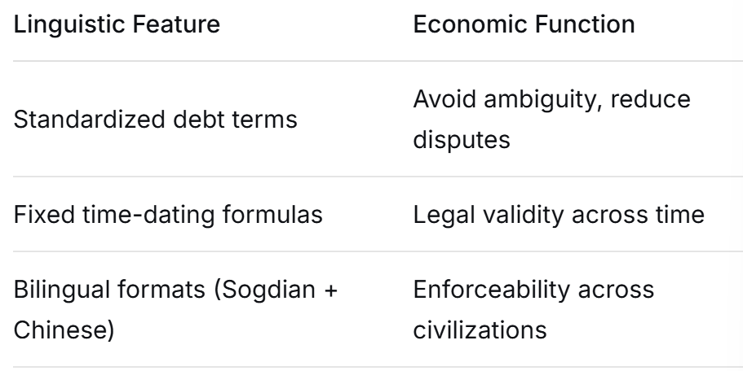
By Yushen
02
Part 2 Case & Language
案例与语言
Linguistic Analysis: How did language enable trade

Slide 9
By Yushen
YOUR LOGO
作者介绍 / 故事剧情 / 作品主题 / 阅读感悟
A UNIVERSITY
Part 3 — From History to Today
03

Slide 10

By Yushen
03
Part 3 — From History to Today
从历史到今天
The Ancient Letter (313 CE
Sogdian Ancient Letter No. 2 (Or.8212/95)*
Sender: Nanai-vandak, a Sogdian merchant in China
Recipient: Partners in Samarkand (over 2,000 miles away)
Content: Business instructions + a will
"Find a wife for my son… and marry him to her."

Slide 11
By Yushen
YOUR LOGO
作者介绍 / 故事剧情 / 作品主题 / 阅读感悟
A UNIVERSITY
Part 4
My AI Work & Conclusion
04

Slide 12

By Yushen
04
Part 4 My AI Work & Conclusion
AI作品和总结
Conclusion:
Language is not merely a communication tool.
It is the institutional infrastructure for building economic trust.
Understanding linguistic power is a prerequisite for reducing economic inequalities — in 313 CE, and today

Slide 13
By Yushen
YOUR LOGO
作者介绍 / 故事剧情 / 作品主题 / 阅读感悟
A UNIVERSITY
谢谢观看
Every Question is welcomed
MO YAN'S LITERATURE AND NOVEL READING SHARING PPT
演讲人：刘畅Grace
时间：2026.5

